Slide 1
Mathematics of retailing
Prepared by:
Mathematical Science Department

Slide 2
LEARNING OUTCOMES
By the end of this chapter, student should be able to :
explain retail price, cost price, markup and markdown,
compute markup per cent,
compute markdown per cent, and
compute gross profit, operating expenses, net profit and breakeven price.

Slide 3
INTRODUCTION
Business of buying and selling products at a profit
Cost is what you pay the vendor for products.
Retail/ Selling Price is what your customers pay for these products.

Slide 4
Important Terms
Selling Price (Retail price): the price of merchandise being sold.
Cost: the price paid for merchandise which includes net price , buying expenses , transportation and handling charges.
Markup: the difference between the cost and selling or retail price. It usually must be enough to pay expenses and make a profit. Its sometimes-called gross profit or gross margin.
Operating Expenses: the cost of running a business operation including such expenses as wages, salaries, rent, utilities , advertising and insurance.
Gross profit: the difference between the selling price and cost when the selling price exceeds the cost of the item.
Loss: the difference between the gross profit and the operating expenses when the operating expenses exceed the gross profit.
Net profit: the difference between the gross profit and operating expenses when the gross profit exceeds the operating expenses.

Slide 5
Markup
Markup = Retail Price – Cost
Markup can be either in amount or a percent. When it is expressed as a percent, it is expressed as a percent of cost or selling price( retail price ).
% of markup based on selling/retail price
% of markup based on cost

Slide 6
Conversion of Markup Percent
The following formula converted markup percent based on retail to markup percent based on cost and vice versa.
a) markup percent based on retail price,
b) markup percent based on cost price

Slide 7
Markdown
Merchants often have to reduce the price of merchandise from the price which it was originally marked.
This reduction may be due to seasonal changes, special promotions, style changes and so on .
Markdown are reductions from the selling price.

Slide 8
Markdown = original retail price – new retail price
Where MD = markdown
OSP = original retail/selling price
NSP = new retail/selling price
MD = OSP - NSP

Slide 9
The markdown percent ,%MD based on original selling price , OSP is expressed as follows
Markdown percent , %MD

Slide 10
Sometimes sellers has to decide what is the lowest price he or she can sell a product without incurring any loss. Thus, the seller can determine the Maximum markdown (MD) as
= retail price – breakeven price
= SP - BE
maximum markdown rate =

Slide 11
Profit, Loss And Breakeven
It is common that not all business make money. A business incurs operating expenses such as rents, lighting, wages bonus etc. Thus, the markup/gross profit must be able to cover the operating expenses.
3 conditions to consider in business operations:
If gross profit/markup > operating expenses → a net profit exist
If gross profit/markup = operating expenses → breakeven exist.
If gross profit/markup < operating expense → loss exist
To determine whether businesses will make profit or face a loss or just breakeven, can be determined the result of (SP – BEP).
If the result is negative => loss, if positive => profit, and if 0 => breakeven

Slide 12
Important formula in mathematics of retailing
Selling price = Cost + markup
SP=C+M
Gross profit = Operating Expenses+ Net Profit
GP=OE+NP
Selling price = Cost + Net Profit + Operating Expenses
SP= C + NP + OE
Breakeven price exists when markup = operating expenses , that is
Breakeven Price = Cost + Operating Expenses
BE = C + OE
Breakeven Price → the retail price just covers the cost price and the operating expenses
( no profit or loss )

Slide 13
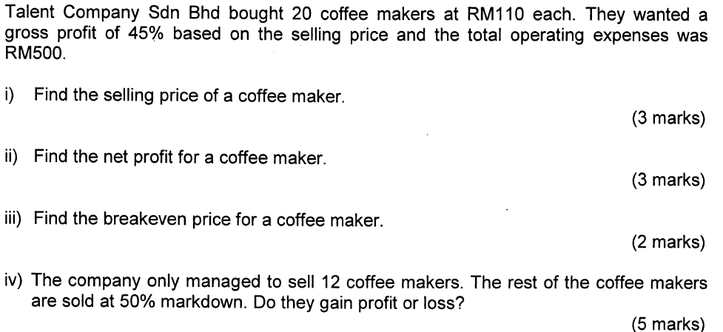
Example 1

Slide 14
SOLUTION
iv)12 coffee makers --> RM200 each
8 coffee makers --> how much each?
50% MD --> NSP = OSP(1 - d)
= 200(1 - 0.5)
= RM100
8 coffee makers --> RM100 each
NP = SP - BE
= (200 x 12)+(100 x 8) – (135 x 20)
= 3200 – 2700
= 500
Profit = RM500

Slide 15
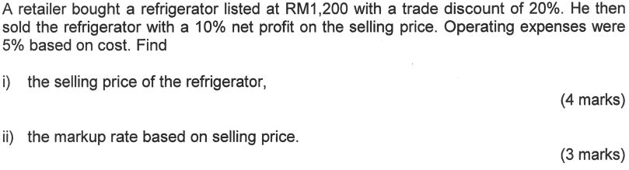
Example 2

Slide 16
SOLUTION
i) NP=LP(1-d)
=1200(1-0.2)
=RM960
C = 960
NP = 0.1SP
OE = 0.05C = 0.05(960) = 48
SP = C + OE + NP
= 960 + 48 + 0.1SP
SP – 0.1SP = 1008
0.9SP = 1008
SP = RM1120

Slide 17
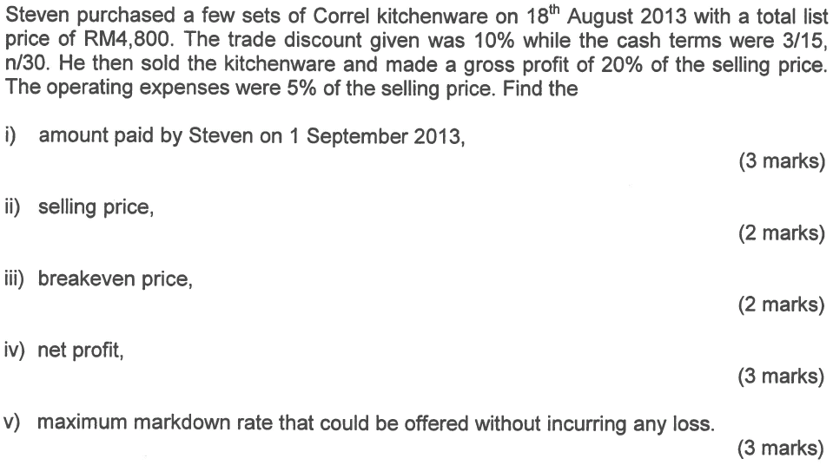
Example 3

Slide 18
SOLUTION
i) 18 Aug – 1 Sept = 14 days
Paid on 1 Sept, entitled for 3% cash discount
NP = LP(1 - d₁)(1 - d₂)
= 4800(1 - 0.1)(1 - 0.03)
= RM4,190.40
Amount paid = RM4190.40

Slide 19
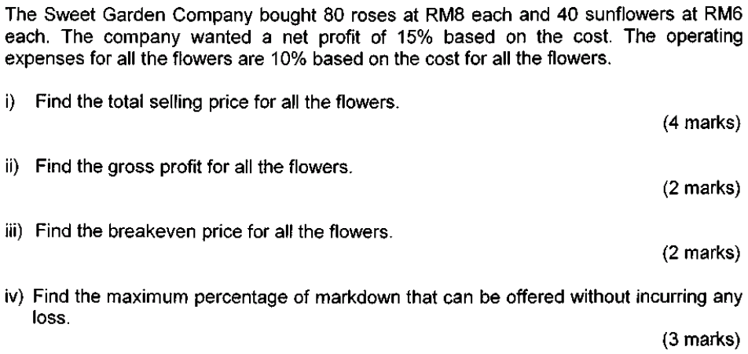
Example 4

Slide 20
SOLUTION

Slide 21
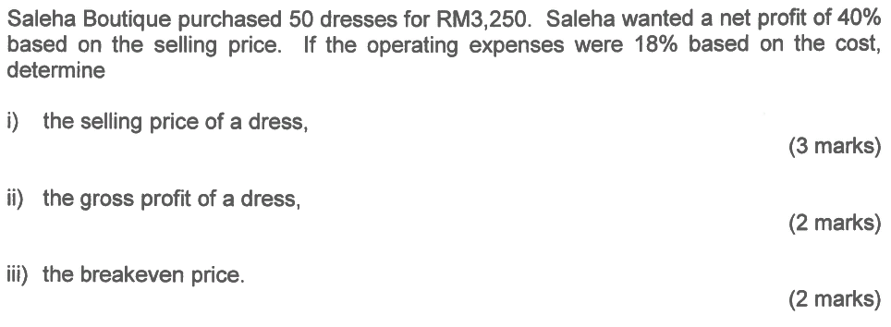
Example 5

Slide 22
SOLUTION

Slide 23
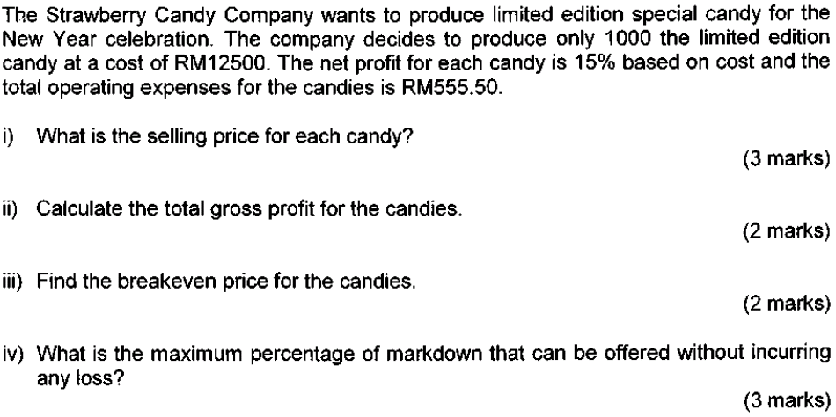
Exercise

