Slide 1
GEOX SABAH REGIONAL
GEOLOGICAL INTELLIGENCE
East Sabah → Dangerous Grounds · Regional Earth system / Basin domain / Local calibration
PETRONAS INTERNAL · LOCAL ONLY · INTERPRETATION · PARTIAL · NOT SEALED
AI_IMAGE_GENERATION: NOT AVAILABLE · EXTERNAL_IMAGE_GENERATION: BLOCKED_C28 · AI-READY CONCEPTUAL VISUAL LAYER · CURRENT IMPLEMENTATION: GOVERNED PROCEDURAL RENDER
Build correctness is not Earth truth. GEOX renders; ARIF adjudicates.
No model is canonical, preferred or closed. P, L and R are drawn with equal weight.
THREE NESTED SCALES
SCALE 1 · Regional Sabah — East Sabah → Dangerous Grounds (this transect)
SCALE 2 · Basin / structural domain — Sabah Trough, toe thrust, thrust sheet, inboard, platform (BIF-KL6)
SCALE 3 · Local calibration — KB-KL2 Rotan–Maligan–Barton
Sources: SRC-XS-PUB · SRC-BIF23-KL6 · v4.2 chronostrat · v4.1 RHG payload · v3.1 surface system (SRC-REST15) · SRC-ESDG-MODELS (hypotheses)
PETRONAS INTERNAL · LOCAL ONLY · INTERPRETATION · PARTIAL · NOT SEALED | GEOX renders; ARIF adjudicates | 1/14

Slide 2
PETRONAS INTERNAL · LOCAL ONLY · INTERPRETATION · PARTIAL · NOT SEALED
EXECUTIVE INTERPRETATION RAIL
No single grand narrative: competing models are listed side by side; nothing here is adjudicated.
DIRECTLY SUPPORTED
One composite seismic display (BIF-KL6) over NW Sabah Platform, Sabah Trough, toe-thrust and thrust-sheet domains: rugose platform seabed, flat trough floor ≈3800 ms, seabed rising SE toward shelf, offset reflectors in toe-thrust panel. Navigation, datum and depth absent.
LOCAL TO KB-KL2
Digitised horizons · Rotan-1 / Maligan-1 / Barton-2 ties (C20: Rotan SRU/H3 FAIL, Maligan SRU FAIL) · Block H operator horizons (H-series, H400 age unassigned) · restoration-pack chronology behind EVENT-C-S.
MAY BE REGIONAL
Shallowing-to-SE seabed trend and trough → toe-thrust → thrust-sheet → shelf domain order, visible on BIF-KL6, consistent with public A–A′ frame order.
REMAINS A CORRELATION
DRU, SRU and H-series continuity from KB-KL2 onto BIF-KL6 · MMU vs DRU across the trough (C9) · KL6 panel positions relative to frame A–A′.
REMAINS A HYPOTHESIS
EVENT-C-M (Sabah Trough tectono-magmatic branch) · crustal models R1–R4 · Models A/B/C of SRC-ESDG-MODELS · onshore–offshore magmatic correlation · 'Mesozoic' attribution of deep SE section.
NOT REPRESENTED BY DATA
East Sabah and interior Sabah subsurface · mapped surface geology along transect · Dangerous Grounds below seabed · crust and Moho everywhere · depth everywhere.
WHAT CHANGES EXPLORATION UNDERSTANDING: KB-KL2 cannot be used as the regional reference — its failed ties stay local. Regional play statements need a navigated dip keyline across the trough tied to wells. (Consequence statements = interpretation, not fact.)
PETRONAS INTERNAL · LOCAL ONLY · INTERPRETATION · PARTIAL · NOT SEALED | GEOX renders; ARIF adjudicates | 2/14

Slide 3
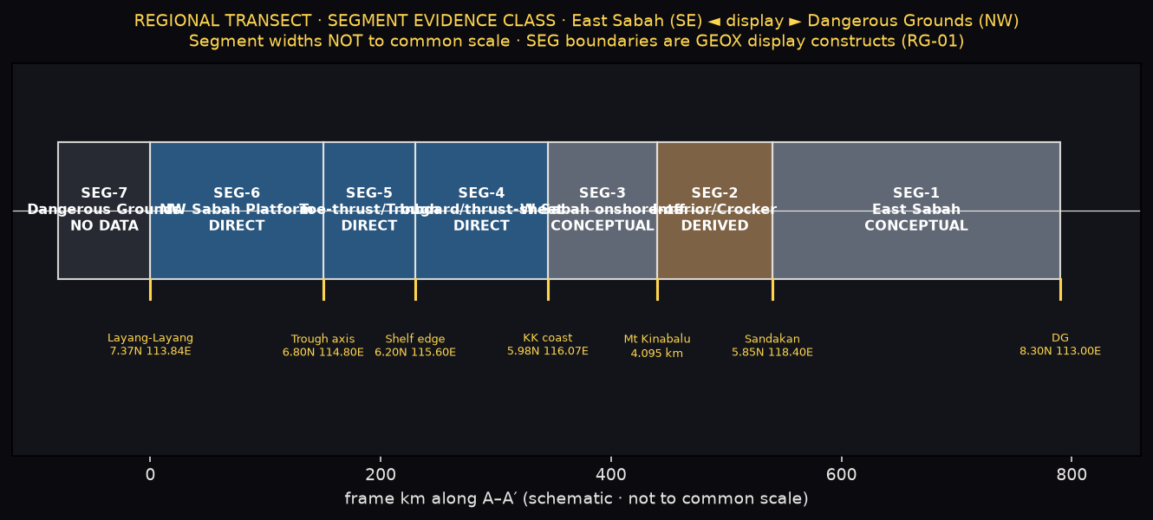
PETRONAS INTERNAL · LOCAL ONLY · INTERPRETATION · PARTIAL · NOT SEALED
REGIONAL TRANSECT · SEGMENT EVIDENCE CLASS
EAST SABAH (SE) ◄ DISPLAY ORIENTATION ► DANGEROUS GROUNDS (NW)
Station order in SRC-XS-PUB: Dangerous Grounds (8.30 N, 113.00 E) → Sandakan Basin (5.85 N, 118.40 E).
Display reverses frame km so East Sabah is on the LEFT. BIF-KL6 is NW→SE as sourced; panels shown unflipped, each with a reversal marker.
Segment widths on the display are NOT to a common horizontal scale. Segment km ranges are GEOX display boundaries constructed on the public schematic A–A′ frame (RG-01); BIF-KL6 panels are placed by structural-domain name, not by coordinates.
PETRONAS INTERNAL · LOCAL ONLY · INTERPRETATION · PARTIAL · NOT SEALED | GEOX renders; ARIF adjudicates | 3/14

Slide 4
PETRONAS INTERNAL · LOCAL ONLY · INTERPRETATION · PARTIAL · NOT SEALED
SEGMENT-BY-SEGMENT · WHAT EACH ONE CONTROLS
SEG-1 · East Sabah
CONCEPTUAL BRIDGE
Geological-map control. SRC-XS-PUB stations (Telupid, Kinabatangan, Sandakan Basin). SB505 / Sandakan / SB304 documents inventoried, NOT ingested.
Unknowns: mapped surface geology along transect; subsurface geometry; seismic. Confidence: LOW. Gate: RG-01.
SEG-2 · Interior Sabah / Crocker–Kinabalu
DERIVED
SRC-XS-PUB topographic nodes (Mt Kinabalu 4.095 km as quoted). SRC-BB-V5 cross-check (secondary).
RC-06: granite root in secondary schematics NOT adopted. Unknowns: surface geology; crustal geometry; emplacement depth/shape of Kinabalu body. Gate: RG-02.
SEG-3 · Western Sabah onshore-to-offshore
CONCEPTUAL BRIDGE
SRC-XS-PUB (Kota Kinabalu coast station). No seismic, no well. Unknowns: any seismic or well tie across the coastline. Confidence: LOW. Gate: RG-01.
SEG-4 · Inboard offshore / thrust-sheet
DIRECT
SRC-BIF23-KL6 px 1130–1590 ('Thrust Sheet'). TWT ms 0–10000. Wells: Dudar, Tekuyong, Kandi, Sugut, Solisip. Navigation UNVERIFIED. Gates: C27, RG-03.
SEG-5 · Toe-thrust / Sabah Trough
DIRECT
SRC-BIF23-KL6 px 393–1130 ('NW Sabah Trough', 'Toe Thrust') + KB-KL2 local calibration (v4.1). Wells: Permai, Buluh, Rotan. C9/C20/C27/C30 open. EVT-C-M corridor has NO geometry.
SEG-6 · NW Sabah Platform
DIRECT
SRC-BIF23-KL6 px 63–393. Rugose seabed ≈1900–2200 ms. RC-03: 'NW Sabah Platform' not in SRC-XS-PUB province list — boundary is a GEOX display construct. Gates: RG-03, RG-04.
SEG-7 · Dangerous Grounds
NO DATA
SRC-XS-PUB stations only (Dangerous Grounds, Layang-Layang; schematic bathymetry nodes). Nothing below seabed. Confidence: UNKNOWN. Gates: C9, RG-04.
PETRONAS INTERNAL · LOCAL ONLY · INTERPRETATION · PARTIAL · NOT SEALED | GEOX renders; ARIF adjudicates | 4/14

Slide 5
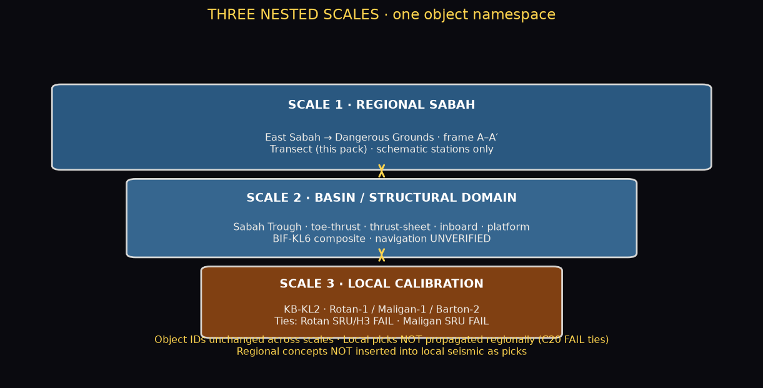
PETRONAS INTERNAL · LOCAL ONLY · INTERPRETATION · PARTIAL · NOT SEALED
THREE NESTED SCALES
Object IDs unchanged across scales · local picks NOT propagated regionally (C20 FAIL ties)
PETRONAS INTERNAL · LOCAL ONLY · INTERPRETATION · PARTIAL · NOT SEALED | GEOX renders; ARIF adjudicates | 5/14

Slide 6
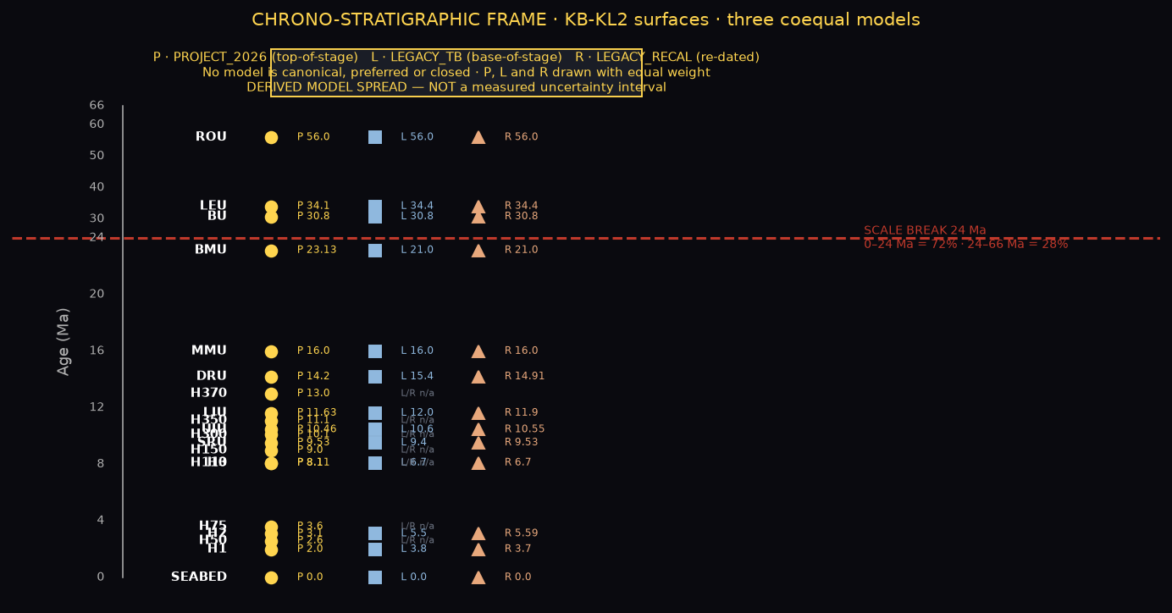
PETRONAS INTERNAL · LOCAL ONLY · INTERPRETATION · PARTIAL · NOT SEALED
CHRONO-STRATIGRAPHIC FRAME · KB-KL2 SURFACES
SCALE BREAK 24 Ma · 0–24 Ma = 72% of height · 24–66 Ma = 28% · piecewise linear · P, L and R drawn with equal weight
MODEL STATUS
P · PROJECT_2026
top-of-stage · SRC-UNI, SRC-P1 not local
L · LEGACY_TB
base-of-stage · SRC-PEN local
R · LEGACY_RECAL
re-dated legacy · hypothesis by construction
DERIVED MODEL SPREAD
NOT a measured uncertainty interval
Age not assigned: H400, H136, H120, U-*
H400 → review card · NO AGE · UNSET
GTS2020 stage column + NN (GTS2012)
TS (interpretation) TTSS00–TTSS55
PETRONAS INTERNAL · LOCAL ONLY · INTERPRETATION · PARTIAL · NOT SEALED | GEOX renders; ARIF adjudicates | 6/14

Slide 7
PETRONAS INTERNAL · LOCAL ONLY · INTERPRETATION · PARTIAL · NOT SEALED
SURFACE CALLOUTS · KB-KL2
P / L / R ages where assigned · restoration-pack quotations marked · confidence per surface
SEABED
P 0.0 · L 0.0 · R 0.0
INTERP LOW-MED · P-gap 0g · C20 UNSET · C20
H50
2.6 Ma · REST15
INTERP LOW-MED · REST15 0g · UNSET
H1
P 2.0 · L 3.8 · R 3.7
INTERP MED · P-gap 1g · C6
H2
P 3.1 · L 5.5 · R 5.59
INTERP MED · P-gap 1g · C6
H3
P 8.11 · L 6.7 · R 6.7
INTERP MED · P-gap 1g · C20 · C5
SRU
P 9.53 · L 9.4 · R 9.53
INTERP MED · P-gap 4g · C20 · C-NWB-05 · C-T6
UIU
P 10.46 · L 10.6 · R 10.55
INTERP MED · P-gap 2g · C-NWB-01 · C3
LIU
P 11.63 · L 12.0 · R 11.9
INTERP LOW-MED · P-gap 1g · C4
DRU
P 14.2 · L 15.4 · R 14.91
INTERP MED · P-gap 2g · C20 · C1 · C9
MMU
P 16.0 · L 16.0 · R 16.0
INTERP LOW-MED · P-gap 1g · C9
BMU
P 23.13 · L 21.0 · R 21.0
INTERP LOW-MED · P-gap 1g · C7
BU
P 30.8 · L 30.8 · R 30.8
INTERP LOW-MED · P-gap 0g
LEU
P 34.1 · L 34.4 · R 34.4
INTERP LOW-MED · P-gap 1g · C11
ROU
P 56.0 · L 56.0 · R 56.0
INTERP LOW-MED · P-gap 1g · C-NWB-04
Restoration surfaces (REST15): H50 2.6 · H75 3.6 · H110 8.1 · H150 9.0 · H300 10.1 · H350 11.1 · H370 13.0 Ma — all INTERP LOW-MED, pack quotations, not governed ages.
PETRONAS INTERNAL · LOCAL ONLY · INTERPRETATION · PARTIAL · NOT SEALED | GEOX renders; ARIF adjudicates | 7/14

Slide 8
PETRONAS INTERNAL · LOCAL ONLY · INTERPRETATION · PARTIAL · NOT SEALED
WELL TIES · KB-KL2 AND REGIONAL CALIBRATION
C20: failed ties stay local — NOT propagated regionally
KB-KL2 WELLS (on the local screenshot)
REGIONAL CALIBRATION WELLS (compiled NN, SRC-PEN)
ROTAN-1
Compiled NN: NN11 / NN10 · checkshot/VSP
SEABED ◆ EDGE · SRU ✕ FAIL · H3 ✕ FAIL
MALIGAN-1
Compiled NN: NN11 / NN10 / NN9 · checkshot/VSP
SRU ✕ FAIL · H3 ? UNKNOWN
BARTON-2
No NN control · checkshot/VSP
Shared object: WELL-ROTAN-1 (5 km off BIF-KL6 as tabulated)
KB-KL2 position on regional transect: navigation UNVERIFIED
GAJAH HITIGA · TIGA PAPAN · MALIGAN · SOLISIP
GLAYZER-3 · RUSA TIMUR · IMBOK · BULUH
DELUAR · KETAM · SOUTH LOKA
Not on KB-KL2 · C12
Gap grammar applied:
Erosion — not drawn (no source asserts located truncation)
Non-deposition — not drawn
Hiatus unresolved: UNKNOWN: EROSION OR NON-DEPOSITION
CONDENSATION CANDIDATE (inferred only)
Poor recovery / caving candidate (C12)
Reworking candidate (C12)
RC-04 · Well stick-to-name ambiguity on BIF-KL6 — three sticks under labels Buluh + Rotan (px 1011/1019/1024) and three under Kandi + Sugut (px 1398/1420/1429). OPEN.
RC-01 · KL2 marker on BIF-KL6 is BIF-KL2, not KB-KL2 — under C27 the printed 'KL2' at the 2W block (trough) is BIF-KL2; KB-KL2 relates to BIF-KL6 only through Rotan-1. OPEN · ARIF_REVIEW.
PETRONAS INTERNAL · LOCAL ONLY · INTERPRETATION · PARTIAL · NOT SEALED | GEOX renders; ARIF adjudicates | 8/14

Slide 9
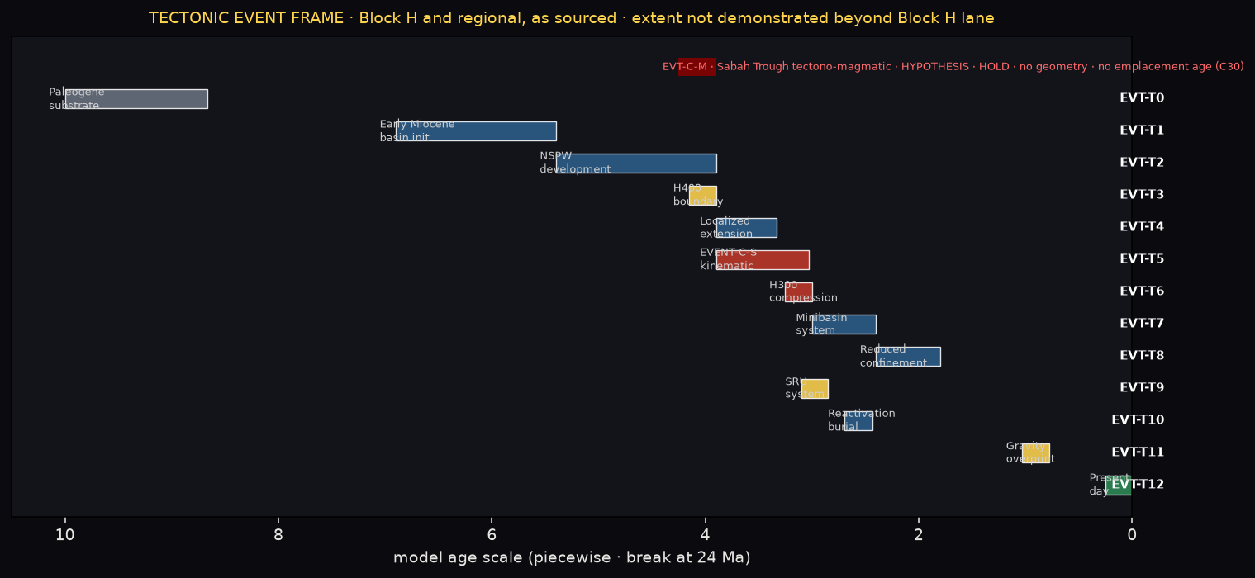
PETRONAS INTERNAL · LOCAL ONLY · INTERPRETATION · PARTIAL · NOT SEALED
TECTONIC EVENT FRAME
All events: Block H and regional as sourced · extent NOT demonstrated beyond Block H lane · every event is INTERPRETATION · PARTIAL
EVENT-C SCOPE — EVENT-C-S: localized H370–H300 kinematic reorganisation in the Tanjung / Rotan restoration corridor (Block H, outboard). Magmatism not shown.
EVENT-C-M: Sabah Trough tectono-magmatic branch — HYPOTHESIS · HOLD · no geometry · no emplacement age (C30). Neither explains the regional transect.
Competing models for EVENT-C-S: syn-compressional gravitational collapse · back-limb extension · strain partitioning · oblique reactivation · mobile-shale decoupling · restoration artefact.
PETRONAS INTERNAL · LOCAL ONLY · INTERPRETATION · PARTIAL · NOT SEALED | GEOX renders; ARIF adjudicates | 9/14

Slide 10
PETRONAS INTERNAL · LOCAL ONLY · INTERPRETATION · PARTIAL · NOT SEALED
EVENT DETAIL · PALEO SYSTEM CONSEQUENCE
Every row: evidence class = INTERPRETATION · PARTIAL · open gates G4/G5 (G6 for Event C)
EVT-T0
Paleogene inherited substrate
Deep surfaces NP14 46.29 / NP8 57.21 Ma model-assigned
Substrate controls heat flow & deep kitchens · unresolved
G4,G5
EVT-T1
Early Miocene basin initiation
RELQ25 p.22 · how NSPW emplaced above older prism (C-T3)
Future mobile-shale supply · NSPW a theoretical source
G4,G5
EVT-T2
NSPW development
circa 18–13 Ma (RELQ25 p.22) · composite NSPW origin (C-T4)
Overpressure potential (analogue)
G4,G5
EVT-T3
H400 structural boundary
Age NOT assigned · pack labels H400 and H370 both 13 Ma (REST15)
Deep kitchens and conduits below H400 poorly imaged
G4,G5
EVT-T4
Localized extension during shortening
13 → 11.1 Ma · collapse / shale-withdrawal / thrust-top? (C-T7)
This depocentre later becomes the Tanjung kitchen
G4,G5
EVT-T5
EVENT-C-S kinematic reorganisation
13 → 10.1 Ma · not mapped to stored surfaces · link to Trough? (C26)
Alters routing of later sands and kitchen geometry
G4,G5
EVT-T6
H300 compressional pulse
10.1 Ma restored → ~10 Ma deformed · detachment geometry open
Rotan trap forms
G4,G5
EVT-T7
Confined-minibasin system
No age assigned · minibasin mechanism (C-T7) · mud genesis (C-T14)
Ponded reservoirs · mud-bounded traps
G4,G5
EVT-T8
Reduced regional confinement
No age assigned · where and why confinement persisted open
Fairways must stay horizon-specific
G4,G5
EVT-T9
SRU surface system
P 9.53 / L 9.4 / R 9.53 Ma · pack-marker equivalence CORRELATION HOLD
Shelf foreset pay · deepwater expression not erosional
G4,G5
EVT-T10
Local reactivation and burial
9.0 → 8.1 Ma · spatial extent of reactivation open
Trap modification · possible breach
G4,G5
EVT-T11
Gravity-dominated overprint
H50 2.6 Ma · Stage IVF (RELQ25 p.24) · gravity vs compression (C-T10)
Hikmat-1: 4.6 m net gas in H50
G4,G5
EVT-T12
Present day
Stress tensor on KL2 UNKNOWN · fluid escape not demonstrated
Partial leakage · most accumulations not filled to spill
G4,G5
H400 AGE · GOVERNED PAYLOAD: UNASSIGNED · REST15 QUOTATIONS: 13 Ma · STATUS: HOLD · ARIF DECISION: UNSET
PETRONAS INTERNAL · LOCAL ONLY · INTERPRETATION · PARTIAL · NOT SEALED | GEOX renders; ARIF adjudicates | 10/14

Slide 11
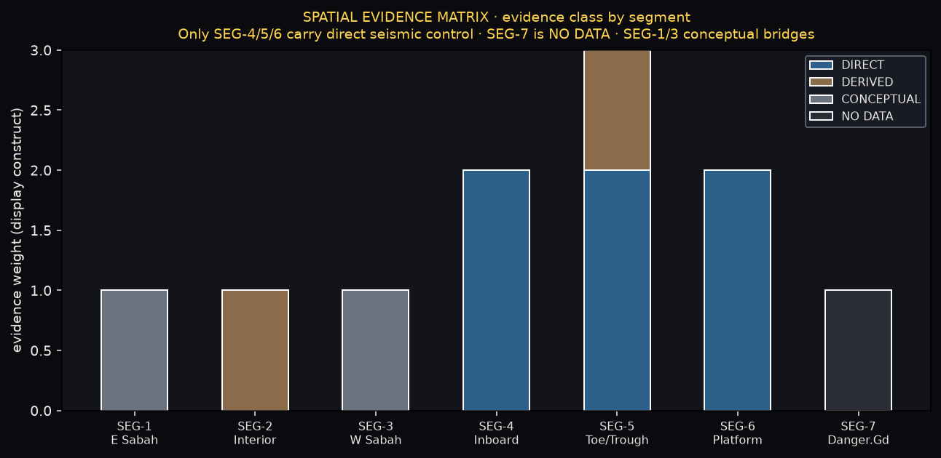
PETRONAS INTERNAL · LOCAL ONLY · INTERPRETATION · PARTIAL · NOT SEALED
SPATIAL EVIDENCE MATRIX
Segment widths NOT to a common scale · SEG boundaries are GEOX display constructs (RG-01)
KEY GATES OPEN
RG-01 Segment display boundaries on frame A–A′
RG-02 Designate DEM topographic source
RG-03 Freeze BIF-KL6 identity and navigation
RG-04 NW Sabah Platform vs Dangerous Grounds boundary
RG-05 Designate East Sabah geological-map control
RG-06 Carry or reject operator 'Mesozoic' attribution
RG-07 Crustal control for R1–R4 (wide-angle / MT)
C9 MMU vs DRU across Sabah Trough — kept separate
C20 Failed KB-KL2 ties stay local
C27 BIF-KL6 namespace: REGIONAL-COMPOSITE-KL6
C30 EVENT-C-M: no geometry, no emplacement age
RC-06 Kinabalu root / igneous corridor NOT adopted
RC-07 Public-frame Moho depths NOT adopted
All decisions: UNSET. GEOX recommends nothing as closed.
PETRONAS INTERNAL · LOCAL ONLY · INTERPRETATION · PARTIAL · NOT SEALED | GEOX renders; ARIF adjudicates | 11/14

Slide 12
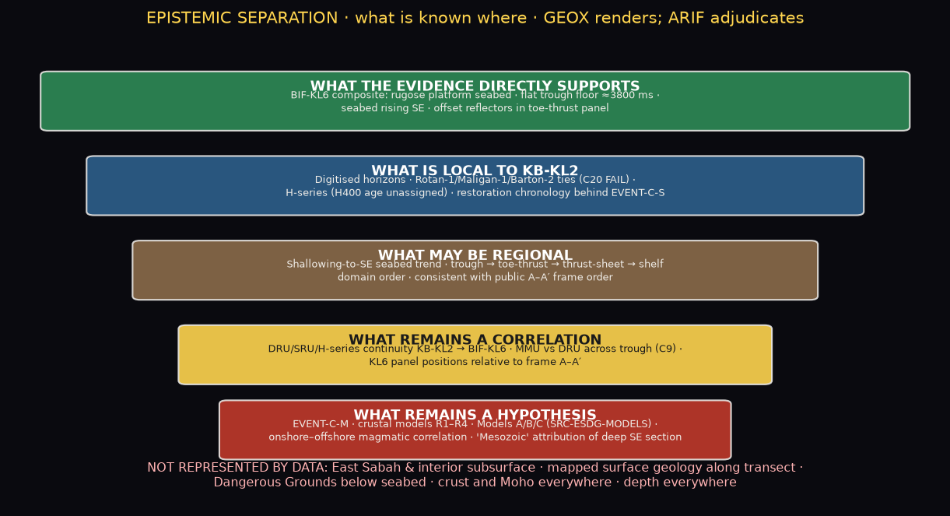
PETRONAS INTERNAL · LOCAL ONLY · INTERPRETATION · PARTIAL · NOT SEALED
EPISTEMIC SEPARATION · WHAT IS KNOWN WHERE
Build correctness is not Earth truth. GEOX renders; ARIF adjudicates.
PETRONAS INTERNAL · LOCAL ONLY · INTERPRETATION · PARTIAL · NOT SEALED | GEOX renders; ARIF adjudicates | 12/14

Slide 13
PETRONAS INTERNAL · LOCAL ONLY · INTERPRETATION · PARTIAL · NOT SEALED
ARIF REGIONAL REVIEW QUEUE
geox_sabah_regional_v1 · all decisions UNSET · GEOX recommends nothing as closed
1
RG-01
Approve GEOX segment display boundaries (SEG-1…SEG-7 km ranges)
ARIF confirmation or replacement transect polyline
2
RG-02
Designate a topographic source (DEM e.g. GEBCO/SRTM) to replace schematic nodes
approved DEM extraction along the transect
3
RG-03
Freeze BIF-KL6 identity and navigation; fix well positions
SEG-Y / navigation, well header coordinates (SRC-SABAH-WSM)
4
RG-04
NW Sabah Platform vs Dangerous Grounds boundary and naming
regional province map
5
RG-05
Designate East Sabah geological-map control (SB505 MR2 / Sandakan / other)
ARIF designation; then ingestion audit
6
RG-06
Carry or reject the operator 'Mesozoic' attribution on BIF-KL6
well / outcrop age control
7
RG-07
Crustal control for R1–R4 (wide-angle, refraction, MT)
geophysical acquisition or published constrained model
8
ARIF-H400-AGE
H400 age: governed UNASSIGNED vs REST15 13 Ma · HOLD
adjudicate 13 Ma REST15 quotation vs unassigned governed age
9
C27 / RC-01
Confirm BIF-KL6 namespace; printed 'KL2' marker is BIF-KL2
line identity
10
C9
MMU vs DRU across the Sabah Trough (kept separate)
dip keyline across DG platforms
11
C20
Failed KB-KL2 ties stay local (no regional propagation)
VSP, navigation, DSG export
12
RC-06
Keep Kinabalu root / igneous corridor out of the governed model
cited constrained model
NEW CONTRADICTIONS: RC-01 KL2 marker identity · RC-02 KB-KL2 position unknown · RC-03 Platform vs Dangerous Grounds province · RC-04 well stick-to-name ambiguity · RC-05 'Mesozoic' outside 0–66 Ma chart · RC-06 Kinabalu root NOT adopted · RC-07 public Moho NOT adopted.
PETRONAS INTERNAL · LOCAL ONLY · INTERPRETATION · PARTIAL · NOT SEALED | GEOX renders; ARIF adjudicates | 13/14

Slide 14
PETRONAS INTERNAL · LOCAL ONLY · INTERPRETATION · PARTIAL · NOT SEALED
HIGHEST INFORMATION VALUE DATA · AND WHAT IT CHANGES
WHAT DATA HAVE THE HIGHEST INFORMATION VALUE
WHAT CHANGES EXPLORATION UNDERSTANDING
1) Navigated SEG-Y of BIF-KL6 (or equivalent dip line) with well ties
→ resolves C9 and the trough-to-shelf correlation
2) Survey IDs and header coordinates for the KL6 wells
(SRC-SABAH-WSM lists several) → resolves RC-04, RG-03
3) Wide-angle / MT along the margin for R1–R4 → resolves RG-07
4) Digitised geological map for SEG-1 / SEG-2 → resolves RG-05
KB-KL2 cannot be used as the regional reference: its failed ties stay local.
Regional play statements need a navigated dip keyline across the trough tied to wells — until then regional maps should carry CORRELATION, not TIE, status.
(Consequence statements are interpretation, not fact.)
SOURCES
SRC-XS-PUB (public schematic frame + place coordinates) · SRC-BIF23-KL6 (NWB23 deck seismic display raster) · kinabalu_chronostrat_v2.json (scale, GTS2020, NN, megasequences, regional wells) · v4.11 RHG payload (surfaces, ties, gates, Wheeler) · v3.1 surface system (operator ages, SRC-REST15) · SRC-ESDG-MODELS (hypotheses) · SRC-RELQ25 · SRC-REP15 · SRC-NWB23 · SRC-ARIF-EVC · SRC-ENT-LL1
Inventoried, NOT ingested: SB505 MR2 · Sandakan publication · SB304 deck. No external calls. No image generation. Base chart: rhg_v4_2_chronostrat KL2_v4_2_CHRONOSTRAT.svg embedded unchanged (hash-checked).
PETRONAS INTERNAL · LOCAL ONLY · INTERPRETATION · PARTIAL · NOT SEALED | GEOX renders; ARIF adjudicates | 14/14

