Slide 1
PETRONAS Proposal Deck: arifOS Governance Kernel
Innovative framework for effective governance and system control
Notes:
AI-generated content may be incorrect. ---

Slide 2
Executive Summary
Notes:
--- This slide references information from the following file: https://aka.ms/spe-openfilelocation arifOS Overview and Strategic Proposition

Slide 3

arifOS Overview and Strategic Proposition
Constitutional AI Governance
arifOS enforces fail-closed governance with nine constitutional floors ensuring integrity and compliance.
Risk Mitigation and Audit
The kernel addresses risks like hallucination and audit complexity with refusal-first logic and audit-ready documentation.
Strategic Alignment and ROI
arifOS aligns with digital governance principles, delivering measurable ROI through operational continuity and risk reduction.
Enterprise-grade Resilience
The solution embodies resilience and robustness, reflected in its motto 'Forged, not given'.
Notes:
--- This slide references information from the following file: https://aka.ms/spe-openfilelocation arifOS is a constitutional AI governance kernel designed to enforce fail-closed governance across enterprise AI systems. It operates under nine constitutional floors, ensuring integrity, truthfulness, clarity, and compliance in all AI-driven workflows. The solution addresses critical risks such as hallucination, compliance breaches, and audit complexity, which are increasingly relevant as PETRONAS scales AI initiatives like TriCipta AI and Production AI. The kernel provides governance artifacts, refusal-first logic, and audit-ready documentation, positioning PETRONAS as a leader in Responsible AI. This proposal emphasizes strategic alignment with PETRONAS Digital Spend Governance principles, delivering measurable ROI through risk mitigation, operational continuity, and audit efficiency. The motto, "DITEMPA, BUKAN DIBERI" (Forged, not given), reflects the solution's resilience and enterprise-grade design.

Slide 4
Why PETRONAS Needs arifOS
Notes:
--- This slide references information from the following file: https://aka.ms/spe-openfilelocation Governance Imperatives for AI Scaling

Slide 5
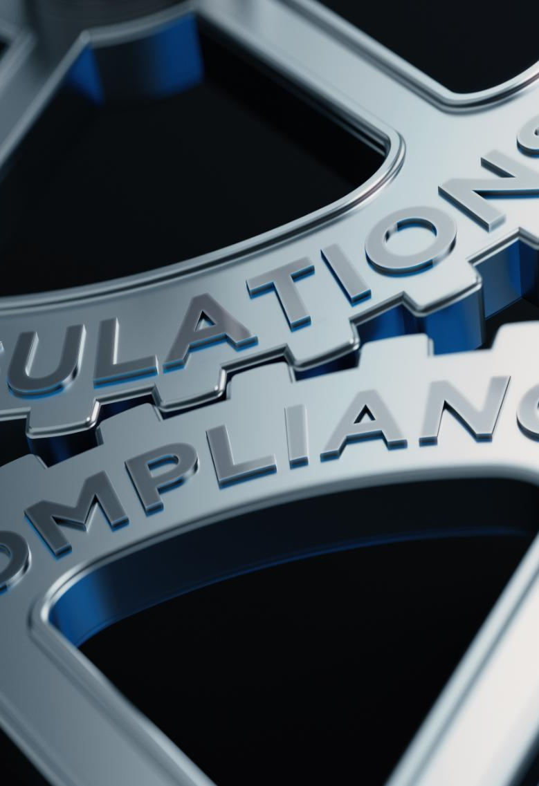
Governance Imperatives for AI Scaling
AI Adoption Challenges
AI initiatives involve complex workflows and high-stakes decisions introducing risks like non-compliance and ethical breaches.
Need for Enhanced Governance
Current frameworks need automated, constitutional-level controls to manage dynamic AI behaviors effectively.
arifOS Solution
arifOS embeds governance logic into AI to ensure compliance with ethics and global standards like EU AI Act and NIST RMF.
Benefits of Governance Implementation
Implementing arifOS safeguards reputation, maintains compliance, and optimizes AI performance safely and transparently.
Notes:
--- This slide references information from the following file: https://aka.ms/spe-openfilelocation PETRONAS is accelerating AI adoption through initiatives such as TriCipta AI and Production AI, which involve complex workflows and high-stakes decision-making. These deployments introduce risks including regulatory non-compliance, ethical breaches, and operational failures. Current governance frameworks, while robust, require augmentation with automated, constitutional-level controls to manage dynamic AI behaviors. arifOS addresses these gaps by embedding governance logic directly into AI systems, ensuring adherence to PETRONAS ethics principles and global standards like the EU AI Act and NIST RMF. By implementing arifOS, PETRONAS can safeguard its reputation, maintain compliance, and optimize AI performance without compromising safety or transparency.

Slide 6
Market Benchmarks
Notes:
--- This slide references information from the following file: https://aka.ms/spe-openfilelocation Global Pricing and Competitor Landscape

Slide 7
Global Pricing and Competitor Landscape
Solution | Pricing Model | Benchmark
Azure Content Safety | Pay-per-use | $0.38 / 1K text records
AWS Guardrails | Pay-per-use | $0.15 / 1K text units
IBM watsonx.governance | SaaS RU metric | $0.60 / RU
ModelOp Center | Enterprise license | $25K/month non-prod
Arize AI | Enterprise observability | $60K/year median
PETRONAS DSG License | Annual enterprise spend | $2.18M/year (~RM 10.2M)
Notes:
--- This slide references information from the following file: https://aka.ms/spe-openfilelocation AI governance solutions vary widely in pricing models and capabilities. Cloud-based guardrails such as Azure AI Content Safety charge approximately $0.38 per 1,000 text records, while AWS Bedrock Guardrails cost around $0.15 per 1,000 text units. Enterprise platforms like IBM watsonx.governance use a resource unit metric (~$0.60 per RU) and offer on-prem licensing per VPC core. ModelOp Center lists non-production instances at $25,000 per month, with production pricing negotiated privately. Observability tools such as Arize AI average $60,000 annually for enterprise deployments. PETRONAS benchmarks, including Halliburton DSG licenses at USD $2.18M/year (~RM 10.2M), confirm the scale of investment for mission-critical digital tools. These figures establish a competitive context for arifOS pricing and value proposition.

Slide 8
Pricing Structure (MYR)
Notes:
--- This slide references information from the following file: https://aka.ms/spe-openfilelocation arifOS Pricing and Deployment Options

Slide 9
arifOS Pricing and Deployment Options
Module | Scope | Pricing (MYR)
Kernel License | Governance OS, refusal logic, audit artifacts | RM 1.41M – RM 5.64M/year
Runtime Guardrails | Prompt shields, groundedness, policy denial | RM 0.94 – RM 4.70 per 1,000 checks
Advisory & Certification | Governance model, compliance mapping, audits | RM 705K – RM 2.35M per program; RM 235K – RM 705K per audit cycle
Notes:
--- This slide references information from the following file: https://aka.ms/spe-openfilelocation arifOS pricing is structured to align with PETRONAS procurement standards and global benchmarks. The Enterprise Kernel License ranges from RM 1.41M to RM 5.64M annually, depending on deployment scope and SLA requirements. Runtime Guardrails are billed on a consumption basis, from RM 0.94 to RM 4.70 per 1,000 checks, offering flexibility for varying workloads. Advisory and Certification services are priced between RM 705K and RM 2.35M per program, with audit cycles ranging from RM 235K to RM 705K. Deployment options include dedicated SaaS or VPC/on-prem environments with MY/SG data residency compliance. Multi-year contracts qualify for discounts of up to 15%, ensuring cost efficiency for long-term governance commitments.

Slide 10
ROI Model
Notes:
--- This slide references information from the following file: https://aka.ms/spe-openfilelocation Value Creation and Risk Mitigation

Slide 11

Value Creation and Risk Mitigation
Compliance Risk Mitigation
Automating governance reduces regulatory penalties exceeding RM 5M per incident, enhancing compliance and risk management.
Operational Continuity
Ensuring continuous operations prevents AI deployment delays, avoiding multi-million RM project overruns and downtime.
Audit Efficiency
Audit cycle times reduce by 50%, saving approximately RM 500K annually in man-hours through automated governance artifacts.
Notes:
--- This slide references information from the following file: https://aka.ms/spe-openfilelocation The ROI model for arifOS is built on three pillars: compliance risk mitigation, operational continuity, and audit efficiency. By automating governance artifacts and enforcing refusal-first logic, arifOS reduces the likelihood of regulatory penalties, which can exceed RM 5M per incident. Audit cycle times are projected to decrease by 50%, saving approximately RM 500K annually in man-hours. Additionally, preventing governance-related AI deployment delays avoids multi-million RM project overruns. Over a three-year horizon, these benefits compound, delivering strategic value and positioning PETRONAS as a global leader in Responsible AI.

Slide 12
Competitive Positioning
Notes:
--- This slide references information from the following file: https://aka.ms/spe-openfilelocation Feature Comparison Table

Slide 13
Feature Comparison Table
Feature | arifOS | IBM watsonx | Credo AI | ModelOp | Observability Tools
Constitutional Kernel | ✅ | ❌ | ❌ | ❌ | ❌
Fail-Closed Governance | ✅ | Partial | Partial | Partial | ❌
Runtime Guardrails | ✅ | ❌ | ❌ | ❌ | Limited
Audit Artifacts | ✅ | ✅ | ✅ | ✅ | ❌
Advisory & Certification | ✅ | Optional | Optional | Optional | ❌
Notes:
--- This slide references information from the following file: https://aka.ms/spe-openfilelocation arifOS differentiates itself through its constitutional governance kernel, fail-closed architecture, and integrated runtime guardrails. Unlike IBM watsonx or Credo AI, which offer partial governance capabilities, arifOS provides comprehensive governance artifacts, refusal-first logic, and advisory services tailored to PETRONAS standards. Observability tools such as Arize and Fiddler focus on monitoring rather than governance enforcement, leaving compliance gaps that arifOS addresses. This unique positioning ensures PETRONAS achieves both operational efficiency and regulatory assurance.

Slide 14
Digital Spend Governance & Procurement Workflow
Notes:
--- This slide references information from the following file: https://aka.ms/spe-openfilelocation Clauses and Workflow Diagram

Slide 15
Clauses and Workflow Diagram
Step | Description
1 | Business Case Prep – ROI justification and risk analysis
2 | Digital Spend Governance Review – Align with Value Charter
3 | TRC Approval – Technical concurrence for integration
4 | MIRS Compliance Check – Data governance validation
5 | EAC Endorsement – Strategic investment sign-off
6 | PO Issuance – Commercial terms finalized
7 | Deployment & Audit – Sandbox to production rollout
Notes:
--- This slide references information from the following file: https://aka.ms/spe-openfilelocation arifOS procurement aligns with PETRONAS Digital Spend Governance principles, ensuring transparency, accountability, and strategic value realization. Key clauses include adherence to Value Charter compliance, transparent billing for runtime guardrails, and quarterly governance audits logged in PETRONAS compliance registry. The procurement workflow involves seven steps: Business Case Preparation, Digital Spend Governance Review, TRC Approval, MIRS Compliance Check, EAC Endorsement, PO Issuance, and Deployment with audit integration. This structured process guarantees compliance with PETRONAS governance standards while enabling efficient rollout of arifOS across enterprise AI initiatives.

