Slide 1
Online Order Management System (OOMS) (A Partial ERP Module for Buying House)

Slide 2
Goal of the project
This project is concerned to Online Order Management System for Buying Houses. Our goal is to examine how this project can help Buying Houses to manage their order management as well as to help the foreign Buyers to get update about their orders at any time via web.

Slide 3
Why this project
Web based ERP system
Less paper work
Reduce procedural time
Easier management of orders
Get order status at runtime

Slide 4
Project Feature
Buyer can place master order from anywhere in the world for specific buying house.
Buying houses can distribute those master orders to different factories.
Factory admin can give the delivery report online against a sub-order.
Buyer can get delivery progress status at anytime through internet.
Buying house can get report on commission and master order value.

Slide 5
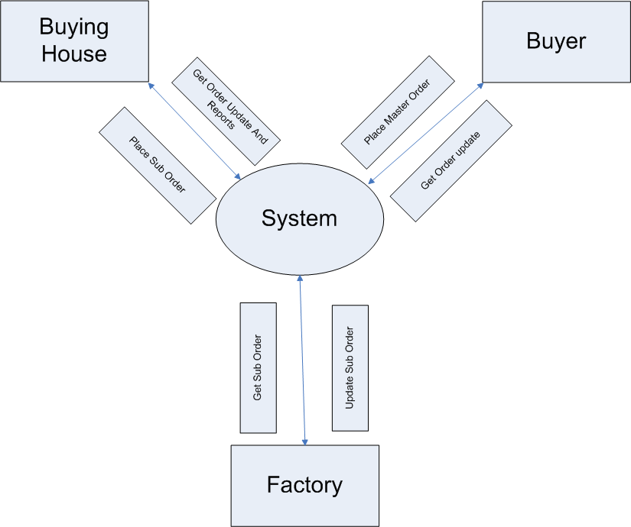
Context Diagram

Slide 6
Buying House
Buying houses can distribute those master orders to different factories.
Buying house can get report on commission and master order value.

Slide 7
Buyer
Buyer can place master order from anywhere in the world for specific buying house.
Buyer can get delivery progress status at anytime through internet.

Slide 8
Factory
Factory admin can give the delivery report online against a sub-order.

Slide 9
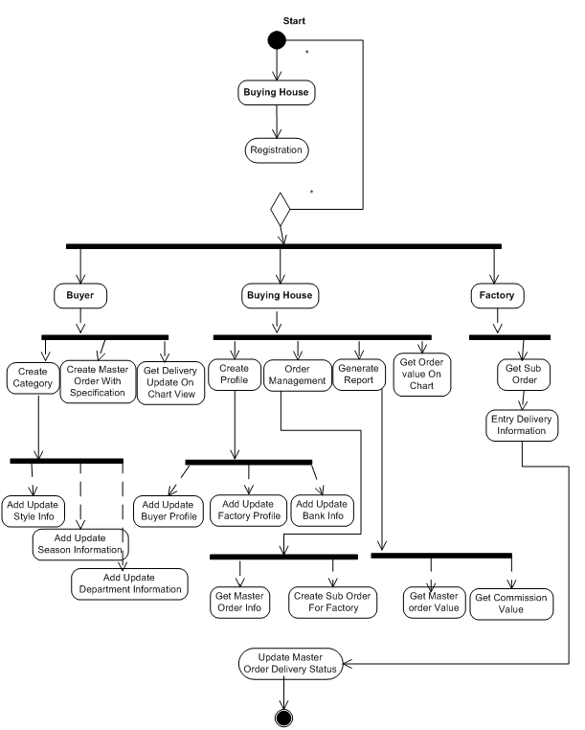
Activity Diagram

Slide 10
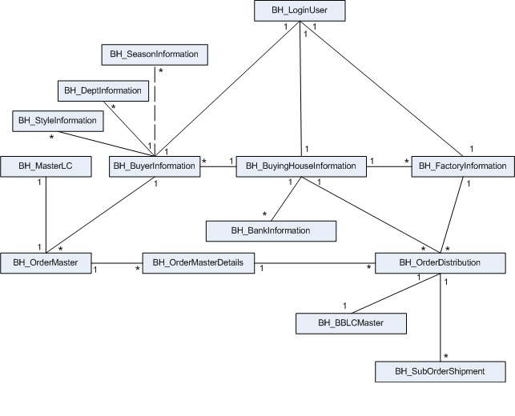
ER diagram OOMS

Slide 11
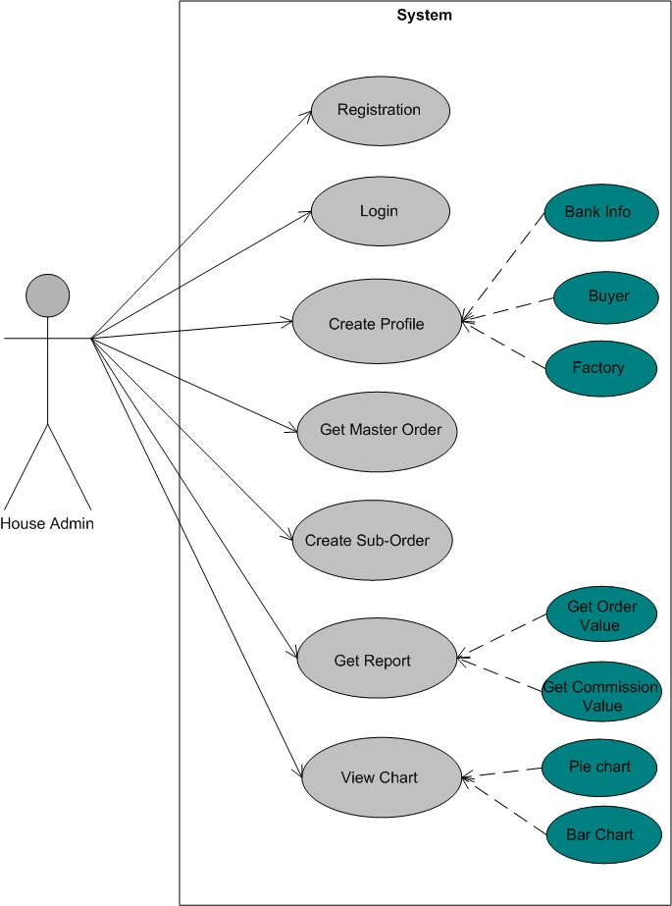
Use Case of House Admin

Slide 12
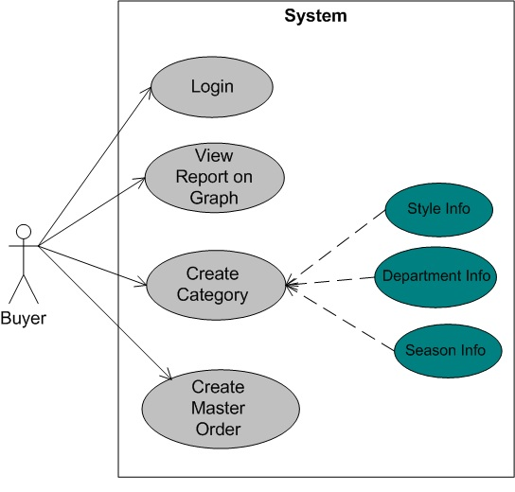
Use Case of Buyer

Slide 13
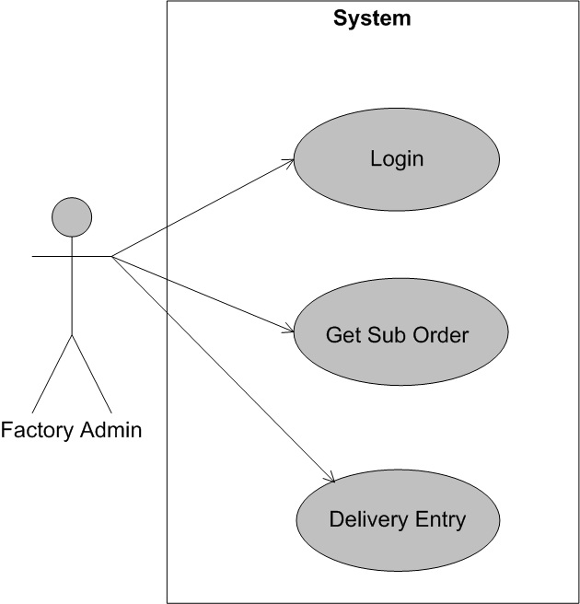
Use Case of Factory Admin

Slide 14
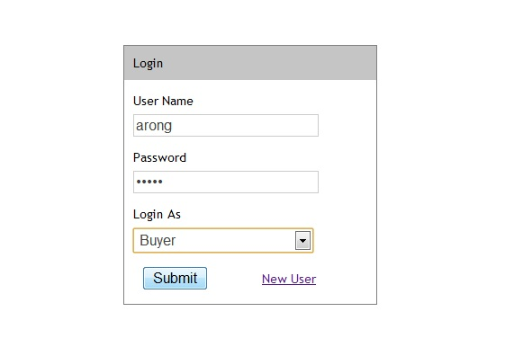
Login

Slide 15
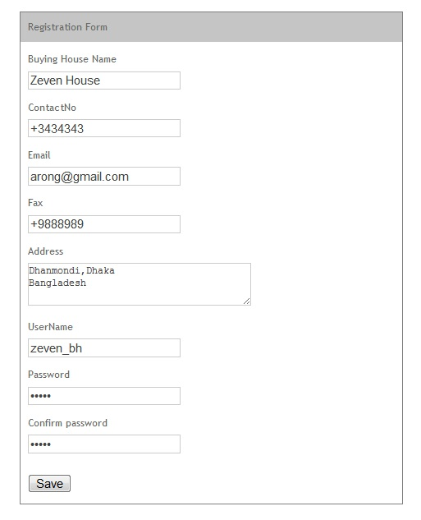
Registration

Slide 16
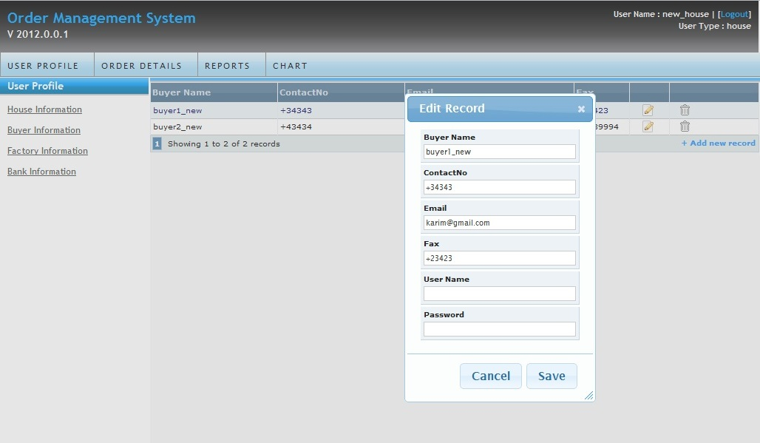
Create Profile by House Admin

Slide 17
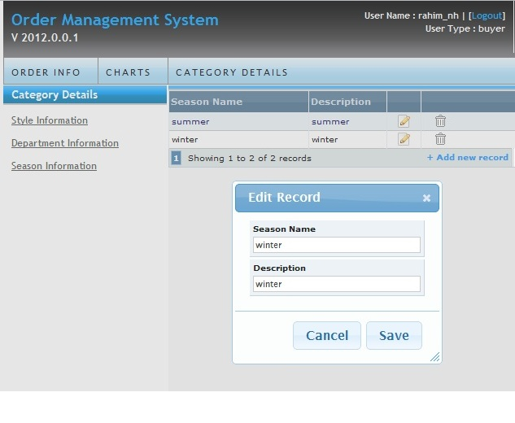
Create Category by Buyer

Slide 18
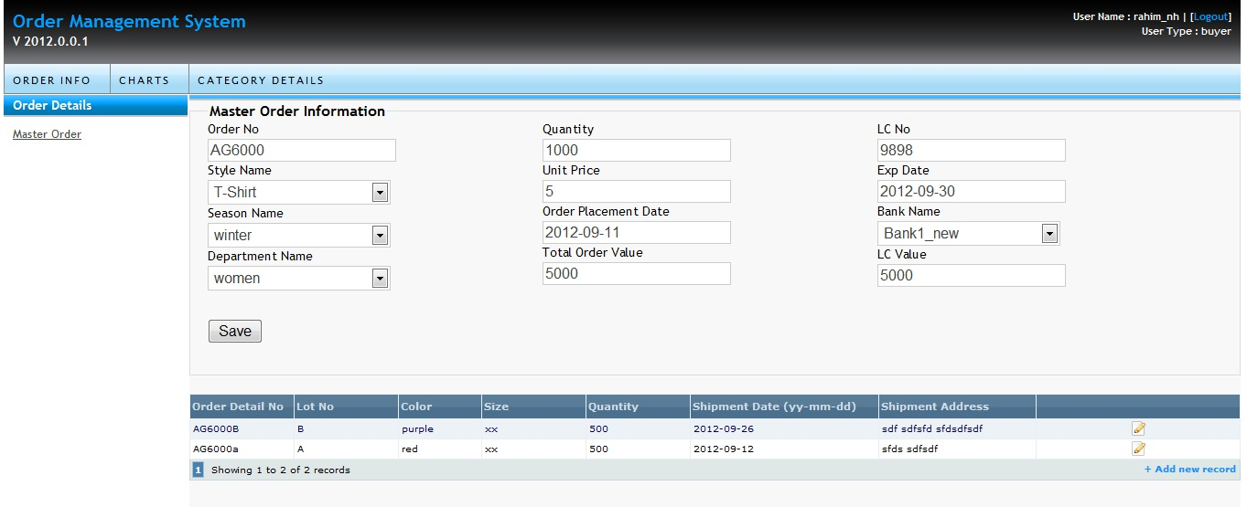
Place Master Order with Specification by Buyer

Slide 19
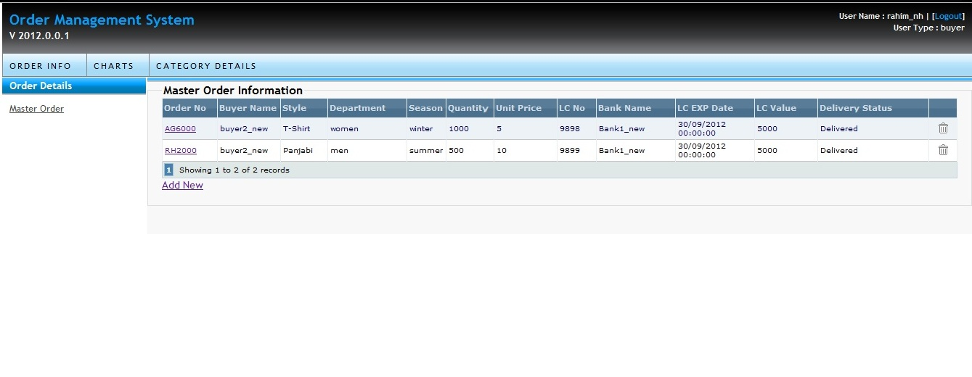
Master Order View

Slide 20
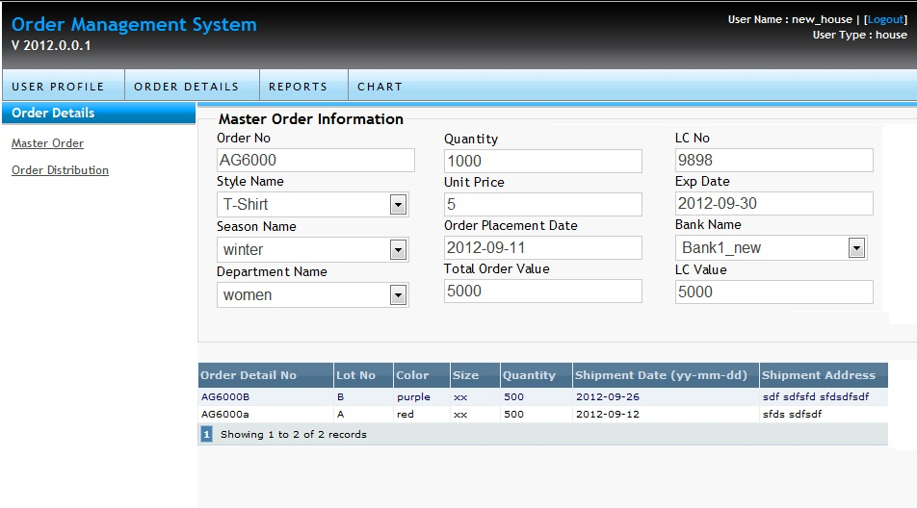
Master Order Specification view

Slide 21
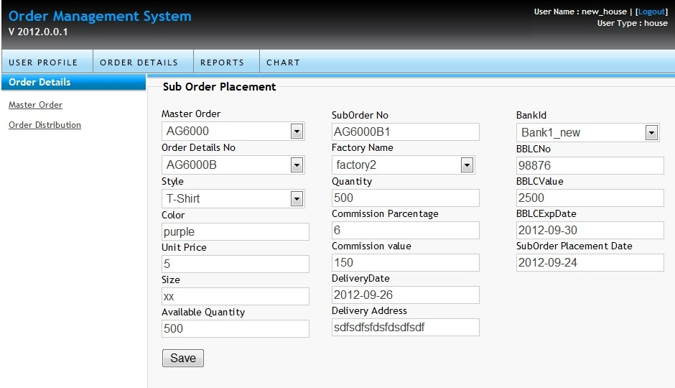
Sub Order

Slide 22
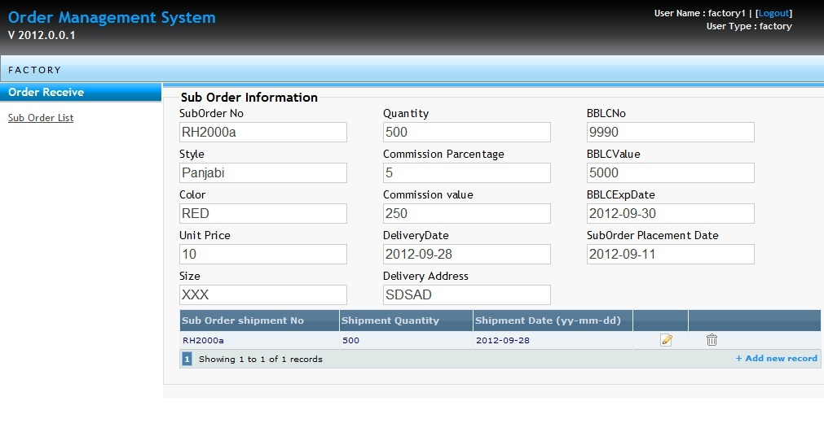
Delivery Info

Slide 23
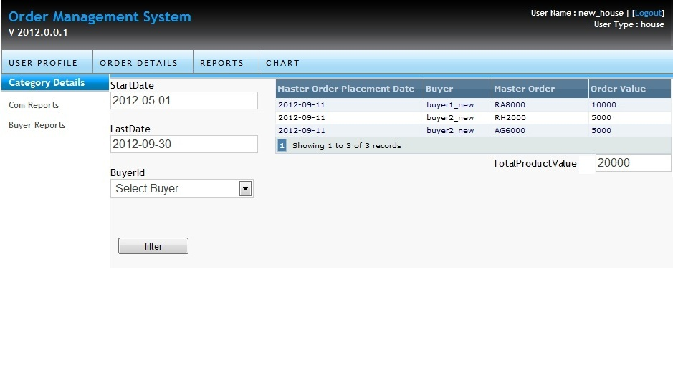
Report Panel

Slide 24
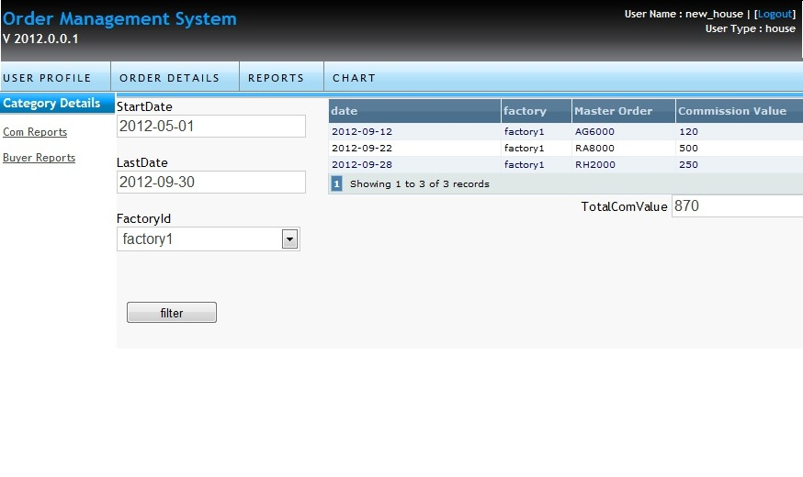
Total Commission value report

Slide 25
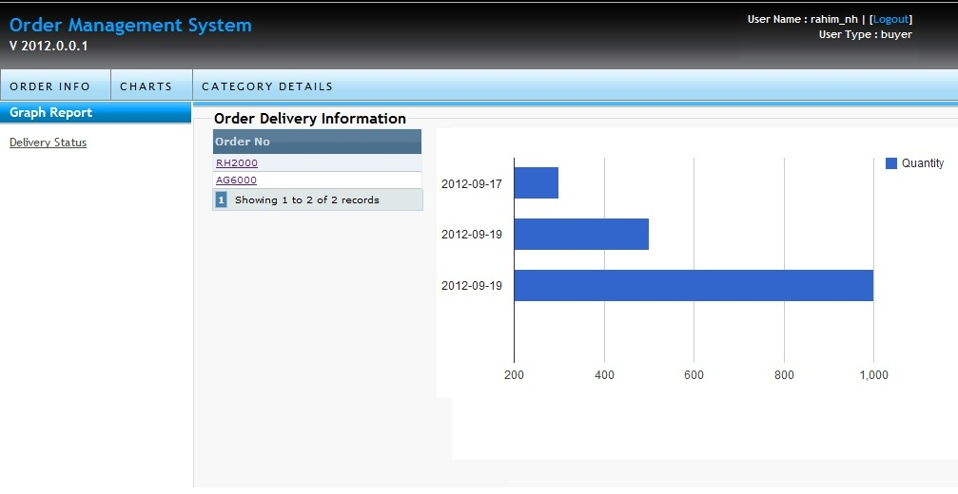
Delivery Status On Chart

Slide 26
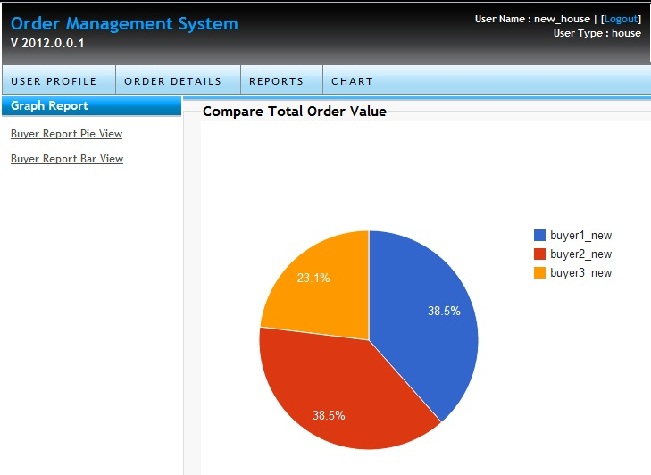
Chart view of order value

Slide 27
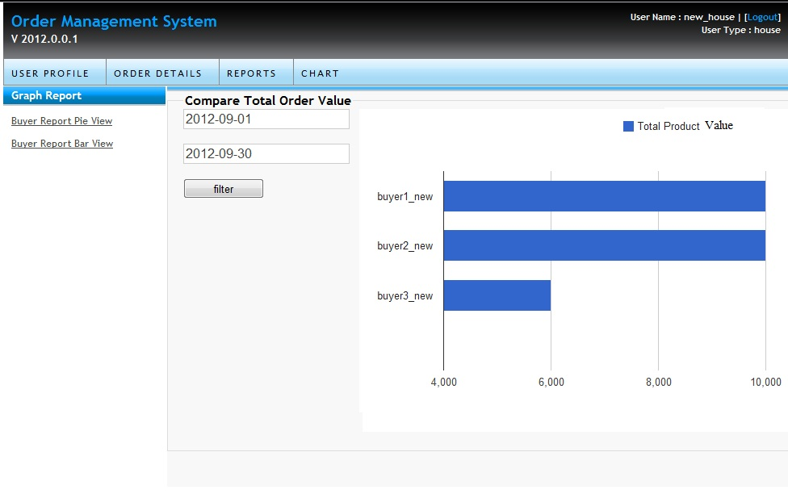
Total Order value report in bar

