Slide 1
Tiara CRM
WhatsApp Sales AI untuk Toko Bunga
AI agent 24/7 + sales pipeline visibility + operator productivity toolkit.
Bangun di atas WhatsApp existing, hosted di server kamu sendiri.
Versi 1.1 · Mei 2026

Slide 2
Masalah Toko Bunga Online
Volume chat tinggi, tim terbatas, conversion lambat
⏱
Slow response = lost sales
🔁
Capek jawab pertanyaan repetitif
Operator nggak sempat balas semua chat → 30-50% inquiry hilang
60% waktu operator habis untuk FAQ harga/ongkir/jam buka
📊
Tidak tahu deal stuck di mana
🔥
Komplain telat di-handle
Bottleneck conversion tak ke-detect — apakah AI sering kirim form tapi customer jarang submit?
Customer kasih review buruk publik → reputation damage
📋
Info customer tersebar
📈
Mau scale, takut hire 5 operator baru
Tidak ada single source of truth → operasional rapuh
Margin tergerus, operasional kompleks

Slide 3
Solusi: Tiara CRM
AI-first WhatsApp sales platform untuk florist
👥
Untuk Customer
👨‍💼
Untuk Operator
📊
Untuk Owner
✓ Balas WA <30 detik 24/7 oleh AI "Tiara"
✓ Inbox terpadu + AI suggest + perhalus
✓ Sales pipeline kanban + forecast revenue
✓ Info harga/stok/ongkir akurat (KB-grounded)
✓ Quick template + snippet pribadi
✓ Heatmap respon time + cohort retention
✓ Order form prefilled — tinggal submit
✓ Customer 360 lengkap (orders, recipients, kategori)
✓ Operator performance leaderboard
✓ Reminder bayar otomatis 2 jam
✓ Tasks + @mention kolaborasi
✓ AI quality scoring weekly
✓ Konfirmasi paid + H-1 + H+1 CSAT
✓ Bulk action (assign/snooze/stage/close)
✓ Daily brief Telegram pukul 09:00

Slide 4
Tiara AI vs Hire 5 Operator Manual
Cost & quality comparison
Aspek | 5 Operator Manual | Tiara CRM (1-2 op + AI)
Cost bulanan | Rp 25-40jt | Rp 8-12jt + LLM ~Rp 2jt
Response time | 2-15 menit (peak 1+ jam) | <30 detik konsisten
Available 24/7 | Tidak (shift) | Ya — AI tidak tidur
Konsistensi tone | Variatif per operator | Persona terkontrol
Track follow-up | Sticky note / WA pribadi | Auto-reminder + pipeline
Risk halusinasi | Tergantung pengalaman | KB-grounded + confidence threshold
Skalabilitas | Linear (2× chat = 2× hire) | Sub-linear (AI handle 80% rutin)
Onboarding op baru | 2-4 minggu | 2-3 hari
Tiara TIDAK menggantikan operator 100% — untuk negosiasi/komplain/custom price tetap handover ke manusia.
AI eliminasi 60-80% pertanyaan rutin supaya operator fokus ke deal high-value.

Slide 5
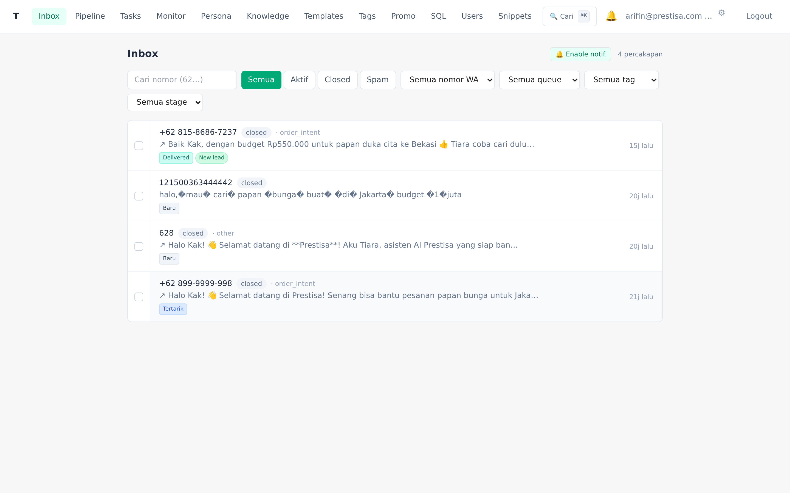
Inbox Terpadu
Semua chat WhatsApp di 1 layar
Filter by status / queue / tag / pipeline stage
Last intent classification AI (order_intent, pricing, complaint…)
Bulk action (assign, snooze, set stage, tag, close — sekaligus)
Live update via Socket.IO (no refresh)
Browser push notification + bell unread badge

Slide 6
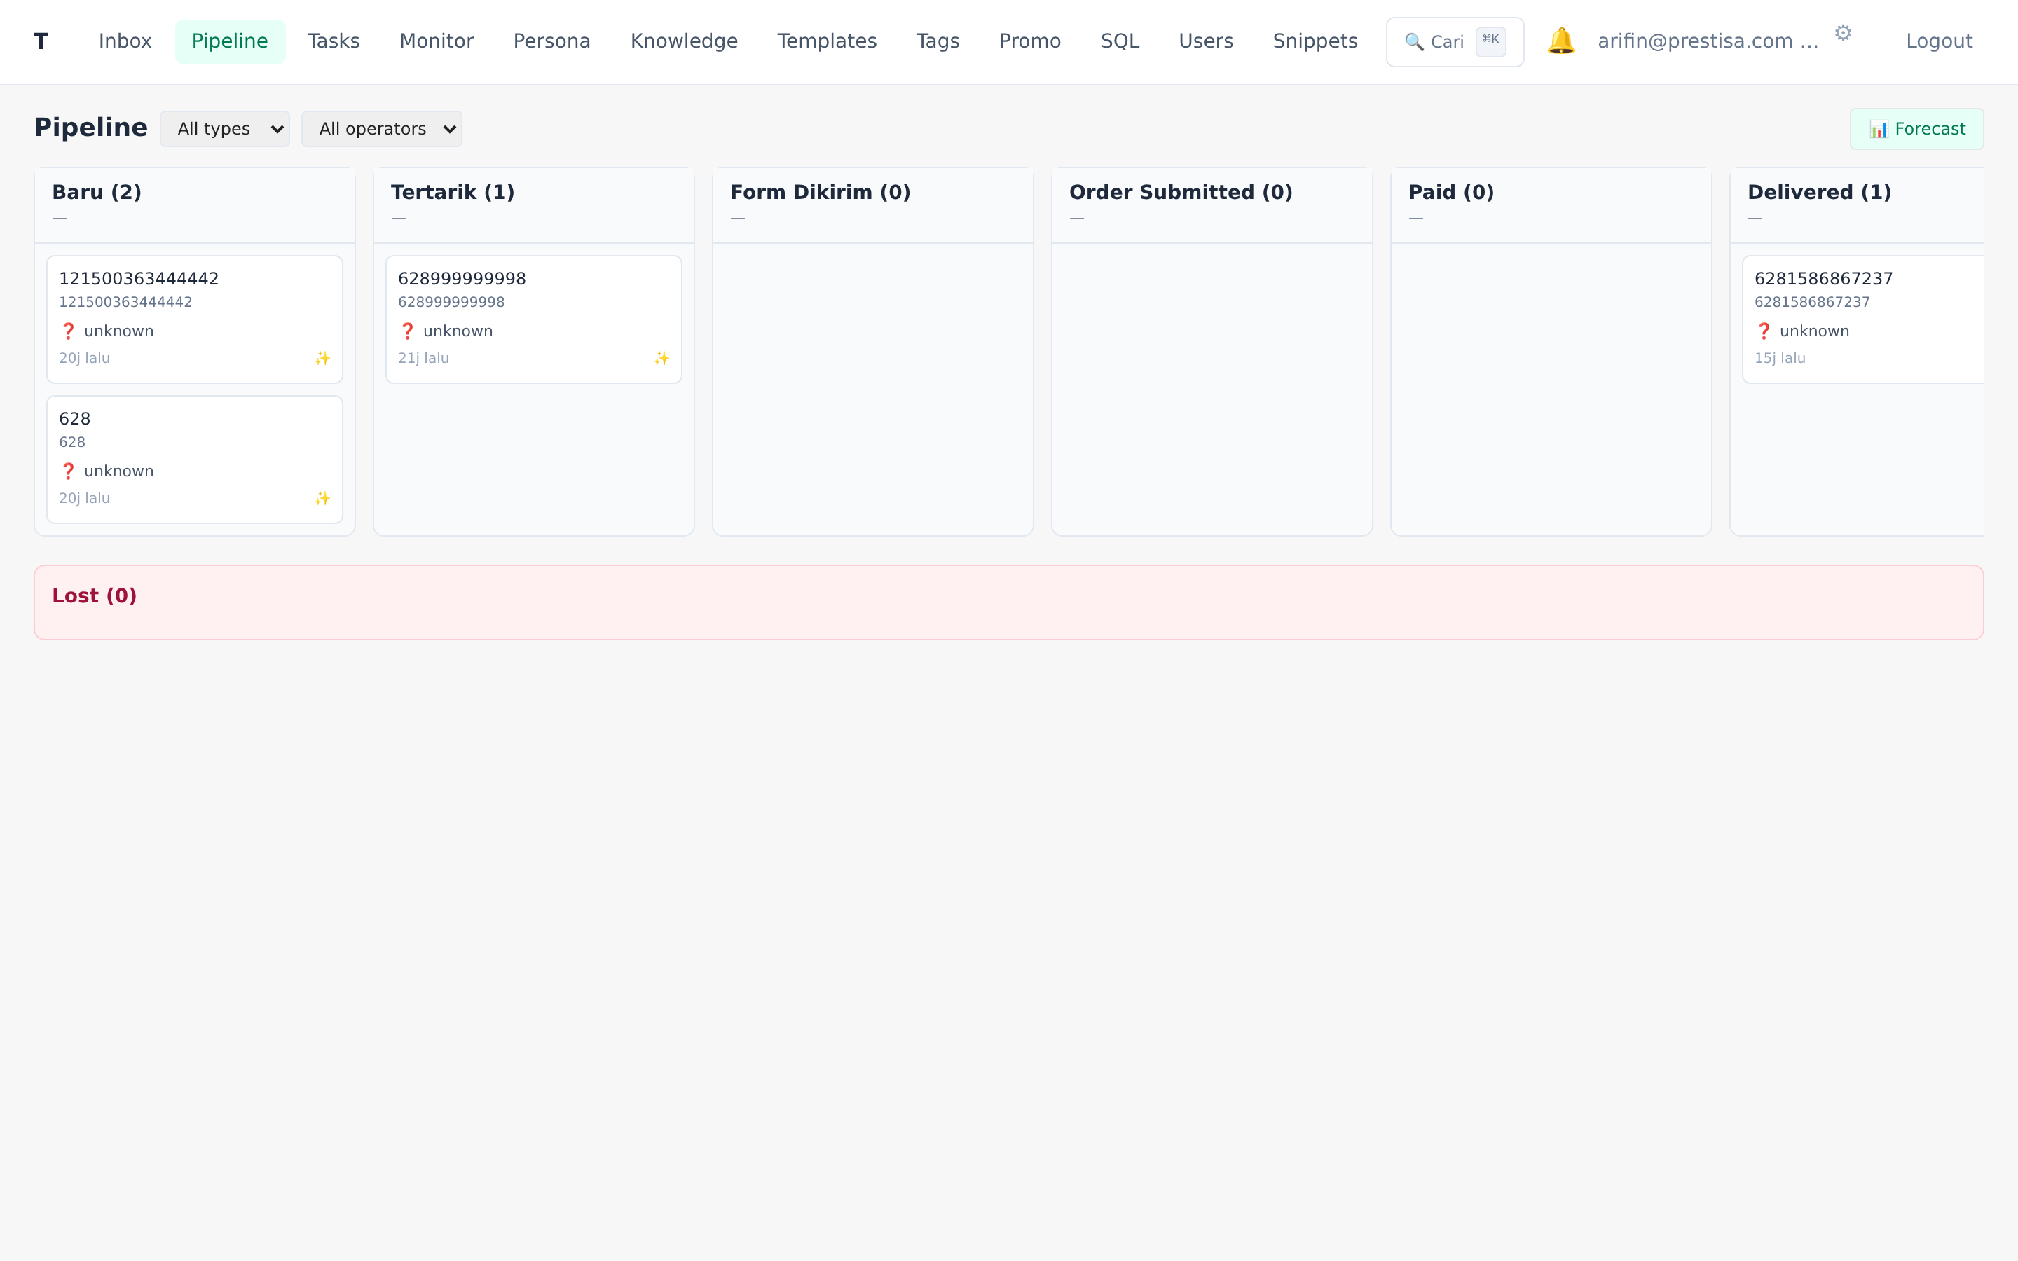
Sales Pipeline Kanban
6 stage + Lost taxonomy, auto-transition dari event
Stage: Baru → Tertarik → Form Dikirim → Submitted → Paid → Delivered
Auto-transition dari event (intent classifier, build_order_form_url, MySQL)
Drag-drop manual override
Forecast: expected revenue × probability per stage
8 Lost reason: no_reply, harga, kompetitor, produk_tidak_cocok, dll

Slide 7
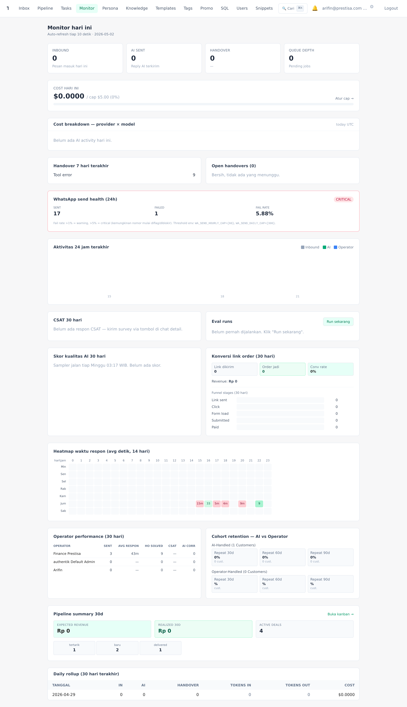
AI Monitor Dashboard
Bird-eye view performa AI, operator, conversion
KPI today (in/AI/operator/cost)
24h timeline chart + heatmap respon time
Operator performance per-staff (sent, respon, CSAT, AI corrections)
Cohort retention — AI vs operator handled (30/60/90d)
Conversion funnel + Pipeline summary 30d

Slide 8
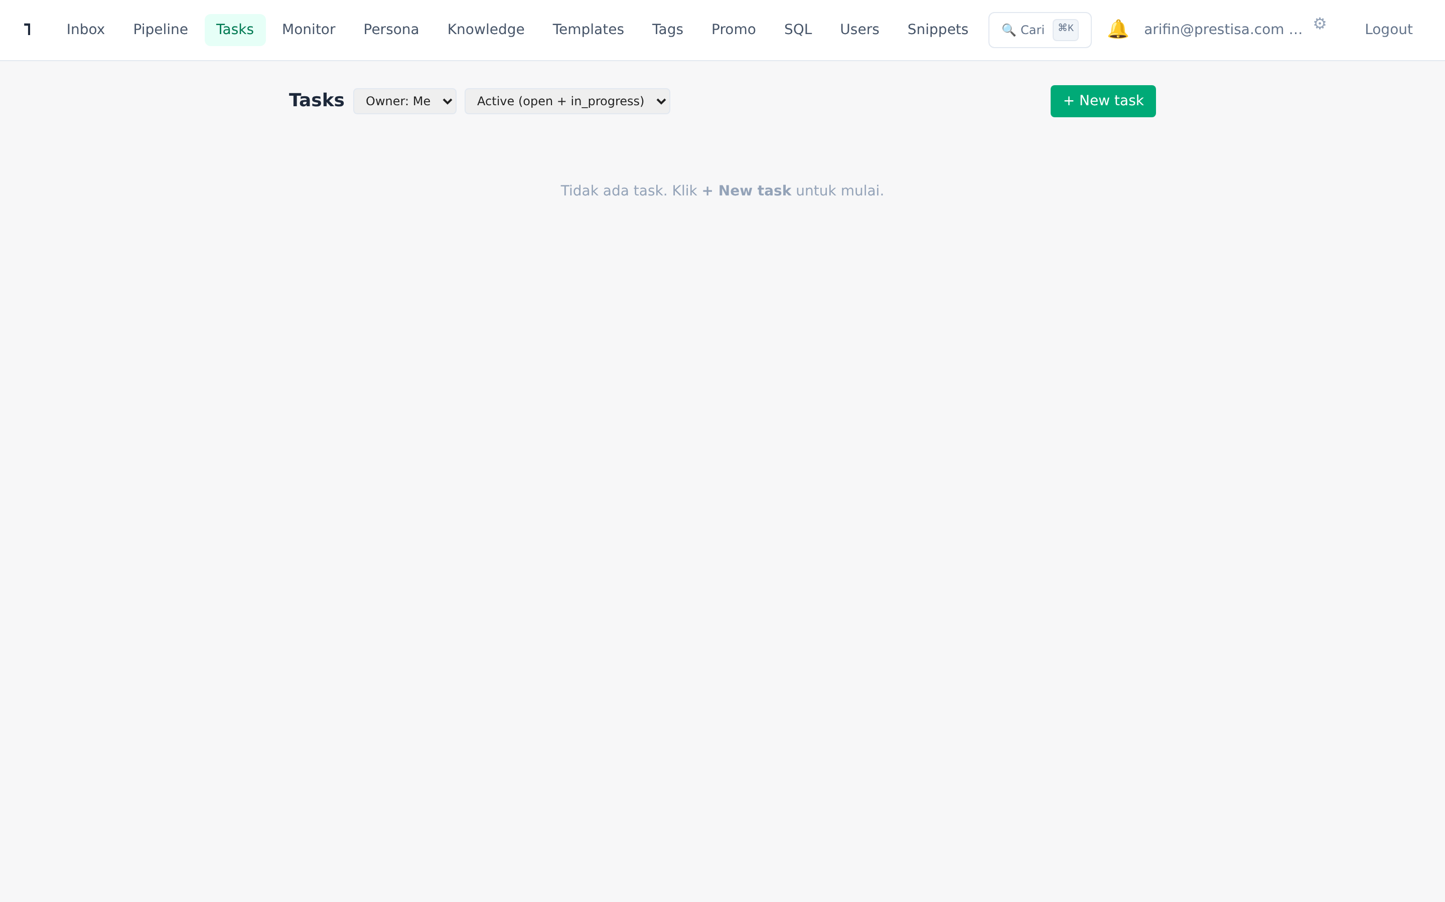
Tasks & Notifications
Operator productivity suite v2
Tasks per-conv atau standalone, due datetime + 4-state workflow
Auto-reminder 1 jam sebelum due → in-app + Telegram personal
Internal comments + @mention live autocomplete (operator-only)
Bell notification dengan unread badge
Telegram personal binding untuk notif HP

Slide 9
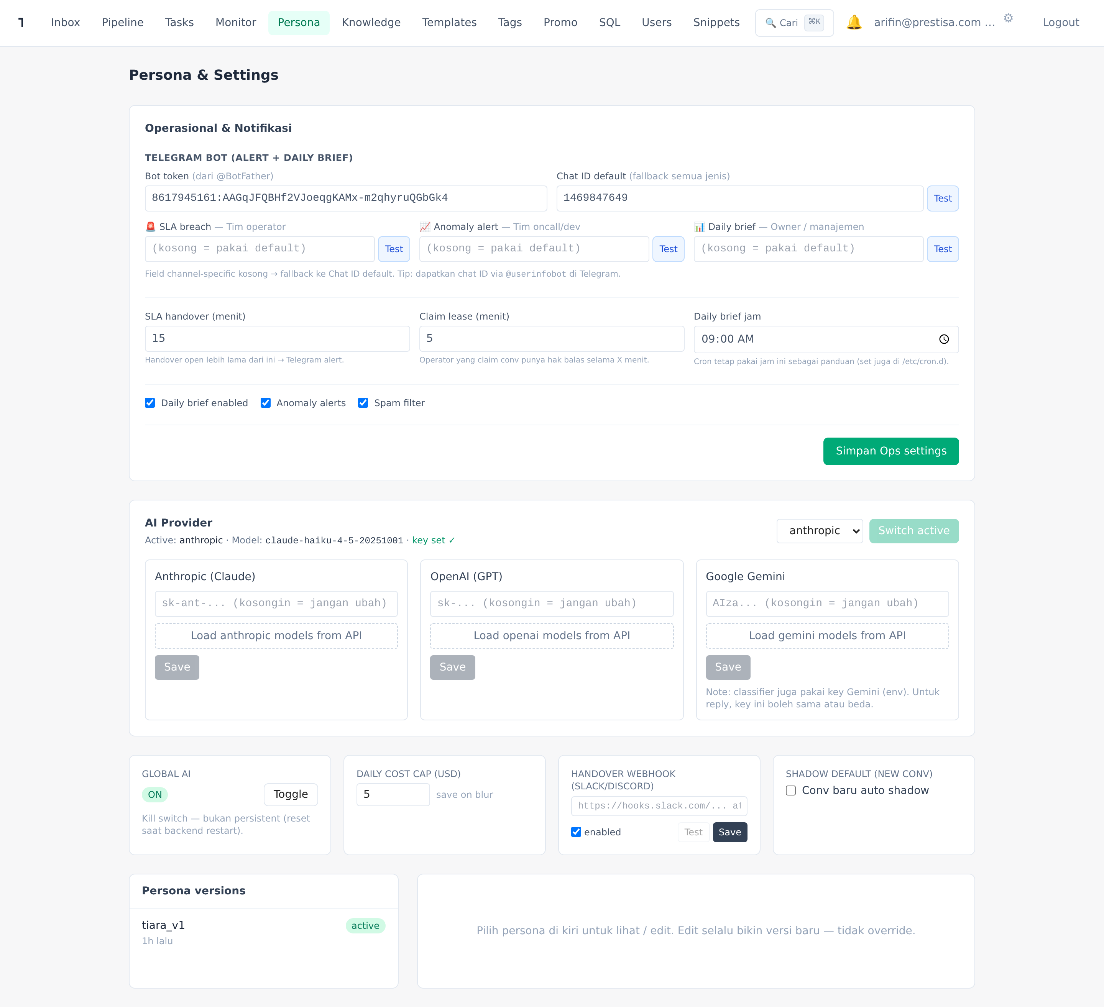
AI Settings
Configurable persona, multi-LLM, multi-channel Telegram
Multi-LLM provider switch live (Claude / OpenAI / Gemini)
Persona editor — edit prompt + version + rollback
Telegram multi-channel (SLA / Anomaly / Brief)
Cost cap — auto-handover saat budget habis
Shadow mode per-conv — operator review sebelum kirim

Slide 10
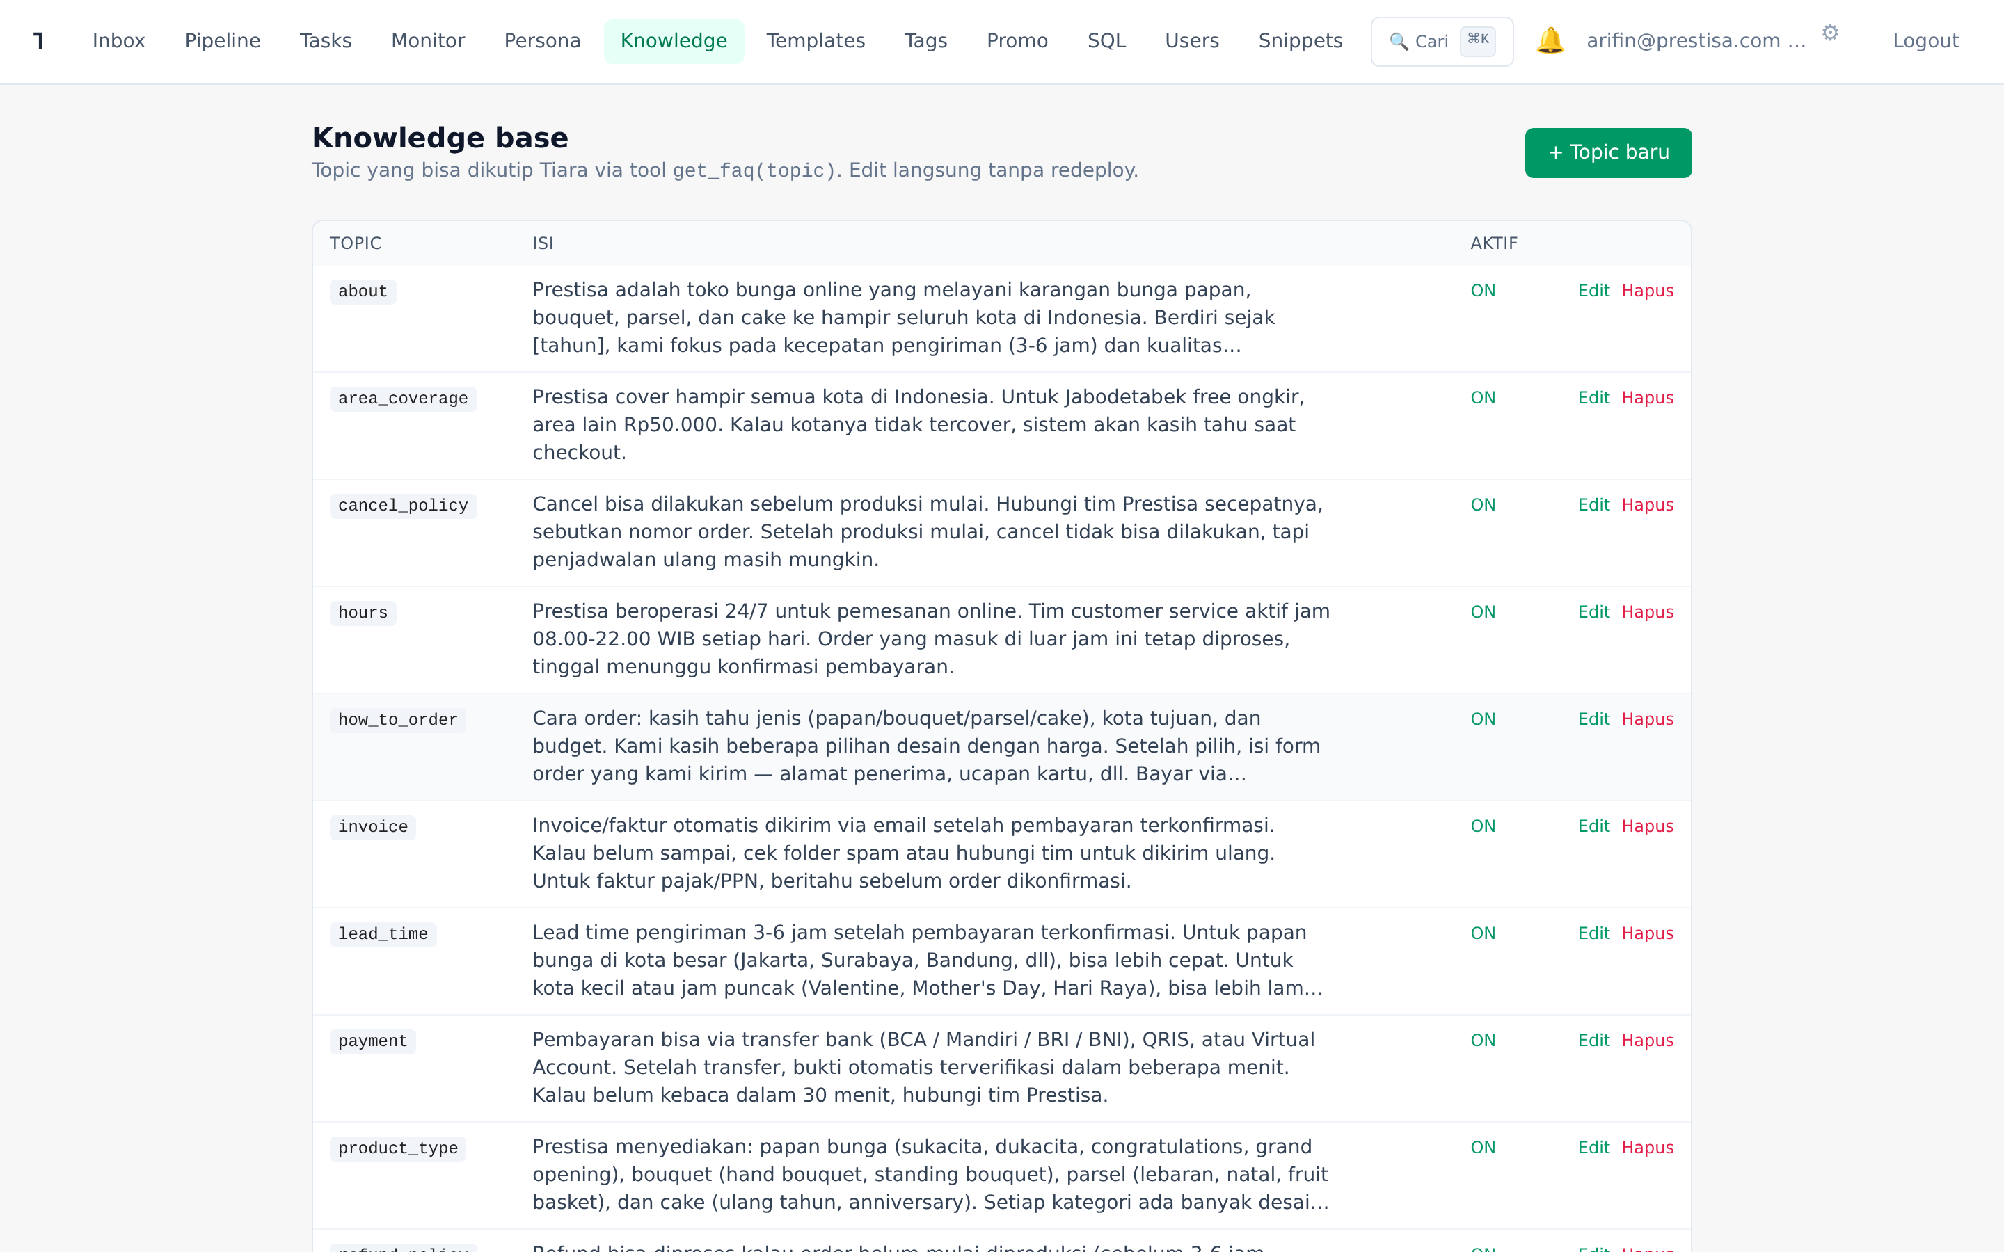
Knowledge Base Self-Improving
Auto-draft KB topic dari handover gap
KB topic dengan semantic search via embeddings
Auto-captured pertanyaan customer saat handover low_confidence
Operator approve → langsung jadi KB topic baru
AI pakai kb_search tool untuk query natural language
Edit langsung di UI tanpa redeploy

Slide 11
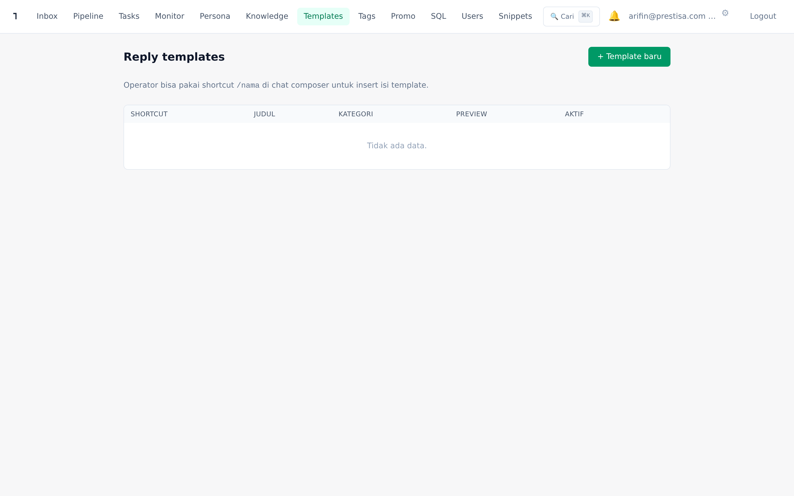
Templates & Snippets
Reply lebih cepat — global + per-operator
Templates global — shared semua operator
Snippets pribadi — per-operator (signature, personal style)
Akses sama: ketik /shortcut di composer → autocomplete
Quick chips — top 6 template di atas composer
Composer 1-tap insert

Slide 12
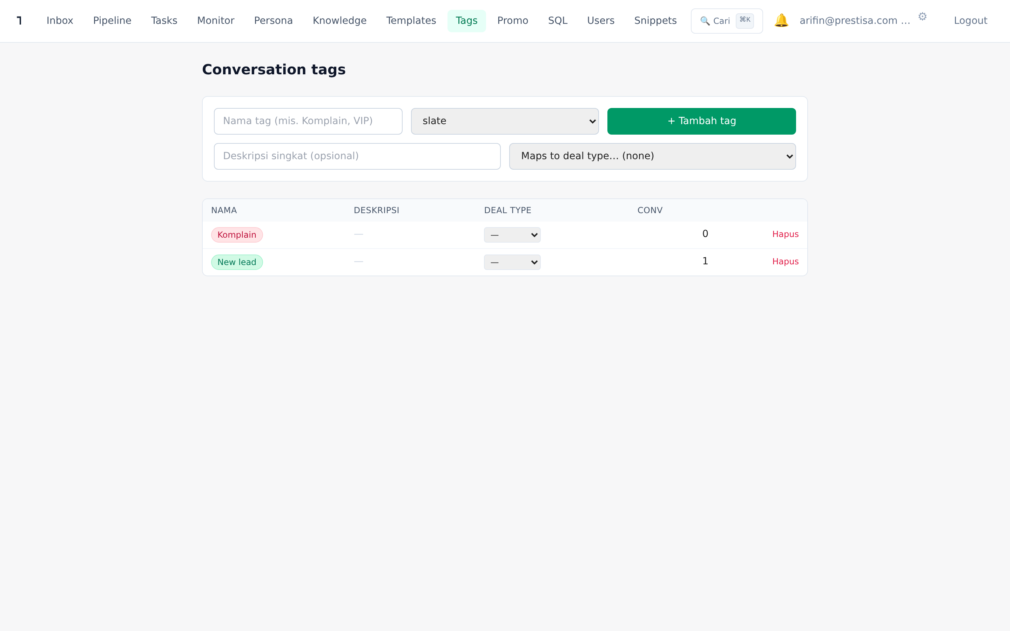
Tags + Pipeline Type Mapping
Klasifikasi conversation + auto-detect deal type
Auto-tagging oleh AI berdasar intent classifier (✨ icon)
Tag bisa map ke pipeline type (mis. "Wedding-2026" → wedding)
Per-tag SLA override (VIP → 5 menit, default → 15 menit)
Tone overlay otomatis di AI persona berdasar tag
Bulk add/remove tag via inbox toolbar

Slide 13
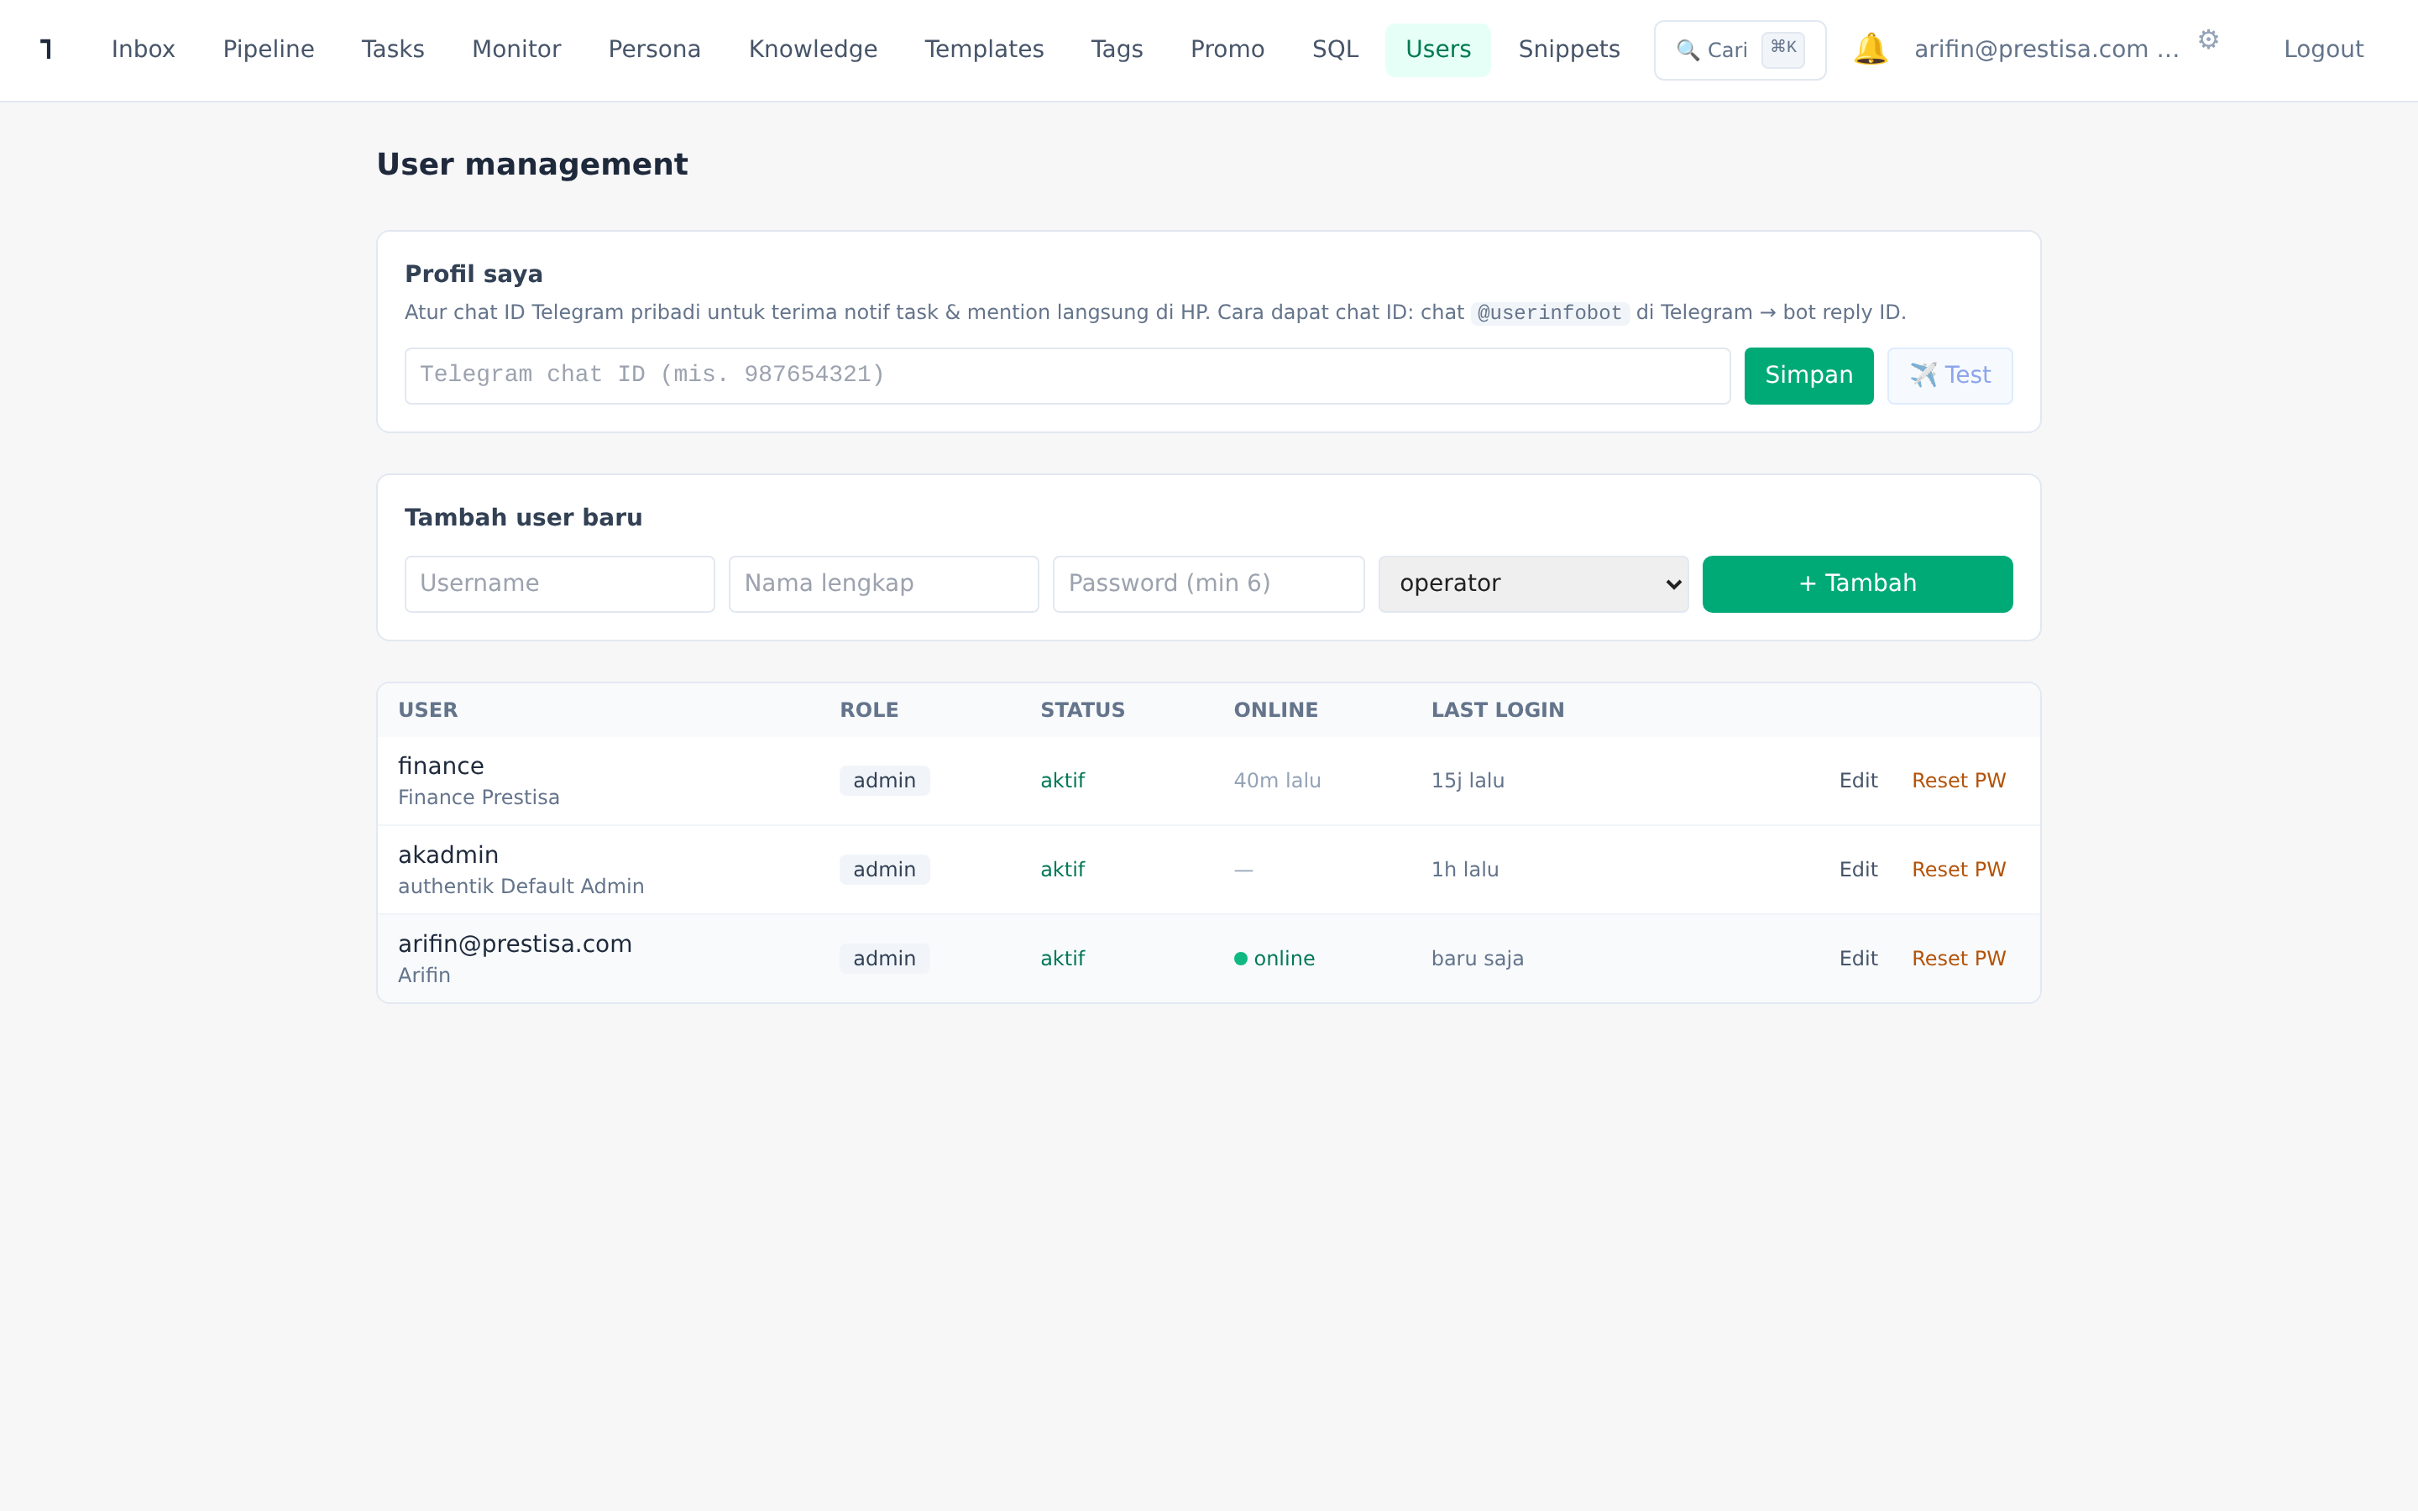
User Management + Profil
Role-based access + Telegram personal
Role admin / operator / viewer
Reset password, disable user
Presence: dot hijau saat operator online (heartbeat 45s)
Last login tracking
Profil pribadi: opt-in Telegram chat ID untuk notif HP

Slide 14
ROI Estimasi
Toko bunga 5,700 chat/hari · 350 unique customer/hari · AOV Rp 500k
🏪 Baseline (manual)
🚀 Setelah Tiara
• 5 operator × Rp 5jt = Rp 25jt/bulan
• 2 operator + AI = Rp 14jt/bulan total
• Conversion rate ~10% (35 order/hari)
• Conversion rate 13-15% (~150 order extra)
• 1,050 order/bulan × Rp 500k = Rp 525jt revenue
• Revenue ~Rp 600jt + LTV naik
• Slow response peak hour (>15 menit)
• Response <30 detik konsisten 24/7
• Tidak ada visibility funnel
• Pipeline visibility lengkap + auto follow-up
💰 Net uplift bulan pertama: Rp 11jt saving + Rp 75jt revenue tambahan = ~Rp 86jt/bulan · ROI break-even <30 hari

Slide 15
Reliability & Stack
Tahan banting + privacy-first
Anti-ban WhatsApp
Privacy & Compliance
Tech Stack
• Typing indicator natural
• Self-hosted di server kamu
• Node 20 + Express 5 + PostgreSQL
• Random reply delay 2-9s
• PII scrubbing built-in
• Next.js 14 + Tailwind + SWR
• Hourly + daily send-rate caps
• Operator audit trail
• Claude Sonnet + Gemini Flash + OpenAI
• Warmup mode untuk nomor baru
• Tidak ada cloud SaaS pihak ke-3
• Self-hosted WAHA (siap migrasi Meta API)
• Quiet hours (Asia/Jakarta)
• Backup harian 02:30 WIB (14 hari)
• Caddy auto-HTTPS + PM2
• Spam contact filter
• LLM provider opt-out training
• Socket.IO realtime

Slide 16
Roadmap
Sudah live · In design · Long-term
✅ Live (v1 + v2)
⏳ Sub-project 3 (in design)
🔮 Long-term
Inbox + chat detail (AI suggest, perhalus, katalog)
Customer segmentation builder
Loyalty points + voucher system
Sales pipeline kanban + forecast
Lifecycle workflow engine (trigger → actions)
Recurring subscription delivery
AI monitor lengkap (operator perf, cohort, funnel)
Pre-built journey templates:
Meta Cloud API migration path
KB self-improving + RAG embeddings
- Birthday / anniversary
Voice agent integration
Multi-LLM + multi-channel Telegram
- Win-back churned customer
Cross-sell ke marketplace
Customer health + facts extracted
- Post-purchase nurture
Delivery comms (paid/H-1/H+1 CSAT)
- Abandoned cart enhanced
Tasks + notifications + @mention (v2)
Telegram personal binding (v2)

Slide 17
Demo + Tanya Jawab
Lihat live, atur demo akun, atau diskusi customization
🌐 salesai.prestisa.net
📧 finance.parselia@gmail.com
📘 Manual: salesai.prestisa.net/docs/Tiara-CRM-Manual.pdf
📊 Marketing PDF: salesai.prestisa.net/docs/Tiara-CRM-Marketing.pdf
Tiara CRM dibangun untuk Prestisa, dapat di-customize untuk toko bunga / florist lain dengan workflow serupa.

