Slide 1
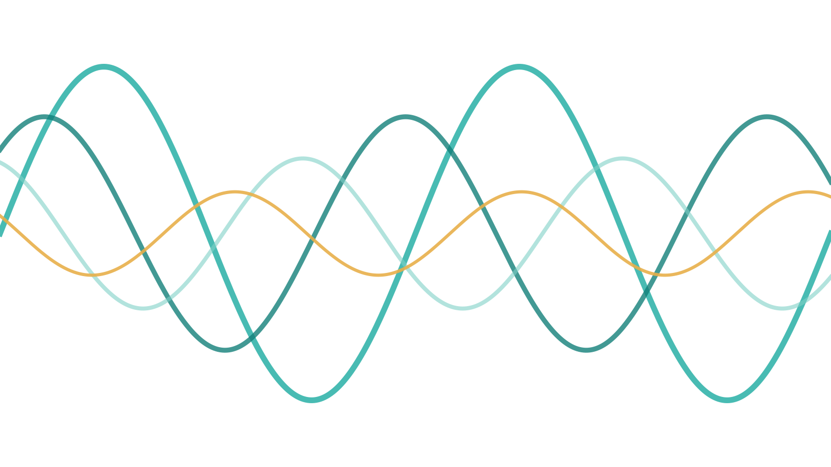
Light and Optics
SFS1112 PHYSICS FOR LIFE SCIENCES · OPTICS I + II
How light carries information about food — from refractometers and cameras to microscopes and spectrometers
Dr. Muhamad Arif Mohamad Jamali
Bachelor of Food Biotechnology, FST, USIM
Week 10 · 30 November – 6 December 2026 · CLO1 & CLO3
Notes:
ONE LECTURE, TWO PARTS
Part 1 · Ray optics (A–D): what light is, reflection, refraction and total internal reflection, lenses and images.
Part 2 · Wave optics (E–H): interference, diffraction and resolution, polarization, colour and spectroscopy.
CALCULATION LEVEL: only the key calculations are kept — photon energy, n = c/v, Snell's law, critical angle, the thin-lens equation, microscope resolution and the three-polarizer result. Everything else is conceptual, with prediction questions and activities.
HOW THIS DECK WORKS
• YOUR TURN / QUICK CHECK / CLASS ACTIVITY / TRY IT LIVE / DEMO slides: ask, let students commit, then click to reveal.
• WORKED EXAMPLE slides reveal one step per click. Animations play in Slide Show.
TIMING: about 2.5 hours with every activity. For 2 hours, set the PhET activity, the CD-grating demo and the sunglasses activity as homework, and shorten the lens-case activity.
PROPS (optional, cheap): a cup, a coin and water; a glass of water and a straw; a magnifying glass; an old CD/DVD and a phone torch; polarized sunglasses (and 3 polarizer sheets if available); a laser pointer.
Reading: OpenStax College Physics 2e Ch. 25–27 (and §29.3 photon energies); Newman, Physics of the Life Sciences, Ch. 19–22.

Slide 2
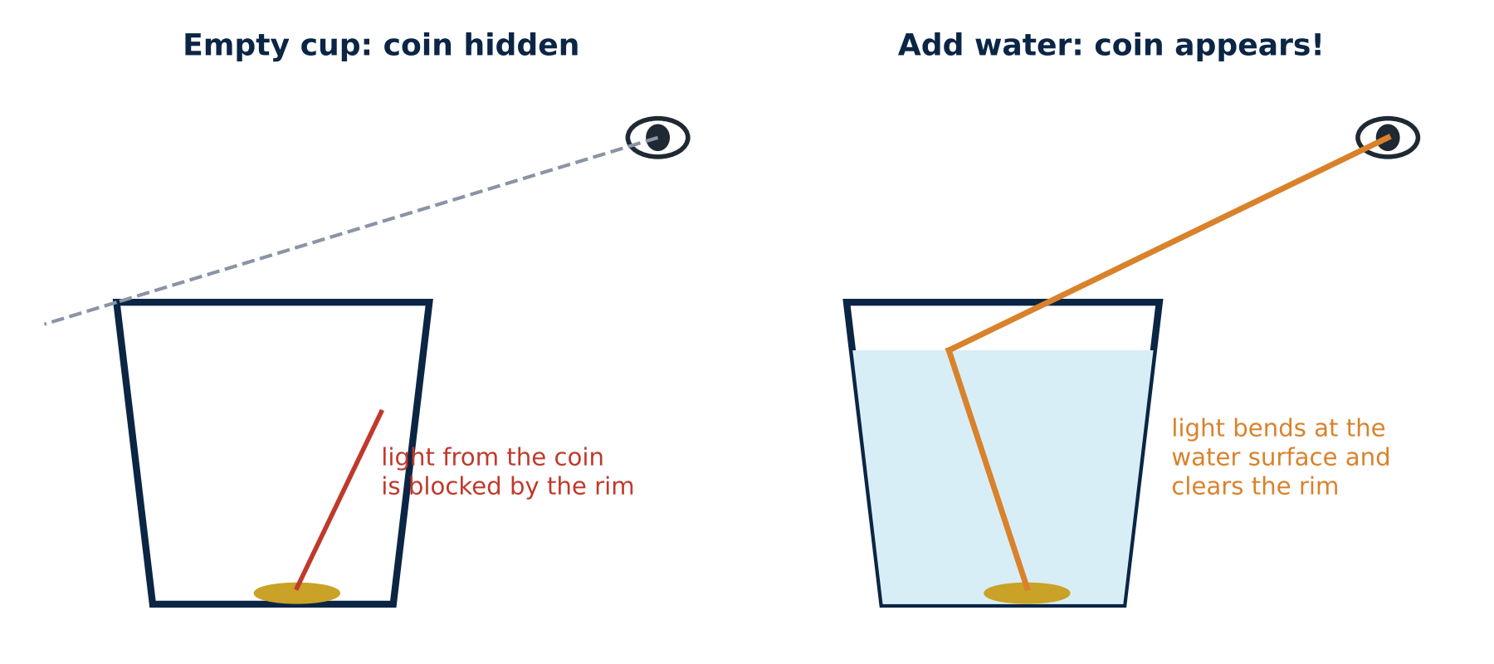
Warm-up: make a coin appear with water
CLASS ACTIVITY
3 minutes, in pairs
1. Put a coin in the bottom of an empty cup.
2. Move your head back until the rim just hides the coin.
3. Keep still while your partner slowly pours in water.
Predict first
Will the coin stay hidden, or reappear? Why?
It reappears — light bends at the water surface
Light from the coin travels in water, then into air. At the surface it changes speed and bends away from the normal, so it now clears the rim and reaches your eye. Nothing moved except the light's path.
This is refraction — the idea behind lenses, refractometers, the eye and "bent" straws. We explain it properly in Part C.
▶ click to reveal
Notes:
Classic, cheap and almost magical demo. If cups are not available, do it once at the front with a visualiser or phone camera.
Ask for predictions before pouring. Then CLICK to reveal. Point out that the brain always assumes light travels in straight lines — that's why the coin seems to "float up".

Slide 3
By the end of today you should be able to…
OVERVIEW
PART 1 · RAY OPTICS
PART 2 · WAVE OPTICS
1
Explain when light behaves as a ray, a wave or a photon; use E = hf.
5
Explain interference in double slits, thin films and gratings.
2
Apply the law of reflection; explain gloss and dullness of food surfaces.
6
Explain why diffraction limits microscope resolution, and how to improve it.
3
Use n = c/v and Snell's law; explain total internal reflection and refractometers.
7
Describe polarization and its use for starch, crystals, sugar and glare.
4
Predict images formed by lenses, the eye and the microscope.
8
Explain food colour, scattering and absorbance (Beer–Lambert) and NIR analysis.
CLO1 describe basic concepts (photons, light). CLO3 ethical measurement: calibration, validation and honest images. Read: OpenStax Ch. 25–27; Newman Ch. 19–22.
Notes:
Optics I (CTP Week 10): photons, reflection, refraction, lenses and image formation. Optics II (CTP Week 11): interference, diffraction, polarization, dispersion and microscopy. Both are covered today.

Slide 4
Today's route: rays first, then waves
OVERVIEW
PART 1 · RAY OPTICS
A
B
C
D
What is light?
Reflection
Refraction & TIR
Lenses & images
PART 2 · WAVE OPTICS
E
F
G
H
Interference
Diffraction & resolution
Polarization
Colour & spectroscopy
Which model? Use rays when everything is much bigger than the wavelength (mirrors, lenses). Use waves when features are close to the wavelength (thin films, small details). Use photons when light is absorbed or emitted.
Notes:
Same thread as the waves lecture: the source sets f; the medium sets the speed (here through the refractive index n); λ = v/f. Light is an EM wave, so everything from the waves lecture applies.

Slide 5
What is light?
A
Ray, wave or photon — three models for three kinds of question, and why photon energy matters for food safety
Notes:
PART A — about 12 minutes.

Slide 6
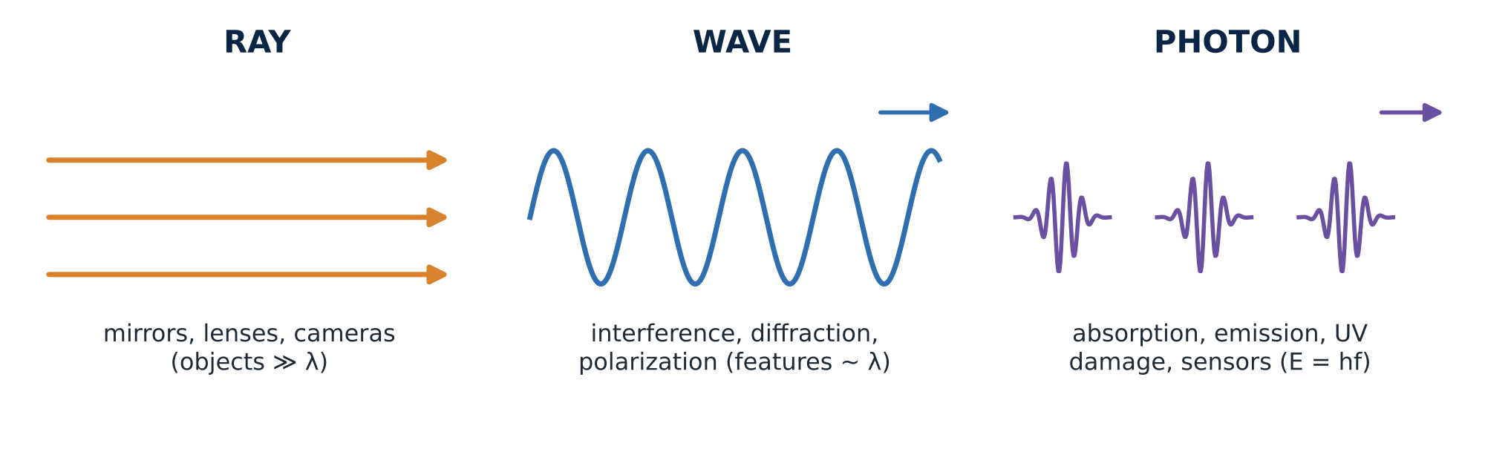
Light: one thing, three useful models
CONCEPT
Light is an electromagnetic wave (waves lecture): electric and magnetic fields oscillating, travelling at c = 3.00 × 10⁸ m/s in vacuum.
When objects are much bigger than λ (≈ 0.0005 mm), the wave travels in straight lines — we can draw rays.
When light is absorbed or emitted, it behaves as packets of energy called photons.
Notes:
Physicists use whichever model answers the question most simply. Rays for mirrors, lenses and cameras (Part 1). Waves for interference, diffraction, polarization (Part 2). Photons for absorption, emission, sensors and radiation damage.
This "wave–particle duality" was settled in the early 1900s: Young's double slit (1801) showed wave behaviour; Einstein's photoelectric effect (1905) showed light arriving in packets.

Slide 7
Photon energy: why UV harms microbes and microwaves don't
CONCEPT
E = h f = h c / λ
Radiation | λ | Energy per photon
Microwave oven | 12 cm | 0.00001 eV
Red light | 650 nm | 1.9 eV
Blue light | 450 nm | 2.8 eV
UV-C lamp | 254 nm | 4.9 eV
X-ray | 0.1 nm | 12 000 eV
h = 6.63 × 10⁻³⁴ J·s (Planck's constant). Shorter wavelength → higher frequency → more energy in each photon. Energies of single photons are often quoted in electron-volts (1 eV = 1.60 × 10⁻¹⁹ J).
The key idea
Breaking a chemical bond (e.g. in DNA) needs about 3–5 eV delivered at once. One UV-C photon can do it; a microwave photon cannot — no matter how many there are. Microwaves heat food by shaking water molecules; UV-C damages microbial DNA.
A typical C–C bond energy is about 3.6 eV.
Notes:
This is the photon idea that matters most for food biotech: whether radiation can break bonds depends on the energy of EACH photon (set by frequency), not on the total brightness.
Values: E = hc/λ. Red 650 nm: 3.06 × 10⁻¹⁹ J = 1.9 eV. UV-C 254 nm: 7.83 × 10⁻¹⁹ J = 4.9 eV. Microwave 2.45 GHz: hf = 1.6 × 10⁻²⁴ J ≈ 10⁻⁵ eV.
Links: UV-C dose (waves lecture), food irradiation with gamma rays (Nuclear Physics), blue light and photo-oxidation of milk in clear bottles (riboflavin absorbs blue light → off-flavours) — a nice extra example.

Slide 8
Worked example: the energy of one UV-C photon
WORKED EXAMPLE
Problem
A germicidal lamp emits UV-C at λ = 254 nm. Find the energy of one photon in joules and in electron-volts, and compare with red light (650 nm).
1
Formula: E = hc/λ
Unit tip
nm → m: × 10⁻⁹
J → eV: ÷ 1.60 × 10⁻¹⁹
Shorter λ always means bigger E.
2
Substitute: E = (6.63 × 10⁻³⁴ × 3.00 × 10⁸) / (254 × 10⁻⁹)
3
Evaluate: E = 7.83 × 10⁻¹⁹ J
4
Convert: 7.83 × 10⁻¹⁹ / 1.60 × 10⁻¹⁹ = 4.9 eV
5
Compare: Red light (650 nm) gives 1.9 eV per photon — not enough to break DNA bonds, however bright the lamp.
Notes:
One step per click. A useful shortcut students may like: E (eV) ≈ 1240 / λ (nm). 1240/254 ≈ 4.9 eV ✓; 1240/650 ≈ 1.9 eV ✓.

Slide 9
A very bright red lamp, or a dim UV-C lamp?
QUICK CHECK
Vote: 1 minute
Which of these is more likely to damage the DNA of bacteria on a cutting board?
A
The very bright red lamp — more light means more damage
B
The dim UV-C lamp
C
Both equally, if the total energy is the same
D
Neither — light cannot affect bacteria
Answer: B
Damage happens one photon at a time. Each red photon (1.9 eV) is too weak to break DNA bonds, so more red photons just warm the board. Each UV-C photon (4.9 eV) can break bonds by itself.
Same logic as Einstein's photoelectric effect: brightness = number of photons; colour = energy per photon.
▶ click to reveal
Notes:
C is the tempting answer. Emphasise: total energy is not what matters for bond breaking; energy per photon is.
Safety (CLO3): UV-C also damages human skin and eyes — UV-C systems must be shielded and interlocked.

Slide 10
Light slows down in matter: the refractive index
CONCEPT
n = c / v
Material | n | speed of light (×10⁸ m/s)
Air | 1.0003 | 3.00
Water | 1.333 | 2.25
20 °Brix sugar solution | 1.364 | 2.20
Vegetable oil | ≈ 1.47 | 2.04
Glass | ≈ 1.52 | 1.97
Diamond | 2.42 | 1.24
n tells you how many times slower light travels in a material than in vacuum.
Light slows because its electric field makes the electrons in the material oscillate; their re-emitted waves combine with the original into a slower wave.
The frequency stays the same; so the wavelength inside is shorter: λ_{medium} = λ / n.
Quick calculation
Speed of light in water: v = c/n = 3.00 × 10⁸ / 1.333 = 2.25 × 10⁸ m/s — still fast, but 25% slower than in air.
Notes:
n is always ≥ 1. More dissolved sugar, salt or protein → more electrons per volume → higher n. That is why refractometers can measure sugar (Part C).
Optional: the wavelength of green light (550 nm) in water is 550/1.333 ≈ 413 nm — but the COLOUR is unchanged, because colour (to the eye) depends on frequency.

Slide 11
Reflection
B
The law of reflection, why some foods shine and others look dull, and how mirrors form images
Notes:
PART B — about 10 minutes.

Slide 12
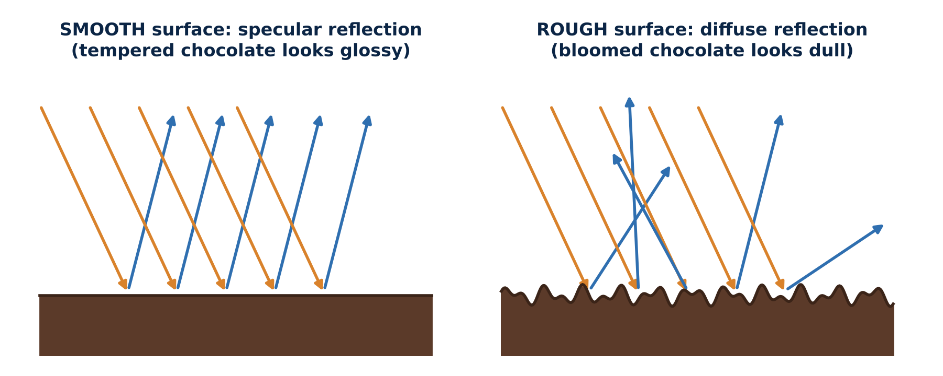
Reflection: smooth surfaces shine, rough surfaces scatter
CONCEPT
Law of reflection: angle of incidence = angle of reflection, measured from the normal — true at every point of every surface.
Smooth surface: all the normals point the same way, so parallel light leaves as one beam — a shine or glare (specular reflection).
Rough surface: the normals point every which way, so light leaves in all directions — a matt look (diffuse reflection). This is how we see most objects.
Notes:
Key point: the law of reflection is never broken; "diffuse" just means the surface has normals in many directions.
Food link: well-tempered chocolate has a smooth surface of small, stable cocoa-butter crystals → glossy. Fat bloom (large crystals at the surface) or sugar bloom (sugar recrystallised after moisture) creates a rough surface → dull, greyish-white. The chocolate is still safe to eat; only the optics changed.
Glossmeters measure specular reflection at set angles (20°, 60°, 85°) to grade coatings, chocolate, fruit wax and packaging.

Slide 13
Why does bloomed chocolate look grey-white and dull?
QUICK CHECK
Vote: 1 minute
Mould has grown on the surface
The cocoa has chemically changed colour
A
B
Tiny crystals make the surface rough, so light is reflected diffusely
The chocolate absorbs more light than before
C
D
Answer: C — a surface-optics change
Fat or sugar crystals at the surface roughen it. Light that used to reflect as one shiny beam is now scattered in all directions, and white crystals scatter all colours — so it looks pale and dull.
Melting and re-tempering restores the smooth surface and the gloss.
▶ click to reveal
Notes:
Many students think bloom is mould. It isn't (mould is fuzzy and usually only on very old or damp products). This is a good example of physics explaining a quality defect.

Slide 14
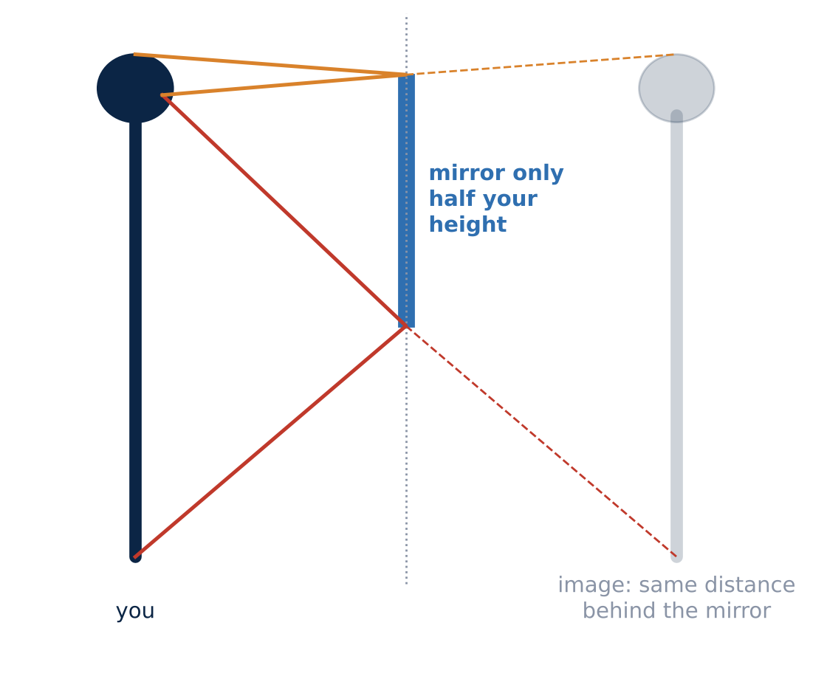
Mirrors: how tall a mirror do you need to see your whole body?
CLASS ACTIVITY
3 minutes
A plane mirror image is upright, the same size, and as far behind the mirror as you are in front.
It is virtual: the light only seems to come from behind the mirror; no light actually goes there.
Predict
Do you need a full-length mirror to see your whole body? Does it help to step back?
Half your height — at any distance
Light from your feet reflects at a point halfway between your eyes and feet; light from your head reflects halfway between your eyes and the top of your head. So the mirror only needs to be half your height (placed at the right height). Stepping back does not change this.
▶ click to reveal
Notes:
Try it with a phone in selfie mode or a small mirror on the wall: mark the top and bottom of what you see; step back and check — the visible portion does not change.
The geometry follows directly from angle of incidence = angle of reflection.

Slide 15
Refraction & TIR
C
Snell's law, why pools look shallow, how refractometers read sugar, and how fibres trap light
Notes:
PART C — about 25 minutes. Calculators out: Snell's law and the critical angle are key calculations.

Slide 16
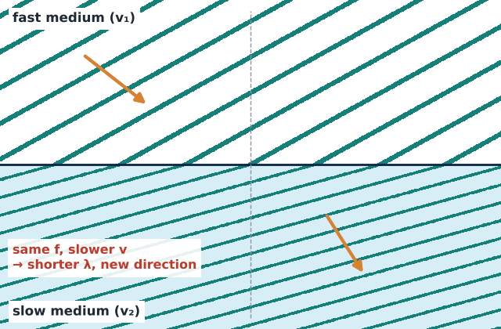
Refraction: light changes speed, so it changes direction
CONCEPT
1
Frequency stays the same — the source sets it (waves lecture).
2
Speed falls in the denser medium: v = c/n.
3
So the wavelength shortens: λ_{medium} = λ / n.
4
At an angle, the wavefront swings: one side slows first, so light bends towards the normal going into higher n, and away from it coming out.
Memory hook
Into a slower medium → bend TOWARDS the normal. Into a faster medium → bend AWAY.
Notes:
Recap of the refraction slides from the waves lecture, now for light. The coin experiment from the warm-up is light going from water into air (faster) → bending AWAY from the normal.
Light along the normal (straight down) does not bend, though it still slows.

Slide 17
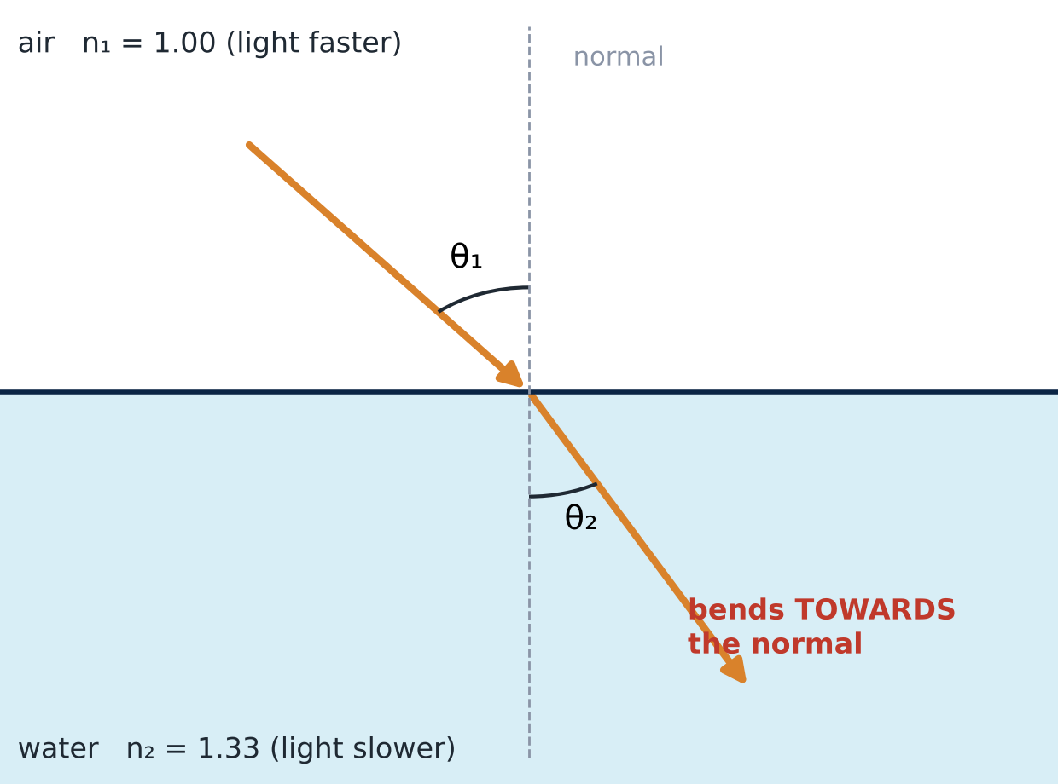
Snell's law puts numbers on the bending
CONCEPT
n₁ sin θ₁ = n₂ sin θ₂
Angles are measured from the normal, not from the surface.
Bigger n → smaller angle: the ray hugs the normal in the slower medium.
If n₁ = n₂, there is no bending — so a glass rod in oil of the same n becomes invisible!
Notes:
Willebrord Snell (1621). Same law as the wave form sin θ₁/v₁ = sin θ₂/v₂ from the waves lecture, using v = c/n.
Fun demo if you have a Pyrex glass rod or beaker and vegetable oil (or glycerol): it almost disappears in the oil because n matches (~1.47). It shows we see transparent objects only because of refraction and reflection at their edges.

Slide 18
Worked example: light entering a glass of water
WORKED EXAMPLE
Problem
A laser beam in air hits a water surface at 40° to the normal. Water has n = 1.33. At what angle does it travel in the water?
1
Write Snell's law: n₁ sin θ₁ = n₂ sin θ₂
Calculator tip
Set the calculator to DEGREES.
Use sin⁻¹ (often SHIFT + sin) for the last step.
2
Substitute: 1.00 × sin 40° = 1.33 × sin θ₂
3
Solve for sin θ₂: sin θ₂ = 0.643 / 1.33 = 0.483
4
Inverse sine: θ₂ = sin⁻¹(0.483) ≈ 28.9°
5
Check: 28.9° < 40°, so the ray bent towards the normal — correct for going into a slower medium ✓
Notes:
One step per click. The most common error is a calculator in radians — have students check sin 30° = 0.5 first.
Exact: sin 40° = 0.6428; 0.6428/1.333 = 0.4822 → 28.8° (28.9° using n = 1.33).

Slide 19
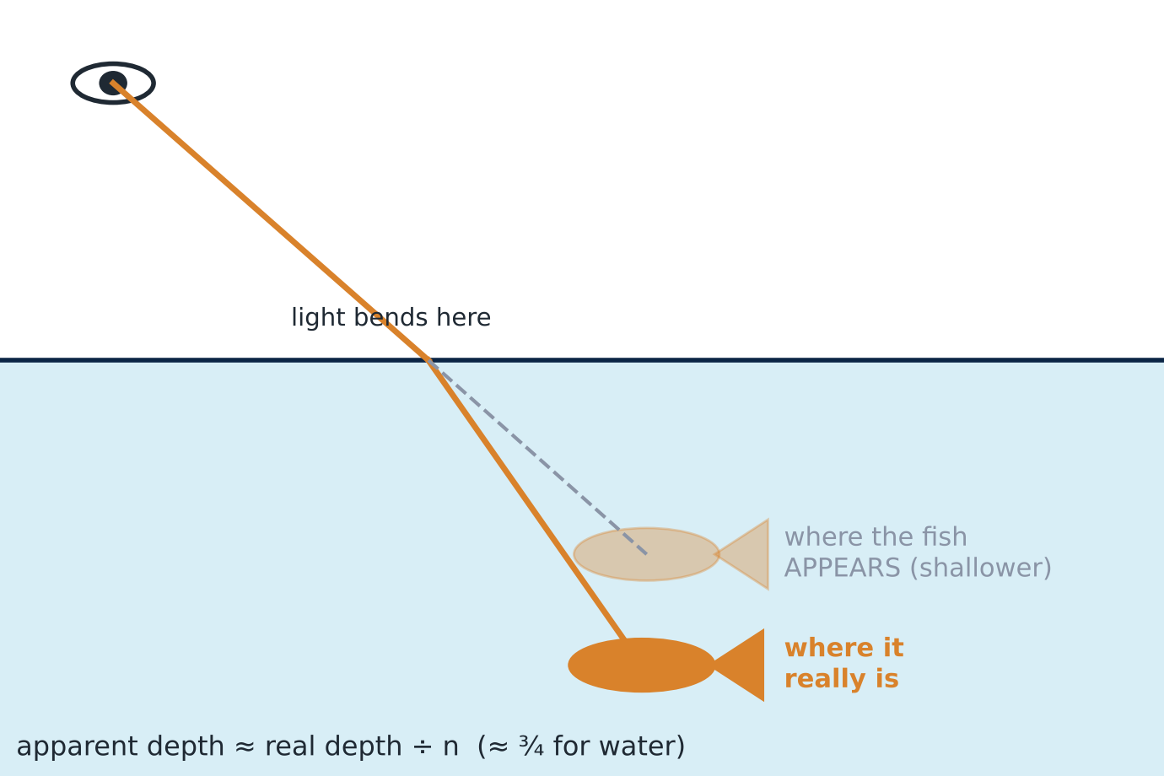
Why pools look shallow and straws look bent
CONCEPT
Light from the fish bends away from the normal as it leaves the water.
Your brain traces the ray back in a straight line, so the fish seems higher than it really is.
Looking straight down, objects seem about ¾ of their real depth (1/n).
Think
A fisherman spears a fish he can see. Should he aim exactly at the fish, above it, or below it?
Below the image he sees
The real fish is deeper than it looks. (An archer fish does the opposite calculation when it spits water at insects above the surface!)
▶ click to reveal
Notes:
Pass a glass of water with a straw around: the straw seems broken at the surface — the same effect.
A swimming pool 2.0 m deep looks only about 1.5 m deep — a real safety issue for people jumping in.

Slide 20
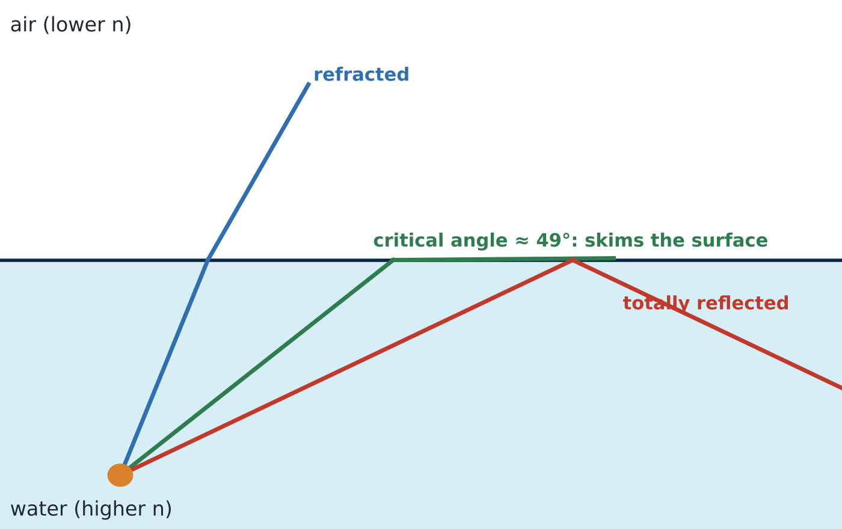
Total internal reflection: when light cannot get out
CONCEPT
Going from high n to low n, light bends away from the normal.
At the critical angle θc, the refracted ray skims along the surface (90°).
Beyond θc, no light escapes: it is 100% reflected — better than any mirror.
sin θc = n₂ / n₁
Water → air: sin θc = 1/1.333 → θc ≈ 49°. Glass → air: ≈ 42°.
Only works one way
TIR needs light travelling from the higher-n material towards the lower-n one.
Notes:
Derive the formula from Snell: n₁ sin θc = n₂ sin 90° = n₂.
Demo: shine a laser pointer upward through the side of a clear tank or a large plastic bottle of water at a steep angle — the beam reflects off the surface back down. A falling stream of water from a hole in a bottle "guides" a laser beam along it (the classic light-guiding fountain).

Slide 21
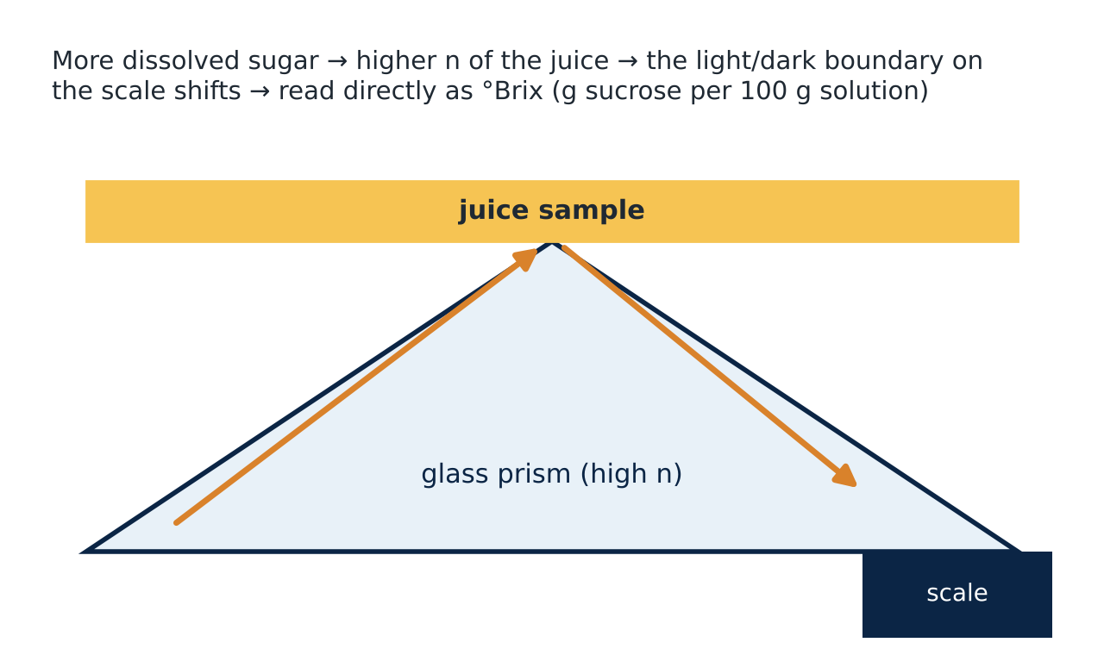
How a refractometer really measures sugar
FOOD BIOTECH LINK
The juice sits on a high-n glass prism. Light enters the prism from the juice at every angle up to a limit — the critical angle for the prism–juice boundary.
So the field of view is bright on one side and dark on the other. Where the edge falls depends on sin θc = n_{juice} / n_{prism}.
More sugar → higher n_{juice} → larger θc → the edge moves. The scale is marked directly in °Brix.
Measurement ethics (CLO3)
n changes with temperature: correct readings to 20 °C and zero the instrument with distilled water. An uncalibrated refractometer gives a precise-looking but wrong Brix value.
Notes:
Last lecture we only said "refraction measures sugar". This is the full explanation: it is a critical-angle measurement.
Uses: fruit ripeness and harvest timing, juice and soft-drink QC, jam setting point, honey moisture (lower n = more water), sugar-cane processing, monitoring fermentation (sugar falls as yeast ferments).
Next slide: students calculate the critical angle for water and for juice to see how big the shift is.

Slide 22
Your turn: how much does sugar move the edge?
YOUR TURN
4 minutes, in pairs
Situation
A refractometer prism has n = 1.72. Compare distilled water (n = 1.333) with a juice at 20 °Brix (n = 1.364).
(a) Find the critical angle θc for the water–prism boundary.
sin θc = 1.333/1.72 = 0.775 → θc ≈ 50.8°
▶ click to reveal
(b) Find θc for the juice–prism boundary.
sin θc = 1.364/1.72 = 0.793 → θc ≈ 52.5°
▶ click to reveal
(c) Why is such a small change in n enough for a good instrument?
A 1.7° shift moves the light/dark edge clearly across the scale; optics magnify it, so a fraction of a °Brix can be read.
▶ click to reveal
Notes:
The prism index of 1.72 is a typical high-index glass; real instruments vary.
The answers show the physics behind the scale: 0 → 20 °Brix moves the critical angle by about 1.7°.

Slide 23
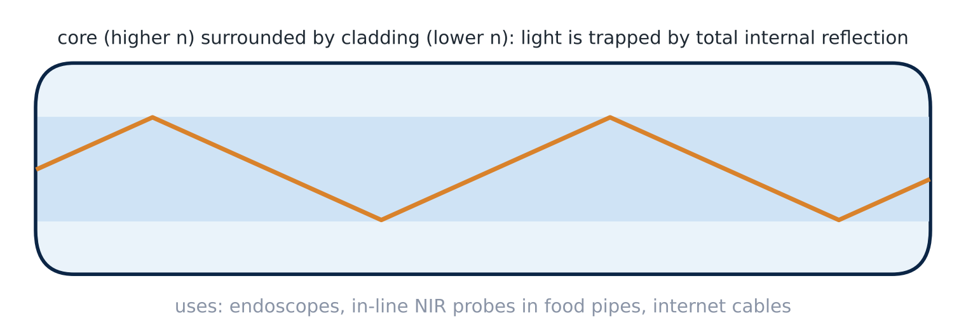
Optical fibres: light trapped by total internal reflection
CONCEPT
Medicine
Endoscopes carry light in and an image out through a flexible bundle of fibres — seeing inside the gut without surgery.
Food processing
Fibre-optic probes put a spectrometer "inside" a pipe or reactor for in-line NIR or fluorescence measurements.
Everyday
Internet and phone data travel as light pulses through glass fibres; the sparkle of diamonds is also TIR.
Notes:
The fibre core has a slightly higher n than the cladding, so light hitting the wall at a shallow angle is always beyond the critical angle and stays inside — even round gentle bends.
Newman Ch. 20 §4 covers optical fibres in medicine.

Slide 24
Light inside glass hits the surface beyond the critical angle…
QUICK CHECK
Vote: 1 minute
It escapes into the air, bending away from the normal
It escapes into the air, bending towards the normal
A
B
All of it reflects back into the glass
It is absorbed by the surface
C
D
Answer: C — total internal reflection
Beyond θc, Snell's law would need sin θ₂ > 1, which is impossible, so there is no refracted ray at all. All the light reflects.
If the light were going from air into glass instead, TIR could never happen.
▶ click to reveal
Notes:
Quick consolidation of C5–C8.

Slide 25
Lenses & images
D
How lenses form images — in cameras, magnifiers, your eye and the microscope
Notes:
PART D — about 25 minutes.

Slide 26
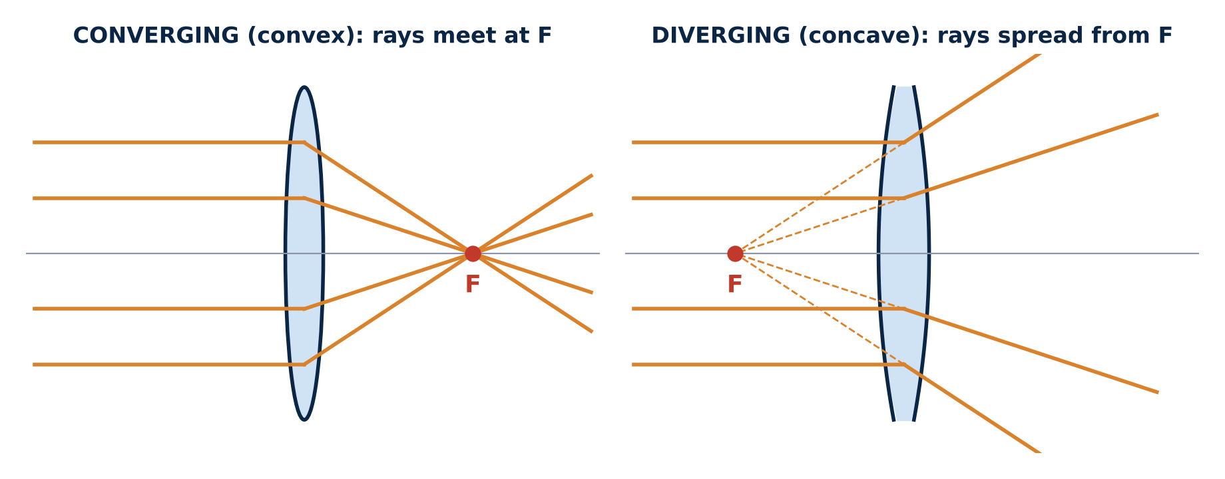
Lenses use refraction at curved surfaces
CONCEPT
Converging (convex) lens: thicker in the middle; bends parallel rays to meet at the focal point F. Used in cameras, magnifiers, microscopes, the eye.
Diverging (concave) lens: thinner in the middle; spreads parallel rays as if they came from F. Used to correct short-sightedness.
Focal length f: distance from lens to F. A shorter f means a stronger lens.
Notes:
Each part of a lens acts like a tiny prism: the edges bend light more than the centre, which is why rays meet at one point.
Opticians quote lens power in dioptres: P = 1/f (f in metres). A +2.5 D reading glass has f = 0.4 m.

Slide 27
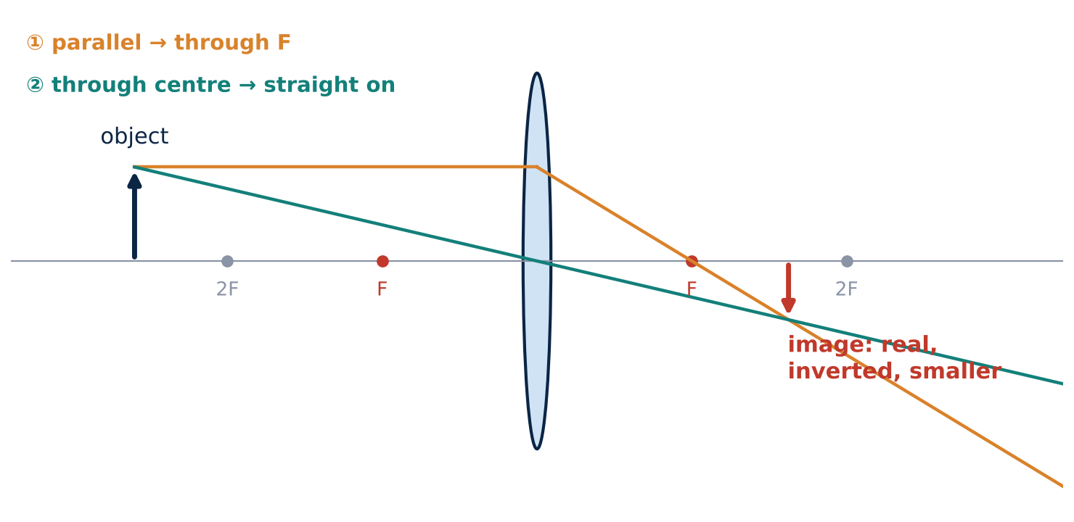
Finding an image with two rays
CONCEPT
1
Ray 1: from the top of the object, parallel to the axis → refracts through F on the far side.
2
Ray 2: through the centre of the lens → goes straight on.
3
Where they cross is the top of the image. (A third ray, through the near F and out parallel, can check it.)
Describe every image with three words
Real or virtual? Upright or inverted? Magnified or diminished?
Real image: light actually meets there (it can be caught on a screen or a camera sensor). Virtual image: light only seems to come from there.
Notes:
Draw this on the board live with the class. Students can try PhET "Geometric Optics" afterwards (link at the end of the deck).

Slide 28
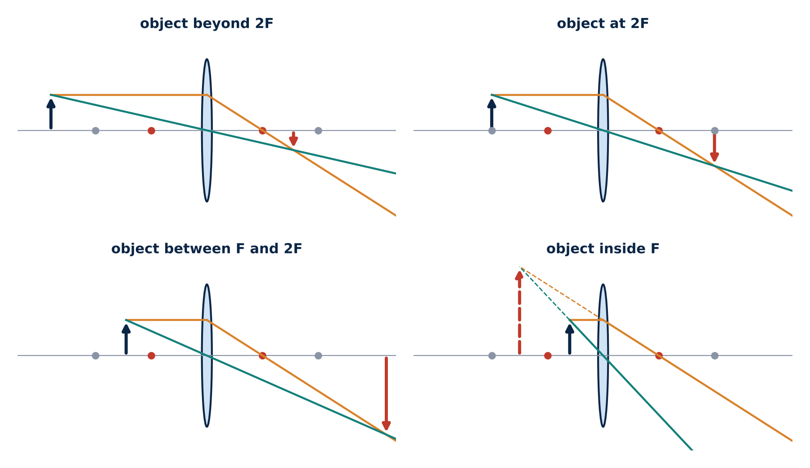
Move the object: what happens to the image?
CLASS ACTIVITY
5 minutes, in pairs
Sketch a ray diagram for each position (or use a magnifying glass and a window across the room). Predict the image, then reveal row by row.
Object position | Image | Where you meet it
Far away, beyond 2F
At 2F
Between F and 2F
Inside F
real, inverted, smaller
camera, the eye
real, inverted, same size
photocopier
real, inverted, larger
projector; microscope objective
virtual, upright, larger
magnifying glass
Pattern
As the object moves towards F, the real image moves away from the lens and grows. Inside F there is no real image — only a virtual, magnified one.
Click 5 shows all four ray diagrams.
Notes:
Interactive table: each click reveals one row; click 5 reveals the four ray diagrams together.
Hands-on version: hold a magnifying glass at arm's length and look at a distant window — you see it small and upside down (real image). Move the lens close to print — it is upright and magnified (virtual image).
You can also focus the image of the window onto a sheet of paper: the lens-to-paper distance is roughly the focal length.

Slide 29
Worked example: a camera on a fruit-grading line
WORKED EXAMPLE
Problem
A machine-vision camera with a 50 mm lens photographs apples 500 mm away. Where does the image form, and how big is an 80 mm apple on the sensor?
1/f = 1/d_{o} + 1/d_{i} m = − d_{i} / d_{o}
1
Image distance: 1/d_{i} = 1/50 − 1/500 = 9/500 → d_{i} = 55.6 mm
2
Magnification: m = − 55.6 / 500 = − 0.111
3
Image size: 80 mm × 0.111 = 8.9 mm, inverted
4
So what? The sensor must sit 55.6 mm behind the lens (slightly more than f) to focus. Knowing m lets software convert pixels into real apple diameters for size grading.
Notes:
Signs: a negative m means inverted (real image). d_i > 0: real image on the far side of the lens.
CLO3 link: a pixel measurement is only meaningful with a calibration (a ruler or a reference object in the image at the same distance). If the camera height changes, m changes and every size grade is wrong.

Slide 30
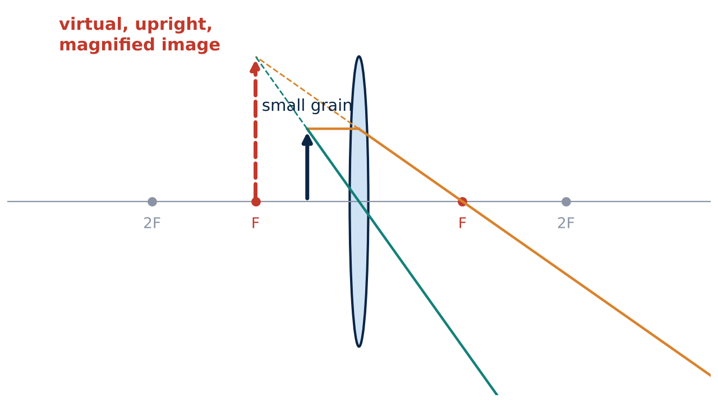
Your turn: checking rice for weevils with a magnifier
YOUR TURN
4 minutes, in pairs
(a) Use 1/f = 1/d_{o} + 1/d_{i} to find d_{i}.
(b) Find the magnification m.
(c) Describe the image in three words. Why can't you catch it on paper?
1/d_{i} = 1/10 − 1/5 = −1/10 → d_{i} = −10 cm
Negative: the image is on the same side as the grain.
▶ click to reveal
m = −(−10)/5 = +2 → twice as big, upright
Situation
A magnifying glass has f = 10 cm. You hold it 5.0 cm above a rice grain.
▶ click to reveal
Virtual, upright, magnified. The light never actually meets there — it only appears to come from behind the lens.
▶ click to reveal
Notes:
Use the sign conventions consistently: d_i < 0 → virtual image; m > 0 → upright.
Food link: stored-grain inspection for insects (rice weevils are 2–3 mm) — a hand lens or low-power stereo microscope is the first check.

Slide 31
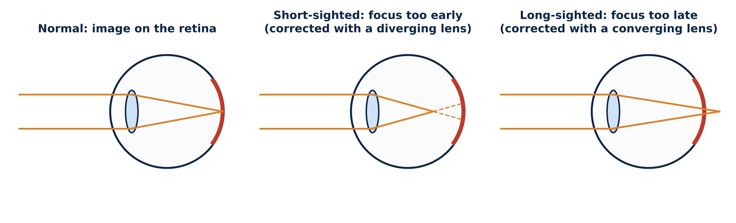
The eye: a camera that refocuses itself
CONCEPT
Most of the focusing is done by the cornea; the lens fine-tunes it by changing shape (accommodation). The image on the retina is real and inverted — the brain flips it.
Short-sighted (myopia): the eye focuses too strongly, in front of the retina → a diverging lens spreads the light first.
Long-sighted (hyperopia) and ageing (presbyopia): too weak → a converging lens adds power.
Notes:
The cornea provides about two-thirds of the eye's focusing power because the biggest jump in n is from air (1.00) to cornea (≈ 1.38). That is why underwater everything is blurry — water (1.33) nearly matches the cornea, so it loses most of its power. Goggles restore the air gap.
Newman Ch. 21 §2 (the human eye).

Slide 32
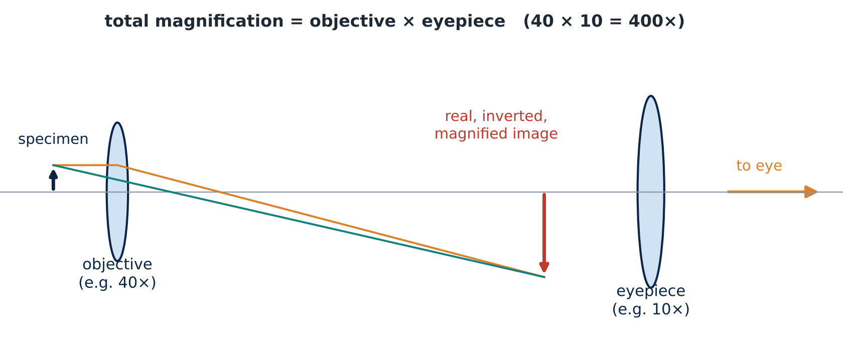
The compound microscope: two lenses working together
CONCEPT
Objective lens (very short f): the specimen sits just outside F, so it forms a real, inverted, magnified image (like a projector).
Eyepiece: acts as a magnifying glass on that image → a virtual, further-magnified image.
Total magnification = objective × eyepiece, e.g. 40× × 10× = 400×; 100× oil × 10× = 1000×.
But magnification is not everything
A bigger image is only useful if it contains more detail. How much detail a microscope can show is set by diffraction — Part F.
Notes:
Link the two lens cases from D3: objective = "object between F and 2F" (real, larger); eyepiece = "object inside F" (virtual, larger).
Students will use 4×, 10×, 40× and 100× (oil) objectives in microbiology labs.

Slide 33
Will a stronger eyepiece show more detail?
QUICK CHECK
Vote: 1 minute
Your 1000× image of yeast cells looks fuzzy even when perfectly focused. A classmate swaps the 10× eyepiece for a 20× one (2000× total). What happens?
A
You see twice as much detail
B
The image is bigger but no sharper
C
The image becomes sharper and brighter
D
You can now see individual proteins
Answer: B — "empty magnification"
The fuzziness comes from diffraction in the objective, not from the image being too small. Magnifying a blurry image just gives a bigger blur.
To see more detail you need better resolution: a higher-NA objective, shorter wavelength light, or a different kind of microscope (Part F).
▶ click to reveal
Notes:
Bridge into Part 2. The useful magnification of a light microscope tops out around 1000–1500×.

Slide 34
Interference
E
Part 2 begins: light behaving as a wave — double slits, soap films, rainbow sheens and gratings
Notes:
PART 2 · WAVE OPTICS. Section E — about 15 minutes. Good place for a 5-minute break just before.

Slide 35
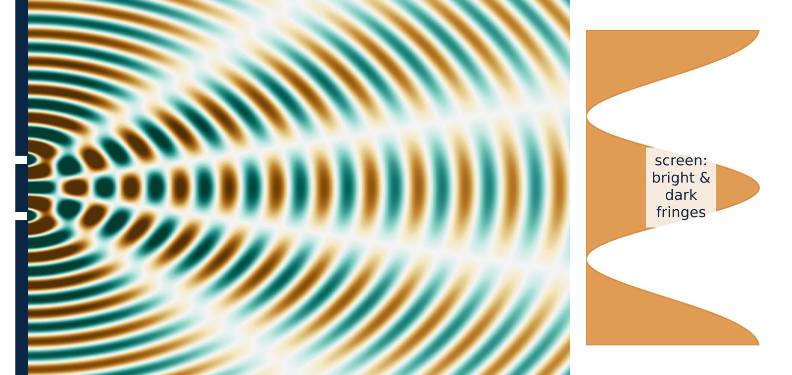
Young's double slit: proof that light is a wave
CONCEPT
Two narrow slits act as two coherent sources (same frequency, fixed phase).
Where crests meet crests (path difference = 0, λ, 2λ …) → bright fringe.
Where crests meet troughs (path difference = ½λ, 1½λ …) → dark fringe.
Particles could never produce dark bands by adding more light — only waves can cancel.
Link
This is the superposition and interference from the waves lecture — now with light.
Notes:
Thomas Young (1801). The fringe spacing on a screen is roughly Δy ≈ λL/d (L = slit-to-screen distance, d = slit spacing) — mention qualitatively on the next slide.
Laser demo: shine a laser pointer through two slits (or a fine comb, or a hair for single-slit diffraction) onto a wall.

Slide 36
Predict, then test: what changes the fringe spacing?
TRY IT LIVE
5 minutes, in pairs
Use the Slits screen with the light source. Change one thing at a time.
Open PhET: Wave Interference ↗
You change… | Fringes become… | Why?
Slits closer together
Red light instead of blue
Screen further away
wider apart
the path difference grows more slowly with angle
wider apart
longer λ needs a bigger path difference for each fringe
wider apart
the same angles spread over a larger distance
In one line
Fringe spacing ≈ λL/d: bigger for longer wavelength, bigger screen distance L, and smaller slit spacing d. Measuring it is one way to measure λ.
Notes:
No calculation needed — the formula is shown only to summarise the three trends.
If Wi-Fi is poor: laser pointer and a double slit slide, or look at a distant street lamp through the fabric of an umbrella or a fine net curtain (a 2-D grating) — you see a grid of coloured spots.

Slide 37
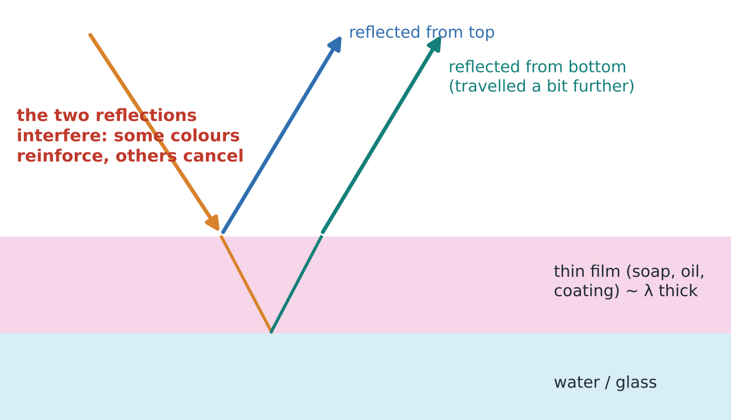
Thin films: colours from thickness, not dye
CONCEPT
Light reflects from both surfaces of a film only a few hundred nanometres thick.
The two reflected waves interfere: for a given thickness some colours reinforce and others cancel.
Change the thickness or viewing angle → change the colour: soap bubbles, oil on a wet road.
Uses
Anti-reflection coatings on camera lenses, glasses and microscope objectives; measuring the thickness of packaging films and edible coatings non-destructively.
Notes:
When the film gets very thin (thinner than about λ/4), all colours cancel in reflection and the film looks black — you can see this at the top of a soap film just before it pops.
This "structural colour" also gives peacock feathers, butterfly wings and some fish scales their shimmer — no pigment involved.

Slide 38
A rainbow sheen on sliced roast beef: what is it?
QUICK CHECK
Vote: 1 minute
A customer returns a pack of sliced roast beef because it shows a green-and-pink rainbow shine. What is the most likely cause?
A
Bacterial spoilage
B
A chemical additive or dye
C
Light diffracted and interfering at the regular cut muscle-fibre structure
D
Oil contamination from the slicer
Answer: C — structural colour
Muscle fibres are made of very regular repeating units. A clean cut across them acts like a diffraction grating, splitting white light into colours. It is harmless and depends on the viewing angle.
Physics knowledge here saves a product recall — and lets QC staff explain the defect honestly to the customer.
▶ click to reveal
Notes:
Iridescence in cut meat (especially cooked cured meats like ham and roast beef) is a well-known optical effect caused by the surface microstructure of cut myofibrils. It changes with viewing angle, which distinguishes it from discoloration due to spoilage.
D is a reasonable distractor (oil films also give thin-film colours), so accept a discussion — but meat iridescence is classically a diffraction effect.

Slide 39
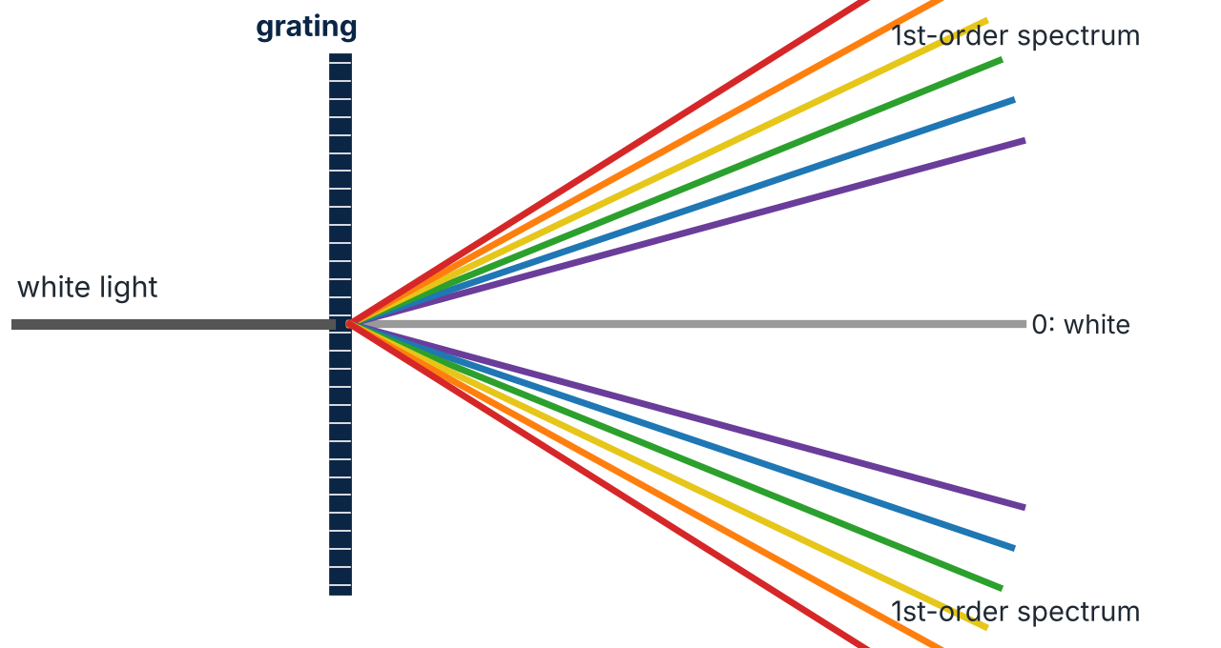
A diffraction grating in your pocket: an old CD
DEMO
2 minutes
A grating has thousands of evenly spaced lines. Each colour interferes constructively at its own angle, so white light spreads into a spectrum.
A CD has tracks about 1.6 µm apart — a natural reflection grating.
Try it: shine a phone torch on a CD in a dim room and look at the reflection on the wall or ceiling.
Why it matters
Every spectrophotometer in the food lab uses a grating (or a prism) to select one wavelength at a time — the basis of colour, absorbance and NIR measurements in Part H.
Notes:
Gratings spread colours much more and more sharply than a prism, which is why modern spectrometers use them. The prism diagram on this slide shows the same idea (colour separation) by refraction; Part H explains dispersion in prisms.
DVD tracks are closer (~0.74 µm), so its colours spread more — students can compare.

Slide 40
Diffraction & resolution
F
Why every image is slightly blurred, how small a microscope can see, and how to see smaller
Notes:
Section F — about 15 minutes. One key calculation: d ≈ 0.61 λ / NA.

Slide 41
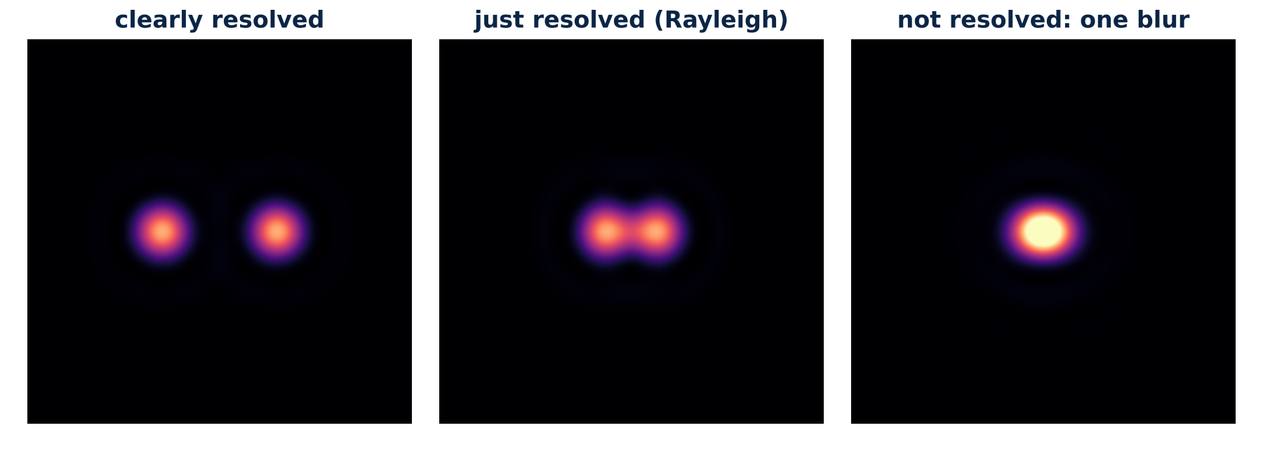
Diffraction blurs every point into a spot
CONCEPT
Light passing through a lens is diffracted by its edge, so even a perfect lens images a point as a small spot with faint rings (an Airy pattern).
Two nearby points are "resolved" only if their spots are far enough apart — roughly when the centre of one sits on the first dark ring of the other (Rayleigh criterion).
The spot is smaller for shorter wavelengths and for lenses that collect light over a wider angle.
Notes:
Link to the waves lecture: diffraction is strong when the opening is comparable to λ. A microscope objective is small and the details we want are close to λ, so diffraction matters.
The same physics limits the eye, telescopes, cameras and even satellite images.

Slide 42
How small can a light microscope see?
WORKED EXAMPLE
d ≈ 0.61 λ / NA NA = n sin α
d = smallest separation that can be resolved. λ = wavelength. NA = numerical aperture: how wide a cone of light the objective collects (α = half-angle) and the n of the medium between lens and slide.
1
Dry 40× objective (NA = 0.65), green light 550 nm: d = 0.61 × 550 / 0.65 ≈ 520 nm
2
Oil immersion 100× (NA = 1.25): d = 0.61 × 550 / 1.25 ≈ 270 nm
3
Why oil helps: oil (n ≈ 1.52) matches the glass, so light rays at wide angles are not lost by refraction or TIR — NA can exceed 1.
4
What it means: bacteria (~1 µm) are visible; their fine surface features, viruses (~0.1 µm) and proteins are not.
Notes:
Only key calculation in this section. Values: 0.61 × 550/0.65 = 516 nm; 0.61 × 550/1.25 = 268 nm.
Practical lab tip: oil immersion only works with the 100× oil objective, a drop of immersion oil, and no air gap — air would throw away the wide-angle light.

Slide 43
Which change lets you resolve finer detail?
QUICK CHECK
Vote: 1 minute
A brighter lamp
A stronger eyepiece
A
B
Blue light and a higher-NA (oil) objective
Red light and a longer tube
C
D
Answer: C
Resolution depends on λ/NA: shorter wavelength (blue, or UV) and larger numerical aperture both shrink the diffraction spot.
Brightness and eyepiece magnification do not change the spot size. Red light makes it worse.
▶ click to reveal
Notes:
Consolidates D8 (empty magnification) and F2.

Slide 44
Choosing the right microscope in a food biotech lab
FOOD BIOTECH LINK
Microscope | Where the contrast comes from | Good for
Bright-field | absorption — often needs staining (e.g. Gram stain) | stained bacteria, tissue sections, starch with iodine
Phase contrast | tiny phase delays in transparent samples turned into brightness | living yeast and bacteria, without staining
Polarized light | ordered (crystalline) structures rotate polarization | starch granules, fat and sugar crystals (Part G)
Fluorescence | dyes or proteins absorb one colour and emit another | live/dead staining, specific cells or proteins
Electron (SEM, TEM, cryo-EM) | electrons with wavelengths of picometres | viruses, phages, protein structures, food microstructure
Physics behind the choice
Most cells are almost transparent, so seeing them is mainly about creating contrast (phase, polarization, fluorescence). Seeing smaller is about shorter wavelengths (electrons).
Notes:
This table connects optics to the microbiology and biochemistry labs students will work in.
Phase contrast (Zernike, Nobel 1953) converts the tiny delay light experiences passing through a transparent cell (higher n than water) into a brightness difference — refraction and interference at work.
Cryo-electron microscopy (Nobel 2017) determines structures of enzymes and other proteins at near-atomic resolution.

Slide 45
Polarization
G
Light as a transverse wave with a direction — glare, sunglasses, starch granules and sugar measurement
Notes:
Section G — about 15 minutes. Polarized sunglasses and phone screens make this very hands-on.

Slide 46
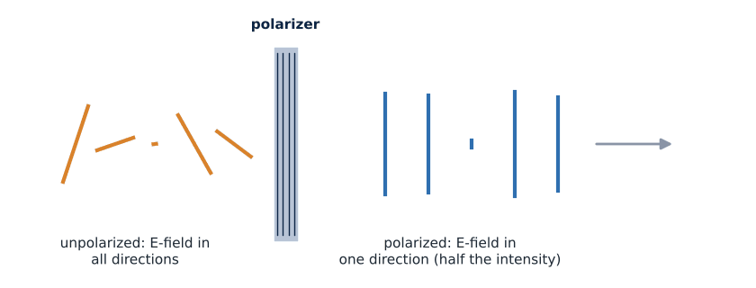
Polarization: the direction the electric field shakes
CONCEPT
Light is a transverse wave: its electric field shakes at right angles to the direction of travel.
Ordinary light (sun, lamps) is unpolarized: the field direction changes randomly.
A polarizer only lets through the component along its axis, so the light that emerges is polarized — and has half the intensity.
Only transverse waves can be polarized — so sound (longitudinal) cannot be.
Notes:
Polarizer films contain long aligned molecules that absorb the field component along them; the light that gets through is polarized at right angles to the molecules.
Ask: "Could you polarize sound?" (No — it is longitudinal. This is an elegant proof that light is transverse.)

Slide 47
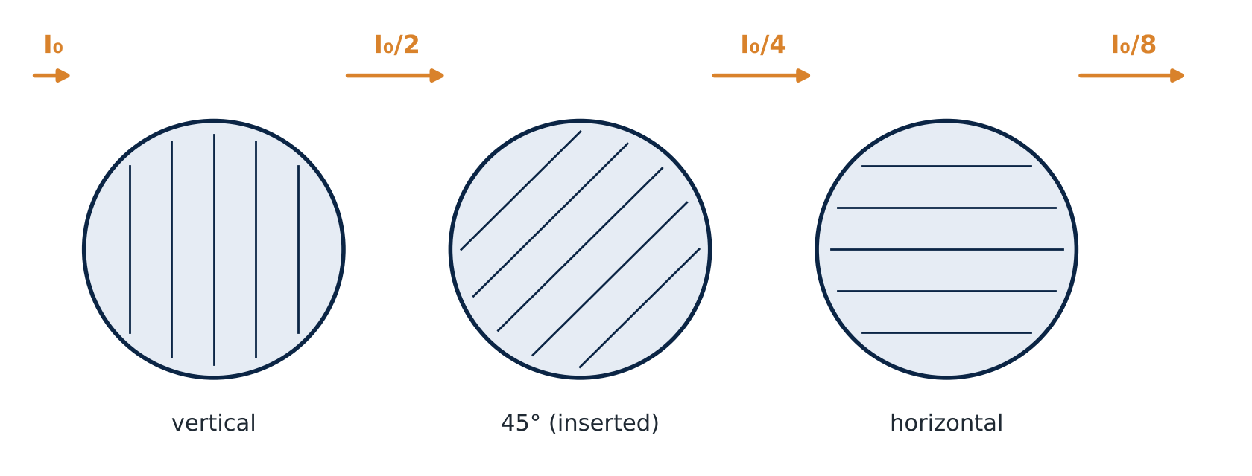
The three-polarizer surprise
DEMO
3 minutes
Malus: I = I₀ cos² θ
Two crossed polarizers (90°) block everything: cos² 90° = 0.
Now slide a third one at 45° in between. Predict: more or less light?
Light comes back through!
Unpolarized → first polarizer: I₀/2. → 45°: × cos² 45° = ½ → I₀/4. → horizontal: × ½ again → I₀/8.
Adding a filter lets MORE light through, because the middle one rotates the polarization direction step by step. A pure particle "sieve" picture cannot explain this; a wave picture can.
▶ click to reveal
Notes:
If you have three polarizer sheets (cheap online, or from old LCD screens), this demo genuinely surprises students.
Calculation: I₀/2 × cos²45° × cos²45° = I₀/2 × 0.5 × 0.5 = I₀/8.

Slide 48
Polarized sunglasses vs your phone screen
CLASS ACTIVITY
3 minutes, in pairs
1. Look at a phone or laptop screen through polarized sunglasses. Slowly rotate the sunglasses (or the phone) by 90°.
2. Look at the glare reflected from a shiny desk, a window or a wet floor through the sunglasses. Tilt your head.
The screen goes dark
LCD and many OLED screens emit polarized light. At 90° the sunglasses act as a crossed polarizer.
▶ click to reveal
Glare is cut
Light reflected from horizontal surfaces (water, roads) is partly polarized horizontally. Polarized sunglasses block horizontal polarization, so glare drops while the rest of the scene stays visible.
Predict
What happens to the screen at 90°? Why do anglers and drivers like polarized sunglasses?
▶ click to reveal
Food link
Machine-vision cameras on packing lines use crossed polarizers to remove glare from shiny fruit, wet fish and glossy packaging before measuring colour and defects.
Notes:
Many students carry polarized sunglasses. Not all sunglasses are polarized — this activity is also a quick test of whether yours are.
Brewster's angle (for interest): reflected light is fully polarized at tan θ = n₂/n₁ (about 53° for water).

Slide 49
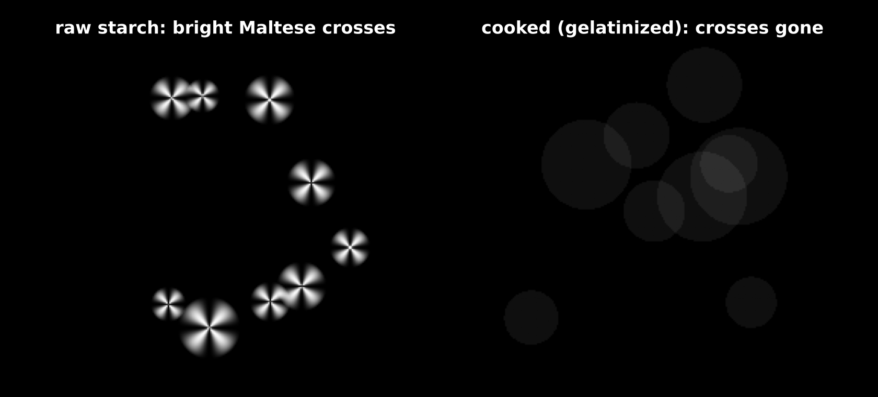
Polarized light in the food lab: starch and sugar
FOOD BIOTECH LINK
Polarimetry: sugar that twists light
Sugar molecules are chiral (left- or right-handed). A sugar solution rotates the plane of polarized light.
The rotation angle is proportional to concentration × path length, so a polarimeter (saccharimeter) measures sugar content — a standard method in the sugar industry.
Sucrose rotates light to the right; when it is split into glucose + fructose ("invert sugar", e.g. in honey), the rotation flips to the left — that is where the name comes from.
Raw starch granules are partly crystalline: under crossed polarizers they glow with a dark "Maltese cross" (birefringence).
Cooking (gelatinization) melts that order: the crosses vanish. Microscopists use this to check how fully starch has been cooked.
Notes:
Birefringence: ordered materials have different refractive indices for different polarization directions, so they can rotate light between crossed polarizers and appear bright on a dark background. Fat crystals in chocolate and margarine, sugar crystals, cellulose fibres and some muscle structures also show it.
Polarimetry: [α] = α / (l × c). Sucrose has [α] ≈ +66.5°; invert sugar is about −20°. The "International Sugar Scale" (°Z) is used by sugar factories.
The starch picture is a schematic illustration, not a micrograph.

Slide 50
Why do the Maltese crosses disappear when starch is cooked?
QUICK CHECK
Vote: 1 minute
The granules dissolve completely and vanish
Heat destroys the ordered crystalline structure, so the granules no longer rotate polarized light
A
B
Cooking makes the starch absorb all the light
The polarizers stop working when the sample is hot
C
D
Answer: B
Gelatinization: water and heat disrupt the ordered, crystalline regions of the granule. Without that order there is no birefringence, so the field stays dark between crossed polarizers.
This loss of birefringence is a standard way to find the gelatinization temperature of a starch.
▶ click to reveal
Notes:
Links polarization to a food-processing measurement students may meet in food chemistry practicals.

Slide 51
Colour & spectroscopy
H
Dispersion, why foods have colour, scattering in milk, and how spectrometers measure what is in food
Notes:
Section H — about 15 minutes.

Slide 52
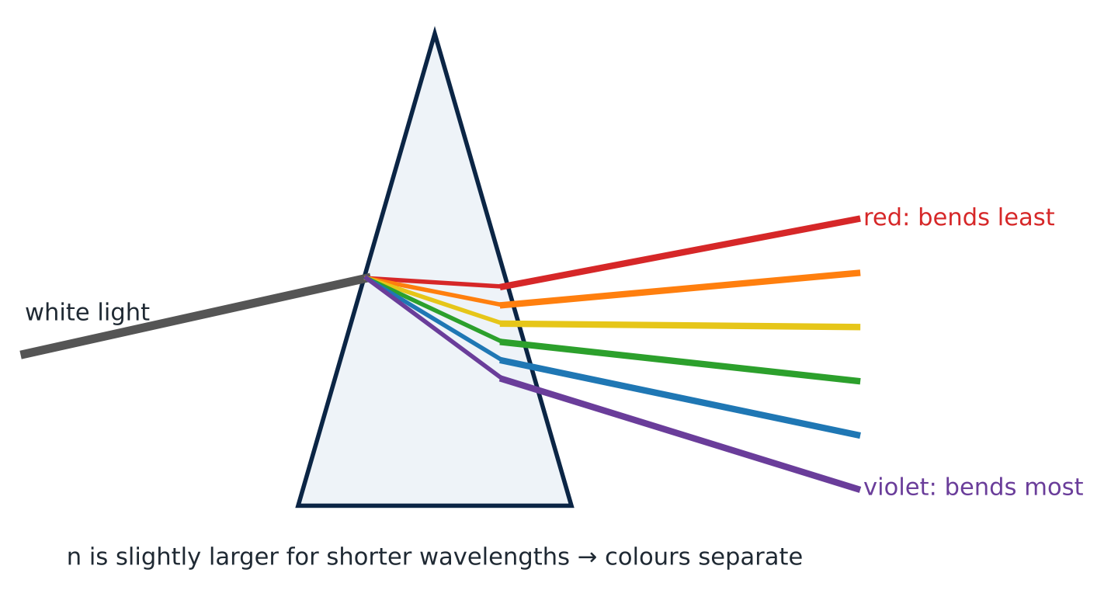
Dispersion: each colour bends by a different amount
CONCEPT
n depends slightly on wavelength: for glass and water it is a little larger for violet than for red.
So violet light bends more and white light fans out into a spectrum.
Rainbows: sunlight refracted, reflected inside raindrops and refracted out again — each colour at its own angle (red ≈ 42°, violet ≈ 40°).
A problem as well as a tool
In cheap lenses dispersion makes coloured fringes (chromatic aberration). Good microscope objectives combine glasses to cancel it ("achromatic", "apochromatic").
Notes:
Newton's prism experiments (1666) showed white light is a mixture of colours.
This is the one place where "the medium sets v" depends on frequency too: dispersion. For sound in water and air (waves lecture) it was negligible; for light in glass it is small but very visible.

Slide 53
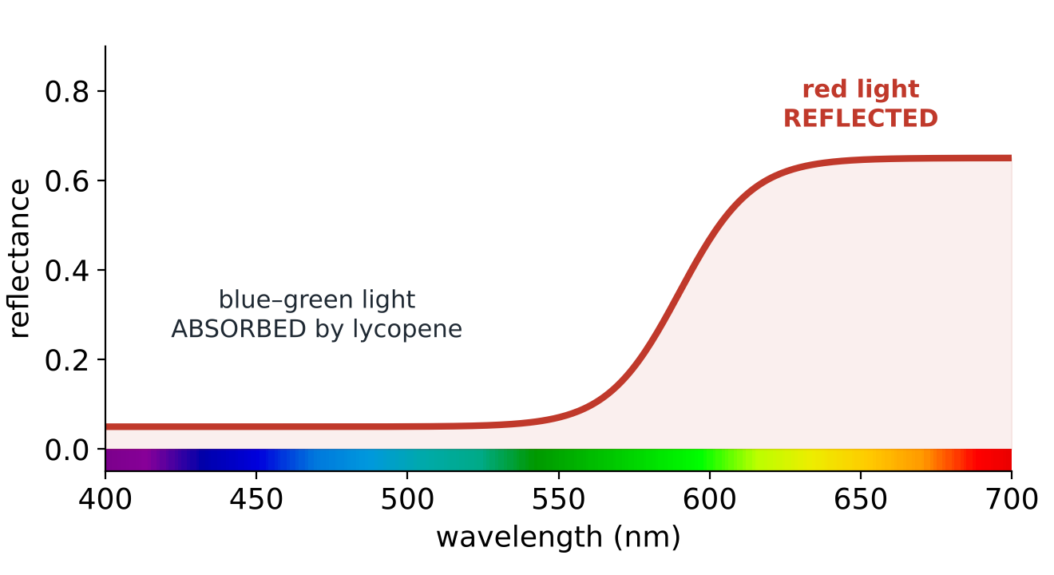
Why a tomato is red
FOOD BIOTECH LINK
A food's colour is the light it does NOT absorb. Lycopene absorbs blue–green light and reflects red.
Pigments are molecules whose electron energy gaps match visible photons (1.7–3.1 eV) — the photon idea again.
Colour also depends on the light source: the same food looks different under warm, cool or coloured lighting.
Think (CLO3)
Some shops light meat or bread with tinted lamps. Is the colour the customer sees a fair measurement of freshness? How should a QC lab measure colour instead?
Use a standard light and a colorimeter
Colour must be measured under standard illumination (e.g. D65 daylight) with an instrument (CIE L*a*b* values), not judged under display lighting.
▶ click to reveal
Notes:
Other pigments: chlorophyll (green: absorbs red and blue), anthocyanins (red–purple, colour changes with pH — a fun kitchen demo with red cabbage), carotenoids (orange), myoglobin (meat colour changes with oxygenation: purple → bright red → brown).
The tomato curve is schematic.

Slide 54
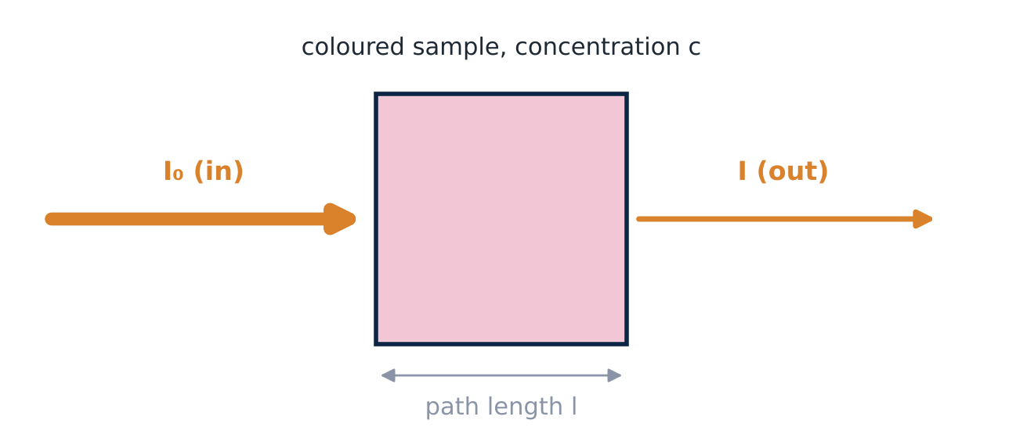
Absorbance: how a spectrophotometer measures concentration
CONCEPT
A = log₁₀(I₀ / I) = ε l c
Absorbance A grows in proportion to concentration c and path length l (Beer–Lambert law).
ε (absorptivity) is how strongly that molecule absorbs at the chosen wavelength.
The spectrophotometer picks one wavelength with a grating, measures I₀ (blank) and I (sample).
Predict
You double the concentration of a coloured extract. What happens to A? And to the transmitted light?
A doubles. The transmitted light does not halve — it falls much more (if A goes from 0.3 to 0.6, transmission falls from 50% to 25%).
▶ click to reveal
Notes:
Students use this in almost every biochemistry practical (protein assays, enzyme kinetics, phenolic content). The physics: each thin layer absorbs the same FRACTION of the light, so intensity falls exponentially and absorbance (a log) rises linearly.
T = I/I₀ = 10^(−A): A = 0.3 → T ≈ 0.50; A = 0.6 → T ≈ 0.25.

Slide 55
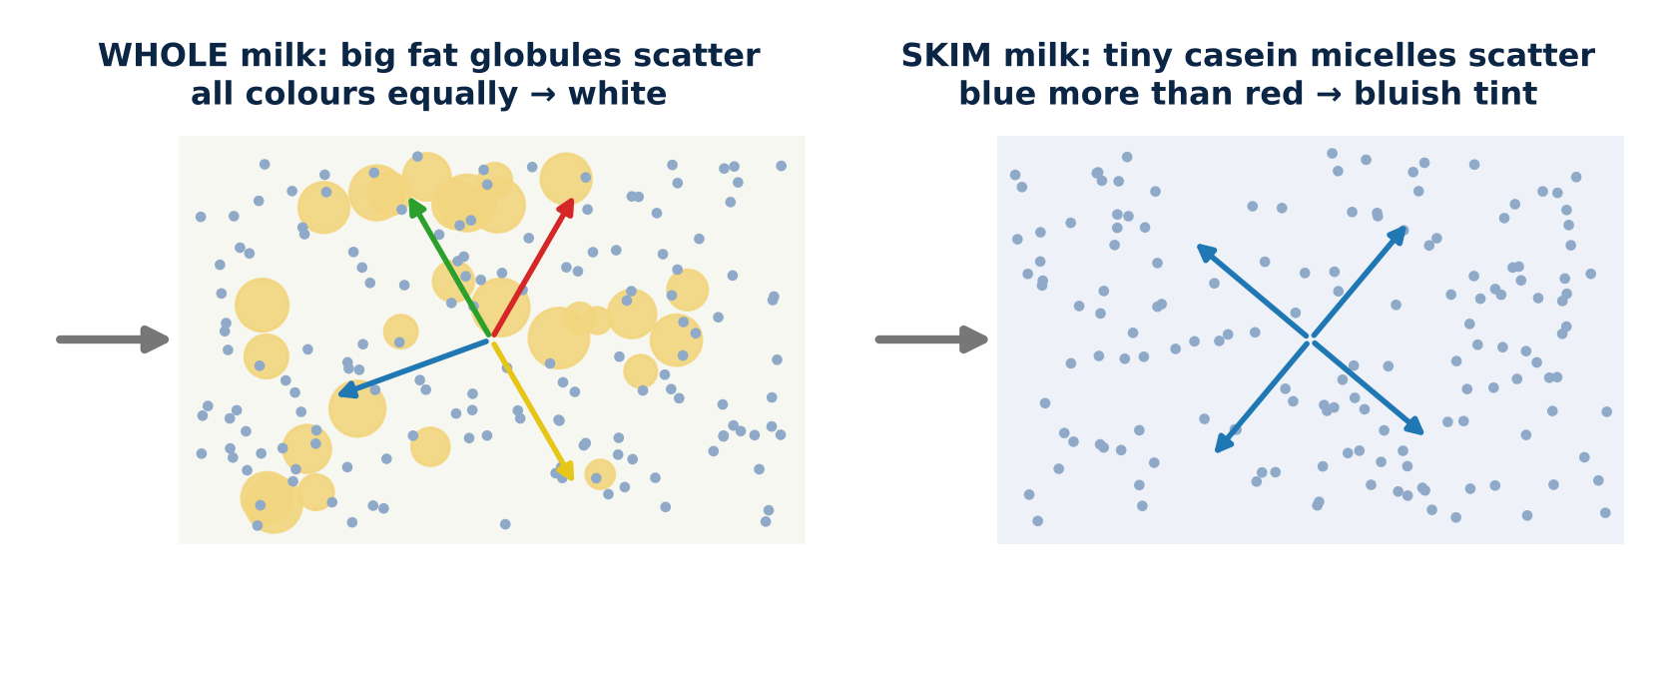
Scattering: why milk is white and skim milk looks bluish
CONCEPT
Milk absorbs very little light — it is white because particles scatter light in all directions many times.
Big particles (fat globules, ~1–10 µm) scatter all colours about equally → white.
Small particles (casein micelles, ~0.1–0.2 µm) scatter blue more than red → skim milk looks slightly bluish (the same reason the sky is blue).
Food uses
Turbidity meters judge haze in beer, wine and juice; light scattering measures droplet and particle size in emulsions and milk (laser diffraction / dynamic light scattering).
Notes:
Scattering by particles much smaller than λ (Rayleigh scattering) is much stronger for short wavelengths (∝ 1/λ⁴). Particles comparable to or larger than λ scatter all colours more evenly (Mie scattering) → white: milk, clouds, mayonnaise, foam.
Homogenized milk looks whiter than unhomogenized because breaking fat globules into more, smaller (but still large) particles increases scattering.

Slide 56
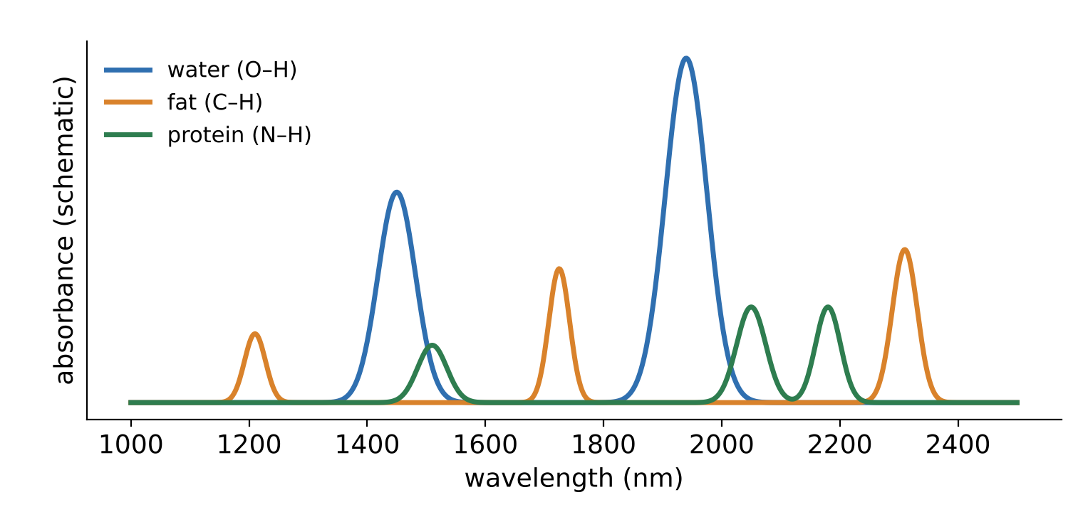
NIR spectroscopy: reading water, fat and protein in seconds
FOOD BIOTECH LINK
Near-infrared light (≈ 780–2500 nm) is absorbed at characteristic wavelengths by O–H, C–H and N–H bonds.
So a NIR spectrum is a fingerprint of water, fat, protein and sugar content.
Fast, non-destructive and in-line: grain protein, meat fat, milk composition, fruit sugar — often through fibre-optic probes.
Ethics of models (CLO3)
NIR results come from statistical calibration models. A model is only trustworthy if it was validated on new, independent samples (different batches, seasons, suppliers) — not just the ones it was built from.
Notes:
The NIR bands are overtones and combinations of the fundamental molecular vibrations in the mid-infrared; they are broad and overlapping, which is why chemometrics (PLS regression, machine learning) is needed.
Hyperspectral imaging = a NIR or visible spectrum at every pixel of an image — used for sorting, bruise detection and contamination screening.
Band positions on the figure are approximate and schematic.

Slide 57
A cloudy extract gives a suspiciously high absorbance. Why?
QUICK CHECK
Vote: 1 minute
A student measures the colour of a fruit extract that was not filtered or centrifuged. The absorbance is higher than expected at every wavelength.
A
The pigment concentration must be higher
B
Particles scatter light away from the detector, which the instrument reads as absorbance
C
The cuvette is too short
D
The lamp is too bright
Answer: B — scattering looks like absorption
The detector only sees light that comes straight through. Light scattered sideways by particles is "missing", so A rises even though no extra pigment absorbed it.
Good practice (CLO3): filter or centrifuge samples, use a proper blank, and report how the sample was prepared.
▶ click to reveal
Notes:
A very common lab error. Clarifying samples or using integrating-sphere instruments avoids it.

Slide 58
Light and optics on one page
WRAP-UP
A · Light
Ray, wave or photon. E = hf = hc/λ: shorter λ, more energy per photon (UV-C breaks DNA bonds).
B · Reflection
Angle in = angle out. Smooth → glossy; rough → diffuse (bloom).
C · Refraction
n = c/v; n₁ sin θ₁ = n₂ sin θ₂. TIR beyond θc (sin θc = n₂/n₁): fibres, refractometers.
D · Lenses
1/f = 1/d_{o} + 1/d_{i}; m = −d_{i}/d_{o}. Camera, eye, magnifier, microscope.
E · Interference
Path difference decides bright or dark: double slits, thin films, gratings, meat iridescence.
F · Resolution
d ≈ 0.61 λ/NA. More magnification ≠ more detail. Shorter λ, higher NA, or electrons.
G · Polarization
Transverse E-field direction. I = I₀ cos²θ. Glare, starch crosses, sugar polarimetry.
H · Colour & spectra
Colour = unabsorbed light. Scattering whitens milk. A = εlc. NIR: water, fat, protein.
Notes:
Recap: cover the slide and ask for one key idea per box. Students can photograph it as a revision sheet.

Slide 59
Exit ticket: three questions before you leave
YOUR TURN
5 minutes, on your own
1
Light travels from a juice (n = 1.36) into air. Find the critical angle. Will light hitting the surface at 50° escape?
2
A lens with f = 20 cm forms an image of an object 60 cm away. Find d_{i} and say whether the image is real or virtual, upright or inverted.
3
Explain why switching from a 10× to a 20× eyepiece does not let you see viruses with a light microscope.
Answers
1. sin θc = 1/1.36 = 0.735 → θc ≈ 47°. At 50° (> θc) it is totally internally reflected — it does not escape.
2. 1/d_{i} = 1/20 − 1/60 = 1/30 → d_{i} = 30 cm: real, inverted (m = −0.5, half size).
3. Resolution is limited by diffraction (d ≈ 0.61λ/NA ≈ 0.2–0.3 µm); viruses (~0.1 µm) are smaller. A stronger eyepiece only enlarges the blur.
▶ click to reveal
Notes:
Q1: critical angle and TIR. Q2: thin-lens equation. Q3: resolution vs magnification (conceptual).

Slide 60
Before next week, and where this came from
WRAP-UP
Independent learning
Read OpenStax College Physics 2e Ch. 25 (geometric optics), Ch. 26 (vision and optical instruments), Ch. 27 (wave optics) and §29.3 (photon energies).
Optional: Newman, Physics of the Life Sciences, Ch. 19–22.
Complete the lens-and-image problems; analyse one microscopy or polarization application.
Try at home: coin-in-cup, CD grating, sunglasses vs phone screen.
Next: Nuclear Physics I
The atomic nucleus, radioactivity, decay modes and half-life.
References
OpenStax (2022). College Physics 2e, Ch. 25 Geometric Optics; Ch. 26 Vision and Optical Instruments; Ch. 27 Wave Optics; §29.3. openstax.org
Newman, J. (2008). Physics of the Life Sciences. Springer. Ch. 19 Electromagnetic Waves; Ch. 20 Geometrical Optics; Ch. 21 Optical Lenses and Devices; Ch. 22 Wave Optics.
Giancoli, D. C. (2013). Physics: Principles with Applications, 7th ed. Pearson. Ch. 23–25.
PhET Interactive Simulations, University of Colorado Boulder.
All diagrams and animations were drawn for this lecture; spectra and micrographs shown are schematic illustrations. Numbers in exercises are illustrative values chosen to be realistic.
PhET: Bending Light ↗
PhET: Geometric Optics ↗
PhET: Wave Interference ↗
Notes:
Remind students of the CTP independent-learning hours for the optics weeks.
Teaser: "Why can food be irradiated with gamma rays without becoming radioactive?" — Nuclear Physics.

