Slide 1

Defining Soccer Playing Styles through a Data-Driven Approach
By: Mohammad Mustafa Arif
Supervisor: Professor Timothy Chan

Slide 2
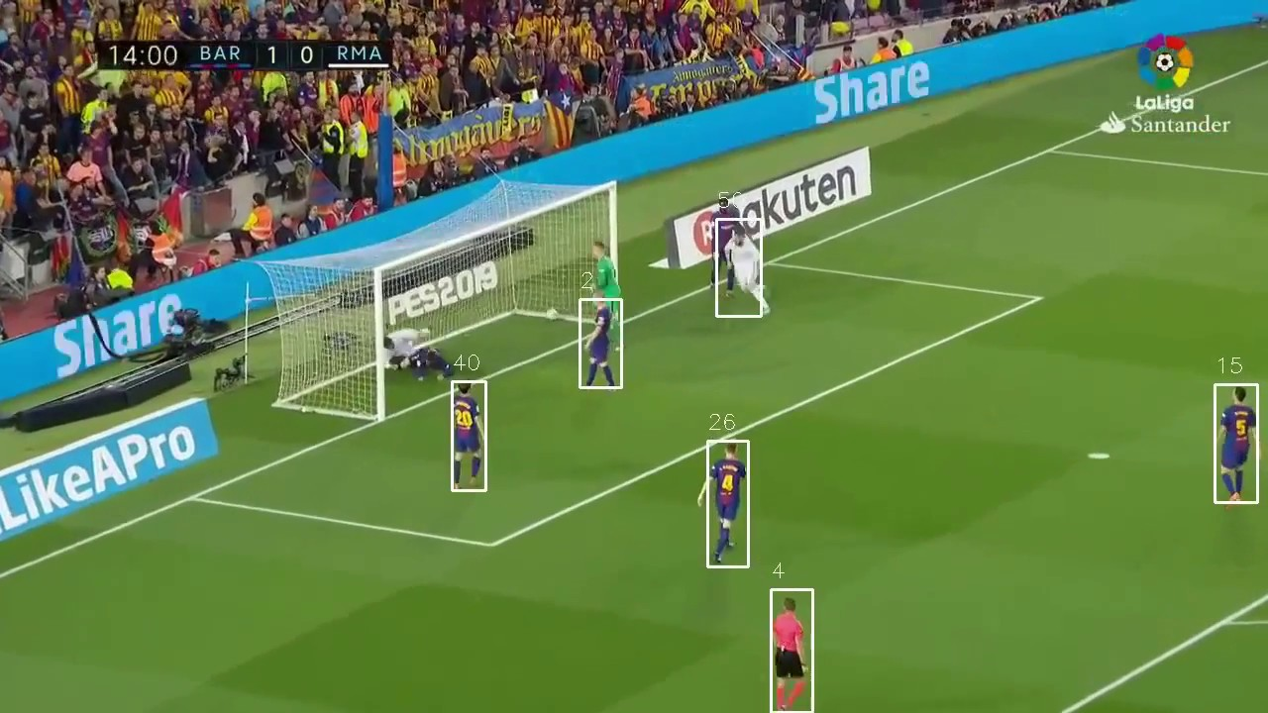
Background

Slide 3



Project Motivation: Identify the Odd One Out

Slide 4

Project Motivation: Identify the Odd One Out

Slide 5
Beyond Trivia: How Can this Help Teams/Coaches?
Intuition
Experience
Human Expertise
Tactical Decision Making
This project: Narrow the focus of human expertise

Slide 6

Project Goals
Objectively Segment Teams into Playing Styles
Provide coaching staff with a decision support tool to focus human efforts.

Slide 7
Dataset: Spatio-Temporal Soccer-Logs [2]
Event: Pass
Origin: [50, 50]
Destination: [65, 78]
Time: 36:07
Tags: {Air Ball, Assist}
Player Involved: {Messi, Suarez}
Spatial Coordinates
Standardized Tags
List of Players Involved

Slide 8
Feature Engineering
Transforming the data into interpretable features

Slide 9
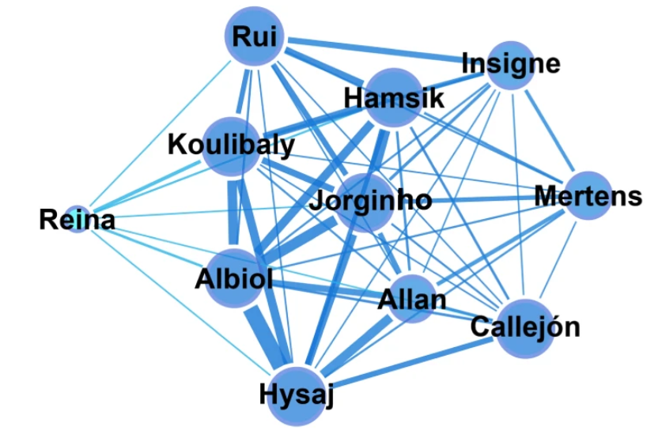
Player Network Graphs
Figure from [1]

Slide 10
Clustering Coefficient: Local Robustness
Low Clustering Coefficient
High Clustering Coefficient

Slide 11
Algebraic Connectivity: Network Integration
1
2
3
1
2
3
4
5
6
4
5
6
Low Algebraic Connectivity
High Algebraic Connectivity

Slide 12
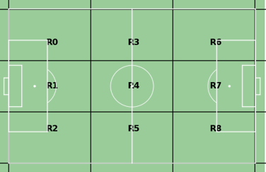
Zonal Network Graphs
0
3
6
1
4
7
2
5
8

Slide 13
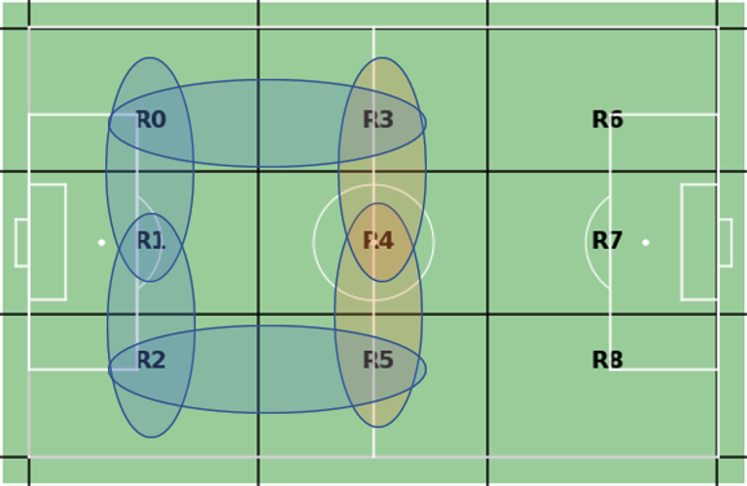
Zonal Network Graphs: Cluster Passing Profiles
Prominent Passing Lanes
Cluster 0
Cluster 1

Slide 14
All Features: A Summary
Type of Analyses | Number of Features Derived
Exploratory Data Analysis | 1
Player Networks | 5
Zonal Networks + Passing Lane Clustering | 4
Defensive Statistics | 10
Total: 20
Note that each of these features is evaluated at a per-game, per-team basis.

Slide 15
Unsupervised Clustering
Clustering Teams by Playing Style Similarity

Slide 16
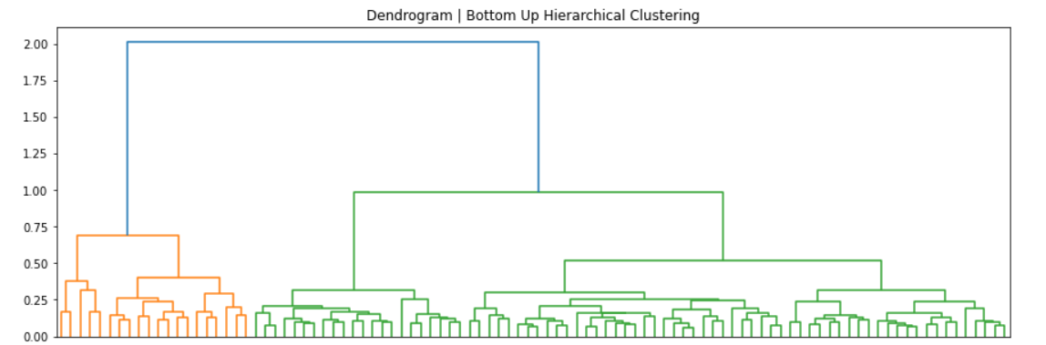
Hierarchical Clustering: WARD’s Algorithm
ESS
K=4
Individual Teams

Slide 17
Cluster Assignments | K=4
Highly Robust Passing
Low Passing Network Integration
Extremely Robust Passing and High Defense Line
Low Possession
Mertz
Leicester City
Newcastle
Barcelona
Man Utd
A.C. Milan
Sevilla
Villareal
Leipzig
Dortmund
Man City
Bayern
Cluster 0, n=56
Cluster 1, n=15
Cluster 2, n=23
Cluster 3, n=4

Slide 18
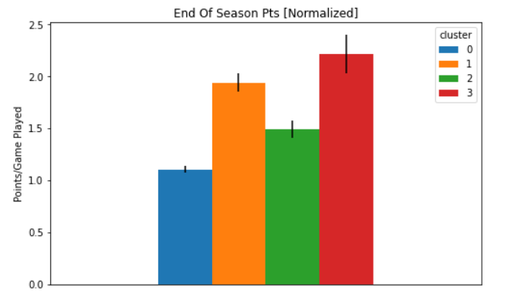
Performance Discrepancy | K=4

Slide 19
Case Study: Cluster 1 vs Cluster 3
Cluster 1
10 / 15 teams top 5
Lower possession
Low average clustering coefficient
Cluster 3
4 / 4 teams top 5
Higher possession
High average clustering coefficient

Slide 20
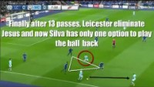
Demo: Manchester City, Cluster 3
Video from [2]

Slide 21
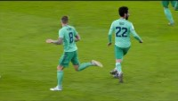
Demo: Real Madrid, Cluster 1
Video from [3]

Slide 22
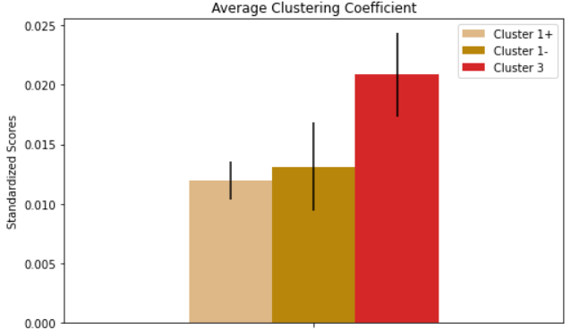
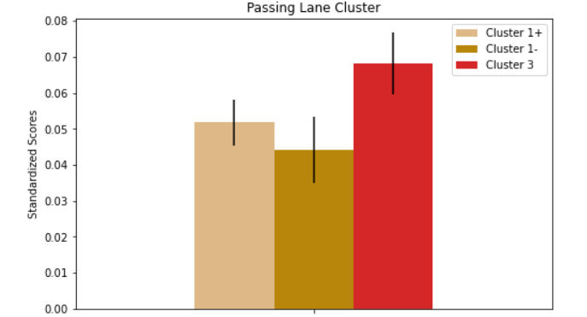
Case Study: Cluster 1 vs Cluster 3
Are we simply rederiving skill level?
Separating the top5 teams in Cluster 1 from the rest, and comparing with Cluster 3:

Slide 23
Project Motivation: Identify the Odd One Out
Cluster 3
Cluster 3
Cluster 1

Slide 24
Limitations & Future Work
01
Feature Space
Many Features Highly Correlated
02
Temporal dimension of data not exploited
Temporal Dimension
03
Assuming playing style is static
Assumption(s)
A potential next step could be to explore methodology for dynamic, time variant (intra game or intra season) playing style classification

Slide 25
Thank You!
Any Questions?

Slide 26
References
[1] L. Pappalardo, P. Cintia, P. Ferragina, E. Massucco, D. Pedreschi, and F. Giannotti, ‘’Playerank: Data-driven performance evaluation and player ranking in soccer via a machine learning approach," ACM Trans. Intell. Syst. Technol., vol. 10, no. 5, Sep. 2019, issn: 2157-6904. doi: 10.1145/3343172. [Online]. Available: https://doi.org/10.1145/3343172.
[2] https://www.youtube.com/watch?v=PM1K7KKJ5EU&t=116s. 2021.
[3] https://www.youtube.com/watch?v=Oi1M9-k5FbU&t=213s. 2021

Slide 27
Appendix
Supplemental slides for Q/A

Slide 28
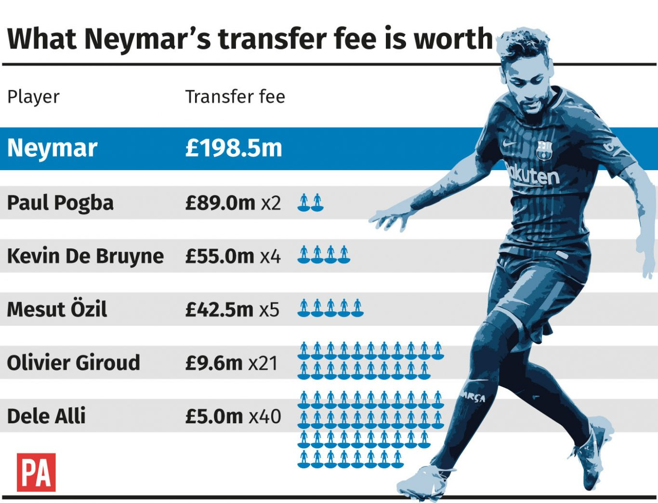
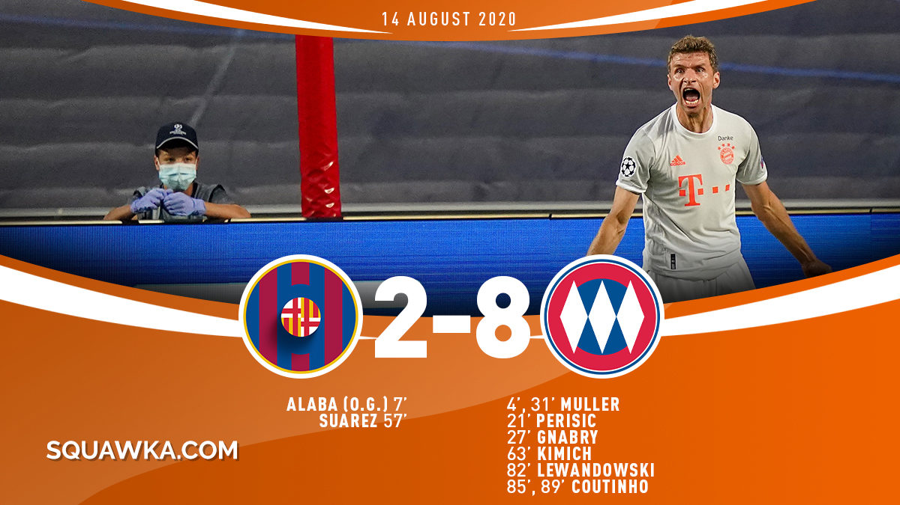
Why Apply Analytics to Soccer?

Slide 29
Why Apply Analytics to Soccer?
“Bringing objectivity & predictability to one of the most opinionated sports in the world”
Daniel Fradley,
Head of Performance Analysis, NYCFC [1]

Slide 30
Cluster Interpretation | K=4
Low possession
Consistent Passing Distribution
Moderately High Local Robustness
Moderately Low Network Integration
Very High Defensive Line
Strong Network Integration, Robustness
Cluster 0, n=56
Cluster 1, n=15
Cluster 2, n=23
Cluster 3, n=4

Slide 31
Defensive Features
Global Statistics
Positional Metrics
Interceptions
Slide Tackles
Dangerous Balls Lost
Yellow Cards
Slide Tackles/ Interceptions Inside Box
X, Y centroids of tackles/ interceptions

Slide 32

All Pairs Topological Shortest Path Lengths
j
k
$$w_{ij}=\frac{1}{\# passes from i to j}$$
i
l
m

Slide 33
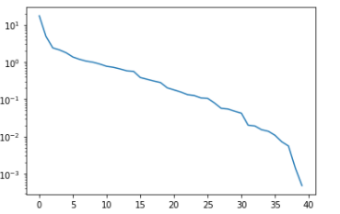
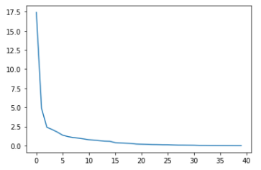
Principal Component Analysis
Mean & variance used on the 20 features.
Explained Variance – Log Scale
Explained Variance
Principal Components
Principal Components

Slide 34
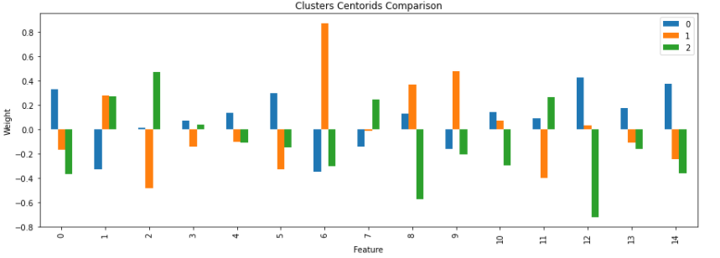
K-means with Top 15 Principal Components

Slide 35
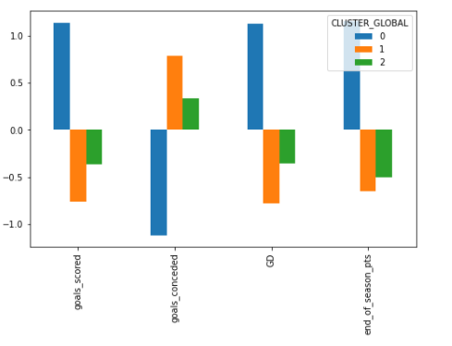
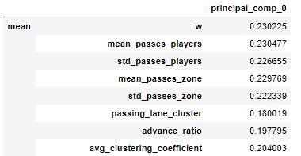
K-means with Top 15 Principal Components
3 clusters, largely uncorrelated (unlike k-means)
Problem: Very difficult interpretation – Difficult to determine what the principal components mean

Slide 36

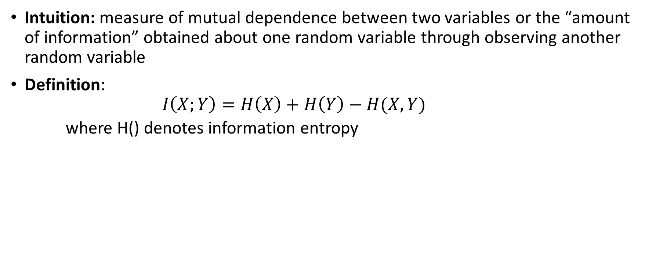
Mutual Information
Intuition: measure of mutual dependence between two variables or the “amount of information” obtained about one random variable through observing another random variable
Definition:
$$I\left(X;Y\right)=H\left(X\right)+H\left(Y\right)−H(X, Y)$$
where H() denotes information entropy

Slide 37
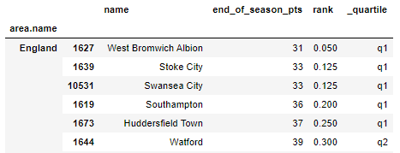
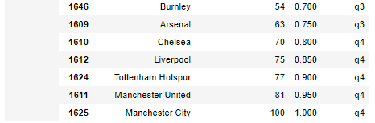
New Approach: Mutual Information
Using methodology from Brain C. Ross [1], evaluated MI between the 40 continuous features and a discrete target variable.
For the discrete target variable, used end of season ranking quartiles, for each domestic league, as shown:
[1] B. C. Ross, “Mutual information between discrete and continuous data sets,” PLoS ONE, vol. 9, no. 2, 2014.

Slide 38
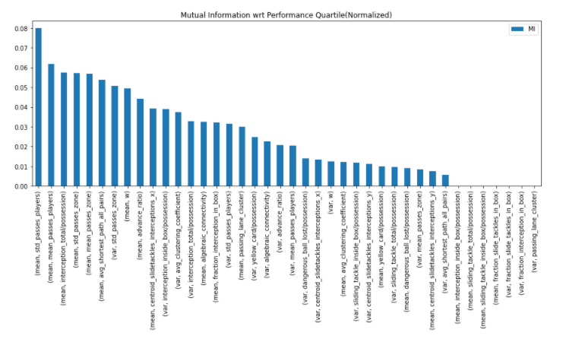
Feature MI

Slide 39
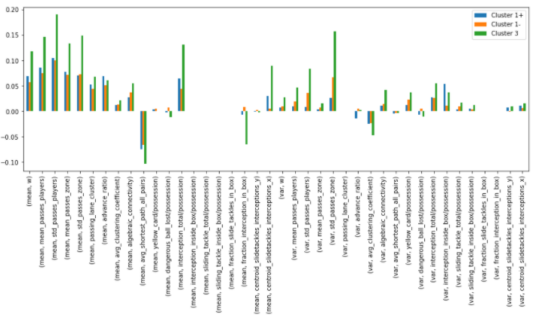
Cluster 1 vs 3: Details

Slide 40
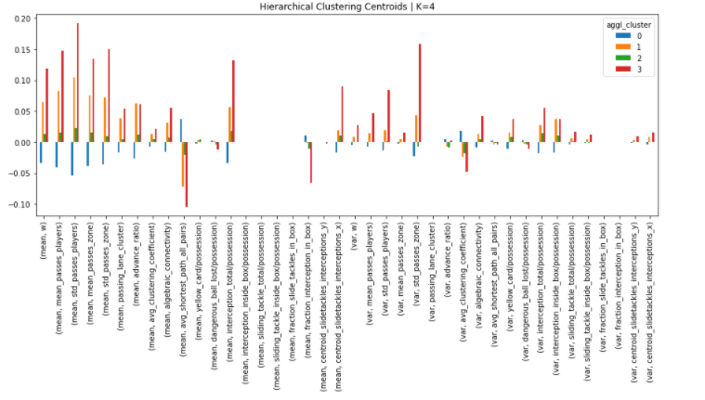
Detailed Centroids

Slide 41
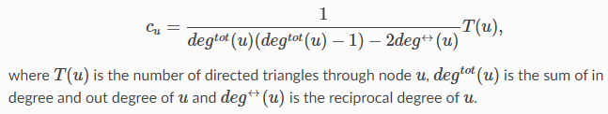
Mathematical Definition: Clustering Coefficient

Slide 42

Mathematical Definition: Algebraic Connectivity
Second smallest eigenvalue of Laplacian matrix (L)
D = diag(v_1, …., v_n) is the degree matrix
A is the adjacency matrix

Slide 43
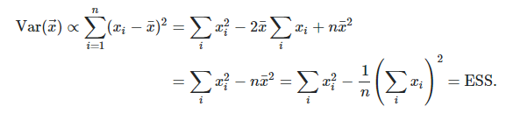
Mathematical Definition: Ward’s Method
Merging Criteria: Minimize total ‘within cluster’ variance every time we need to merge.
Initial step: Merge closest neighbours by Euclidean distance

