Slide 1

Soccer Analytics
More Passing Analysis & Network Algorithms

Slide 2
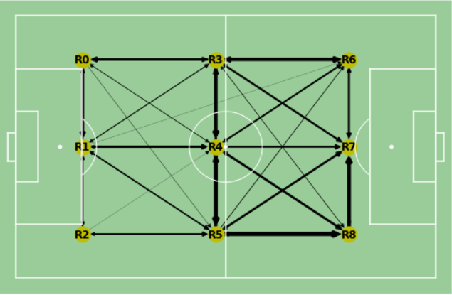
Last Time: Passing Lanes Between Zones

Slide 3
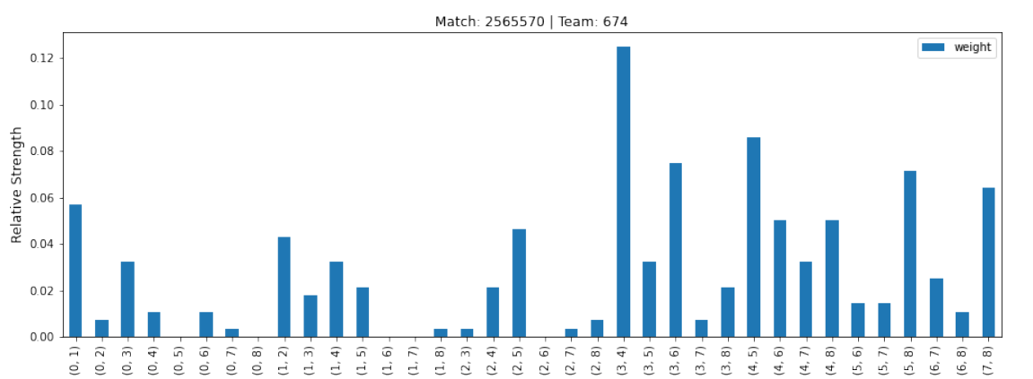
Last Time: Passing Lane Relative Strength

Slide 4
Now: Clustering Individual Performances by Passing Lane Distributions
K-Means Algorithm

Slide 5
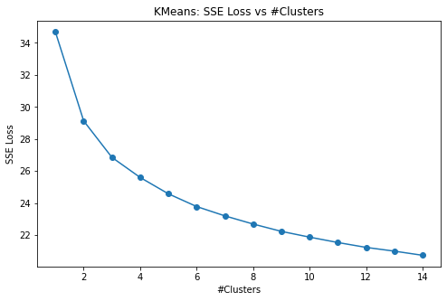
K-Means: Elbow Point

Slide 6
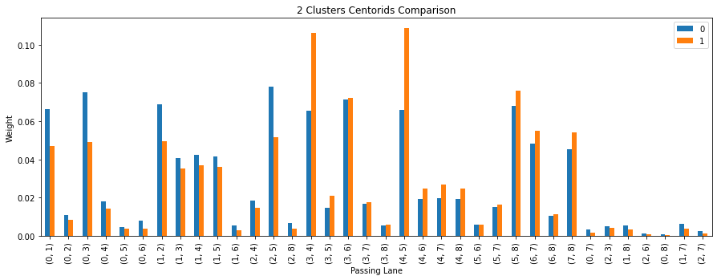
How Do The Clusters Primarily Differ?

Slide 7
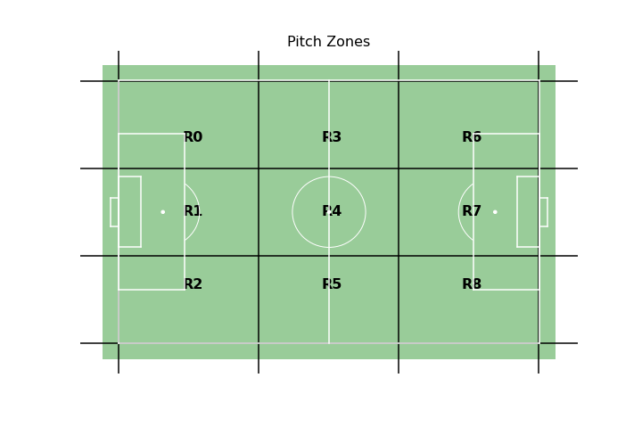
Major Differences in Passing Activity Across the Highlighted Zones
Note: The clustering is done for each performance

Slide 8
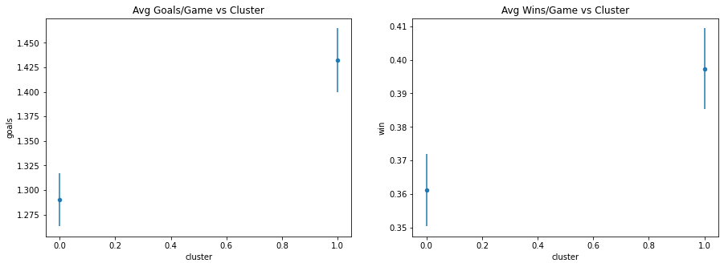
Strong Correlation between Individual Cluster Assignment and Performance Outcome

Slide 9
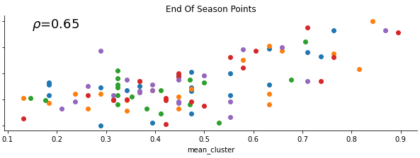
Strong Correlation between Macro-Averaged Cluster Assignment and Season Outcome

Slide 10
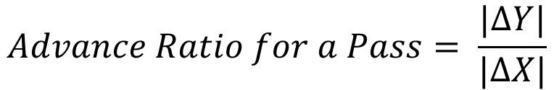
Analysis
Passing activity in cluster 1 appears to have a strong signal with respect to the team’s overall performance
Note that cluster 1’s distinct features are the high lateral passing activity in the midfield, specifically R3-R4 and R4-R5
Moving to individual passes, we can move away from discretized pitch zones and formalize the idea using the advance ratio:
Here, Y is the lateral direction (left/right) and X is the vertical direction(towards/away from the opponent’s goal)
$$Advance Ratio for a Pass= \frac{|ΔY|}{|ΔX|}$$

Slide 11
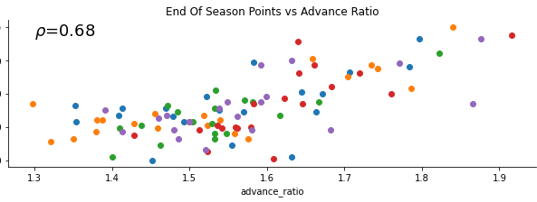
Macro-Averaged Advance Ratio vs Season Outcome

Slide 12
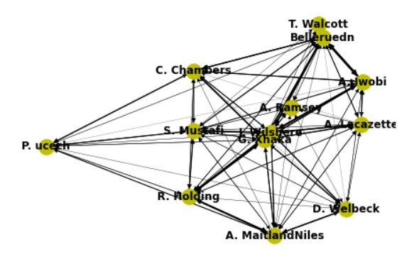
Revisiting Player Networks

Slide 13

Network Analysis Metrics
Clustering Coefficient (node):
Measure of local node robustness
Calculates the (weighted) number of triangles centered around the node as with respect to the number of possible triangles the could have been
Formally,
We use the average clustering coefficient for all players in a team as a single metric for a particular performance

Slide 14
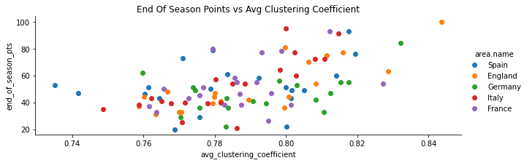

Macro Averaged Clustering Coefficient vs Season Performance
$$ρ=0.52$$

Slide 15
Network Analysis Metrics
Algebraic Connectivity (graph):
Quantifies integration/segregation between players
A value of 0 indicates complete separation of communities
Fault tolerance interpretation: A high algebraic connectivity means a network is tolerant to faults in certain nodes. This means if a player is marked(by an opponent’s defender) or off the field(red card or injury), the network as a whole is tolerant highly to it in terms of ball movement.
Formally, it is the second smallest eigenvalue of the Laplacian(D-A) matrix of the graph

Slide 16
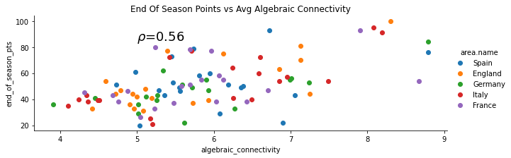
Macro Averaged Algebraic Connectivity vs Season Performance

Slide 17
Network Analysis Metrics
Average All-Pairs Topological Shortest Path(graph):
Shortest path between all pairs of nodes(players) in a network graph where edge weights are defined as 1/frequency of passes between the nodes.
This definition of edge weights is inverse to all other analyses done till this point
A low value indicates movement of the ball between 2 random nodes, on average, was performed frequently

Slide 18
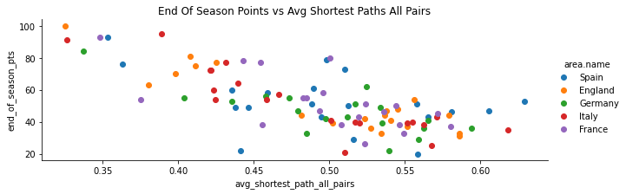

Macro Averaged All-Pairs Topological Shortest Path vs Season Performance
$$ρ=−0.73$$

