Slide 1

Soccer Analytics
Deep Dive: Play Style Clustering

Slide 2
So Far…
Type of Analysis | Number of Features Derived
Exploratory Data Analysis | 1
Zonal Networks | 3
Passing Lane Analysis | 1 cluster label or 36 individual features
Player Networks | 5
Defense Metrics | 10
20 Metrics Overall
All of these metrics were evaluated per-team, per performance

Slide 3
Condensing Features to Team Granularity
Previously: Just group by teams and take the mean across all performances in the season
Now: Try using mean, median, min, max, and variance in each metric for all the performances in the season. This results in 100 features per team.
Variance specially may be important as consistency could be an attribute of playing style

Slide 4
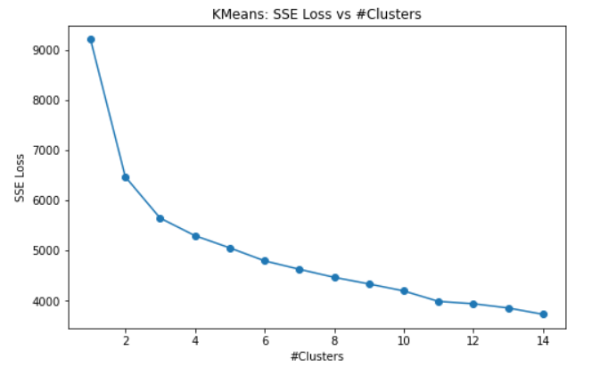
Revisiting K-Means Using the 100 Features
Again using K=2 as the elbow

Slide 5
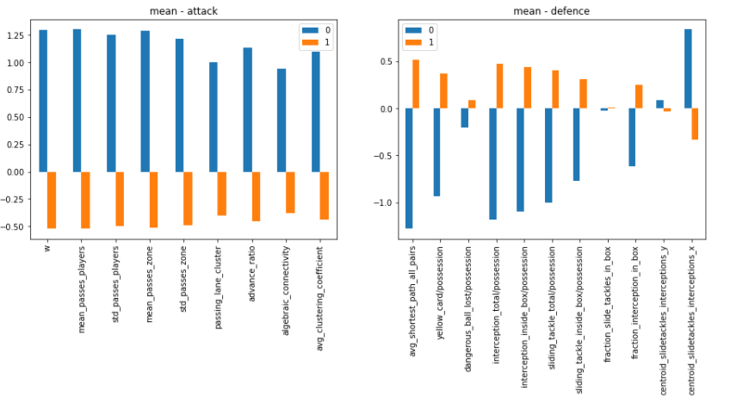
Cluster Behaviour wrt Features

Slide 6
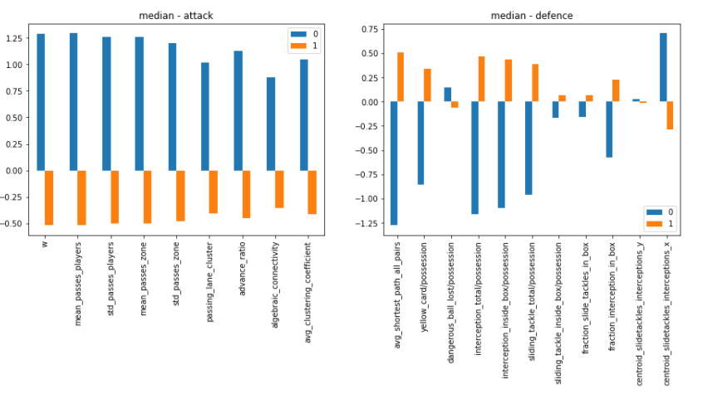
Cluster Behaviour wrt Features

Slide 7
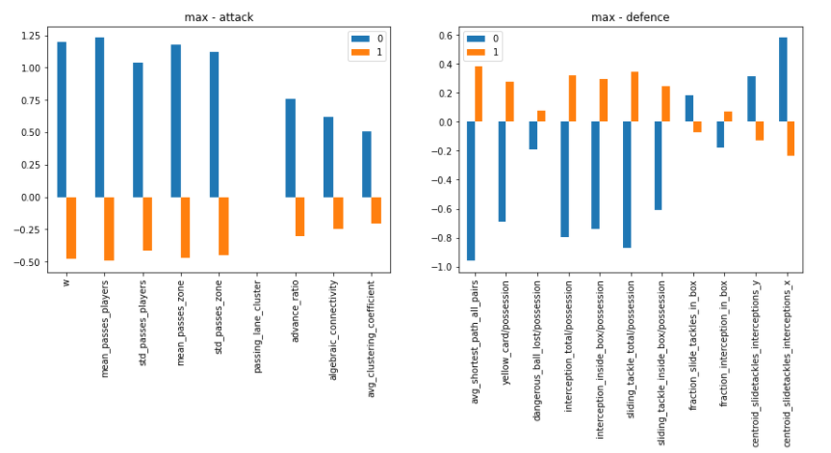
Cluster Behaviour wrt Features

Slide 8
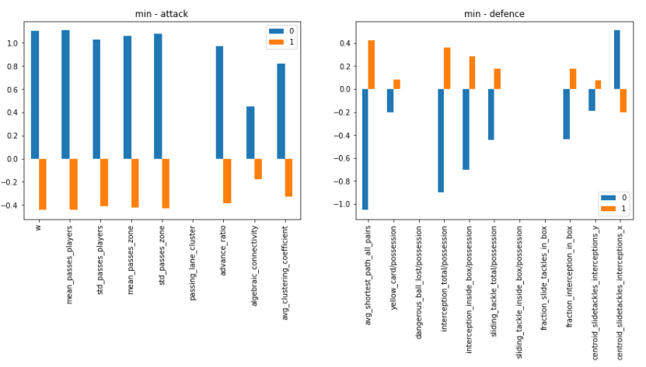
Cluster Behaviour wrt Features

Slide 9
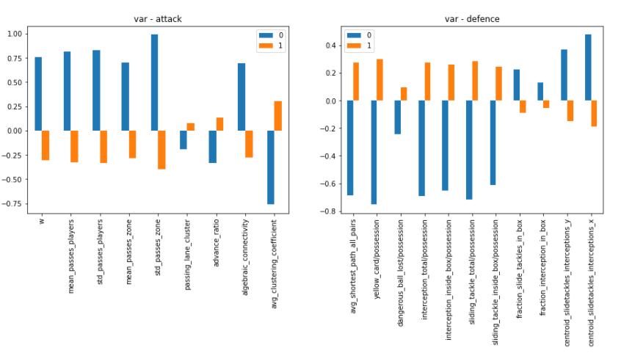
Cluster Behaviour wrt Features

Slide 10
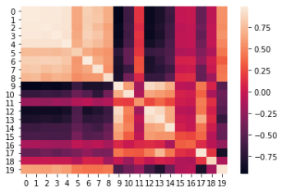
Correlations
Generally, aggregating through mean, median, min and max yielded very similar results for cluster assignments.
Raw values also showed high correlations
Median Aggregations
Mean Aggregations

Slide 11
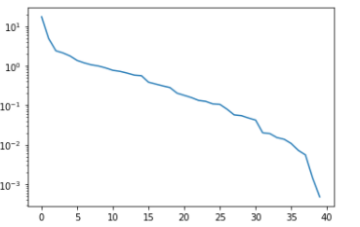
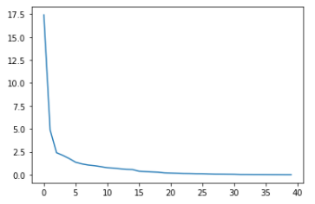
Principal Component Analysis
Moving on, only mean and variance were chosen as the aggregation methods and a principal component analysis was done:
Explained Variance – Log Scale
Explained Variance
Principal Components
Principal Components

Slide 12
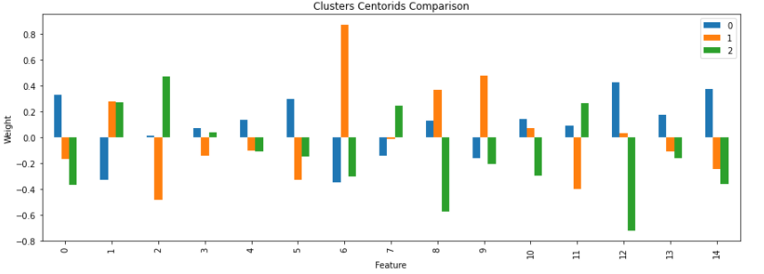
K-means with Top 15 Principal Components

Slide 13
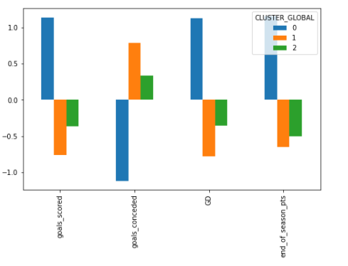
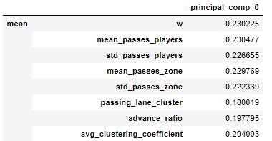
K-means with Top 15 Principal Components
3 clusters, largely uncorrelated (unlike k-means)
Problem: Very difficult interpretation – Difficult to determine what the principal components mean

Slide 14
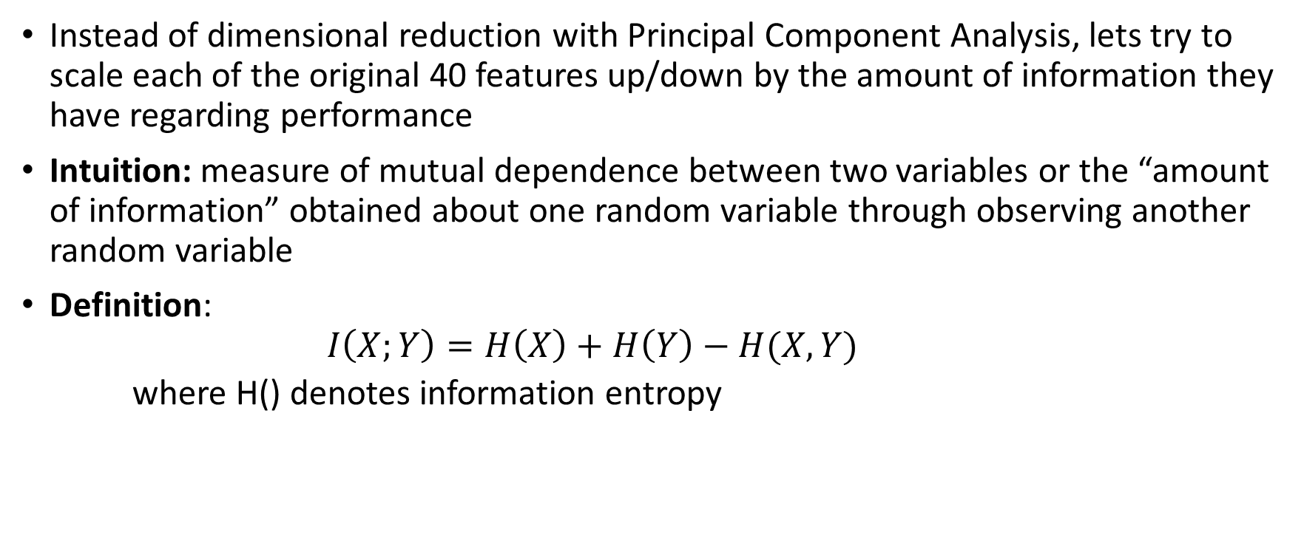
New Approach: Mutual Information
Instead of dimensional reduction with Principal Component Analysis, lets try to scale each of the original 40 features up/down by the amount of information they have regarding performance
Intuition: measure of mutual dependence between two variables or the “amount of information” obtained about one random variable through observing another random variable
Definition:
$$I\left(X;Y\right)=H\left(X\right)+H\left(Y\right)−H(X, Y)$$
where H() denotes information entropy

Slide 15
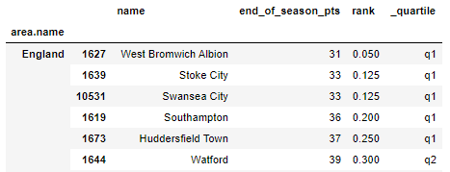
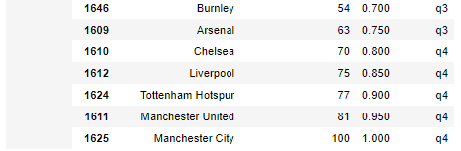
New Approach: Mutual Information
Using methodology from Brain C. Ross [1], evaluated MI between the 40 continuous features and a discrete target variable.
For the discrete target variable, used end of season ranking quartiles, for each domestic league, as shown:
[1] B. C. Ross, “Mutual information between discrete and continuous data sets,” PLoS ONE, vol. 9, no. 2, 2014.

Slide 16
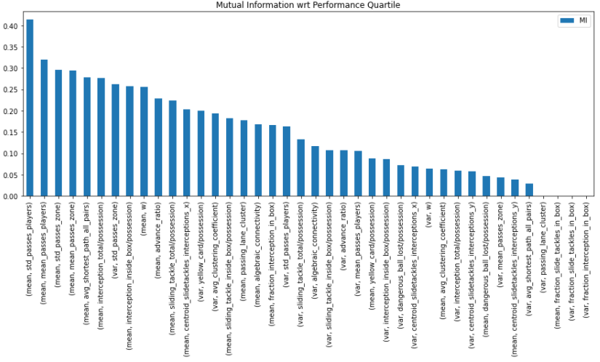
New Approach: Mutual Information

Slide 17
New Approach: Mutual Information
Moving on, each dimension was first normalized to 0 mean, 1 standard deviation, and then scaled up by the mutual information score in that dimension.
This means if we use Euclidean distance as the proximity measure for clustering, the distances are weighed according to the amount of information in each dimension

Slide 18
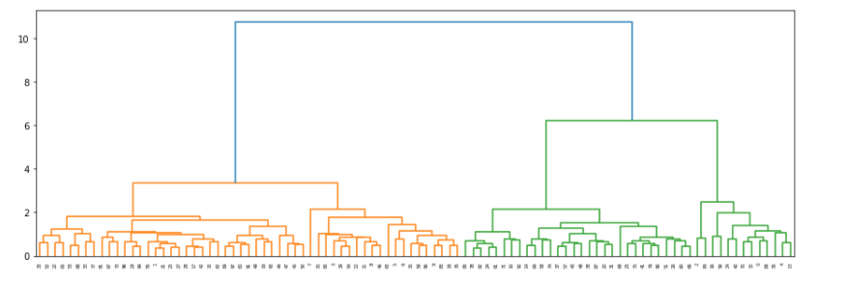
Scaled Data: Hierarchical Clustering (WARD’s Algorithm)
Choosing K=3 Clusters

Slide 19
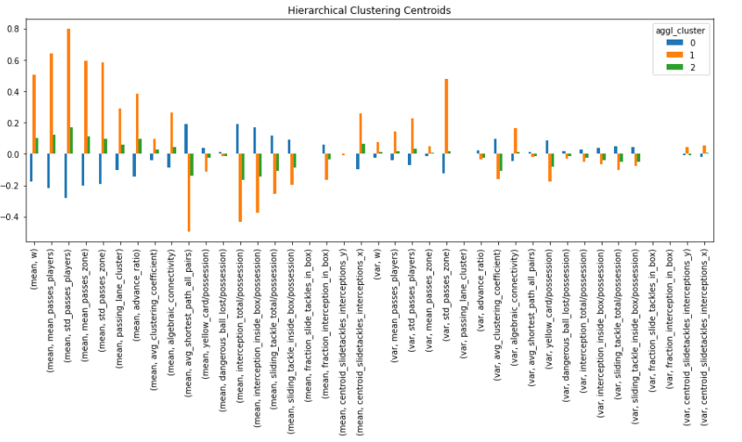
Scaled Data: Hierarchical Clustering (WARD’s Algorithm)

Slide 20
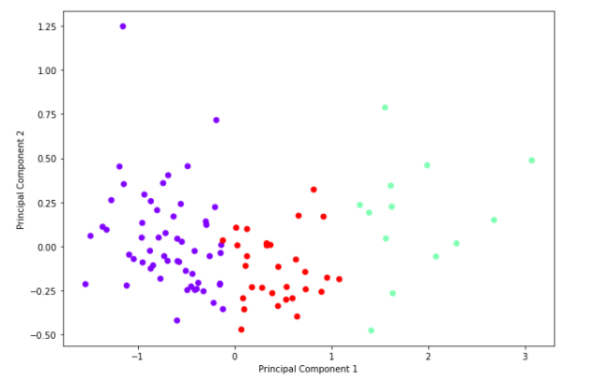
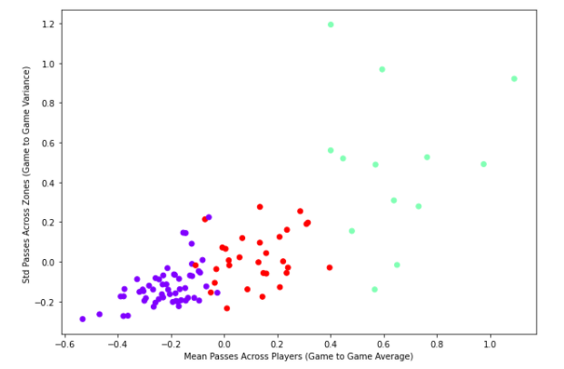
Scaled Data: Hierarchical Clustering (WARD’s Algorithm)

Slide 21
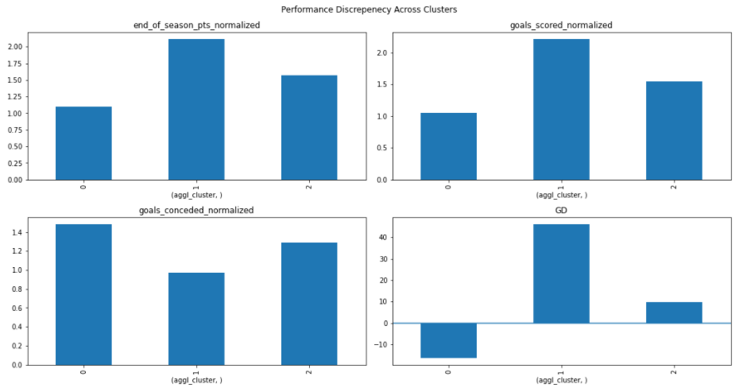
Scaled Data: Hierarchical Clustering (WARD’s Algorithm)
Both centroids and performance show high correlation between clusters 1 and 2

Slide 22
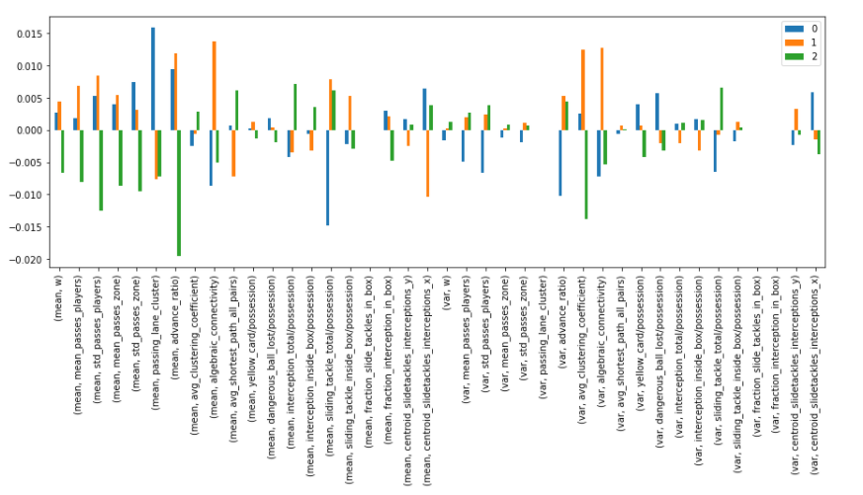
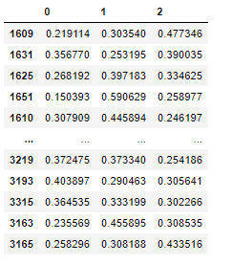
Scaled Data: Soft Clustering with Gaussian Mixture Models

Slide 23
Summary
Clustering Type | Remarks
Simple K-Means (100 Features) | 2 clusters, attack/defense discrepancy, large correlations across dimensions
PCA + K-Means (15 Principal Components) | 3 uncorrelated clusters, observable performance discrepancy, hard to interpret with fundamentals
MI + Hierarchical Clustering (40 features) | 3 clusters, observable performance discrepancy, strong correlation amongst 2 of the clusters
MI + Gaussian Mixture Models | Each team probabilistically assigned to 1 of 3 clusters, uncorrelated, hard to study performance discrepancy.
Other methods such as OPTICS, mean shift clustering, and affinity propagation clustering were also explored but they were deemed unfeasible as clusters were either too big/small, the algorithms did not converge, or they were highly sensitive to initialization

