Slide 1

Soccer Analytics
Some Defensive Metrics & First Attempt at Play Style Clustering

Slide 2
Simple Count Based Metrics
These simple count based metrics were derived simply by enumerating tagged events in the dataset per team, per game.
The raw counts were normalized by possession distributions that game
Metric | Macro-Averaged Correlation with End-of-Season Points
Number of Yellow Cards / Game | -0.43
Dangerous Ball Lost | -0.30
Total Interceptions | -0.67
Total Slide Tackles | -0.55

Slide 3
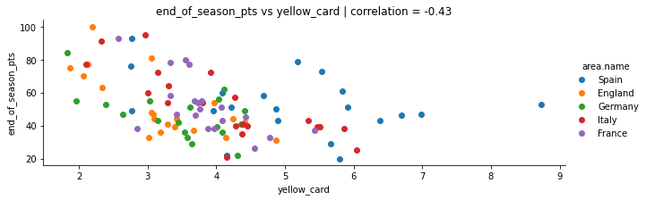
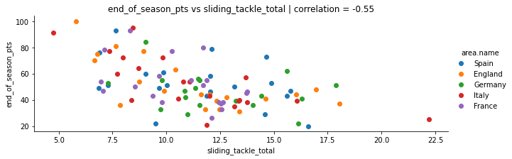

Slide 4
Fundamental Spatial Analysis: Inside vs Outside Penalty Box
Next, we can see if there’s a noticeable difference if we isolate these defensive events within the penalty box and in the outfield in terms of correlation magnitudes.
Metric | Macro-Averaged Correlation with End-of-Season Points
Interceptions Inside Box | -0.66
Slides Tackles Inside Box | -0.57
Total Interceptions | -0.67
Total Slide Tackles | -0.55
Fraction of Slide Tackles in Box | -0.25
Fraction of Slide Interceptions in Box | -0.48
No significant difference in correlation power
Fraction evaluated at per team, per match granularity

Slide 5
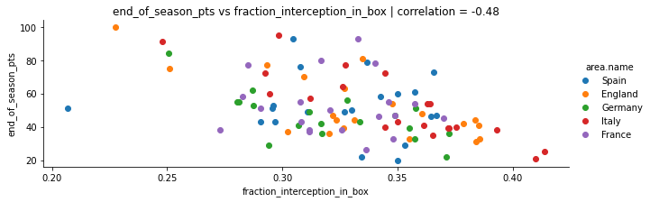
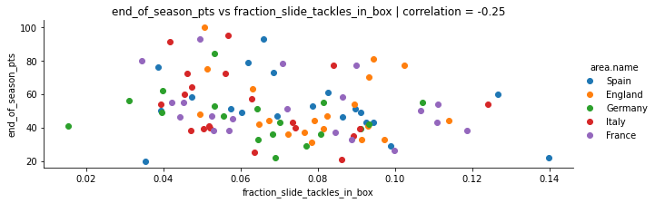

Slide 6
Story So Far
From the previous investigation, we did not find much of a difference between slide-tackles/interceptions within the box and total counts
However, the fraction of slide-tackles/interceptions within the box also gave us significant negative correlations, which begs the question:
Does this pattern continue further down the pitch? Does the position of defensive events (slide-tackles/interceptions) correlate with performance? Or is it unique to the penalty box?

Slide 7
Deeper Look at Spatial Coordinates
Lets analyse spatial distributions more thoroughly. We can compute the <X> and <Y> centroids of the slide-tackle/interception events per game for each team.
Answer: Yes. The pattern certainly continues through the whole pitch, and yields a stronger correlation than before. Note the correlation is only apparent in the forward/backward direction. The left/right coordinate is immaterial as far as correlation with performance is concerned.
Possible explanation: stopping opponent attacks further down the pitch is less risky as set pieces become more difficult/xG decreases.
Metric | Macro-Averaged Correlation with End-of-Season Points
<X> | 0.64
<Y> | -0.06

Slide 8
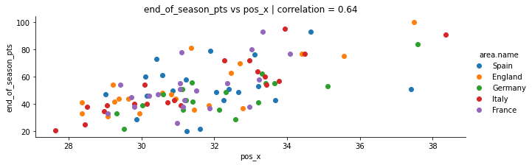
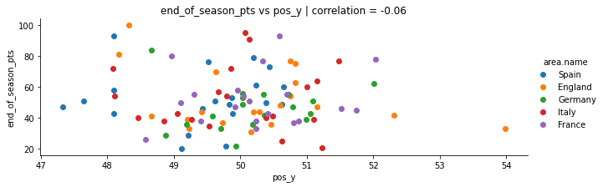

Slide 9
Fouls
Fouls can be risky in two ways:
Committing a foul gets results in a set piece for the opponent which can result in a goal
Fouls can result in yellow/red card resulting in players being sent-off
Is one of these factors empirically more influential than others? Is there a strategic way to foul to gain competitive advantage?

Slide 10
Fouls
Let's analyse the total volume of fouls vs performance and the number of yellow cards/foul committed vs performance
Essentially, we are asking how does the “riskiness” of the fowls committed compare to how many fouls were committed in total.
Answer: “Riskiness” of the fouls committed is far weaker an indicator of performance than the total number of fouls.
Fundamental soccer interpretation: Committing fouls gives us a negative correlation with performance but note that the number of yellow cards per foul committed is an incredibly weak performance indicator. Thus, the performance degradation that comes with fouls is likely to have come from conceding set pieces rather than bookings/send offs
Metric | Macro-Averaged Correlation with End-of-Season Points
Number of Fouls Committed | -0.34
Yellow Cards per Foul Committed | -0.01

Slide 11
Big Picture: How Many Features Do We Have Altogether?
Type of Analysis | Number of Features Derived
EDA & Fundamental Graph Analysis | 6
Graph Network Theory Algorithms | 3
Passing Lane Analysis | 1 cluster label or 36 individual features
Count Based Defense Metrics | 14
24
Note that each of these features is evaluated at a per-game, per-team basis. For performance studied we studied macro-averages over all games from single teams vs their end of season points
When we average per-team performances, we generally get fairly normally-distributed features with slight positive and negative skews
For the individual performances however, power law behavior can definitely be observed

Slide 12
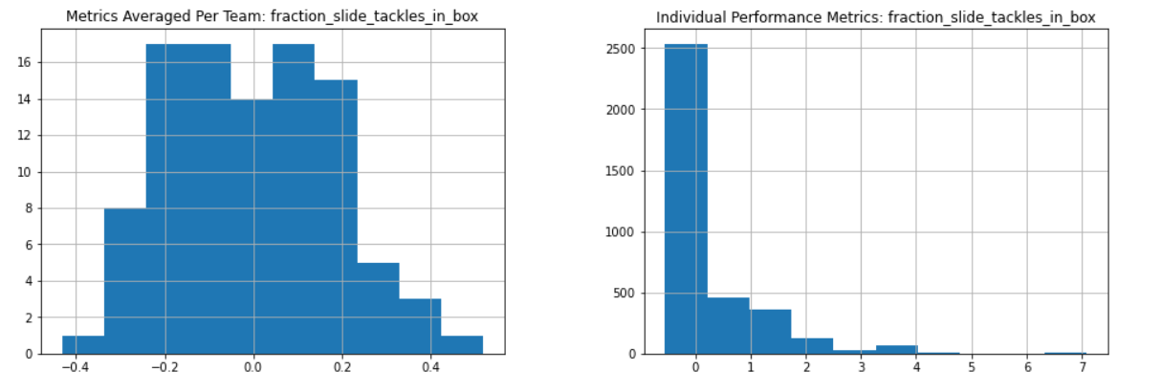
For this feature, the power law is evident for the performance distribution. However, the team averages look more symmetric/normal.
Bigger question: Should I classifying playing styles by team (taking averaged metrics for the whole season) or by individual performance?

Slide 13
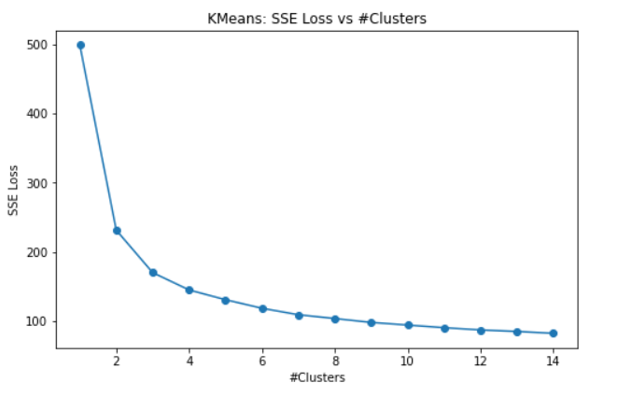
First Attempt: Cluster Teams Using Macro-Averaged Metrics
We’re now clustering in 24 dimensional space
Cluster 0
Cluster 1
Real Madrid,
Barcelona,
Liverpool,
Manchester City
Valencia,
Atletico Madrid,
Leicester City,
Shalke
A sample of team cluster assignments at K=2 clusters
Elbow Point

Slide 14
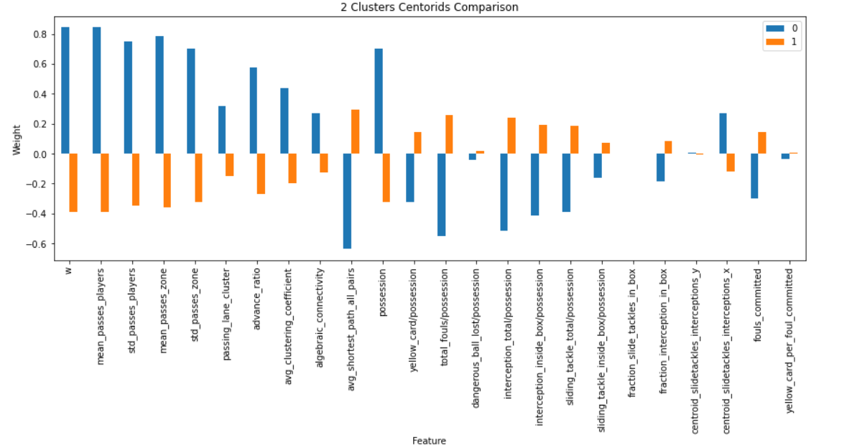
Cluster Centroids at K=2
Clear “attacking” & “defensive” style separation

Slide 15
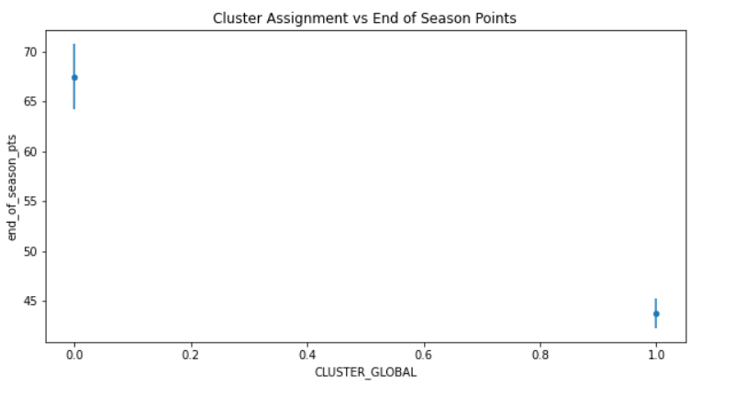
Average Performance/Cluster

Slide 16
Next Steps
Look at deeper interpretations about these clusters
Should clustering really be done by teams? How would we intuitively verify clusters if performances are categorized instead of teams?
Is hierarchical clustering applicable? We can try to derive deeper interpretations using agglomerative clustering
Look at feature importance with respect to the end of season points – perhaps try to use mutual information
Try attribution approaches – what makes a good team good, given all this information. Feature selection/compression techniques might be useful.
Interim Report

