Slide 1

Soccer Analytics
Clustering Questions

Slide 2
Last Time: Different Clustering Techniques
Clustering Type | Remarks
Simple K-Means (100 Features) | 2 clusters, attack/defense discrepancy, large correlations across dimensions
PCA + K-Means (15 Principal Components) | 3 uncorrelated clusters, observable performance discrepancy, hard to interpret with fundamentals
MI + Hierarchical Clustering (40 features) | 3 clusters, observable performance discrepancy, strong correlation amongst 2 of the clusters
MI + Gaussian Mixture Models | Each team probabilistically assigned to 1 of 3 clusters, uncorrelated, hard to study performance discrepancy.
Drop
More Exploration
More Exploration
Other methods such as OPTICS, mean shift clustering, and affinity propagation clustering were also explored but they were deemed unfeasible as clusters were either too big/small, the algorithms did not converge, or they were highly sensitive to initialization

Slide 3
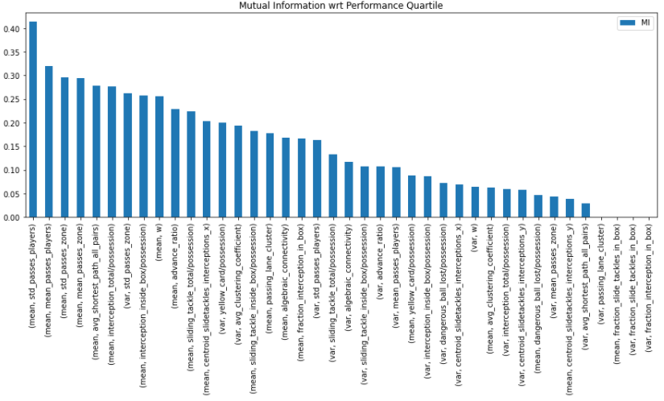
Q1: Does Normalizing MI over features Change Anything?

Slide 4
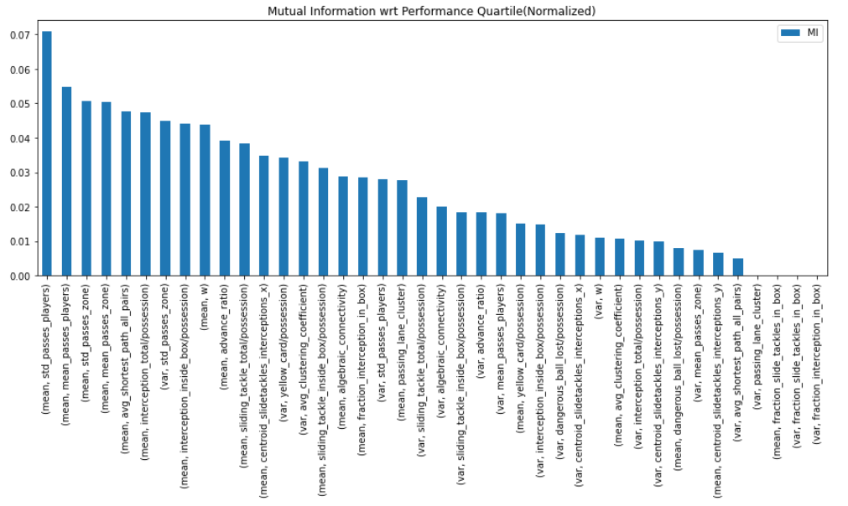
Q1: Does Normalizing MI over features Change Anything?

Slide 5
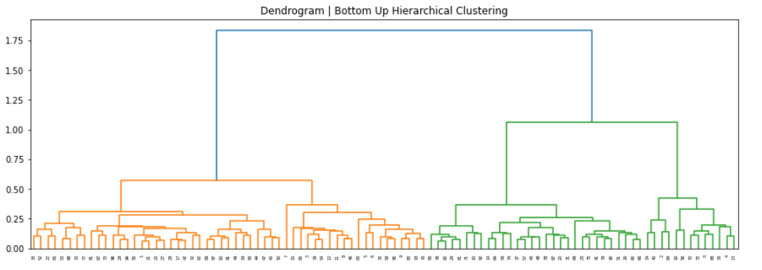
Same Bottom Up Hierarchical Clustering
K=2
K=3
K=4
K=5

Slide 6
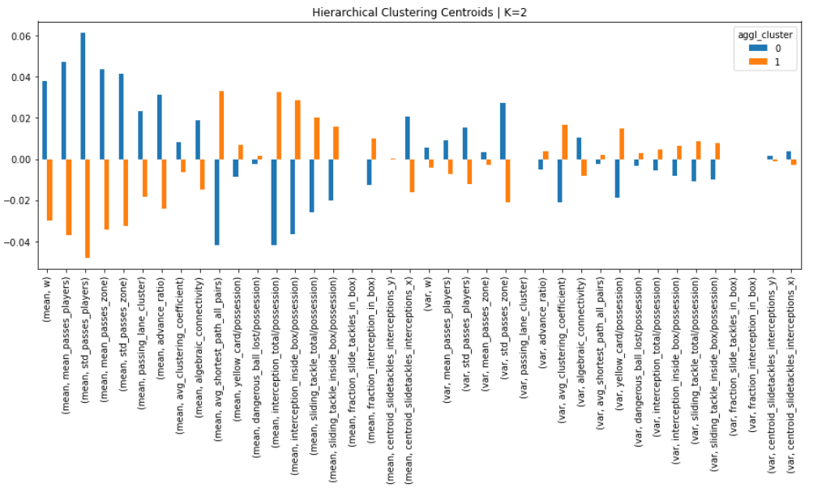
Centroids | K=2

Slide 7
Sample Assignments | K=2
Roma
Atletico Madrid
PSG
Manchester United
Olympique Marseille
Toulhouse
Chievo
Athletic Club
Crystal Palace
Espanyol
Cluster 0
Cluster 1

Slide 8
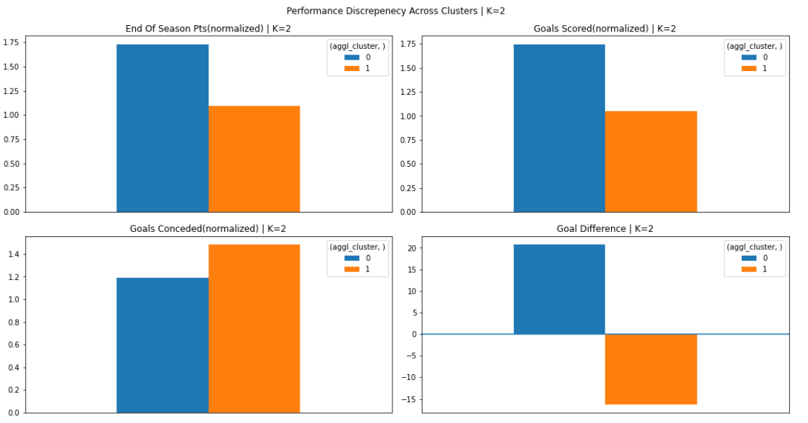
Performance| K=2

Slide 9
Same Bottom Up Hierarchical Clustering
K=2
K=3
K=4
K=5

Slide 10
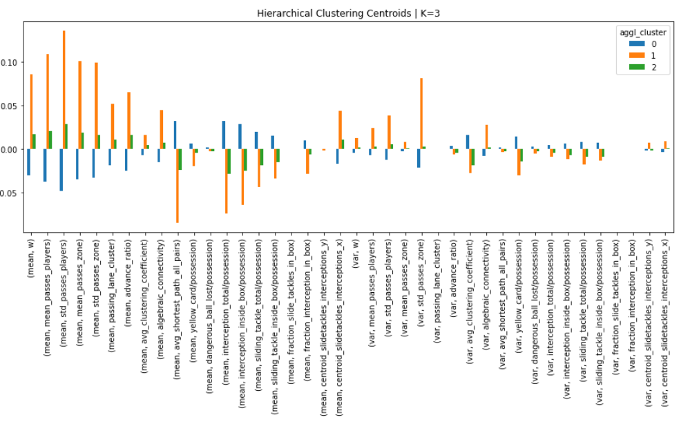
Centroids | K=3

Slide 11
Sample Assignments | K=3
West Ham
Udinese
Angers
Bologna
West Bromwich
Tottenham
Chelsea
Arsenal
Juventus
Liverpool
Milan
Villareal
Real Sociedad
RB Leipzig
Valencia
Cluster 0
Cluster 1
Cluster 2

Slide 12
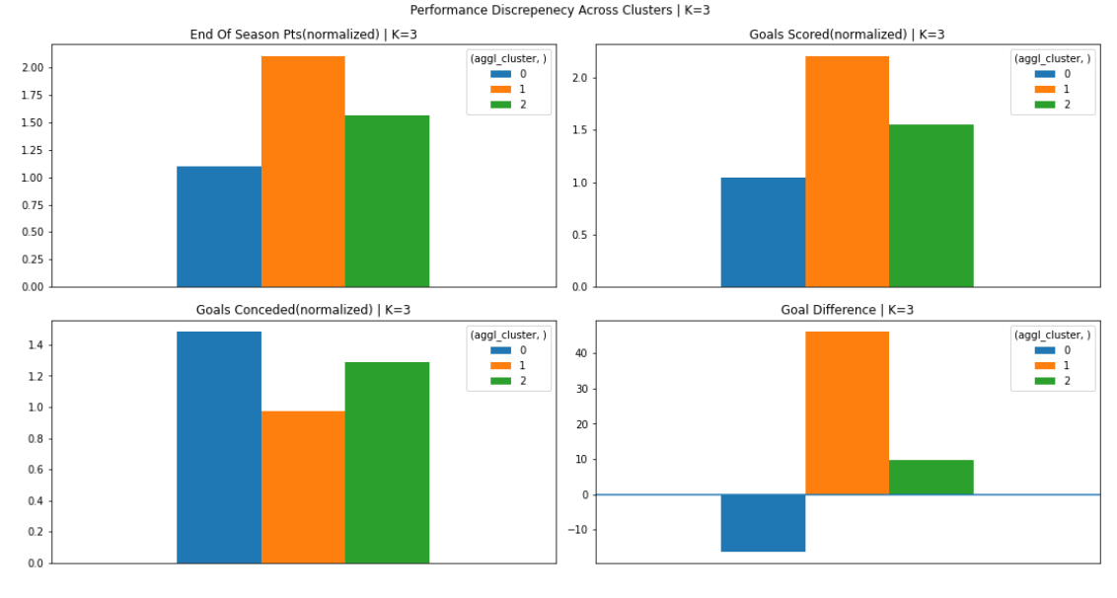
Performance| K=3

Slide 13
Same Bottom Up Hierarchical Clustering
K=2
K=3
K=4
K=5

Slide 14
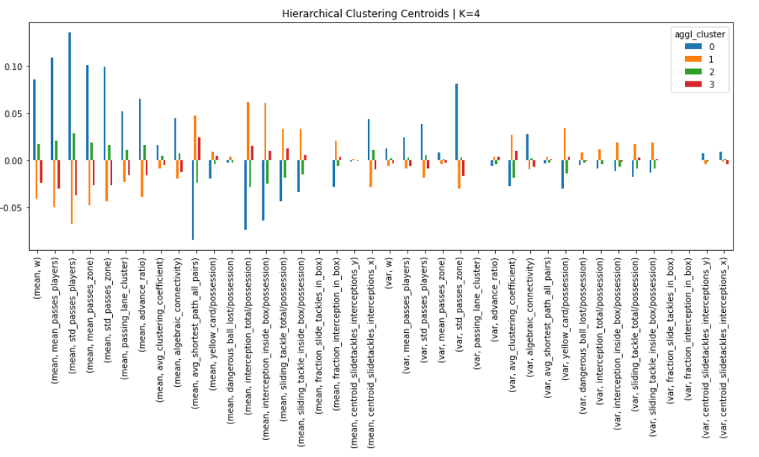
Centroids | K=4

Slide 15
Sample Assignments | K=3
Barcelona
Napoli
PSG
Bayern
Liverpool
Deprotivo
Levante
West Brom
Aimens
Brighton
Roma
Bayer Leverkusen
Sevilla
Real Sociedad
Milan
West Ham
Udinese
Angers
Bologna
West Bromwich
Cluster 0
Cluster 1
Cluster 2
Cluster 3

Slide 16
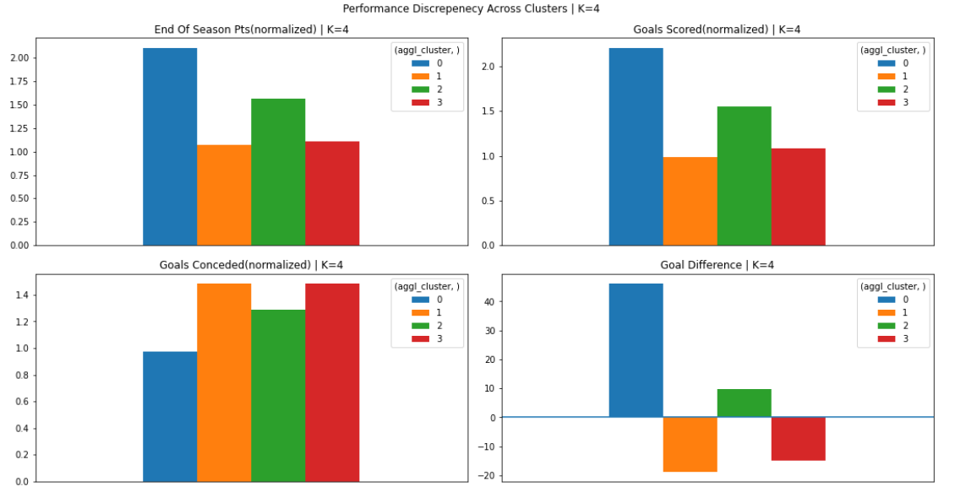
Performance| K=4

Slide 17
Same Bottom Up Hierarchical Clustering
K=2
K=3
K=4
K=5

Slide 18
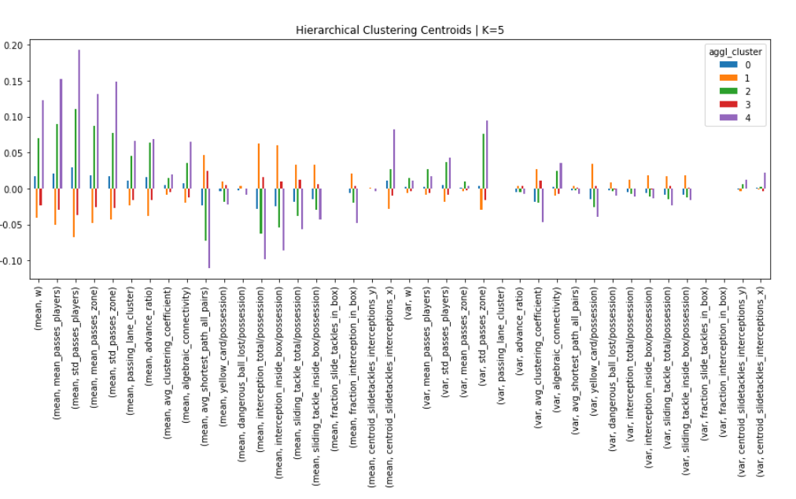
Centroids | K=5

Slide 19
Sample Assignments | K=5
Valencia
Real Sociedad
Man Utd
Atletico Madrid
Hoeffenheim
Burnley
WestHam
Levante
Deprotivo
Aimens
Chelsea
Arsenal
Tottenham
Juventus
Liverpool
Augsburg
Nantes
Angers
Stuttgard
Athletic Club
Man City
Bayern
Napoli
PSG
Cluster 0
Cluster 1
Cluster 2
Cluster 3
Cluster 4

Slide 20
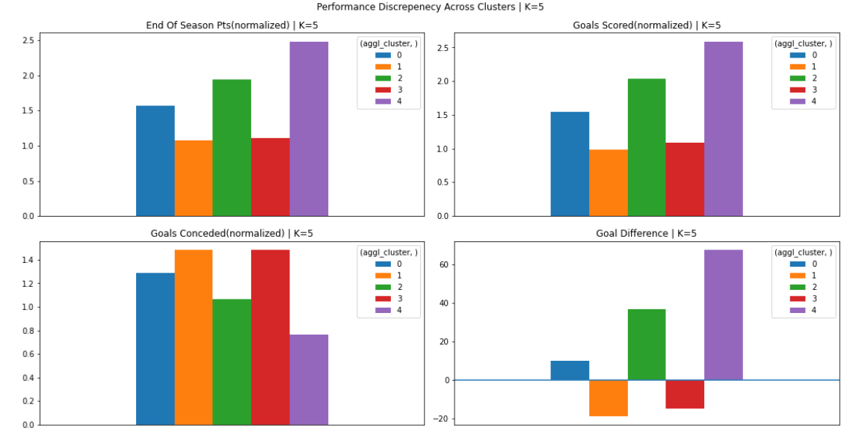
Performance| K=5

Slide 21
Do KMeans & GMM Converge?

Slide 22
Option 1: Initialize with KMeans and fit GMM with Expectation Maximization

Slide 23
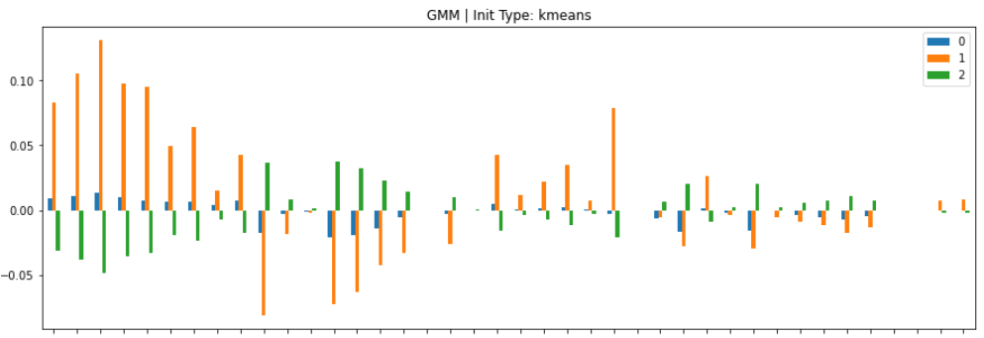
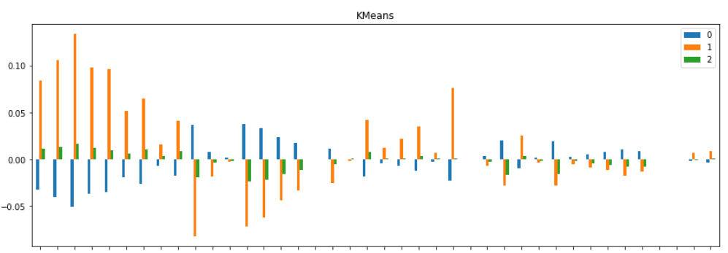
Very Similar Centroids

Slide 24
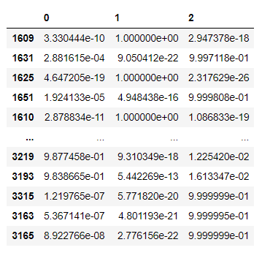
87 times out of 98, GMM argmax and KMeans yield the same cluster.
However, the soft clustering is very similar to hard clustering:

Slide 25
Option 2: Initialize Randomly and fit GMM with Expectation Maximization

Slide 26
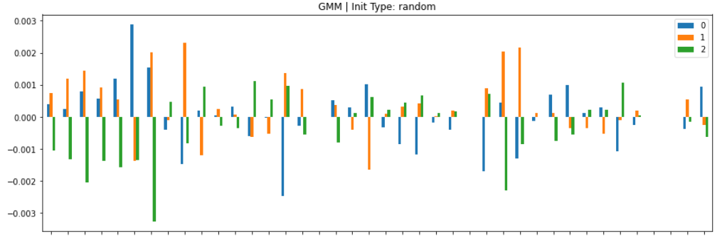
Very Different Centroids

Slide 27
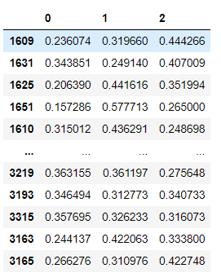
35 times out of 98, GMM argmax and KMeans yield the same cluster.
Now, the soft clustering assignments are more nuanced

Slide 28
Code Availability
Last Update (Different Clustering Techniques): https://github.com/arifmoh2/thesis_soccer/blob/master/notebooks/13_clustering_suggestions_craig.ipynb
This Update (More Exploration on MI, Hierarchical Clustering, & GMM: https://github.com/arifmoh2/thesis_soccer/blob/master/notebooks/13_clustering_suggestions_craig.ipynb

