Slide 1

Soccer Analytics
EDA: Zone Analysis

Slide 2

What Spatial Information can we Analyze?

Slide 3
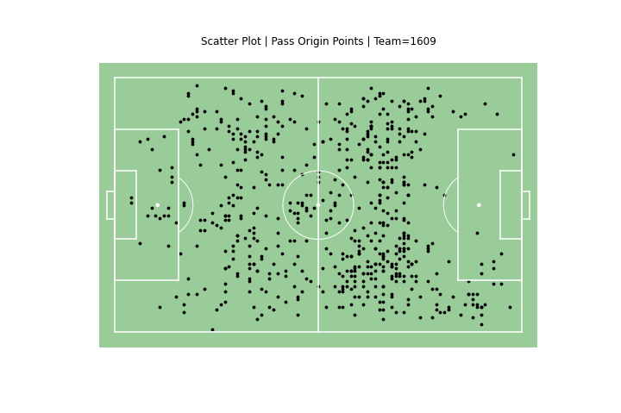
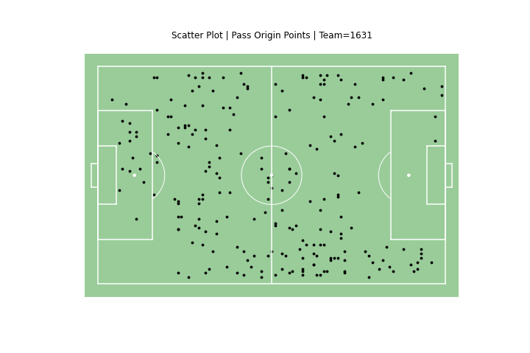
Pass Origin Points
Attacking Direction
Attacking Direction

Slide 4
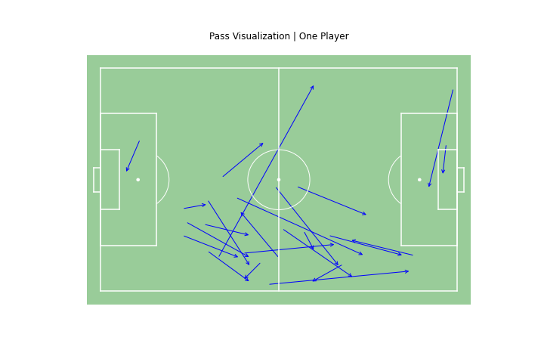
Passes Completed by One Player

Slide 5
Discretizing the Pitch Zones

Slide 6
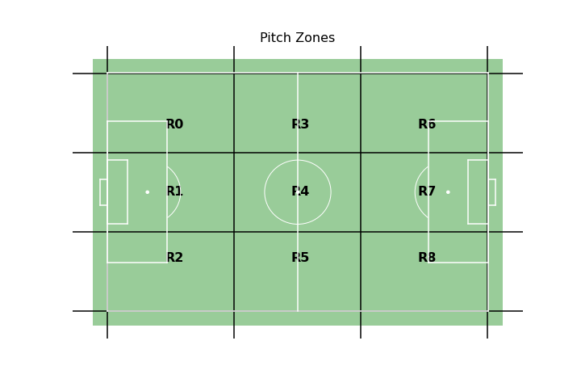
9 Zone Approach

Slide 7
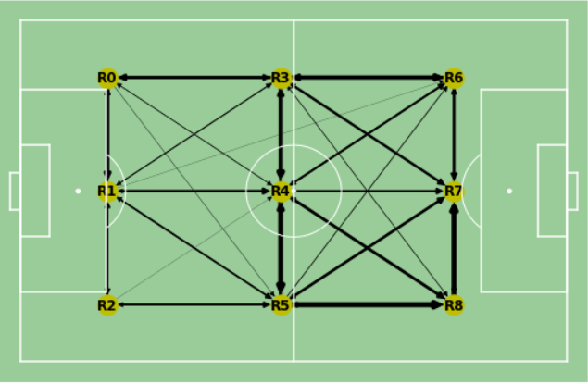
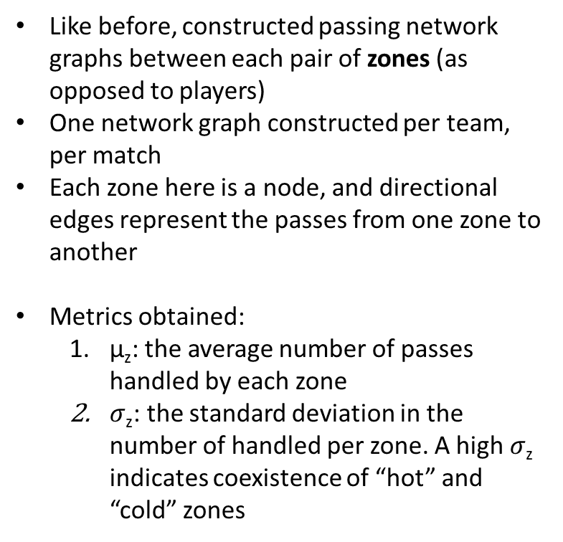
Zonal Network Graphs
Like before, constructed passing network graphs between each pair of zones (as opposed to players)
One network graph constructed per team, per match
Each zone here is a node, and directional edges represent the passes from one zone to another
Metrics obtained:
µ_{z}: the average number of passes handled by each zone
$σ$_{z}: the standard deviation in the number of handled per zone. A high $σ$_{z} indicates coexistence of “hot” and “cold” zones

Slide 8
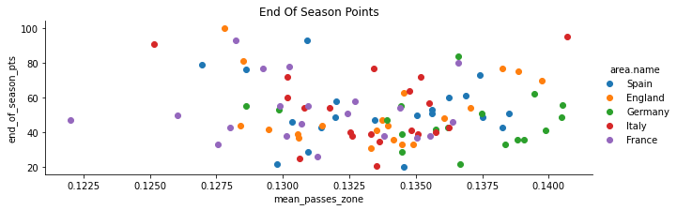
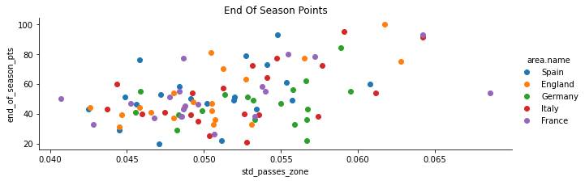
Visual Comparison with Performance

Slide 9
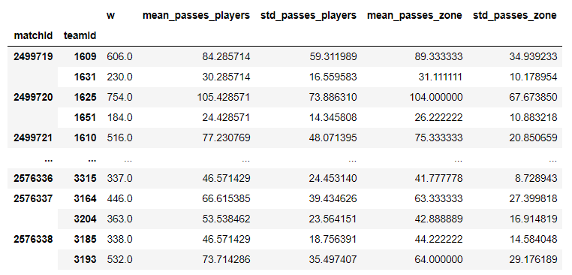
Metrics/Features So Far

Slide 10
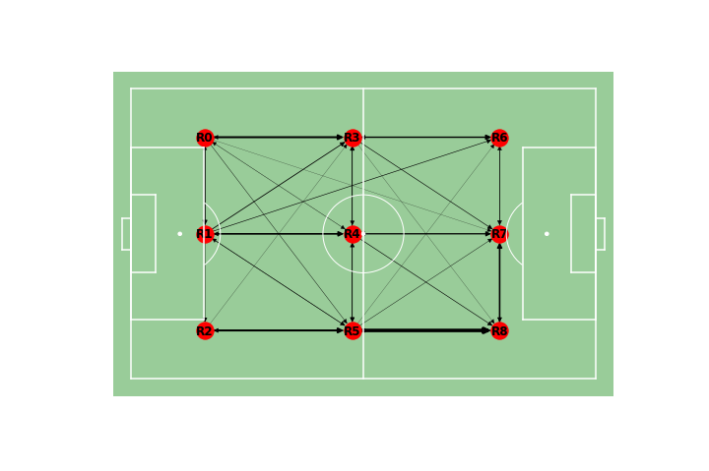
Deeper Dive: Key Passing Lanes
Key Passing Lane

Slide 11
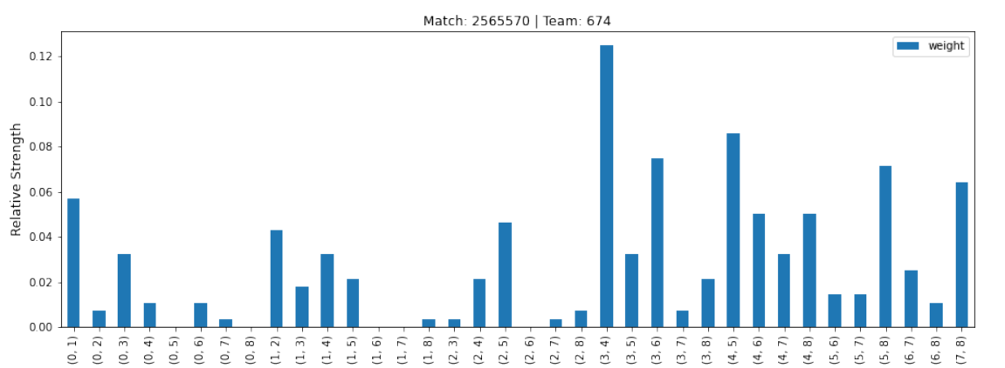
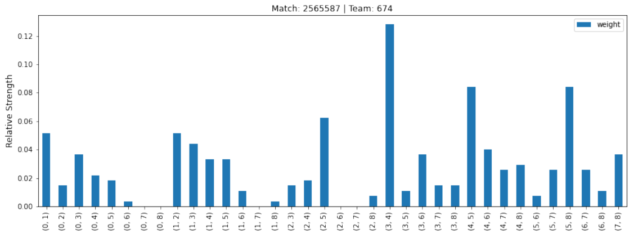
Identifying Key Passing Lanes

Slide 12
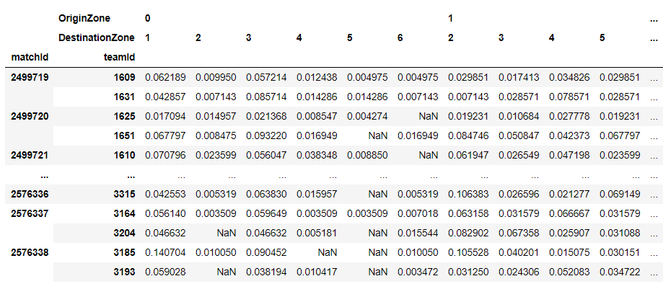
Using Relative Strength As Features
36 more features per team, per game

Slide 13
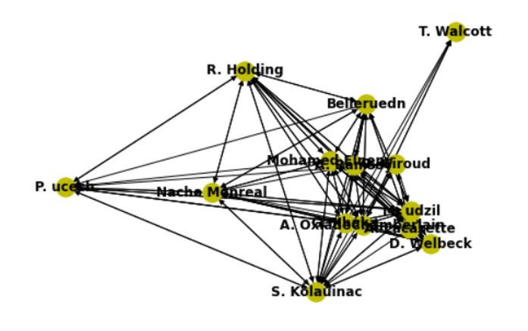
Revisiting Player Networks: Literature Review
More metrics from Buldú, J.M., Busquets, J., Echegoyen, I. et al. Defining a historic football team: Using Network Science to analyze Guardiola’s F.C. Barcelona.
Clustering Coefficient (local robustness): The clustering coefficient of a node i measures the likelihood of i’s neighbours being connected.
Shortest Path: The minimum length (inverse of # passes) the ball has to travel to get from node i to node j (we will average over all possible pairs).

Slide 14
Revisiting Player Networks: Literature Review
3. Largest Eigenvalue of Adjacency Matrix: Measures how connected important “hubs” are in the network
4. Algebraic Connectivity: Measures structural integration in networks. Existence of independent subgroups will make this value low.
5. Eigenvector Centrality: Measure of node importance. Higher number links with other nodes will increase this metric. Being connected to other nodes that also have a high eigenvector centrality will also increase this metric.
6. DY/DX (advance ratio): Total ball movement from passes laterally / total ball movement towards the opponent’s goal

Slide 15
Next Steps
Implement these advanced graph algorithms on my own network graphs (some available but clojure is hard to decipher)
Derive defensive metrics
Move towards team classification

