Slide 1

Soccer Analytics
EDA: Revisiting the H-Statistic Building Blocks

Slide 2
Refresher: Wyscout Dataset
Collection of soccer logs containing events (passes, shots, fouls, etc..) tagged by position, time, outcome, players-involved and event specific tags
Data collected from Wyscout through human analysts trained to study video footage with the help of a proprietary tagger software
Each touch gets mapped to a new event
Coverage of the 2017/18 season for five European leagues: Spanish first division, Italian first division, English first division, German first division, French first division
Format: The dataset is provided as a series of JSON files for events, matches, players, and competitions
Challenge: The dataset is too big to open locally without chunking it into smaller pieces

Slide 3
Operational Update: Handling the Large Dataset
Raw Dataset (JSON)
Cleaned Dataset
(JSONs, CSVs, PKLs)
Cleaning
Formatting
CLOUD (AZURE)
LOCAL PYTHON
Raw Dataset (JSON)
Cleaned Dataset
(JSONs, CSVs, PKLs)
Analysis

Slide 4

Analysis

Slide 5
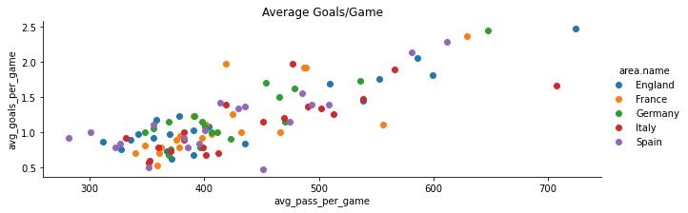
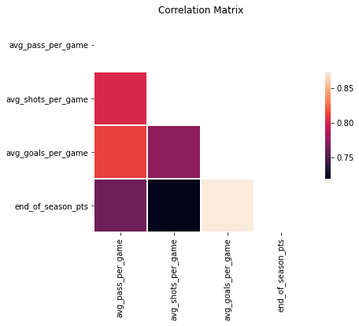
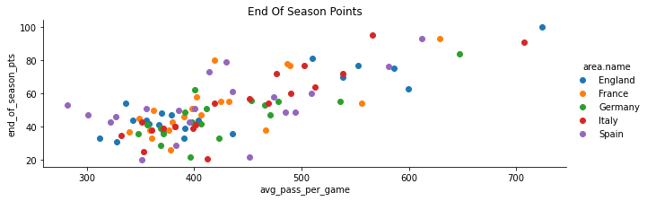
Passing Volume vs Performance

Slide 6
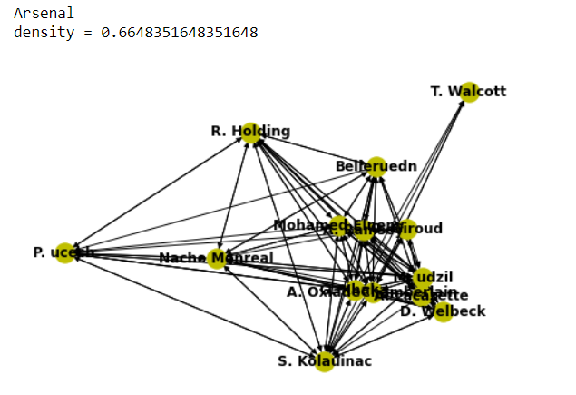
Deeper Look At Passing: Player Networks
These network graphs are constructed per match
Each player is represented by a node and the edge weight for edge <i, j> represents the number of passes from player i to player j
Naïve Assumption: A pass from player i is to player j if the next pass from the team originates from player j
(in-degree + out-degree) for a node represents the number of passes a player is involved in

Slide 7
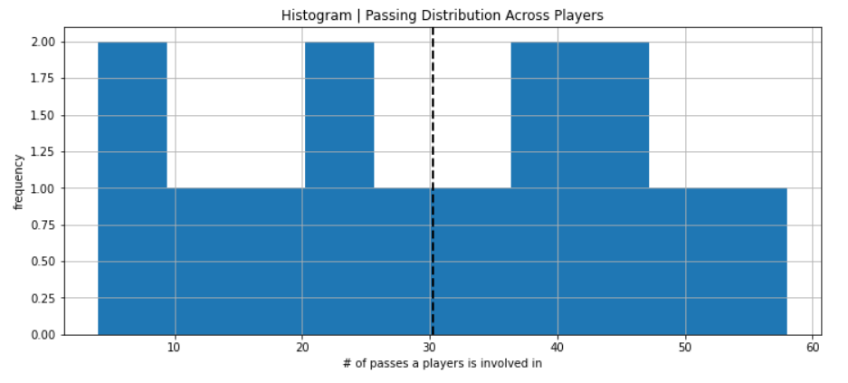
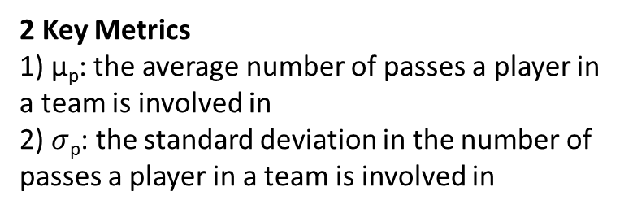

Deeper Look At Passing: Player Networks
2 Key Metrics
1) µ_{p}: the average number of passes a player in a team is involved in
2) $σ$_{p}: the standard deviation in the number of passes a player in a team is involved in
A high $σ$_{p} indicated the coexistence of players with high passing volume and low passing volume in the game

Slide 8
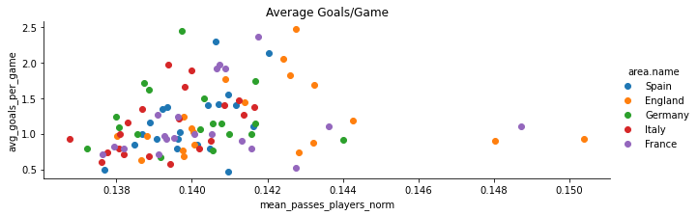
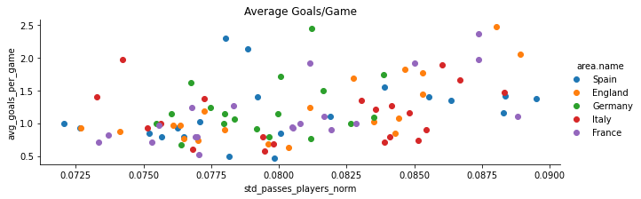
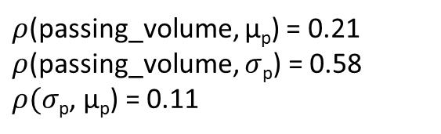
2 New Metrics
$ρ$(passing_volume, µ_{p}) = 0.21
$ρ$(passing_volume, $σ$_{p}) = 0.58
$ρ(σ$_{p}, µ_{p}) = 0.11

Slide 9
Next Steps
A lot more graph algorithms to explore, many cited in literature in the context of soccer^{1, 2}.
Replicate player graphs to make zonal graphs – one node per zone
Measure pass difficulty via length, vertical/lateral breakdown, and position on the field
Explore metrics to measure defensive ability

