Slide 1
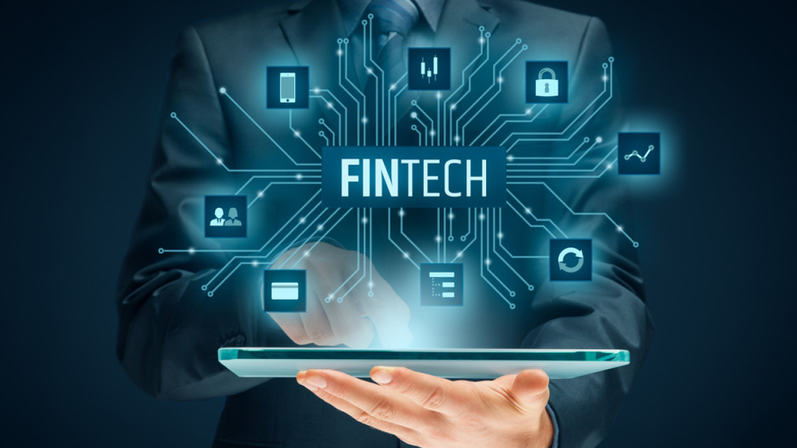

Slide 2
Contents
Introduction
What is fintech
History of fintech
Why fintech
Fintech Trends
Types of fintech
Challenges
Conclusion
Reference

Slide 3
Introduction
Fintech, short for financial technology, refers to the integration of technology into the financial services industry. This can encompass a wide range of products and services, including mobile banking, online investment platforms, digital currencies, and more. The rise of fintech has disrupted traditional financial institutions, providing consumers with more convenient and accessible financial services. Fintech has also opened up new opportunities for businesses and entrepreneurs, allowing them to offer innovative financial solutions to a growing market. The growth of fintech has been driven by advancements in technology, as well as changes in consumer behavior and increasing demand for accessible and convenient financial services. With the rapid pace of technological change and the continued growth of the fintech sector, it is expected to play a major role in shaping the future of finance and commerce

Slide 4
What is fintech?
Fintech or financial technology refers to the application of software and hardware to financial services and processes, making them faster, easier to use and more secure. The fintech industry includes everything from payment processing solutions to mobile banking apps.
Artificial intelligence, blockchain, cloud computing, and big data are regarded as the "ABCD" (four key areas) of fintech.
Fintech companies consist of both startups and established financial institutions and technology companies trying to replace or enhance the usage of financial services provided by existing financial companies.
A subset of fintech companies that focus on the insurance industry are collectively known as insurtech or insuretech companies.

Slide 5
History
While fintech seems like a recent series of technological breakthroughs, the basic concept has existed for some time. Early creditcards in 1950s, generally represent the first fintech products available to the public, in that they eliminated the need for consumers to carry physical currency in their day-to-day lives. From there, fintech evolved to include bank mainframes and online stock trading services. In 1998, PayPal was founded, representing one of the first fintech companies to operate primarily on the internet — a breakthrough that has been further revolutionized by mobile technology, social media, and data encryption. This fintech revolution has led to the mobile payment apps, blockchain networks, and social media-housed payment options we regularly use today.

Slide 6
Why fintech
FinTech simplifies financial transactions for consumers or businesses, making them more accessible and generally more affordable.
It can also apply to companies and services utilizing AI, big data, and encrypted blockchain technology to facilitate highly secure transactions amongst an internal network.
Broadly speaking, fintech strives to streamline the transaction process, eliminating potentially unnecessary steps for all involved parties. For example, a mobile service like Venmo or CashApp allows you to pay other people at any time of day, sending funds directly to their desired bank account. However, if you paid instead with cash or a check, the recipient would have to make a trip to the bank to deposit the money.

Slide 7
Fintech Trends
Over the years, fintech has grown and changed in response to developments within the wider technology sector. In 2022, this growth was defined by several prevailing trends:
Digital banking
Blockchain
Artificial Intelligence (AI) and Machine Learning (ML)

Slide 8
Digital banking continues to grow:
Digital banking is easier to access than ever before. Many consumers already manage their money, request and pay loans, and purchase insurance through digital-first banks. This simplicity and convenience will likely drive additional growth in this sector, with the global digital banking platform market expected to grow at a compound annual growth rate (CAGR) of 11.5 Percent by 2026.

Slide 9
Blockchain
Blockchain technology allows for decentralized transactions without a government entity or other third-party organization being involved. Blockchain technology and applications have been growing quickly for years, and this trend is likely to continue as more industries turn to advanced data encryption.

Slide 10
Artificial Intelligence (AI) and Machine Learning
AI and ML technologies have changed how fintech companies scale, redefining the services they offer to clients. AI and ML can reduce operational costs, increase the value provided to clients, and detect fraud. As these technologies become more affordable and accessible, expect them to play an increasingly large role in fintech’s continue revolution.

Slide 11
Types of Fintech
Blockchain and cryptocurrency
Peer-to-peer lending and borrowing
Insurance Technology
Mobile payments
Crowdfunding
Personal finance management
Robot-based Advice and Stock Trading

Slide 12
Blockchain and cryptocurrency
Blockchain is a bit like a global spreadsheet or ledger. It does not have a central database; instead, it runs on computers provided by volunteers around the world. A blockchain is public: anyone can view it at any time because it resides on the network, not within a single institution. A blockchain is encrypted and it uses public and private keys to maintain a sort of virtual security. A blockchain allows a person to safely send money to another person without going through a bank or financial services provider.
Cryptocurrencies, based on blockchain technology, are also another notable example of fintech types with a formidable impact on financial services. Blockchain could help in enabling better privacy, security, and transparency in tracking financial transactions throughout their entire lifespan. Cryptocurrencies could utilize the traits of blockchain to ensure better monitoring and control over their assets. Examples of the popularity of Bitcoin,Etherium, stablecoins, and many other crypto assets have proved how cryptocurrencies are integral to the future of fintech.

Slide 13
Blockchain
Blockchain is simply a type of database. However, the key difference between blockchain and common databases is the way the data is structured. Unlike standard databases which store data in centralized, relational tables, blockchain is an open, peer-to-peer (P2P) network that favors communal functionality in lieu of a centralized controlling entity.
In blockchain, data is collected into groupings called blocks. Each block has a certain storage capacity so, when it is filled, it is linked to the previously filled block forming a chain of data — hence the name “blockchain.” When additional information is subsequently added, another new block is formed and added to the existing blockchain.
An important characteristic of blockchain is that, as each block is completed, a time stamp is generated. This makes each blockchain a “timeline of data”; differentiating it from standard databases as well.

Slide 14
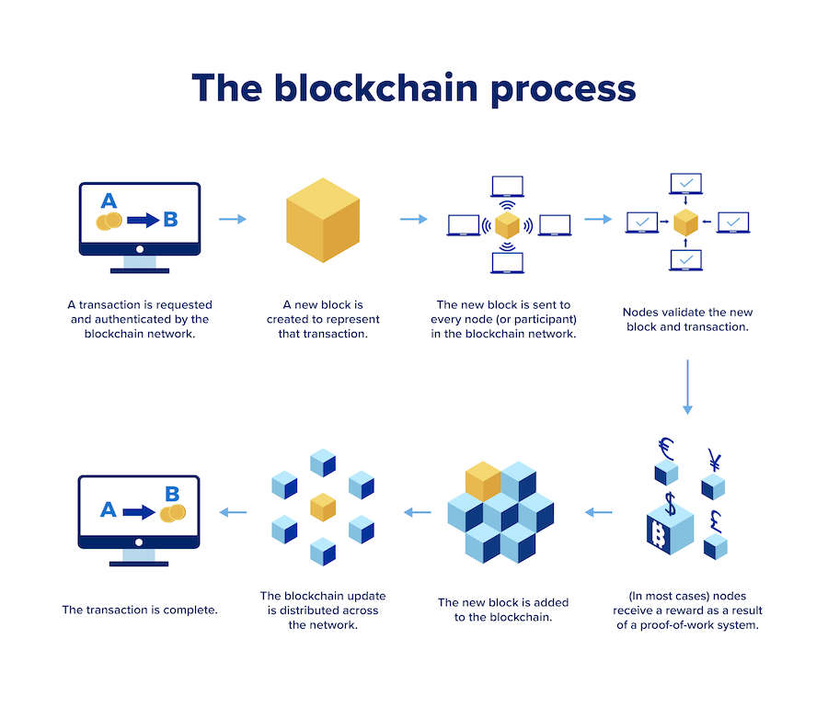
Blockchain Process

Slide 15
Cryptocurrency
Cryptocurrency serves as a medium of exchange, a store of value, and a unit of measure. While cryptocurrencies have little inherent value, they are used to price the value of other assets. Bitcoin is a cryptocurrency (means of payment) but it can be seen as a speculative commodity (how much is it trading for), it was launched in 2009 and it is widely considered the first digital asset. Digital assets, also known as crypto assets, are digital representations of value made possible by cryptography and blockchain. Their original intent was to serve as a vehicle for transferring value without the use of a bank or other trusted third-party entity. Cryptoassets (digital assets) are categorized into three main types: cryptocurrencies, crypto commodities, and crypto tokens.

Slide 16
Insurance Technology
The next prominent addition among finance technology fintech types would refer to insurance technology or InsurTech. The growth of digital financial service ecosystems has enabled flexibility for developing insurance solutions with high value to improve user experience. Insurers are trying to use fintech variants for the integration of smartphone apps, AI, IoT, machine learning, and many other technologies to improve the value of insurance services.
Fintech could enable formidable improvements in insurance services, such as an easier collection of insurance details on smartphones. Similarly, user-friendly apps could play a crucial role in ensuring easier management of coverage. Many providers have been working on telematics to improve core insurance products and streamline coverage. At the same time, InsurTech also changes the perspective of users on insurance products with many value advantages.

Slide 17
Mobile Payments
One of the common answers to “What are the different types of fintech?” would also point to mobile payment systems. Some of you must have used popular applications such as PayPal, Apple Pay, Google Pay, Venmo, or Google Play for sending or receiving payments.
The impact of a global pandemic turned the whole world’s attention toward possibilities for cashless transactions. The continuously declining relevance of cash in the post-pandemic era has also called for organizations in every industry to think about payments.
Depending on the individual functionalities, mobile payments have different value propositions. Popular mobile payment solutions such as Google Pay and Venmo have gained a substantial number of users. For example, Venmo has more than 65 million daily users, indicating the trust of users in the app.

Slide 18
Peer-to-Peer Lending and Borrowing
The introduction of financial technology has also presented viable prospects for the transformation of lending and borrowing systems. Fintech has been a crucial player in simplification of the approaches people follow for borrowing money. The types of financial technology used for transforming financial services like lending have introduced P2P lending protocols.
Any individual could access these platforms and borrow loans anytime. Interestingly, users of such fintech solutions would also find flexible opportunities for evaluation of a borrower’s credit readiness. At the same time, the implementation of fintech also removes the need for attending any office or bank to obtain loans.
P2P lending protocols rely on the power of DeFi to enable seamless access to financial services and improve user experience. For example, Compound and Aave are popular lending protocols based on DeFi. Another popular example of lending applications in fintech types would refer to Credit Karma.
It is a renowned personal finance provider with more than 110 million users in the USA. The app has developed a reputation for offering free and trustworthy credit score reports. Users can also avail of productive tools for identity and credit monitoring, loan shopping, and feasible credit card recommendations.

Slide 19
Personal Finance Management
Personal finance management is also another proven response to “What are the different types of fintech?” with popular examples. It is a unique and personalized category of fintech focused on enhancing wealth management and retail investment practices. Personal finance technology, or WealthTech, is a popular and value-based variant of fintech, which can improve and facilitate operations with better efficiency and automation.
The primary goal of WealthTech focuses on streamlining the investment process, which can help investors in easier management of investment portfolios. One of the notable examples of personal finance management solutions among fintech variants is Monie, a personal finance application for the Egyptian market.

Slide 20
Crowdfunding
The crowdfunding market has the potential for steady growth in the forecast period from 2021 to 2026, with a CAGR of more than 16%. Crowdfunding platforms have removed the need to visit a bank or pitch ideas before venture capitalists to obtain loans or funding for projects.
The outline of different fintech categories would also emphasize the new methods for raising capital by employing innovative improvements. Crowdfunding fintech services could offer the ideal opportunity for micro and small enterprises to discover investors for their projects.

Slide 21
Robot-based Advice and Stock Trading
The most formidable example of financial technology fintech types would refer to robot-based advisors. You must have learned about the importance of AI and machine learning in the burgeoning fintech industry. Robot-based advisors are applications powered by AI and ML for offering recommendations regarding financial decisions. As a result, financial service users could figure out an alternative to hiring an advice for financial expense. Most important of all, your robot advisor would never take breaks and would provide round-the-clock data analysis capabilities.
Similarly, the outline of different types of financial technology also includes references to stock trading apps. Stock trading apps are useful tools for investors to conduct desired transactions directly from their smartphones. The power of AI and ML could help in capitalizing on meaningful insights from humongous piles of data. At the same time, the use of blockchain could also streamline the security of the personal and financial data of investors.

Slide 22
Benefits of fintech
Benefits of Fintech in General
1. Facilitate Financial Transactions
The presence of fintech makes financial transactions more practical. With just one mobile phone, you can make various financial transactions without the need to queue, go to the bank, or bother to provide change. Different layers of society can use it.
2. Ease of Access to Funding
The existence of fintech is very helpful for those who need a fast funding alternative. That way, anyone has the opportunity to get business capital or even meet daily living expenses.
3. Participate in Supporting National Financial Inclusion
Financial inclusion is an economic activity in which the community is involved and has access to financial institutions. Currently, financial inclusion is still at 49% of the government's target of 75%.

Slide 23
Benefits of fintech
Thanks to the presence of fintech that offers effectiveness and convenience through technology, people can now more easily access various financial services. For example, making payments, buying and selling, saving, borrowing funds, and much more.
4. Improving Living Standards
Thanks to the ease of access available, people's standard of living have increased. People can easily meet their financial needs. This includes those who have limited access to conventional banks.
5. Faster Turnover of the Economy
Fintech can also help accelerate the economy. One reason is that access to finance is much easier. This is aimed at accelerating the economic turnaround because more and more small businesses are being helped.

Slide 24
Benefits of fintech
The Benefits of Fintech for a Country
1. Support economic development
2. Accelerating the velocity of money which has an impact on improving the community's economy
3. Participate in developing the National Strategy for Financial Inclusion (SNKI)

Slide 25
Challenges
Data security
Compliance with Government Regulations
Lack of Mobile and Tech Expertise
User Retention and User Experience

Slide 26
Conclusion
Fintech refers to the application of software and hardware to financial services and processes, making them faster, easier to use and more secure. The fintech industry includes everything from payment processing solutions to mobile banking apps.
Artificial intelligence,blockchain,cloud computing, and big data are regarded as the "ABCD" (four key areas) of fintech.
The history of fintech starts from 1950s with the invention of credit cards.
There are several types of fintech.
Fintech has more benefits as well some challenges .

Slide 27
References
Lai, T. L.; Liao, S.-W.; Wong, S. P. S.; Xu, H. (2020). "Statistical models and stochastic optimization in financial technology and investment science" (PDF). Annals of Mathematical Sciences and Applications. 5 (2): 317-345.
Lai, T. L.; Liao, S.-W.; Wong, S. P. S.; Xu, H. (2020). "Statistical models and stochastic optimization in financial technology and investment science“
"KPMG Pulse of Fintech H1 2021 - Global". KPMG. 2021. Retrieved December 28, 2021

