Slide 1
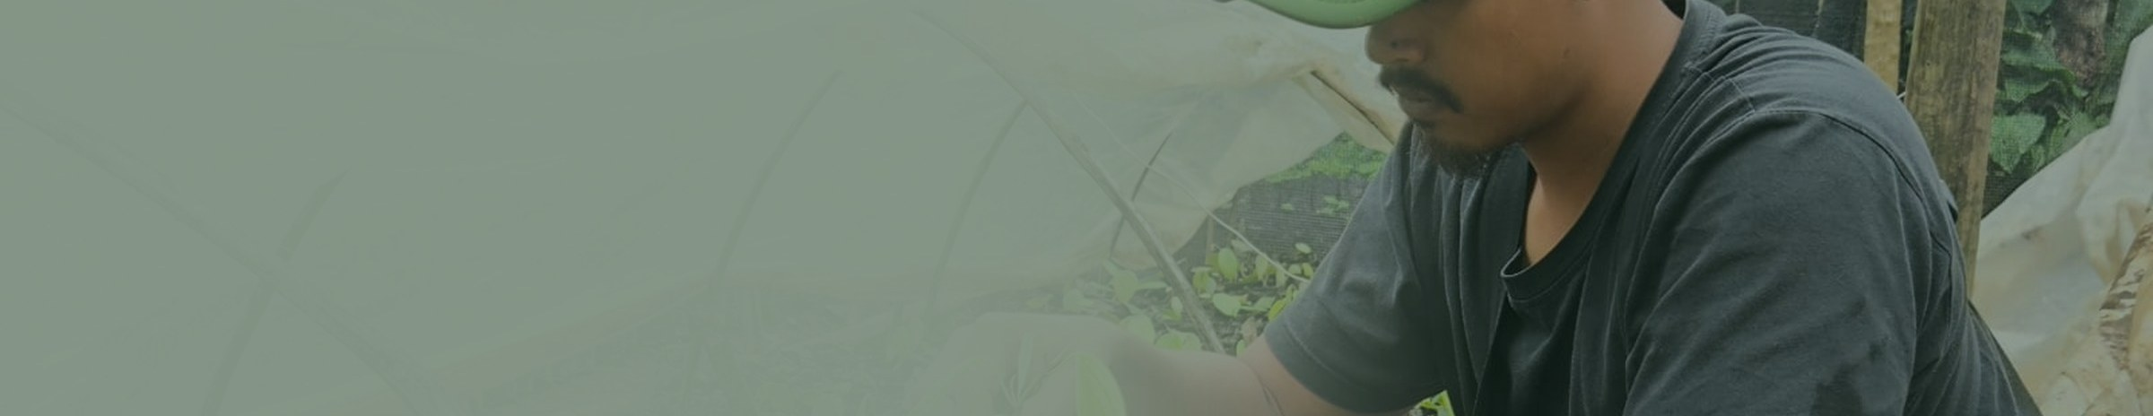




PT KLUMBAYAN GOLD FARM · LAMPUNG, INDONESIA
Traceable spices and cocoa,
plot to container
1,250 agroforestry smallholders · 2,000-tonne facility at Natar · every lot verified in TAPAK
Prepared for
ATDAG Cairo · September 2026
WHO WE ARE
AT A GLANCE
KGF is an Indonesian spice and cocoa company based in Lampung, the country's principal pepper-producing province. We are not a broker. We buy directly from 1,250 smallholder farmers we organised and trained across three regencies — Pesawaran, Tanggamus and Lampung Barat — grade and consolidate at our own 2,000-tonne warehouse in Natar, and ship under contract.
The company was founded in 2022 to restore land degraded by former gold mining and return villagers to professional farming. That is the origin of the name.
2022
Established, Pesawaran, Lampung
1,250
Smallholder farmers under contract
~600 ha
Under management (1,250 × 0.5 ha assumed)
2,000 t
Warehouse and processing, Gudang Natar
TWO BUSINESSES THAT FUND EACH OTHER
17
Verified field buying stations, Tanggamus
15
Internal staff, incl. 5 field facilitators
Tech-enabled trading. Buying direct removes the layers of collectors that normally sit between an Indonesian smallholder and an exporter. That is what makes both the traceability claim and the farmer price premium real.
Regenerative agribusiness. Our supply base is agroforestry, not monoculture. Crops grow in a multi-strata system alongside shade and timber trees, on land being restored rather than cleared — producing the verified deforestation-free supply that premium buyers increasingly require.
WHERE WE SHIP TODAY
Verstegen Spices and Sauces of the Netherlands contracts 80–100 t of black pepper for 2026 and audited our Natar warehouse in August. Europe is our only export market to date — Egypt is the second we are here to open.
Lead local implementer, aGROWforests
PT Klumbayan Gold Farm · Company Profile · Page 1 of 3

Slide 2
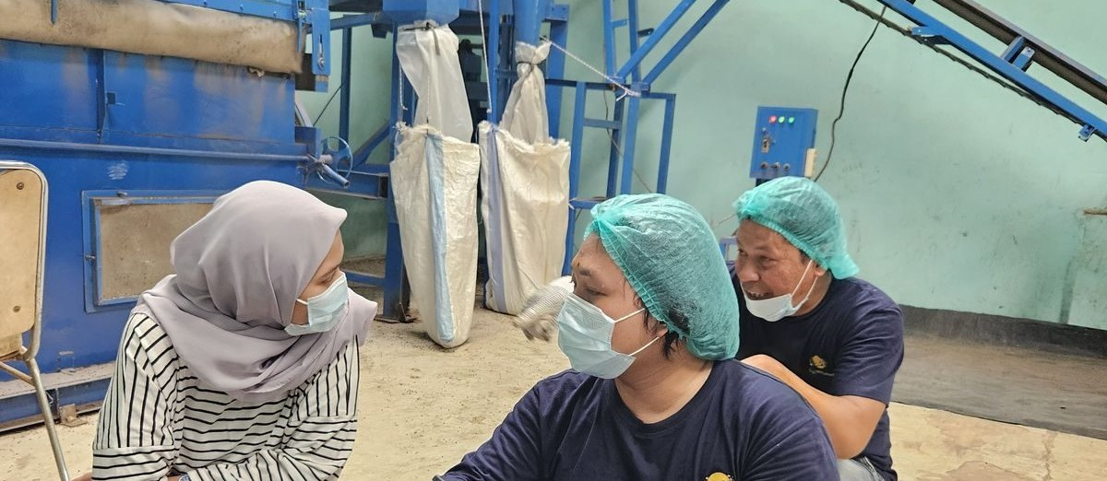
Capability, stated honestly
PT KLUMBAYAN GOLD FARM
CAPACITY — THE CONSTRAINT IS WORKING CAPITAL, NOT PLANT
Our facility at Natar is deliberately not running at its limit. Machine hours are available and our farmer network can supply more than we currently buy, because until now we concentrated on a single European contract. New buyer volume displaces nothing.
LINE
POSITION TODAY
FACILITY
Black pepper, premium 580 g/l
80–100 t contracted for 2026; expandable against a firm 2027 order
Natar
Black pepper, standard 500 g/l
Available now — 200 t per year
Natar
SUSTAINABILITY
Robusta coffee, green
300 t/month sustained, headroom to 720 t/month
Natar + 17 stations
aGROWforests — a consortium funded by GIZ, the German development agency — covers land restoration, deforestation prevention and certified supply chains. GIZ funds it and audits compliance. KGF is the lead local implementer.
Composting runs at our LKC and Taman Sari facilities plus two communal units in Ulu Belu. More than 10 tonnes of compost has been distributed to farmers to date.
Cocoa, bean and processed
Available; powder and nibs produced in-house
Natar
TAPAK — traceability that can be checked
Traceability and Accountability of Professional Agri-KGF. Our own platform, live and in production. It records farmer identity, plot polygon coordinates, purchase volume per transaction, digital receipts, and warehouse lot movement.
A buyer asking which farms a container came from receives a plot-level answer. We can grant dashboard access for independent verification rather than asking a buyer to take our word for it.
COMPLIANCE — INCLUDING WHAT WE DO NOT HOLD
Halal (BPJPH) — Not yet held. Will be obtained to buyer requirement.
Organic — Not certified. Land in transition; we do not claim it.
EUDR due diligence — In preparation with Verstegen and Fairfood.
K3 and waste SOP — In place at Gudang Natar.
BPJS and payroll — Paid and active.
PT Klumbayan Gold Farm · Company Profile · Page 2 of 3

Slide 3
Product catalogue
ORIGIN: LAMPUNG, INDONESIA
PRODUCT
GRADE / FORM
SPECIFICATION
AVAILABILITY
Black pepper — Premium
Premium FAQ, export grade
Bulk density min. 580 g/l. Lampung Black Pepper is a protected origin name.
≈100 t/year, contracted to our European buyer. Expandable against a firm 2027 order.
Black pepper — Standard
Grinding and blending grade
Bulk density 500 g/l. Sound, clean pepper below European premium density.
Available now — 200 t/year. Does not compete with the premium line.
Robusta coffee
Green bean
Dry natural (asalan kering), and sorted to defect 80 / 120.
300 t/month sustained, headroom to 720 t/month. Sourced Tanggamus.
Cocoa bean
Fermented and non-fermented
Fermented carries a premium over non-fermented at the farm gate.
Available across the Lampung network.
Cocoa processed
Powder and nibs
Downstream processed in-house at Natar, not raw bean only.
Available.
Cocoa butter
Pressed
Specification confirmed against enquiry.
Sourced to order — not a stocked line.
Nutmeg
Whole dried
Specification confirmed against enquiry.
Sourced to order — not a stocked line.
Also sourced to order
Cloves (cengkeh), Java long pepper (cabe jawa) and cubeb (kemukus), all whole dried, from the same farmer network. Volume confirmed against enquiry.
Confirmed per order
Moisture and foreign matter, packaging and net weight, shelf life, MOQ, incoterms, port of loading and lead time are agreed against each enquiry. Pricing on application.
What we are asking of ATDAG Cairo
Introductions to Egyptian importers, grinders and distributors whose requirements match this portfolio. We would open any relationship with a trial container, so quality is judged on the product rather than on paper.
Arif Rachman · Operational Director
arif@klumbayanfarm.com · +62 853 7887 0007
Jln. Wolter Monginsidi No. 159, Bandar Lampung · www.klumbayanfarm.com
PT Klumbayan Gold Farm · Product Catalogue · Page 3 of 3

