Slide 1
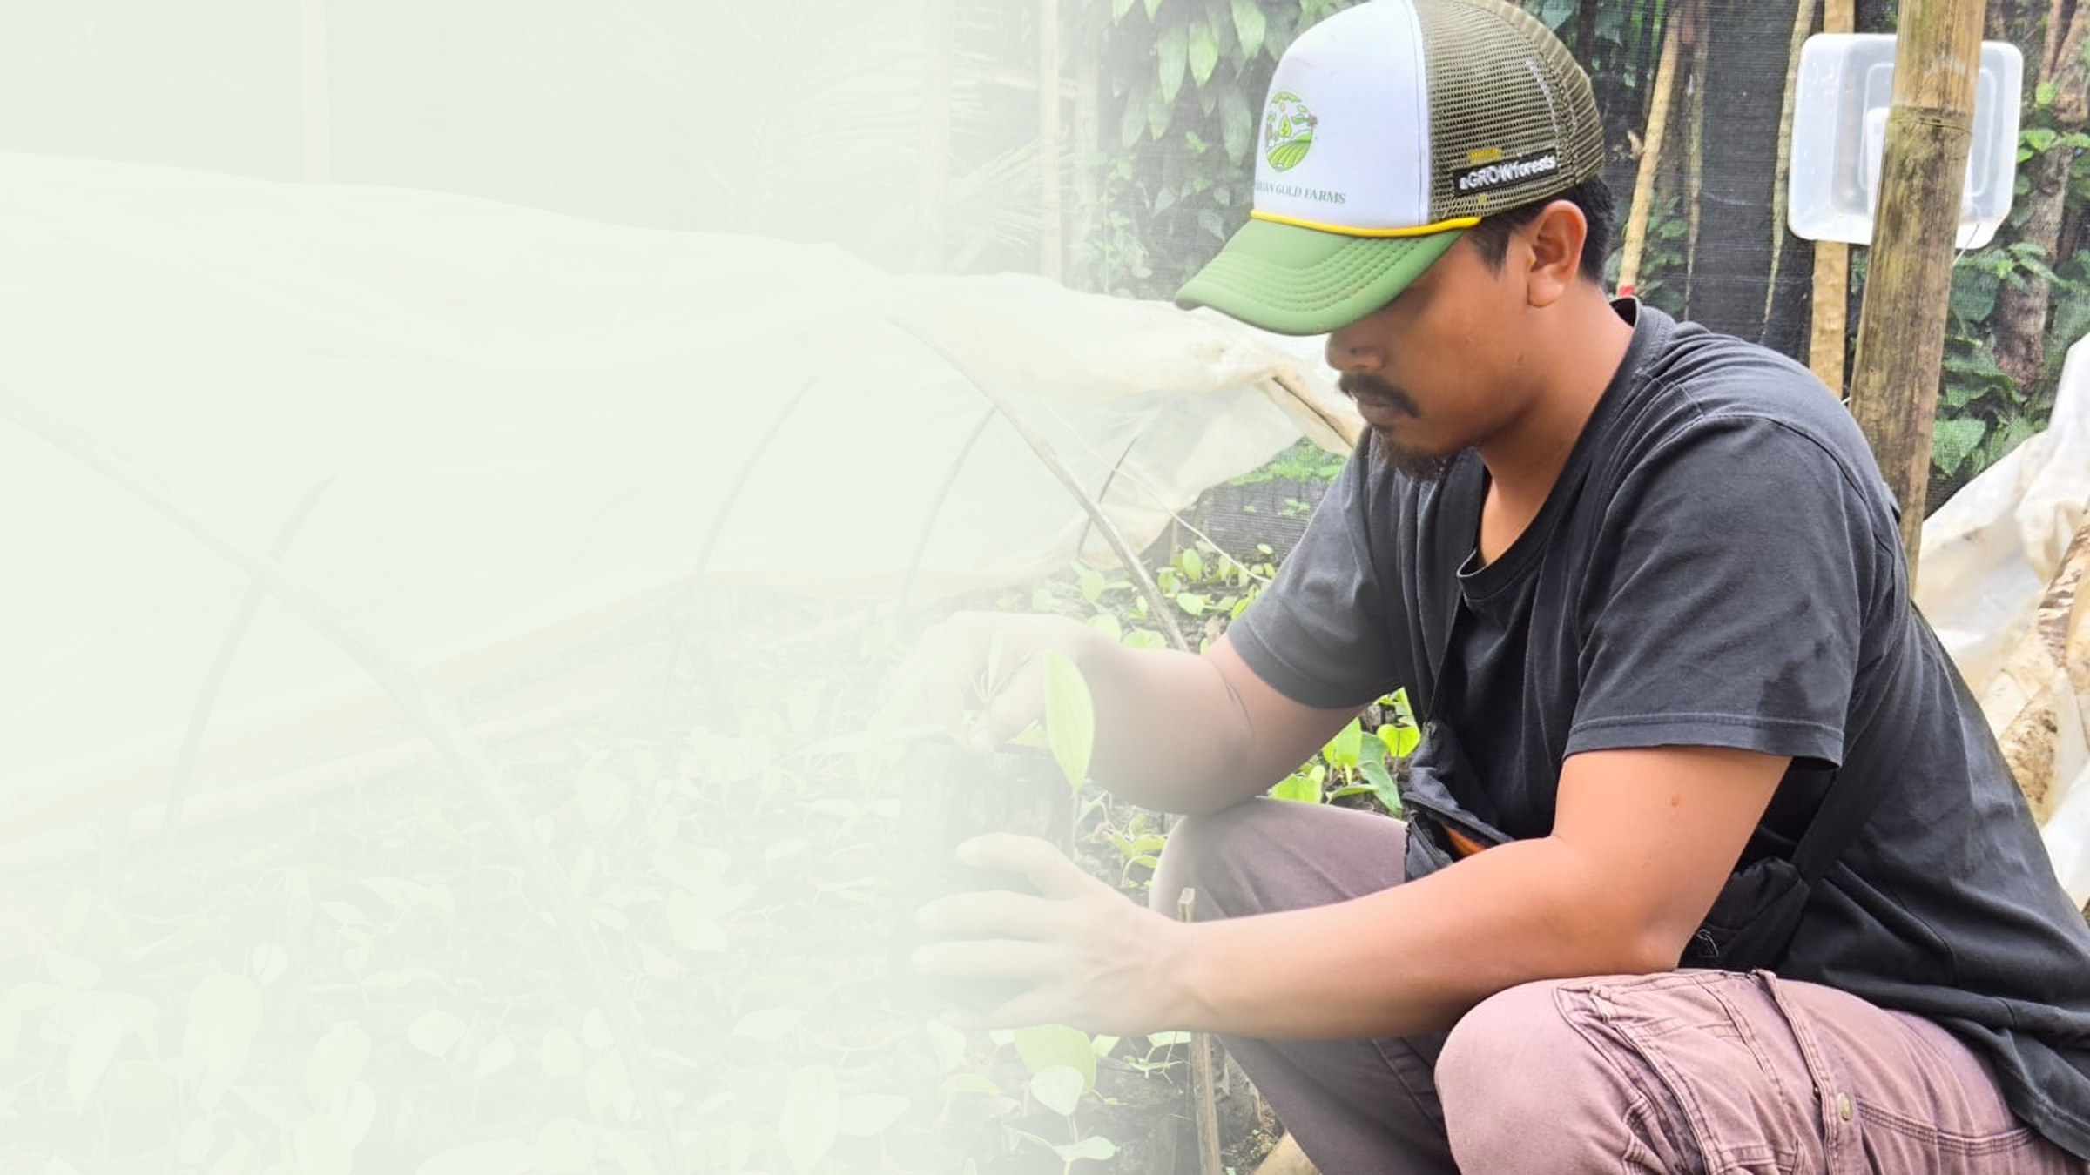

PT Klumbayan Gold Farm
LAMPUNG · INDONESIA · EST. 2022
Graded for Europe.
Available to Bangladesh.
A tech-enabled agroforestry off-taker in Lampung supplying black pepper, robusta coffee, cocoa and cloves with plot-level traceability.
PREPARED FOR
H.E. the Ambassador of Bangladesh
to the Republic of Indonesia
COMPANY PROFILE · BANGLADESH EDITION · AUGUST 2026
klumbayanfarm.com arif@klumbayanfarm.com +62 853 7887 0007

Slide 2
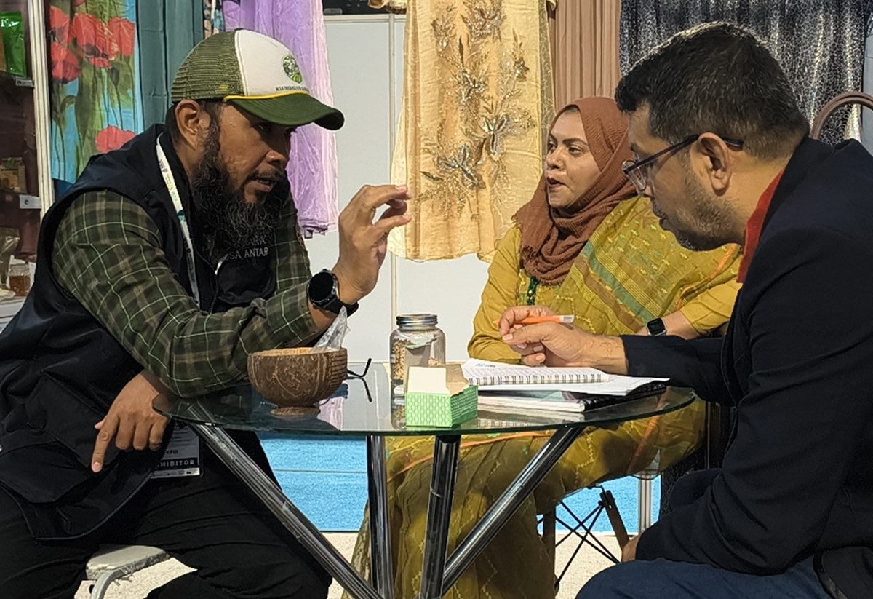
01 WHY WE ARE WRITING
We did not arrive at Bangladesh cold.
D-8 HALAL EXPO
SITE VISIT TO LAMPUNG
STANDING SUPPLY
Business matching, July 2026
11 July 2026
What we are asking for now
We met Bangladeshi buyers during business matching at the D-8 Halal Expo Indonesia. One of them then travelled to Lampung and inspected our gardens, our processing line and our warehouse in person. Our interest in this market is therefore not speculative.
What we now seek is a durable supply relationship with the Bangladesh market, and the Embassy's help in reaching the importers who fit our portfolio.
BUSINESS MATCHING, D-8 HALAL EXPO
PT KLUMBAYAN GOLD FARM · COMPANY PROFILE · BANGLADESH EDITION
01

Slide 3
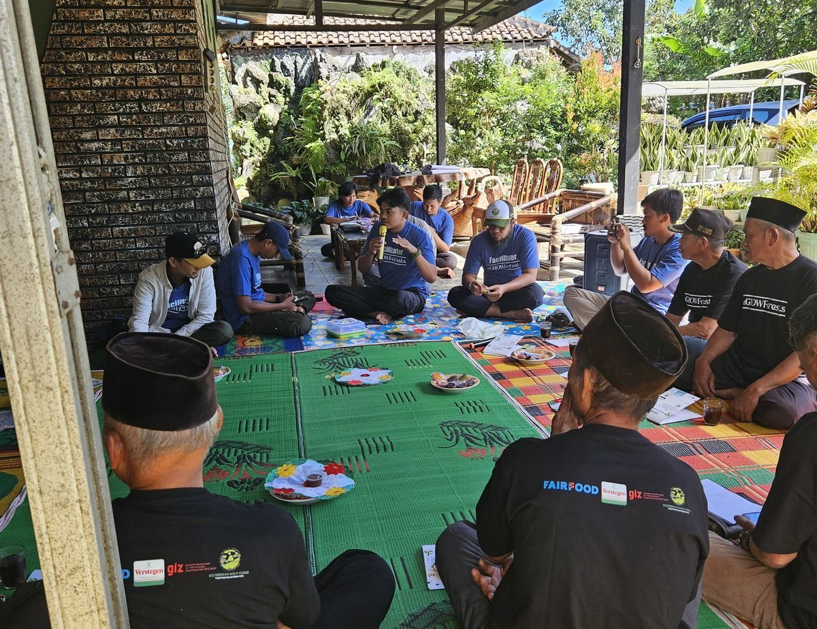
02 WHO WE ARE
We are the farm side of the chain, not a broker.
PT Klumbayan Gold Farm sources directly from smallholder farmers we organised and trained ourselves, and consolidates and quality-controls at our own 2,000-tonne warehouse in Natar. There is no chain of collectors between the farm and the container.
Our anchor buyer is Verstegen Spices and Sauces of the Netherlands, which contracts our black pepper against European quality standards and audits our facility.
2022
1,250
17
FOUNDED
FARMERS
BUYING STATIONS
FARMER TRAINING, LAMPUNG
PT KLUMBAYAN GOLD FARM · COMPANY PROFILE · BANGLADESH EDITION
02

Slide 4
03 THE CASE FOR INDONESIAN ORIGIN
A second origin is a commercial safeguard.
Concentration is exposure
Lampung is an established origin
Cloves are not a substitution
Bangladesh imports the greater part of the black pepper it consumes, and that supply sits on a small number of origins, principally Vietnam and India.
Indonesia is a credible second origin rather than an experiment, and Lampung is among its established pepper-producing provinces, with a long export history.
Indonesia is a leading global producer of cloves. For that commodity, Indonesian origin is the natural fit for Bangladeshi demand rather than a replacement for someone else.
Both countries are D-8 members, and halal integrity in the supply chain is a shared requirement rather than an added condition.
Origin shares are stated in general terms from public trade reporting, not from our own data.
PT KLUMBAYAN GOLD FARM · COMPANY PROFILE · BANGLADESH EDITION
03

Slide 5
04 THE MODEL
One company from the plot to the container.
FARMERS
BUYING STATIONS
GUDANG NATAR
EXPORT CONTAINER
1,250 registered
17 verified
2,000 tonnes
Lot-level record
TAPAK records farmer identity, plot coordinates, volume and receipts at every step
We organise the farmers
We own the middle
We record as we go
1,250 registered, trained and bought from directly.
17 verified buying stations and our own 2,000-tonne facility, so consolidation and quality control are not outsourced.
Captured at the moment of purchase, not reconstructed afterwards.
PT KLUMBAYAN GOLD FARM · COMPANY PROFILE · BANGLADESH EDITION
04

Slide 6
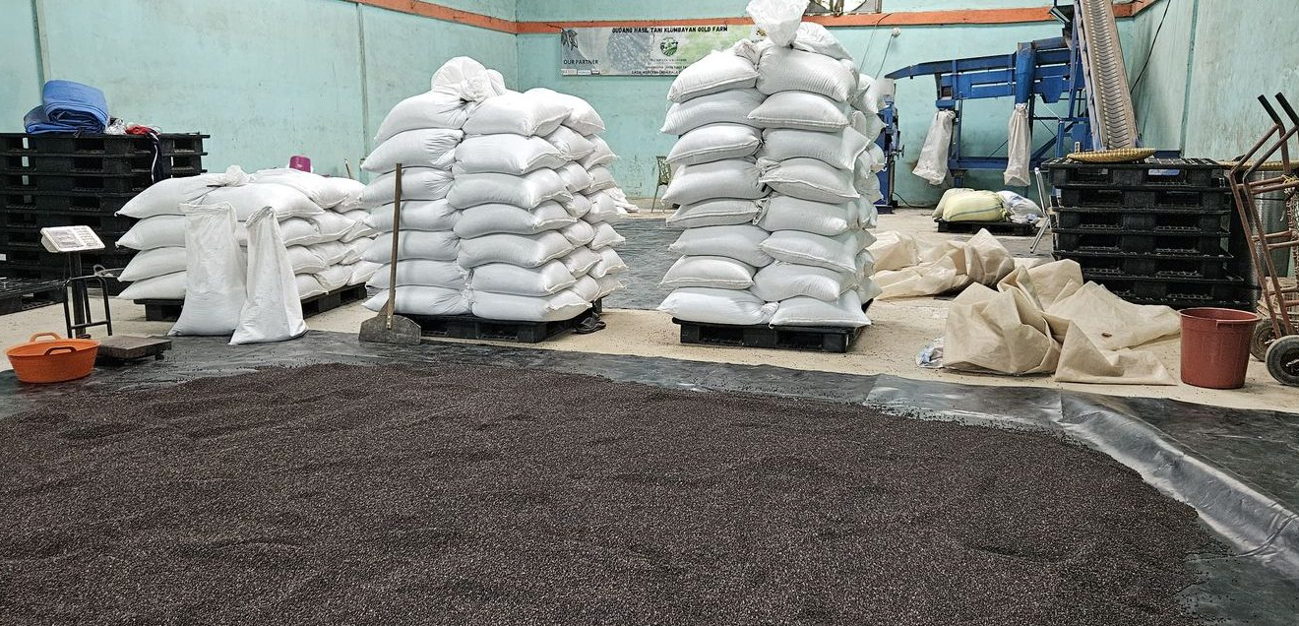
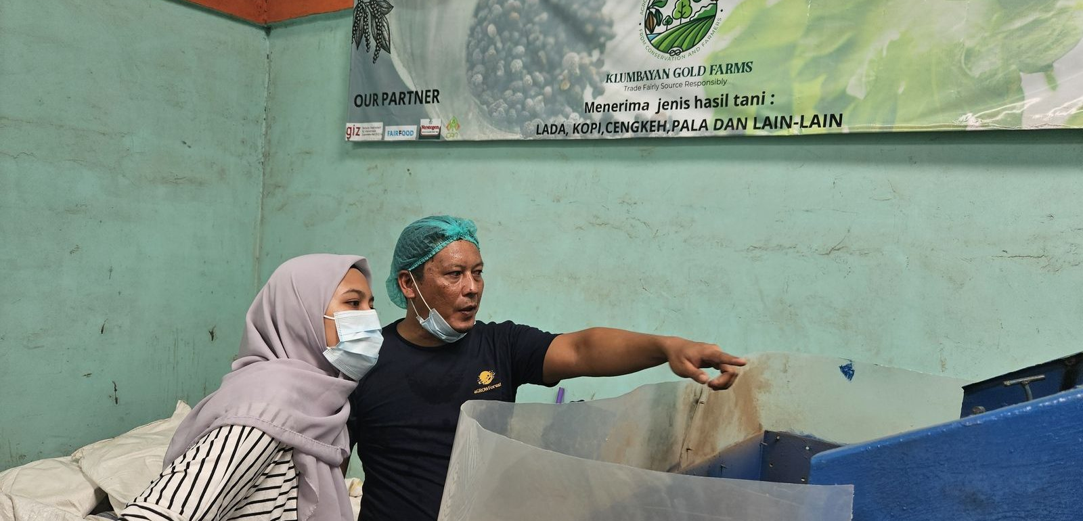
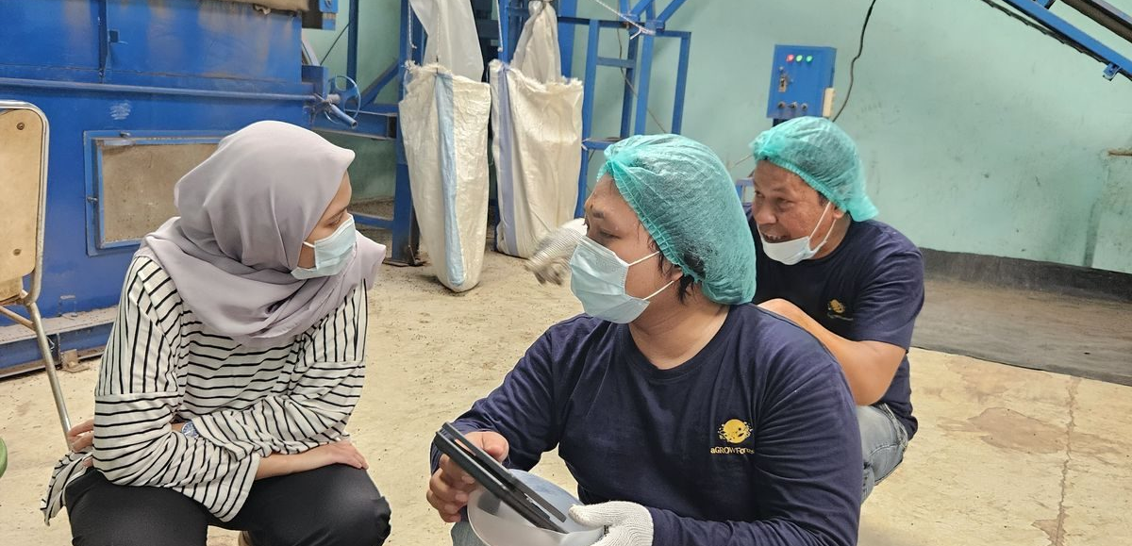
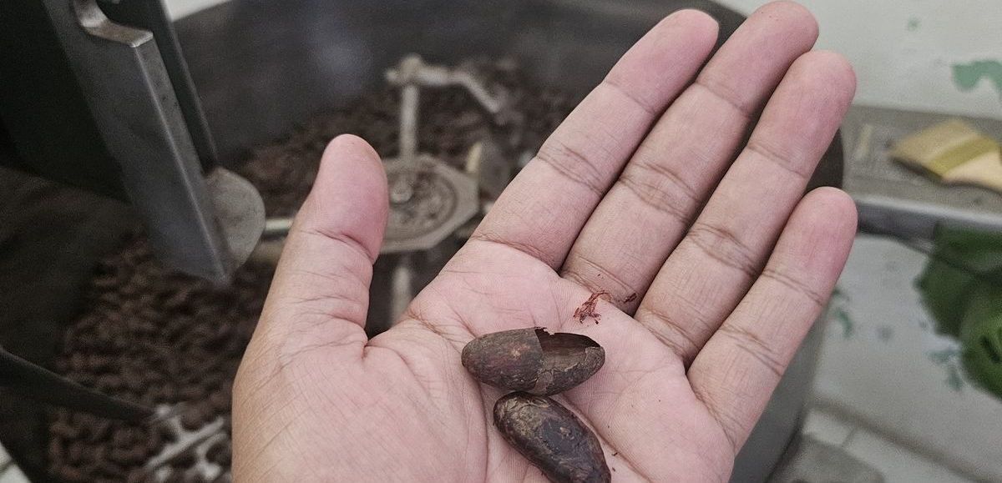
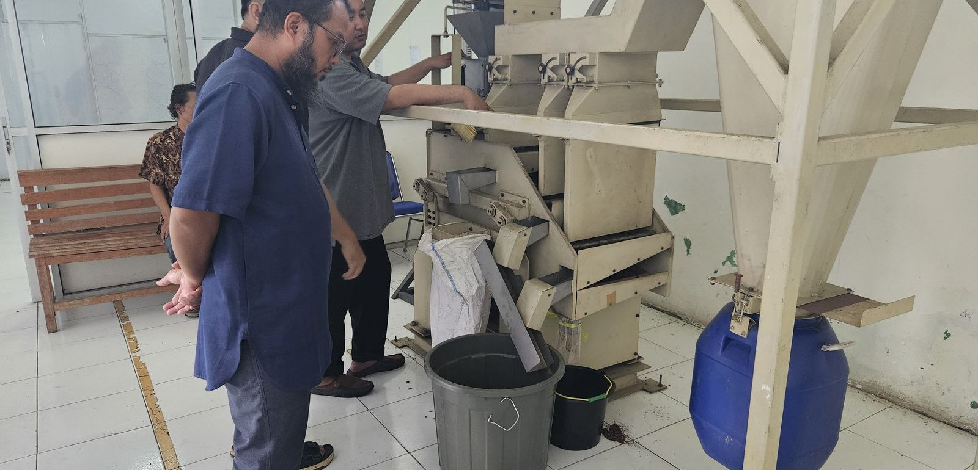
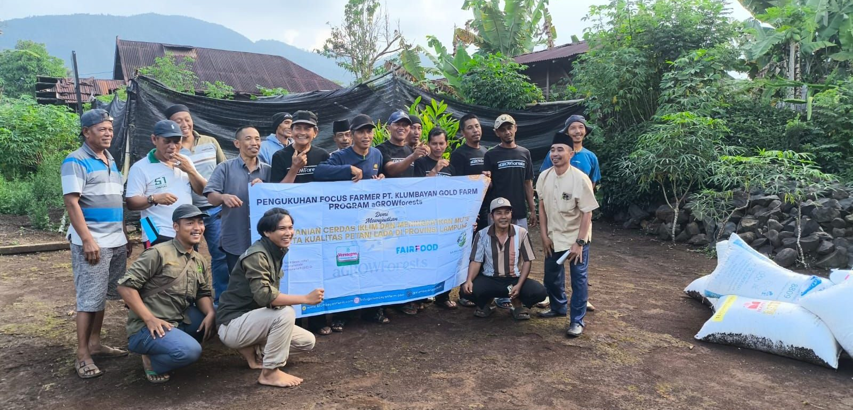
05 OPERATIONS
Built and running, not proposed.
NATAR WAREHOUSE
CLEANING AND GRADING LINE
QUALITY CONTROL
CACAO ROASTING
CACAO WINNOWING
FIELD SCHOOL
Gudang Natar: 2,000 tonnes · green house · sifting machine · Suton machine · oven
PT KLUMBAYAN GOLD FARM · COMPANY PROFILE · BANGLADESH EDITION
05

Slide 7
06 PORTFOLIO
Six commodities from one supply base.
PRODUCT
GRADE AND SPECIFICATION
AVAILABILITY
Black pepper, standard
Bulk density 500 g/l
AVAILABLE NOW
200 MT / year
Cloves
Whole dried
TO ORDER
Volume on enquiry
Robusta coffee, green
Dry natural, defect 80 / 120
AVAILABLE NOW
300 MT / month
Cocoa
Beans, powder and nibs
AVAILABLE
Processed in-house
Black pepper, premium
Premium FAQ, min. 580 g/l
CONTRACTED 2026
80 to 100 MT, Europe
Java long pepper, cubeb
Whole dried, specialty
TO ORDER
Volume on enquiry
[ TO COMPLETE: moisture, foreign matter, packaging, MOQ, incoterms ]
Full parameters are in our Product Specification Sheet.
PT KLUMBAYAN GOLD FARM · COMPANY PROFILE · BANGLADESH EDITION
06

Slide 8
07 THE GRADE SPLIT
One harvest, two grades. One is available.
PREMIUM · 580 g/l · CONTRACTED TO EUROPE
80 to 100 tonnes for 2026
ONE HARVEST
GRADE TO 580 G/L
Lampung black pepper
European spec
STANDARD · 500 g/l · AVAILABLE NOW
200 tonnes per year
Lower-grade raw material bought in directly
Grading to the European threshold separates out a lower-density fraction of the same harvest: sound, clean pepper that simply sits below the premium density line. Standard grade is precisely what the Bangladesh market buys for grinding and blending, so the two grades do not compete for the same buyer.
PT KLUMBAYAN GOLD FARM · COMPANY PROFILE · BANGLADESH EDITION
07

Slide 9
08 CAPACITY
The plant is running below its limit, on purpose.
We concentrated on a single European contract, so machine hours and farmer supply both have headroom. New buyer volume does not displace anything. It fills capacity that already exists.
200 MT/yr
300 MT/mo
2,000 MT
STANDARD PEPPER, AVAILABLE
ROBUSTA, CEILING 720
WAREHOUSE AT NATAR
The limit is how far ahead an order is placed, not whether we have the plant or the farmers to fulfil it.
We would still prefer to open a relationship with a trial container, so quality is judged on the product and the volume grows from a shipment that has actually landed.
PT KLUMBAYAN GOLD FARM · COMPANY PROFILE · BANGLADESH EDITION
08

Slide 10
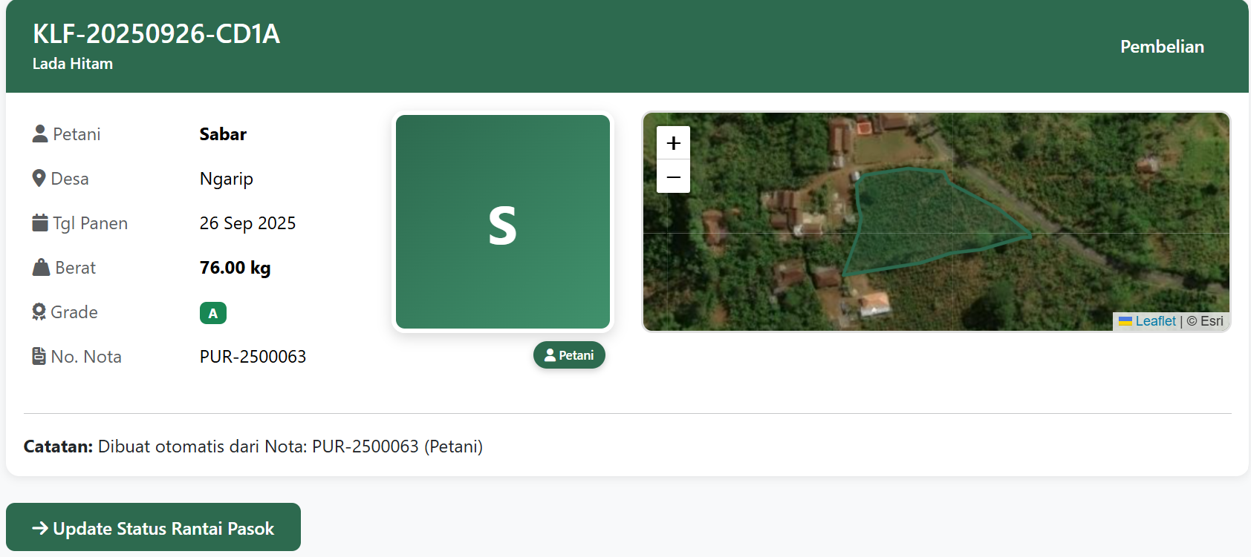
09 TRACEABILITY
TAPAK: every lot traced to a mapped plot.
TRACEABILITY AND ACCOUNTABILITY OF PROFESSIONAL AGRI-KGF
Live and in production use. Every purchase records farmer identity, plot polygon coordinates, volume, digital receipts and warehouse lot movement.
An importer asking which farms a container came from receives a plot-level answer, and can be granted dashboard access to verify it independently rather than taking our word for it.
The same record is what makes our deforestation-free claim survive an audit.
PT KLUMBAYAN GOLD FARM · COMPANY PROFILE · BANGLADESH EDITION
09

Slide 11
10 HALAL AND DOCUMENTATION
What we hold, and what we do not.
Halal certification
IN PROGRESS
Phytosanitary certificate
TO CONFIRM
Business licence and KBLI
UPDATE IN PROGRESS
Plot-level traceability
LIVE
Health, safety and waste SOP, Natar
IN PLACE
Social security and payroll
PAID AND ACTIVE
EU deforestation due diligence
IN PREPARATION
Organic certification
NOT HELD, LAND IN TRANSITION
We state each item at the stage it has actually reached, rather than claim what is not yet issued.
[ TO COMPLETE: halal certifying body and target issue date, phytosanitary channel ]
PT KLUMBAYAN GOLD FARM · COMPANY PROFILE · BANGLADESH EDITION
10

Slide 12
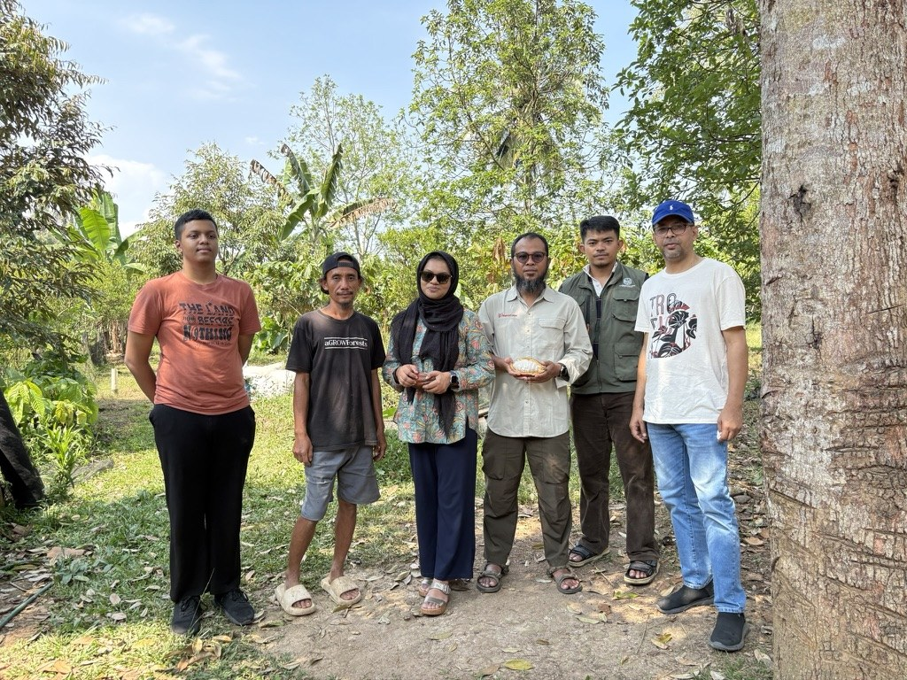
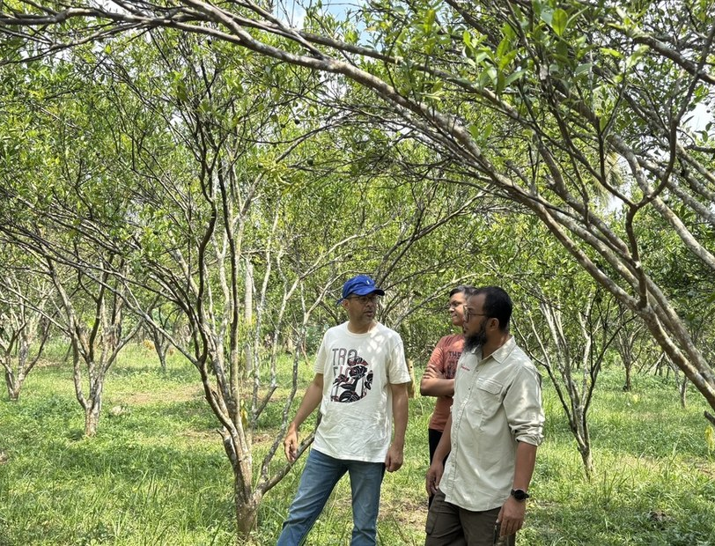
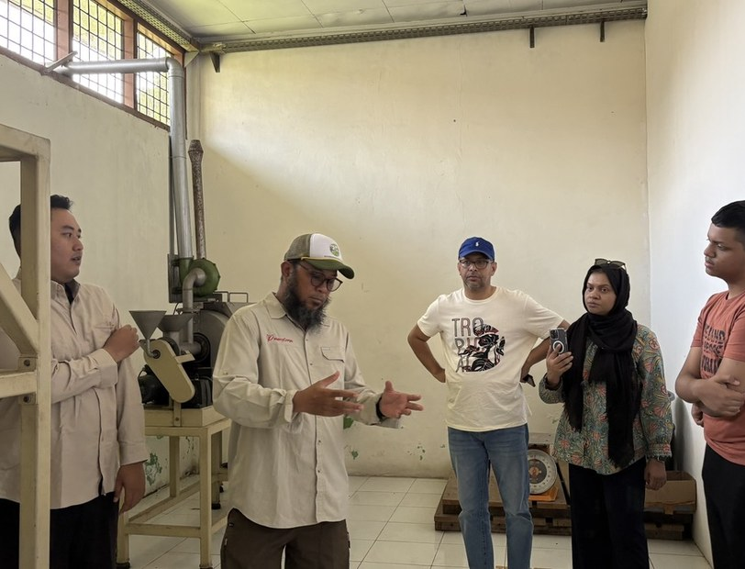
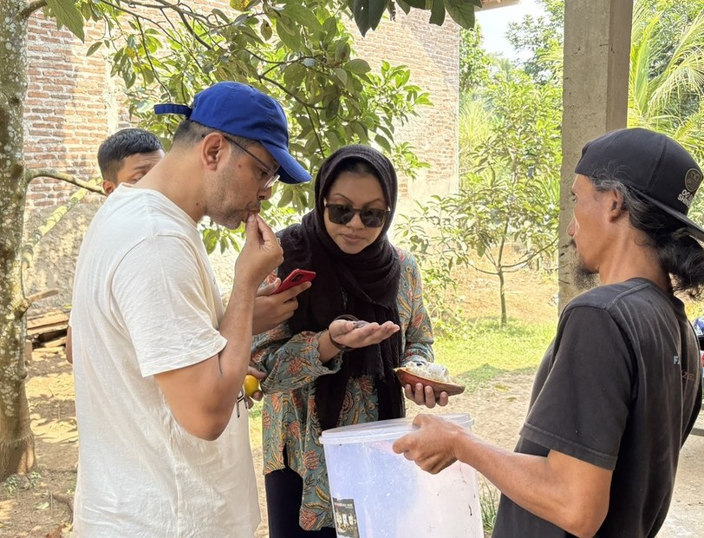
11 ENGAGEMENT ALREADY UNDER WAY
A Bangladeshi buyer has already walked our gardens.
Following business matching at the D-8 Halal Expo Indonesia, Shondhibazar of Dhaka travelled to Lampung on 11 July 2026 and inspected the gardens, the processing line and the warehouse in person.
THEIR INTEREST COVERED
IN THE GARDENS
AGROFORESTRY PLOT
Black pepper
Robusta green beans
Cocoa beans and processed cocoa
Cocoa pods
That range tells us Bangladeshi demand for Indonesian origin is not confined to one commodity, and reaches parts of the crop conventional exporters treat as residue.
PROCESSING LINE
PRODUCT INSPECTION
SHONDHIBAZAR DELEGATION · LAMPUNG, 11 JULY 2026
PT KLUMBAYAN GOLD FARM · COMPANY PROFILE · BANGLADESH EDITION
11

Slide 13

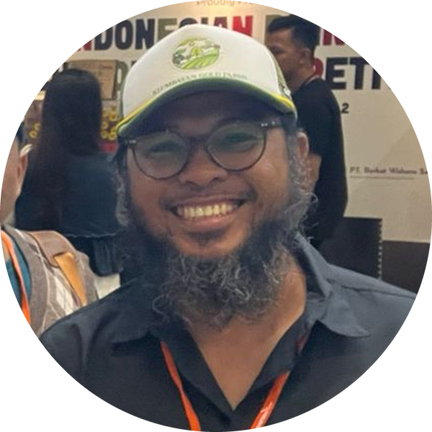
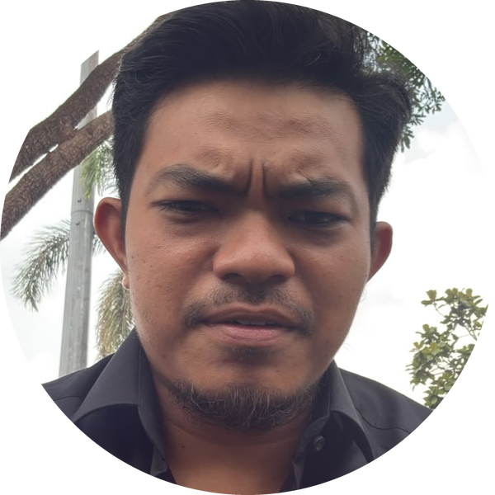
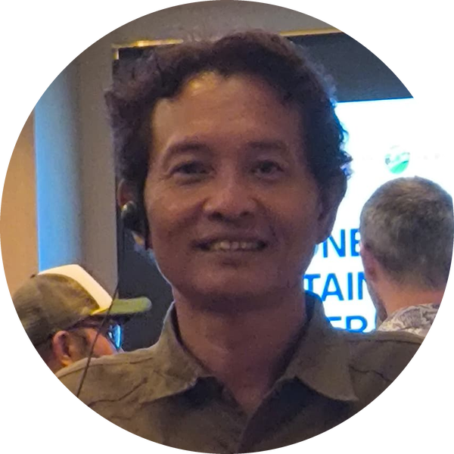
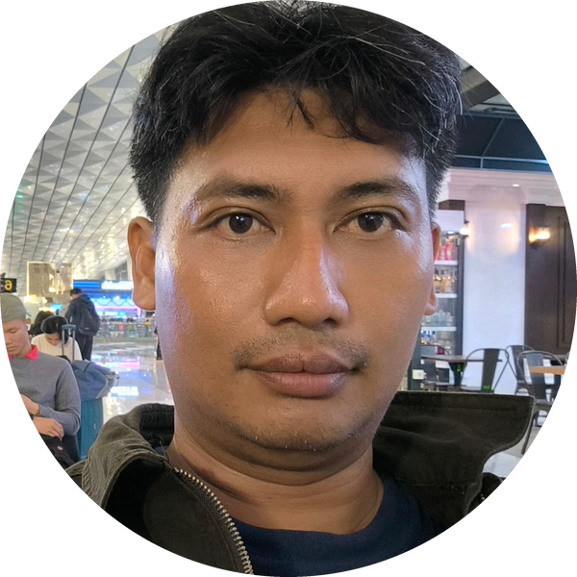
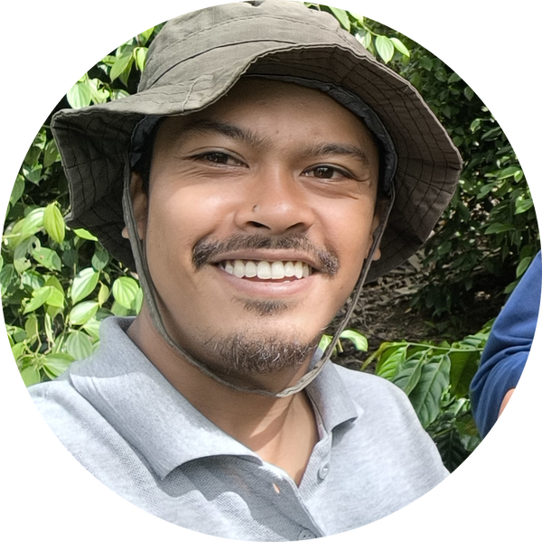
12 TEAM
The people who run it.
Faizal Riza
Arif Rachman
Muhammad Rafiq
CHIEF EXECUTIVE OFFICER
OPERATIONAL DIRECTOR
TECHNICAL MANAGER
Heri Adi Prasetya
Nico Setyo Utomo
Yanfa Ghiyats Ghifari
OPERATIONS MANAGER - IT DEV
DATA AND MANAGEMENT
SENIOR FACILITATOR
15 internal staff, including five field facilitators working directly with farmer groups across Lampung.
PT KLUMBAYAN GOLD FARM · COMPANY PROFILE · BANGLADESH EDITION
12

Slide 14






13 PARTNERS
We do not do this alone.
MARKET
PROGRAMME
RESEARCH
INSTITUTIONAL
Buyer and national supply
Funders and platforms
Applied science partners
Government and national
PT CAN
Bank Indonesia
Solidaridad
ASTRA
Verstegen
PT CAN
GIZ
SSI-I
Solidaridad
BRIN
SITH ITB
Kemenperin
Bank Indonesia
ASTRA
KGF is the field implementer and off-taker inside the aGROWforests consortium, funded by GIZ.
PT KLUMBAYAN GOLD FARM · COMPANY PROFILE · BANGLADESH EDITION
13

Slide 15
14 WHAT WE ASK
What we ask of the Embassy.
1
Introductions to importers
Importers in Dhaka and Chattogram whose requirements match our portfolio.
2
Guidance on documentation
Bangladeshi import requirements, halal recognition and phytosanitary channels.
3
A trial shipment
One container of standard-grade black pepper, so quality is assessed on the product rather than on paper. Robusta can follow the same route.
4
A standing seasonal relationship
Standard grade is produced every harvest, so supply is annual rather than one-off. A forward commitment lets us register farmers for the 2027 crop.
We host buyer inspections of our farms and facility at any time.
PT KLUMBAYAN GOLD FARM · COMPANY PROFILE · BANGLADESH EDITION
14

Slide 16
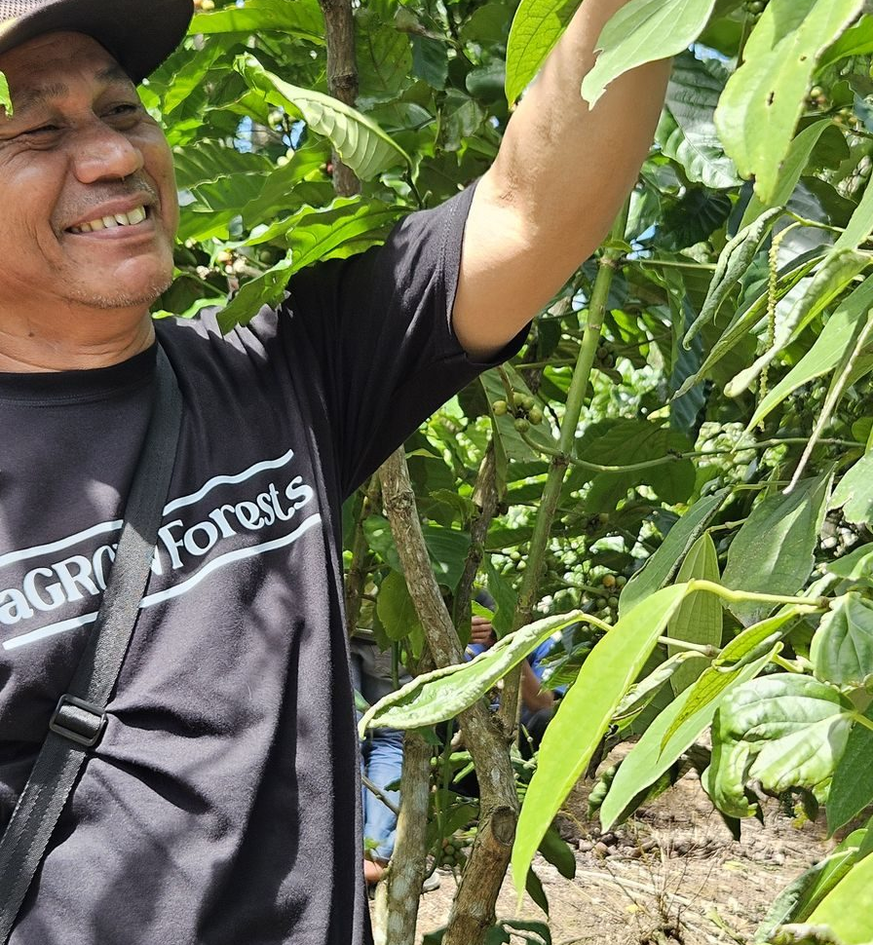
Come and see the plots.
PT Klumbayan Gold Farm
Jln. Wolter Monginsidi No. 159
Bandar Lampung, Lampung, Indonesia
Warehouse: Gudang Natar, Lampung Selatan
Arif Rachman, Operational Director
arif@klumbayanfarm.com
+62 853 7887 0007
KLUMBAYANFARM.COM

