Slide 1
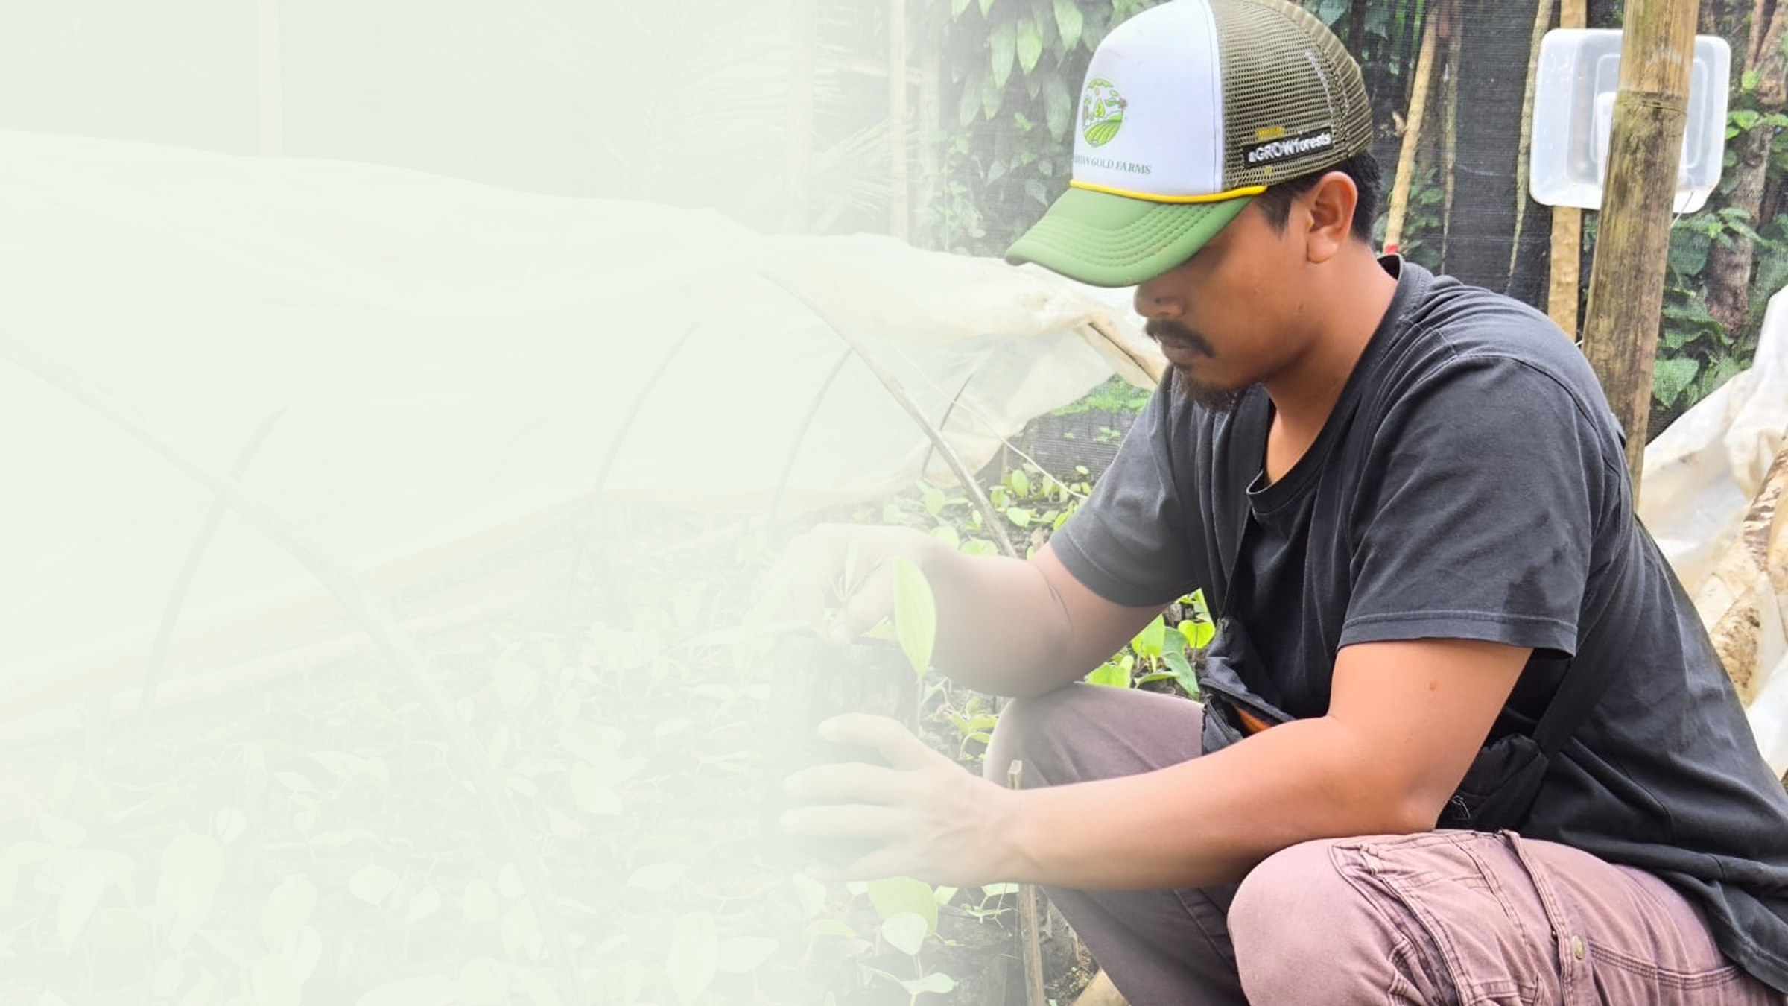





PT Klumbayan Gold Farm
LAMPUNG · INDONESIA · EST. 2022
Graded for Europe.
Available to you.
A tech-enabled agroforestry off-taker in Lampung supplying black pepper, robusta coffee and cocoa with plot-level traceability.
MEMBER OF
COMPANY PROFILE · BUYER EDITION · AUGUST 2026
klumbayanfarm.com arif@klumbayanfarm.com +62 853 7887 0007

Slide 2
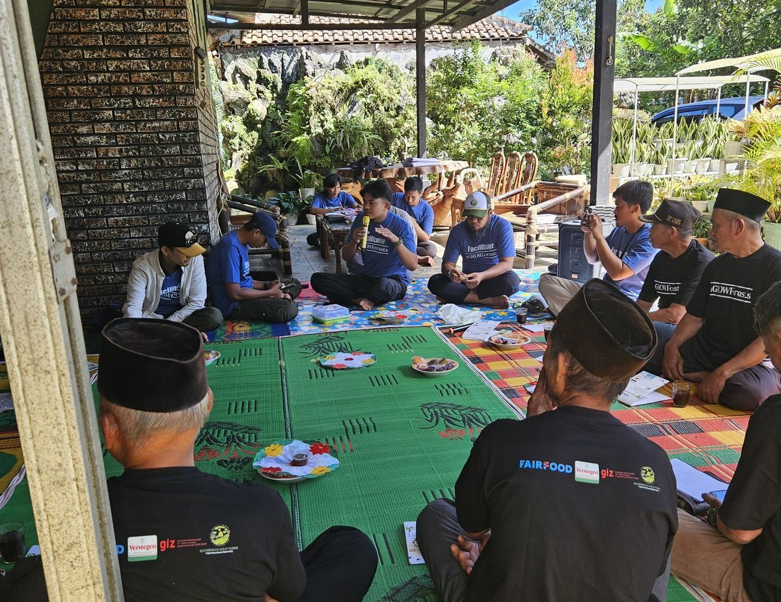
01 ORIGIN
We started by repairing land, not by trading it.
PT Klumbayan Gold Farm was founded in 2022 in Pesawaran to restore land degraded by former gold mining, and to bring villagers back into professional farming through regenerative agribusiness. The company name records where the work began.
We did not add sustainability to a trading business. We added a trading business to a restoration project.
2022
1,250
17
FOUNDED
FARMERS
BUYING STATIONS
FARMER TRAINING, LAMPUNG
PT KLUMBAYAN GOLD FARM · COMPANY PROFILE
01

Slide 3
02 THE PROBLEM
A buyer cannot see past the collector.
Origin becomes an estimate
Quality becomes an average
Compliance becomes a risk
Indonesian spice normally passes through several layers of collectors. By the time it reaches an exporter, the farm it came from is no longer knowable, only assertable.
Mixed lots from unknown plots mean specification is managed by blending after the fact, rather than by control at source.
Once EU deforestation rules apply, an unverifiable origin is not a documentation gap. It is a market access failure.
Every one of these is a sourcing problem before it is a paperwork problem.
PT KLUMBAYAN GOLD FARM · COMPANY PROFILE
02

Slide 4
03 THE MODEL
One company from the plot to the container.
FARMERS
BUYING STATIONS
GUDANG NATAR
EXPORT CONTAINER
1,250 registered
17 verified
2,000 tonnes
Lot-level record
TAPAK records farmer identity, plot coordinates, volume and receipts at every step
We organise the farmers
We own the middle
We record as we go
1,250 registered, trained and bought from directly.
17 verified buying stations and our own 2,000-tonne facility, so consolidation and quality control are not outsourced.
Captured at the moment of purchase, not reconstructed afterwards.
PT KLUMBAYAN GOLD FARM · COMPANY PROFILE
03

Slide 5
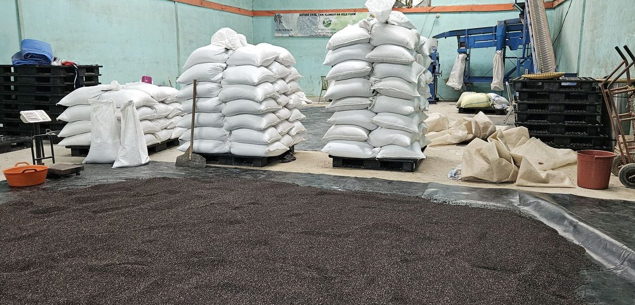
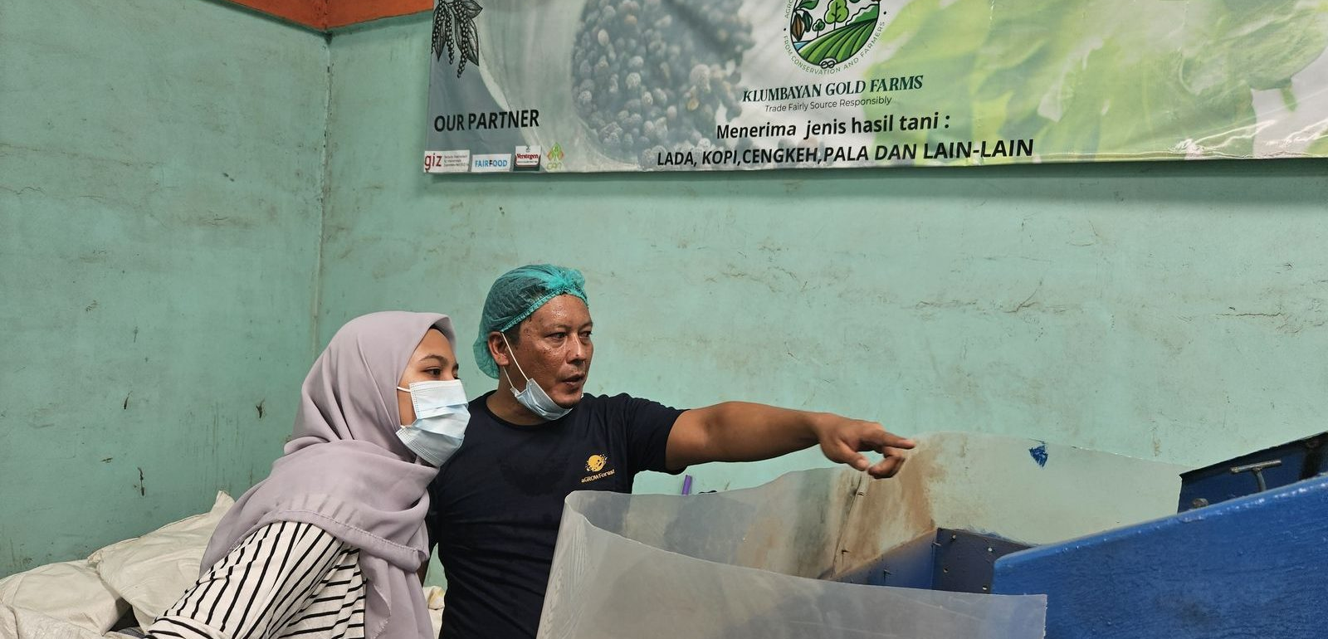
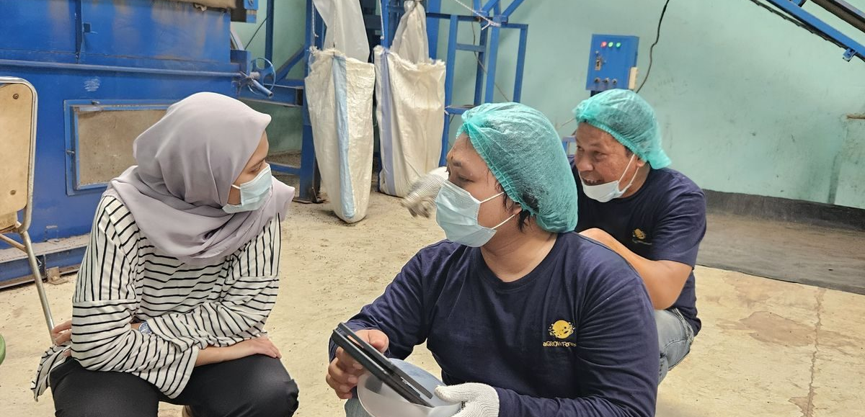
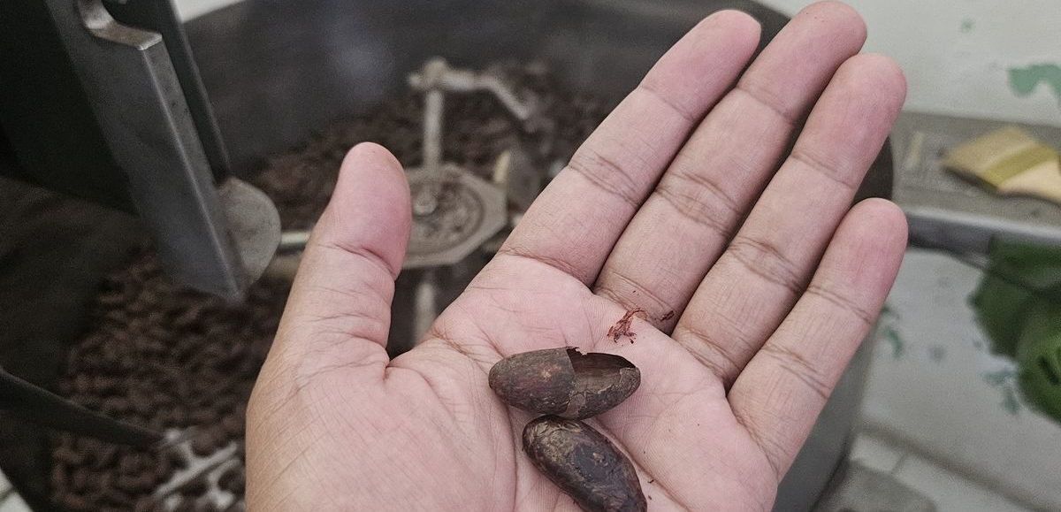
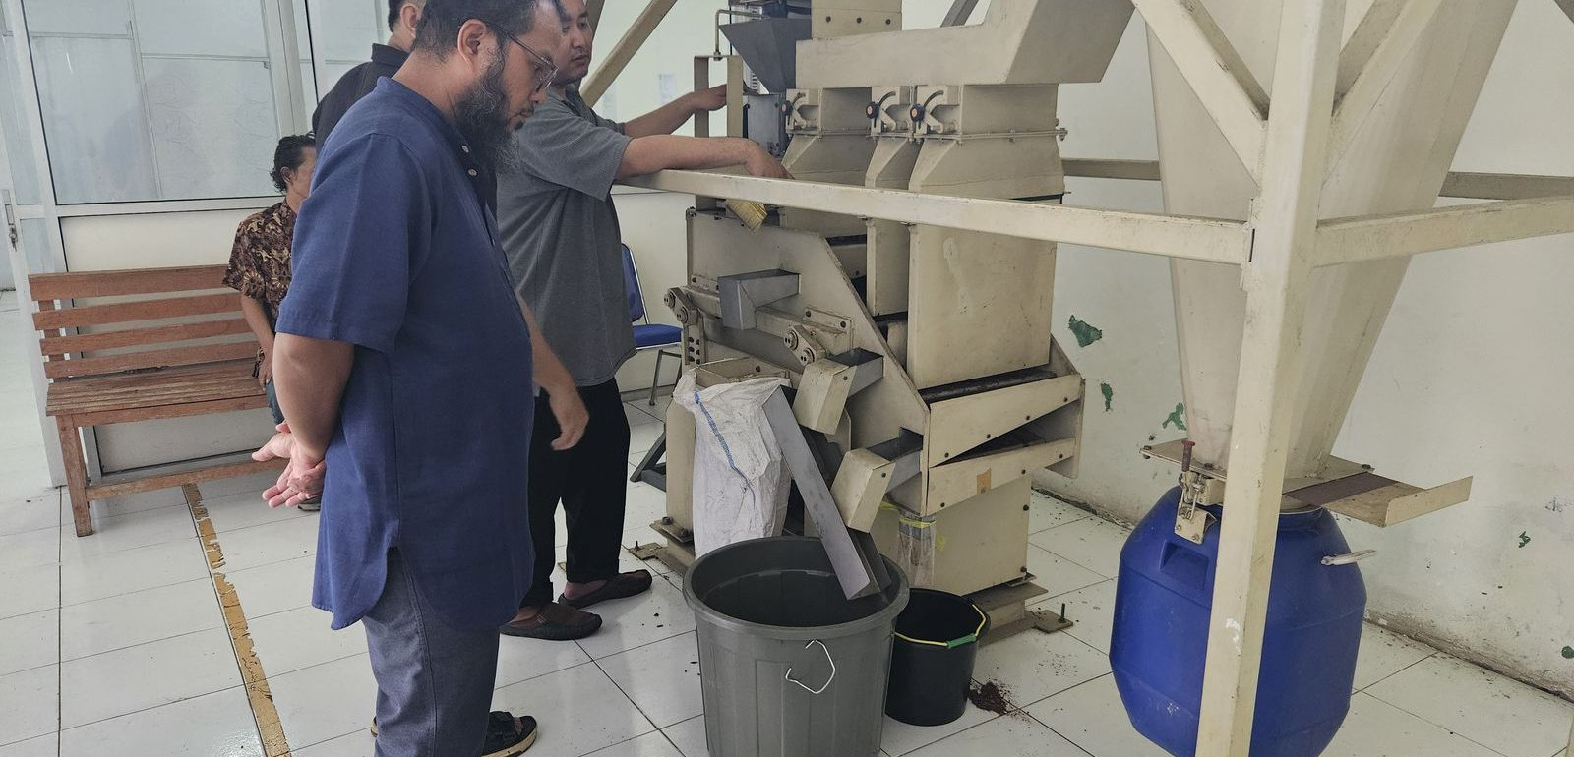
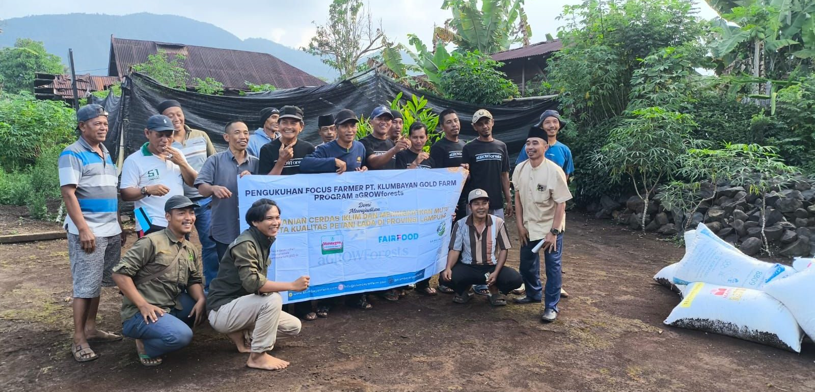
04 OPERATIONS
Built and running, not proposed.
NATAR WAREHOUSE
CLEANING AND GRADING LINE
QUALITY CONTROL
CACAO ROASTING
CACAO WINNOWING
FIELD SCHOOL
Gudang Natar: 2,000 tonnes · green house · sifting machine · Suton machine · oven
PT KLUMBAYAN GOLD FARM · COMPANY PROFILE
04

Slide 6
05 PRODUCT CATALOGUE
Six commodities from one supply base.
PRODUCT
GRADE AND SPECIFICATION
AVAILABILITY
Black pepper, standard
Bulk density 500 g/l
AVAILABLE NOW
200 MT / year
Black pepper, premium
Premium FAQ, min. 580 g/l
CONTRACTED 2026
80 to 100 MT, Europe
Robusta coffee, green
Dry natural, defect 80 / 120
AVAILABLE NOW
300 MT / month
Cocoa
Beans, powder and nibs
AVAILABLE
Processed in-house
Cloves
Whole dried
TO ORDER
Volume on enquiry
Java long pepper, cubeb
Whole dried, specialty
TO ORDER
Volume on enquiry
Full parameters for every product are set out in our Product Specification Sheet.
PT KLUMBAYAN GOLD FARM · COMPANY PROFILE
05

Slide 7
06 THE GRADE SPLIT
One harvest, two grades. One is available.
PREMIUM · 580 g/l · CONTRACTED TO EUROPE
80 to 100 tonnes for 2026
ONE HARVEST
GRADE TO 580 G/L
Lampung black pepper
European spec
STANDARD · 500 g/l · AVAILABLE NOW
200 tonnes per year
Lower-grade raw material bought in directly
The two do not compete. A buyer serving the grinding and blending market gets available volume at a standard price, rather than paying a premium for specification they do not need.
PT KLUMBAYAN GOLD FARM · COMPANY PROFILE
06

Slide 8
07 CAPACITY
The plant is running below its limit, on purpose.
We concentrated on a single European contract, so machine hours and farmer supply both have headroom. New buyer volume does not displace anything. It fills capacity that already exists.
200 MT/yr
300 MT/mo
2,000 MT
STANDARD PEPPER, AVAILABLE
ROBUSTA, CEILING 720
WAREHOUSE AT NATAR
The limit is how far ahead an order is placed, not whether we have the plant or the farmers to fulfil it.
PT KLUMBAYAN GOLD FARM · COMPANY PROFILE
07

Slide 9
08 TECHNOLOGY
TAPAK: every lot traced to a mapped plot.
TRACEABILITY AND ACCOUNTABILITY OF PROFESSIONAL AGRI-KGF
Live and in production use. Every purchase records farmer identity, plot polygon coordinates, volume, digital receipts and warehouse lot movement.
TAPAK PLOT MAP, PERSONAL DATA MASKED
A buyer asking which farms a container came from receives a plot-level answer, and can be granted dashboard access to verify it independently rather than taking our word for it.
PT KLUMBAYAN GOLD FARM · COMPANY PROFILE
08

Slide 10
09 QUALITY AND COMPLIANCE
What we hold, and what we do not.
Plot-level traceability
LIVE
Health, safety and waste SOP, Natar
IN PLACE
Social security and payroll
PAID AND ACTIVE
EU deforestation due diligence
IN PREPARATION
Business licence and KBLI
UPDATE IN PROGRESS
Phytosanitary certificate
TO CONFIRM
Halal certification
IN PROGRESS
Organic certification
IN PROGRESS
We state each item at the stage it has actually reached, rather than claim what is not yet issued.
PT KLUMBAYAN GOLD FARM · COMPANY PROFILE
09

Slide 11
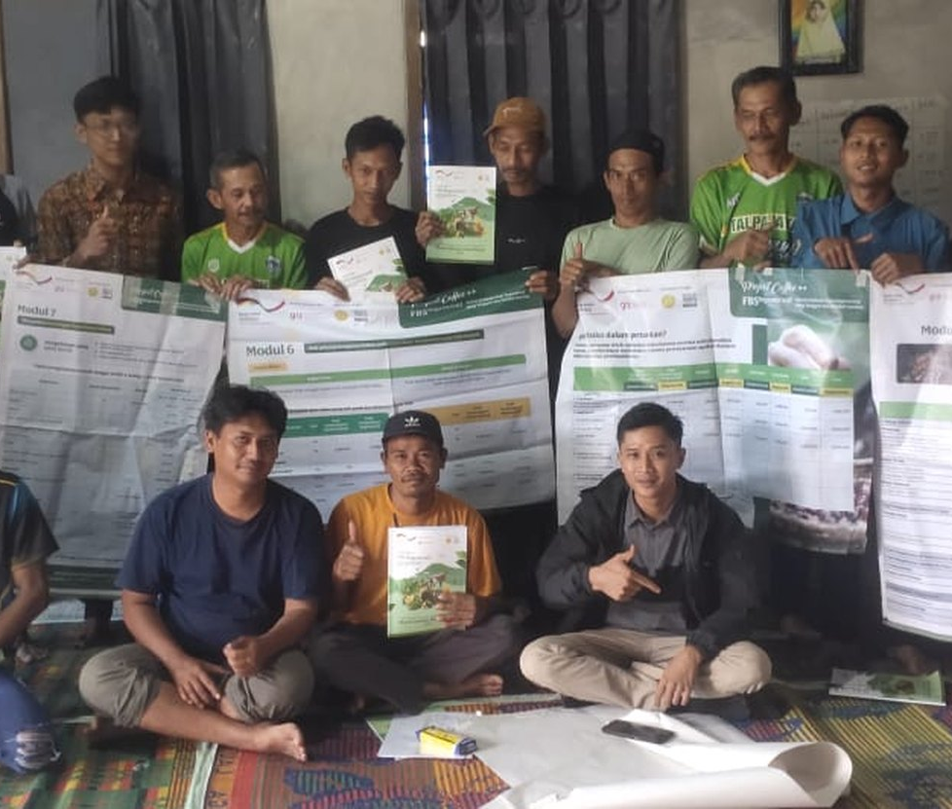
10 PROOF
Buyers have already inspected the operation.
A foreign buyer travelled to Lampung and inspected our gardens, processing line and warehouse in person. Their interest covered black pepper, robusta green beans, cocoa beans and processed cocoa, and cocoa pods.
Verstegen
Contracts against European quality standards and audits our facility.
GIZ
Funds and audits the aGROWforests consortium we lead locally.
Netherlands
Our current export market.
BUYER VISIT TO THE GARDENS
PT KLUMBAYAN GOLD FARM · COMPANY PROFILE
10

Slide 12

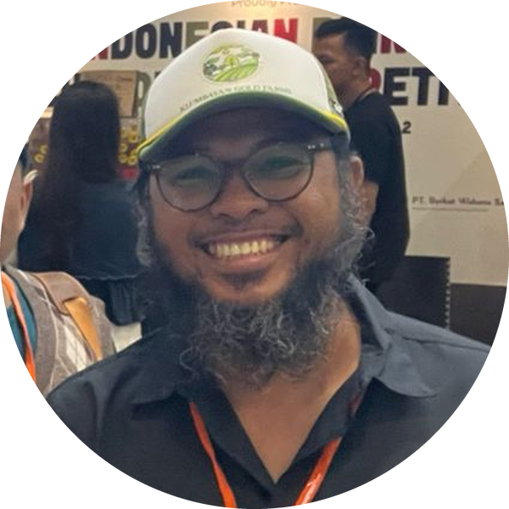
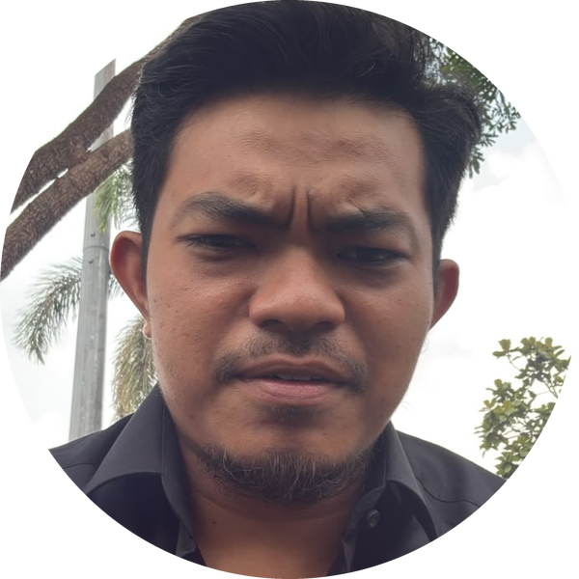
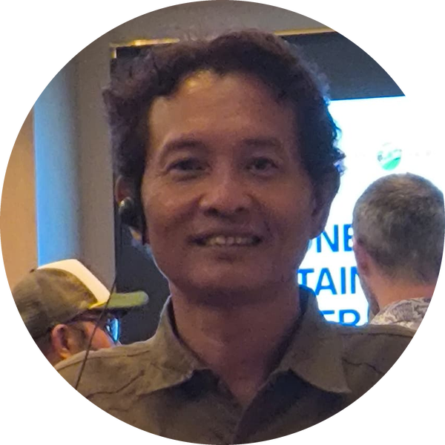
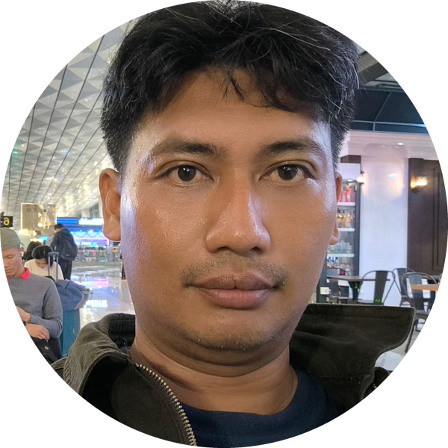
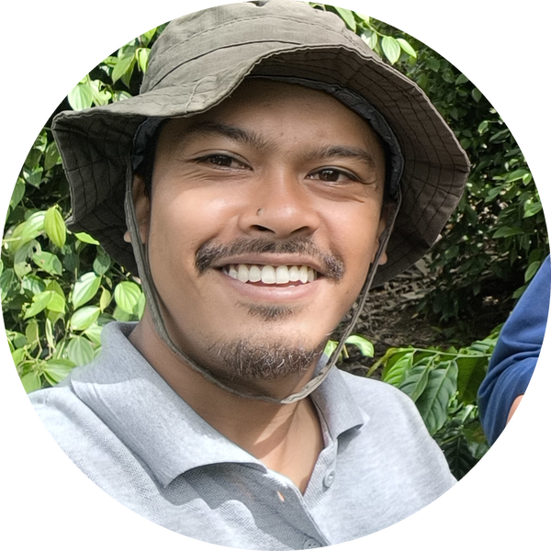
11 TEAM
The people who run it.
Faizal Riza
Arif Rachman
Muhammad Rafiq
CHIEF EXECUTIVE OFFICER
COO / PROJECT DIRECTOR
TECHNICAL MANAGER
Heri Adi Prasetya
Nico Setyo Utomo
Yanfa Ghiyats Ghifari
OPERATIONS MANAGER - IT DEV
DATA AND MANAGEMENT
SENIOR FACILITATOR
15 internal staff, including five field facilitators working directly with farmer groups across Lampung.
PT KLUMBAYAN GOLD FARM · COMPANY PROFILE
11

Slide 13







12 PARTNERS
We do not do this alone.
MARKET
PROGRAMME
RESEARCH
INSTITUTIONAL
Buyer and national supply
Funders and platforms
Applied science partners
Government and national
Bank Indonesia
ASTRA
Verstegen
PT CAN
GIZ
SSI-I
Solidaridad
BRIN
SITH ITB
Kemenperin
Bank Indonesia
ASTRA
KGF is the field implementer and off-taker inside the aGROWforests consortium.
PT KLUMBAYAN GOLD FARM · COMPANY PROFILE
12

Slide 14
13 HOW TO BUY
What we propose, in the order we propose it.
1
Send an enquiry
Product, grade, quantity and delivery period.
2
We quote
Full specification, with availability confirmed.
3
Samples
Despatched for approval before any commitment.
4
A trial container
So quality is judged on the product, not on paper.
5
A standing relationship
Seasonal supply, documentation aligned to your market, halal included.
We host buyer inspections of our farms and facility at any time.
PT KLUMBAYAN GOLD FARM · COMPANY PROFILE
13

Slide 15
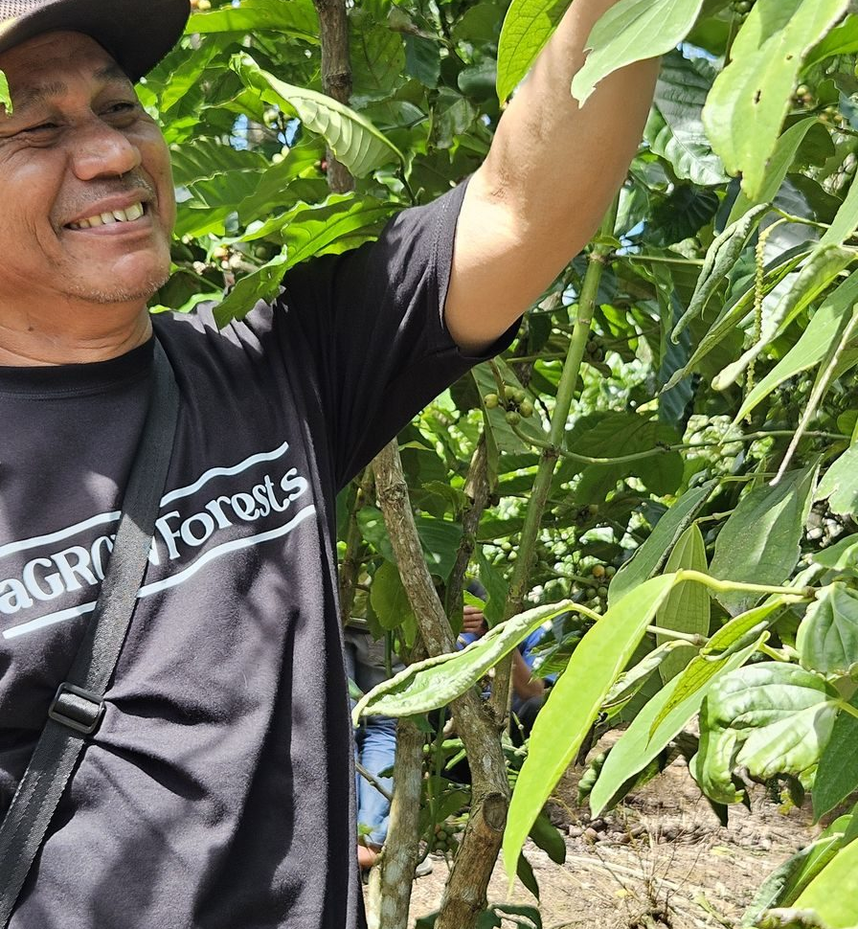
Come and see the plots.
PT Klumbayan Gold Farm
Jln. Wolter Monginsidi No. 159
Bandar Lampung, Lampung, Indonesia
Warehouse: Gudang Natar, Lampung Selatan
Arif Rachman, Operational Director
arif@klumbayanfarm.com
+62 853 7887 0007
KLUMBAYANFARM.COM

