Slide 1
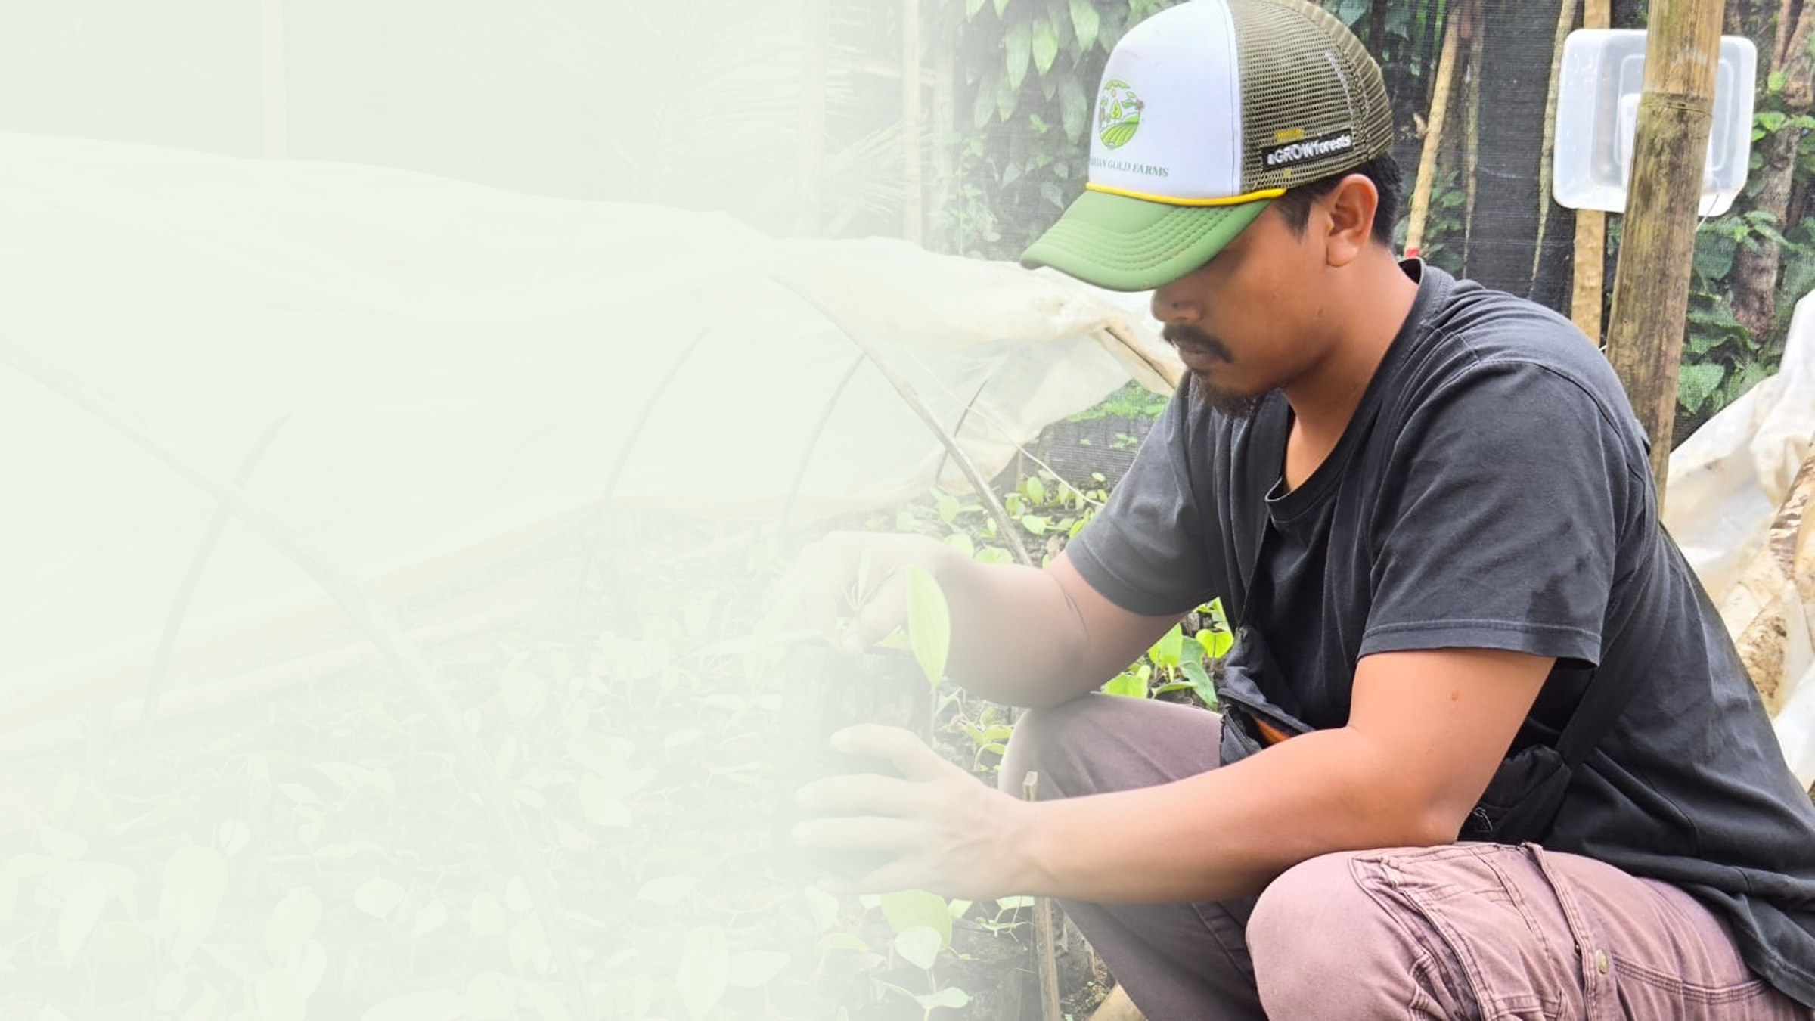



PT Klumbayan Gold Farm
LAMPUNG · INDONESIA · EST. 2022
From mined-out land
to a European supply chain.
Regenerative agroforestry on degraded post-mining land in Lampung, traded into Europe with plot-level traceability.
MEMBER OF
SUSTAINABLE SPICES INITIATIVE INDONESIA
aGROWforests CONSORTIUM · GIZ FUNDED
ICIF NETHERLANDS BUSINESS MISSION 2026 · CATEGORY 03
klumbayanfarm.com arif@klumbayanfarm.com +62 853 7887 0007

Slide 2
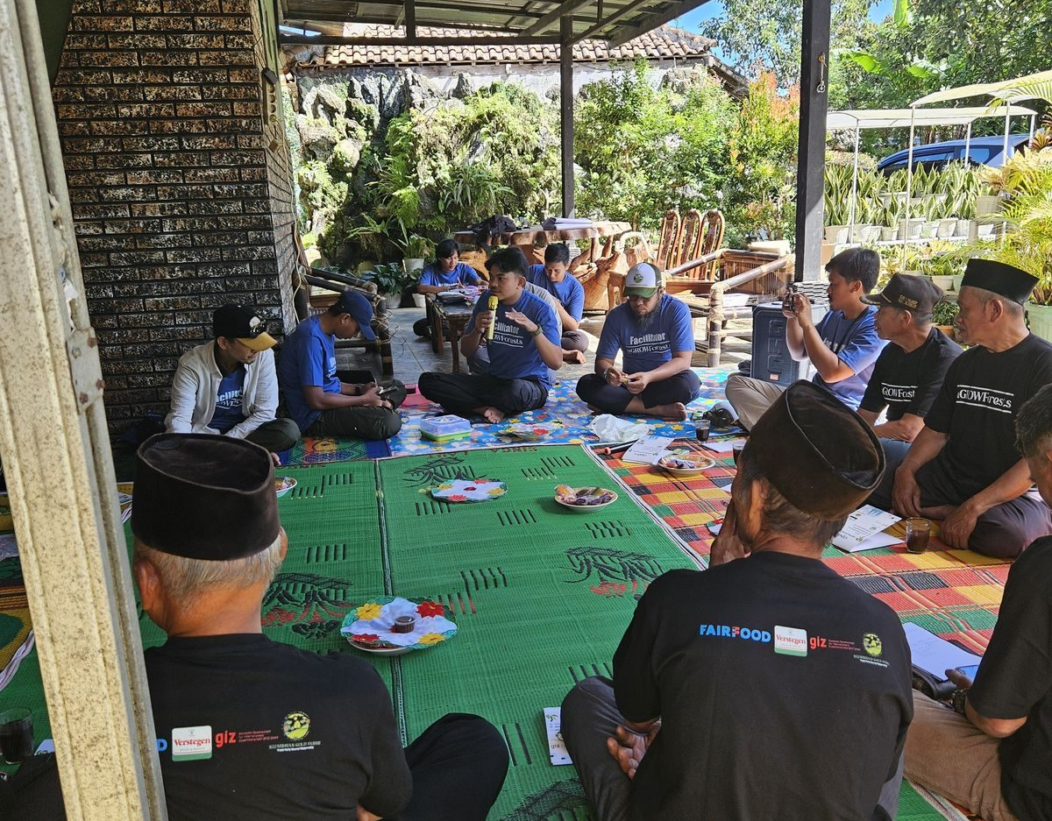
01 THESIS
Circular agriculture starts with the land.
Most circular economy work begins after a product exists: recover it, recycle it, reuse the material. In agriculture the largest circular gain sits earlier. Land already destroyed can be brought back into production, instead of clearing new forest to replace it.
Restoring damaged land, rather than opening new land, is the circular principle applied at landscape scale.
2022
1,250
17
RESTORATION BEGAN
FARMER HOUSEHOLDS
BUYING STATIONS
AGROFORESTRY ON RESTORED LAND
PT KLUMBAYAN GOLD FARM · COMPANY PROFILE
01

Slide 3
02 ORIGIN
We began on land a gold mine left behind.
PT Klumbayan Gold Farm was founded in Pesawaran, Lampung in 2022 with a single purpose: restore land degraded by former gold mining, and bring villagers back into professional farming through regenerative agribusiness. The company name records where that work began.
DEGRADED
REPLANTED
PRODUCTIVE
TRADED
Post-mining land, stripped and unproductive
Multi-strata agroforestry, not monoculture
Pepper, robusta and cocoa grown under shade
Contracted into European supply chains
We did not add sustainability to a trading business. We added a trading business to a restoration project.
PT KLUMBAYAN GOLD FARM · COMPANY PROFILE
02

Slide 4
03 CIRCULARITY
Where the circularity actually is.
A spice company is not an obvious circular business, so we will be precise.
Circular land use
Residue returned to soil
Verification, not assertion
Value kept at origin
Degraded and post-mining land restored into production instead of clearing forest to expand. Audited by GIZ under aGROWforests.
Composting runs at our LKC and Taman Sari motherplants, plus two communal units in Ulu Belu. Over 10 tonnes distributed so far.
Plot polygons and every transaction recorded in TAPAK, so a restoration or deforestation-free claim can be checked by a third party.
Cocoa processed into powder and nibs in Lampung rather than exported as raw beans, so processing value stays in the producing region.
ICIF category 03, Circular Food and Agriculture, with a second fit in category 04, Bio Material and Biomass Innovation.
PT KLUMBAYAN GOLD FARM · COMPANY PROFILE
03

Slide 5
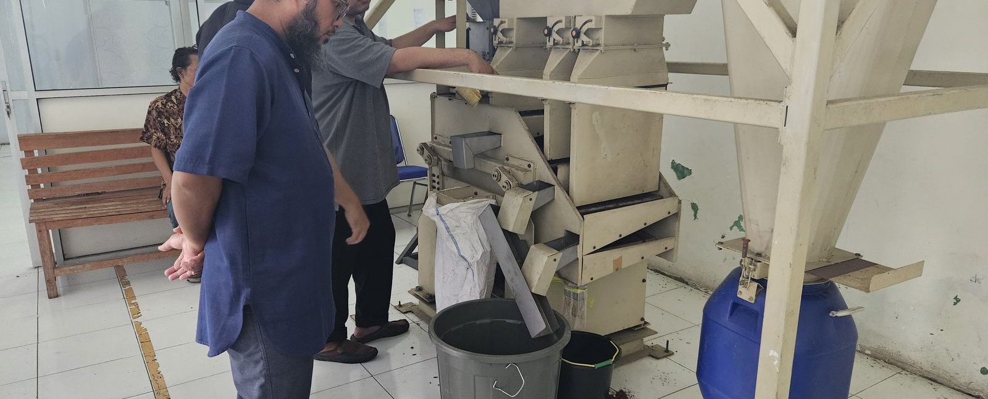
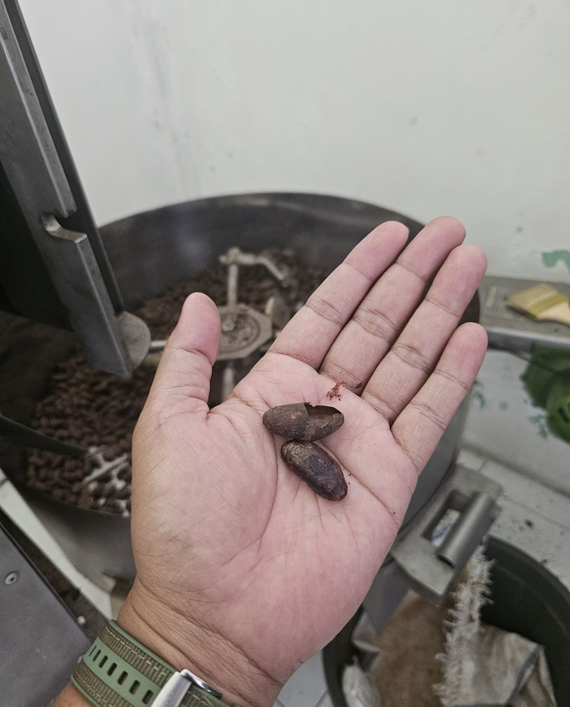
04 FROM WASTE TO WORTH
A buyer asked for the pod, not the bean.
An overseas buyer travelled to Lampung, inspected our gardens and processing line, and enquired about black pepper, robusta green beans, cocoa beans and processed cocoa, and cocoa pods.
A buyer asking for the pod is evidence that what a conventional exporter treats as a disposal cost already has a market.
CACAO WINNOWING
COMPOSTING ALREADY RUNNING
LKC and Taman Sari motherplant, plus two communal units in Ulu Belu. Farmers are trained to make their own.
10+ MT
COMPOST DISTRIBUTED TO FARMERS
DOWNSTREAM PROCESSING IN LAMPUNG
PT KLUMBAYAN GOLD FARM · COMPANY PROFILE
04

Slide 6
05 THE MODEL
One company from the plot to the container.
FARMERS
BUYING STATIONS
GUDANG NATAR
EXPORT CONTAINER
1,250 registered
17 verified
2,000 tonnes
Lot-level record
TAPAK records farmer identity, plot coordinates, volume and receipts at every step
We organise the farmers
We own the middle
We record as we go
1,250 households registered, trained and bought from directly, with no collector layer in between.
17 verified buying stations and our own 2,000-tonne facility, so consolidation and quality control are not outsourced.
Captured at the moment of purchase, not reconstructed afterwards for an audit.
PT KLUMBAYAN GOLD FARM · COMPANY PROFILE
05

Slide 7
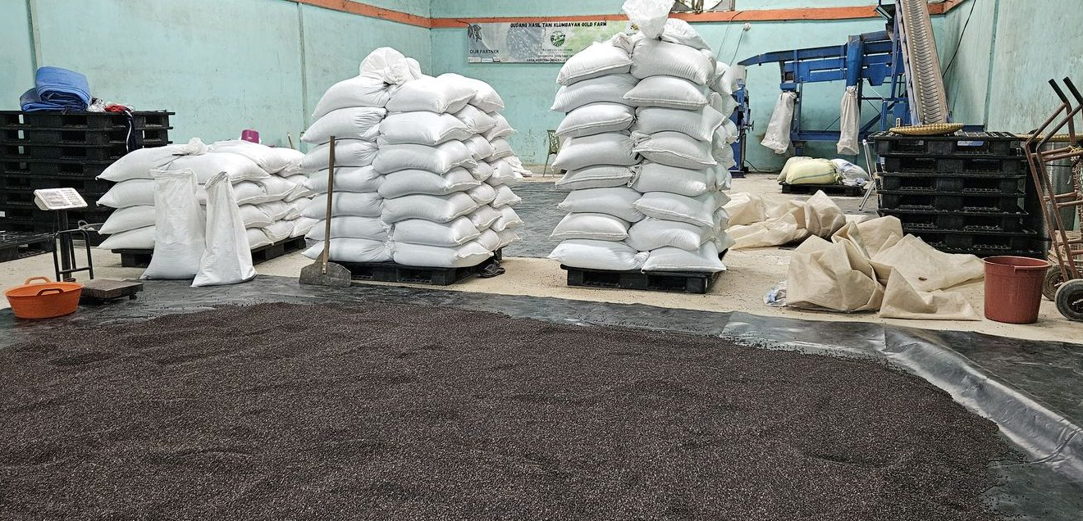
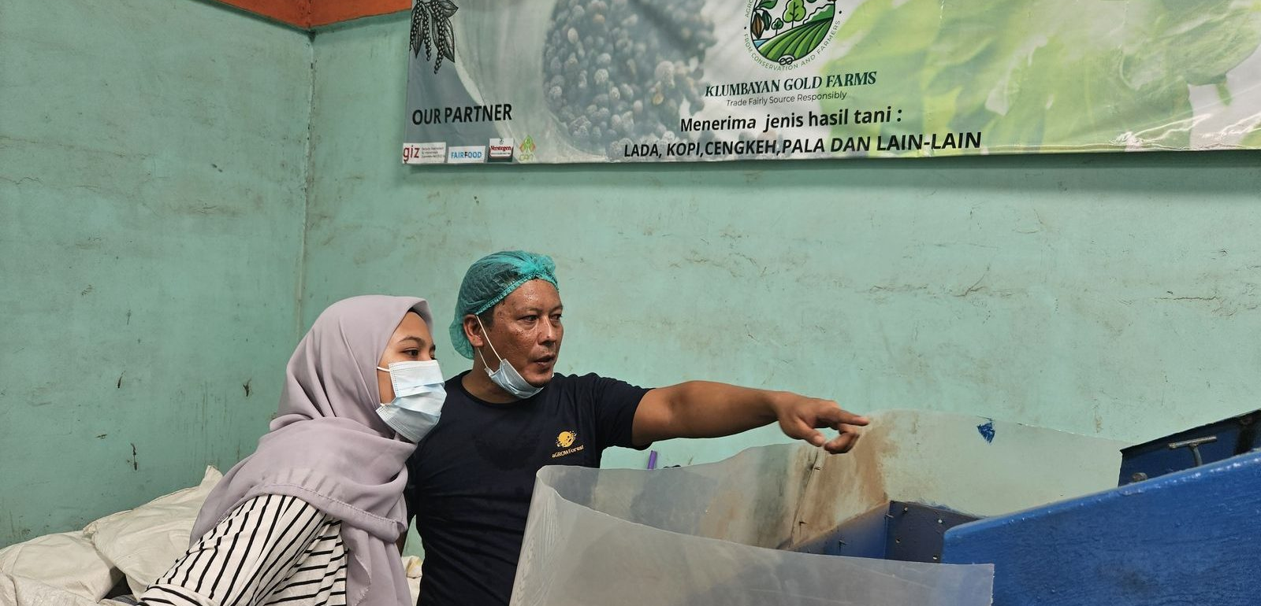
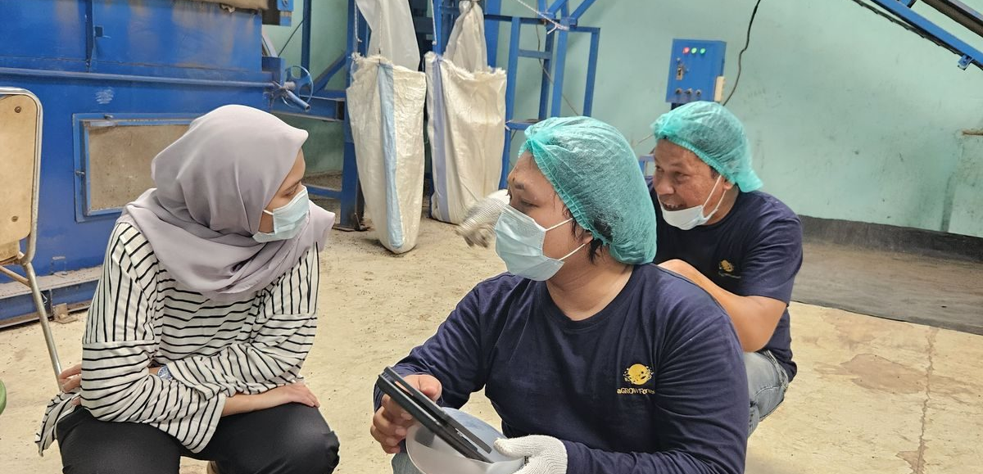
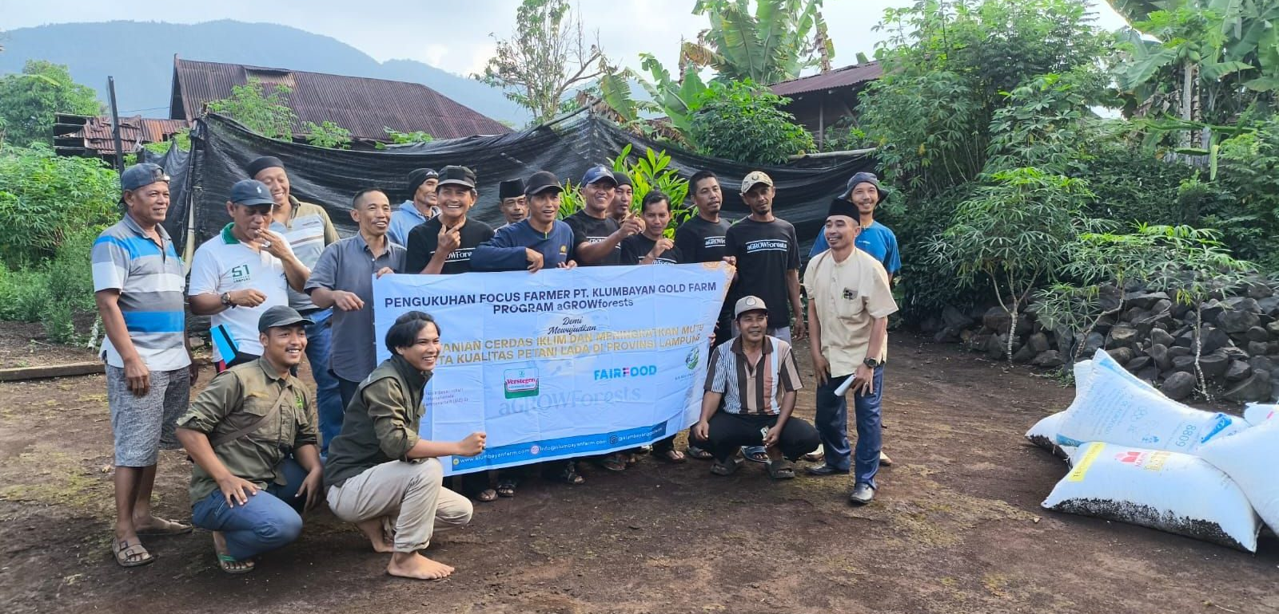
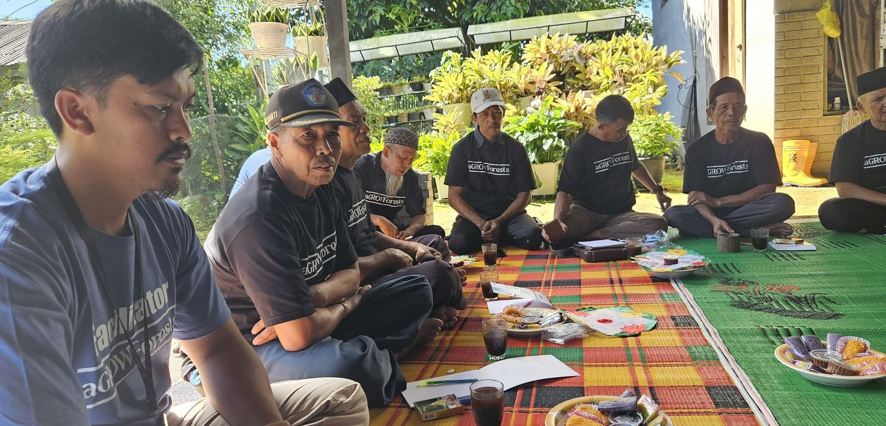
06 OPERATIONS
Built and running, not proposed.
NATAR WAREHOUSE, 2,000 T
CLEANING AND GRADING LINE
QUALITY CONTROL
CACAO ROASTING
FIELD SCHOOL
FARMER TRAINING
Facilities commissioned between 2024 and 2026. Warehouse capacity 2,000 tonnes.
PT KLUMBAYAN GOLD FARM · COMPANY PROFILE
06

Slide 8
07 TECHNOLOGY
TAPAK: every lot traced to a mapped plot.
TRACEABILITY AND ACCOUNTABILITY OF PROFESSIONAL AGRI-KGF
Our own platform, live and in production use. Every purchase records farmer identity, plot polygon coordinates, volume, digital receipts and warehouse lot movement.
TAPAK PLOT MAP, PERSONAL DATA MASKED
An investor or buyer asking which farms a container came from receives a plot-level answer, and can be granted dashboard access to verify it independently rather than taking our word for it.
PT KLUMBAYAN GOLD FARM · COMPANY PROFILE
07

Slide 9
08 EUROPE
Europe will require what we already built.
From the point EU deforestation rules apply, plot-level traceability stops being a differentiator and becomes a condition of market access. Suppliers who have not built it face a cost we have largely already absorbed.
Already exporting
Due diligence underway
Audited by a European buyer
Contracted to Verstegen Spices and Sauces, Netherlands, against European quality standards.
Plot polygons collected and validated with Verstegen and Fairfood for EU deforestation compliance.
Our Natar facility is inspected against the requirements of the buyer, not against our own checklist.
Our two closest partners, Verstegen and Fairfood, are both Dutch. Amsterdam is where this relationship already lives.
PT KLUMBAYAN GOLD FARM · COMPANY PROFILE
08

Slide 10
09 TRACTION
Already shipping to the Netherlands.
80-100 MT
300 MT/mo
2,000 MT
1,250
PEPPER CONTRACTED, 2026
ROBUSTA, CEILING 720
WAREHOUSE CAPACITY
FARMER HOUSEHOLDS
Anchor buyer
Verstegen Spices and Sauces, Netherlands. Contracted with 80 per cent payment on goods ready for shipment.
Programme
Lead local implementer of aGROWforests, funded and audited by GIZ. Its successor aGROWForests+ is conditionally awarded up to €3m by the European Commission.
Government
The Governor of Lampung has asked us in writing to help attract investors into agricultural and plantation development. Letter of May 2025.
Realised revenue figures available to qualified investors on request.
PT KLUMBAYAN GOLD FARM · COMPANY PROFILE
09

Slide 11
10 DELEGATION FIT
Why we fit this delegation.
Export-ready
Investment-ready
Shipping to the Netherlands under contract today.
A written provincial mandate to attract investors, plus donor-compliance financial systems.
Scalable
Innovation-driven
The plant is underused. Growth needs working capital, not new land or new machinery.
TAPAK, our own plot-level traceability platform, live in production.
Sustainability-focused
Open to collaboration
GIZ-funded land restoration, EUDR preparation, and on-site composting.
Existing consortium with Verstegen, Fairfood and PT CAN.
Measured against the six participant criteria published in the ICIF prospectus.
PT KLUMBAYAN GOLD FARM · COMPANY PROFILE
10

Slide 12
11 GROUND CAPACITY
What a new programme would plug into.
Our current partners are references, not the limit of who we can work with. An organisation bringing a programme to Lampung does not have to build a farmer base first.
1,250
≈600 ha
17
5
2,000 MT
FARMER HOUSEHOLDS
UNDER MANAGEMENT
BUYING STATIONS
FIELD FACILITATORS
FACILITY AT NATAR
Registered, not estimated
Resident, not visiting
We buy, not just deliver
Every farmer has an identity record and a mapped plot.
Fifteen staff, resident across all three regencies.
We are the off-taker too, not only a delivery agent.
Pesawaran · Tanggamus · Lampung Barat
aGROWforests implementer, audited by GIZ
Area estimated at 0.5 ha average holding. TAPAK holds the plot polygons to compute it exactly.
PT KLUMBAYAN GOLD FARM · COMPANY PROFILE
11

Slide 13
12 THE ASK
What we are looking for in Amsterdam.
1
New programmes for Lampung
Not investment in KGF. New projects across commodities and forestry in the province, with us delivering them on the ground.
2
A European partner to apply with
Programmes like GIZ develoPPP need an applicant domiciled in the EU or OECD-DAC. We are not eligible, and do not need to be.
3
European buyers and distributors
Robusta coffee and processed cocoa are uncommitted. Our premium pepper is already contracted to a Dutch buyer.
4
Circular processing partners
Routes for coffee husk and cocoa pod husk that we could adopt in Lampung.
We cannot cover the delegate fee. The next page sets out the alternative.
PT KLUMBAYAN GOLD FARM · COMPANY PROFILE
12

Slide 14
13 SPONSORED PARTICIPATION
We cannot fund the seat. We can fill it.
We told the organisers plainly that the IDR 75,000,000 delegate fee is beyond us. Rather than withdraw, we set out here what a sponsored seat would actually be funding.
A provincial mandate, not a company trip
A case that shows well on a stage
The Governor of Lampung asked us in writing to help bring investment into the province.
Post-mining land restored into a traded, deforestation-free supply chain, with the data to show it.
An EU grant, conditionally awarded
Dutch counterparts already in place
aGROWForests+ selected for up to €3m by the European Commission. KGF is a co-applicant.
Verstegen and Fairfood are both Dutch. The mission deepens partnerships we already hold.
What we bring instead of a fee is a case the province, the programme funder and the European buyer will each vouch for.
PT KLUMBAYAN GOLD FARM · COMPANY PROFILE
13

Slide 15

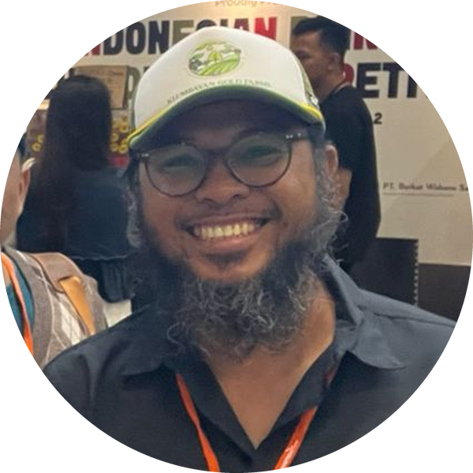
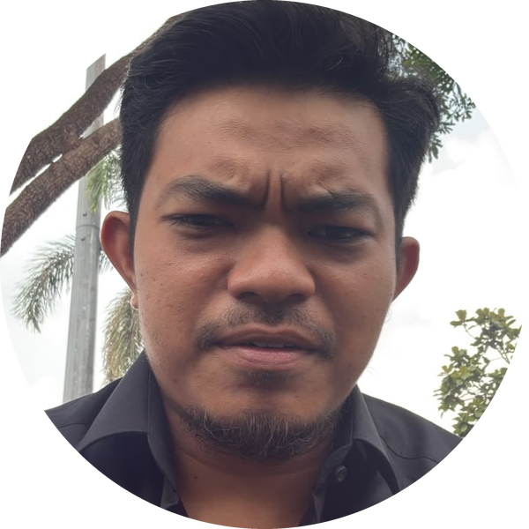
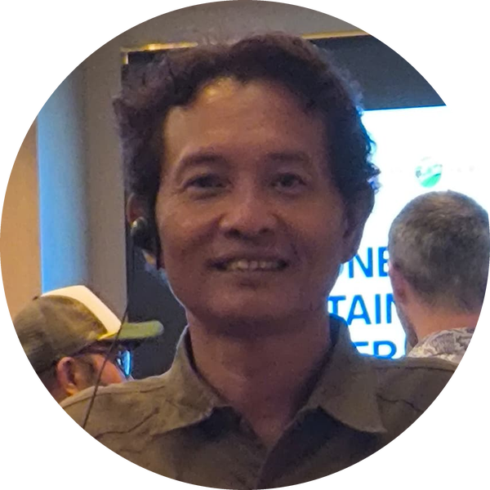
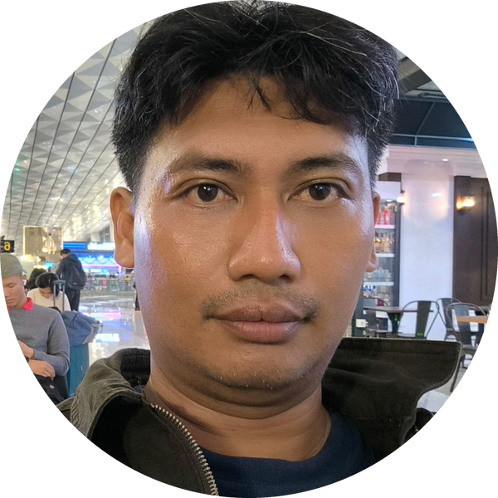
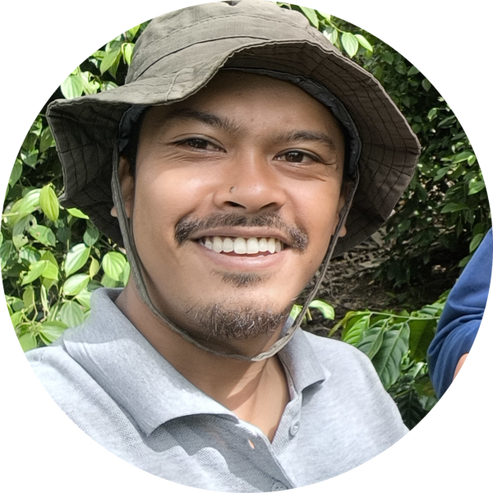
14 TEAM
The people who run it.
Faizal Riza
Arif Rachman
Muhammad Rafiq
CHIEF EXECUTIVE OFFICER
COO / PROJECT DIRECTOR
TECHNICAL MANAGER
Heri Adi Prasetya
Nico Setyo Utomo
Yanfa Ghiyats Ghifari
OPERATIONS MANAGER - IT DEV
DATA AND MANAGEMENT
SENIOR FACILITATOR
A resident team in Lampung, not a head office at a distance. 15 internal staff, including five field facilitators.
PT KLUMBAYAN GOLD FARM · COMPANY PROFILE
14

Slide 16





15 PARTNERS
We do not do this alone.
MARKET
PROGRAMME
RESEARCH
INSTITUTIONAL
Buyer and national supply
Funders and platforms
Applied science partners
Government and national
PT CAN
Bank Indonesia
Solidaridad
ASTRA
Verstegen
PT CAN
GIZ
SSI-I
Solidaridad
BRIN
SITH ITB
Kemenperin
Bank Indonesia
ASTRA
KGF is the field implementer and off-taker inside the aGROWforests consortium.
PT KLUMBAYAN GOLD FARM · COMPANY PROFILE
15

Slide 17
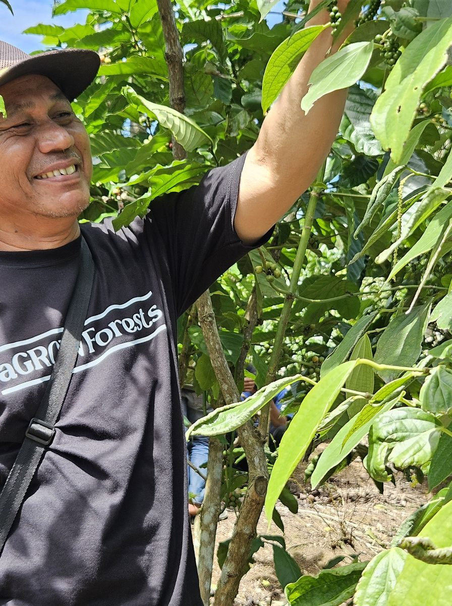
From waste to worth,
and back to the soil.
PT Klumbayan Gold Farm
Jln. Wolter Monginsidi No. 159
Bandar Lampung, Lampung, Indonesia
Warehouse: Gudang Natar, Lampung Selatan
Arif Rachman, COO / Project Director
arif@klumbayanfarm.com
+62 853 7887 0007
KLUMBAYANFARM.COM

