Slide 1
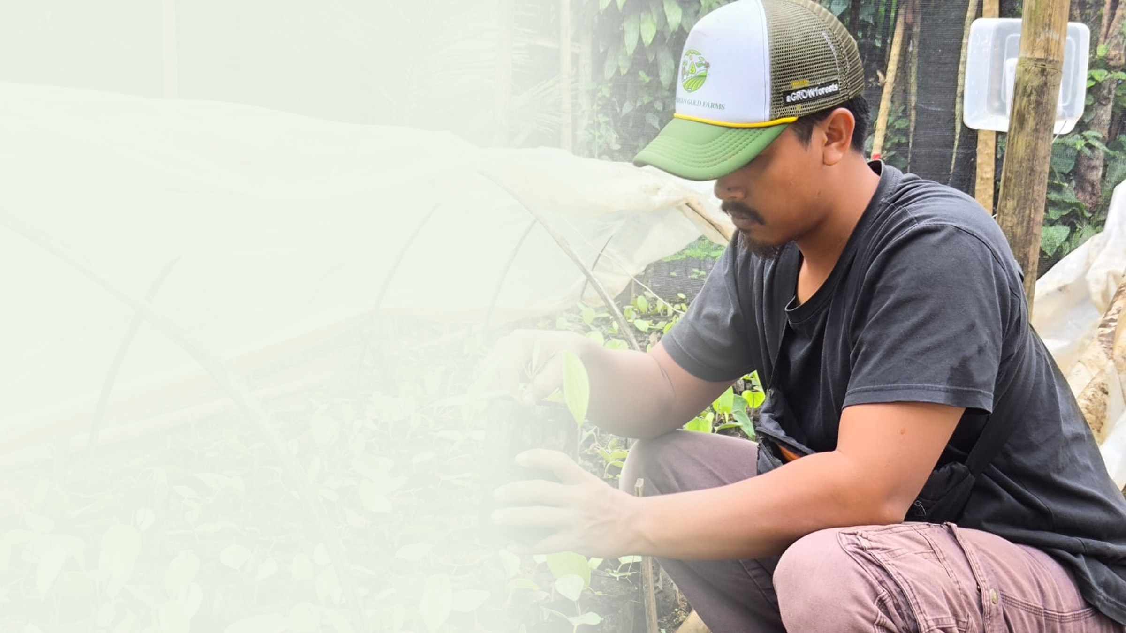



PT Klumbayan Gold Farm
LAMPUNG · INDONESIA · EST. 2022
We built
the farmer network.
Now we need to pay
all of it.
A tech-enabled agroforestry off-taker in Lampung, moving smallholder black pepper, coffee and cacao into European markets with plot-level traceability. 1,250 farmers registered. Fewer than 100 selling to us today.
PORTFOLIO & PITCH DECK · AUGUST 2026
klumbayanfarm.com arif@klumbayanfarm.com +62 853 7887 0007

Slide 2
01 THESIS
Agroforestry here is inherited, not introduced.
Lampung smallholders have intercropped pepper, coffee, cacao, cloves and fruit trees for generations. The land is already a mosaic. What is missing is not the practice. It is disease-free planting material, post-harvest quality, and a buyer who pays for what the system actually produces: less volume, higher grade, canopy left standing.
Our job is not to change how these families farm. It is to make an inherited system finally pay.
1,250
1,393 ha
89%
90%
FARMERS REGISTERED
SURVEYED
CSA TRAINED
INCOME DIVERSIFIED
Tanggamus & Pesawaran regencies
697% of initial baseline target
1,111 farmers, climate-smart practice
Household income beyond pepper alone
PT KLUMBAYAN GOLD FARM · C3 NATURE IMPACT ACCELERATOR
01

Slide 3
02 THE PROBLEM
Two ledgers fail at once.
MARKET SIDE
FARM SIDE
LANDSCAPE SIDE
Buyers cannot prove origin
Good land, thin returns
Extraction pays better
European food and spice houses carry EUDR obligations on coffee and cacao, and corporate due-diligence exposure across everything else they source. Fragmented smallholder networks cannot deliver plot-level proof, so compliant volume is scarce and priced accordingly.
Ageing tree stock, no access to clean planting material and weak post-harvest handling keep quality below export grade. Households sell to village traders at commodity prices and absorb every price shock directly.
Where farm income falls short, artisanal gold mining and land conversion become the rational alternative. The forest margin is lost to economics, not ignorance.
PT KLUMBAYAN GOLD FARM · C3 NATURE IMPACT ACCELERATOR
02

Slide 4
03 THE MODEL
One company across the whole chain.
KGF is both the field implementor and the off-taker. We are not a project that hands farmers to a trader at the end. We buy, we process, we export, and the premium travels back down the same line it came up.
01 · PRODUCE
02 · PROCESS
03 · PLACE
Planting material & practice
Grade, not just volume
Contracted off-take
Mother Plant Farm in Pesawaran producing disease-free pepper and cacao seedlings, supported by village nurseries, demonstration plots, composting for organic inputs, and field schools for Good Agricultural Practice.
Natar facility handling cleaning, grading and drying to ASTA 550 for black pepper, sorted grade 1 robusta, and controlled cacao fermentation with downstream roasting and winnowing.
Binding B2B purchase agreements with European buyers, guaranteed farm-gate pricing 10 to 20 percent above the village trader, and ethical premium returned to the producing household.
PT KLUMBAYAN GOLD FARM · C3 NATURE IMPACT ACCELERATOR
03

Slide 5
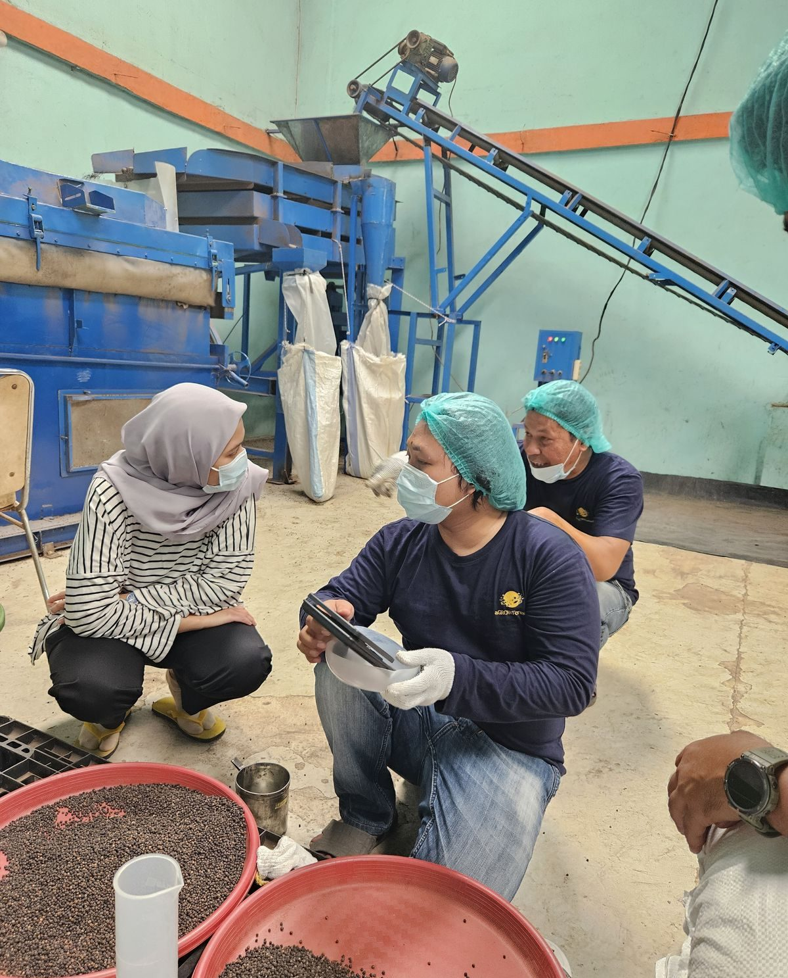
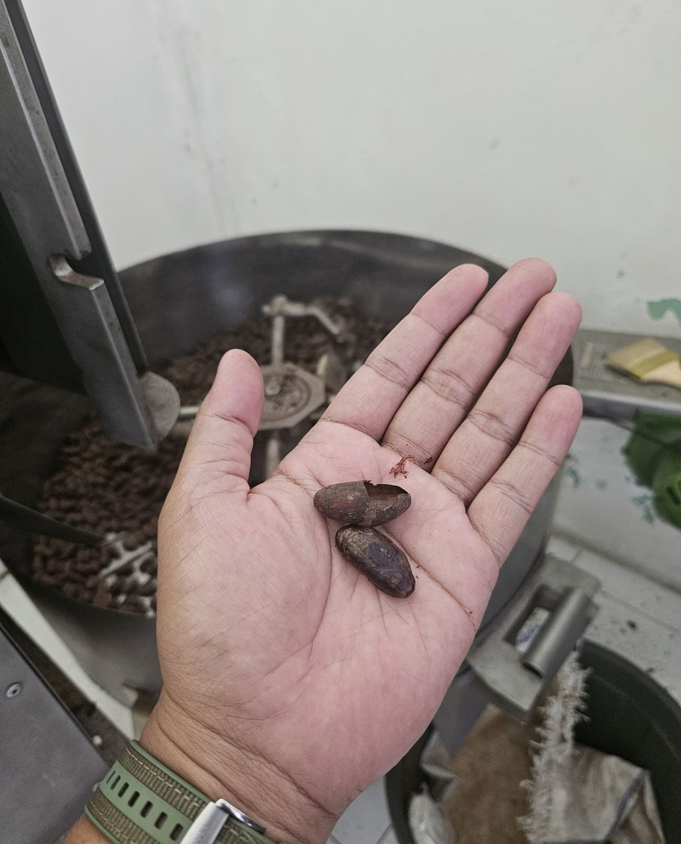
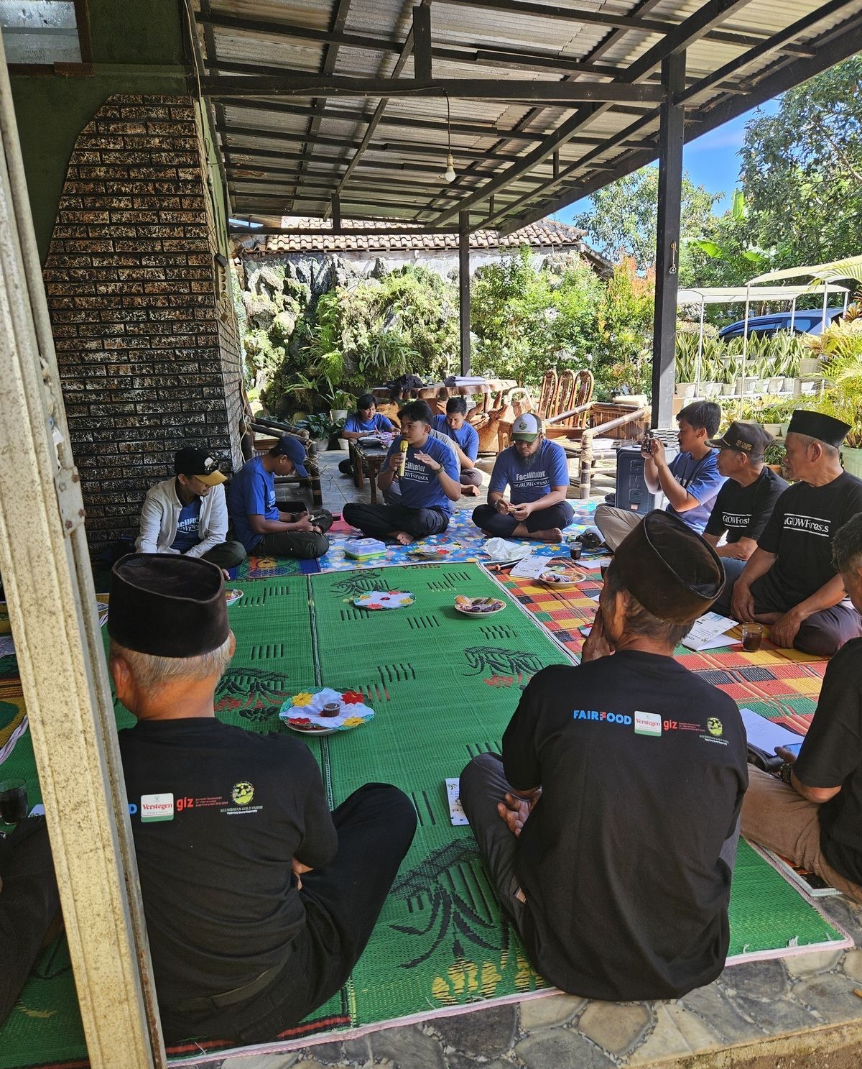
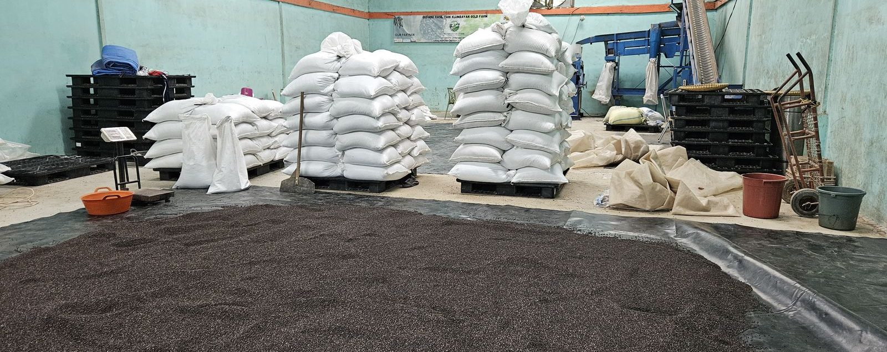
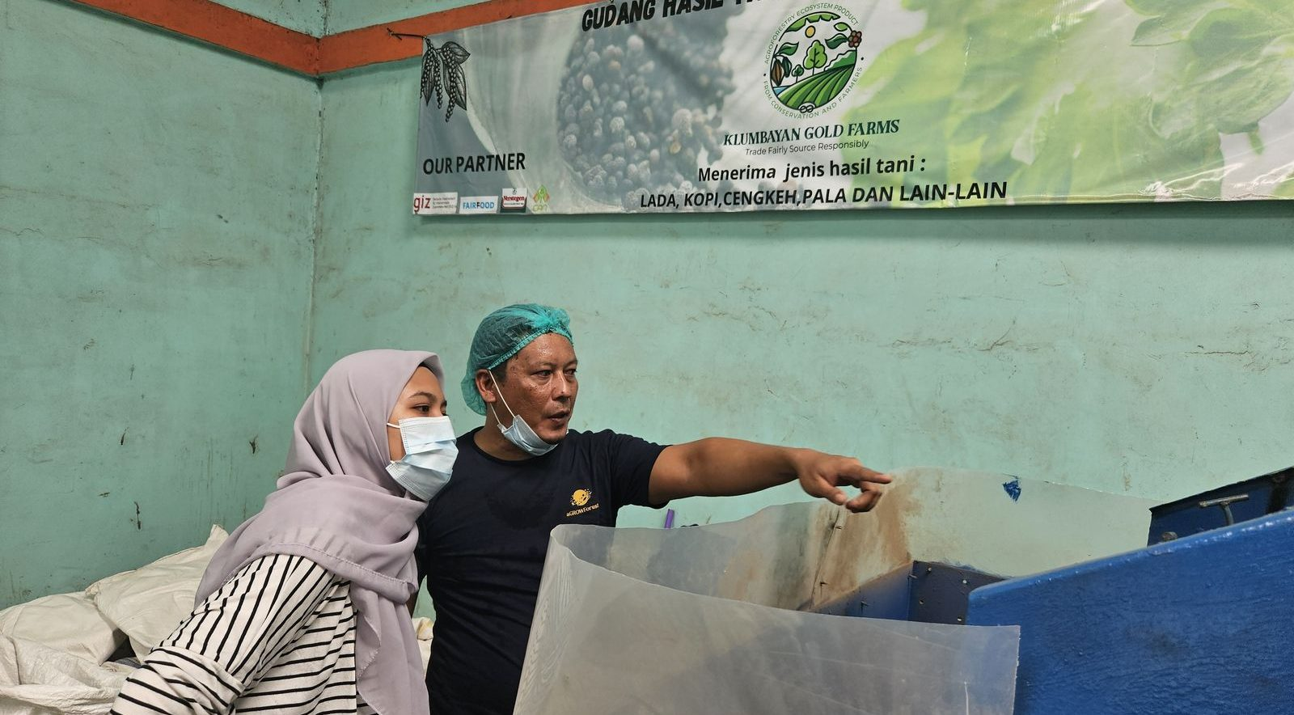
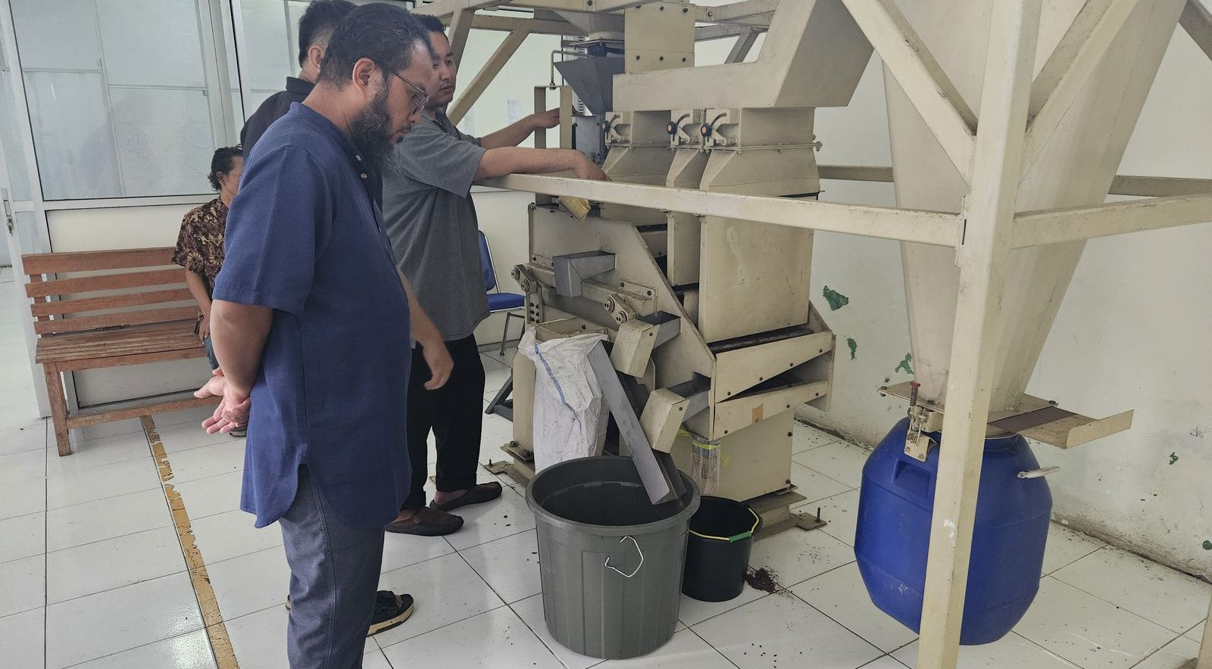
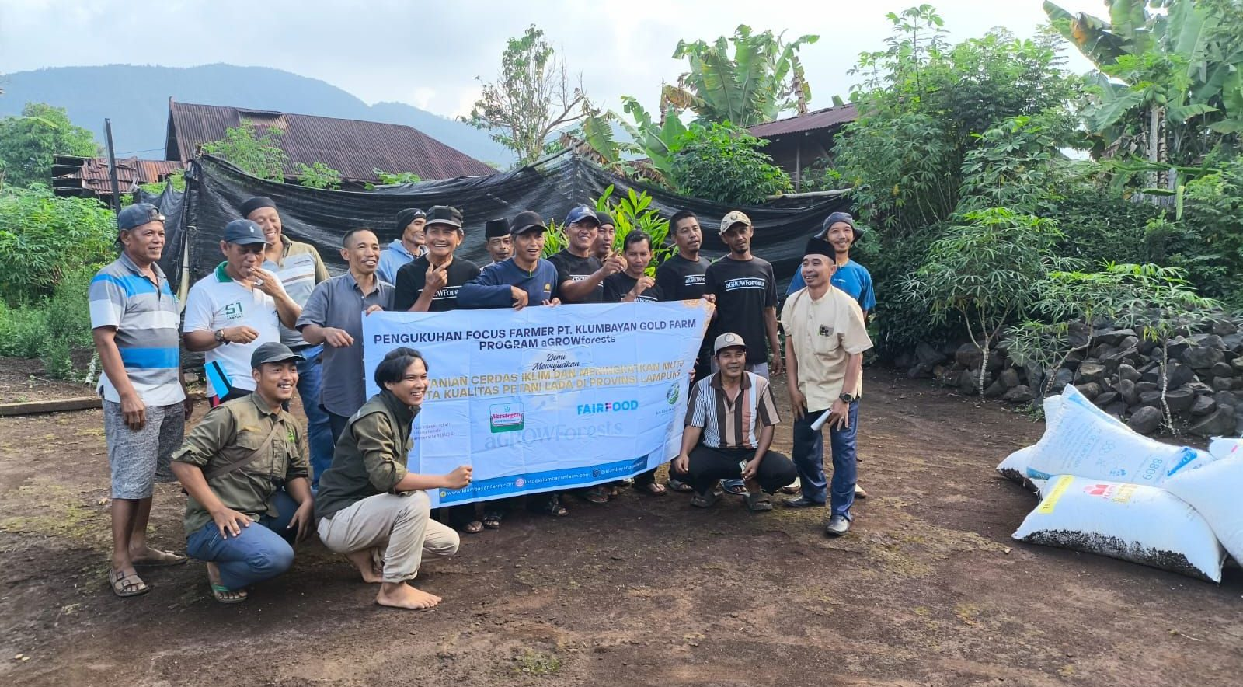
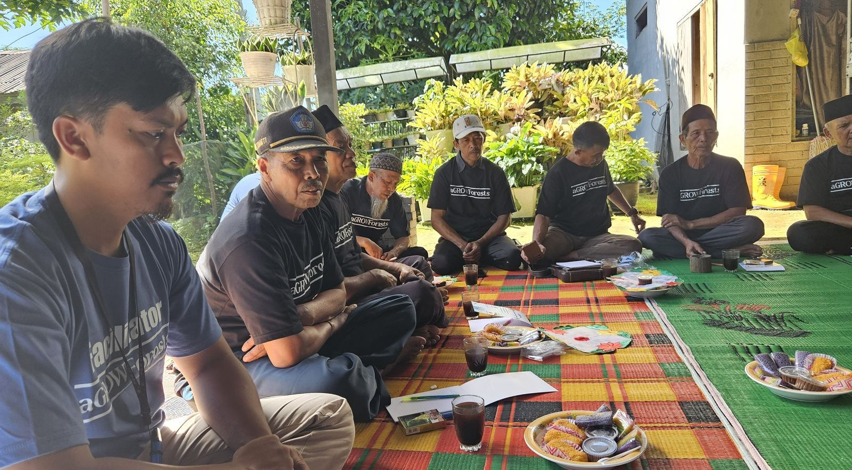
04 PORTFOLIO · OPERATIONS
Built and running, not proposed.
Facilities commissioned between 2024 and 2026. This is the operating base an investment would scale, not create.
QUALITY CONTROL
CACAO ROASTING
FARMER TRAINING
NATAR WAREHOUSE
CLEANING & GRADING LINE
CACAO WINNOWING
FIELD SCHOOL
TRAINING FOR QUALITY
PT KLUMBAYAN GOLD FARM · C3 NATURE IMPACT ACCELERATOR
04

Slide 6
05 COMMODITIES
A polyculture farm produces a polyculture basket.
This is the structural reason a single spice buyer can never absorb our supply. One farm yields five sellable crops across a staggered calendar, which is exactly what makes the household resilient and exactly what makes our buyer problem urgent.
Pepper
Coffee
Cacao
ASTA 550 · CONTRACTED
FINE ROBUSTA · EUDR SCOPE
FERMENTED · EUDR SCOPE
Black pepper, the anchor commodity. Off-take secured with Verstegen Spices & Sauces since 2023.
Sorted grade 1 robusta and arabica. Off-take route via Sucafina Indonesia.
Controlled fermentation and local downstream processing with Pemkab Pesawaran.
Cloves
Nutmeg
Shade trees
SECONDARY
SECONDARY · MACE
TAJAR & FRUIT
Traditional intercrop, seasonal household income.
Hand-picked, high value per kilogram.
Gamal, dadap, avocado, durian, petai, aren, kemiri. Living support and canopy.
PT KLUMBAYAN GOLD FARM · C3 NATURE IMPACT ACCELERATOR
05

Slide 7
06 TRACTION
Off-take tripled in two years on our own execution.
No grant financed this growth. Contracted commercial volume with a Dutch B-Corp buyer, scaled year on year while the farmer base and facilities were built underneath it.
MILESTONES
2023
MoU with Verstegen Spices & Sauces BV, Rotterdam
-
2024
Joined aGROWforests consortium. First order signed at Trade Expo Indonesia
32 MT
2025
Mother Plant Farm, demoplot, composting and nursery commissioned
50 MT
2026
Off-take doubled. Three institutional accelerators
100 MT
2028
Full farmer base transacting, multi-buyer placement
350 MT
2030
Regional off-take platform at scale
500 MT
PT KLUMBAYAN GOLD FARM · C3 NATURE IMPACT ACCELERATOR
06

Slide 8
07 THE GAP
1,250 farmers registered.
Fewer than 100 sell to us.
This is the honest centre of our business and the reason we are raising. The relationships exist. The plots are mapped, the training is delivered, the trust is built. What is missing is the ability to place and pay for everything those 1,250 households grow.
<100
1,250
1
TRANSACTING TODAY
TARGET, 24 MONTHS
BUYER ABSORBING VOLUME
Farmers who sold to KGF and received a premium
Every registered household buying-in and paid
A single spice house takes nearly everything we move
Buying from all 1,250 means placing every crop they grow. Concentration is the constraint, not commitment.
PT KLUMBAYAN GOLD FARM · C3 NATURE IMPACT ACCELERATOR
07

Slide 9
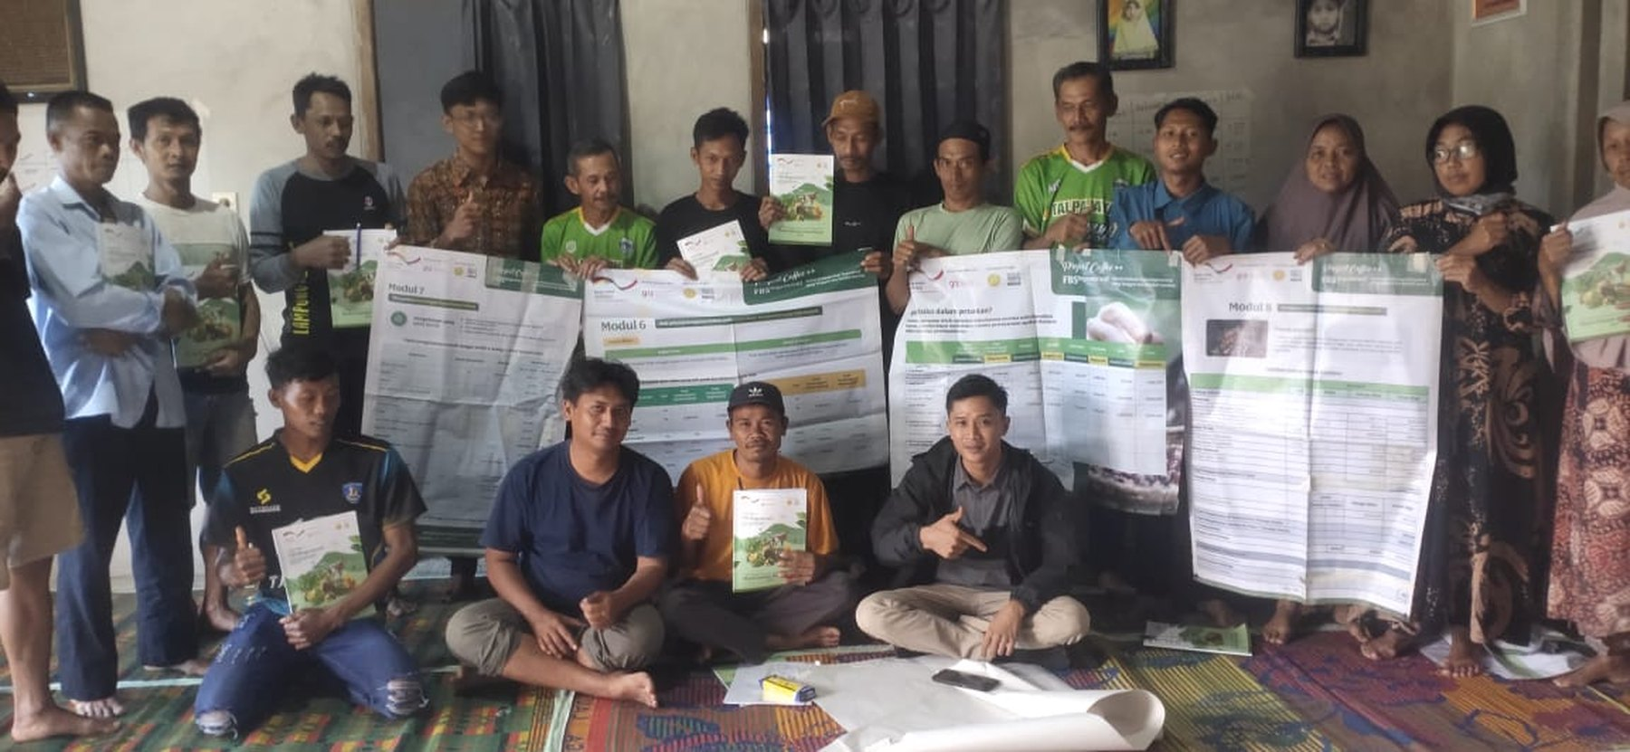
08 IMPACT · NEXT 12-24 MONTHS
Paid by us, not merely counted by us.
1,250
10-20%
90%
350 MT
FARMERS TRANSACTING
ABOVE VILLAGE TRADER
PRACTICING CSA
OFF-TAKE BY 2028
From fewer than 100 today
Farm-gate premium, paid not promised
Practice, not attendance. Climate resilience at household level
On the path to 500 MT by 2030
These families already farm agroforestry across 1,393 hectares: less volume, higher quality, canopy and biodiversity left standing, and buyers who pay precisely for that. The premium is what makes the model self-financing rather than donor-dependent.
PT KLUMBAYAN GOLD FARM · C3 NATURE IMPACT ACCELERATOR
FARMER BUSINESS SCHOOL · TRAINING MODULES
08

Slide 10
09 TECHNOLOGY
TAPAK: every lot traced to a mapped plot.
Our own ERP and traceability system, built in-house. It is what lets a European buyer accept our volume without taking our word for it.
FIELD LAYER
CHAIN LAYER
Offline capture
Event-sourced lot tracking
GPS polygon farm boundaries, household registration, harvest logs and training records captured offline by facilitators and synced when connectivity returns.
Every batch carries a graph of events from plot through collection, drying, grading and container loading. A lot number resolves back to the farmers who filled it.
COMPLIANCE LAYER
DECISION LAYER
Regulation-accurate claims
AI-CCDSS
EUDR compliance for coffee and cacao. Deforestation-free verification for pepper under buyer due-diligence. We do not overstate which rule applies.
Climate decision support over the same data: planting windows, disease pressure and yield signals returned to facilitators as advice a farmer can act on.
PT KLUMBAYAN GOLD FARM · C3 NATURE IMPACT ACCELERATOR
09

Slide 11

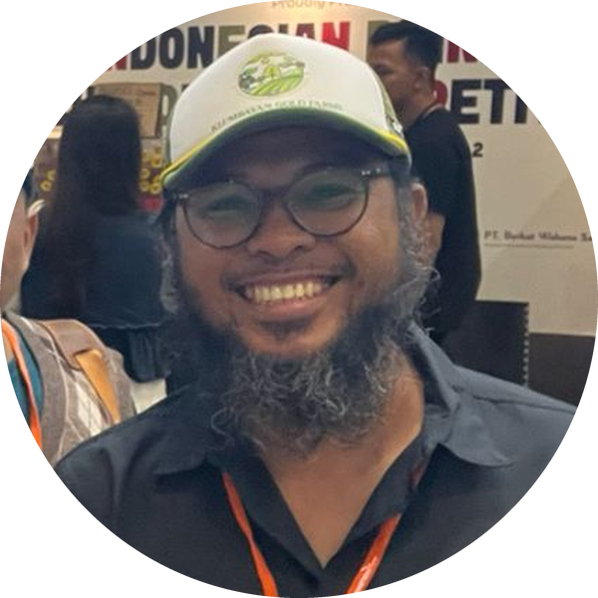
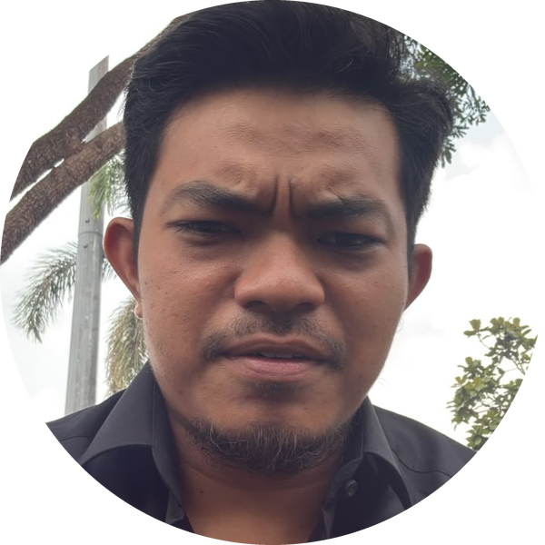
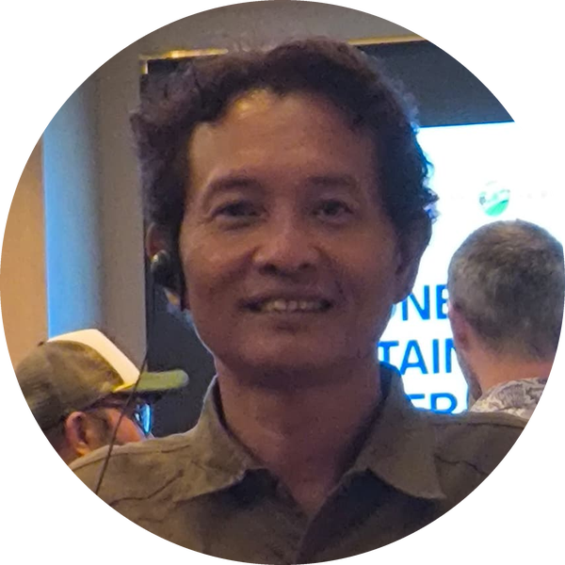
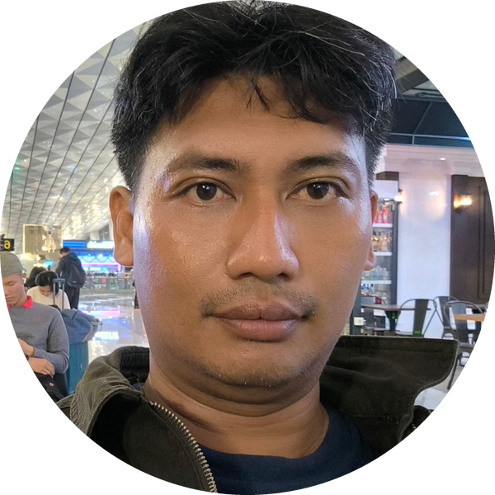
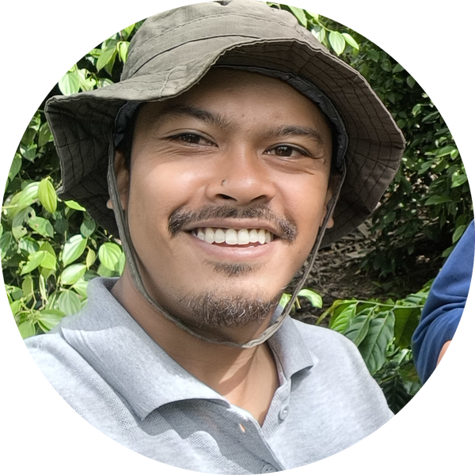
10 TEAM
The people who run it.
A resident team in Lampung, not a head office managing at a distance. Field facilitation, processing, data and trading sit under one roof.
Faizal Riza
Arif Rachman
Muhammad Rafiq
CHIEF EXECUTIVE OFFICER
COO / PROJECT DIRECTOR
TECHNICAL MANAGER
Heri Adi Prasetya
Nico Setyo Utomo
Yanfa Ghiyats Ghifari
OPERATION MANAGER
DATA AND MANAGEMENT
SR. FIELD FACILITATOR
PT KLUMBAYAN GOLD FARM · C3 NATURE IMPACT ACCELERATOR
10

Slide 12










11 CONSORTIUM & PARTNERS
We do not do this alone.
KGF is the field implementor and off-taker inside a consortium that carries the buyer relationship, the traceability technology, the research base and the standards platform.
IMPLEMENTOR & OFF-TAKER
CONSORTIUM PROGRAMME
BUYER · NETHERLANDS
TRACEABILITY TECHNOLOGY
SECTOR PLATFORM
PROGRAMME FUNDER
RESEARCH PARTNER
NATIONAL RESEARCH AGENCY
Ministry of industry
REPUBLIC OF INDONESIA
NATURE IMPACT ACCELERATOR
PT KLUMBAYAN GOLD FARM · C3 NATURE IMPACT ACCELERATOR
11

Slide 13
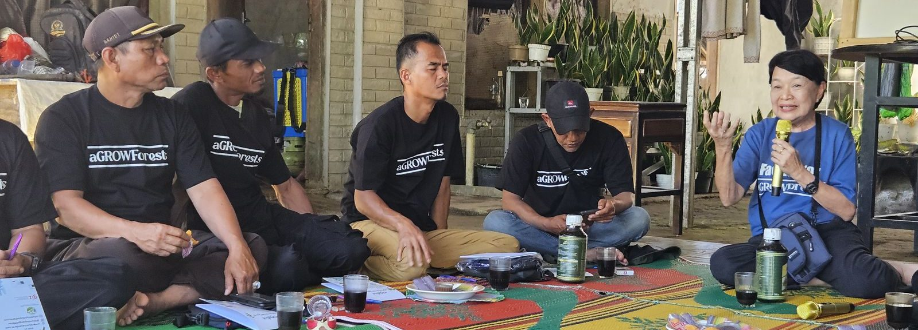
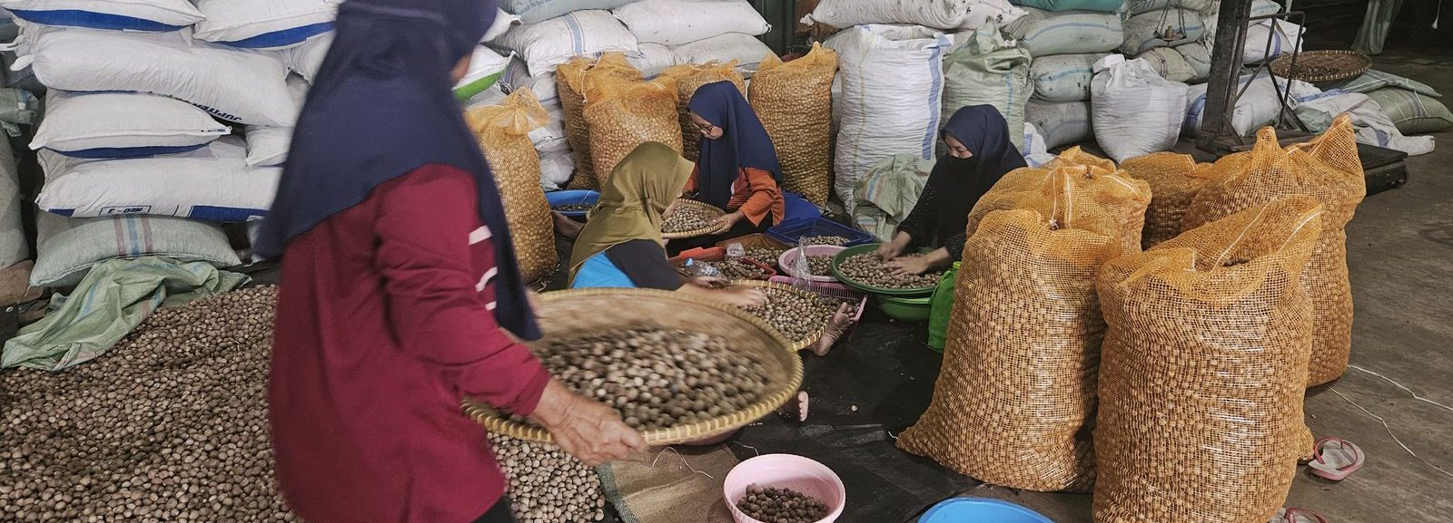
12 RECOGNITION
Vetted by people who audit for a living.
Bank Indonesia
SMEs Go Export
Ministry of Industry
Desa Sejahtera Astra International
National Research and Innovation Agency
2026 ACCELERATION
Technical Training · 2026
EXPORT CHAMPION 2026
RESEARCH COLLABORATION
Sustainable agribusiness and export finance
Green processing and downstream value addition
Supply chain governance and export readiness
Farmer training and applied agronomy
FARMER TRAINING WITH BRIN
HAND SELECTION · NUTMEG
PT KLUMBAYAN GOLD FARM · C3 NATURE IMPACT ACCELERATOR
12

Slide 14
13 ROADMAP
Where the next four years go.
2026-2027
2027-2028
2028-2029
2029-2030
Close the transaction gap
Diversify the buyer book
Downstream in-country
Platform
Move from under 100 to the full 1,250 registered households buying-in, with working capital and placement capacity to match.
Add coffee and cacao off-take contracts beyond the single spice relationship. Target 350 MT total placed volume.
Cacao fermentation and processing scaled with Pemkab Pesawaran so value is captured in the regency, not exported raw.
500 MT and a replicable operating model other Indonesian landscapes can adopt without rebuilding TAPAK from scratch.
PT KLUMBAYAN GOLD FARM · C3 NATURE IMPACT ACCELERATOR
13

Slide 15
14 THE ASK
What we need, in the order we need it.
01
Buyers
Introductions to food and spice groups across Europe and MENAT who can absorb coffee, cacao, cloves and nutmeg alongside pepper. Concentration on one buyer is the binding constraint on farmer reach.
02
Working capital
Trade finance structured for the gap between paying farmers at harvest and being paid by buyers on shipment. This converts registered farmers into transacting farmers.
03
Transition finance structuring
Support to shape KGF's commercial model for results-based finance on smallholder ecosystem services, so nature outcomes carry their own revenue line.
04
A platform to be seen from
Presenting KGF as a bankable nature-based solution where commercial return and landscape restoration are the same mechanism, not a trade-off.
PT KLUMBAYAN GOLD FARM · C3 NATURE IMPACT ACCELERATOR
14

Slide 16
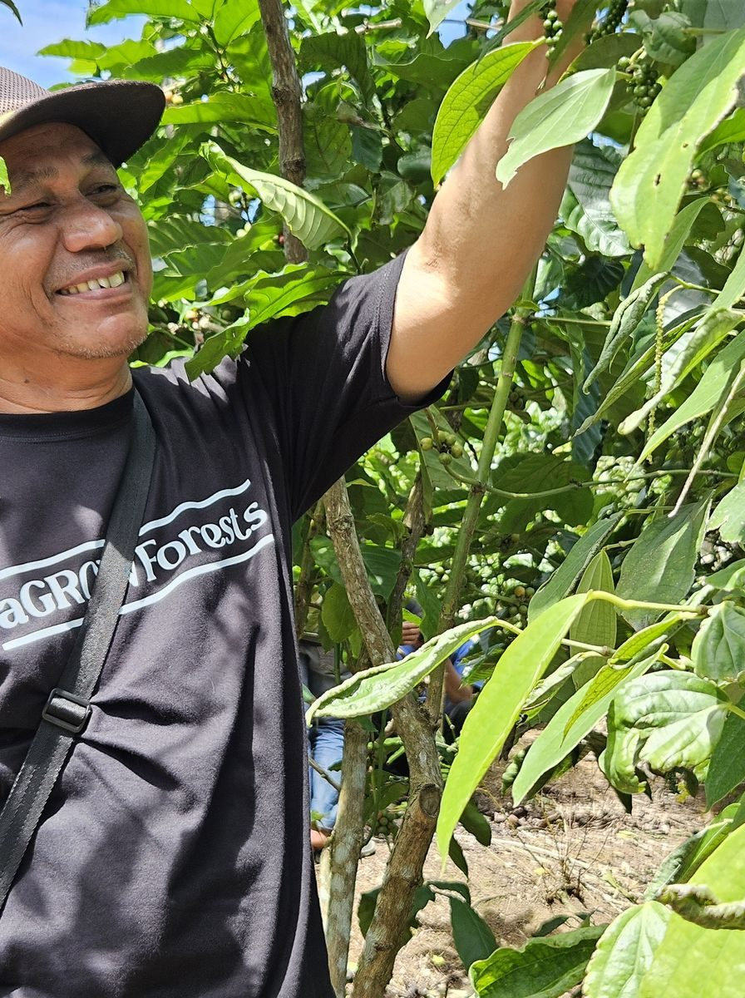
PT Klumbayan Gold Farm
TECH-ENABLED AGROFORESTRY OFF-TAKER
CONTACT
Arif Rachman
EMAIL
arif@klumbayanfarm.com
MOBILE / WA
+62 853 7887 0007
WEB
www.klumbayanfarm.com
Bandar Lampung and Natar warehouse, Lampung, Indonesia. Operating in Tanggamus and Pesawaran regencies since 2022.

