Slide 1


Consumer Goods Ad_Hoc Insights

Slide 2
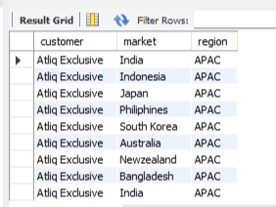
Que 1. Provide the list of markets in which customer "Atliq Exclusive" operates its business in the APAC region.
select customer,market,region from dim_customerwhere customer="Atliq
Exclusive" and region="APAC";

Slide 3
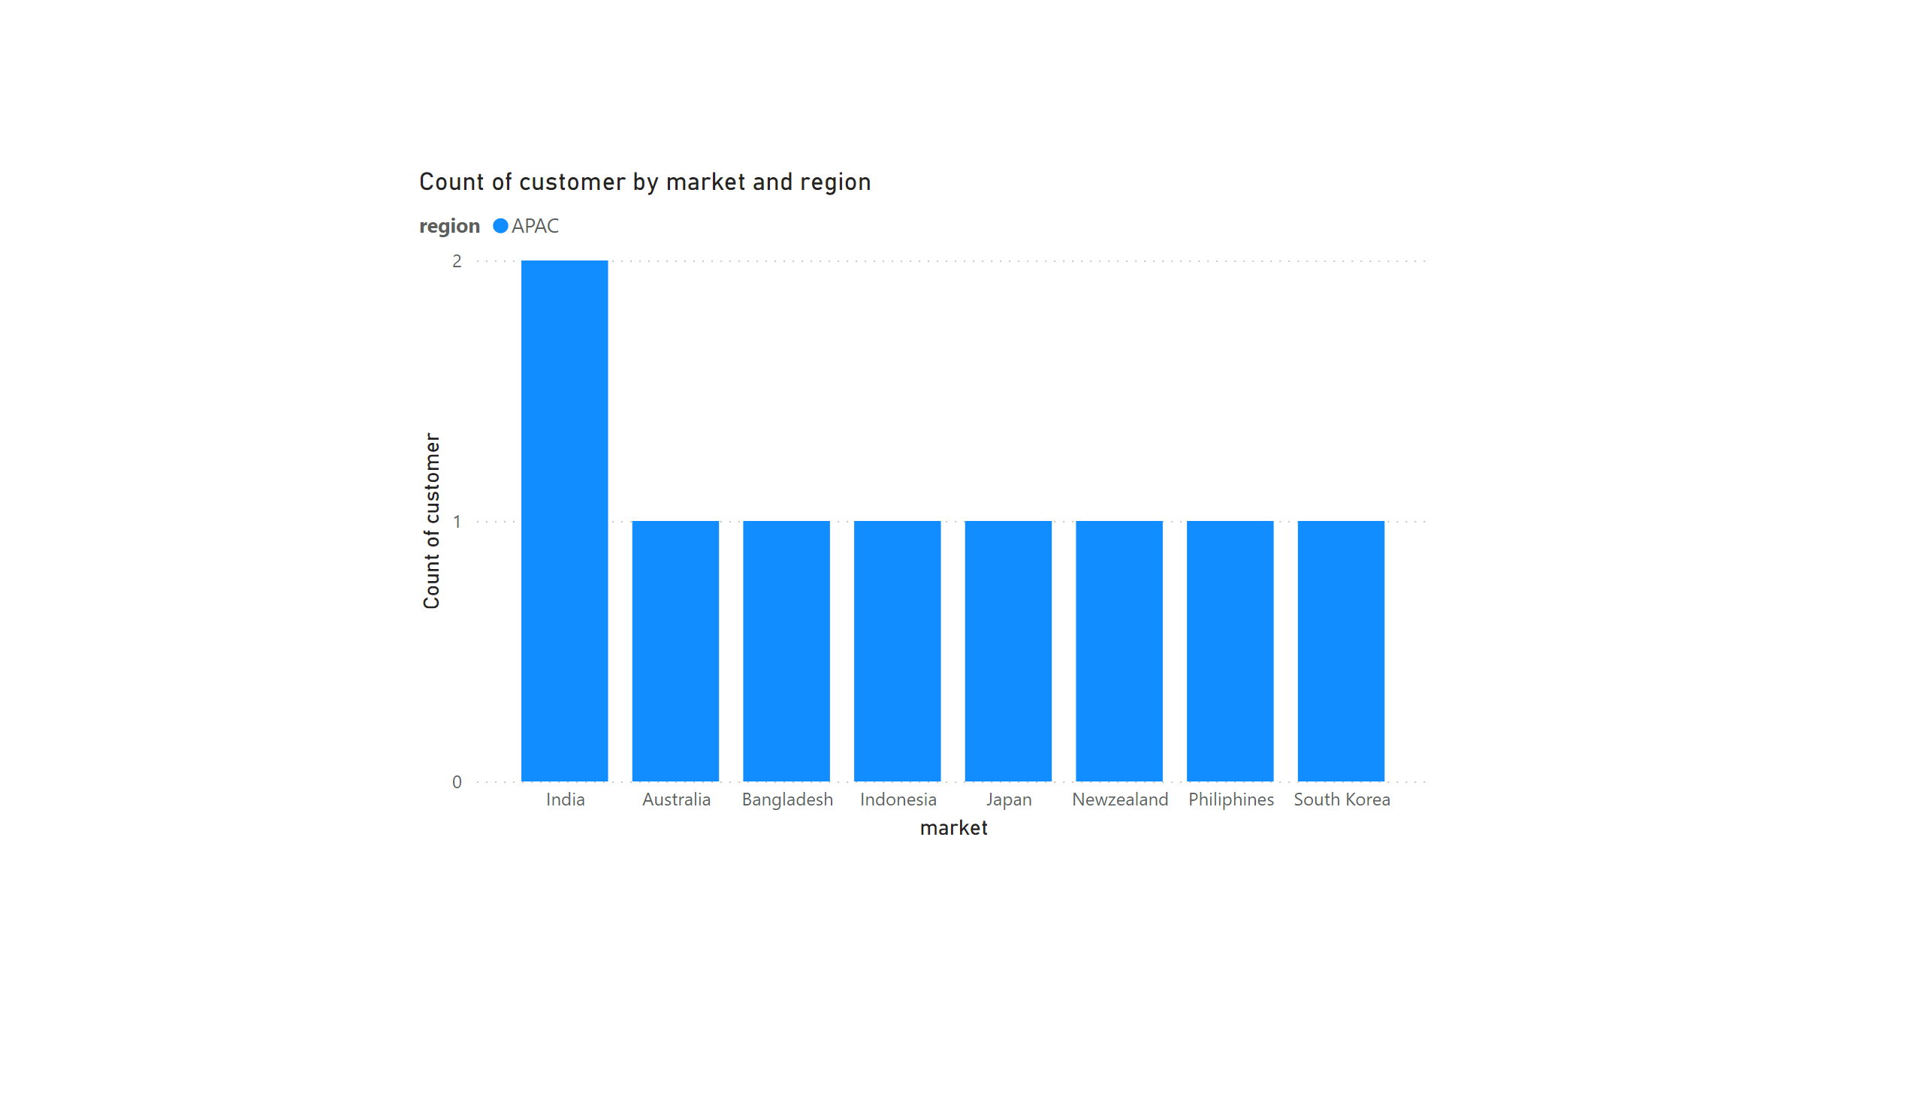
Insights:- India, Indonesia, Japan, Philippines, South Korea, Australia, Newzealand, and Bangladesh are the markets where "Atliq Exclusive" operates its business in the APAC region.

Slide 4
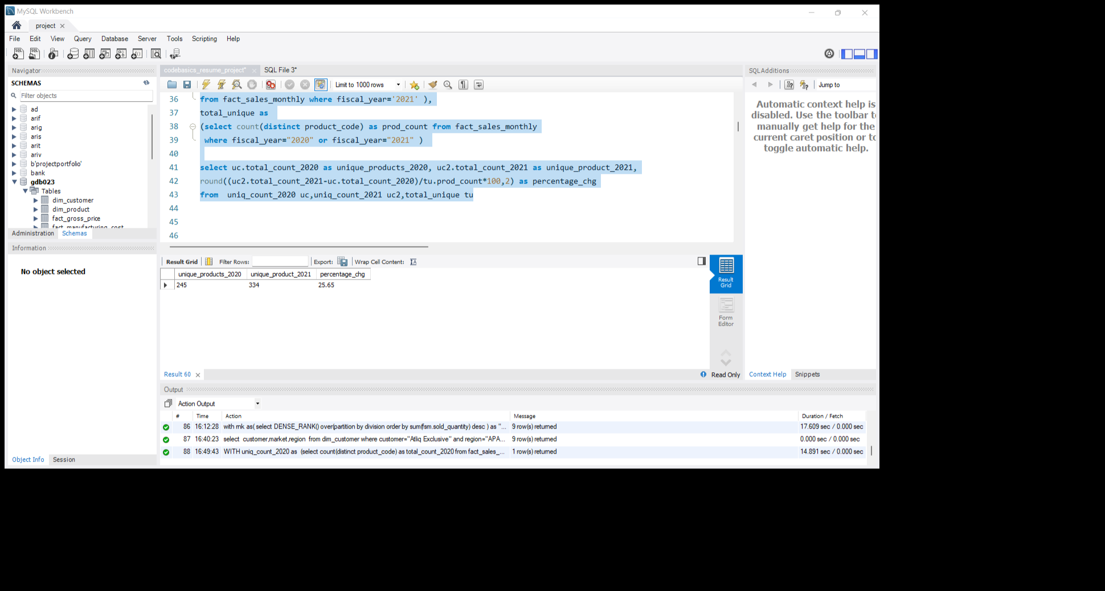
Que 2. What is the percentage of unique product increase in 2021 vs. 2020? The final output contains these fields, unique_products_2020 unique_products_2021 percentage_chg

Slide 5
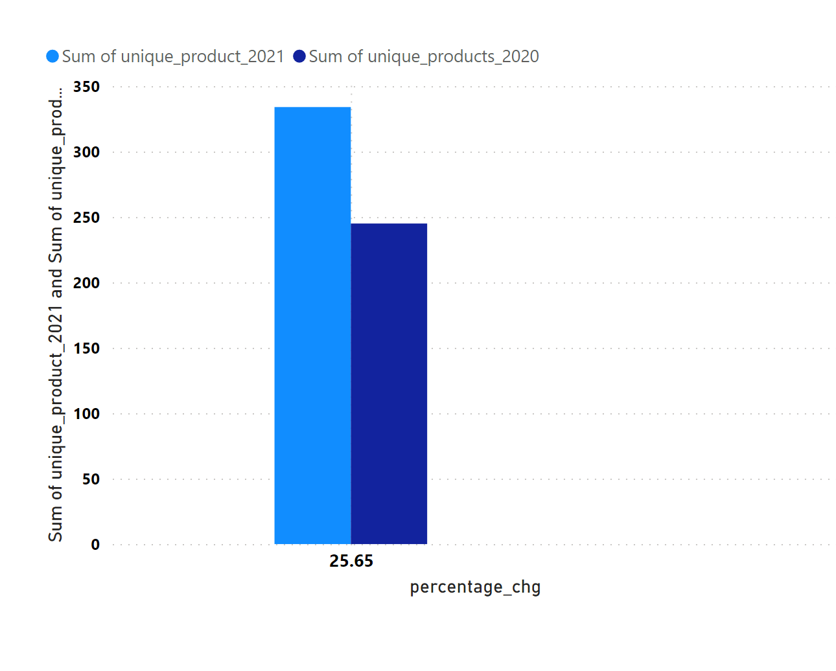
Insights:- Unique product counts in the years 2020 and 2021 are 245 and 334 respectively. The percentage change in the unique product in the year 2021 is 25.65% as compared to the year 2020.

Slide 6
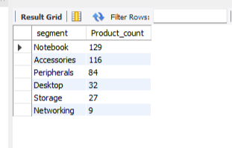
Que 3. Provide a report with all the unique product counts for each segment and sort them in descending order of product counts. The final output contains 2 fields, segment product_count

Slide 7
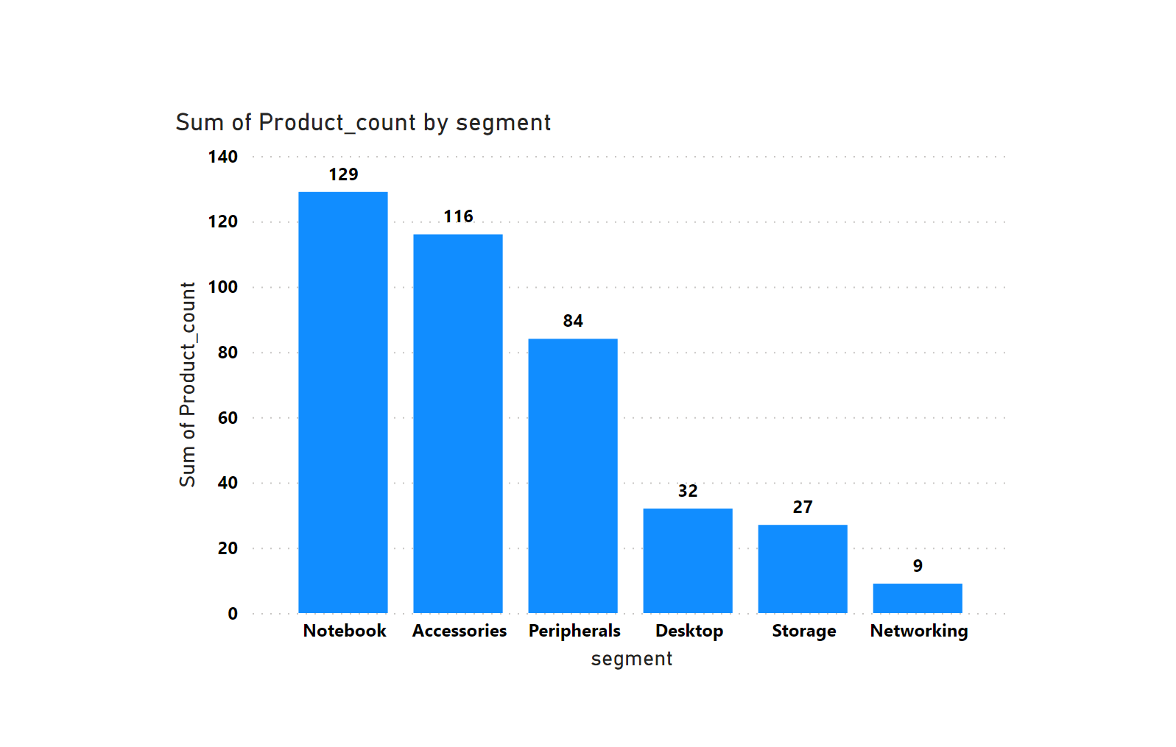
Insights:- In the segment, the notebook had the most number of unique products

Slide 8
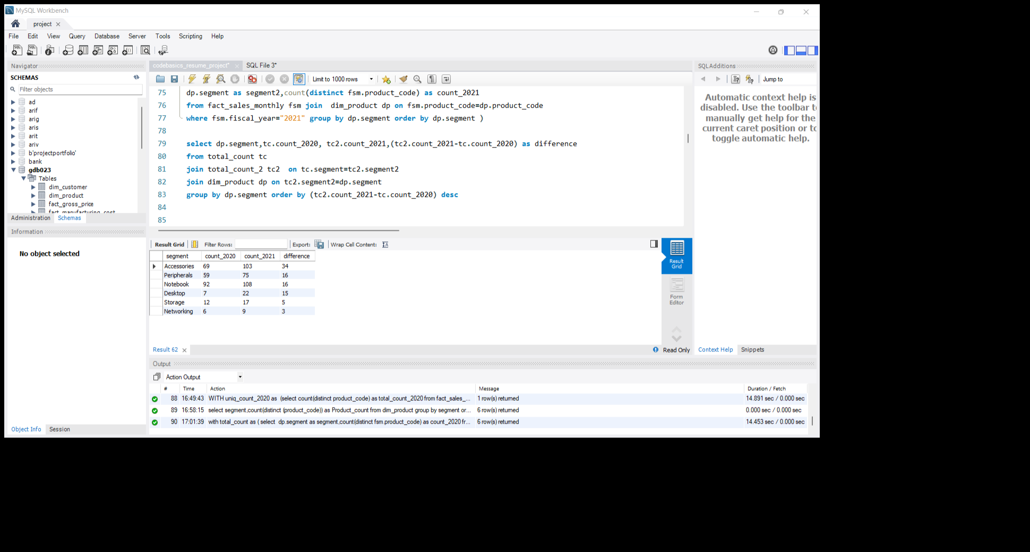
Que 4. Follow-up: Which segment had the most increase in unique products in 2021 vs 2020? The final output contains these fields, segment product_count_2020 product_count_2021 difference

Slide 9
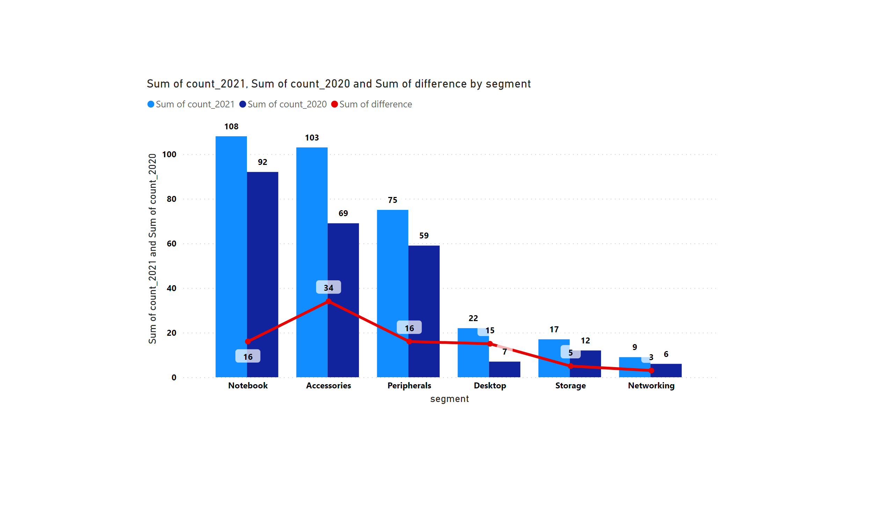
Insights:- Accessories segment had most increase in unique products in year 2021

Slide 10
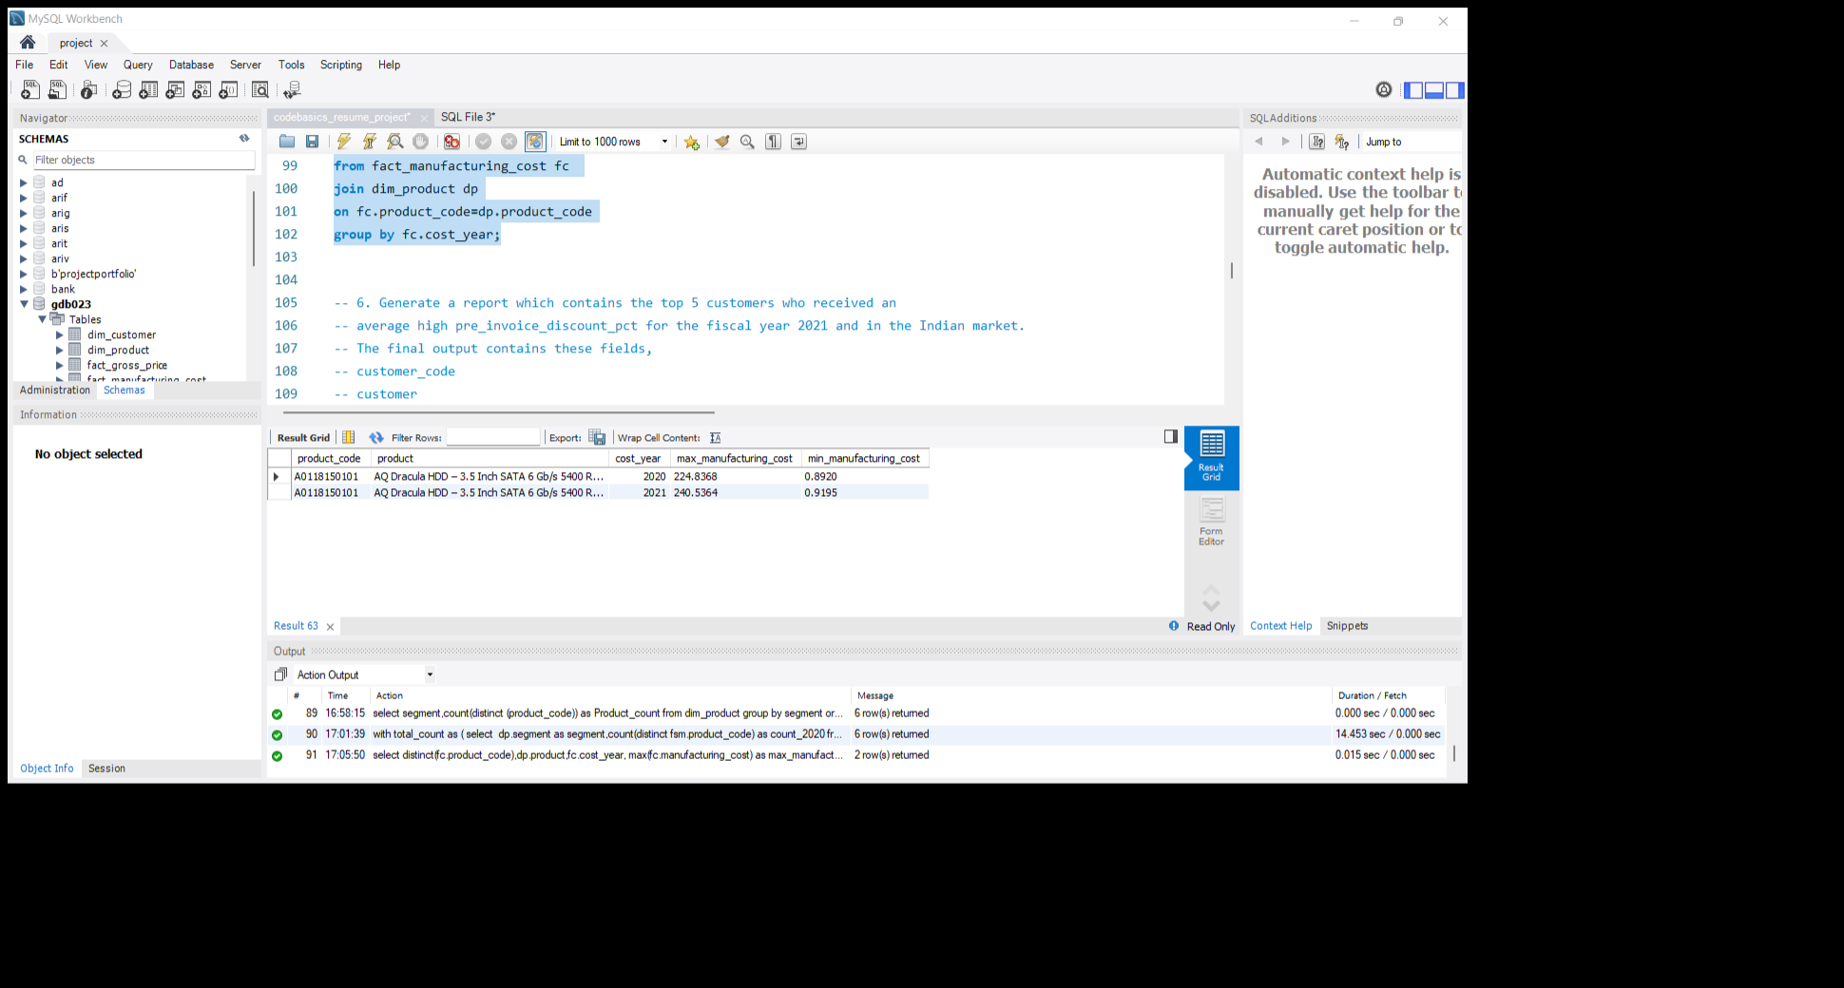
Que 5. Get the products that have the highest and lowest manufacturing costs. The final output should contain these fields, product_code product manufacturing_cost

Slide 11
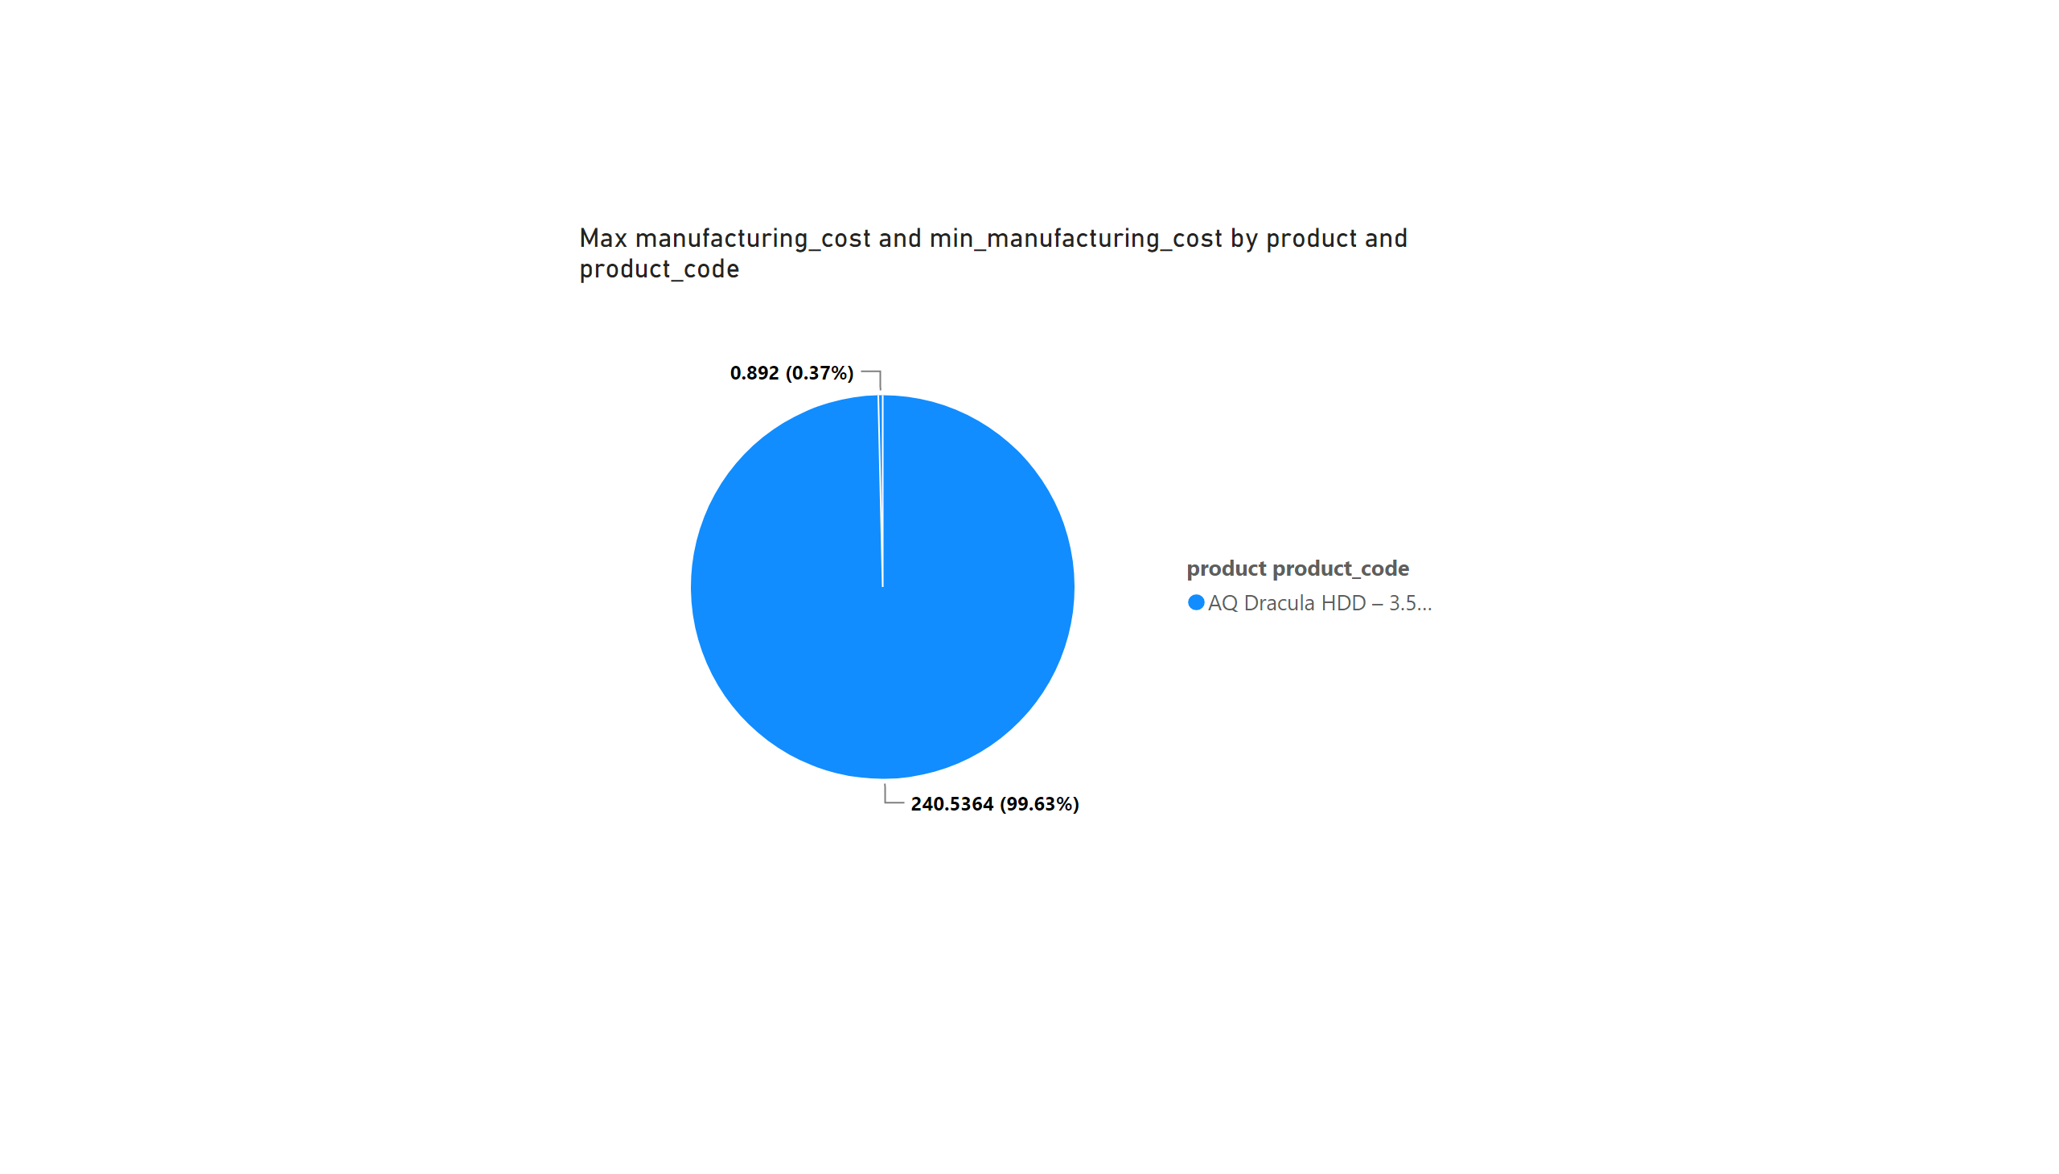
Insights:- AQ Dracula HDD 3.5 inch had max and min manufacturing costs. The Max cost of AQ Dracula is 224 in the year 2020 and approx 240 in the year 2021. The Min cost of AQ Dracula is 0.89 in the year 2020 and approx 0.91 in the year 2021

Slide 12
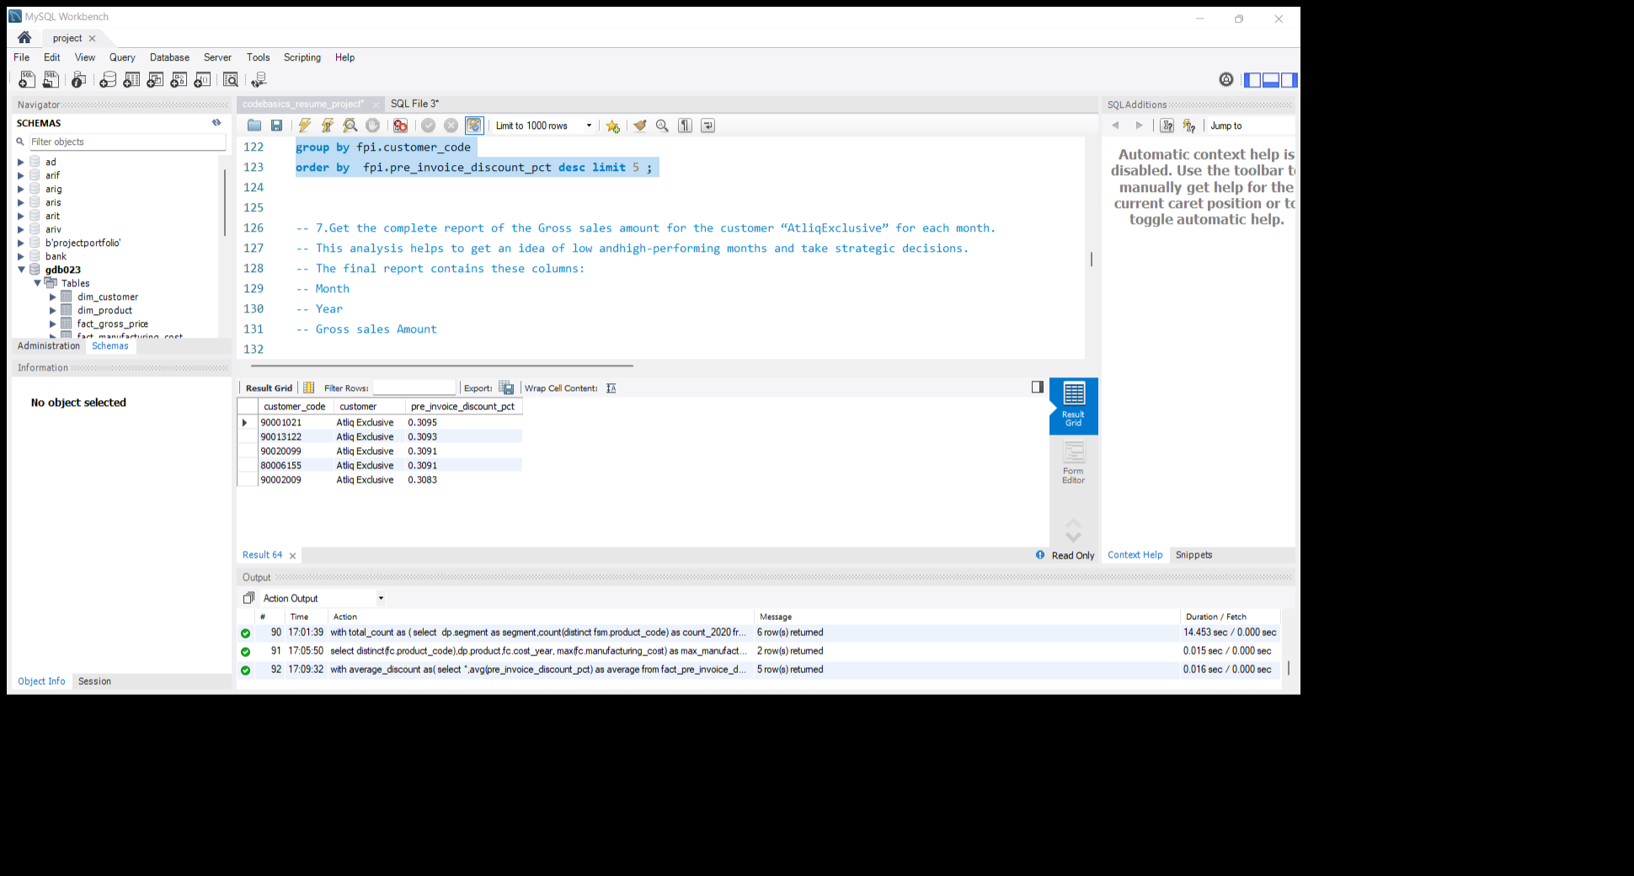
Que 6. Generate a report which contains the top 5 customers who received an average high pre_invoice_discount_pct for the fiscal year 2021 and in the Indian market. The final output contains these fields, customer_code customer average_discount_percentage

Slide 13
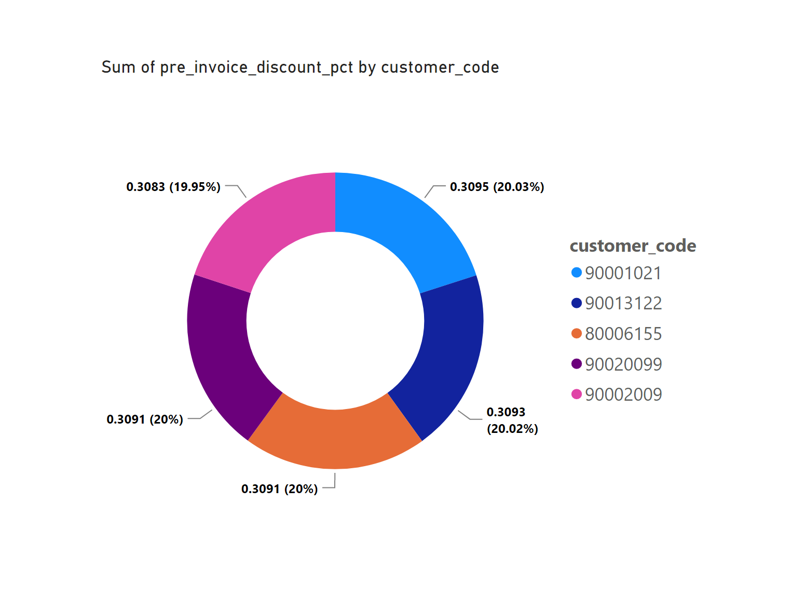
Insights:- five customers from “Atliq Exclusive” received an average high discount for the fiscal year 2021in the Indian market.

Slide 14
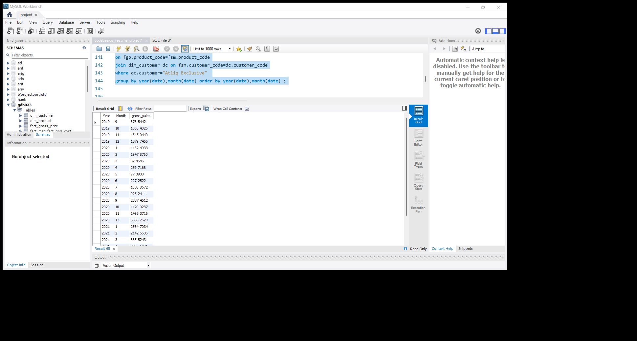

Que 7. Get the complete report of the Gross sales amount for the customer “Atliq Exclusive” for each month. This analysis helps to get an idea of low and high-performing months and take strategic decisions. The final report contains these columns: Month Year Gross sales Amount

Slide 15
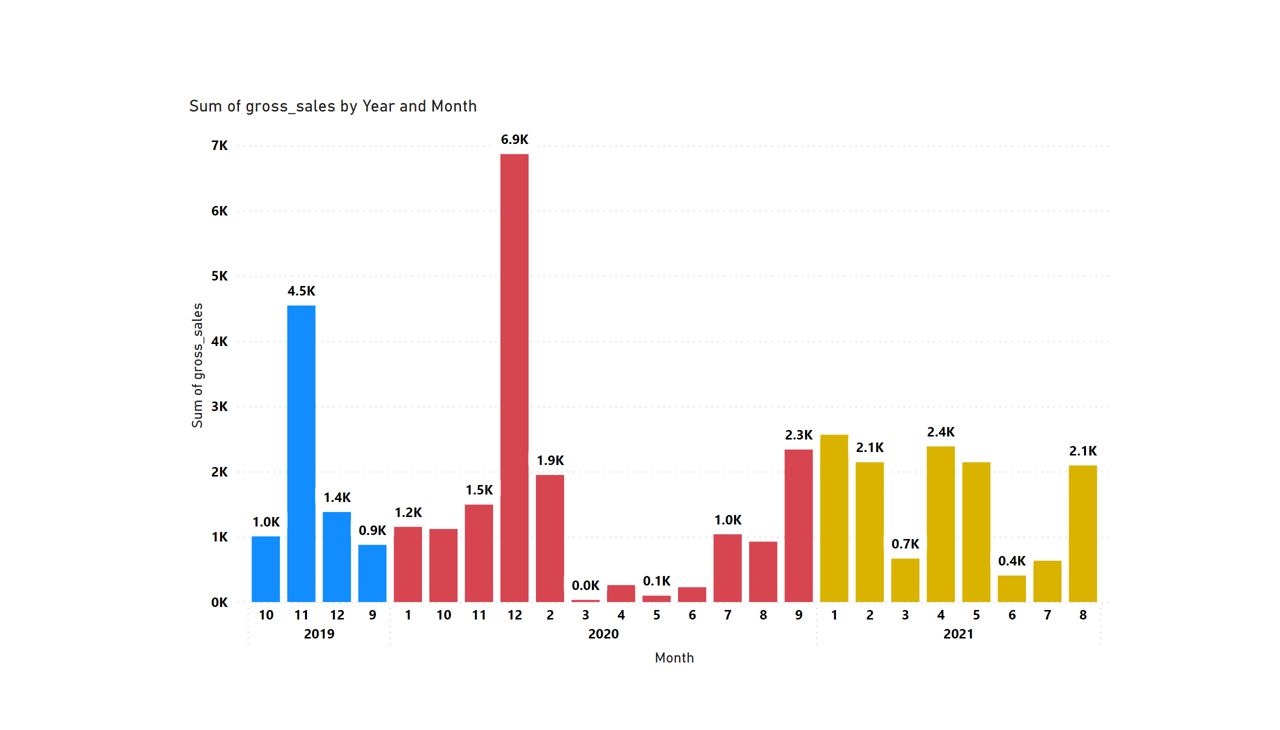
Insights:- In the years 2019 and 2020, November and December are high-performing months respectively March, April, and May is the low-performing month in 2020 and March, June, and July are in 2021. More focus is needed on March, April, May, and July for more gross sales.

Slide 16
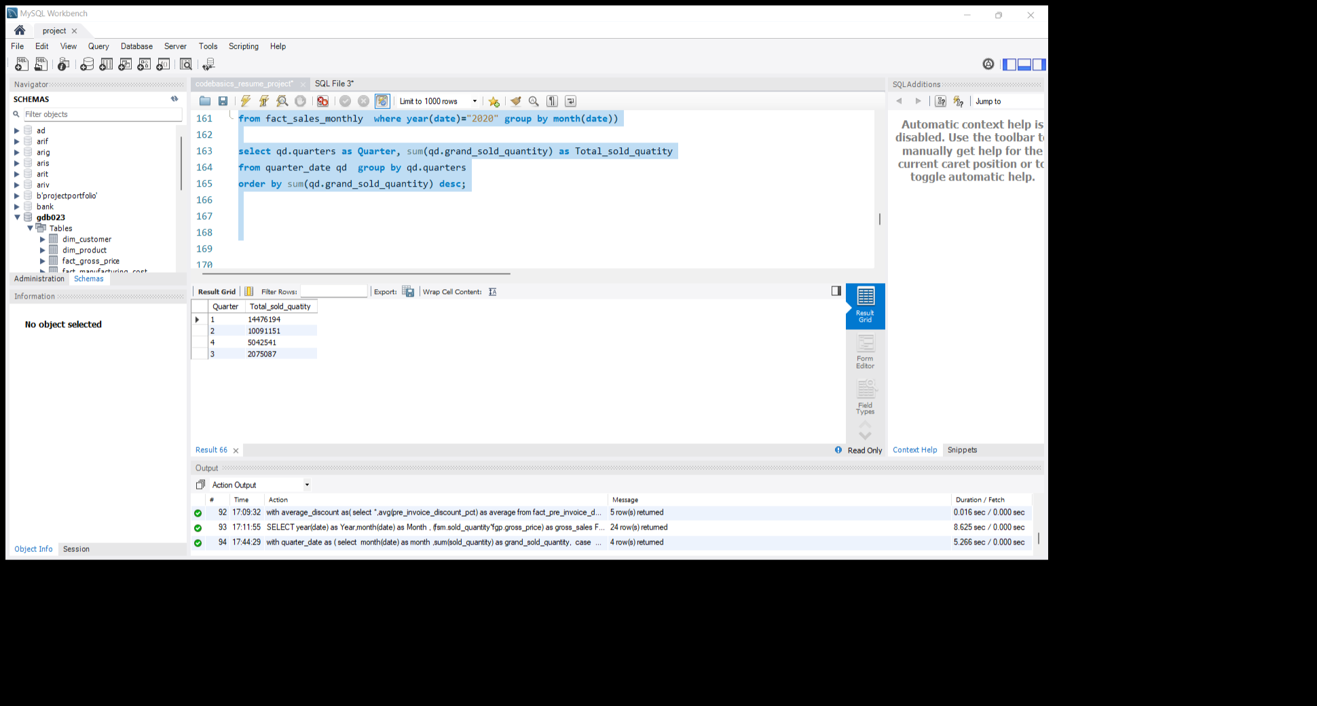
Que 8. In which quarter of 2020, got the maximum total_sold_quantity? The final output contains these fields sorted by the total_sold_quantity, Quarter total_sold_quantity

Slide 17
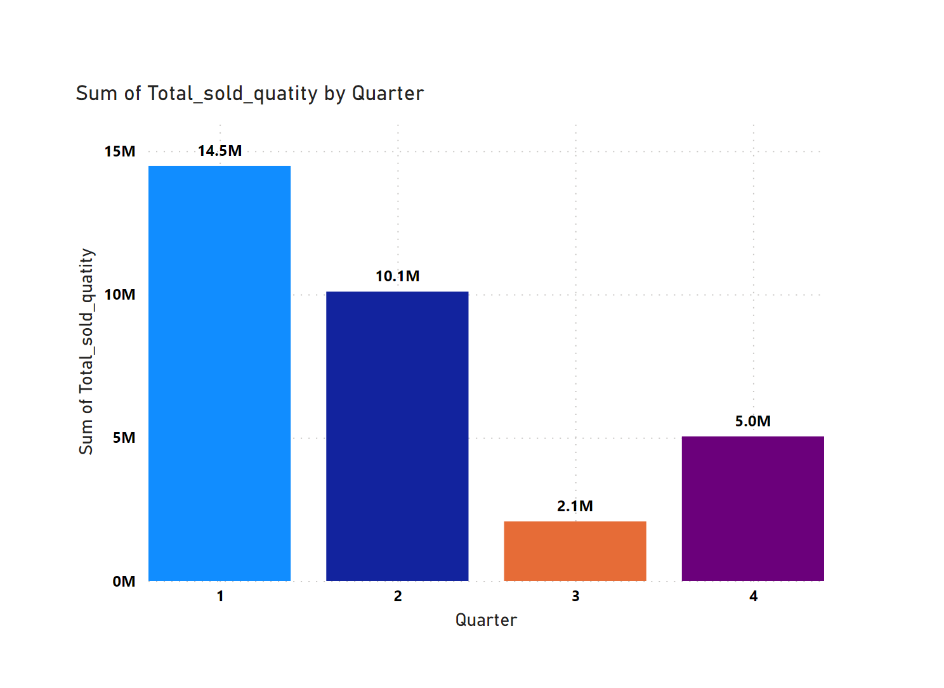
Insights:- Quarter 1 has sold the maximum quantity. least sales happened in quarter 3. need to focus on the last two quarters to increase overall sales.

Slide 18
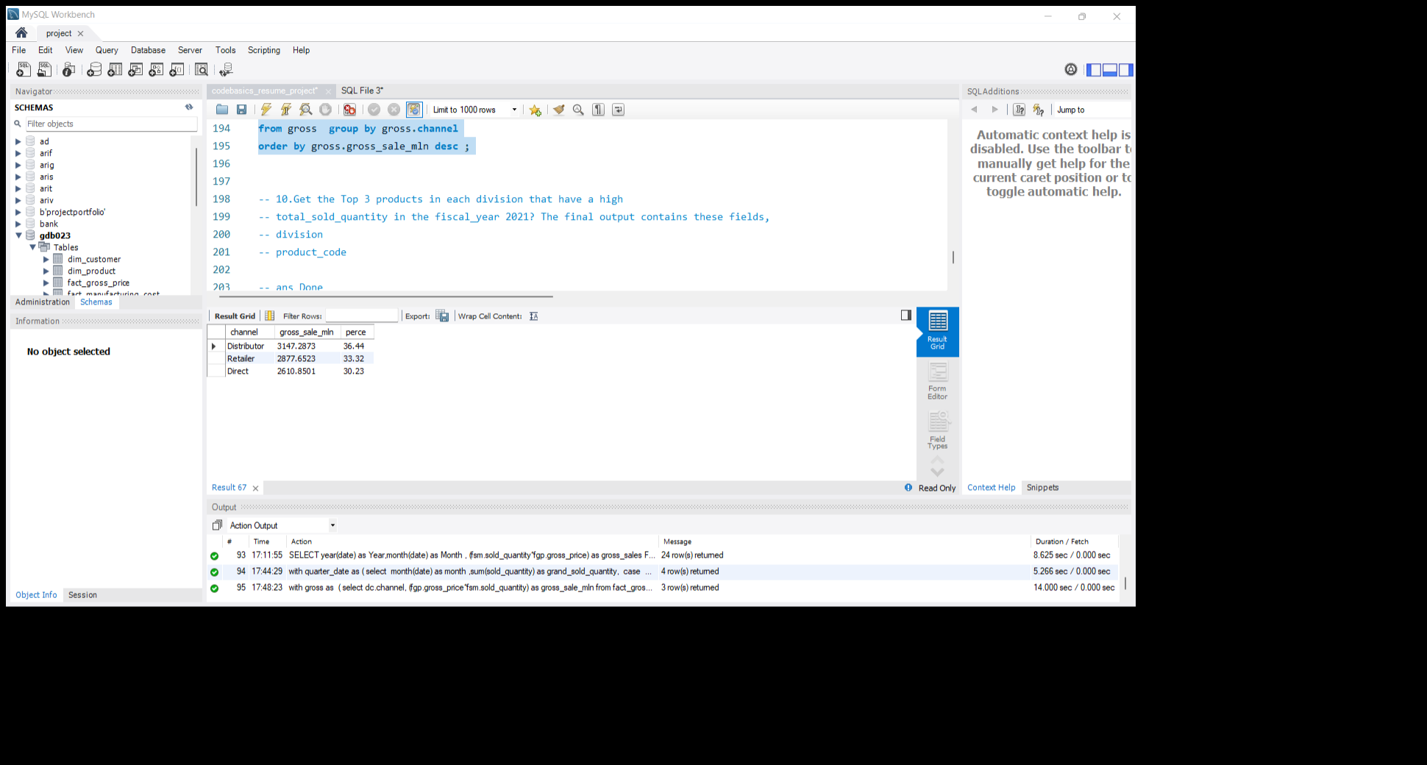
Que 9. Which channel helped to bring more gross sales in the fiscal year 2021 and the percentage of contribution? The final output contains these fields, channel gross_sales_mln percentage

Slide 19
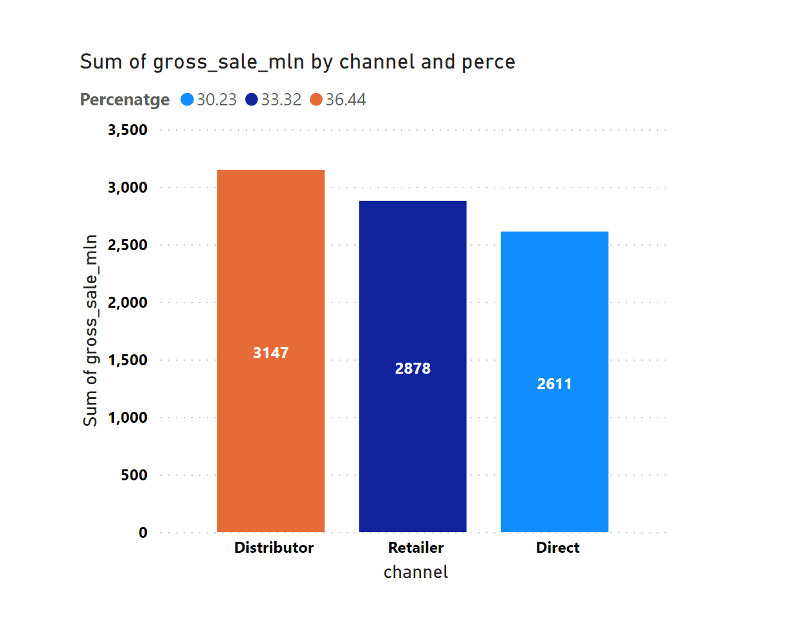
Insights:- distributor channel brings more sales in the year 2021. the company had strong retail and distributor network.

Slide 20
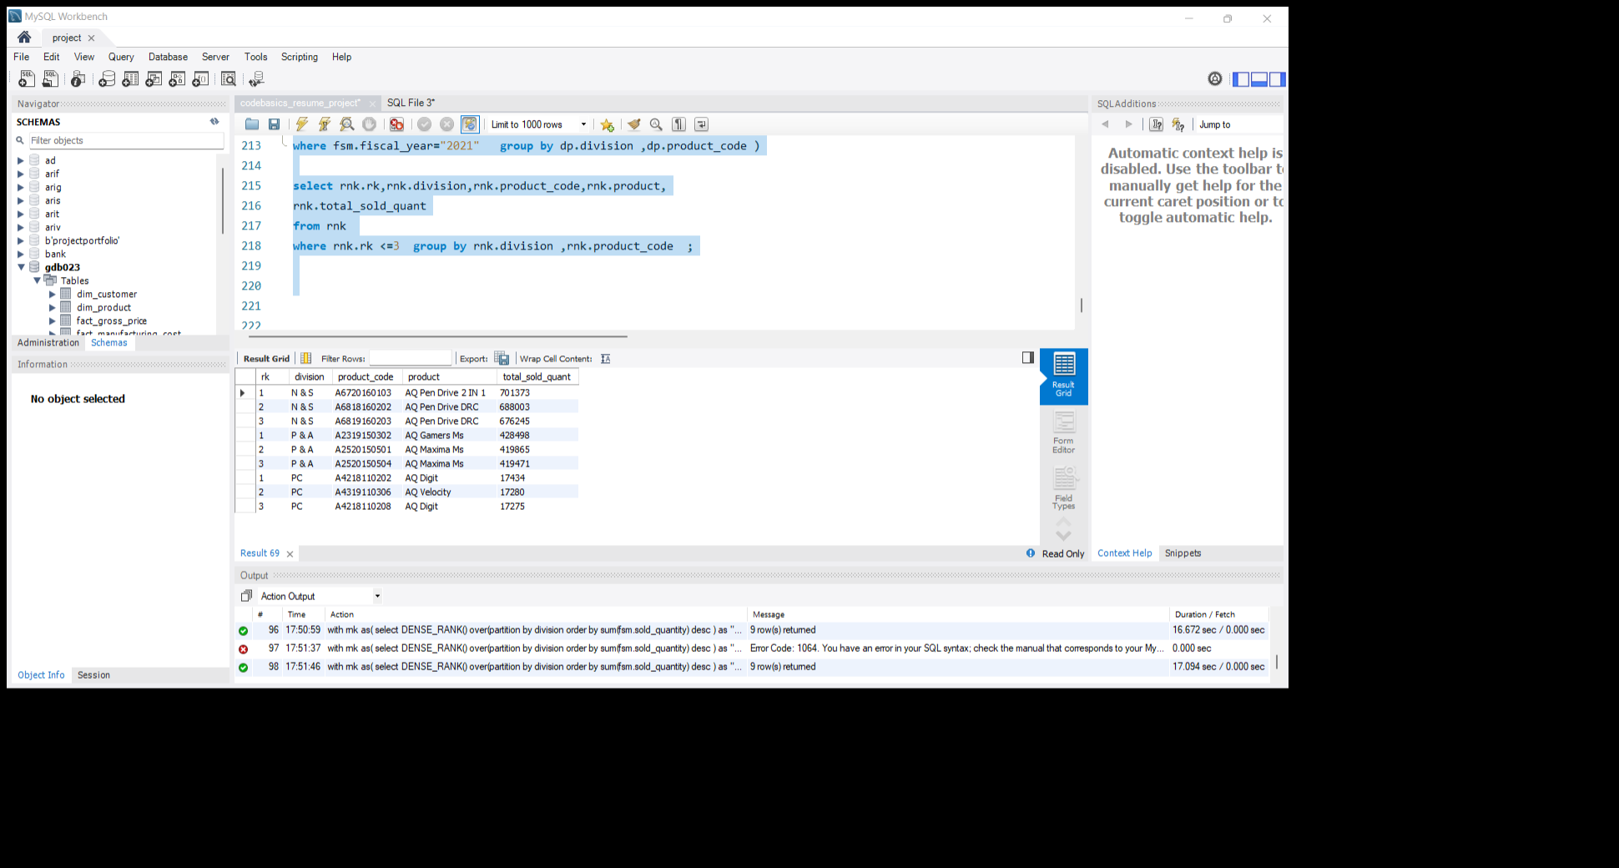
Que 10. Get the Top 3 products in each division that have a high total_sold_quantity in the fiscal_year 2021? The final output contains these fields, division product_code codebasics.io product total_sold_quantity rank_order

Slide 21
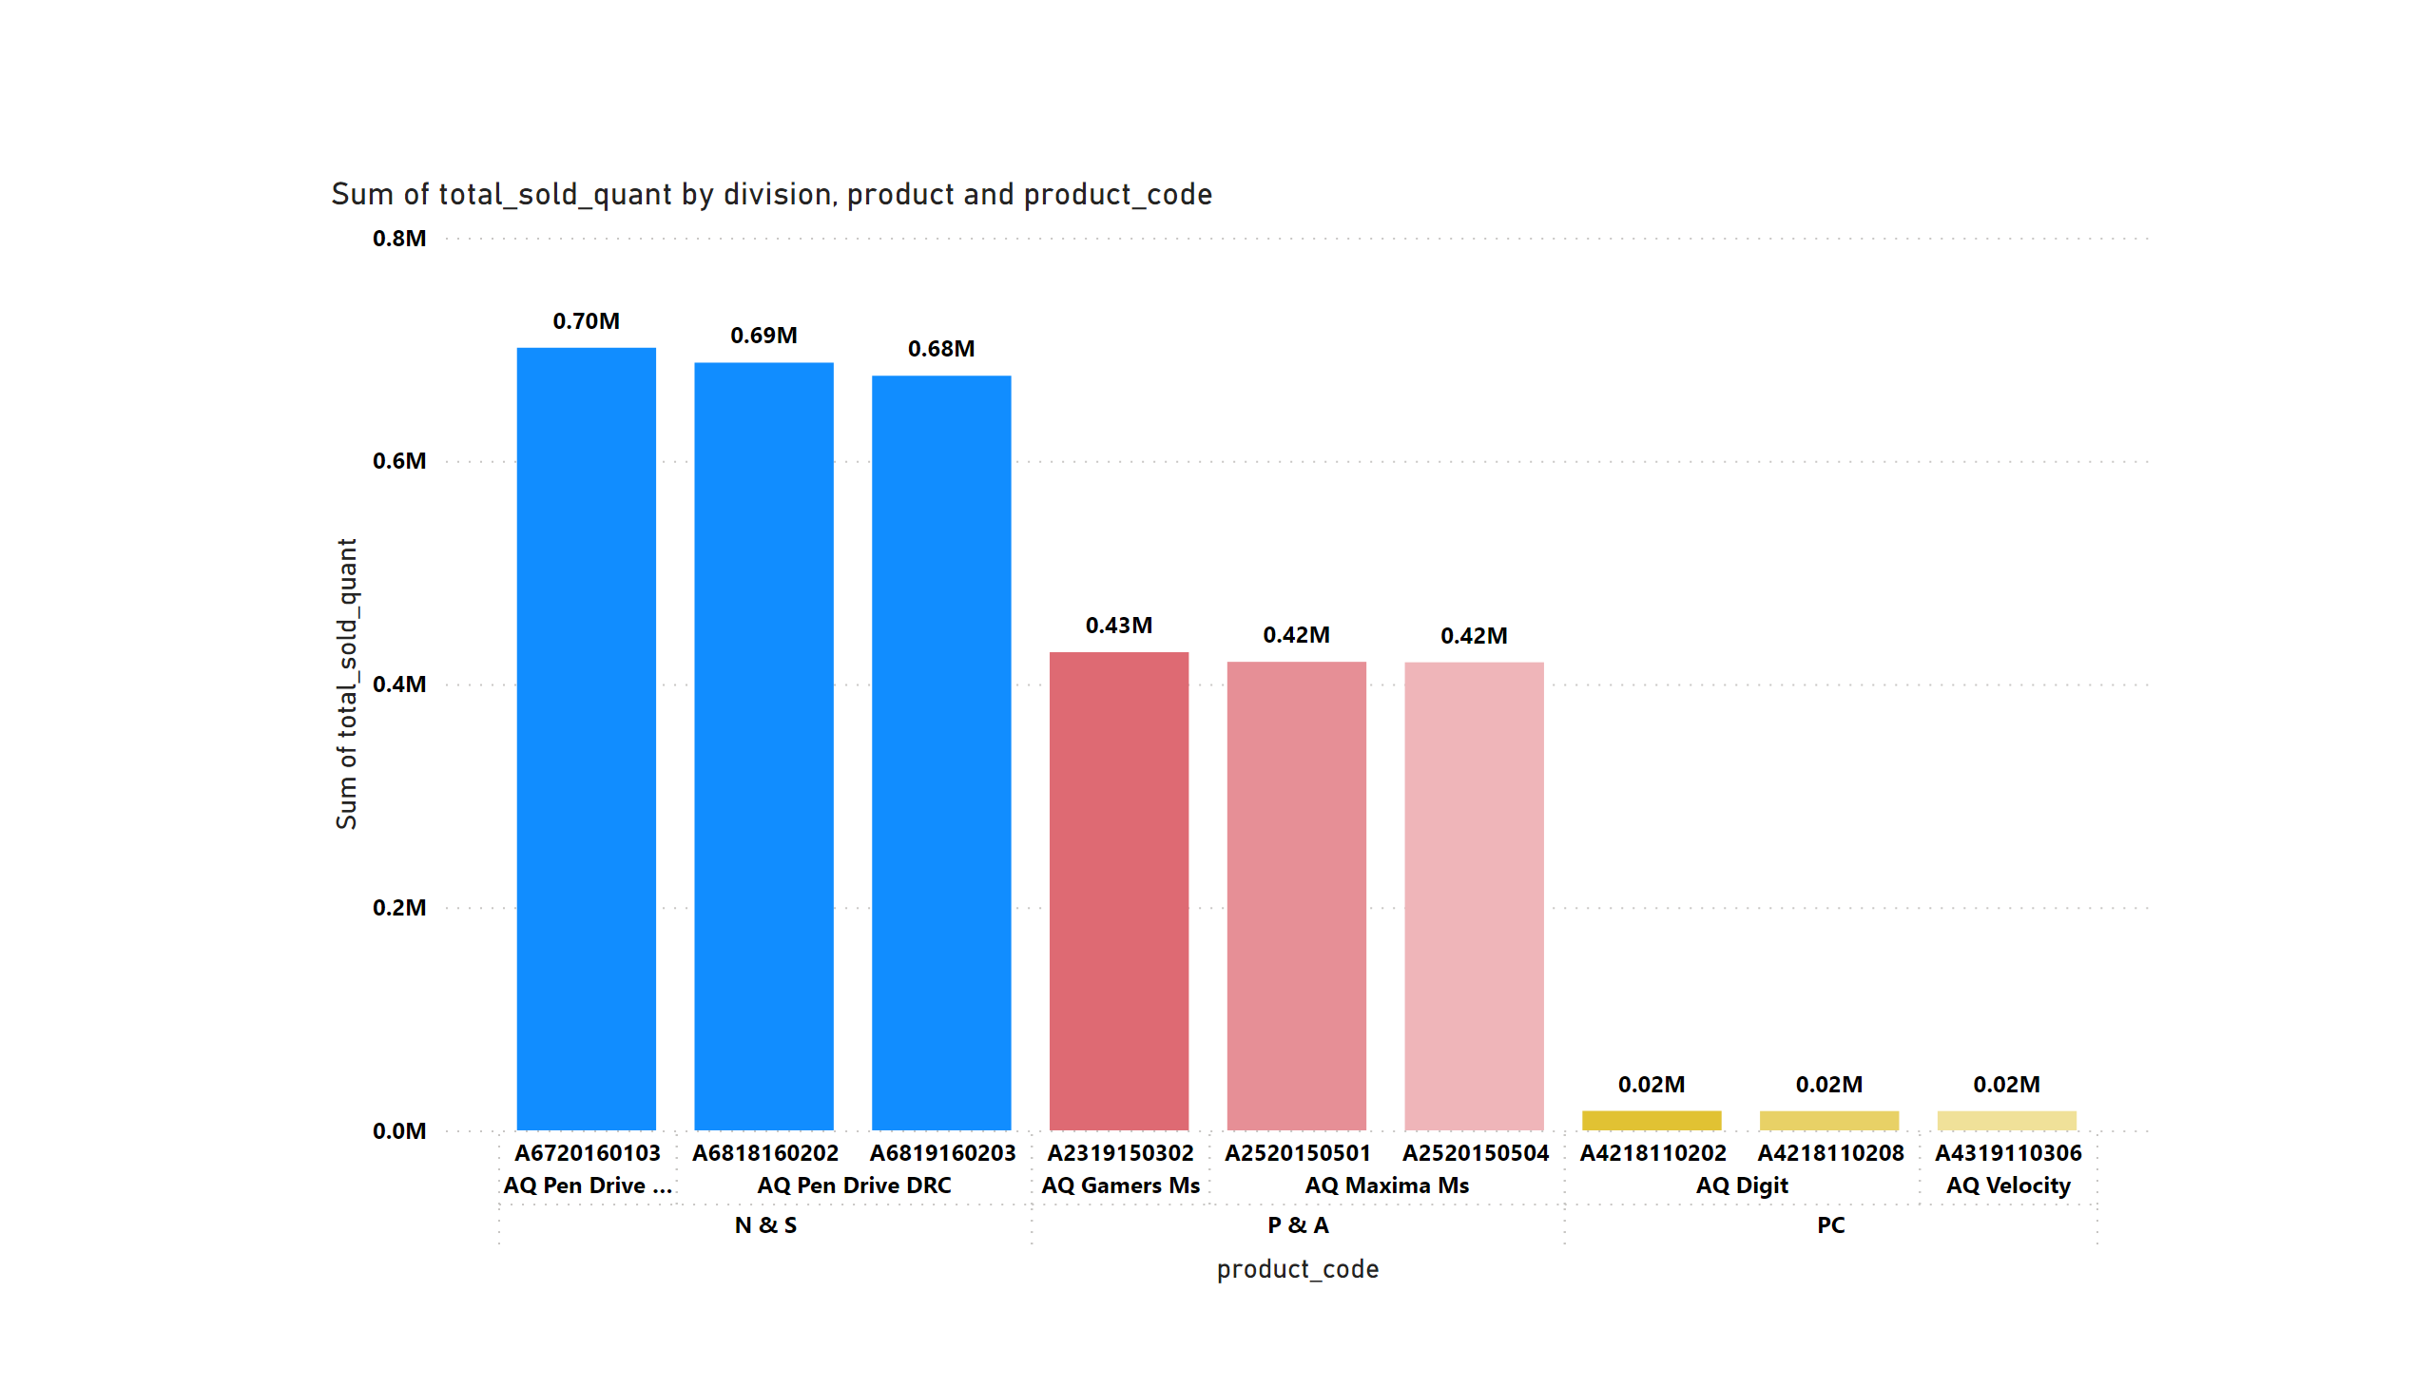
Insights:- N&S, P&A, and PC divisions had high sale quantity. As compared to other divisions, PC had less sold quantity.

