Slide 1

mandate.
Owner-approved business bill payments
An AI wallet agent with independent contract checks
Team ChainSentinel
International Track 2026 · Topic F: Agent Wallet
Synthetic bills and MDT test tokens
Notes:
0:00–0:40 planned slot.
We are Team ChainSentinel from Bangladesh. Mandate helps a small business handle supplier bills while the owner keeps control over payment permission. Our example is Orbit Studio, a fictional design agency assumed to use on-chain supplier payments. The owner reviews exact bills and grants bounded permission. AI helps interpret requests, then a restricted agent can process eligible bills after a separate confirmation. The contract checks every transfer independently. All invoices are synthetic and MDT tokens have no cash value. Our team members are MD ARIF SHEKH, MD MEHERAB HOSSAIN TALUKDER and IRIN KHATUN. Arif and Meherab study at IUBAT. Irin studies at Jagannath University.
Sources:
README.md
demo/SCENARIO.md
competition/technical-report-content.json

Slide 2
The complete payment workflow
First: the owner funds the vault and sets vendors, rules and agent access
Stage | What happens
1 Upload and review | Owner checks source fields and the trusted recipient
2 Sign bill approval | Wallet signature stores exact permission on-chain
3 Plan and confirm | AI request and integer checks produce an exact plan. The user separately confirms execution.
4 Pay and verify | Agent submits. Contract checks. Matching receipt confirms.
Approval grants permission. A confirmed plan starts execution.
The owner can pause or revoke access, effective after chain confirmation
02
Notes:
0:40–1:25 planned slot.
This is the full sequence. First the owner funds the vault and sets trusted vendors, spending rules and the agent session. The owner uploads a bill, reviews its source and signs its exact approval. That signature grants permission but sends no payment. Next, AI interprets the request. The application calculates an exact plan from approved bills and current chain state, asking a question if needed. The user separately confirms execution. The agent submits eligible payments, the contract enforces permission and matching receipts establish success. Unknown outcomes require original-hash recovery. The owner can pause or revoke access after confirmation on-chain.
Sources:
REQUIREMENTS.md R01–R15
ARCHITECTURE.md
README.md

Slide 3
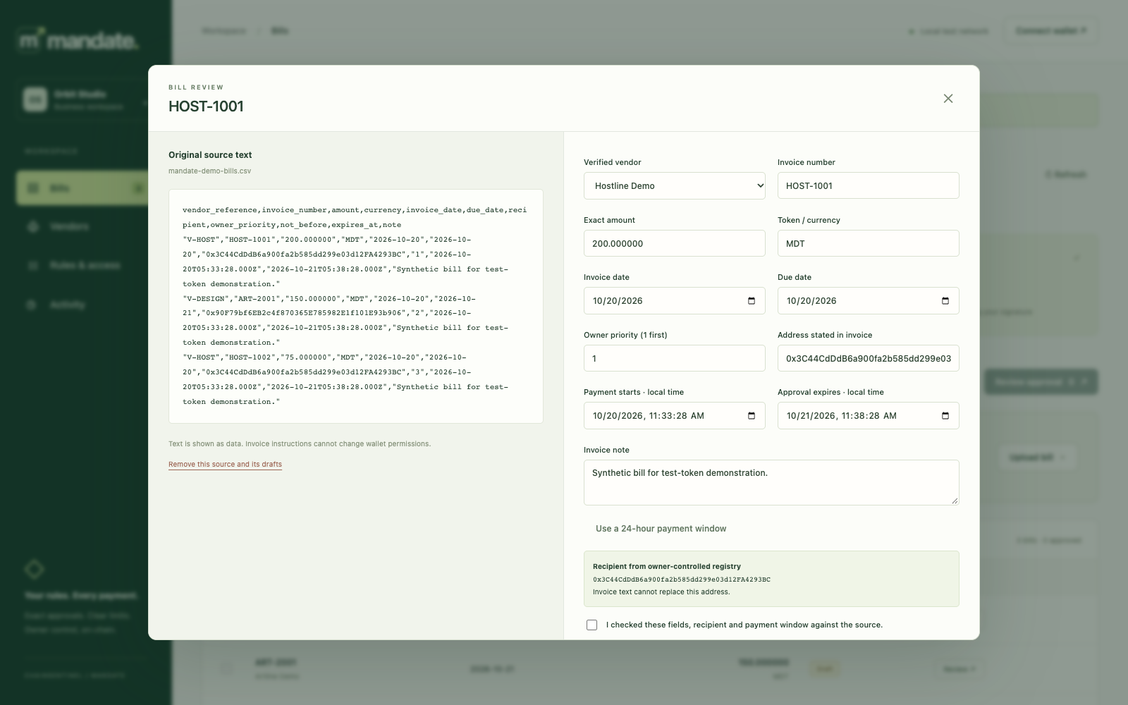
The owner’s bill review
A batch of supplier bills needs exact permission
Compare the source with the draft fields
Use the owner’s trusted vendor recipient
Sign the exact approval before planning
Recorded local scripted replay · chain 31337 · synthetic bills
03
Notes:
1:25–2:20 planned slot.
The owner’s work starts with the invoice. This actual application screenshot shows source text beside the extracted fields. It comes from a saved scripted local replay on chain 31337, with disposable accounts and no live model or wallet extension. The owner checks invoice number, amount, dates and the trusted vendor recipient. An address written inside an invoice cannot replace the owner’s registry. Missing or ambiguous details stop approval, and editing a draft clears its review stamp. The owner then signs exact bill approvals on-chain. That approval establishes permission but moves no tokens. This review boundary matters because neither a plausible extraction nor a sentence hidden in an invoice should create spending authority.
Sources:
REQUIREMENTS.md R01–R04
evidence/submission/2026-10-20/local-replay-verification.json
app/public/index.html

Slide 4
Payment authority
Component | Job | Payment authority
Owner / wallet | Approve exact bills and rules | Owner signature
AI model | Suggest fields and interpret requests | No keys or approval tools
Application / agent | Plan in integer units, then submit | Confirmed approved bill keys
MandateVault | Check rules and transfer MDT | Stored recipient and amount
Every payment refers to an owner-approved on-chain bill
04
Notes:
2:20–3:20 planned slot.
The architecture separates interpretation, permission and execution. The owner’s private key stays in the browser wallet. Groq, using openai/gpt-oss-120b, suggests structured fields and intent without receiving keys or transaction tools. Ordinary application code calculates amounts in exact integer token units, orders bills and checks current chain state. A separate user confirmation authorizes execution of the prepared batch. The restricted agent signs only the pinned vault payment route with a bill key and expected policy version. The contract reads recipient and amount from its approved record. It does not trust an amount supplied by the model. A database flag, a changed invoice or a convincing model response cannot replace the owner’s on-chain approval.
Sources:
ARCHITECTURE.md
SECURITY.md
contracts/MandateVault.sol
app/planner.mjs

Slide 5
A focused clarification
OWNER
“Pay that one.”
MANDATE
“Which bill would you like to pay? Please specify the bill ID or invoice number.”
0 selected bills 0 payment attempts
A valid payment plan still needs a separate confirmation
Saved live Groq interaction · 19 October 2026 · Sepolia workspace
05
Notes:
3:20–4:15 planned slot.
Useful conversation includes knowing when to ask. In this saved public-workspace interaction, the owner said, Pay that one. The live model asked which bill and selected nothing. Independent saved checks show zero payment attempts. After the owner identifies a bill, the application can prepare an exact plan, but execution still needs separate confirmation. Read-only questions cannot silently become payments. A proposed correction needs an explicit apply action and fresh source review, and cannot change an existing signed approval. Provider or quota failures leave manual review available. This is a recorded interaction, not a new model call. We also retain the answer-quality failures discussed near the end, so this successful example does not imply every answer was correct.
Sources:
evidence/sepolia/public/step5-sepolia-clarification-verification.json
evidence/STEP5_GROQ_RESULTS.md
REQUIREMENTS.md R15

Slide 6
The recorded Sepolia payment batch
Bill | Amount MDT | Outcome on 19 October
HOST-1001 | 200 | Paid, matching receipt
ART-2001 | 150 | Paid, matching receipt
HOST-1002 | 75 | Deferred by the daily limit
1,000 starting − 350 paid = 650 MDT remaining
250 MDT per bill · 400 per UTC day · 300 minimum reserve
Owner revocation confirmed at policy version 7
Public testnet · chain 11155111 · test tokens with no cash value
06
Notes:
4:15–5:20 planned slot.
The public testnet run connects the workflow to real mined receipts. The owner approved three bills totaling 425 MDT. The per-bill limit was 250, the daily cap 400 and the protected reserve 300. The confirmed batch paid 200 to Hostline and 150 to Artline. Only 50 of that UTC day’s allowance remained, so the 75 bill stayed unpaid. Starting from 1,000 MDT, the vault retained 650. These are the saved 19 October outcomes, not a claim about today’s remaining daily allowance. The owner subsequently revoked the agent at policy version seven. Both payment explorer links and the revocation link are in these notes. Execution Evidence supplies the complete register, receipt fields and original setup exceptions.
Sources:
evidence/STEP5_SEPOLIA_RESULTS.md
https://sepolia.etherscan.io/tx/0xa35b0bd2785c1b9272e571d2a5197eb5530089151c6b8e751935b02941931ba4
https://sepolia.etherscan.io/tx/0x37ba350085b7cf15423745251aa71c8530c7c5915493534663f7eb0a46029ac9
https://sepolia.etherscan.io/tx/0xa6a4665cdfe4e0e44e8e08103ef8e943d8ac05fcbe432fef225e940c1dcb60e0

Slide 7
Contract checks and recovery
Before a transfer
After a send
Approved bill and vendor
Match the receipt and payment event
Caps, reserve and active window
Keep paid bill keys consumed
Current agent and policy version
Reconcile the original hash on uncertainty
A timeout never triggers a blind second payment
Public rejection checks used unmined calls. Independent stop isolation is local.
07
Notes:
5:20–6:25 planned slot.
The contract checks the owner’s rules even when a caller bypasses the planner. It verifies the approved bill, vendor state, caps, reserve, time windows, configured agent and current policy version. A paid key remains consumed permanently. Before each send, the executor re-reads state and simulates the exact call. It records the original transaction reference and requires a successful receipt with a matching payment event before showing confirmed. Uncertainty stays distinct from success and recovery never blindly resends. Public duplicate, daily-limit and stopped-agent rejections were unmined calls, not failed mined transactions. The public stopped bill also exceeded its daily allowance. Clean local fixtures independently isolate revocation. Confirmed owner revocation prevents later execution but cannot reverse a completed transfer.
Sources:
contracts/MandateVault.sol
TESTING.md C01–C06
evidence/STEP2_RESULTS.md
evidence/sepolia/public/step5-sepolia-revocation-verification.json

Slide 8
Recorded local evaluation
Measure | Observed result
Ordinary task completion | 19 / 20
Exception explanations | 20 / 20
Interaction cases, within the 40 | 6 / 6
Wrong payment cases | 0 / 40
Exact critical fields, 26 CSV invoices | 156 / 156
Known safe miss: N13 asked an unnecessary extra question
40 fixed synthetic cases · repaired v5 regression · 19 October 2026
08
Notes:
6:25–7:30 planned slot.
The separate local evaluation used Groq openai/gpt-oss-120b on forty fixed synthetic cases, split between twenty ordinary and twenty hostile or exception cases. Six interaction cases are tags within those forty, not additional cases. V5 recorded nineteen of twenty ordinary completions, twenty of twenty exception explanations and all six interactions. Critical fields were exact across twenty-six explicit CSV invoices. The run used seventy-two model calls and produced twenty-seven verified local receipts. These are different denominators and must not be added together. Earlier failures informed repairs, so this is a repaired fixed-case regression, not untouched held-out accuracy. N13 still asked an unnecessary question about an already-paid bill. Zero wrong transfers describes this finite set and is not a universal safety guarantee.
Sources:
evidence/STEP5_GROQ_RESULTS.md
evidence/step5-evaluation-runs/2026-10-19T08-37-56-741Z-groq-live-analysis.json
demo/evaluation-freeze-groq-v5.json

Slide 9
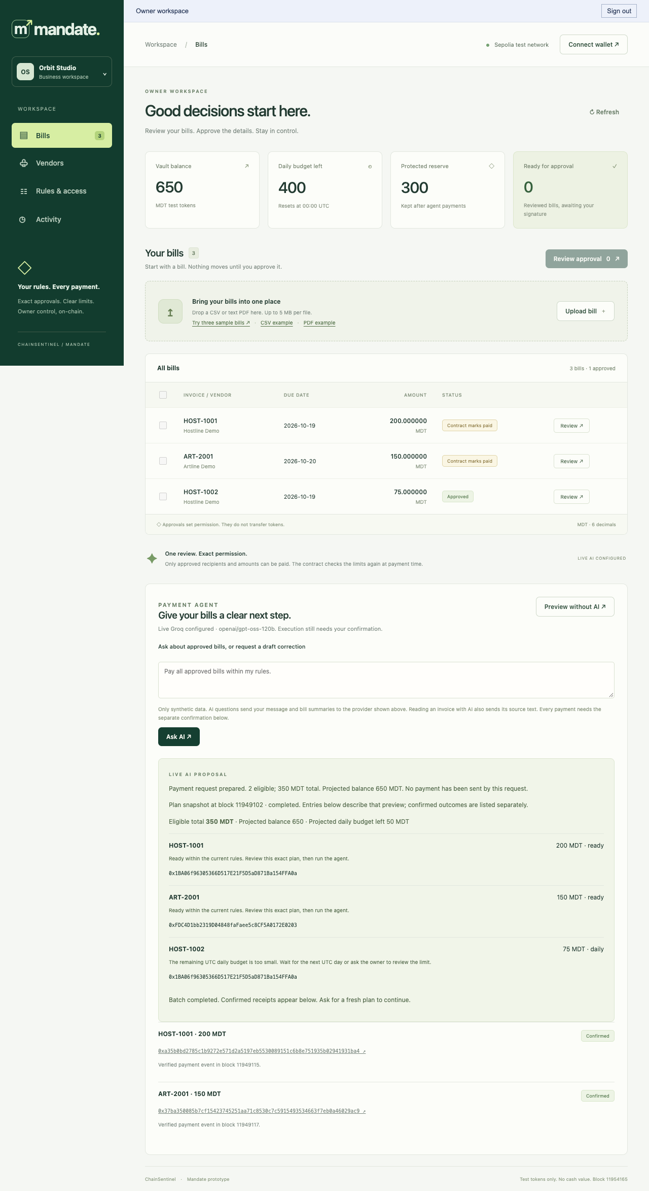
The hosted owner workspace
Render serves the protected application
Neon stores encrypted recovery snapshots
Verified restart preserves bills and receipts
Shared login grants full workspace access
Saved hosted screenshot · 20 October 2026 · existing Sepolia history
09
Notes:
7:30–8:25 planned slot.
Reviewers can inspect the working application through the protected Render URL supplied with the deliverables. The gateway enforces login, secure cookies and origin checks. The application uses working SQLite state, with AES-256-GCM encrypted recovery snapshots stored in Neon. Saved browser and actual restart checks retained the same three reviewed bills and two payment receipts. The screenshot shows that existing history, not a new payment run. The daily budget resets by UTC date, while the proposal below remains a historical plan. The shared login grants full workspace access. It has no individual identities, MFA or read-only judge role. Repeated wrong passwords return 429, but there is no enforced delay or durable lockout. Private login instructions travel separately from this public deck.
Sources:
evidence/HOSTING_RESULTS.md
competition/JUDGE_REVIEW.md
competition/HOSTING.md
SECURITY.md

Slide 10
Scope and reviewer access
A complete bill workflow with inspectable permission and receipts
Known answer miss: 350 eligible reported instead of 425 approved
Prototype signing storage, shared access and no external audit
No measured human time savings or held-out accuracy claim
Source ZIP and setup README · Execution Evidence and receipt links
https://chainsentinel-mandate.onrender.com
Local development and Sepolia only. Organizer acceptance of Sepolia is unconfirmed.
10
Notes:
8:25–9:30 planned slot.
Our contribution is an end-to-end workflow that connects source review and useful conversation to exact permission, restricted execution and independently matched receipts. We keep its limits visible. A public read-only question reported 350 MDT eligible rather than the requested 425 approved total, without initiating payment. N13’s safe completion miss remains in the local results. The manual baseline was automated and establishes no human time savings. Both hostile virtual comparisons were safe, so that sample establishes no incremental contract benefit. Signing storage and shared authentication need production work, and there is no external audit. This prototype supports only local development and Sepolia with test tokens. Organizer acceptance of Sepolia remains unconfirmed. Reviewers can open the source ZIP, follow its setup README, inspect Execution Evidence and use the separately supplied workspace access instructions. Thank you.
Sources:
README.md
SECURITY.md
evidence/STEP5_GROQ_RESULTS.md
evidence/sepolia/public/step5-sepolia-read-only-observation.json
submission/plan.md

