Slide 1
CAR-MARKET
Pınar Bayata
Kübra Nur Güzel
Arif Can Terzioğlu
Ömer Berk Uçar

Slide 2

Project Purpose
With Car Market, we plan to create a user friendly, easy to use product with some features that we thought would create a more trustworthy trading environment for regular users.

Slide 3

Project Key Stakeholders
Development Team
Potential sellers/buyers
Customer Services
Project manager
Sales Directors
Solutions Consultant

Slide 4
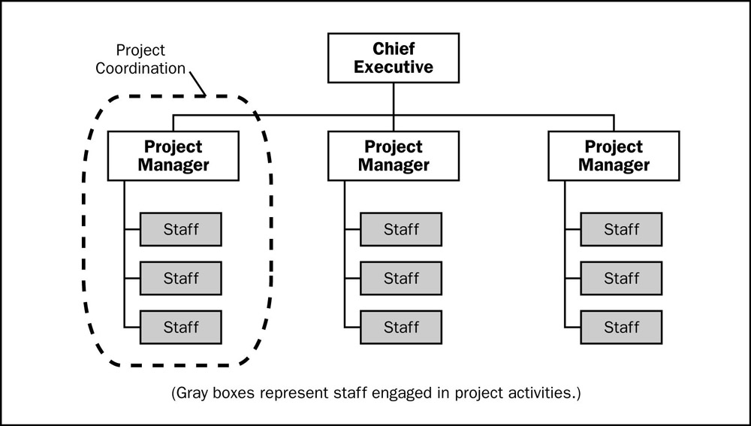
Project Organization
Projectized Organization Structure
Team of 10 Members
Project Manager
Software Architect
Backend/Frontend Developers
UX Specialist
Testing and Validation Specialists
Database Analyst

Slide 5

Schedule of Deliverables
Low-Level Design Report
High-Level Design Report
Functional Test
User Acceptance Tests
Pilot Usage (Project Demo)
Effects of the Project

Slide 6

Project Constraints and Requirements
Legal, security, reliability, sustainability, technical and implementation related constraints were conducted carefully.
Hardware and software related requirements were analyzed.
Observed the rivals on the market and came up with different system features.

Slide 7
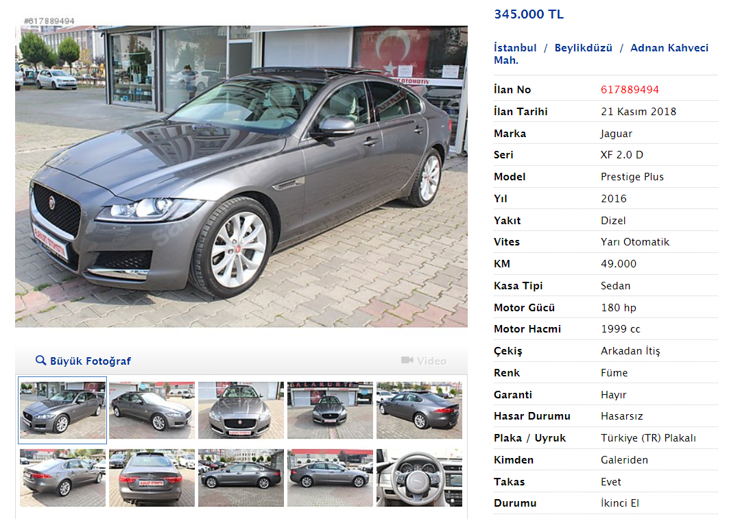

Slide 8
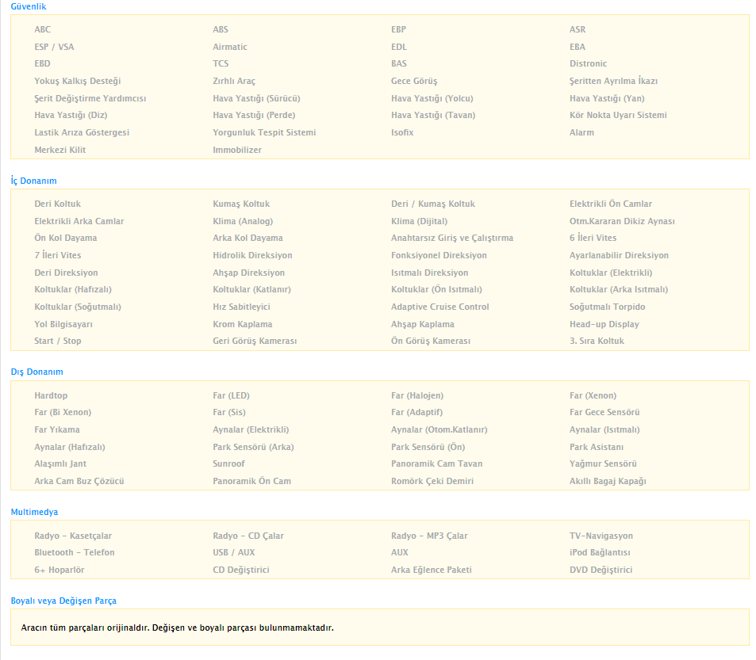
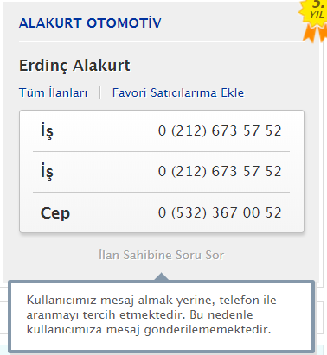


Slide 9
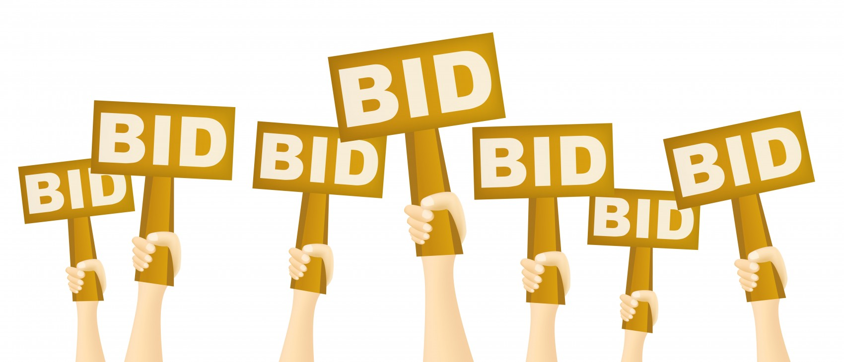
What is different with Car Market?
Online Auction System with secure bidding

Slide 10

What is different with Car Market?
Online chatting between the buyers and sellers
Online customer service

Slide 11

What is different with Car Market?
“Reliability Rate” for the users in order to create a more trustworthy environment and prevent possible fraud issues.

Slide 12

What is different with Car Market?
Professional Driver Assistant for purchases from different cities.
Easy trading processes with the notary authority.
Change to have it returned after examination.

Slide 13
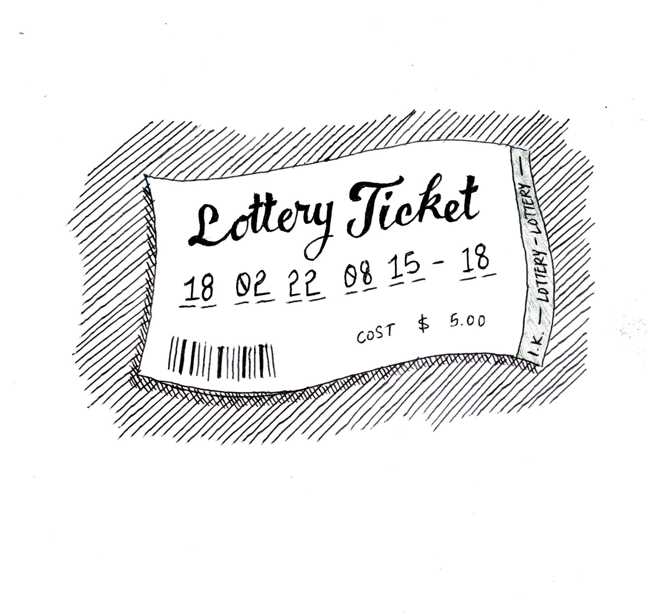
Risk Response Strategies
Risks are analyzed by the team and explained in detail on our SPMP Report.
We will try to Mitigate our risks that we encounter.

Slide 14



Managerial Process Plan
Highly skilled employee profile
Best parallelization of tasks
Well Planned Work Breakdown Structure
10 Months

Slide 15

Managerial Process Plan
Budget for Project Planning = 4,000 TL
Budget for Software Engineering = 285,000 TL
System Engineering and Deployment = 8700 TL
Infrastructure (Server/ Domain...) = 2400 $ per month
Future Updates and Maintenance = 15,000 TL per month

Slide 16
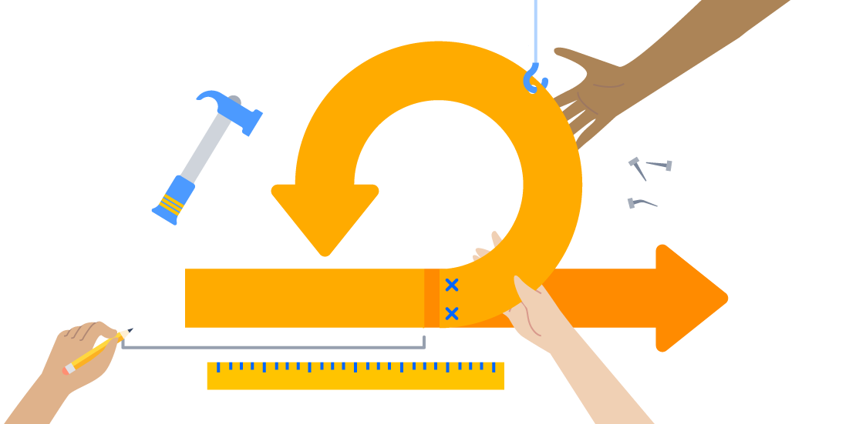
Methods, Tools and Techniques
Agile Methodology will be used for CarMarket.
For the development of the system, MySQL database will be used.
PHP will be used for backend development.
HTML and CSS for the frontend development will be used.
The system will work on every web browser that supports HTML.

Slide 17
Demo of the Product Stereotype

