Slide 1
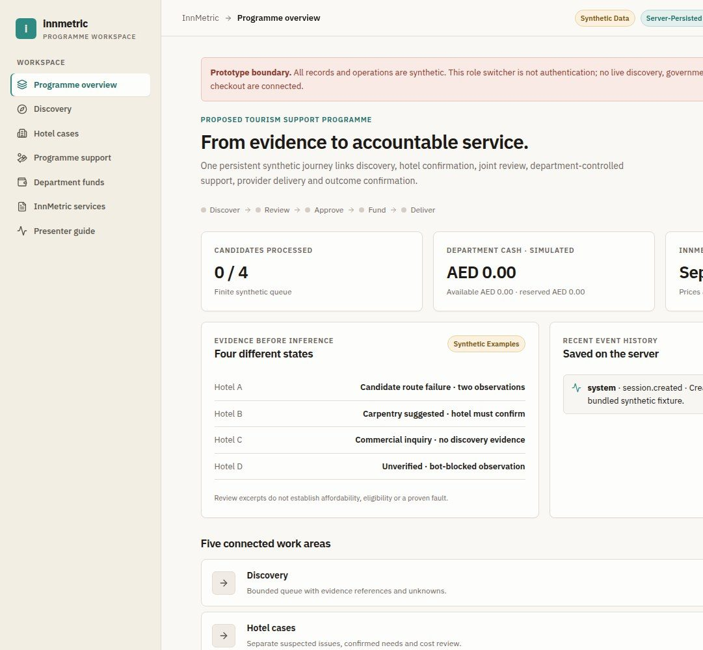

INNMETRIC
InnMetric:
From evidence
to accountable
service
AI-assisted hotel discovery, human review and
department-administered support
Proposed Tourism Department programme
Separate InnMetric commercial services
Working demonstration using synthetic data

Slide 2
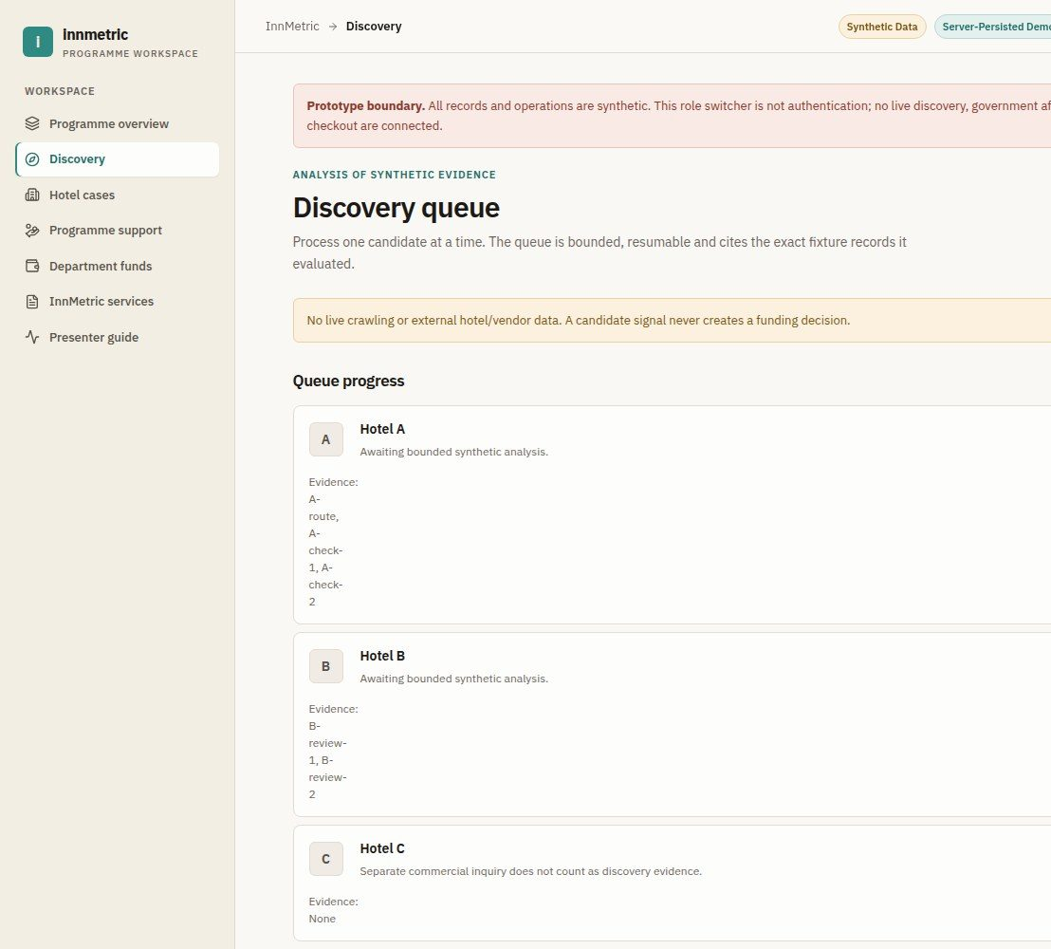


02 / 06
Discover signals.
Confirm needs.
Hotel A: repeated booking-path
observations suggest an issue
Hotel B: review signals suggest
carpentry; the hotel confirms
the need
Hotel D: blocked or uncertain
evidence stays unverified
Reviews alone never establish
affordability

Slide 3
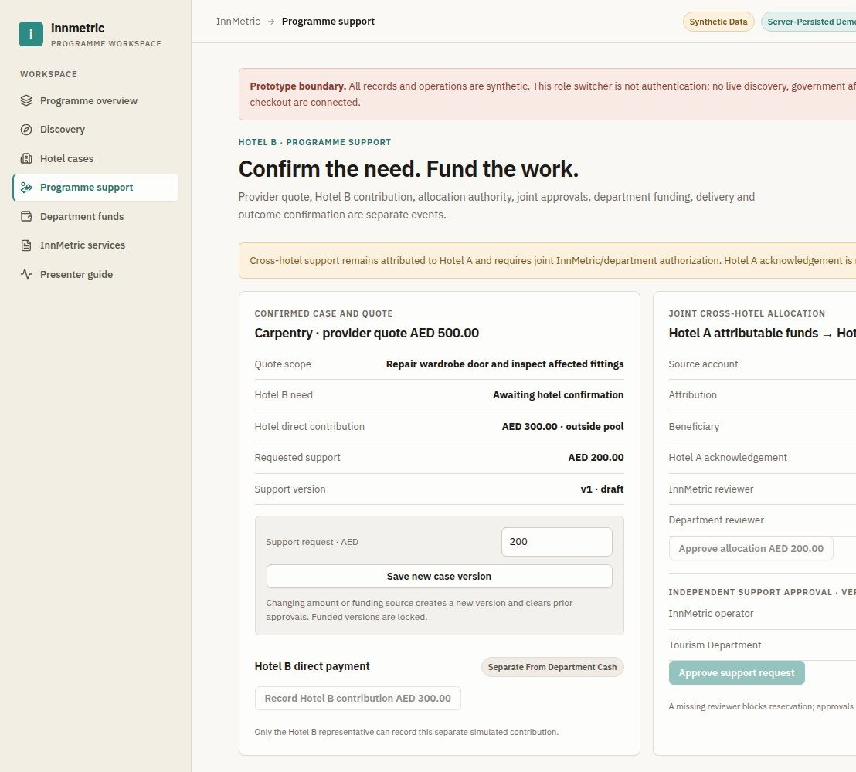
03 / 06
One connected
service journey
Discover, investigate and confirm the
hotel need
InnMetric and the department jointly
review support
Department records funding;
provider records delivery
Department, hotel and InnMetric all
confirm the final outcome

Slide 4
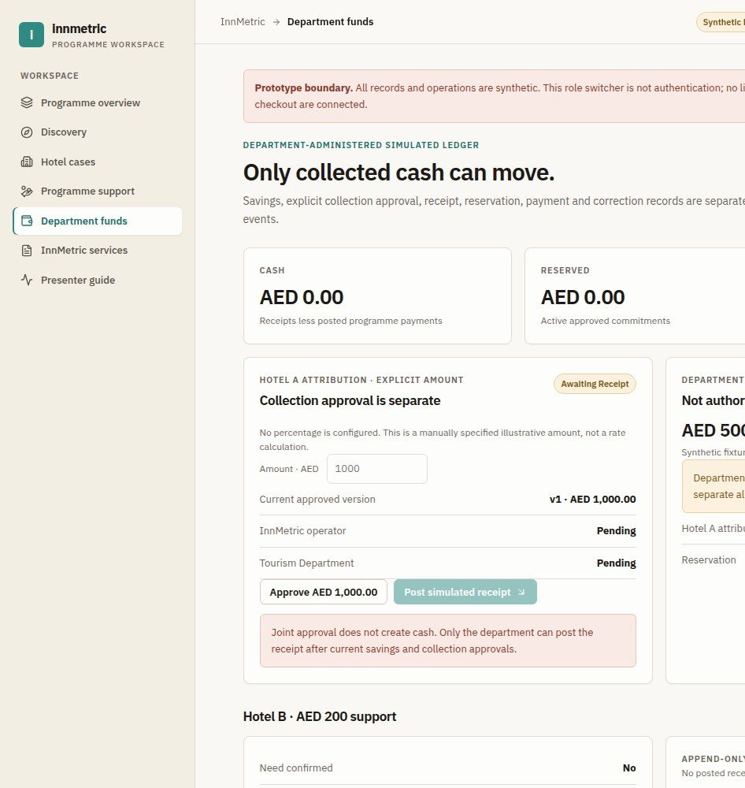

04 / 06
CAPTURED SCREEN
Savings are not spendable cash
ILLUSTRATIVE SEQUENCE
Synthetic costs: AED 5,000 baseline minus AED 4,000
observed equals AED 1,000 candidate savings
Savings verification and collection approval are
separate joint reviews
AED 1,000 receipt minus AED 200 support payment
leaves AED 800
Hotel B pays AED 300 separately, outside
department cash
InnMetric cannot execute pool payments
Captured before funding · illustrative sequence
shown separately

Slide 5
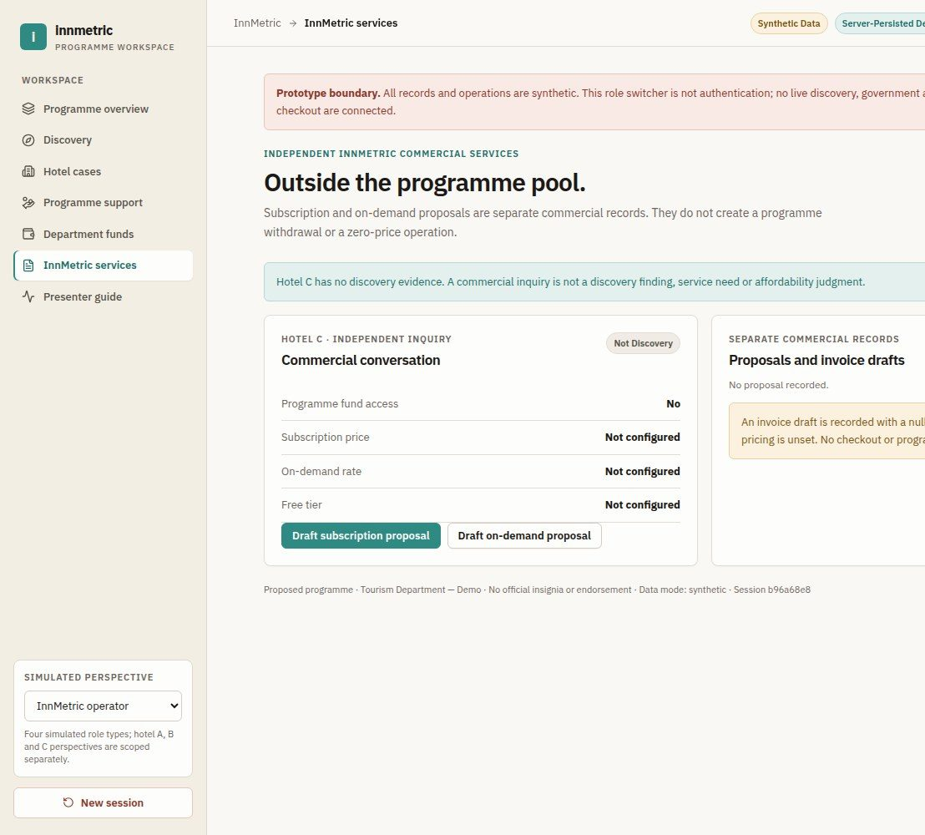
05 / 06
Two business lines.
Separate finances.
Programme: discovery, reviewed
support and provider coordination
Commercial: advanced subscription
or on-demand proposals
Commercial proposals never
withdraw programme funds
Prices and contribution percentages
remain unconfigured

Slide 6
06 / 06
Demonstrate today. Validate next.
WORKING SOFTWARE
Working software: persisted cases, calculations, review gates and
traceable records
SIMULATED
Simulated: evidence, role identities, receipts and payments
NOT ESTABLISHED
Not established: government affiliation, real hotel savings or live financial
integrations
NEXT
Next: validate one authorized hotel case and one provider workflow
Seeking feedback on the operating model and a suitable pilot partner

