Slide 1
Colruyt Group
Look-alike Modeling
for Highbrow Wines
May 08, 2019
Arif Thayal

Slide 2
« Data Science Solution »
Context and Briefing
Data Discovery
Data Preparation
Modeling Approach
Decision Making
Deliverables
Agenda
26 April 2017 | 3

Slide 3

Context & Briefing
Problem Statement: To identify the customers who are most likely to buy highbrow wines on the retailers webshop in 2017.
Solution:
Based on 2016 available data, build a Look-alike model which predicts the most likeliness to target the highbrow wine customers in 2017.
Look-alike modeling “results in double or even triple the results of standard targeting, according to the 30 percent of advertisers and more than half of agencies who reported using the tactic.”
Using Data science, we can treat this as a Classification problem

Slide 4
Context & Briefing - Points
Goal: Develop a Look-alike model for Highbrow wine online customers and predict the results for 2017 based on this model
Relevant information: 2016 labeled data of the customers, 2017 unlabeled data of the customers
Deliverables:
2017 predictions for Highbrow wine customers and code block used for development
Validation metrics used:
Prediction metrics on validation datasets (Confusion matrix, ROC curve)
Prediction vs Actuals for the unlabeled data (Handled by Validators)

Slide 5
Context & Briefing - Modeling approach
Data Preparation
Modeling Pipeline
Train & Score
Data transformation
Encoding & Scaling
Data discovey
Data collection
Data Exploration
Hypertuning
Predict the labels
Model Evaluation
Model selection
Feature Selection
Scoring the Unlabeled data

Slide 6
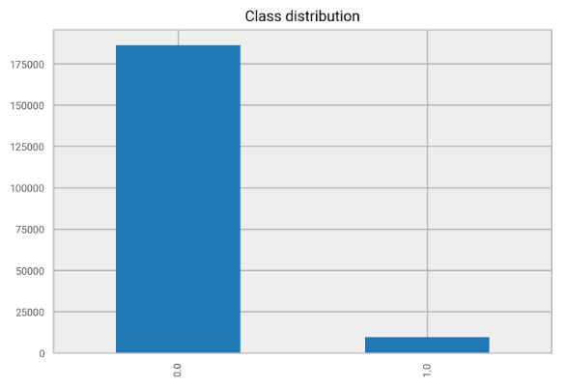

Data Discovery – Imbalanced datasets
Target Class distribution is highly imbalanced
Solution for Modeling:
Use Re-sampling techniques to better predict the minority class during training.
Use class weight balancing and stratified sampling during training.

Slide 7
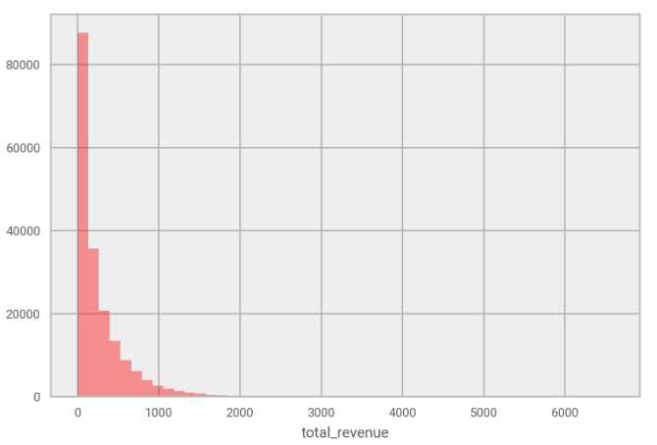
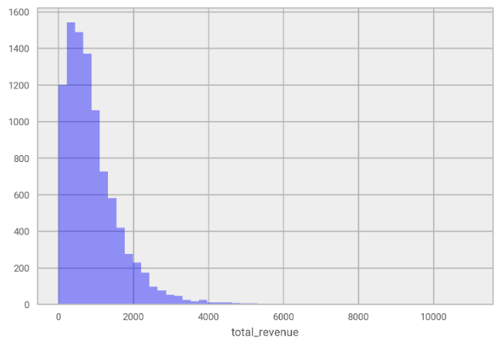
Data Discovery – Revenue distribution
Feature “total_revenue”
Class 0 shows many customers as less active, but Class 1 has proper distribution of total revenue
Class 0 Class 1

Slide 8
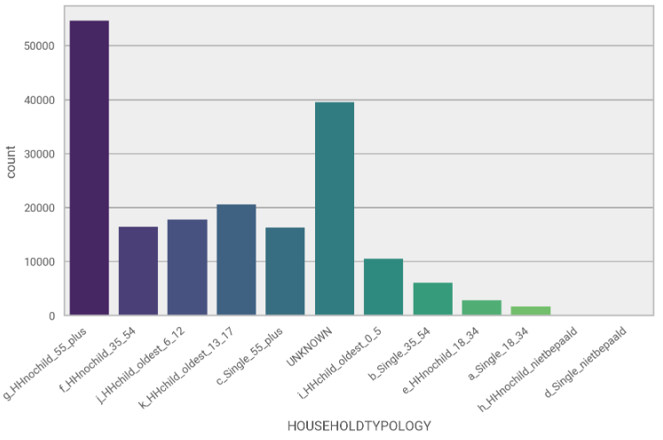
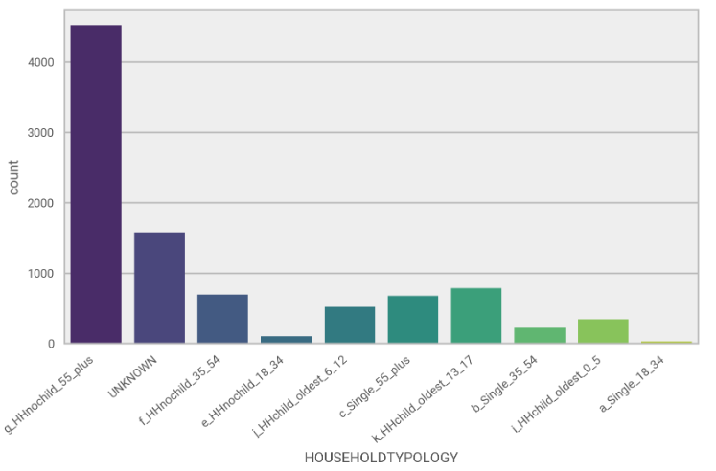
Data Discovery – Household typology
Feature “HOUSEHOLDTYPOLOY”
‘HHnochild_55_plus’ customers stands out for both Class 0 and 1. This could be due to loyal customers as pensioners and having same behavior online and offline
Class 0 Class 1

Slide 9
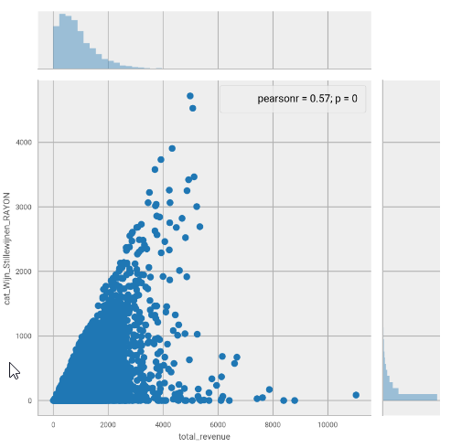
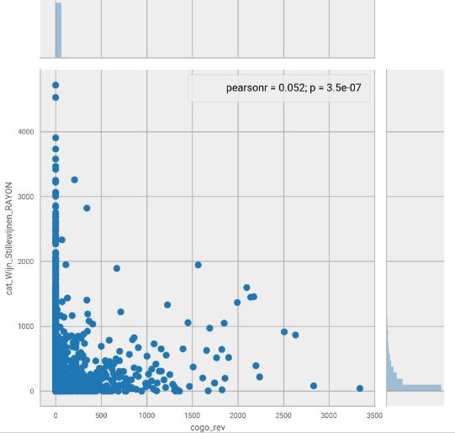
Data Discovery – Wijn & Revenue relation
Finding relation between “Wijn” turnover with “total revenue” and “collect&go revenue”
Wijn and total revenue are correlated, but no explicit behavior between collect&go revenue

Slide 10
Data Preparation - Transformation
Below data transformation steps are performed to clean the data;
Removed target variables with null values (can’t be trained)
Removed ‘Jaar’ column which was constant across the data
Enriched missing/null/negative values
Collishop_customer (‘Null’ to ‘N’)
Total_Revenue (‘Null’ to mean value)
Category turnovers (‘Null’ and negative to 0)
Transform Negative to Positive
Price sensitivity and Total discount values are stored as negative values
Absolute values are considered for transformation
Removing Outlier observations (based on frequency and turnover in SOW_type_colr)

Slide 11
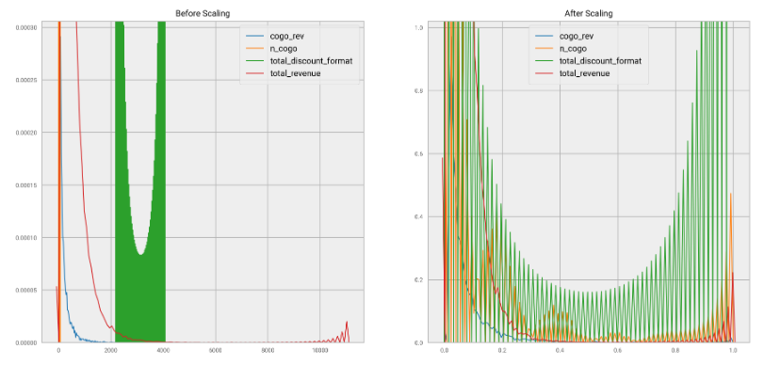
Data Preparation - Encoding
Used OnHotEncoding for categorical variables
Used MinMaxScaler to scale the features between 0 and 1

Slide 12
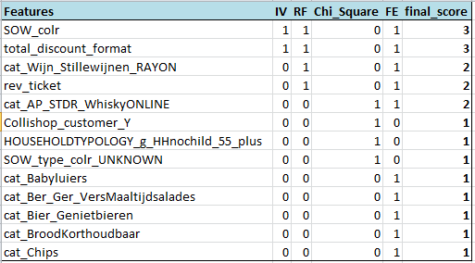
Modeling Approach – Feature Selection
The following methods were used for feature selection and used voting to select the best predictors from them;
Information Value using WOE
FE using Random Forest
Chi Square best variables
RFE using Logit
In total 23 best features were selected
(out of 55 features)

Slide 13
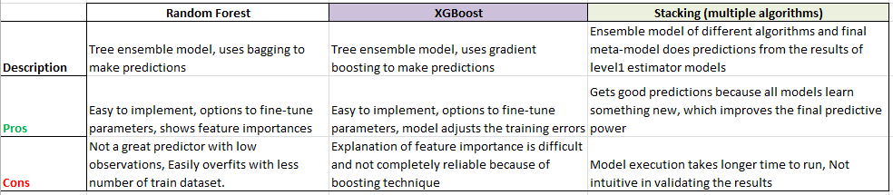
Modeling Approach – Model Selection
XGBoost and Stacking models were used for this project;
Both models gave interesting results
Usage of “Model Business Value Framework” can be used to decide the final results

Slide 14
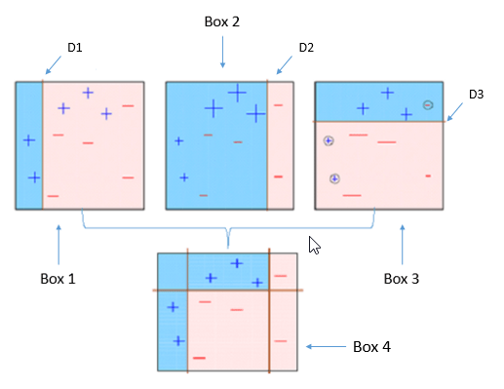
Modeling Approach – XGBoost Pipeline
Optimized distributed gradient boosting algorithm, known for its speed and performance.
Core algorithm is parallelizable
Consistently outperforms other algorithm methods
Wide variety of tuning parameters

Slide 15
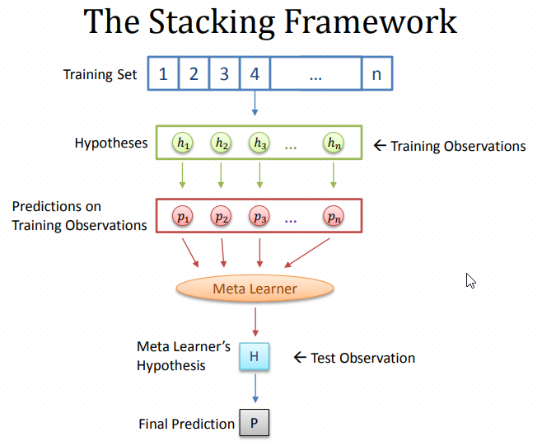
Modeling Approach – Stacking Pipeline
Stacks multiple estimator models, which are normally different learning path and meta-model aggregates and learns from their results to get powerful predictions
Mostly used in Kaggle competitions to get better output
Can add n number of estimators and layers for intensive training the model
Takes more time for execution when training set is large

Slide 16
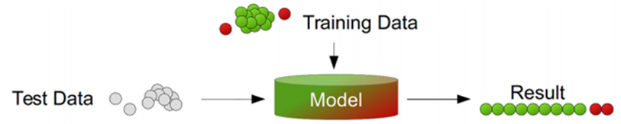
Modeling Approach
Training the model:
Prepare the ML pipeline with different options (XGBoost, Random Forest, Stacking)
GridSearch technique is used to tune the hyper parameters
Re-sampling option is used for one of the iteration to compare the results.
Model is evaluated for the Classification metrics
Trained model and validation results are saved in a pickle file.

Slide 17
Modeling Approach – XGBoost
Training the model:
Over-sampling the minority class – SMOTE algorithm
Hyper tuned parameters
n_estimators= 150,
colsample_bytree=0.8,
gamma=0.5,
learning_rate=0.7,
max_depth=5,
min_child_weight=1.5,
reg_alpha=0.75,
reg_lambda=0.45,
nthread=6,
scale_pos_weight=0.5,
subsample=0.9

Slide 18
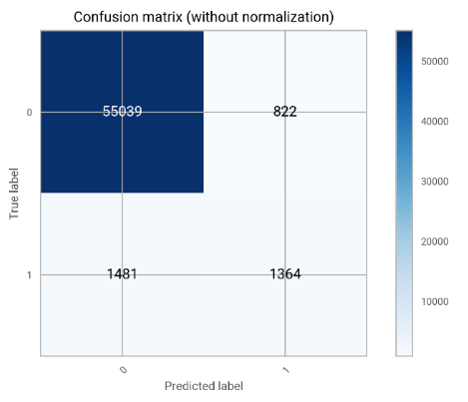
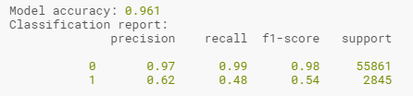
Modeling Approach – XGBoost
Model evaluation:
Trained model is validated with test data predictions and evaluated with below metrics
Metrics used -> Model accuracy , Confusion matrix, Precision, Recall and ROC curve
Accuracy = 96,1%

Slide 19
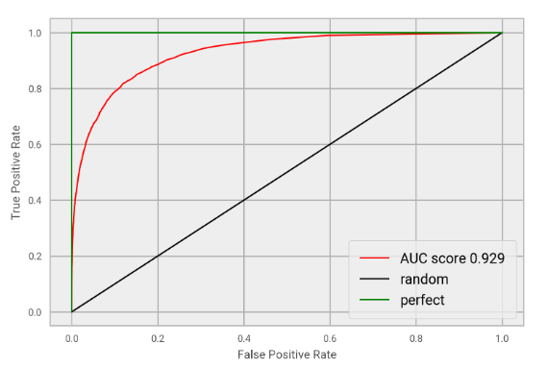
Modeling Approach – XGBoost
Model evaluation:
Even though model accuracy is very good, real goal of this model is to predict Class 1 customers (which is not that great)
As we see, for Class 1, Recall = 48% & Precision = 62%
AUC score and ROC curve shows this is the maximum model could achieve.
AUC score = 92%

Slide 20
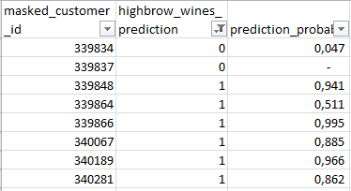

Modeling Approach – XGBoost
Model scoring:
The trained and evaluated model is used to predict the un-labeled data of 2017 (scoring)
After scoring, the new predictions along with prediction probabilities are saved in CSV file

Slide 21
Modeling Approach – Stacking
Training the model:
Over-sampling the minority class – SMOTE algorithm
L1 estimator models used => Random Forest Classifier, AdaBoost Classifier, XGB Classifier, Support Vector Machine Classifier
Meta-learner model used => Logistic Regression
Hyper-parameters => Variant A (for out-of-fold train datasets), ROC AUC metric score (for tuning auc metrics), Stratified boolean (to handle the imbalanced data)

Slide 22
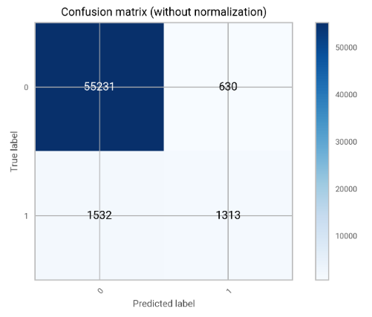

Modeling Approach – Stacking
Model evaluation:
Trained model is validated with test data predictions and evaluated with below metrics
Metrics used -> Model accuracy , Confusion matrix, Precision, Recall and ROC curve
Accuracy = 96,3%

Slide 23
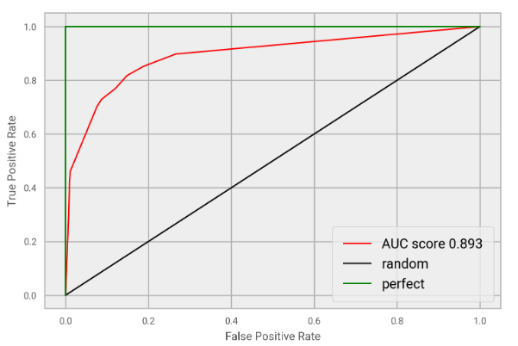
Modeling Approach – Stacking
Model evaluation:
Even though model accuracy is very good, real goal of this model to predict Class 1 customers is not that good.
As we see, for Class 1, Recall = 46% & Precision = 68%
AUC score and ROC curve shows this is the maximum model could achieve.
AUC score = 89%

Slide 24
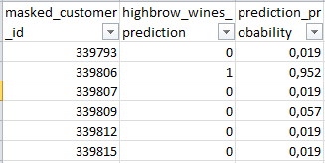

Modeling Approach – Stacking
Model scoring:
The trained and evaluated model is used to predict the un-labeled data of 2017 (scoring)
After scoring, the new predictions along with prediction probabilities are saved in CSV file

Slide 25
Decision Making – Comparing models
Comparing Models thru values:
Accuracy score can be misleading + Evaluation metrics of models are almost same here.
Best model depends on what we want to achieve with the model
Using a common framework with “Model Business Value” calculation can be used to compare and decide on the model to use
XGBoost model: Stacking Model
Accuracy = 96,1% Accuracy = 96,3%
F1 score = 54% F1 score = 55%
Customers targeted =9% Customers targeted =25%

Slide 26
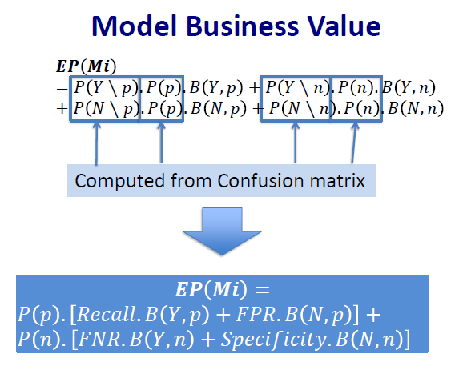
Decision Making – Model Business Value
Using the values of Confusion Matrix, Cost/Benefit for the business can be computed (Expected Value of a model)
𝑬𝑷𝑴𝒊= 𝑃(𝑌,𝑝).𝐵(𝑌,𝑝)+𝑃(𝑌,𝑛).𝐵(𝑌,𝑛) +
𝑃(𝑁,𝑝).𝐵(𝑁,𝑝)+𝑃(𝑁,𝑛).𝐵(𝑁,𝑛)
Where,
P(Y,p) = probability of predicted class = Yes and true class (Positive (p))
B(N,n) = benefit when predicted class = No and true class (Negative (n))

Slide 27
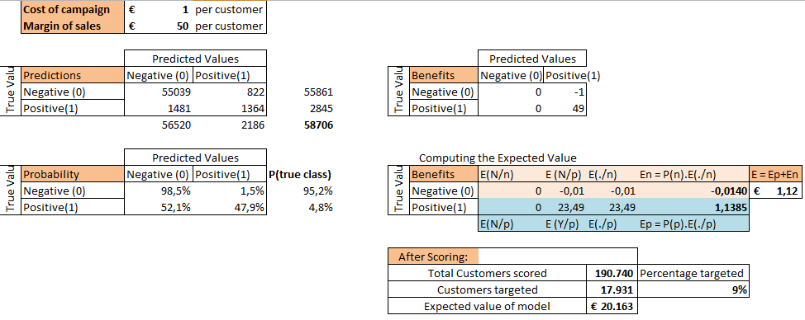
Decision Making – XGBoost Expected Value

Slide 28
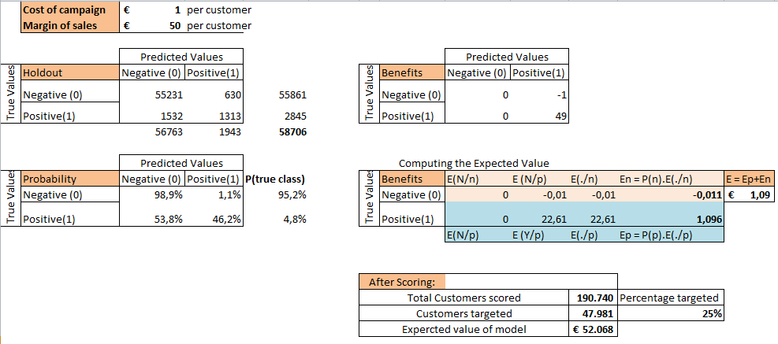
Decision Making – Stacking Expected Value

Slide 29
Decision Making – Final
Which Model and Results to be used ?
With the input on Cost – Benefits details of the campaign, we will be able to decide which results could be finalized (to be discussed in tomorrow’s meeting) !

Slide 30
Deliverables
Lookalike_model_results_2017.xlsx => CustomerID, Highbrow wines predictions (0 or 1), prediction probability
3 result sheets are given (Model1 and Model2 results to be considered)
ValueBasedFramework.xlsx => To be discussed during the meeting tomorrow
code_03_Lookalike_proj => python codes following the functional programming structure (Modules and Functions)
Source codes are python (.py) files
Code is developed in modularized approach
Common functions and ML algorithms are
encapsulated in to separate modules and functions
Execute 00_main.py source to execute the full flow

Slide 31
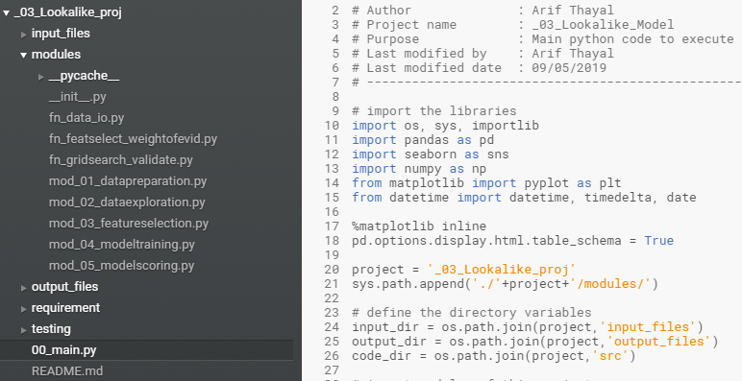
Deliverables – Code flow

Slide 32
Appendix

Slide 33
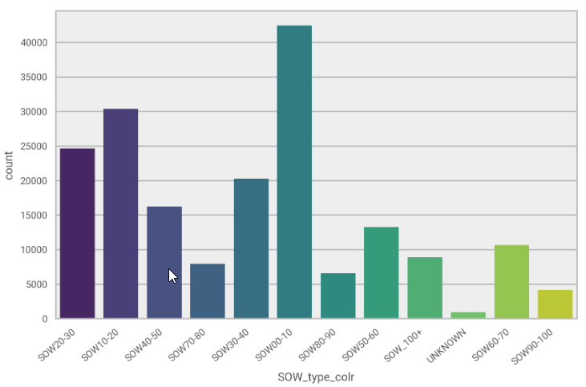
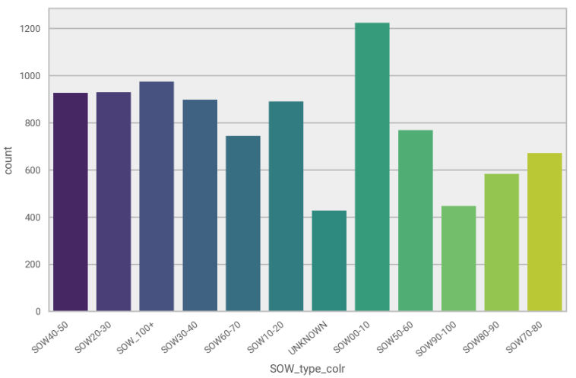
Data Discovery
Class 0 Class 1

Slide 34
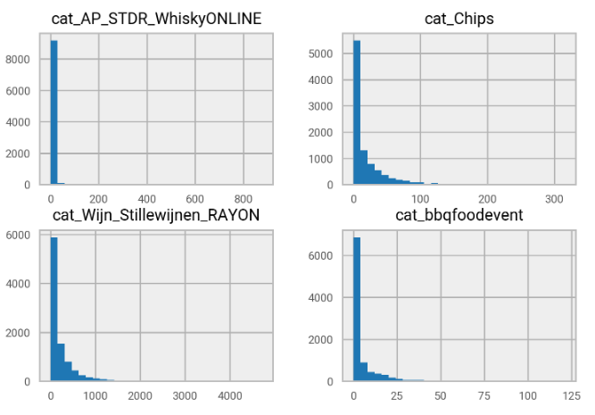
Data Discovery

Slide 35
Features Selected
Features | IV | RF | Chi_Square | FE | final_score
total_revenue | 1 | 1 | 1 | 1 | 4
SOW_colr | 1 | 1 | 0 | 1 | 3
total_discount_format | 1 | 1 | 0 | 1 | 3
cat_Wijn_Stillewijnen_RAYON | 0 | 1 | 0 | 1 | 2
rev_ticket | 0 | 1 | 0 | 1 | 2
cat_AP_STDR_WhiskyONLINE | 0 | 0 | 1 | 1 | 2
Collishop_customer_Y | 0 | 0 | 1 | 0 | 1
HOUSEHOLDTYPOLOGY_g_HHnochild_55_plus | 0 | 0 | 1 | 0 | 1
SOW_type_colr_UNKNOWN | 0 | 0 | 1 | 0 | 1
cat_Babyluiers | 0 | 0 | 0 | 1 | 1
cat_Ber_Ger_VersMaaltijdsalades | 0 | 0 | 0 | 1 | 1
cat_Bier_Genietbieren | 0 | 0 | 0 | 1 | 1
cat_BroodKorthoudbaar | 0 | 0 | 0 | 1 | 1
cat_Chips | 0 | 0 | 0 | 1 | 1
cat_Houtpelletskolen_briketten | 0 | 0 | 0 | 1 | 1
cat_Incontinentie_luiers | 0 | 0 | 0 | 1 | 1
cat_KaasSeizoenskazen | 0 | 0 | 0 | 1 | 1
cat_Kauwgum | 0 | 0 | 0 | 1 | 1
cat_KoudeSauzen | 0 | 0 | 0 | 1 | 1
cat_Notengedroogdfruit_groenten | 0 | 0 | 0 | 1 | 1
cat_Ontbijtgranen_Volwassenen | 0 | 0 | 0 | 1 | 1
cat_VNCBerBurgers | 0 | 0 | 0 | 1 | 1
cat_VerseKaasFruitkazen | 0 | 0 | 0 | 1 | 1
n_tickets | 1 | 0 | 0 | 0 | 1
price_sens_colr_format | 1 | 0 | 0 | 0 | 1

Slide 36
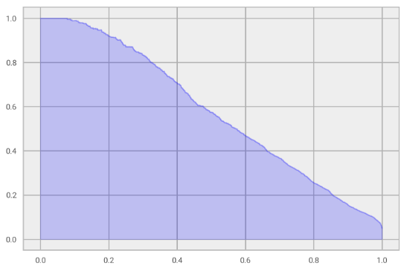
Precision Recall Curve - XGBoost

Slide 37
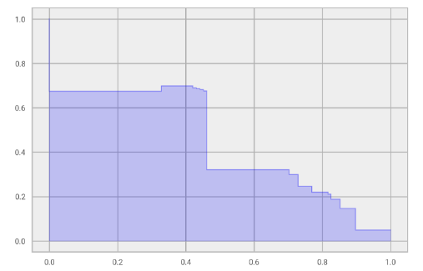
Precision Recall Curve - Stacking

Slide 38
Model Feature Importance

Slide 39
Questions?

Slide 40

Technology Trends – Retail Industry
“Disruptive change has come to the supermarket sector. Technological innovations and analytics usage for online and in-store, as well as shifting consumer expectations, are changing the way food retailers operate.”
Below 5 upcoming trends to focus;
Tech-transformation in E-commerce
Digital transformation of physical stores
Advancing “social commerce”
Tech advancement in supply chain
Data and information traceability

Slide 41

Technology Trends – E-commerce
“E-commerce have been a disruptive force, taking market share from traditional bricks-and-mortar retailers”
Omni-channel -> Improving the shopper experiences combining online and offline needs
Requirement of fresh-food online
Warehouse automation and AI for logistics operations and personalization per region

Slide 42
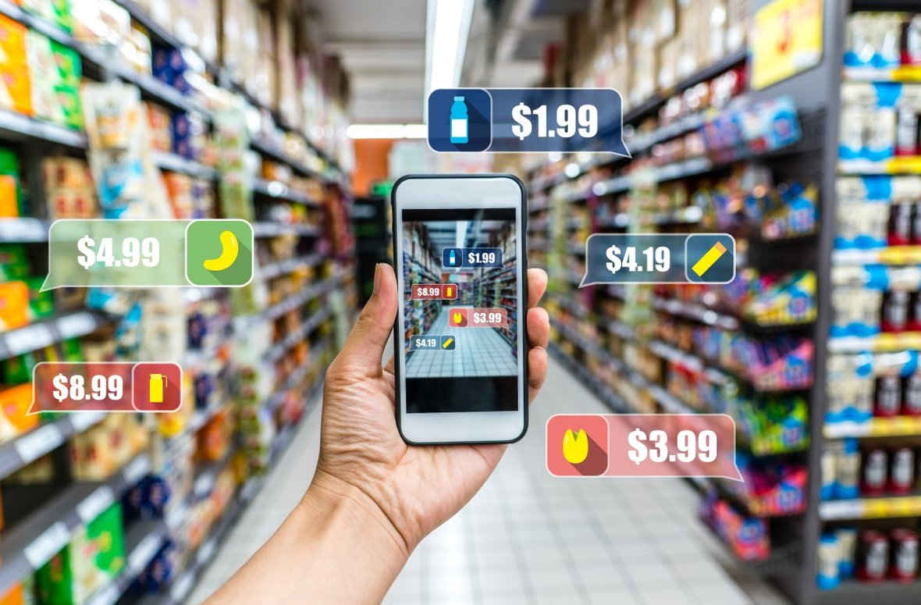
Technology Trends – Digital Stores
“Technological advances are changing the course how people shop for groceries in-store”
Physical stores offer more digital experiences
Guiding shoppers thru in-store aisle
Shopping-cart mounted devices
Sensors connecting POS and carts
Personalized recommendations for in-store consumers

Slide 43

Technology Trends – Social Commerce
“The evolution of e-commerce could result in new ways of shopping – more social and instantaneous”
Retailers making every moment shoppable
Social networks deliver targeted marketing, with instant buy options
Online photos, videos, ads makes it more convenient and simpler to shop

Slide 44

Technology Trends – Supply chain tech
“Supply chain needs to know in precise what is coming-in from field, what is in-storage and what is the demand to be more efficient”
Many production units use internet-of-things. These data can be utilized to know the incoming stock
On-shelf availability programs can be used to know the existing storage
These advancements could significantly reduce food waste, supermarket’s floor space and storage requirements

Slide 45
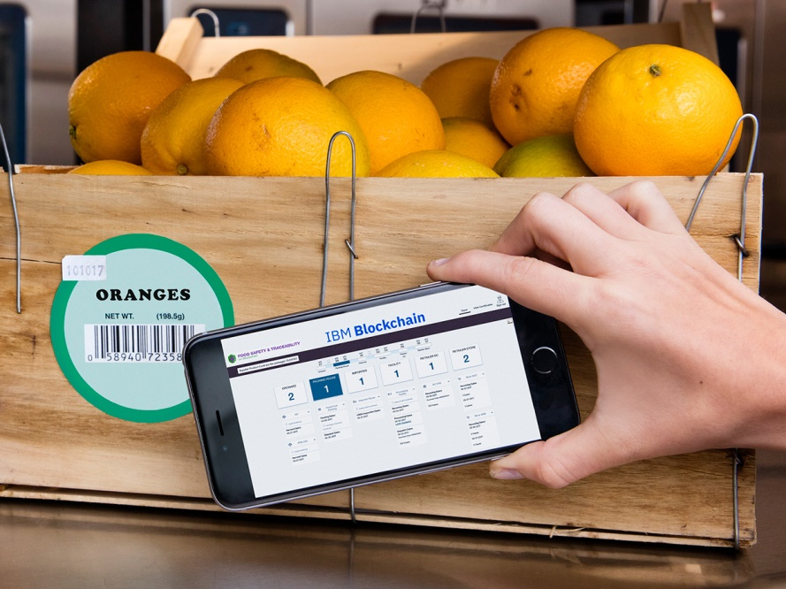
Technology Trends – Traceability
“Gaining consumer confidence with access to detailed information on the origin of products”
Block chain technology is used for getting the complete lifecycle of products
Improved access to data will extend to nutrition and taste
It will also be used for personalized recommendation of recipes and food pairings

