Slide 1
Capstone Project - 3 CoronaVirus Tweet Sentimental Analysis

Slide 2

Index
1) Aim of Our project
2) Why Sentimental Analysis?
3) Data Summary
4) Exploratory data Analysis
5) Insights from EDA
6) What and Why Preprocessing?
7) Model Training
8) Count Vectorisation Method
9) Tf-IDF Method
10) Comparison of both method
11) Conclusion

Slide 3
Aim of our project
This challenge asks you to build a classification model to predict the sentiment of COVID-19 tweets.The tweets have been pulled from Twitter and manual tagging has been done then.
3

Slide 4
What is Sentimental Analysis?
Sentiment analysis (or opinion mining) is a natural language processing technique used to determine whether data is positive, negative or neutral.
Sentiment analysis is often performed on textual data to help businesses monitor brand and product sentiment in customer feedback, and understand customer needs.

Slide 5
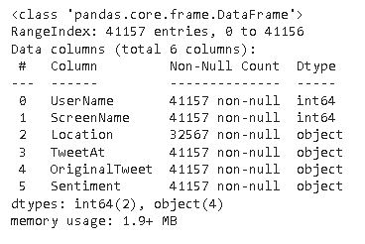
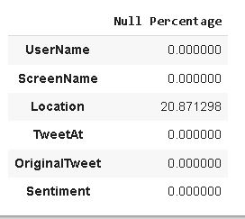
Data Summary
The following images gives basic detail about our data.
Total Number of rows are 41156
Data of type int64(2) and Object(4) are only present
Location column has some null values.
About 20.8% null values are present in location column, whereas all other columns are clean.

Slide 6
Exploratory Data Analysis

Slide 7
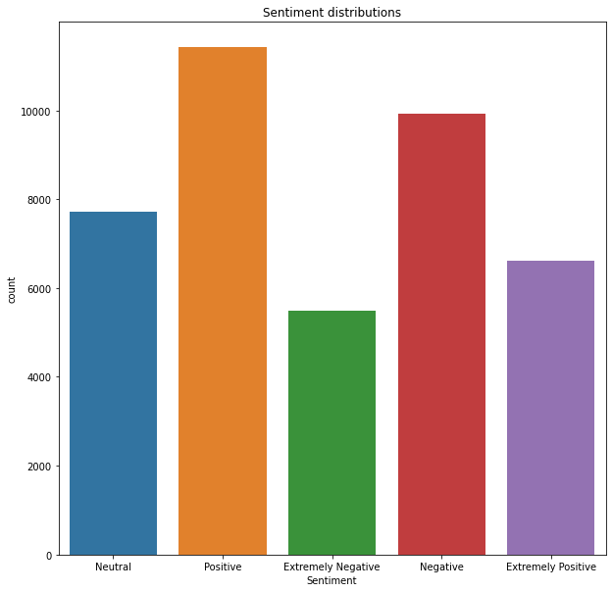
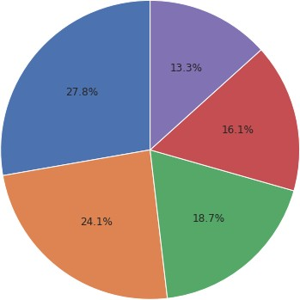
Sentimental Distribution

Slide 8
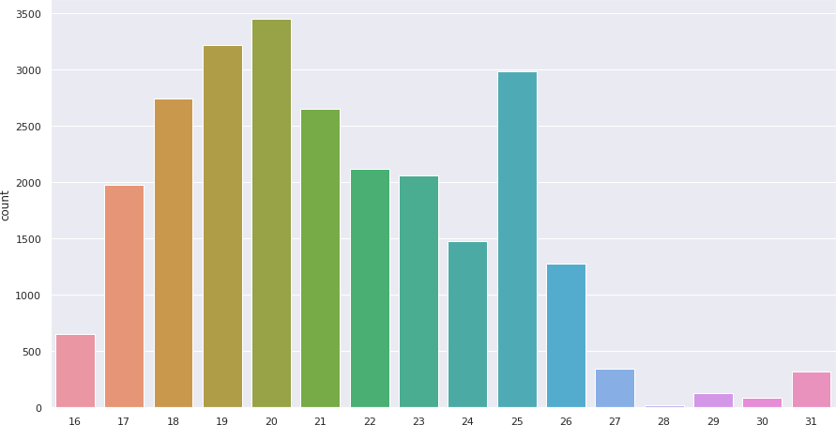
Tweet distribution in March

Slide 9
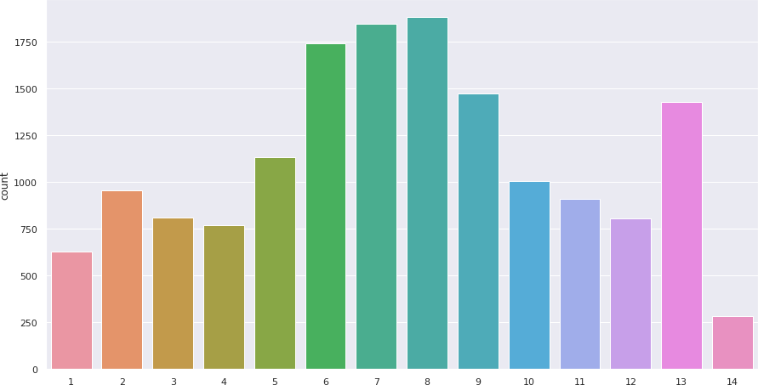
Tweet distribution in April

Slide 10
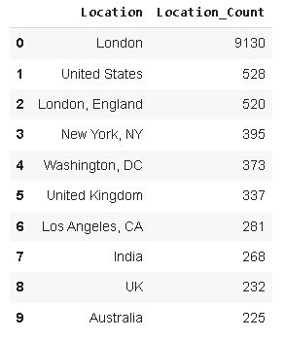
Top 10 locations which has most tweets from them.

Slide 11
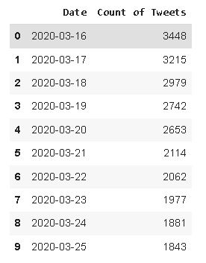
Top 10 dates on which maximums tweets have been made.

Slide 12
Insights from EDA
1) From sentimental distribution, it was clear that 24.1% people tweets something positive, which is help-full.
2) There are a total of 12220 uniques locations of tweets.
3) London has most active people who tweets related to covid-19.
4) India Ranks 7th in most active locations with an average of 4.4 tweets related to corona per day.
5) 16 MARCH 2020 had most number of tweets related to corona, with main as lockdown in most country had started on that day.

Slide 13
Preprocessing of data
The preprocessing of the text data is an essential step as it makes the raw text ready for mining, i.e., it becomes easier to extract information from the text and apply machine learning algorithms to it. If we skip this step then there is a higher chance that you are working with noisy and inconsistent data.
The objective of this step is to clean noise those are less relevant to find the sentiment of tweets such as punctuation, special characters, numbers, and terms which don’t carry much weightage in context to the text.

Slide 14
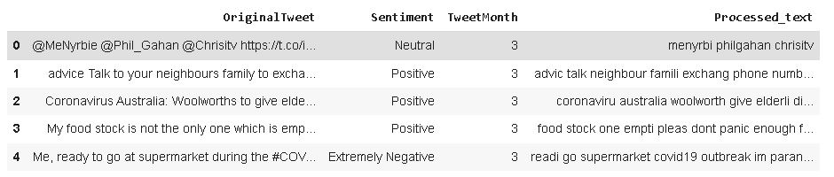

Slide 15
Model Training

Slide 16
A) Count Vectorizer Method
In order to use textual data for predictive modeling, the text must be parsed to remove certain words – this process is called tokenization. These words need to then be encoded as integers, or floating-point values, for use as inputs in machine learning algorithms.
Scikit-learn’s CountVectorizer is used to convert a collection of text documents to a vector of term/token counts .it also enables the pre-processing of text data prior to generating the vector representation.This functionality makes it a highly flexible feature representation module for text.

Slide 17
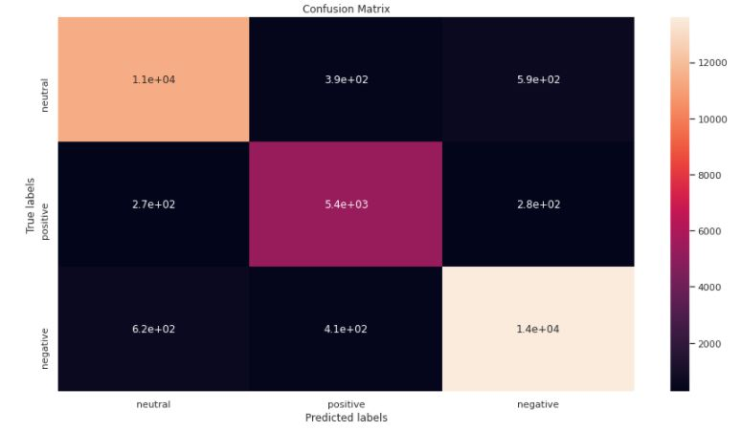
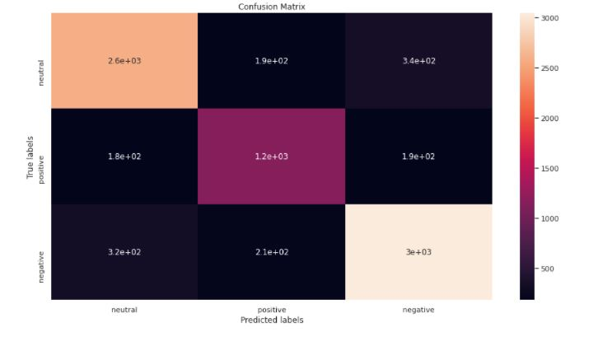
Confusion Matrix for train and Test set
Train Set confusion matrix ● Test Set confusion matrix

Slide 18
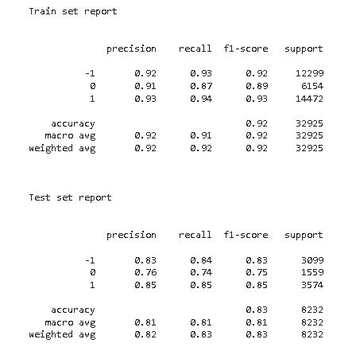
Classification Report of Train and Test Set

Slide 19
B) Tf-IDF Method
This is another method which is based on the frequency method but it is different to the bag-of- words approach in the sense that it takes into account, not just the occurrence of a word in a single document (or tweet) but in the entire corpus.
TF-IDF works by penalizing the common words by assigning them lower weights while giving importance to words which are rare in the entire corpus but appear in good numbers in few documents.
Let’s have a look at the important terms related to TF-IDF:
TF = (Number of times term t appears in a document)/(Number of terms in the document)
IDF = log(N/n), where, N is the number of documents and n is the number of documents a term t has appeared in.
TF-IDF = TF*IDF

Slide 20
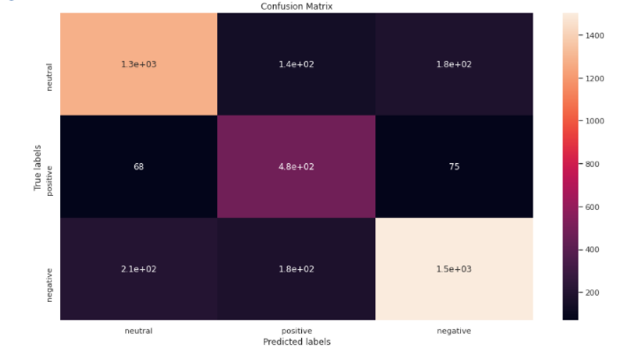
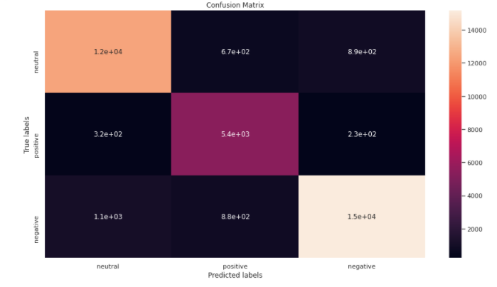
Confusion matrix for train and test data
Test Confusion Matrix ● Train Confusion Matrix

Slide 21
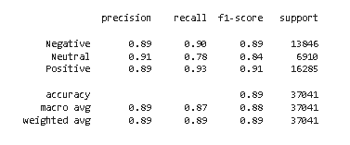
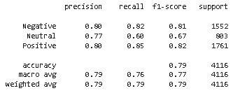
Classification report for train and test data
Train set
Test Set
21

