Slide 1
Capstone Project - 1
Exploratory data analysis-
Hotel Booking Analysis
Sajal sinha
Mohammed arifuddin atif

Slide 2
Agenda
In this project, we will perform Exploratory Data Analysis on Hotel Booking Dataset and will get some meaningful insights.

Slide 3
What is Exploratory Data Analysis?
Exploratory Data Analysis refers to the critical process of performing initial investigations on data so on discover patterns, to spot anomalies, to test hypothesis and to see assumptions with the assistance of summary statistics and graphical representations.

Slide 4
About Our Dataset
This data set contains booking information for a city hotel and a resort hotel, and includes information such as when the booking was made, length of stay, the number of adults, children, and/or babies, and the number of available parking spaces, among other things. All personally identifying information has been removed from the data.

Slide 5
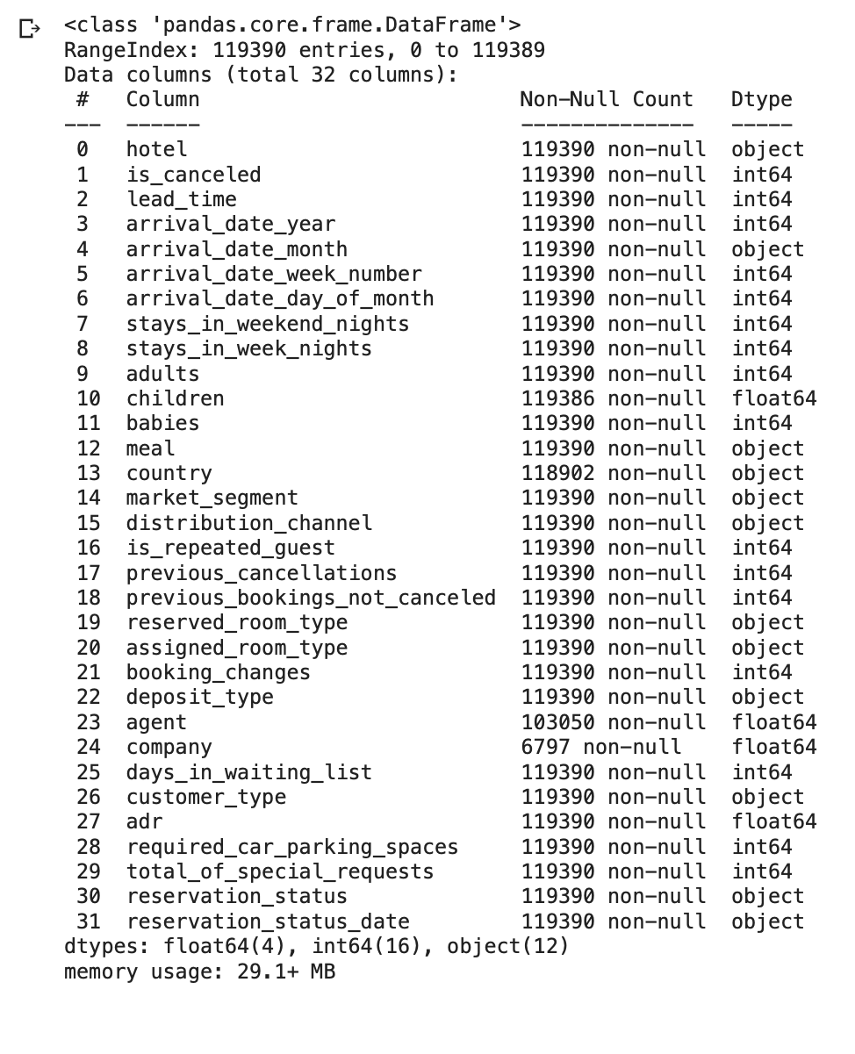
Let’s know our data
Hotel: Type of hotel
is_canceled : if bookings were canceled
lead_time:
arrival_date_year: in which year did customer arrived
arrival_date_month: in which month did customer arrived
arrival_date_week_number:
arrival_date_day_of_month:
stays_in_weekend_nights:
stays_in_week_nights:
Adults:
Children:
Babies:
Meal:
Country:
market_segment:
distribution_channel:
is_repeated_guest:
previous_cancellation:

Slide 6
Exploratory Data Analysis

Slide 7
Data cleaning and Manipulation
While checking for null values, 4 columns had null values in them. They were children, country, agent, and company.
As company column had more than 50% of null values, dropping it was more beneficial.
Other columns were filled using mean, median and mode.
Data Type of some columns were changed in order to get proper result.

Slide 8
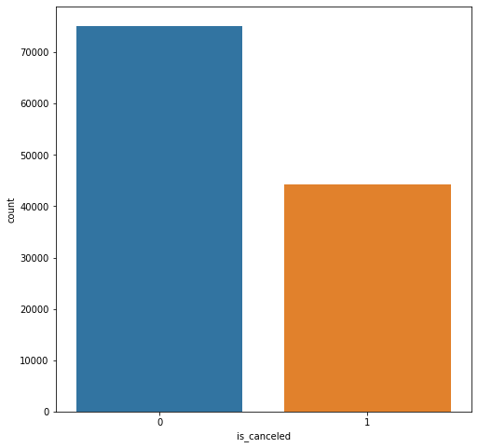
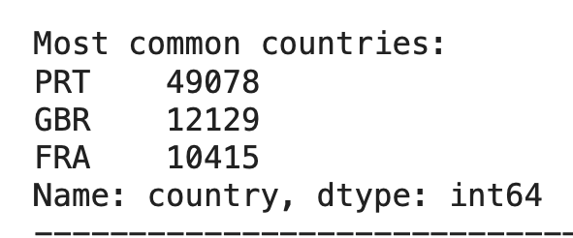
Count of bookings that were Canceled=1, Not canceled= 0
Top 3 countries which has most bookings

Slide 9
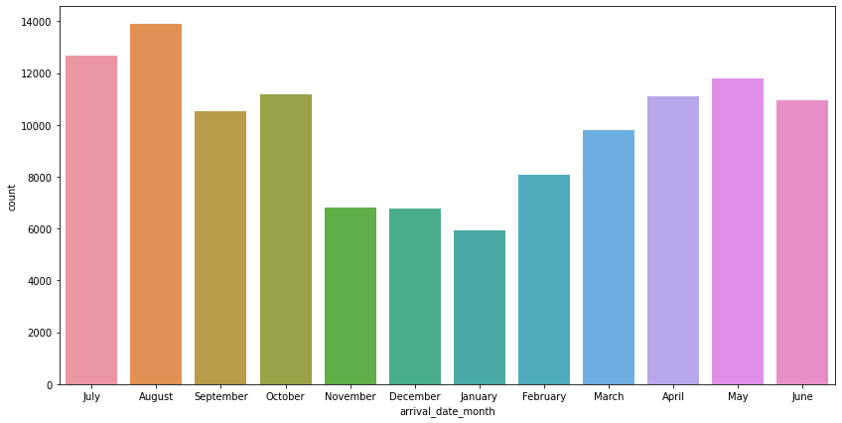
Number of Booking in each month

Slide 10
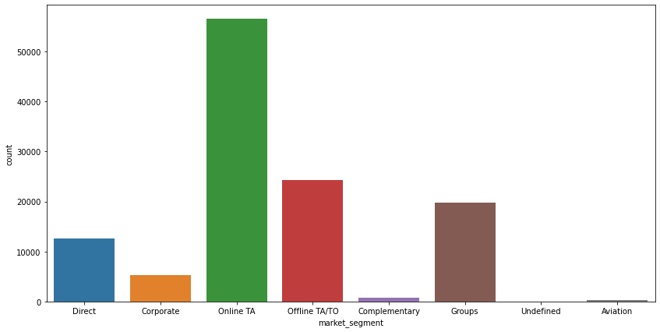
Type of market segment customers belong.

Slide 11
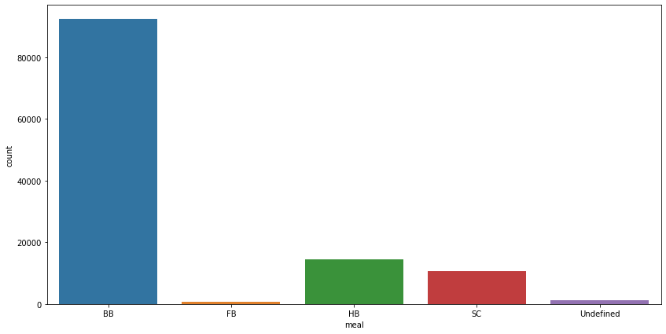
Type of Meal customers preferred.

Slide 12
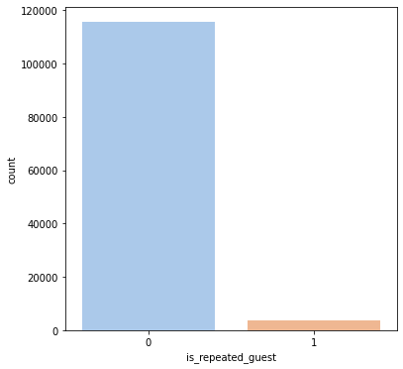
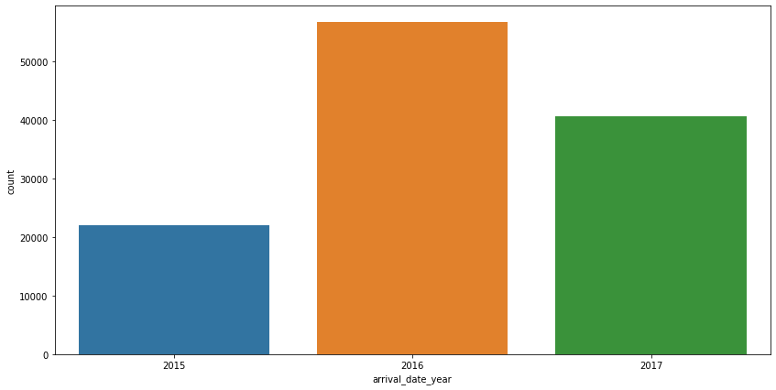
Count of customers each year
Count of Customers that were repeated.

Slide 13
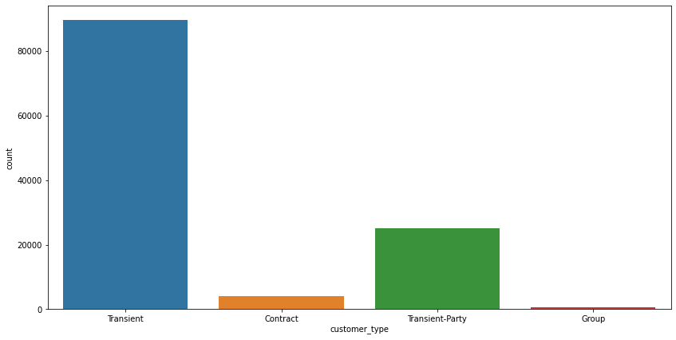
Count of customers based on customer type

Slide 14
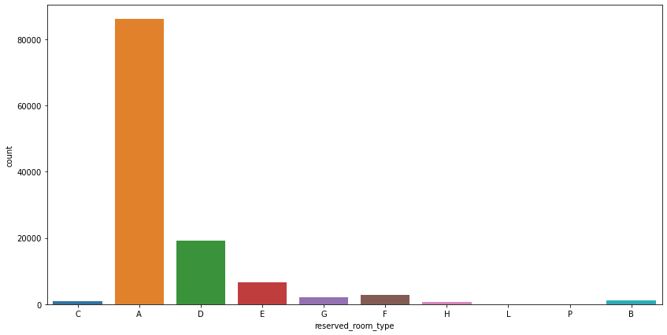
Type of rooms which were most reserved.

Slide 15
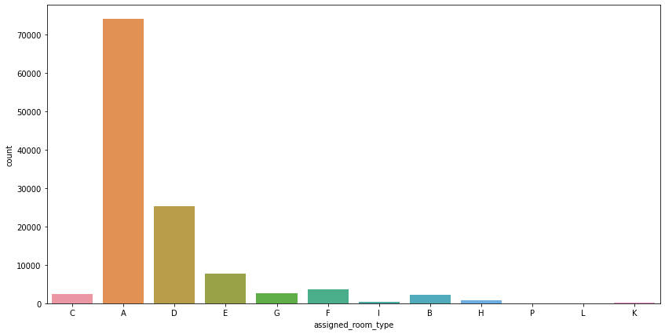
Type of rooms that were assigned the most.

Slide 16
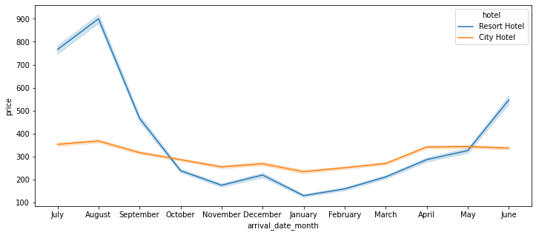
Average Daily Rate (per person)

Slide 17
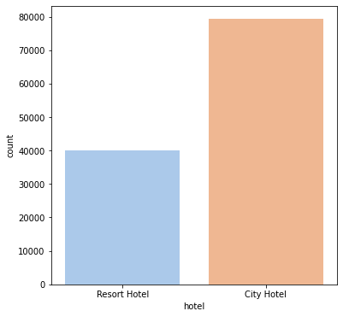
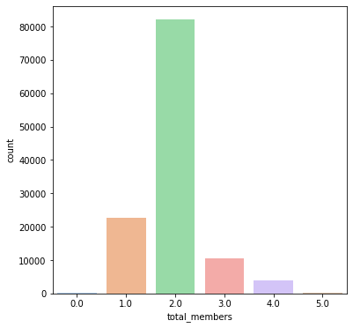
Count of customer
Family members of customers.

Slide 18
Conclusions
Portugal, Great Britain, and France are native place of most customers.
August is the MOST busiest month.
Most of our customers were brought in by Online Travel Agents.
Bed and Breakfast is most preferred meal package.
In 2016, we had most customers considering overall customers whereas city hotel had more bookings compared to resort hotels.
Most of the time, people come in pair.
Room Type A is MOST favourite room type among customers.

