Slide 1
Lather Defect Detection Using Deep Learning Approach.
Ariful Islam Mozumder
Shah Muhammad Imtiyaj Uddin

Slide 2
Contains
Introduction
Methods & Materials
Dataset
Prepressing
Model
Results
Conclusion

Slide 3
Introduction
The defects on a leather surface may be caused by the poor material handling process during the production and manufacturing stages.
It is essential to eliminate the natural variations and artificial injuries on the leather surfaces, in order to control the quality of the products and achieve customer satisfaction.
Manual inspection of leather surfaces is subjective and inconsistent in nature; hence machine vision systems have been widely adopted for the automated inspection of leather defects.
In this work, we are going to detect the defect of leather using a deep learning model.
Here, we build a model, that classifies images into ‘Good’ or ‘Anomaly’ classes and returns an encompassing box for the defect if the image is classified as an ‘Anomaly’.

Slide 4
Methods and Materials
Dataset:
We have used MVTEC (MVTec Anomaly Detection Dataset: MVTec Software) Anomaly Detection Dataset, this dataset has 300 to 400 images, which contain images of good items labeled as the class 'Good', and items with a defect labeled as class 'Anomaly’.
The Dataset was imbalanced with more samples of good images than defective ones.
We build a model, that classifies images into ‘Good’ or ‘Anomaly’ classes and returns an encompassing box for the defect if the image is classified as an ‘Anomaly’.

Slide 5
Preprocessing
Data preprocessing step, resize images to 224×224 pixels for fastness training.
Images in most are of size 1024×1024, but as defects are also of considerable size, we may resize the image to a lower resolution without sacrificing model accuracy.
After deploying to production our model data will be in precisely the same format as in the dataset we have currently. Split the data into train or test parts.
We would like to have train, validation, and test parts for training a model, tuning hyperparameters, and evaluating model accuracy, respectively.
We have only 300 to 400 images, we put 80% of the images into the train set and 20% into the test set. For small datasets, we may perform 5-Fold cross-validation to make sure that evaluation results are robust.

Slide 6
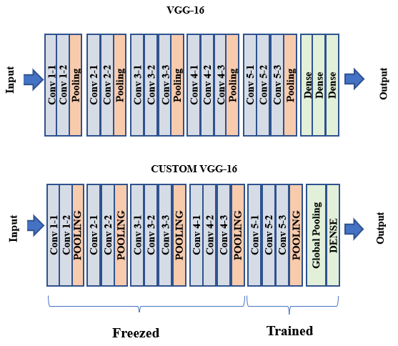
Model Architecture
Figure 1. Custom VGG-16 model

Slide 7
Model Architecture (Cont:)
We take VGG16 pre-trained on ImageNet and change its classification head to replace Flattening and Dense layers with Global Average Pooling and a single Dense layer.
We train the model as a typical 2-class classification model.
The model outputs a 2-dimensional vector that contains probabilities for classes 'Good' and 'Anomaly’.
During training, the first 10 convolutional layers are frozen, we train only the classification head and the last 3 convolutional layers. That is because our dataset is small to finetune the whole model.
Loss is Cross-Entropy; the optimizer is Adam with a learning rate of 0.0001.
We have trained the model with batch size=10 for at most 100 epochs and early stopping when the train set accuracy reaches 98%.

Slide 8
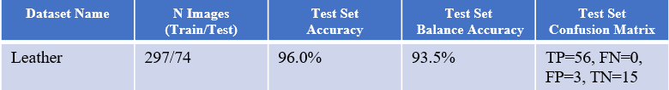
Evaluation and Result
We have trained a model; 20% of images were selected as a test set and in a stratified manner.
We applied class weighing in loss function 1 for the 'Good' class and 3 for 'Anomaly' because in most cases there are 3 times more good images than anomalous ones.
The model was trained for at most 100 epochs with early stopping if the train set accuracy reaches 98%.
The train set size is 74 to 297 images. Balanced Accuracy is between 92.1% and 96.0%.
Below are the evaluation results.
Table 01: Evaluations of testing accuracy

Slide 9
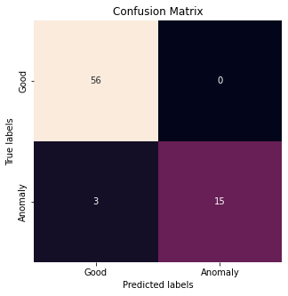
Matrix
Figure 3. Confusion Matrix

Slide 10
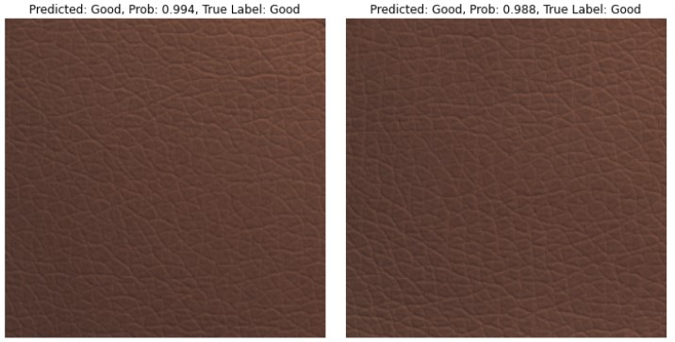
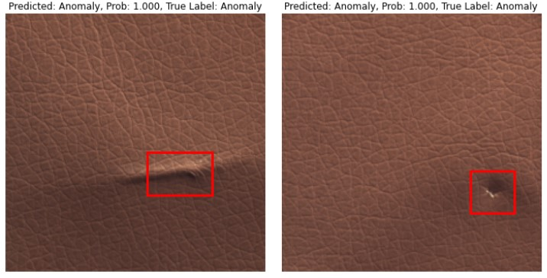
Visualization
Prediction
Good
Anomaly
Figure 3. Leather predictions on the test set.

Slide 11
Conclusion
In conclusion, focusing on the requirement of leather quality inspection, we proposed an optimized CNN model to achieve the defect classification of the leather surface good and anomaly area of safety based on a VGG-16 conv_base, which was trained on the database.
Experiment results are presented to verify the proposed method.
This research mainly focuses on defect detection on the leather surface.
Our future research will focus on reconstructing or generating more images so that the test approach adapts to the classification of micron-level defects.

