Slide 1
Text Classification

Slide 2
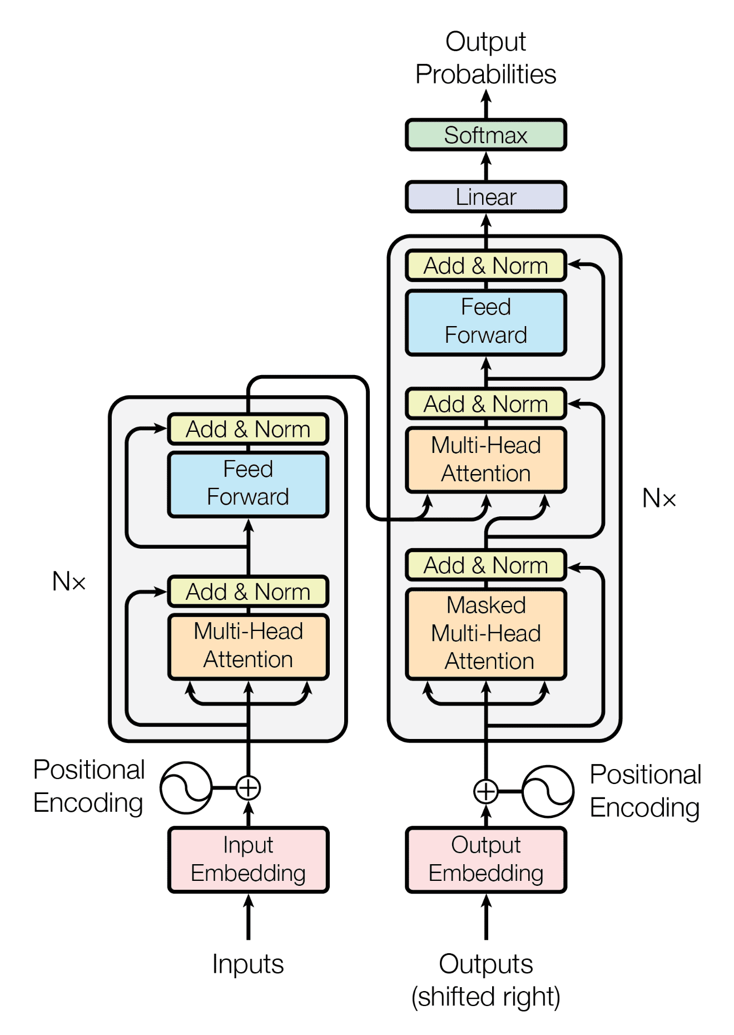
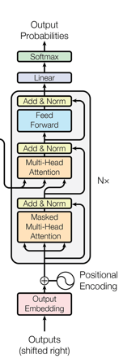
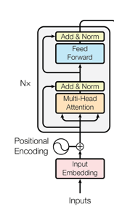
Introduction

Slide 3
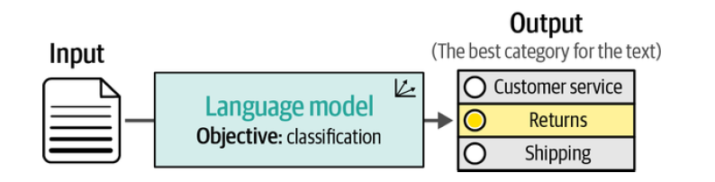
Introduction
A common task in natural language processing is classification. The goal of the task is to train a model to assign a label or class to some input text
Will discuss several ways to use language models for classifying text.

Slide 4
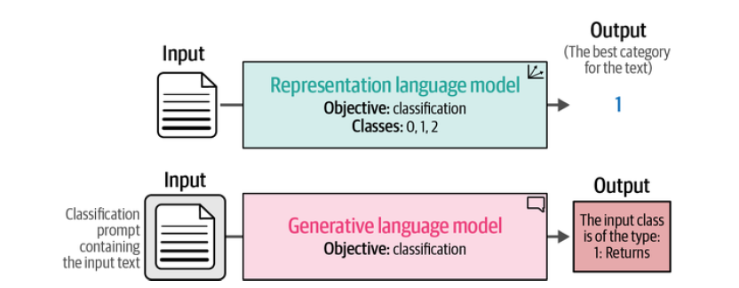
Introduction
We will discuss several techniques and use them to explore the field of language models:
“Text Classification with Representation Models” demonstrates the flexibility of nongenerative models for classification. We will cover both task-specific models and embedding models.
“Text Classification with Generative Models” is an introduction to generative language models as most of them can be used for classification.

Slide 5
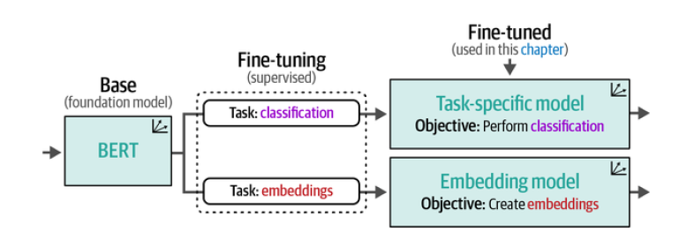
Text Classification with Representation Models
The Sentiment Analysis
We will use the well-known “rotten_tomatoes” dataset to train and evaluate our models. It contains
5,331 positive and 5,331 negative movie reviews from Rotten Tomatoes.
Text Classification with Representation Models
Classification with pretrained representation models generally comes in two flavors, either using a task-specific model or an embedding model.

Slide 6
Text Classification with Representation Models
Task Specific Model
A task-specific pretrained model is a model that has been pretrained on a related task and then fine-tuned for your specific classification task
For the task-specific model, we are choosing the Twitter-RoBERTa-base for Sentiment Analysis model. This is a RoBERTa model fine-tuned on tweets for sentiment analysis. Although this was not trained specifically for movie reviews, it is interesting to explore how this model generalises.
Embedding Model
An embedding model is a pretrained model used to convert inputs into vector representations (embeddings). These embeddings capture semantic or structural information about the input. The classification is not done by the model itself; instead, a separate classifier (like logistic regression, SVM, or a small neural network) is trained on these embeddings.
We will use sentence-transformers/all-mpnet-base-v2 as the embedding model

Slide 7
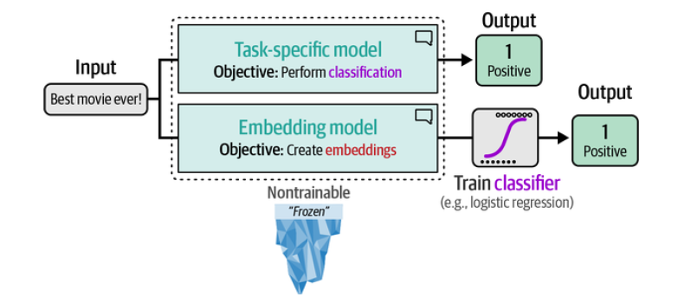
Text Classification with Representation Models
We keep both models frozen (nontrainable) and only use their output
Will leverage pretrained models that others have already fine-tuned for us and explore how they can be used to classify our selected movie reviews.

Slide 8
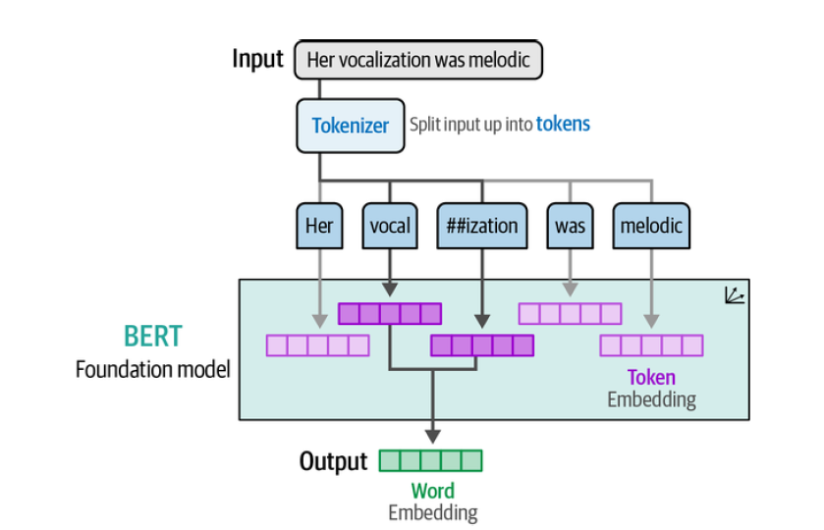
Text Classification with Representation Models
Using a Task-Specific Model

Slide 9
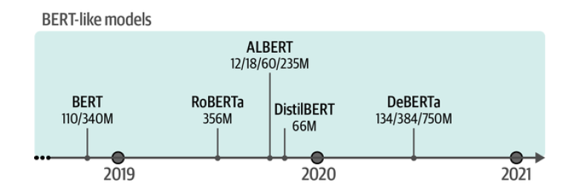
Text Classification with Representation Models
Model Selection
BERT, a well-known encoder-only architecture, is a popular choice for creating task-specific and embedding models.
Over the years, many variations of BERT have been developed, including RoBERTa,2 DistilBERT,3 ALBERT,4 and DeBERTa,5 each trained in various contexts.

Slide 10
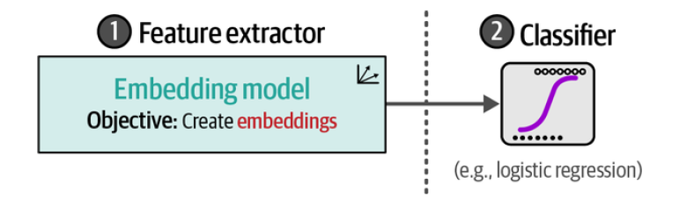
Text Classification with Representation Models
Classification Tasks That Leverage Embeddings
we used a pretrained task-specific model for sentiment analysis. However, what if we cannot find a model that was pretrained for this specific task?
Do we need to fine-tune a representation model ourselves? The answer is no!
Supervised Classification
Instead of directly using the representation model for classification, we will use an embedding model for generating features. Those features can then be fed into a classifier, thereby creating a two-step approach.
A major benefit of this separation is that we do not need to fine-tune our embedding model, which can be costly. In contrast, we can train a classifier, like a logistic regression,

Slide 11
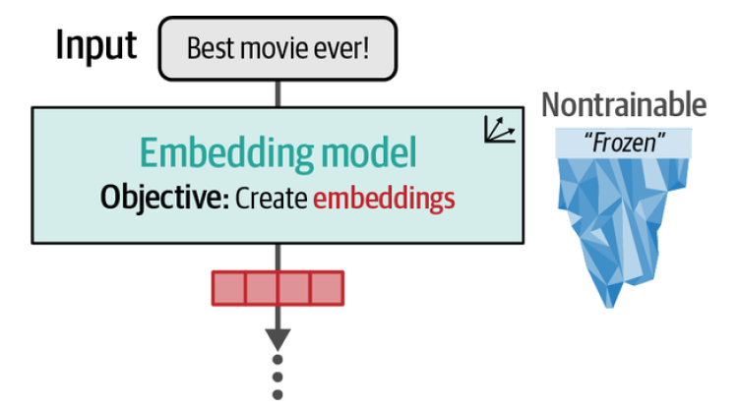
Text Classification with Representation Models
Classification Tasks That Leverage Embeddings
In the first step, we convert our textual input to embeddings using the embedding model
Note that this model is similarly kept frozen and is not updated during the training process.
The second step, these embeddings serve as the input features to the classifier.
The classifier is trainable and not limited to logistic regression and can take on any form as long as it performs classification.

Slide 12
Text Classification with Representation Models
What If We Do Not Have Labeled Data?
In our previous example, we had labeled data that we could leverage, but this might
not always be the case in practice.
Getting labeled data is a resource-intensive task that can require significant human labor.
Zero-Shot Classification
To test this, we can perform zero-shot classification, where we have no labeled data to explore whether the task seems feasible.
Zero-shot classification is the task of classifying data into categories the model hasn’t seen during training, using a pretrained model that understands language or semantics.
Key idea: Instead of training the model on labeled examples, you describe the categories in words, and the model decides which label fits best.
Zero-shot classification attempts to predict the labels of input text even though it was not trained on them.

Slide 13
Text Classification with Representation Models
Zero-Shot Classification
To perform zero-shot classification with embeddings, We can describe our labels based on what they should represent.
For example, a negative label for movie reviews can be described as “This is a negative movie review.”
Review: "The plot was boring and predictable."
Embeddings similarity:
- "This is a positive movie review." → 0.2
- "This is a negative movie review." → 0.9 ✅

Slide 14
Text Classification with Generative Models
Text Classification with Generative Models
Classification with generative language models, such as OpenAI’s GPT models, works a bit differently from what we have done thus far.
These models take as input some text and generative text and are thereby aptly named sequence-to-sequence models.

Slide 15
Text Classification with Generative Models
Generative models are generally trained on a wide variety of tasks and usually do not perform your use case out of the box.
For instance, if we give a generative model a movie review without any context, it has no idea what to do with it.
We need to help it understand the context and guide it toward the answers that we are looking for.
This guiding process is done mainly through the instruction, or prompt, that you give to such a model. Iteratively improving your prompt to get your preferred output is called prompt engineering.

Slide 16
Text Classification with Generative Models
Using the Text-to-Text Transfer Transformer
The original Transformer architecture actually consists of an encoder-decoder architecture. Like the decoder-only models, these encoder-decoder models are sequence-to-sequence models and generally fall in the category of
generative models.
An interesting family of models that leverage this architecture is the Text-to-Text Transfer Transformer or T5 model. Its architecture is similar to the original Transformer where 12 decoders and 12 encoders are stacked together

Slide 17
Text Classification with Generative Models
Using the Text-to-Text Transfer Transformer
With this architecture, these models were first pretrained using masked language modelling.
In the first step of training, instead of masking individual tokens, sets of tokens (or token spans) were masked during pretraining.

Slide 18
Text Classification with Generative Models
Using the Text-to-Text Transfer Transformer
The second step of training, namely fine-tuning the base model.
Instead of fine-tuning the model for one specific task, each task is converted to a sequence-to-sequence task and trained simultaneously.
This resulted in the Flan-T5 family of models that benefit from this large variety of tasks.
To use this pretrained Flan-T5 model for classification, we will start by loading it through the "text2text-generation" task, which is generally reserved for these encoder-decoder models

Slide 19

Thank You

