Slide 1
Deep Learning Based Person Recognition for Automated Record Retrieval and Management

Slide 2
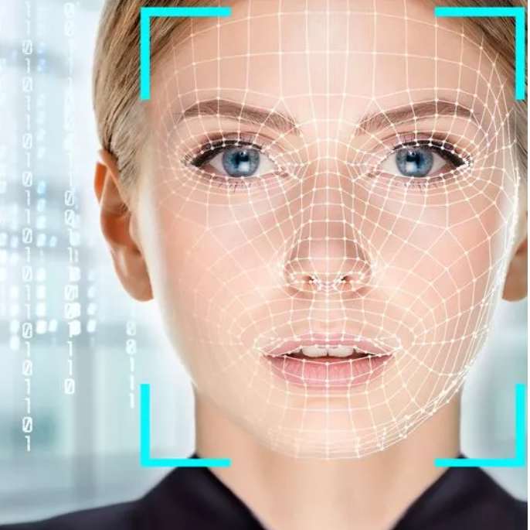
Introduction
This project aims to integrate the developed person recognition system into existing record retrieval and management workflows, thereby streamlining processes, reducing manual intervention, and enhancing overall efficiency.
This model is ideal for applications that require real-time face recognition and classification.
Through automation, organizations can achieve faster response times, minimize errors, and ensure compliance with regulatory requirements.

Slide 3
Proposed Method
In this project, we have customized YOLOv8m to detect and classify faces into ten distinct classes.
This model is ideal for applications that require real-time face recognition and classification.
When we input the image into the model, it will recognize the image and then display the information according to the given image.

Slide 4
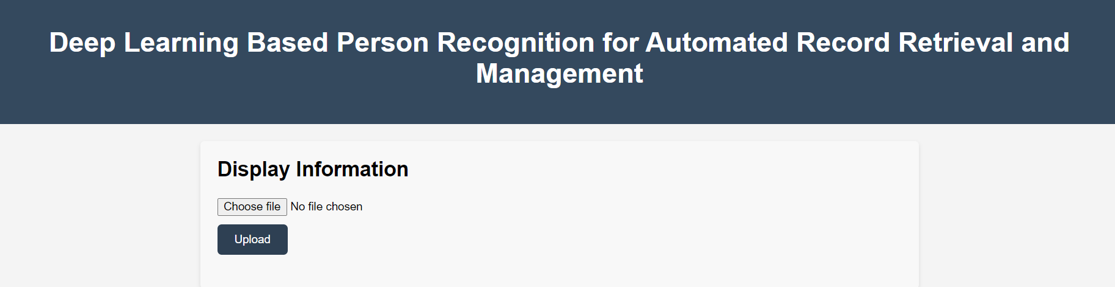
User Interface
This is a user interface a Deep learning-based person face recognition for automated record retrieval and management system.

Slide 5
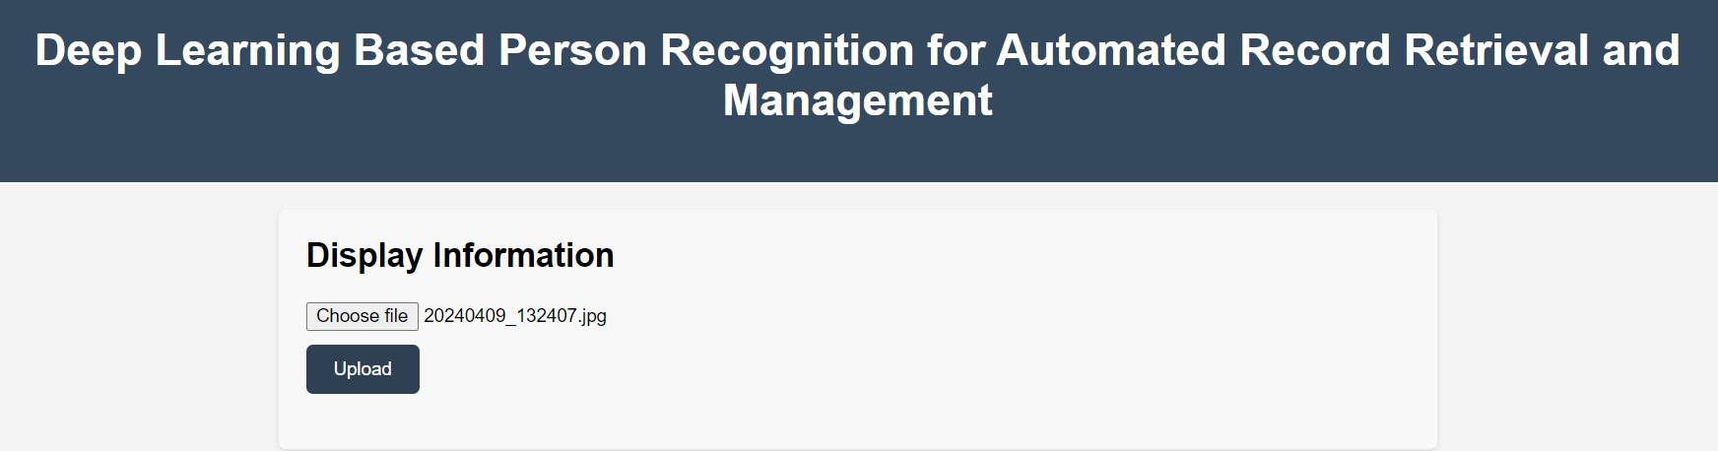
User Interface
First, we choose the image, and then we upload it.

Slide 6
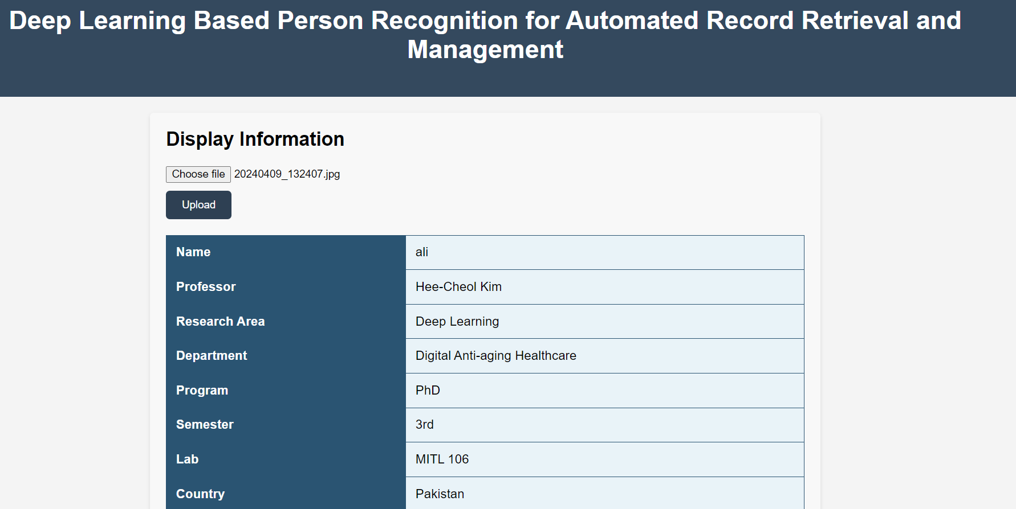
User Interface
The model recognized a person according to the given picture, retrieved the personal information from the Excel file, and displayed it on the web page or screen.

Slide 7
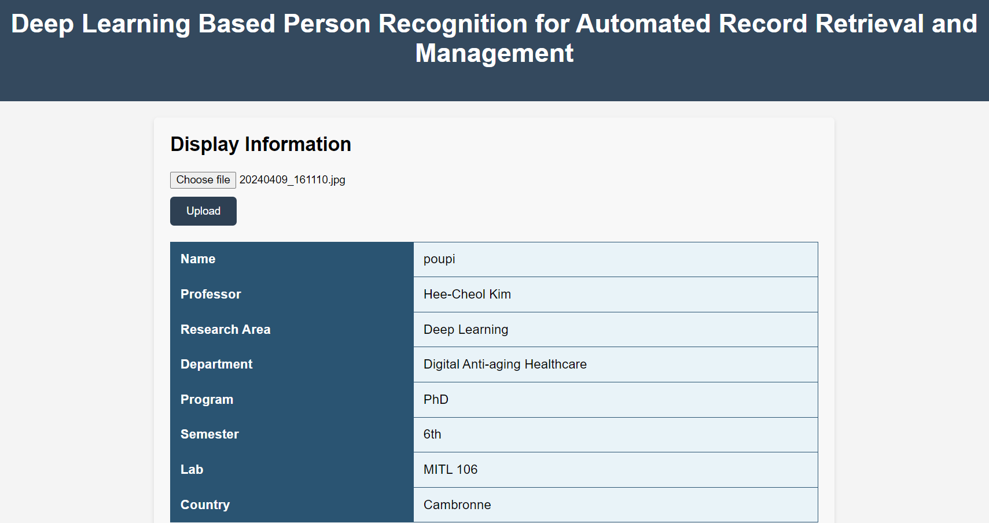
User Interface
The model recognized a person according to the given picture, retrieved the personal information from the Excel file, and displayed it on the web page or screen.

Slide 8
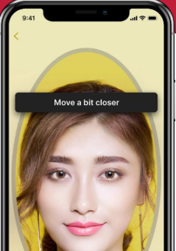
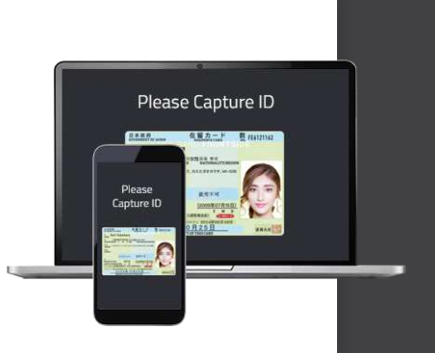
Applications and Future Work
Efficient Digital Onboarding
Eliminate extra steps and increase accuracy with a solution that automatically captures the user ID once it is clear and properly positioned in the camera frame.
Let your users complete the account opening process via API, mobile SDK (apps) and mobile web.
https://www.youtube.com/watch?v=O6CGh_cwNa8

Slide 9
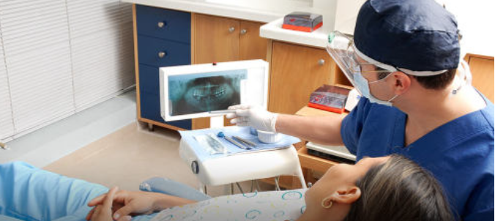
Applications and Future Work
Facial Recognition in Healthcare
In the healthcare field, the future use of face recognition technology can be broadly divided into two parts; patience identification and disease diagnosis.
In the future, the patient identification is your face.
Health care organizations will use face technology to support safer and smoother patient access and information sharing, for example, by using facial recognition there will be less confusion with patient identification in emergencies.
https://itrexgroup.com/blog/facial-recognition-benefits-applications-challenges/

Slide 10
Conclusion
This is a YOLOv8 model based on deep learning, on which I used a customized dataset, trained the model, and then used it to detect faces of individuals.
A face recognition system is a system that allows us to access the records of multiple persons.
This can be used on a larger dataset of people.
It can also be used based on videos as well as pictures.

