Slide 1




Baseball Detection API using Flask and YOLO

Slide 2
Introduction
What is this project about?
A Flask-based API for baseball detection in videos using YOLO 11.
Takes a video as input, performs inference, and returns the processed video.
Integrated with a Flutter application for real-time analysis.

Slide 3

Technologies Used
Backend: Flask, Python
Deep Learning Model: YOLO (Ultralytics)
Storage: Local file system (uploads & outputs directories)
integration: Flutter for mobile application

Slide 4
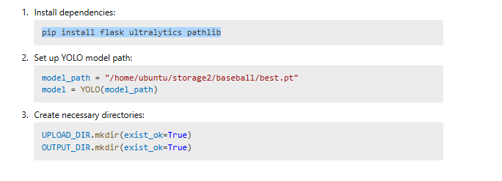
Project Setup

Slide 5
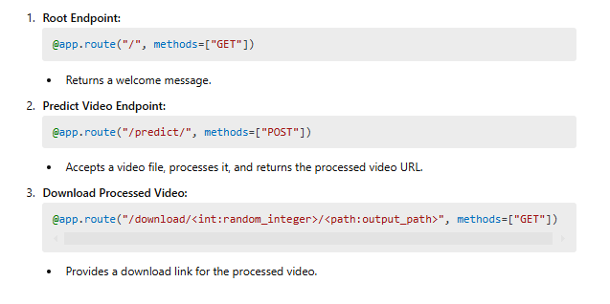
API Endpoints

Slide 6
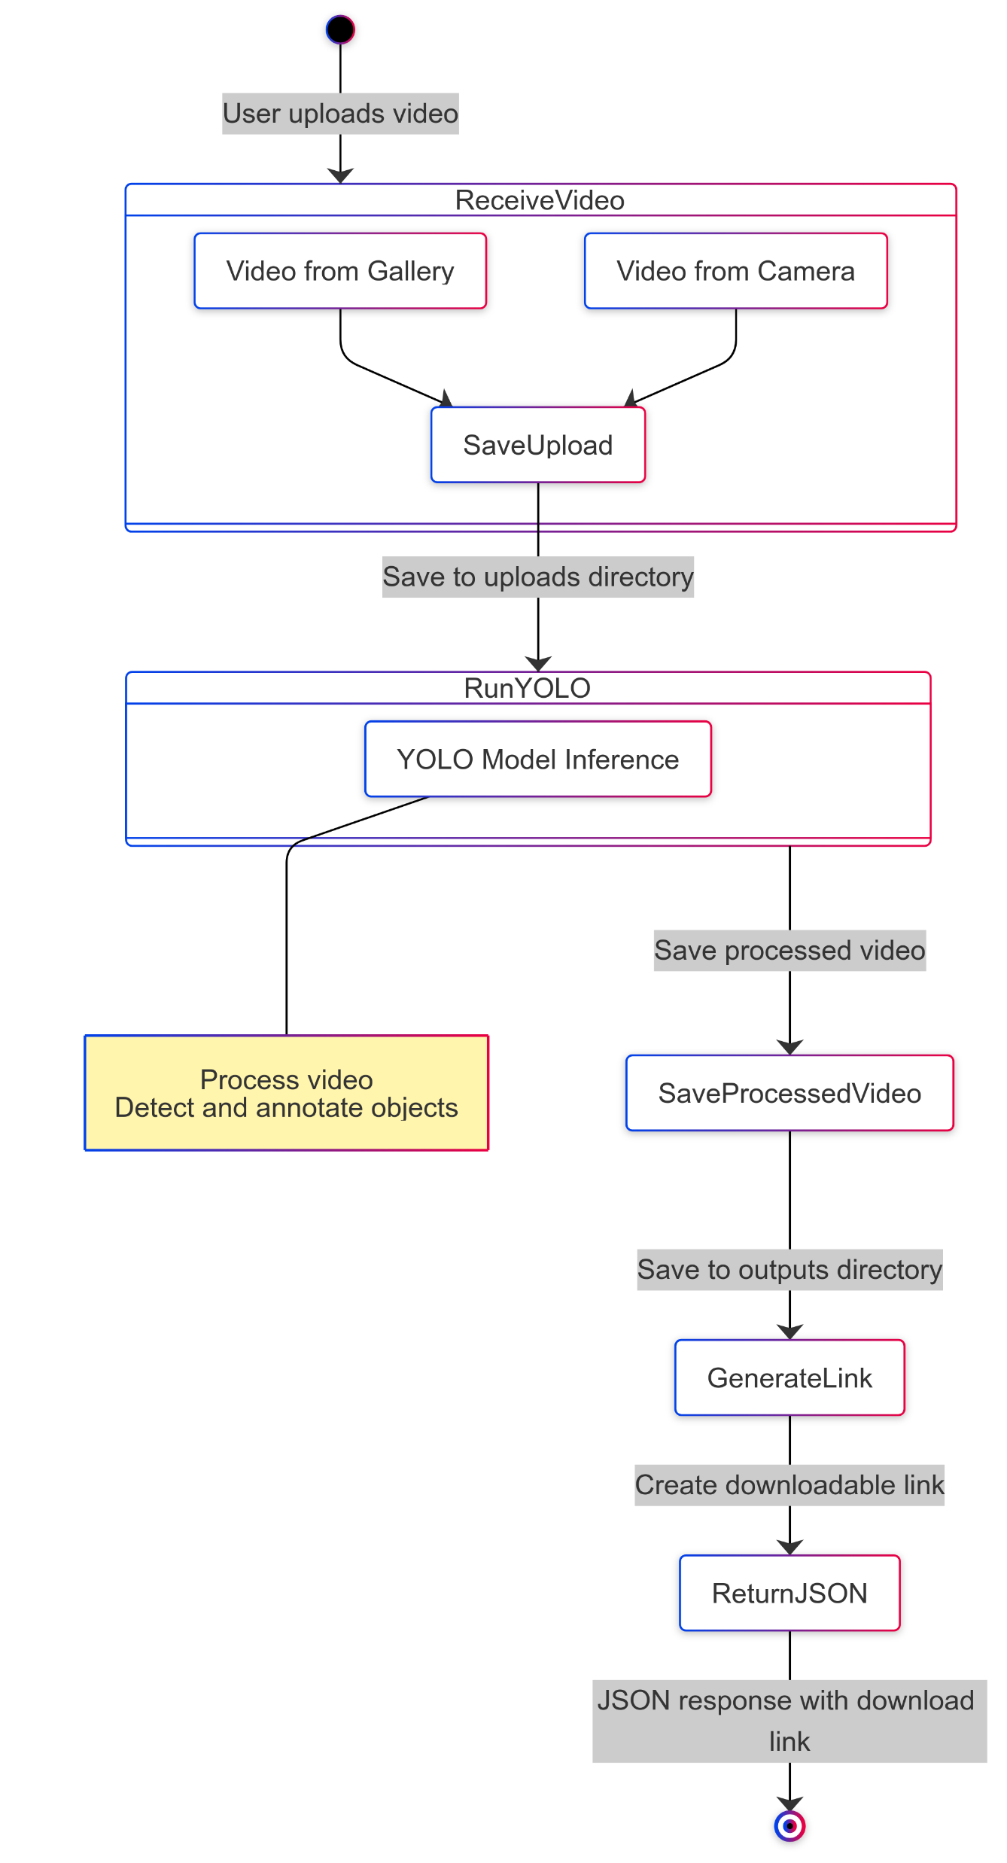
Video Processing Workflow
Receive the uploaded video from the Flutter app. (Gallery or Camera)
Save it in the uploads directory.
Run YOLO model inference on the video.
Save the processed video in the outputs directory.
Generate a download link and return it as JSON response.

Slide 7
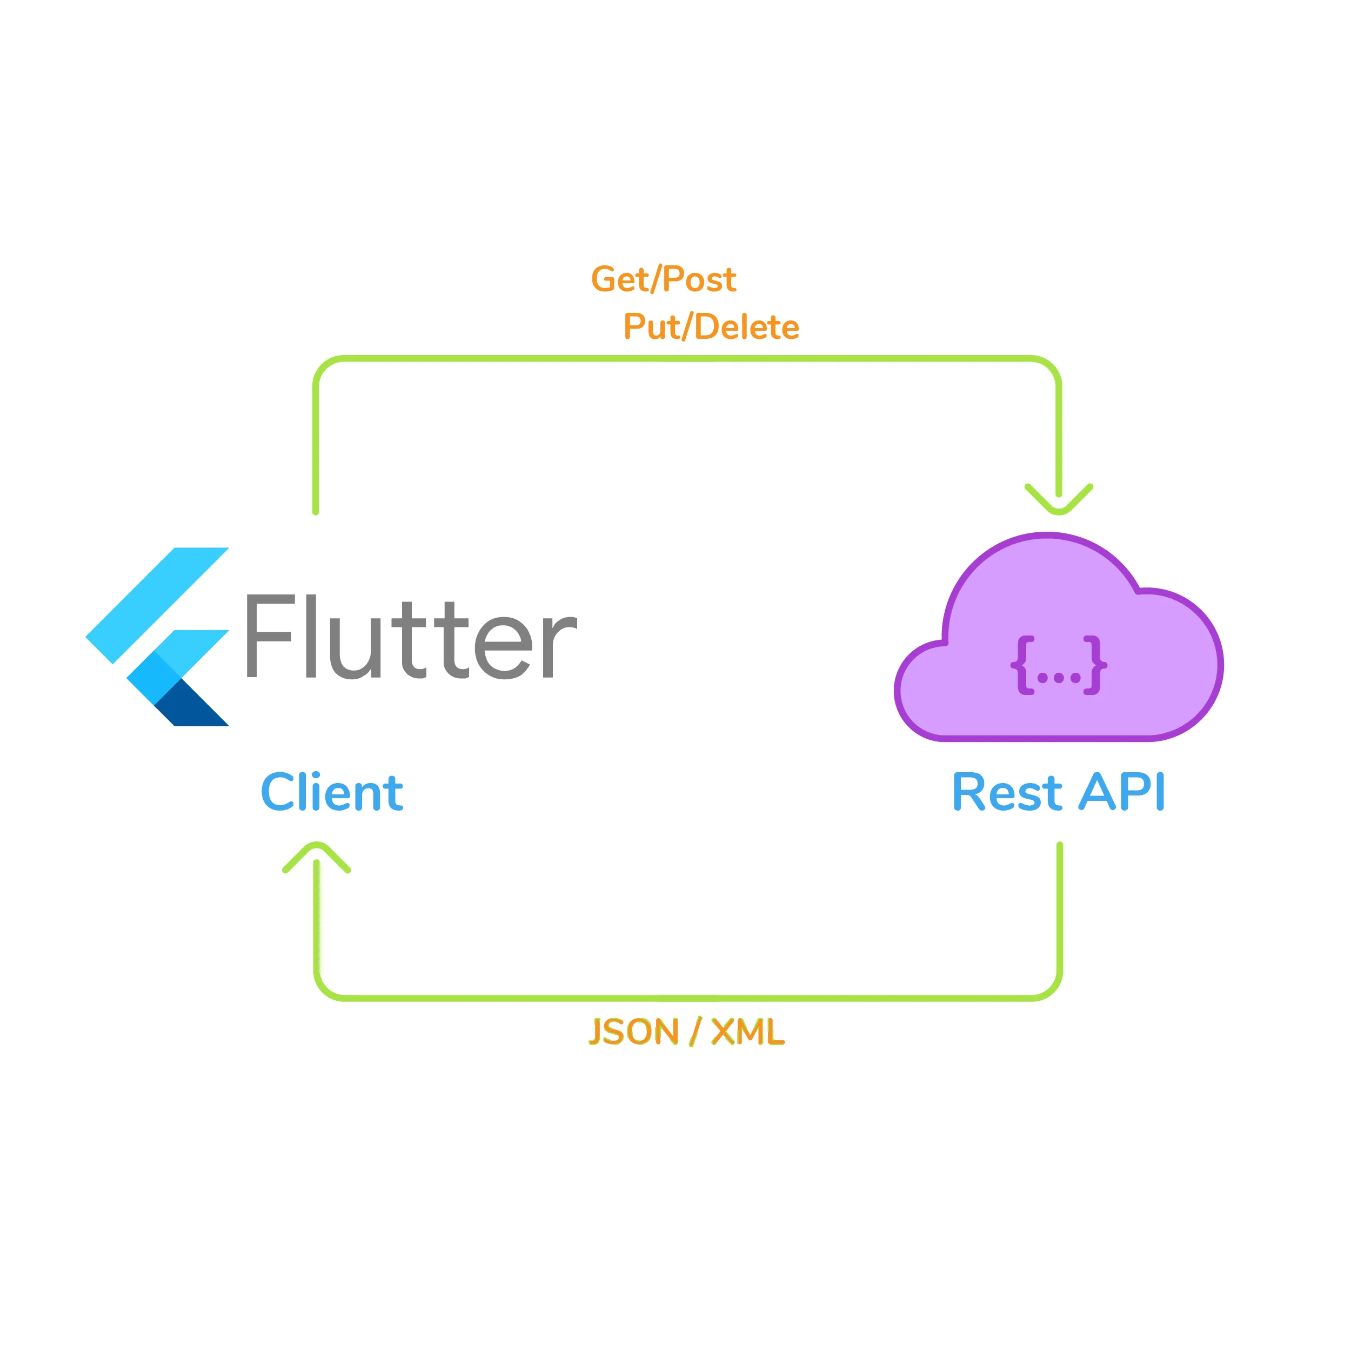
Integration with Flutter
The Flutter app captures or selects a video.
Sends the video to the Flask API via an HTTP POST request.
Receives a processed video download link.
Downloads and displays the processed video.

Slide 8
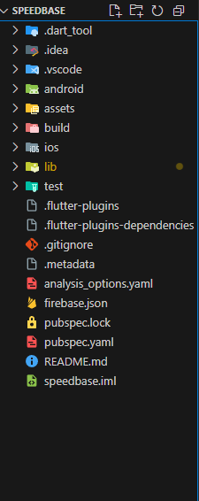
Integration with Flutter
The pubspec.yaml file is a configuration file in Flutter projects that defines dependencies, metadata, and assets for the app.
It includes:
Project Metadata: Name, description, version, and environment settings (e.g., Flutter SDK version).
Dependencies: Lists packages (e.g., firebase_core, flutter_riverpod) and their versions for the app.
Assets: Specifies images, fonts, or other files used in the app.
Dev Dependencies: Packages used only during development (e.g., testing libraries).

Slide 9
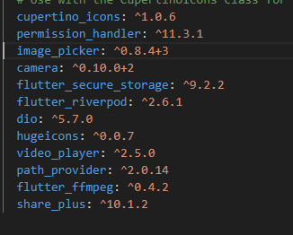
Used Dependencies
cupertino_icons: Provides iOS-style icons for Flutter apps.
permission_handler: Manages runtime permissions for device features.
image_picker: Allows picking images from the gallery or camera.
camera: Provides access to device cameras for capturing photos/videos.
flutter_secure_storage: Securely stores sensitive data on the device.
flutter_riverpod: State management library for Flutter apps.

Slide 10
Used Dependencies
dio: Powerful HTTP client for making network requests.
hugeicons: Offers a collection of customizable icons.
video_player: Enables video playback in Flutter apps.
path_provider: Provides access to device file system paths.
flutter_ffmpeg: Integrates FFmpeg for video/audio processing.
share_plus: Allows sharing content from the app to other platforms.

Slide 11
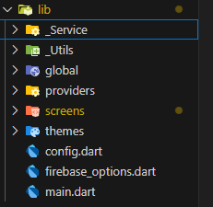
lib
The lib folder in a Flutter project is the main directory where the app's source code is stored. It typically contains:
Main Entry Point: main.dart file, which is the starting point of the app.
Screens/Pages: UI components for different app screens.
Widgets: Reusable UI components.
Models: Data structures and business logic.
Services: Code for APIs, databases, or external integrations.
Providers/State Management: Logic for managing app state (e.g., Riverpod, Provider).

Slide 12
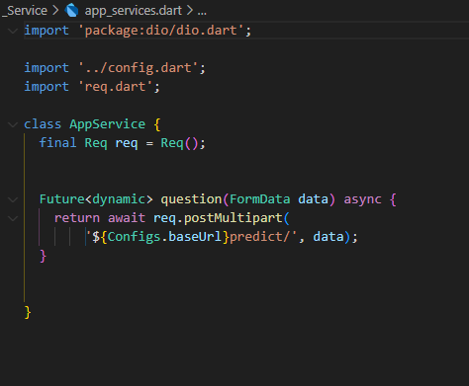
Service
app_services.dart: Contains core app services or business logic.
Call ApI endpoint here
req.dart: Handles API requests or network-related operations and Also error Handling
storage.dart: Manages local storage or caching functionality.

Slide 13
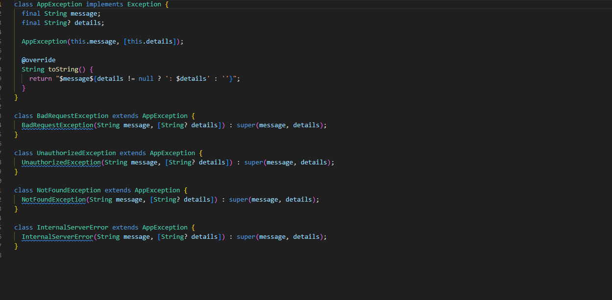
Utils
app_exceptions.dart: Handles custom exceptions or error handling for the app.

Slide 14
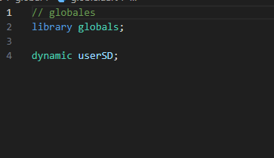
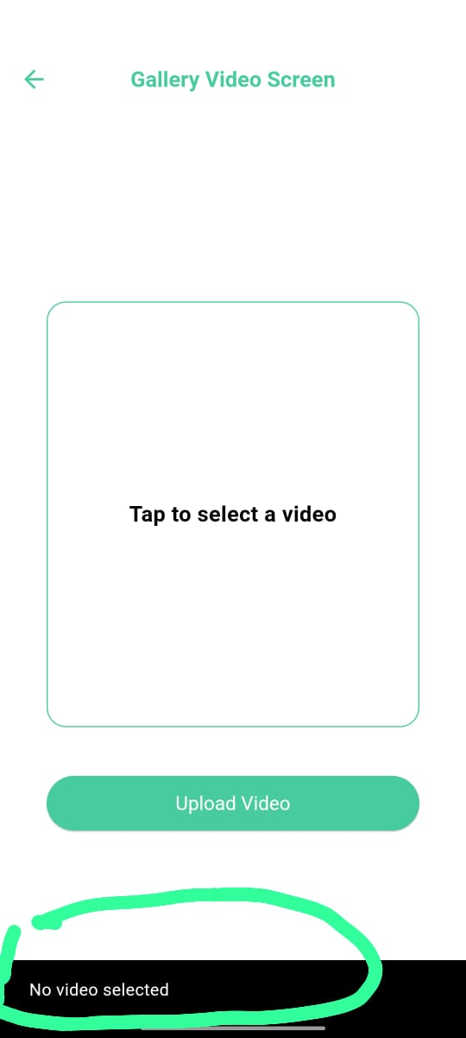
Global:
global.dart: Contains global variable, constants, or utility functions used across the app.
SnackbarHelper.dart: A helper file for displaying snackbars (e.g., error messages, notifications) in a consistent way.

Slide 15
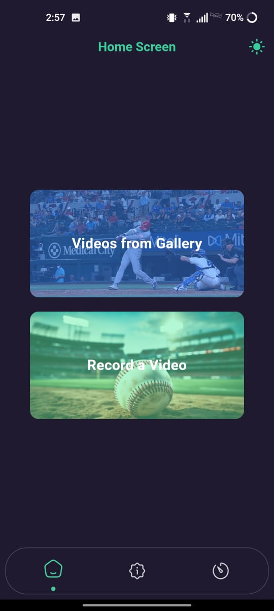
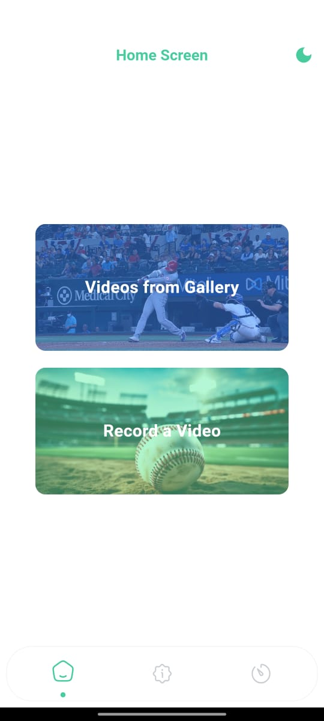
Providers:
The theme_provider.dart file is typically used in conjunction with the Theme widget in Flutter to apply the selected theme across the app. (controle theme)

Slide 16
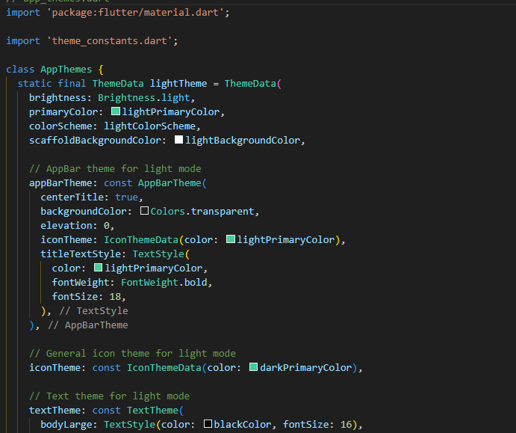
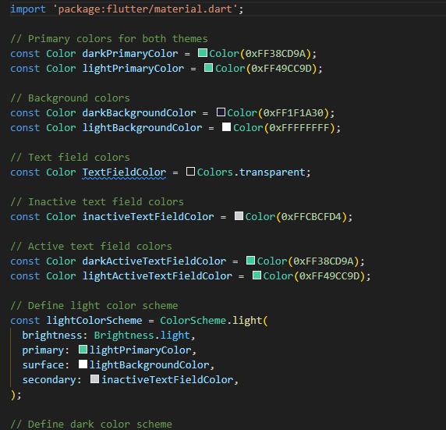
Theme:
app_themes.dart:
Contains ThemeData objects that specify colors, fonts, and other styling properties for the app.
theme_constants.dart:
Stores theme-related constants like colors, font sizes, and other reusable styling values.

Slide 17

Config :
Base URL of API

Slide 18
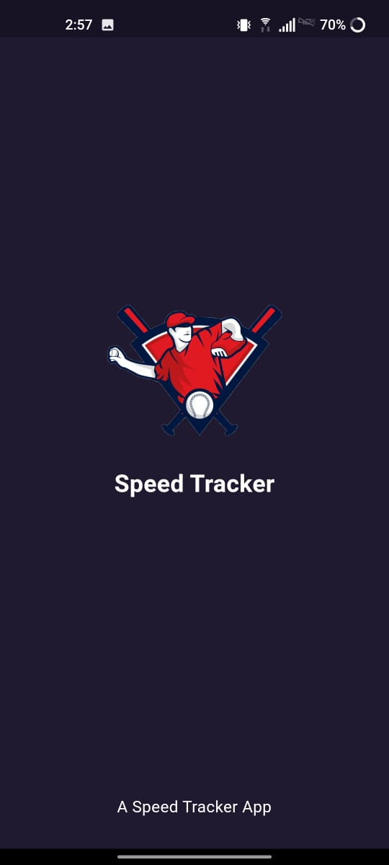
Screens
SplashScreen.dart: The initial screen displayed when the app launches, often used for branding or loading.

Slide 19
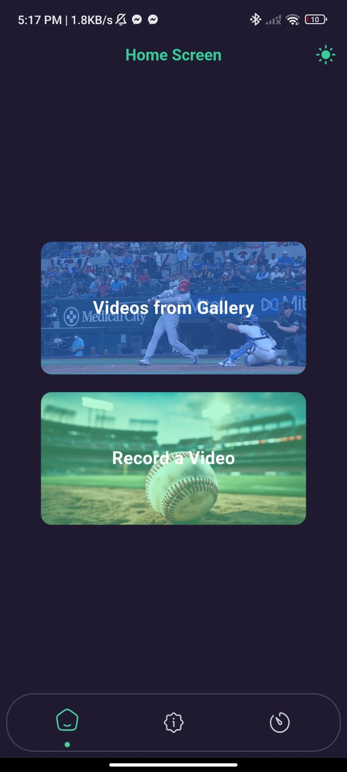
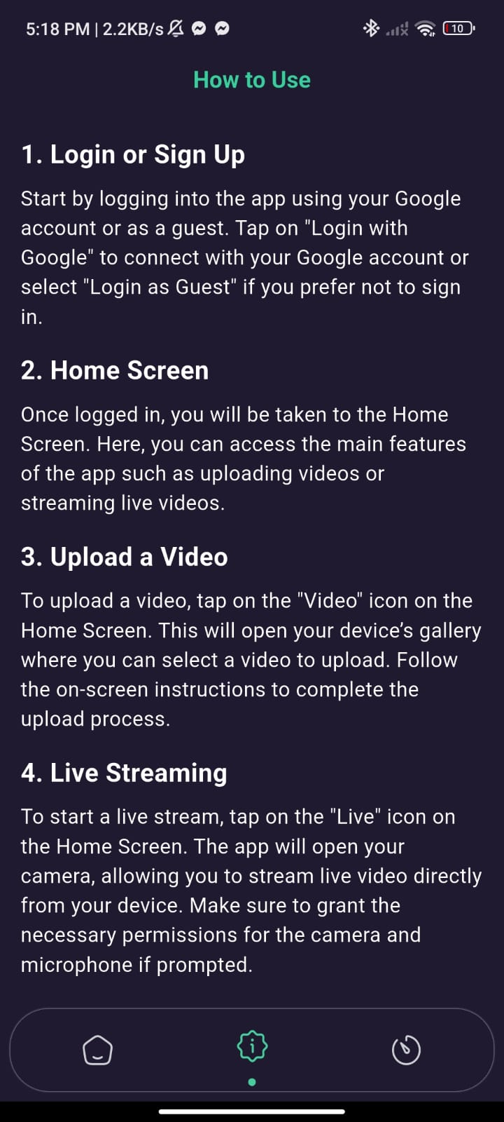
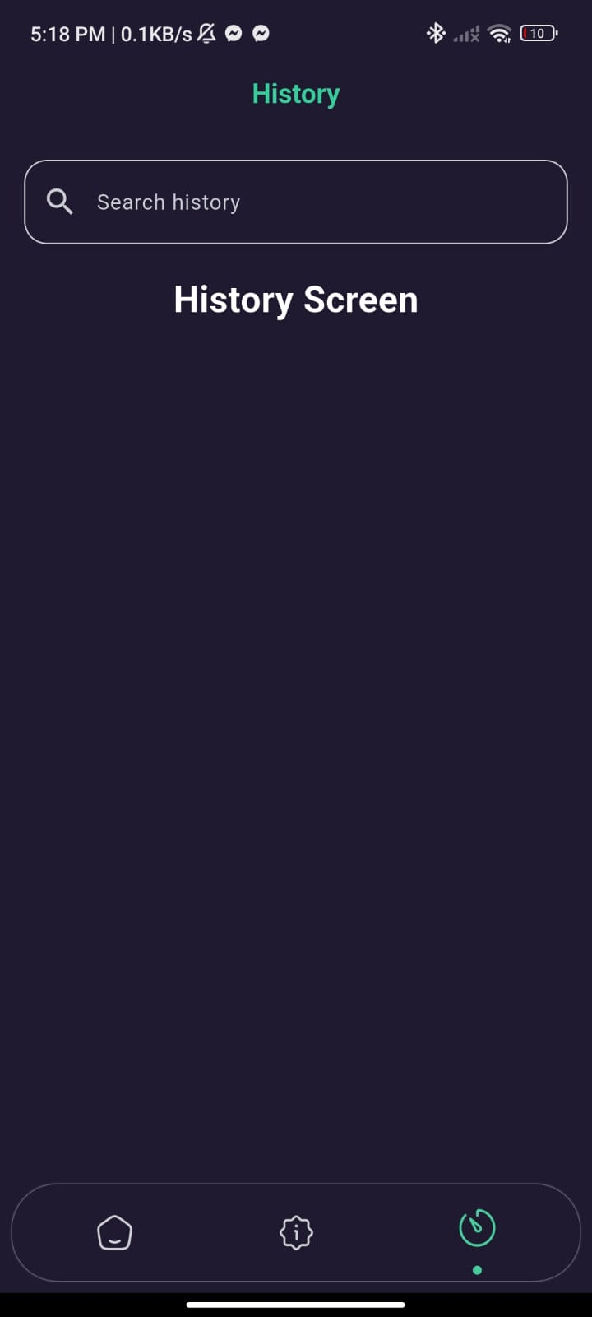
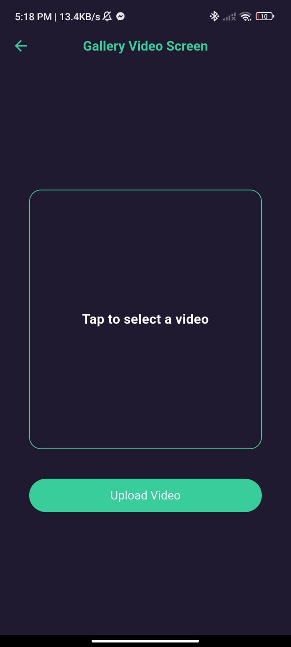
Screens

Slide 20
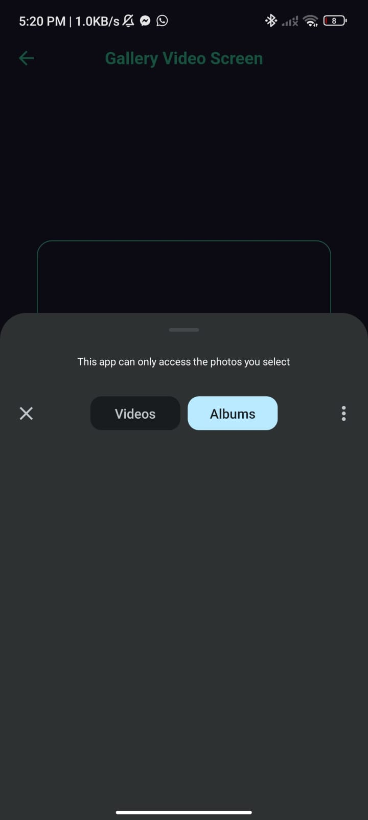
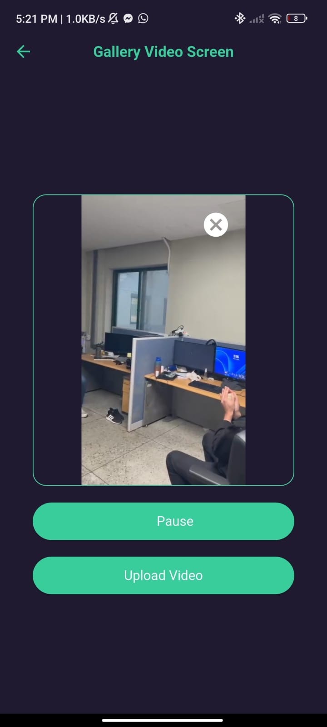
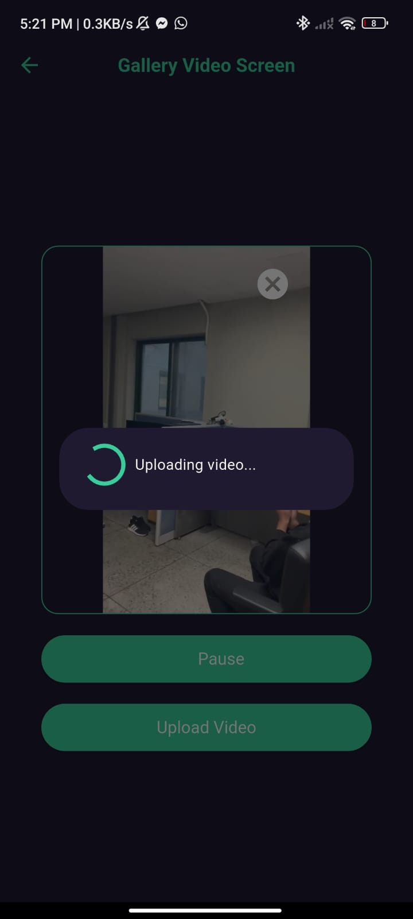
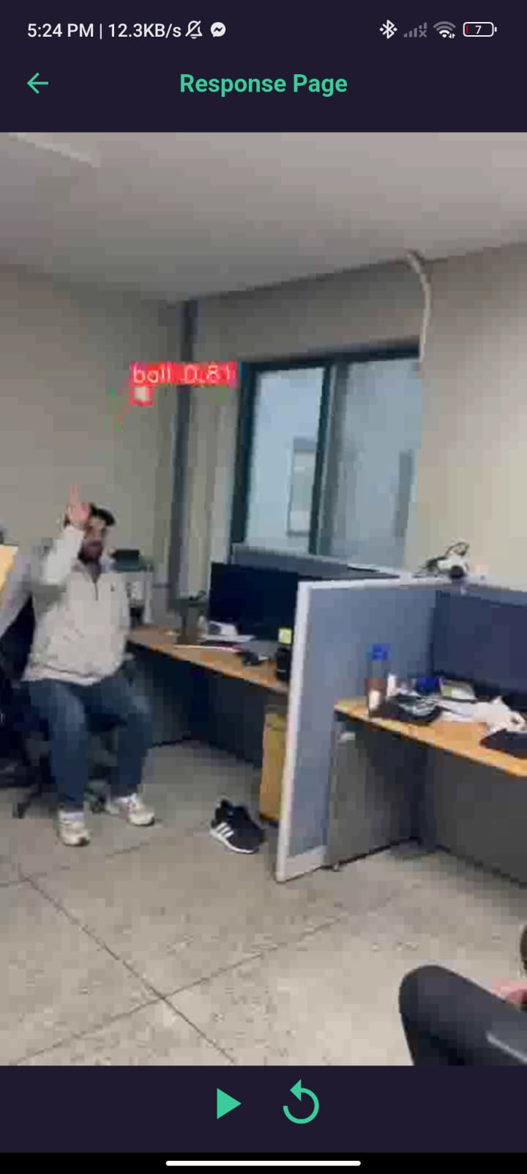
Screens

Slide 21
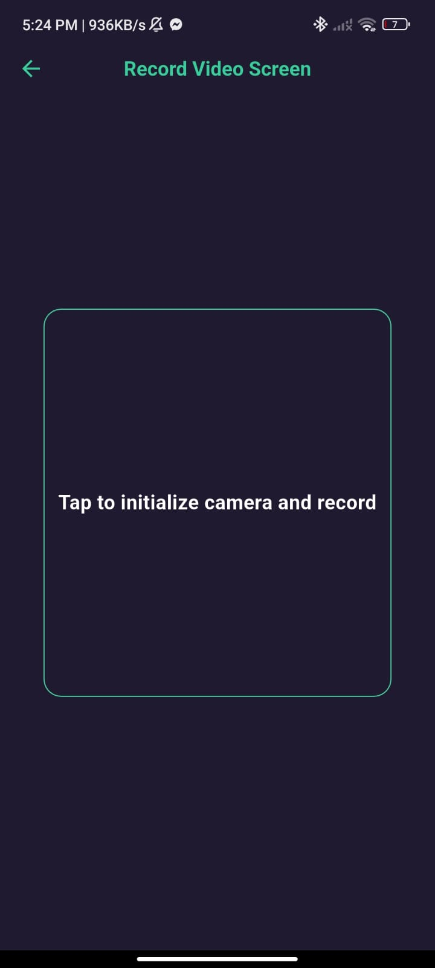
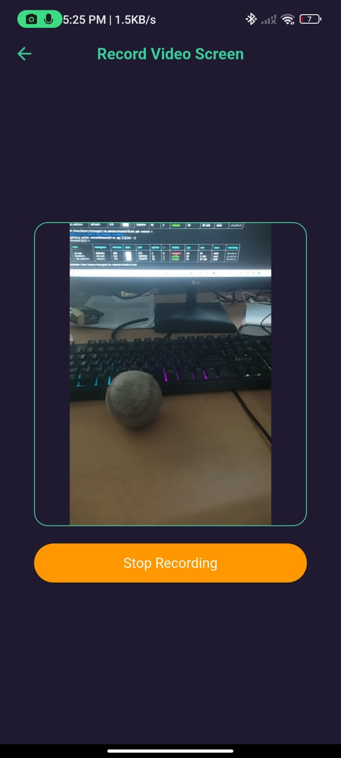
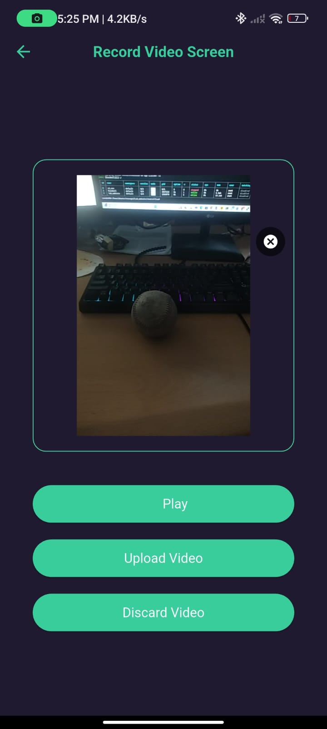
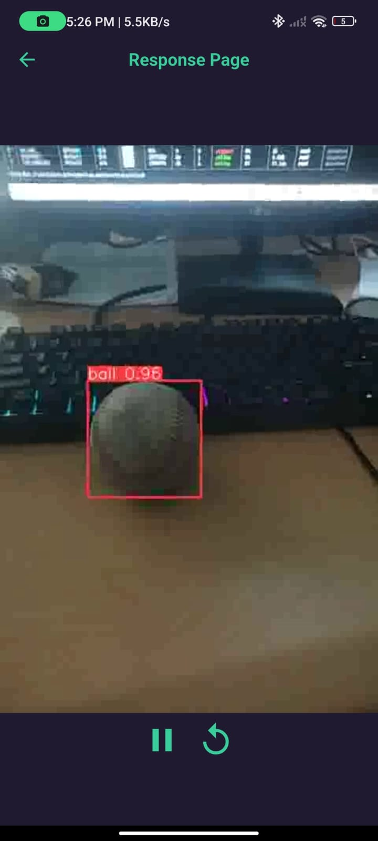
Screens

Slide 22


