Slide 1



WINDOWS VS LINUX
A presentation on
Presented by
Ariful Islam Marfy

Slide 2
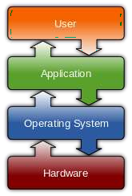
WHAT IS AN OPERATING SYSTEM?
An operating system is software that manages computer hardware and software resources and provides common services for computer programs.
The operating system is an essential component of the system software in a computer system. Application programs usually require an operating system to function.

Slide 3







History
Unix
Mac
Linux
Solaris
Debium
Redhat
Slackware
DOS
MS DOS
WINDOWS

Slide 4
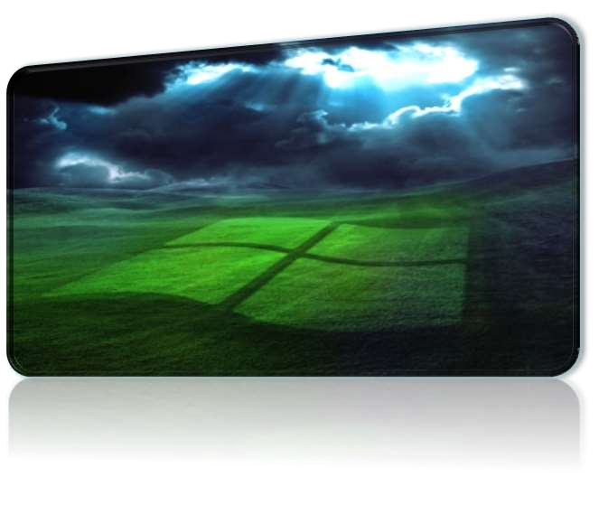
WINDOWS OS
Microsoft Windows operating system was developed by Microsoft to overcome the limitation of its own MS- DOS operating system.
First successful version were Windows 3.0, released in 1990.Subsequently released version were “Windows 95, Windows 98, Windows 2000, Windows XP, Windows XP Professional , Windows Vista, Windows 7, Windows 8, Windows 8.1 and nowadays Microsoft launches it’s latest OS Windows 10.”

Slide 5


Linux OS
Linux is a free Unix-type operating system originally created by Linus Torvalds developed under the General Public License and the source code of which is freely available to every one.
LINUX kernel created by Finnish college student, Linus Torvalds in 1991.
LINUS TORVALDS

Slide 6
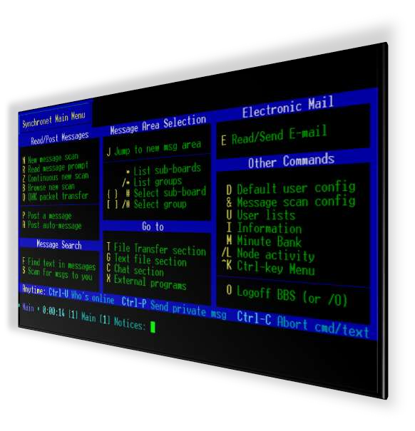

COMPARISION
Windows OS
Linux OS

Slide 7
COMPARISION
Security & Price
Windows OS
Linux OS
THERE ARE MANY TYPES OF VIRUSES IN WINDOWS OS BECAUSE OF A LARGE AMOUNT OF MARKET SHARE
WINDOWS IS EXPENSIVE
THERE ARE LESSER AMOUNT OF VIRUSES IN LINUX AS COMPARED TO WINDOWS BECAUSE LINUX IS AN OPEN SOURCE OS
LINUX SOFTWARE IS TOTALLY FREE

Slide 8
COMPARISION
Compatibility & Reliability
Windows OS
Linux OS
ANYONE CAN INSTALL ANY TYPE OF GAME INTO WINDOWS PC WINDOWS PC IS COMPATIBLE OF ALL TYPE OF SOFTWARES AND GAMES
WINDOWS IS RELIABLE BUT DUE TO VIRUSES IT STRUCKS
LINUX IS A OPEN SOURCE SOFTWARE SO YOU CAN PROGRAM THE SOFTWARES THAT YOU WANT
LINUX IS NOT A COMPLETE OS YOU CAN MODIFY IT FOR THAT TYPE OF USAGE THAT YOU WANT

Slide 9
Comparision
Windows OS
Linux OS
No Full Access on OS
Licensing Restrictions
No Command Line
Explicitly we need to Install Drivers
Flat File Systems
Threat detection is slow & fixing
patches takes 2 to 3 months
Paid help desk support
Paid Software's Eg. Ms Office
Full Access on OS
Licensing Freedom
Command Line
Inbuilt Drivers
Hierarchal file system
Threat detection & clearing threats
is very fast
Online peer support
Free Software's Eg. Libre office

Slide 10
Conclusion
In conclusion, no operating system is really better, the choice is up to you. If you're a gamer, then you have no choice, go for Windows. Programmers might prefer Linux and video/graphics producers will probably tend towards Mac. The best thing to do is probably to try each OS and see which is best for you!

Slide 11
THANK YOU

