Slide 1
Welcome
TO
Presentation

Slide 2

Project Title
School Management System

Slide 3

Contents
1. Introduction 2. Project Organization 3. Hardware and Software Requirements 4. System Architecture 5. Class Diagram of your System 6. Project Demonstration 7. Testing 8. Limitations

Slide 4

Introduction
A Student Management System is an integrated software application designed to streamline the administration, management, and reporting of student data in educational institutions. It serves as a centralized platform for managing student information, academic records, and administrative tasks.

Slide 5
Project Organization
1. Md. Ariful Islam: Focus on developing the Admin features
3. Saira Jahan: Focus on designing and implementing the Student user interface
2. Tinni Banik: Focus on developing the Teacher and Parent features
4. Zarin Tasnima Azad: Focus on designing and implementing the Admin and Parent user interfaces

Slide 6
Hardware and software requirements
Server-side Software Web Server
Database
Programming Language Framework
Backup Software
Client-side Software
Web Browser
PDF Reader
Antivirus Software
Development Environment XAMPP
Vs Code
Version Control

Slide 7
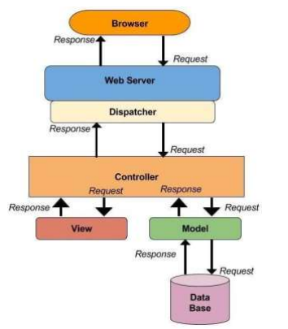
System Architecture
MVC Architecture

Slide 8
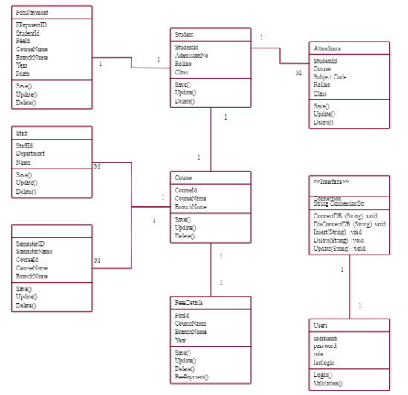
Class Dia of our System

Slide 9

Project Demonstration
1. Admin Management
2. Teacher Functionality
3. Student Enrollment
4. Parent Monitoring

Slide 10
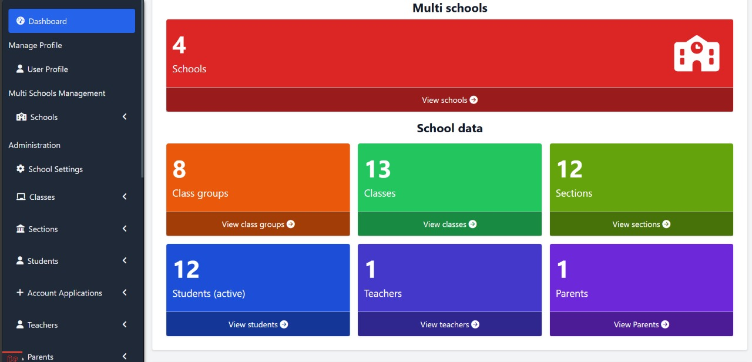
Testing

Slide 11
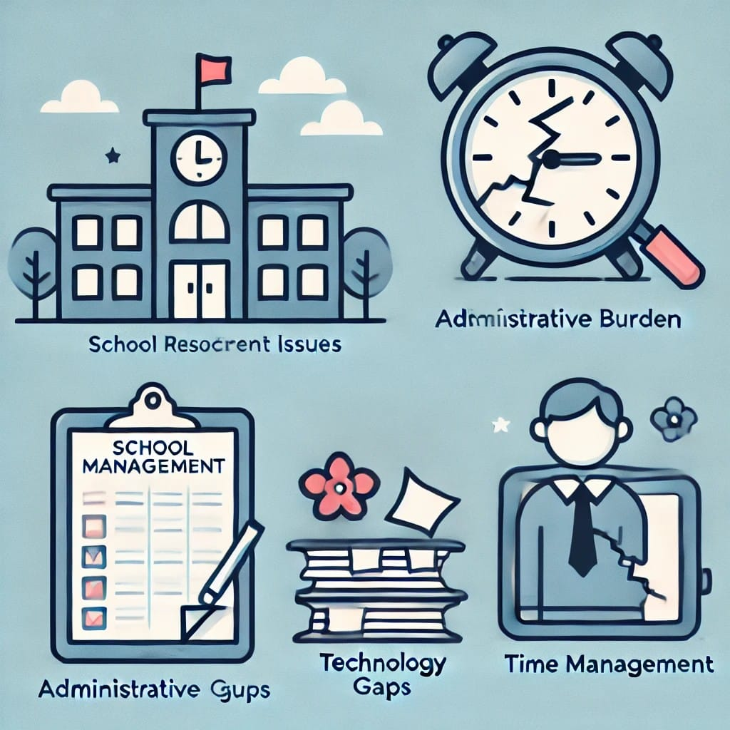
Limitations
High Initial Costs
Complexity
Dependence on Technology
Resistance to Change
Limited Customization
Data Management Challenges
User Limitations
Maintenance and Updates
Inadequate Support
Data Privacy Concerns

