Slide 1
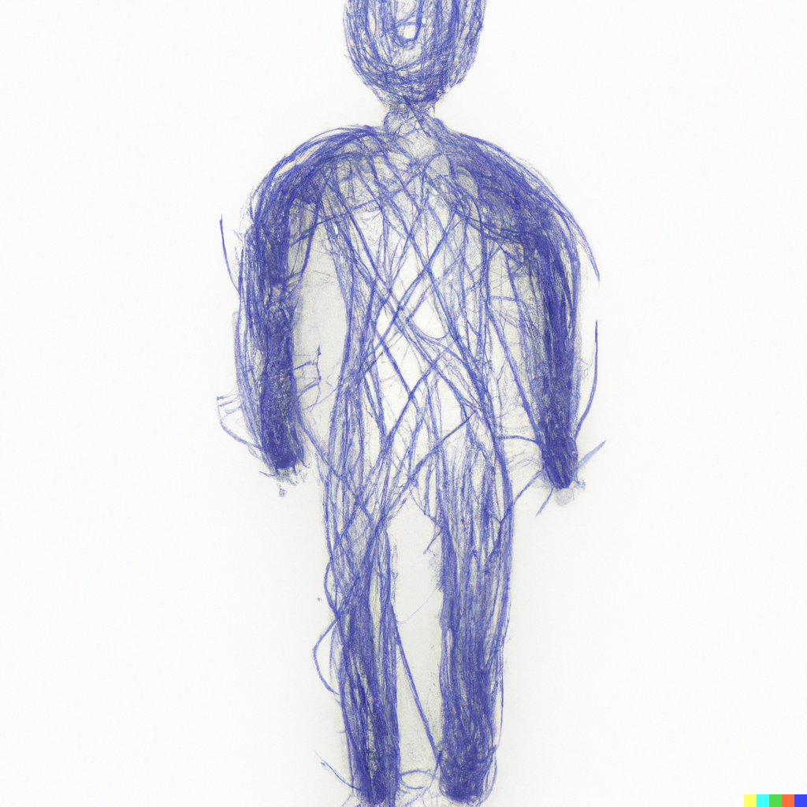
ARIFUR RAHMAN
Leading the way to success with hard work, dedication, and innovation.
Email: arifur.rahman3395@gmail.com
Phone: +8801674693395
LinkedIn: arifur-rahman

Slide 2
About me
I am an extremely hardworking and dedicated person who is passionate about expanding my knowledge and skills. I have a proven track record of success in project management, decision making, problem solving, and team building. I possess strong communication skills and am service-oriented in my approach to work. I am confident that my skills and experience will make me a valuable asset to any organization.

Slide 3
Education
I am a highly educated individual with a strong academic background. I completed my B.Sc. in Textile Engineering (Yarn) from Bangladesh University of Textiles with a CGPA of 3.24 out of 4.00. My dedication to education was evident early on as I achieved a perfect score of 5.00 out of 5.00 in both my HSC and SSC degrees from ST. Joseph Higher Secondary School and S.M. Model Govt. High School respectively. My education has equipped me with the knowledge and skills necessary to excel in any professional setting.

Slide 4
Professional Experience
I am an extremely hardworking and dedicated person who is passionate about expanding my knowledge and skills. I have a proven track record of success in project management, decision making, problem solving, and team building. I possess strong communication skills and am service-oriented in my approach to work. I am confident that my skills and experience will make me a valuable asset to any organization.

