Slide 1

Talk to Your Documents
Case study: MetMate
Question: What are the library opening hours?
Dr Mohammad Arifur Rahman · Analyst Programmer · Wimmera CMA, Victoria
Notes:
Terminologies

Slide 2
PHASE 1 · JUST ASK CHATGPT
Upload a PDF, ask a question
ONE long piece of text
ChatGPT application
handbook.pdf (200 pages)
<entire text of handbook.pdf>
+
“What are the library
opening hours?”
under the
GPT 5.5
What are the library opening hours?
hood
reads it all, writes the answer
8am–10pm on term days. ✓
Dr Mohammad Arifur Rahman · Analyst Programmer · Wimmera CMA, Victoria
Notes:
Under the hood

Slide 3
PHASE 1 · IT DOESN'T SCALE
Why this doesn't scale
1
A paid license per student
2
Costly product
3
Extensive knowledge base, always changing
Knowledge Base (KB)
Dr Mohammad Arifur Rahman · Analyst Programmer · Wimmera CMA, Victoria
Notes:
KB

Slide 4
PHASE 2 · OUR OWN BOT
Our own bot — same trick, our pipes
OpenAI API
Student's browser chat page
Our web application
GPT 5.5
KB + Question
Dr Mohammad Arifur Rahman · Analyst Programmer · Wimmera CMA, Victoria
Notes:
OpenAI -> ChatGPT

Slide 5
PHASE 2 · AI VS NOT-AI
How much of this is actually AI?
OpenAI API
Student's browser chat page
Our web application
GPT 5.5
KB + Question
Non-AI –deterministic
AI – non-deterministic
Dr Mohammad Arifur Rahman · Analyst Programmer · Wimmera CMA, Victoria
Notes:
All docs

Slide 6
PHASE 2 · IT BREAKS
One question, two million words
the KB
the prompt
the result
300 PDFs
ALL of it
~1 minute
≈ 2 million words
Dr Mohammad Arifur Rahman · Analyst Programmer · Wimmera CMA, Victoria
Notes:
OpenAI API – magic box

Slide 7
PHASE 3 · SEARCH FIRST
Send less: Chunking
KB documents
split into chunks
pick the top 5 for this question
prompt: 5 chunks + question
GPT 5.5
answer
New terminology: chunk
200 pages → 2 pages per question
Dr Mohammad Arifur Rahman · Analyst Programmer · Wimmera CMA, Victoria
Notes:
chunk

Slide 8
PHASE 3 · SEARCH FIRST
Finding the pieces — no AI needed
“What are the library opening hours?”
THE KB, AS ACTUALLY STORED — A TABLE OF CHUNKS
A
“Library opening hours: 8am–10pm on term days.”
library · opening · hours
score 3 ✓
B
“Enrolment closes at the census date.”
—
score 0
C
“Exam Period Appendix: library access 24/7 during exam period.”
score 1
library
Keyword search (BM25)
Dr Mohammad Arifur Rahman · Analyst Programmer · Wimmera CMA, Victoria
Notes:
BM25

Slide 9
PHASE 3 · IT BREAKS
Right words, wrong rule
Week 3 of term. Student asks: “Can I access the library 24/7?”
Exam Period Appendix
General rule — governs this week
“…library access 24/7 during the exam period…”
“Library opening hours: 8am–10pm on term days.”
shares: library · access · 24/7 → score 3 → wins
shares: library → score 1 → left behind
MetMate: “Yes — the library is open 24/7.”
Confident. Wrong.
Failed
LEXICAL matching fails
SEMANTIC matching - solution
Dr Mohammad Arifur Rahman · Analyst Programmer · Wimmera CMA, Victoria
Notes:
Semantic

Slide 10
PHASE 4 · SEARCH BY MEANING
Math with words
Three words: enrolment, registration, withdrawal
1 apart — similar ✓
withdrawal
enrolment
registration
Embedding
-5
0
5
6
Dr Mohammad Arifur Rahman · Analyst Programmer · Wimmera CMA, Victoria
Notes:
Pass

Slide 11
PHASE 4 · SEARCH BY MEANING
One number isn't enough — vectors
New word comess: pass
pass [0, 5]
course [2.5, 2.5]
Vector
withdrawal [−5, 0]
enrolment [5, 0]
registration [6, 0]
Embedding models
fail [0, −5]
Dr Mohammad Arifur Rahman · Analyst Programmer · Wimmera CMA, Victoria
Notes:
Pass, fail, course
Dimension
300-3000

Slide 12
PHASE 4 · SEARCH BY MEANING
Who assigns the numbers?
“Students must enrol before the census date.”
“Students must ______ before the census date.”
Initial
End
enrol
[-1.2, 0.1]
[5.2, 1.2]
the model guesses:
register
[1.3, -0.2]
[5.1, 1.3]
enrol
62%
party
[-2, 0.3]
[-1.2, 5.1]
register
31%
party
0.1%
Random initialisation
Dr Mohammad Arifur Rahman · Analyst Programmer · Wimmera CMA, Victoria
Notes:
Representation learning
Local embedding models

Slide 13
PHASE 4 · SEARCH BY MEANING
MetMate searches by meaning
“Enrolment corrections must be lodged before census.”
[ 5.2, 0.1, …]
“Library opening hours: 8am–10pm on term days.”
[−0.2, 4.7, …]
[−4.8, 0.3, …]
“Withdrawal without penalty: apply before week 4.”
“How do I fix a mistake in my registration?”
ZERO shared words — found by meaning ✓
[ 5.6, 0.2, …]
Dr Mohammad Arifur Rahman · Analyst Programmer · Wimmera CMA, Victoria

Slide 14
ALL TOGETHER
The whole picture — you built RAG
BUILT ONCE — Building up Knowledge
AI or Non-AI?
Documents (KB)
Split into chunks
Chunk → vector
Store: chunk + vector
EVERY QUESTION, LIVE
Question → vector
Find nearest chunks
Build prompt: chunks + question
Question
Model writes
Answer
The AI box
RETRIEVAL — find it
AUGMENTED — add it
GENERATION — write it
Retrieval-Augmented Generation
Dr Mohammad Arifur Rahman · Analyst Programmer · Wimmera CMA, Victoria

Slide 15
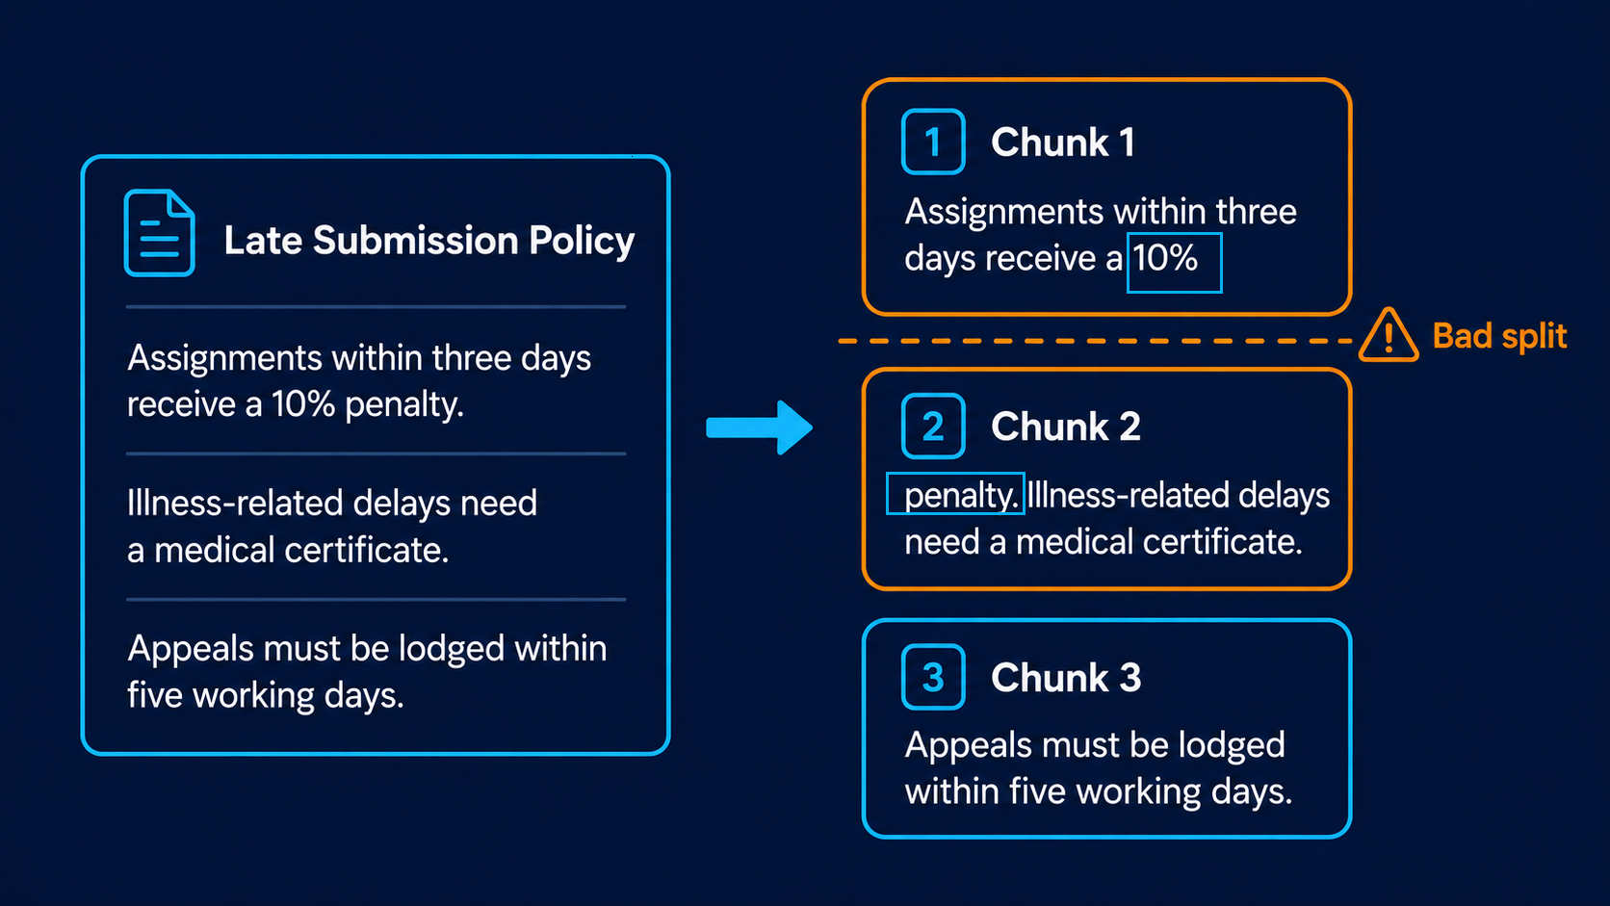
Remaining Issues
Bad Split
Dr Mohammad Arifur Rahman · Analyst Programmer · Wimmera CMA, Victoria
Notes:
chunk

Slide 16
PHASE 5 · TOWARD THE REAL WORLD
What real chatbots add
Hierarchical chunking
Context-aware chunking
Hybrid search
Reranking
Conversation memory
Verification
Thank you. Any questions?
Dr Mohammad Arifur Rahman · Analyst Programmer · Wimmera CMA, Victoria

