Slide 1

Arianna Galzerano - 10563365
Leonardo Giusti - 10633778
Francesco Govigli - 10556637
Gamified Application

Slide 2
Specifications
The goal of this project is to develop a web application to collect data from registered users about their feedbacks on products which are made available by administrators.
The project can be divided in 2 main parts:
User App:
Admin App:
Main functionalities are the compilation of the proposed questionnaire and the visualization of a leaderboard composed by all users who filled in the form for the specific product.
Scoring is done following a specific policy explained in the next slides.
Main functionalities are the creation of new products for a present or posterior date and the inspection and deletion of past data.

Slide 3
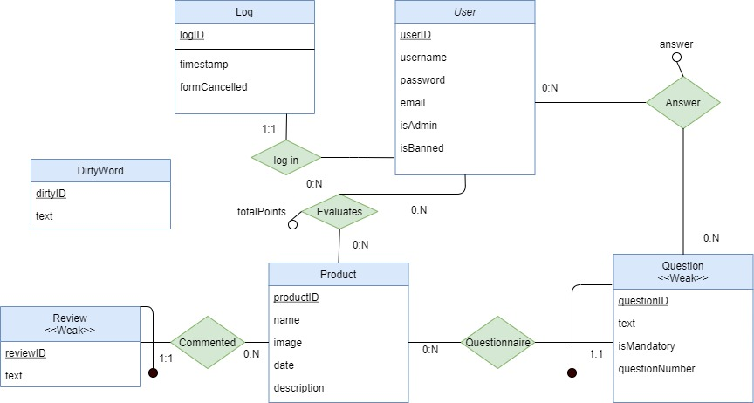
Database ER-Schema

Slide 4
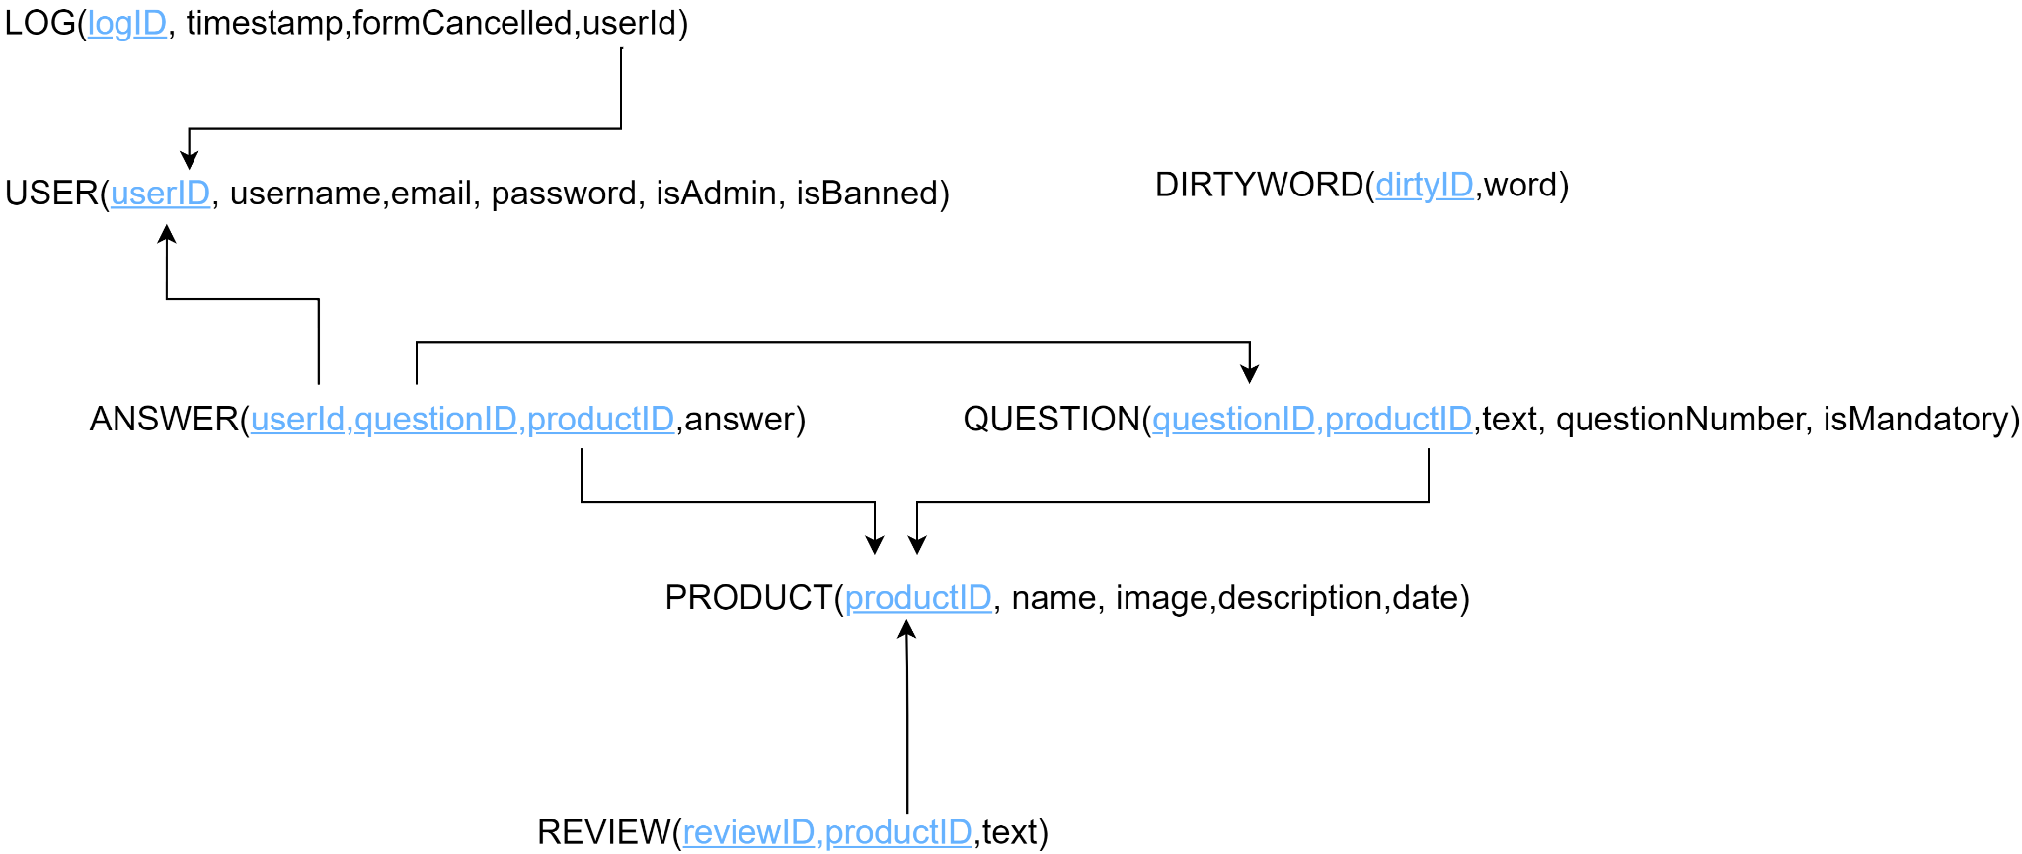
Logical Schema

Slide 5
Design choices
In the admin application there was no need of the deletionPage and we added just the delete functionality of an inspected questionnaire.
Reviews are dynamically inserted, only by the admin, during the creation of a product.
Admins are assumed to be already registered in the application and don’t need to Signup
Review and Question entities are identified as weak w.r.t Product because they have no meaning with no associated product.
The user ban is managed only in a soft-way, where the user can still access, but cannot fill in the questionnaire
The deletion is managed by deleting the product corresponding to the specified date and thus, all the associated entities.
The information that a user has canceled a questionnaire is saved in the user log

Slide 6
Trigger’s Motivation
As part of the implementation, a Trigger is inserted in order to automatically compute the total points a User obtains by submitting the answers to a questionnaire.
Every time a mandatory or optional answer is inserted into the ANSWERS table, the points gained with the new answer are added to the total score for a specific user and for the product of the day in the EVALUATION table.
This choice was made in order to avoid expensive queries to compute the total points that have to be displayed in the LEADERBOARD.

Slide 7
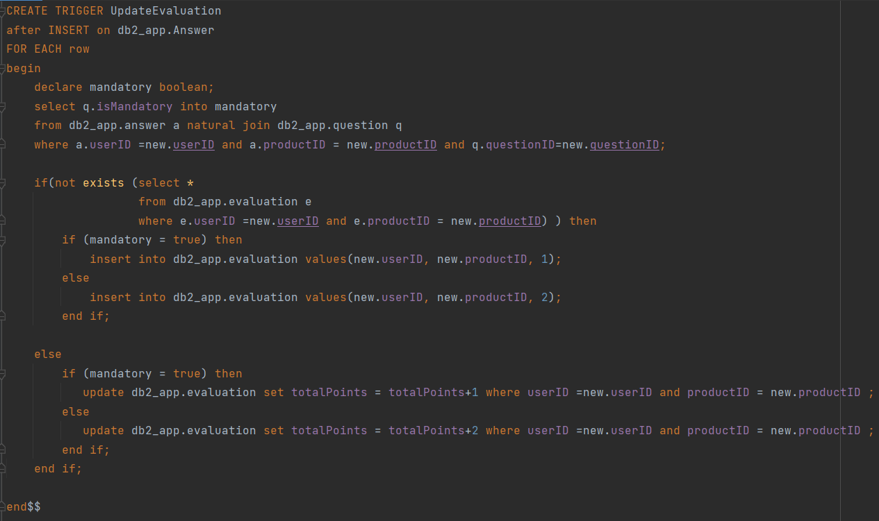
Trigger Implementation
Evaluation Policy:
Through the trigger, the rules applied for the total scores computations consist in:
+1 for replying to a mandatory question
+2 for replying to a optional question
Idea:
It creates a new evaluation if there are still none related to the specific user and product, else
it just updates the totalPoints associated to the instance

Slide 8
Relationship “log in”
0:N
1:1
User -> Log (@OneToMany)
We just consider it bidirectional for simplicity, even if it is not needed by the specifications.
Log -> User (@ManytoOne)
This relationship is used to retrieve the
current log instance of a user when he
decides to cancel a questionnaire to set the
log attribute isFormCancelled = true.
USER
login
LOG
*
USER
LOG
1
USER
LOG

Slide 9
Relationship “evaluates”
totalPoints
For this relationship we have created a JoinTable called Evaluation, which contains the 2 collections of both users and products with a @ManyToMany bidirectional relationship.
Evaluation Table is just a utility to manage and keep the totalPoints of a user updated in order to create the Leaderboard.
0:N
0:N
USER
evaluates
PRODUCT
*
USER
PRODUCT
*
USER
PRODUCT

Slide 10
Relationship “commented”
REVIEW
1:1
Product->Review (@OneToMany)
This relationship is used to retrieve the
reviews of a given product which can be added only by the admins on the application
Review->Product (@ManytoOne)
We just consider it bidirectional for simplicity even if it is not needed by the specifications.
commented
PRODUCT
<<weak>>
0:N
REVIEW
*
PRODUCT
<<weak>>
REVIEW
PRODUCT
<<weak>>
1

Slide 11
Relationship “questionnaire”
0:N
1:1
QUESTION
Product->Question(@OneToMany)
This relationship is necessary to retrieve all the questions for the product of the day, to display them in the questionnaire for the users.
Question->Product (@ManytoOne)
This side of the relationship is kept for
simplicity and for completion purpose.
PRODUCT
questionnaire
<<weak>>
*
QUESTION
PRODUCT
<<weak>>
1
QUESTION
PRODUCT
<<weak>>

Slide 12
Relationship “Answer”
answer
0:N
0:N
With this relationship N:N between Question and User we are able to track the answers that a User gives to a question (related to a specific product since question is a weak entity).
In the project, it is modelled as a new entity Answer which has two unidirectional @ManyToOne relationships with Question and with User because for each user there are multiple answers and for each question there are multiple answers.
We decided to model unidirectionally the relationship because in the inspection the author of an answer is needed and also the related question.
USER
Answer
QUESTION
*
USER
QUESTION
*
USER
QUESTION

Slide 13
Entities design
User
Question
Review
Product
Log
Dirty Word

Slide 14
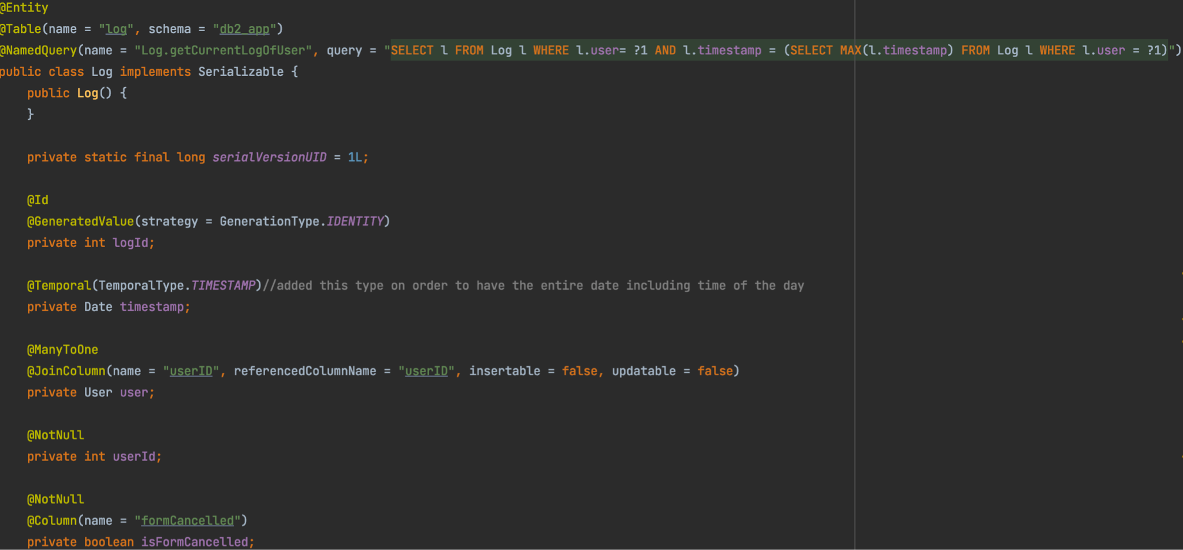
Log Entity

Slide 15
Motivations
isFormCancelled introduced to note down questionnaire canceled by users because we do not save the record in the Answers table;
The reason behind this design choice is that it is given the chance for a user to first cancel and then submit a questionnaire in the same day
Bidirectional many-to-one association Log to User :
- Owner class is Log
- insertable = false, updatable = false because it's not the responsibility of the Log entity to create or update a User

Slide 16
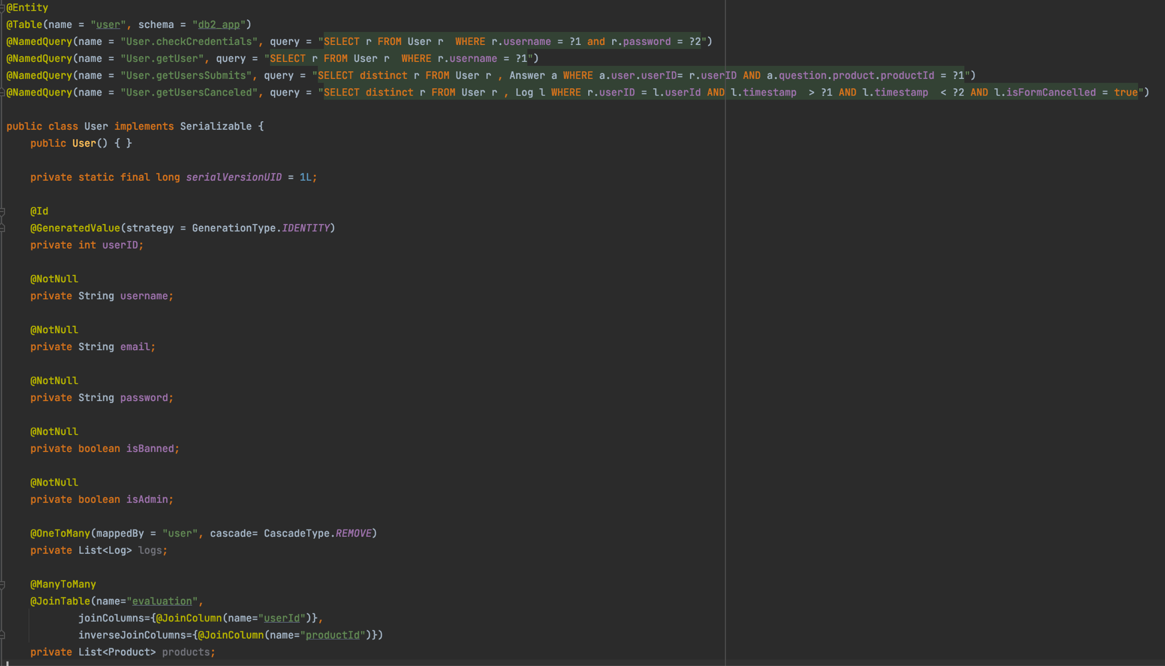
User Entity

Slide 17
Motivations
Bidirectional Many-to-Many association Product to User :
- JoinTable is Evaluation that has as primary keys userID and productID
Bidirectional One-to-Many association Log to User :
- Owner class is Log
User.getUsersCanceled is a Named Query used to retrieve all the logs of a given user from 00:00.01 to 23:59.59 of a certain day

Slide 18
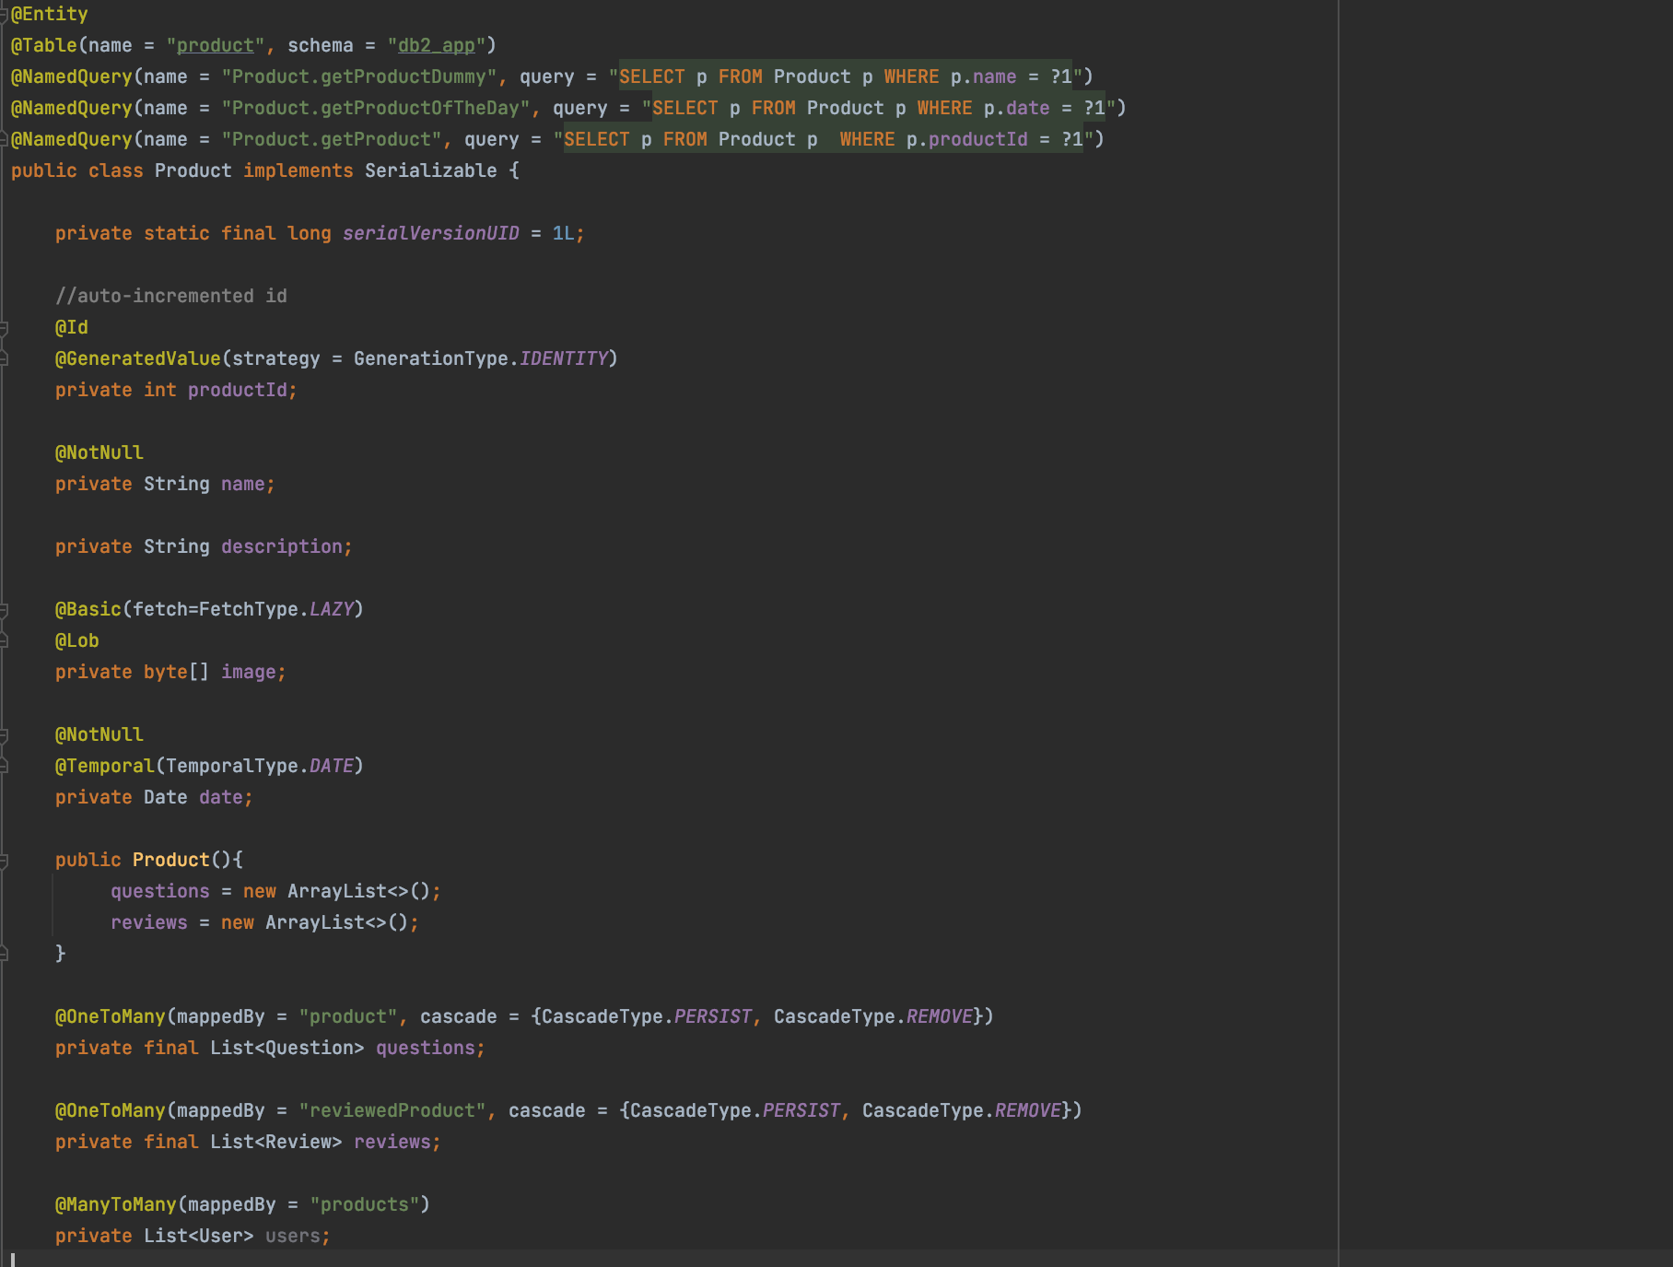
Product Entity

Slide 19
Motivations
Since the product related questions and reviews are two weak entities, the CascadeType is set to:
CascadeType.PERSIST → to persist all questions and reviews of a specific item CascadeType.REMOVE → to directly delete the instances when the product is deleted by the admin in the inspection page.
OrphanRemoval deletes an instance if it is no more attached to any parent in any relationship. Since we are just adding the attached reviews and questions just during the product creation phase and never dynamically changing the relationship collection, we decided to use the cascading instead of OrphanRemoval
FetchType is kept to EAGER, since every time we access the product we are interested in getting questions.

Slide 20
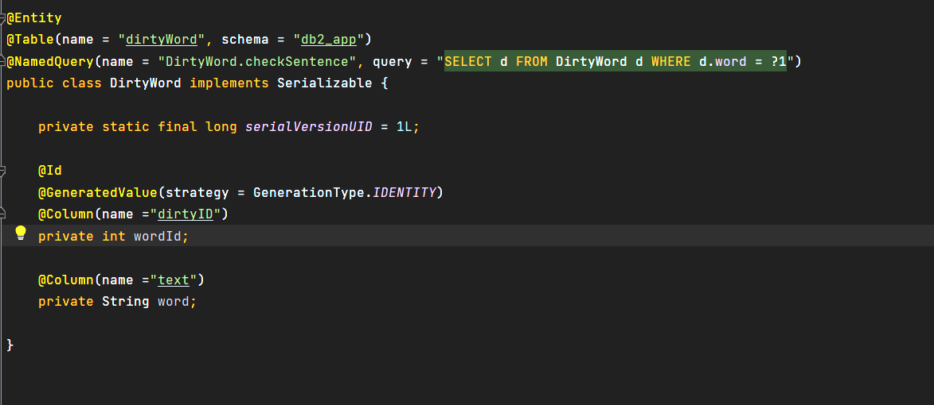
Dirty Word Entity
Dirty words are directly stored in the DB.
They are kept independent w.r.t other entities since the words are static and fixed instances.

Slide 21
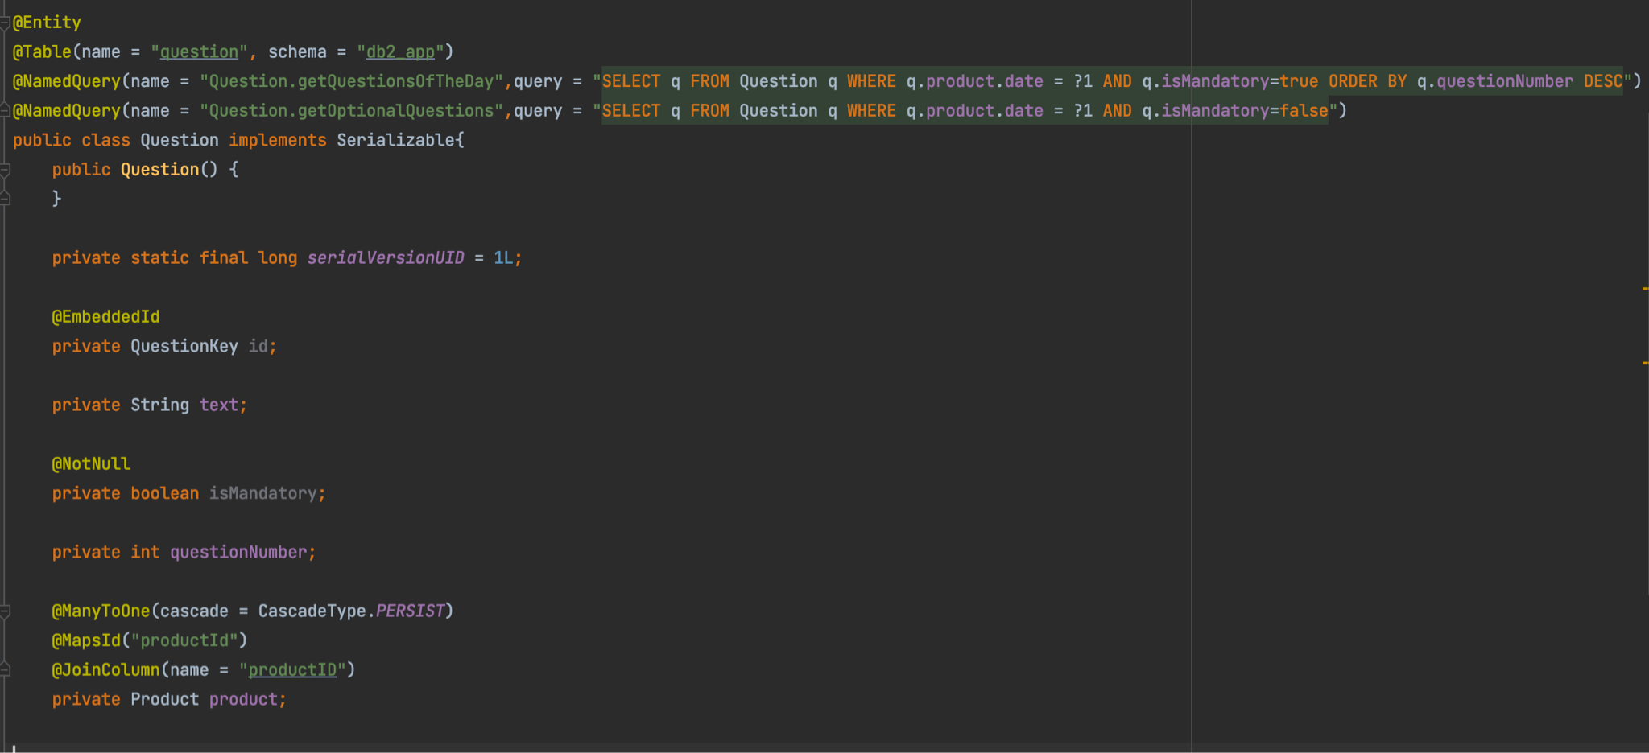
Question Entity

Slide 22
Motivations
Since a questionnaire exists only if related to a Product, the Question entity is weak and depends on the Product entity
Named query ‘Question.getQuestionsOfTheDay’ can be used to extract the ordered collection of questions of a product by means of a JPQL query, as an alternative to relationship navigation
Bi-directional @ManytoOne association Question to Product, where the former entity is defined as Owner
Persistence operations are cascaded to the dependent entity Question

Slide 23
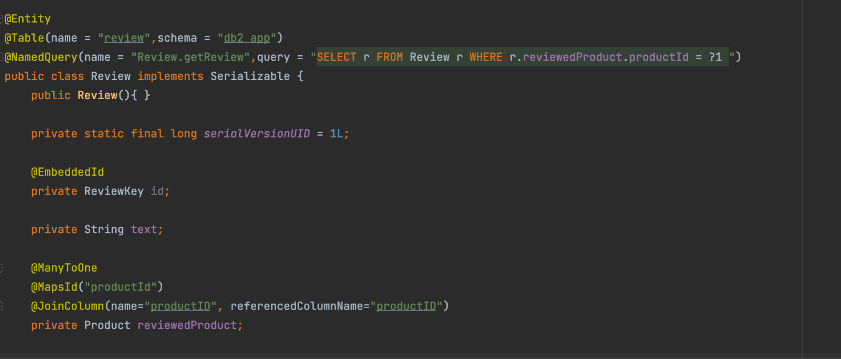
Review Entity
Bi-directional one-to-one association to Product
Review is the owner entity

Slide 24
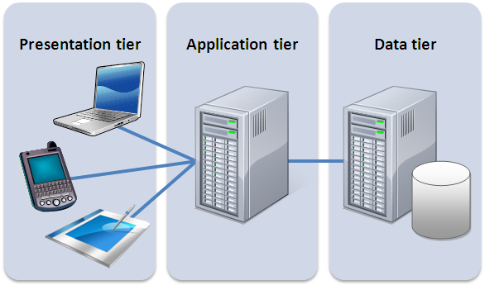
Components
Web Tier Components:
Login/Logout
Error
ADMIN side:
Creation - post new product
Deletion - post deleted product
Inspection - inspect previous inserted products
USER side:
GoToHomepage - get homepage required data through a json file
QuestionnaireData - get data for questionnaire through json file
Leaderboard - get data for Leaderboard through json
AnswerData - post users’ answers
Clients
WebTier: Servlets
+
BusinessTier: EJBs
Database

Slide 25
Business Tier Components - ProductService
@Stateless ProductService:
public Product getProductOfTheDay(Date date)
public Product checkDateAvailability(Date date)
public void createNewProduct(String name,String description,Date date,List<String> questions,byte[] image,List<String> productReviews)
public static byte[] readImage(InputStream imageInputStream)
public void deleteProduct(Product product)

Slide 26
Business Tier Components -
UserService
@Stateless UserService:
public User addUser(String username, String email, String password, boolean banned)
public User getUser(String username)
public User checkCredentials(String username, String password)
public void banUser(String username)
public UserStatus checkUserStatus(User user, Product product)
public void LogUser(User user)
public void cancelForm(User user)
public List<String> getUsersWhoCanceled(Product product)
public List<String> getUsersWhoSubmits(Product product)
public List<String> getAnsweredQuestions(Product product,String username)
public Date getCorrectFormatDate(LocalDateTime now)

Slide 27
Business Tier Components -
QuestionnaireService
@Stateless QuestionnaireService:
public List<Question> getQuestionsOfTheDay()
public List<Question> getOptionalQuestions()
public List<String> convertToString(List<Question> questions)

Slide 28
Business Tier Components -
AnswerService
@Stateless AnswerService:
public boolean hasDirtyWord(String[] answers)
public String[] correctAnswerFormat(String[] answers)
public void addAnswer(String response, User user, Question question)
public boolean alreadyFilled(String username, Product product)
public List<Answer> getUserAnswers(Product product, String s)
public List<String> getAnswerText(List<Answer> answersFromUser)
public boolean checkMandatoryOK(String[] mandatory_answers)

Slide 29
Business Tier Components -
EvaluationService - ReviewService
@Stateless EvaluationService:
public List<Evaluation> getLeaderboard(Product product)
public List<String> convertToString(List<Evaluation> evaluations)
@Stateless ReviewService:
public ArrayList<String> getReviews(int productID)

Slide 30
Motivations
Components are stateless because all client requests are served independently and update the database, no main memory conversational state need to be maintained
There is no need to save the states since all method calls are independent from each other and don’t interact between them
We could have done an alternative design by putting the ReviewService method directly inside ProductService

