Slide 1
DISTRICT MANAGER BRIEFING
AI Efficiency Team
An operations-led AI hub that gives every manager in your district a faster, safer way to handle the writing, planning, and reporting that fills their day — with you in control of every step.
Built by FedEx operations people, for FedEx operations people.
Public-safe · Human-reviewed · Safety Above All.

Slide 2
Why This Matters for FedEx
2 PB+
Dec 2025
52
DATA GENERATED DAILY
FEDEX AI EDUCATION PROGRAM LAUNCHED
COPY-PASTE PROMPTS READY NOW
“The future of business is being shaped by data and AI more than ever before. As FedEx continues its evolution into an AI-powered enterprise, our people remain at the heart of everything we do.”
— Raj Subramaniam, President & CEO, FedEx Corporation
This is our region's contribution to that company-wide mission — something your managers can use this week.
Public sources collected in docs/presentation-proof-points.md.

Slide 3
The Daily Reality It Helps
AI is not abstract here. It removes friction from the work your managers already do every shift — at every station in your district.
Before the shift
Pull public weather and road signals, then draft a pre-shift huddle and safety note in minutes instead of scrolling five tabs.
During the shift
Turn a messy escalation into a clear handoff, summarize a metric spike, or rough out a customer service alert.
After the shift
Draft an after-action review, a near-miss report, or an executive update the manager edits and owns.
For a district: small daily time savings, multiplied across every manager and station, add up to hours of reclaimed capacity each week — without changing a single operational decision.

Slide 4
What It Is
One clean hub your whole district can pull from, with three plain entry points:
For your managers
Ready-to-use prompts and a daily playbook for shift briefs, safety memos, peak planning, and customer notes. Nothing to install — copy, paste, edit, done.
For a first pilot
A live demo tool and starter projects your team can try today — using only public or made-up data, never FedEx data.
For governance
Review checklists, pilot templates, and clear data boundaries, so IT, legal, and compliance can sign off with confidence.
You hold the gate: everything uses public or made-up (synthetic) data until FedEx formally approves more. Nothing here touches real FedEx systems.

Slide 5
Prompt Library — 52 FedEx-Specific Prompts
Organized by what managers actually do, not by AI theory. A “prompt” is just a ready-made request your manager pastes into Gemini or ChatGPT and fills in the blanks:
Daily Operations — Shift briefs, handoffs, escalations, after-action reviews
Safety & Compliance — Pre-shift huddles, near-miss reports, seasonal alerts
Peak Season & Surge — Contingency plans, ISP coordination, sort hub staffing
Meeting & Communication — Agendas, action items, emails, executive updates
Customer & Contractor — Service alerts, escalation responses, team recognition
Linehaul & Routing — Feeder delays, alternate routing, yard management
Process Improvement — Root cause analysis, improvement proposals
Data & Reporting — Metrics summaries, trend explanations
Every prompt includes the Safe Prompt Rule: remove sensitive data first, review output before sharing, keep a human in charge.

Slide 6
DAILY HABIT
The Daily Ops Playbook
A single printable page that turns the prompt library into a daily habit — copy, paste, edit, done.
What it is
A copy-paste daily checklist with the go-to prompts for a manager's morning, mid-shift, and end-of-shift routine. Print it, pin it by the desk, work down the list.
Why it matters
Lowers the barrier for the least technical teammate. No tool to learn — just a page that says what to do and which prompt to use, with the Safe Prompt Rule on every step.
docs/daily-ops-playbook.md

Slide 7
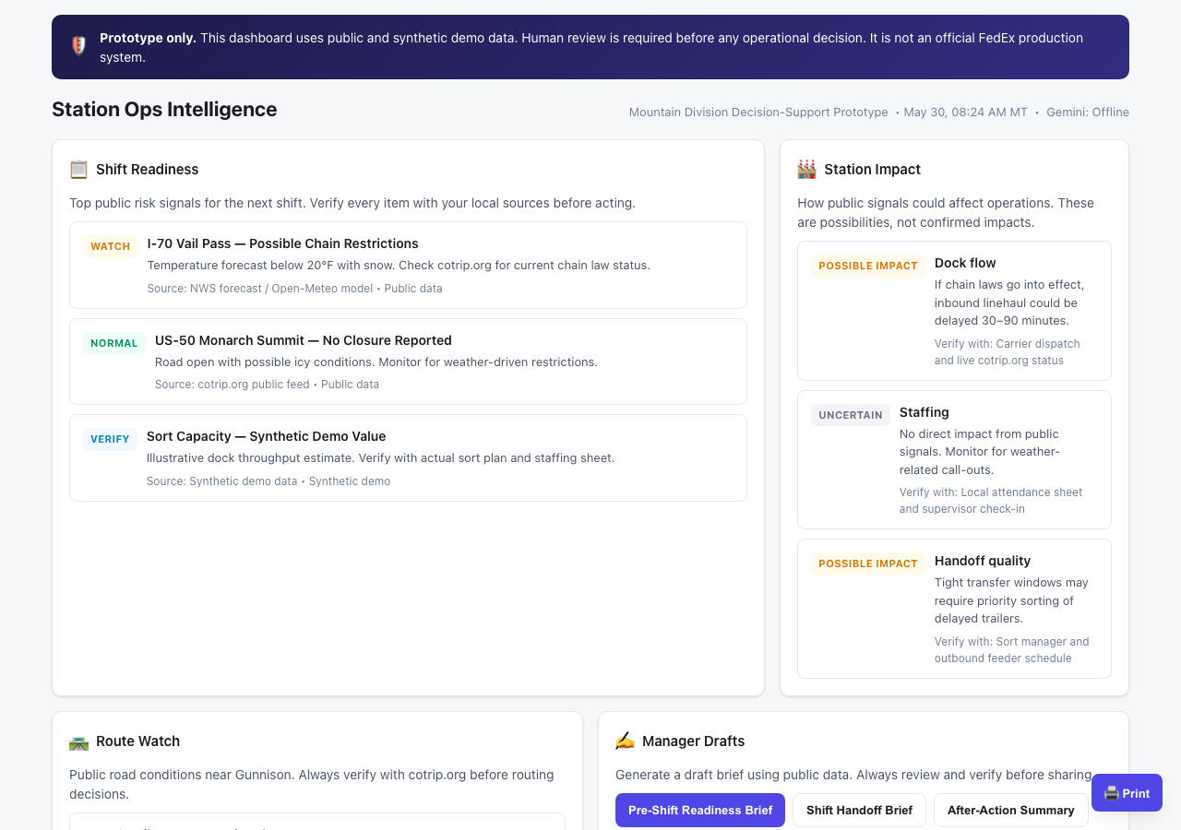
Featured Project: Logistics Intelligence System
A live demo tool (not a production system) that turns public risk signals into draft shift briefings — for any station in your district.
What it does
Shows public weather, road risk, and regional disruption before a shift, then drafts a briefing a manager can edit. Every number is labeled with its source.
What it never does
No package data. No route manifests. No customer info. No live dispatch. No production claims.

Slide 8
Live Demo
Pick any station — the tool tailors the risks and the draft brief to that exact location. Four very different station types:
Gunnison, CO
Mountain station — winter weather, chain laws, I-70 restrictions
Memphis, TN
World Hub area — thunderstorms, construction, air cargo windows
Indianapolis, IN
Secondary hub — highway accidents, wind advisories, yard safety
Phoenix, AZ
Desert station — excessive heat, dust storms, hydration protocols
https://fedex-logistics-intelligence-system-267358751314.us-east1.run.app

Slide 9
BUILT · RUNS ON YOUR LAPTOP
The Efficiency Toolkit: Two Review Tools
After the week closes, two simple tools answer the two questions every efficiency review asks. Both open in a browser with no install and no internet — your real numbers never leave your machine.
Dock Efficiency Signal Lab — “Is the change real?”
Looks at your weekly dock numbers and flags which moves are a genuine trend versus normal week-to-week noise — so you chase what matters. Ranks best and worst facilities and shows the gap-to-goal in dollars.
TLH / SPH Explorer — “Which lever moved it?”
For any week-over-week efficiency change, it separates how much came from doing more per hour (SPH) versus simply cutting hours (TLH) — so a staffing cut is never mistaken for a real productivity gain.
Built for your view: filter by region or district (set up around the six Western focus districts) so you see your facilities, not the whole network. Demo data today; load a real weekly CSV locally during a pilot.

Slide 10
Safety & Governance Built In
Data boundaries
Human review
Public or synthetic data only
Every signal has a source label
Synthetic values marked “demo”
No internal FedEx systems touched
Every AI draft says “Needs manager verification”
No live-action buttons
No automatic external sends
Prototype banner on every screen
This is a public-data decision-support prototype. It helps managers notice and explain regional risk faster, but it does not make operational decisions and it does not use FedEx internal data.

Slide 11
From Prototype to Pilot
We are not asking for production approval today. We are asking to run small, measurable pilots that you control.
1
Propose
2
Run
3
Decide
Use the pilot template: problem, scope, data classification, success criteria, risk review.
Small experiment with synthetic data, clear metrics, and a human review step.
Evidence-based go / no-go. Bring IT, legal, and compliance into the conversation with data, not just ideas.
The template includes demo readiness checklists, failure criteria, and governance review steps.

Slide 12
Decision Requested Today
One small, reversible next step — with public, synthetic, or scrubbed data only, and you in control:
1
Name an owner
2
Open prompt intake
3
Keep the gate
Nominate one low-risk pilot owner and backup owner from your district.
Collect 10 manager workflow prompts over 30 days, with sensitive details removed.
No internal data, production workflow, or external messages until the project checklist is complete.
Candidate first pilots are listed in docs/pilot-candidate-shortlist.md.

Slide 13
Questions?
The repo is public. The prompts are copy-paste ready. The prototype source is available for review.
https://github.com/arigatoexpress/AI-Efficiency
Appendix follows for technical questions: how we test before we trust, and the engineering forward path.
FedEx AI Efficiency Team — District Manager Briefing · Built with Safety Above All.

Slide 14
APPENDIX · OPTIONAL
We Test Before We Trust
When a flashier AI tool shows up, we don't just adopt it. We make it prove it beats the simple, explainable tool we already trust — in a fair head-to-head test — before it earns a pilot.
The first test we ran
A fancy AI forecasting model versus our simple, explainable one, on the same data. The simple tool won. So we kept it and spent no pilot, no budget, and no team time on the upgrade.
Why it matters to a district
This is how we keep hype from wasting your team's time and money. Nothing gets adopted on a sales pitch — only on measured results — and we write down exactly when it's worth a second look.
We also confirmed privacy-preserving (encrypted) scoring is feasible — kept on the research shelf pending a security review.

Slide 15
APPENDIX · FOR TECHNICAL Q&A
The Engineering Forward Path
If a pilot earns it, here is the governed path from today's demo to a real tool — built entirely on Google Cloud and Gemini tools FedEx already uses. Internal FedEx data stays locked behind governance the entire way.
Google AI Studio
›
Gemini / Vertex AI
›
Agent Development Kit (ADK)
›
Vertex AI Agent Engine
›
Cloud Run
›
Foundry — governance-gated
Plain version: we would build it on the cloud tools FedEx already pays for, and access to internal data is earned with evidence from small pilots — never assumed.

