Slide 1
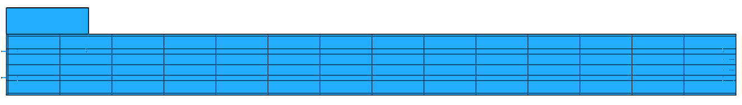
2020-03-25 Stave Geometry (re IR image analysis)
155
Z
50
98
50
115
Module 13
Overall Length = 1375.
Module 0
Dimensions in mm.
Module 0 is aligned flush with the start of the stave (Z=0)
Module 13 extends to Z = 14*98 = 1372. Overall stave core extends a further 3mm to Z=1375.
Pipes are symmetrically placed, with axes ±25mm from the stave mid-line.
The width of the regions of interest (above the pipes) should probably be 8mm (i.e. ±4mm from the axis of each pipe). However, we may want to tune this to find the most reliable mesure of thermal impedance (given camera resolution and rapid temperature change with distance from the pipe). So it should be a parameter (or at least something easy to change).
Next slide is about the U-bend.

Slide 2
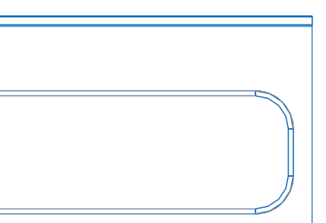
U-bend region
Z
The straight, longitudinal section of (each) pipe extends to 24mm from Z=0 (the start of the stave).
Beyond that the pipe bends through 90° with a radius of 15mm.
The transverse straight section is therefore (50 – 2*15 =) 20mm long, located 9mm from the the start of stave.
I am not sure how to include this section in a neat way.
Perhaps for now just take the Module0 boundaries as Z = 24 and Z = 98, which would give the mean thermal impedance over 76% of the module length: (98-24)/98 .
Need to think how to improve on this (special case)!
50
20
15
9

