Slide 1
August 4, 2026
Black Women’s Cambridge
A Case Study on Critical GIS and Black Feminist Geographies
Ari Hammond

Slide 2
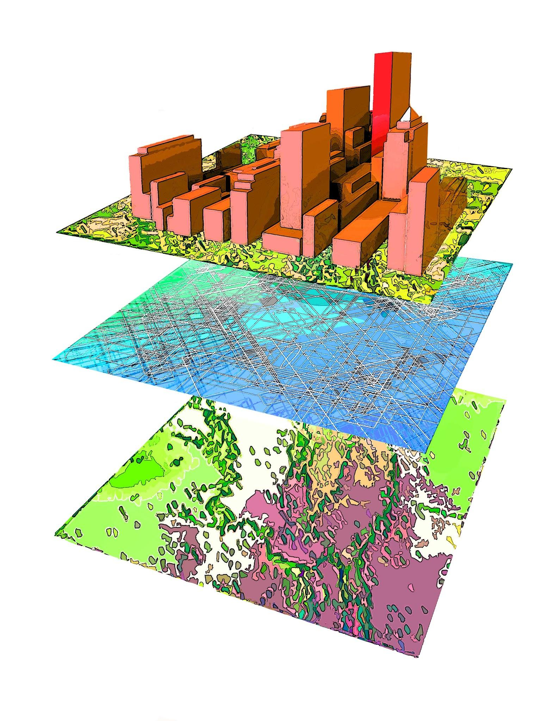
Geographic Information Systems (GIS)
Computer programs that store, manage, analyze, and visualize geographic data
Generalizes Knowledge
Seeks to generate “universally applicable principles or to make generalizations about the world”
Imposes Binaries
Positions one interpretation/representation as “unquestionable facts” and classifies data to fit this narrative
Purports Objectivity and Neutrality
All data and visualizations are objective and neutral

Slide 3
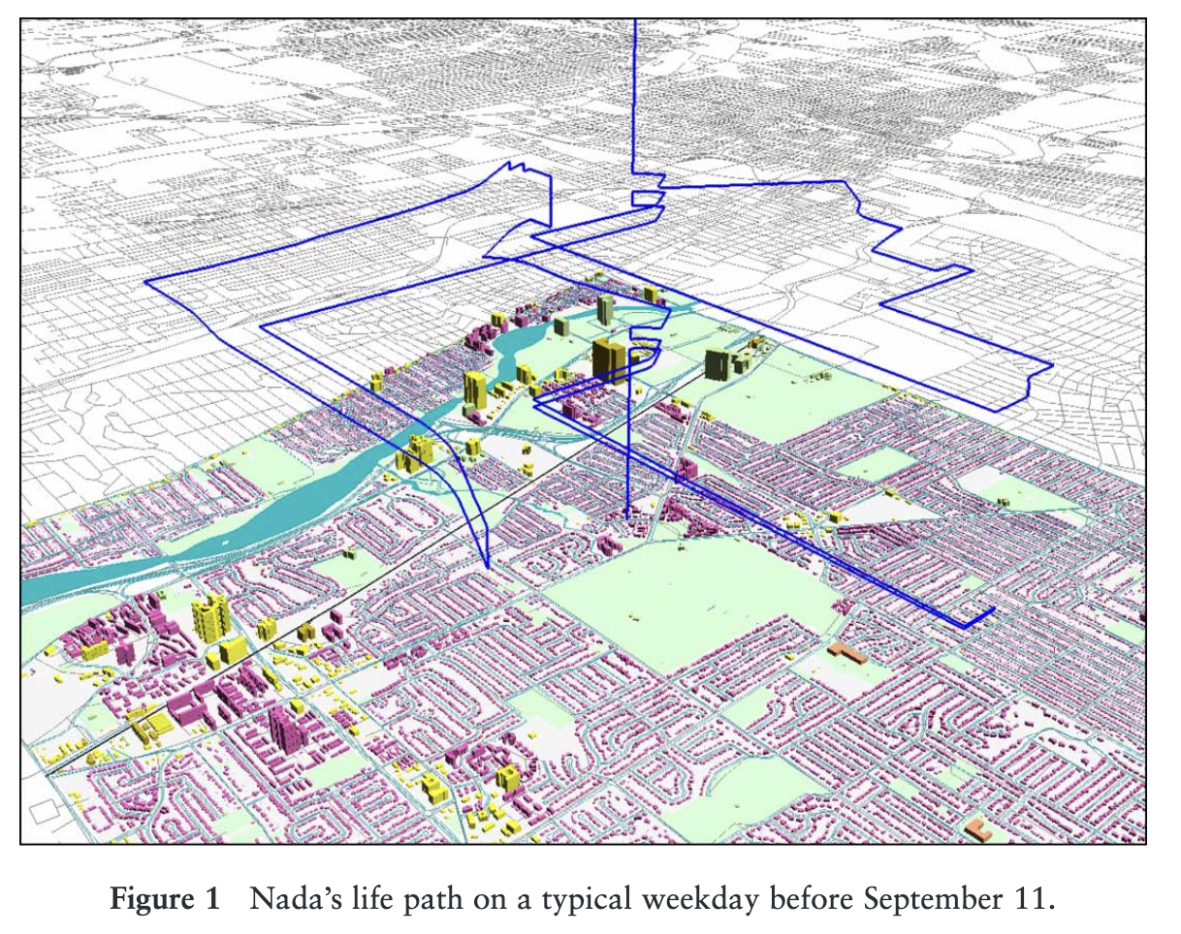
Critical GIS
A set of practices, methods, and approaches to GIS that push back against its perceived objectivity and positivist assumptions.
Situated Knowledge
Acknowledges that “all knowledge comes from somewhere and is therefore partial”
Multiple Perspectives
Examines knowledge across multiple scales and contexts
Bodies and Emotions
Requires subjectivity by “recognizing emotion and embodiment as ways of knowing”

Slide 4
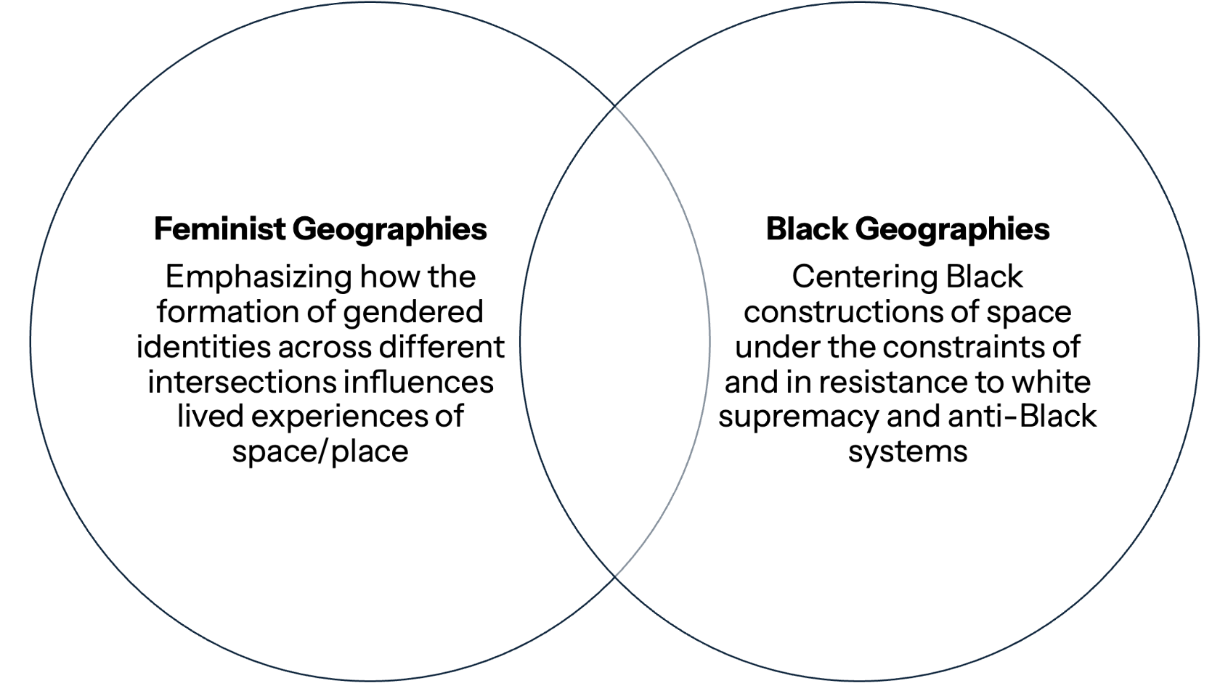
?

Slide 5
Black Feminist Geographies
However, Black women’s intersectional geographies and ways of knowing have not been directly considered or applied to critical GIS.
Black feminist geographies describe how Black women’s uniquely intersectional experience of racial-sexual hierarchies and oppression shape our creation and definition of geographic landscapes.
This creates an ambiguous, subjective experience of geography that captures understandings of space made “both for [us] through processes of control and by [us] through means of resistance.”
Notes:
Revise heavily

Slide 6
Inserting Black feminist perspectives into critical GIS
How might visualizing Black feminist geographies disrupt traditional assumptions in GIS technology?

Slide 7
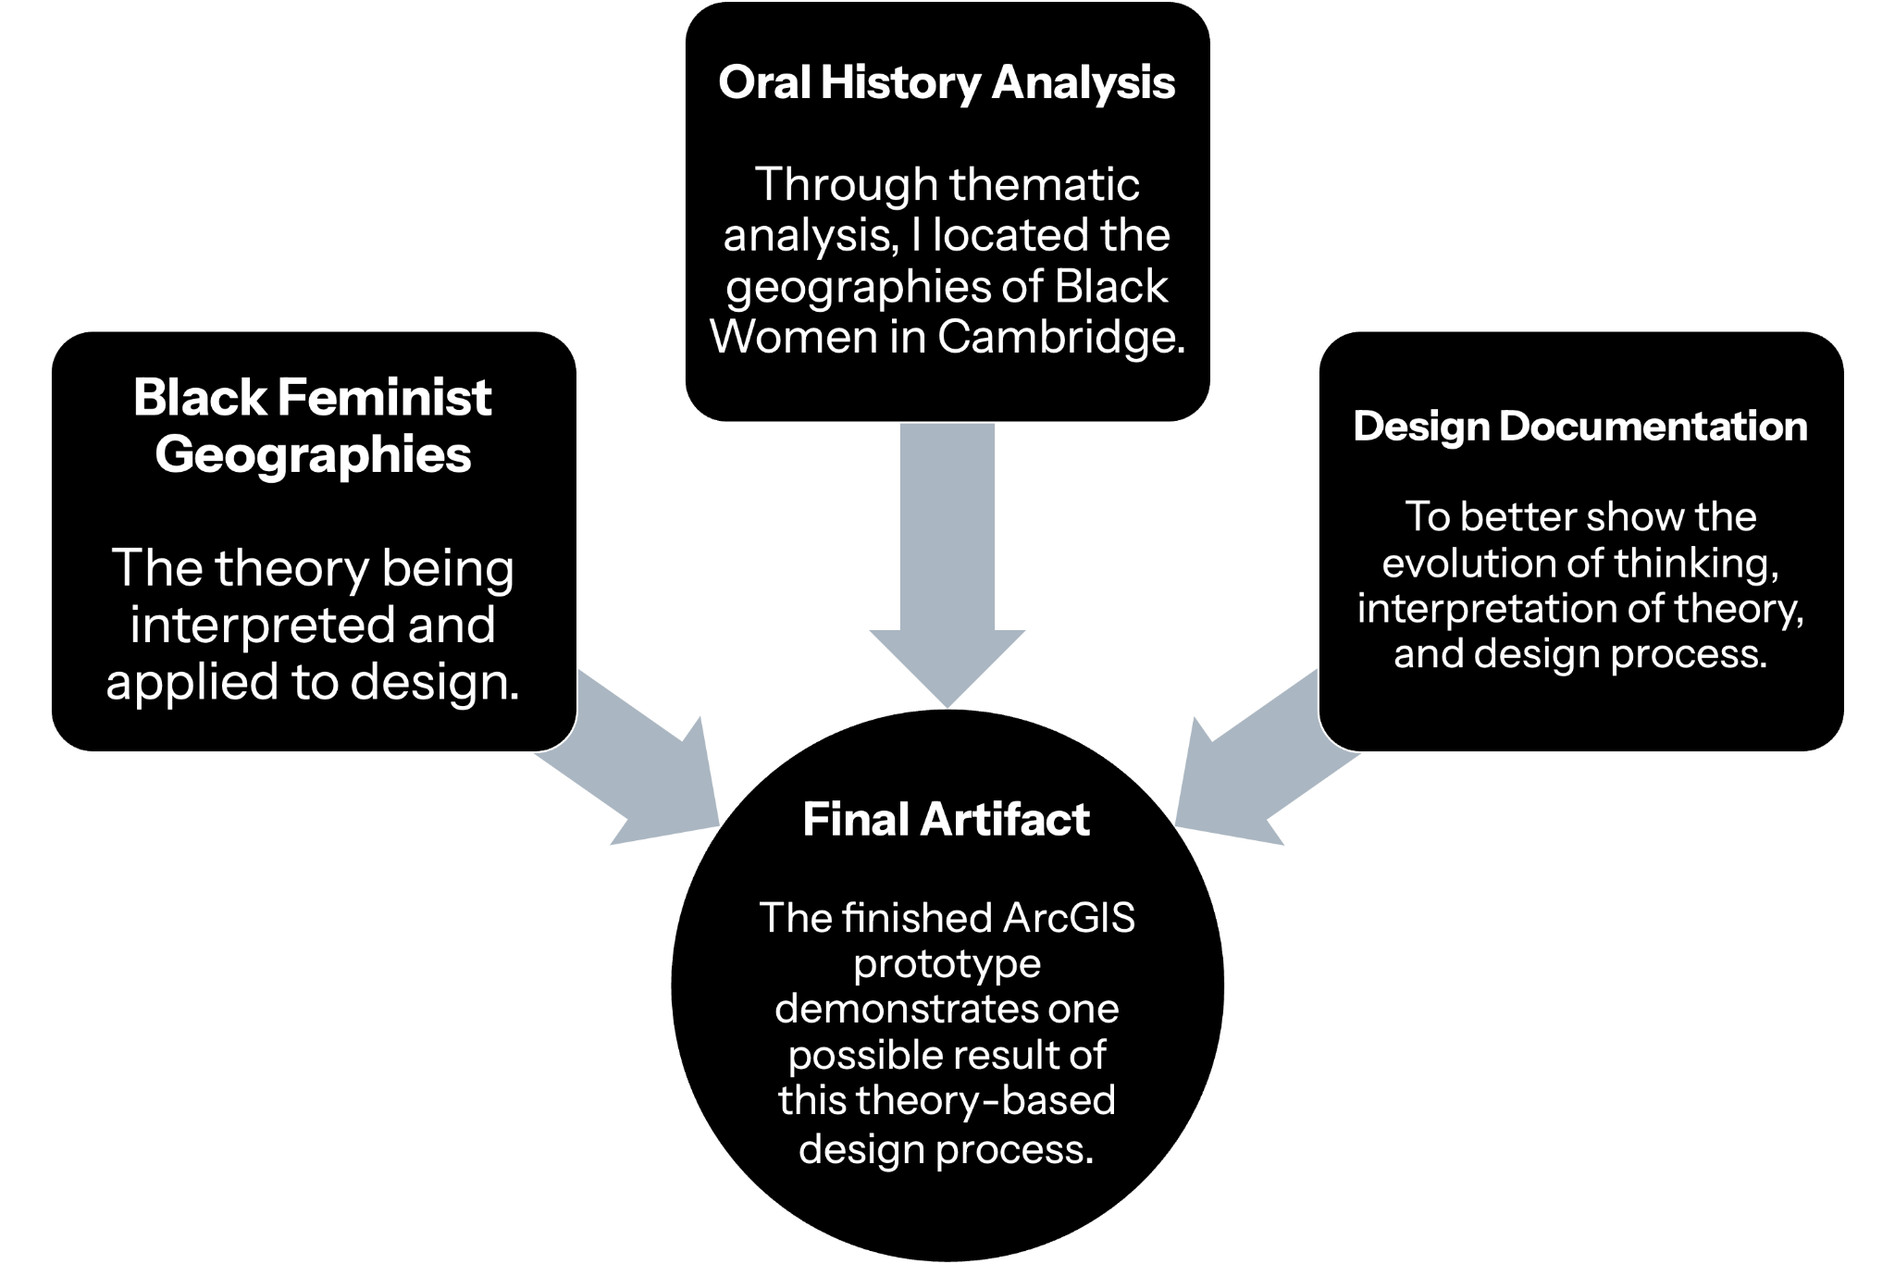
Design as a Mode of Inquiry
A research-through-design study of Black feminist geographies using oral histories and ArcGIS to visualize Black women’s geographies of Cambridge.

Slide 8
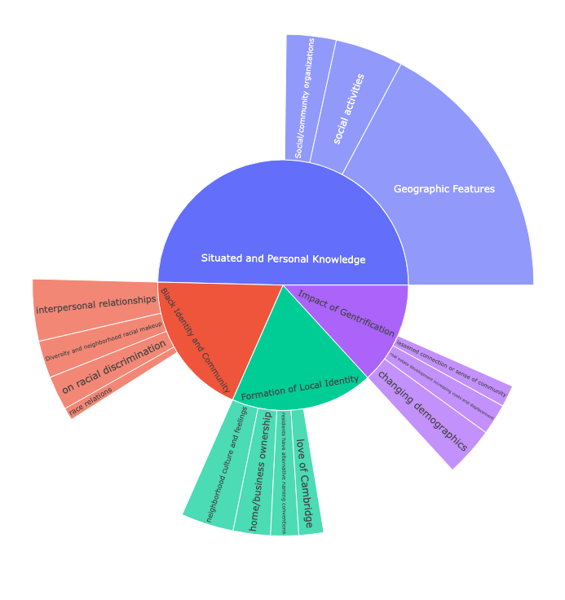
Oral History Thematic Analysis
Common Neighborhoods, Places, and Streets
Names of churches, schools, streets, and other activity spaces to serve as anchors around which to orient more situated knowledge
Pride in Community and Homeownership
All women spoke with pride, affection, and nostalgia for their neighborhoods, particularly about homeownership and communal care
Prevalent Negativity about Gentrification
Despite conflicting opinions on race in the 20th century, all women mentioned demographic, social and cultural changes resulting from displacement caused by real estate speculation

Slide 9
Design Process: Data Feminism and Geospatial Technologies
Data
Design
Process
Consider Context: Situated knowledge and personal geographies
Rethink Binaries: Uplift endonyms expressed by Black women rather than exonyms designated by those in power
Embrace Pluralism: Contradictory and complementary accounts of spatial and social phenomena
Embrace Pluralism: Multiple points of entry and forms of information. Leveraging multimedia affordances
Embodiment and Affect: Color choices associated with expressed or inferred emotions
Rethink Binaries: Alternative conceptions of open/closed borders.
Reflexivity: Using the documentation process to stop and reflect on my decisions given the purpose, medium and audience
Make Labor Visible: Highlight the labor of the archivists and community groups recording the histories

Slide 10
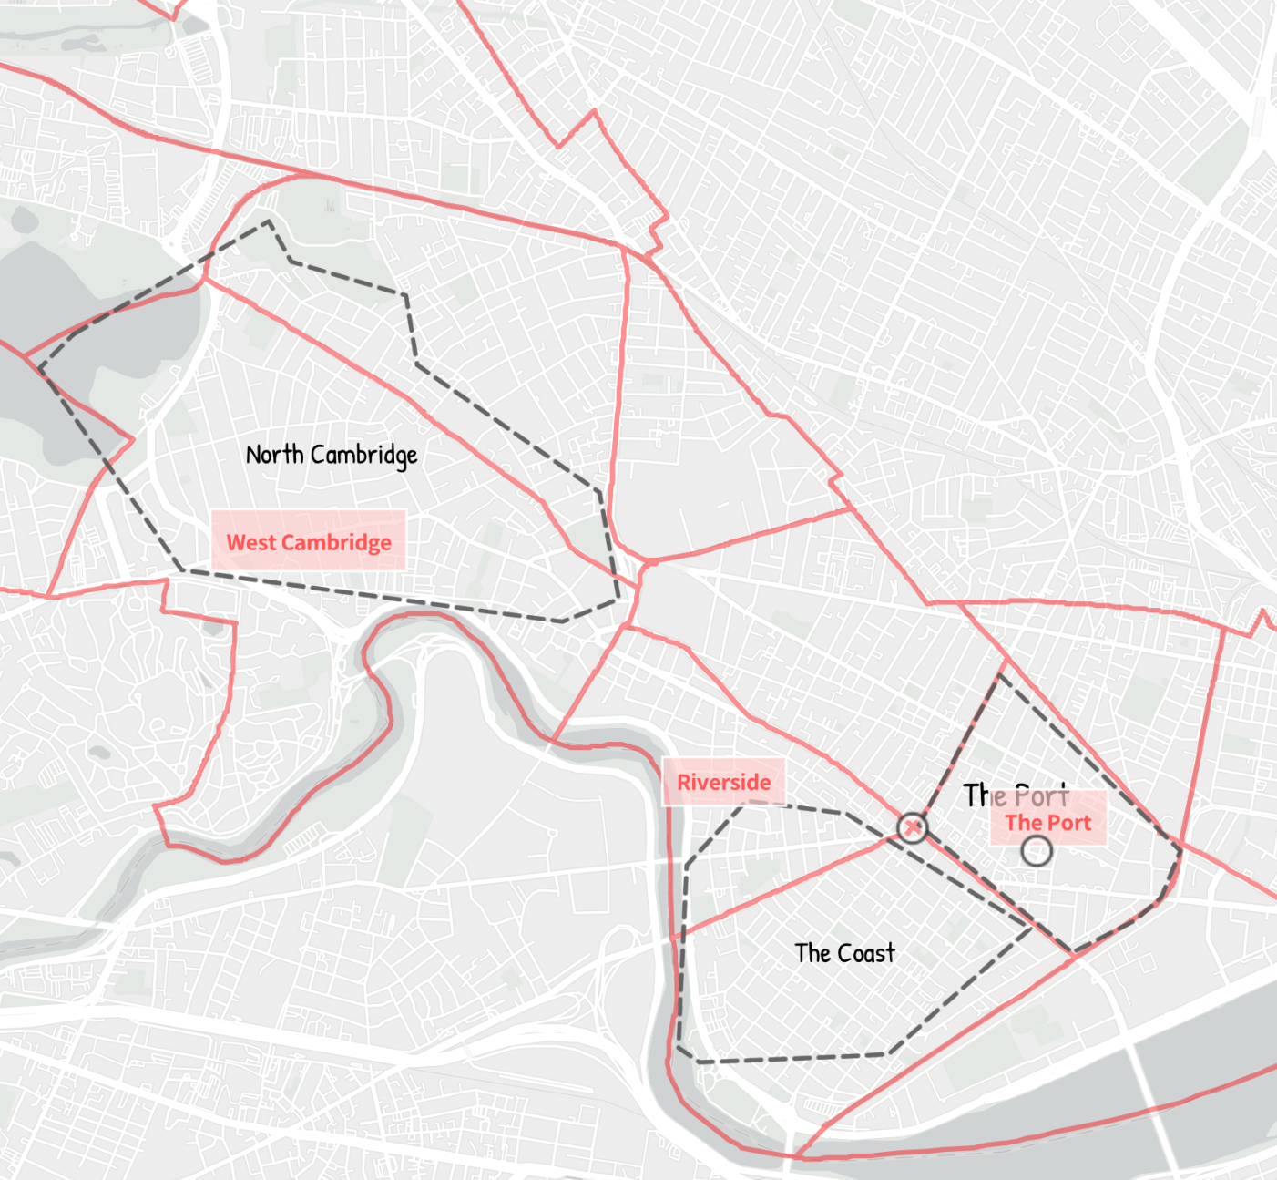
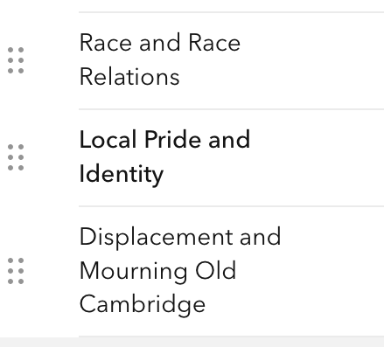
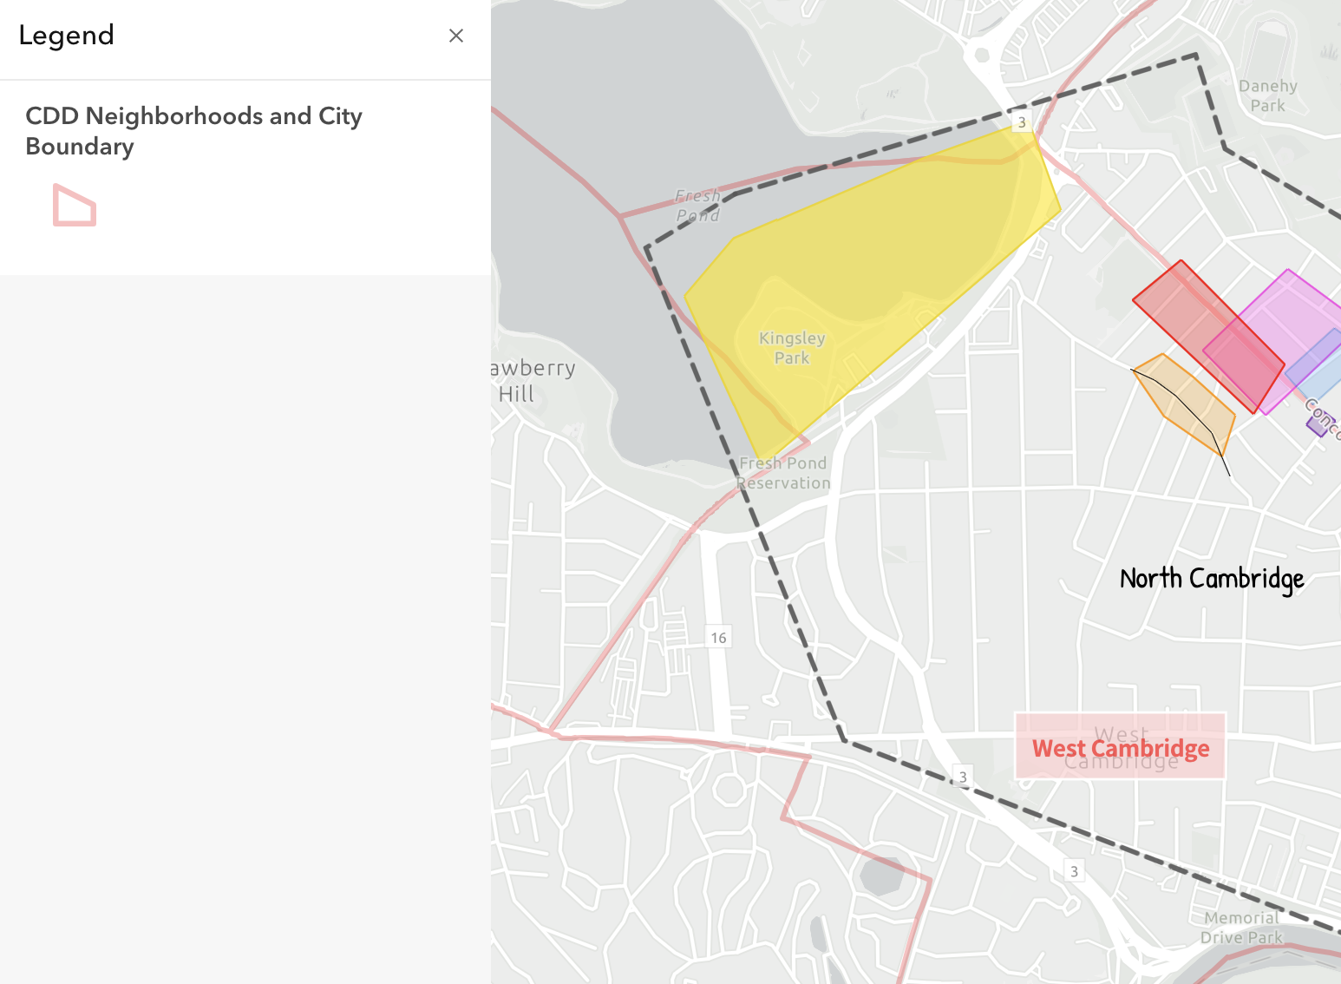
Findings from Final Visualization
Self-Identification vs Imposed Definition
Emotional Complexity through Layers
Minimal Possible Disruption
Neighborhoods were named and defined differently by these Black women than by the city. Centering these borders and endonyms counters the definitions imposed by city data and reinforced by ArcGIS basemaps
Despite feelings of disconnection and frustration with gentrification, these women still discussed their homes and neighborhoods with pride and affection. Map layers can reveal, hide, and overlay these emotions to convey the complexity of these women’s experiences
Throughout the design process, I ran into limitations with including sketch features in the map legend and stylizing pop-ups that were expected given the attempt to translate qualitative data in a quantitative platform.

Slide 11
Conclusion
Implications
Cultural Memory in Cambridge: These mapping the embodied and emotional geographies of Black Cantabrigian women offers unique insights on how the continued development of the city directly impacts.
Critical GIS: This work corroborates previous findings in critical GIS that identify limitations of other software in visualizing embodied geographies and specifically explores these limitations as they apply to Black women’s geographies.
Future Work
Larger Scale/Extent: Examining Black Women’s geographies across multiple cities or diasporic perspectives, or with a larger corpus of oral histories offers more variation and depth of knowledge
Participatory Approach: Semi-structured interviews specifically about Black women’s geographic perspectives and/or community mapping projects provide situated knowledge from primary sources

Slide 12
References
Literature
Oral Histories
Brailas, A., Tragou, E., & Papachristopoulos, K. (2023). Introduction to Qualitative Data Analysis and Coding with QualCoder. American Journal of Qualitative Research, 7(3), 19–31. https://doi.org/10.29333/ajqr/13230
Brand, A. L., & Miller, C. (2020). Tomorrow I’ll Be at the Table: Black Geographies and Urban Planning: A Review of the Literature. Journal of Planning Literature, 35(4), 460–474. https://doi.org/10.1177/0885412220928575
Braun, V., Clarke, V., Hayfield, N., & Terry, G. (2019). Thematic Analysis. In Handbook of Research Methods in Health Social Sciences (pp. 843–860). Springer, Singapore. https://doi.org/10.1007/978-981-10-5251-4_103
Fike, K. J., & Mattis, J. S. (2024). Gender, race, and space: A qualitative exploration of young Black women’s perceptions of urban neighborhoods. American Journal of Community Psychology, 74(1–2), 152–168. https://doi.org/10.1002/ajcp.12752
Kelly, M. (2023). Feminist geography and geospatial technologies. In The Routledge Handbook of Geospatial Technologies and Society. Routledge.
Kwan, M.-P. (2002). Feminist Visualization: Re-envisioning GIS as a Method in Feminist Geographic Research. Annals of the Association of American Geographers, 92(4), 645–661. https://doi.org/10.1111/1467-8306.00309
Kwan, M.-P. (2008). From oral histories to visual narratives: Re-presenting the post-September 11 experiences of the Muslim women in the USA. Social & Cultural Geography. https://doi.org/10.1080/14649360802292462
McKITTRICK, K. (2006). Demonic Grounds: Black Women and the Cartographies of Struggle (NED-New edition). University of Minnesota Press. https://www.jstor.org/stable/10.5749/j.ctttv711
McLafferty, S. L. (2002). Mapping Women’s Worlds: Knowledge, power and the bounds of GIS. Gender, Place & Culture, 9(3), 263–269. https://doi.org/10.1080/0966369022000003879
Naeem, M., Ozuem, W., Howell, K., & Ranfagni, S. (2023). A Step-by-Step Process of Thematic Analysis to Develop a Conceptual Model in Qualitative Research. International Journal of Qualitative Methods, 22, 16094069231205789. https://doi.org/10.1177/16094069231205789
Noxolo, P. (2024). Geographies of race and ethnicity II: Black Feminist Geographies. Progress in Human Geography, 48(1), 85–93. https://doi.org/10.1177/03091325231194656
Sadokierski, Z. (2020). Developing critical documentation practices for design researchers. Design Studies, 69, 100940. https://doi.org/10.1016/j.destud.2020.03.002
Thorne, E. (2022). Interview by Mcree, R. Lift Every Voice. Cambridge Black History Project. Cambridge Public Library, Cambridge, MA.
Harding Scott, E.T. (2022). Interview by Harrington, C. Lift Every Voice. Cambridge Black History Project. Cambridge Public Library, Cambridge, MA.
Pina, J. D. (2022). Interview by Harrington, C. Lift Every Voice. Cambridge Black History Project. Cambridge Public Library, Cambridge, MA.
Johnson, M. (2022). Interview by Paris, P. Lift Every Voice. Cambridge Black History Project. Cambridge Public Library, Cambridge, MA.
Lewis, P. (2023). Interview by Harrington, C. Lift Every Voice. Cambridge Black History Project. Cambridge Public Library, Cambridge, MA.
Paris, P. (2023). Interview by Harrington, C. Lift Every Voice. Cambridge Black History Project. Cambridge Public Library, Cambridge, MA.
Janey, P. W. (2022). Interview by Brunetta, L. Lift Every Voice. Cambridge Black History Project. Cambridge Public Library, Cambridge, MA.

