Slide 1
Ferns & Petals (FNP) Sales Analysis
Executive Summary Dashboard Insights (2023)

Slide 2
Key Business Metrics
Total Revenue: INR 3,520,984
Total Orders: 1,000
Average Customer Spending: INR 3,520.98
Average Delivery Time: 5.53 Days
These metrics indicate strong customer spending behavior and stable operational delivery performance.

Slide 3
Monthly Sales Performance
Sales fluctuate throughout the year with major peaks during seasonal and festive months.
High spikes observed during Raksha Bandhan and Valentine-related periods.
Lower performance in mid-year months suggests potential marketing opportunities.
Recommendation: Focus promotional campaigns during slower months to balance revenue flow.

Slide 4
Top Product Performance
Magnam Set, Quia Gift, Dolores Gift, Harum Pack, and Dignissimos Pack are the top revenue-generating products.
Gift bundles and decorative items drive higher customer spending.
These Top 5 products contribute a significant portion of total revenue.
Recommendation: Increase inventory and marketing focus on to maximize revenue during peak occasions. Magnam Set, Quia Gift, Dolores Gift, Harum Pack, and Dignissimos Pack

Slide 5
Top Cities by Order Volume
Imphal, Dhanbad, Kavali, and Haridwar generate the highest number of orders among all cities.
Bidhanagar, Durgapur, and Gunakal also contribute a significant share of total orders.
These urban and tier-2 cities show strong demand for gifting services, indicating a wide geographic customer base.
Recommendation: Optimize delivery logistics and inventory distribution in Imphal, Dhanbad, Kavali, Haridwar, and Bidhanagar to reduce delivery time and improve customer satisfaction.

Slide 6
Revenue by Occasion
Anniversaries and Raksha Bandhan generate the highest revenue.
Valentine’s Day and Holi also contribute strong seasonal demand.
Occasion-driven purchasing is a key revenue driver for FNP.
Recommendation: Launch targeted campaigns before major occasions.

Slide 7
Order Quantity vs Delivery Time
Average delivery time remains around 5–6 days.
No major operational delays observed despite order volume.
Logistics efficiency remains stable across demand spikes.

Slide 8
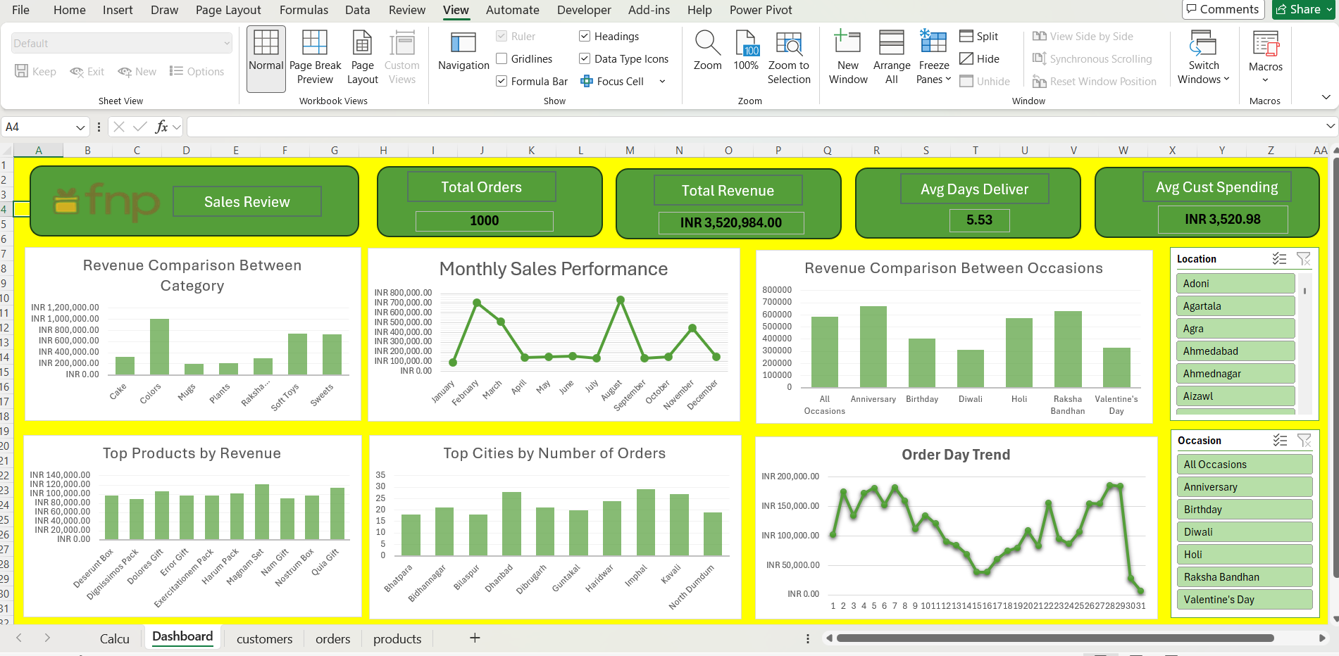
Dashboard Overview

Slide 9
Strategic Recommendations
Increase marketing campaigns during low‑sales months.
Prioritize top-performing products in promotions.
Prepare inventory ahead of major gifting occasions.
Improve logistics infrastructure in high‑order cities.
Introduce occasion-based product bundles to increase average order value.

