Slide 1
QuickBite Express – Crisis Recovery Analysis
SQL | SSMS | Power BI
Codebasics Resume Challenge

Slide 2
Agenda
Company Overview
Problem Statement
Objectives
Data Overview
Analytical Approach
Primary Insights (Q1–Q10)
Key Takeaways & Recommendations

Slide 3
Company Overview
QuickBite Express is a Bengaluru-based food-tech startup, founded in 2020, that connects customers with nearby restaurants and cloud kitchens through a seamless digital platform.
🔹 Key Highlights:
📍 Headquarters: Bengaluru, India
📅 Founded: 2020
🍽️ Business Model: Online Food Delivery Platform
🤝 Partners: Restaurants & Cloud Kitchens
🚚 Core Service: Fast and reliable food delivery
🔹 Value Proposition:
Wide variety of cuisines and restaurants
Quick and efficient delivery service
User-friendly ordering experience
Strong focus on customer satisfaction

Slide 4
Problem Statement
The company is now focused on driving recovery through improved operations, customer engagement, and strategic partnerships. However, to ensure an effective turnaround, it is critical to deeply analyze customer behavior, delivery performance, and operational gaps across different phases—pre-crisis, crisis, and recovery.
This project aims to leverage data-driven insights to:
Identify recoverable customer segments
Understand shifts in order and cancellation patterns
Evaluate delivery efficiency and service reliability
Assess restaurant partner performance
Recommend targeted strategies to rebuild trust, improve retention, and drive sustainable growth

Slide 5
Objectives
Identify impacted customer & restaurant segments
Analyze delivery & operational gaps
Understand behavioral changes
Provide actionable recovery strategies

Slide 6
Data Overview
Tables: dim_customer, dim_delivery_partner, dim_menu_item, fact_order_items, fact_orders, dim_restaurant, fact_ratings, fact_delivery_performance
Timeframe: Jan–Sep 2025
Phases: Pre-crisis vs Crisis
Tools: SQL, SSMS, Power BI

Slide 7
Analytical Approach
Conducted data analysis using SQL (SSMS)
Designed a Star Schema data model
Developed key KPIs using DAX
Performed Pre vs Crisis comparative analysis
Built interactive dashboards for actionable insights

Slide 8
Primary Insights – Key Highlights
Orders declined by ~71% (1.07L → 31K), indicating a severe demand collapse
Revenue dropped by ~71% (₹3.76 Cr → ₹1.09 Cr), driven by reduced order volume
Cancellation rates doubled (~3.3% → ~6.7%), reflecting operational inefficiencies
Delivery performance deteriorated significantly:
Delivery time ↑ +52% (39 → 60 mins)
Delays ↑ ~9x (2 → 17.6 mins)
Customer ratings fell sharply:
4.5 → 2.6 in June (−1.86 drop)
Remained low throughout the crisis period

Slide 9
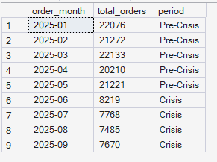
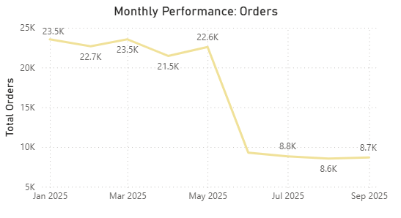
Compare total orders across pre-crisis (Jan–May 2025) vs crisis (Jun–Sep 2025). How severe is the decline?
Orders declined by ~71% (1.07L → 31K) during the crisis.
Indicates a severe collapse in demand driven by trust loss and delivery failures

Slide 10
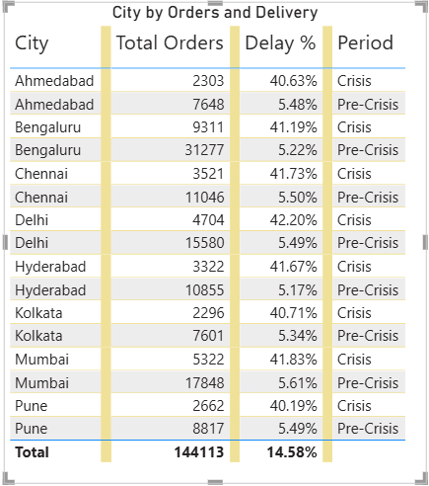
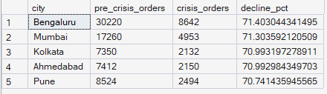
Which top 5 city groups experienced the highest percentage decline in orders during the crisis period compared to the pre-crisis period?
Major metro cities experienced a ~71% decline in orders, with Bengaluru and Mumbai leading the drop
The decline is consistent across Tier-1 cities, indicating a platform-wide trust and demand collapse rather than a localized issue
This reflects a systemic breakdown in customer trust and service reliability during the crisis

Slide 11
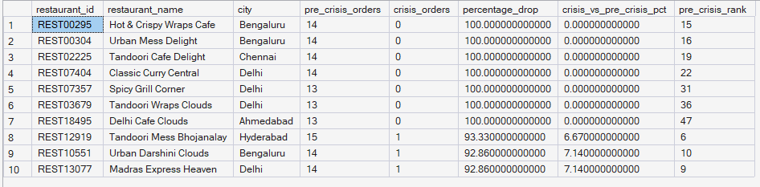
Among restaurants with at least 50 pre-crisis orders, which top 10 high-volume restaurants experienced the largest percentage decline in order counts during the crisis period?
The crisis led to near-total demand collapse for several restaurants, not just gradual decline
This reflects a platform-level demand shock impacting partner sustainability

Slide 12
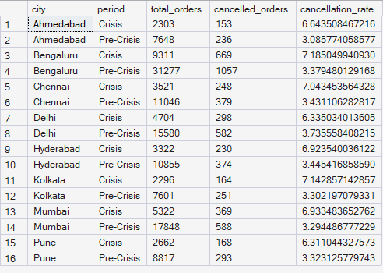
Cancellation Analysis: What is the cancellation rate trend pre-crisis vs crisis, and which cities are most affected?
The crisis led to a 2x increase in cancellations, driven by delivery delays and service unreliability
High-volume cities like Bengaluru and Mumbai amplify business impact, making them critical for recovery

Slide 13

Delivery SLA: Measure average delivery time across phases. Did SLA compliance worsen significantly in the crisis period?
Delivery performance worsened drastically, with delays increasing nearly 9x
Indicates operational failure in last-mile delivery, not just higher demand or external factors

Slide 14

Among customers who placed five or more orders before the crisis, determine how many stopped ordering during the crisis, and out of those, how many had an average rating above 4.5?
The crisis caused deep, trust-driven churn among high-value users, which is the most damaging form of customer loss
Retaining these customers is critical for long-term revenue recovery

Slide 15
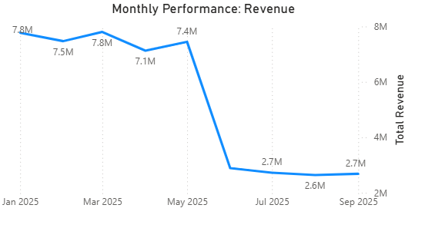

Revenue Impact: Estimate revenue loss from pre-crisis vs crisis (based on subtotal, discount, and delivery fee).
The crisis caused a ~71% revenue contraction, closely mirroring the drop in orders
Indicates that demand collapse—not pricing—was the primary driver of revenue loss

Slide 16
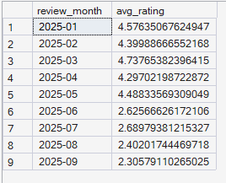
Ratings Fluctuation: Track average customer rating month-by-month. Which months saw the sharpest drop?
Customer satisfaction experienced a sudden and sustained collapse, not a temporary dip
This reflects a deep trust deficit and ongoing service quality issues

Slide 17
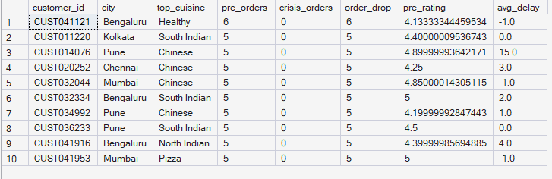
Which high-value customers (top 5% by total spend before the crisis) showed the largest drop in order frequency and ratings during the crisis? What common patterns (e.g., location, cuisine preference, delivery delays) do they share?
High-value, high-satisfaction customers completely disengaged, indicating trust-driven churn rather than gradual dissatisfaction
The churn is clustered in key metros and popular cuisines, amplifying revenue impact

Slide 18
Key Takeaways
The crisis led to a ~70% drop in orders and revenue, driven by a collapse in customer trust
Delivery failures (delays ↑, SLA ↓, cancellations 2x) were the primary trigger for negative customer experience
Customer satisfaction saw a sharp and sustained decline (ratings 4.5 → 2.6), not a temporary dip
Impact was consistent across Tier-1 cities, indicating a platform-wide issue, not regional
Several restaurants experienced near-total demand loss (90–100%), affecting partner stability
High-value, high-rated customers churned, highlighting trust-driven disengagement
Market comparison shows competitors grew, proving the crisis was internal, not industry-wide
Customers shifted toward low-value “survival orders”, reflecting reduced confidence and spending

Slide 19
Crisis Recovery Strategy – Action Plan
Pillar | Focus Area | Key Actions | Business Impact
🛡️ Restore Trust | Food Safety & Transparency | Hygiene-certified badges, audit reports, transparency campaigns | Rebuild customer confidence & improve ratings
🚚 Fix Operations | Delivery & SLA | Route optimization, real-time tracking, delay compensation | Reduce cancellations & improve reliability
🎯 Re-engage Customers | High-Value Users | Personalized offers, loyalty rewards, priority delivery | Recover high-value churned customers
🏙️ Targeted Recovery | City-Level Focus | Focus on Bengaluru & Mumbai, geo-targeted campaigns | Faster demand recovery in key markets
🍽️ Partner Stability | Restaurant Support | Visibility boosts, incentives for small/cloud kitchens | Reduce partner churn & improve supply
💸 Smart Marketing | CAC Optimization | Shift to retargeting, reduce blanket discounts | Improve ROI & lower acquisition cost
📊 Monitor Continuously | Real-Time Insights | Track SLA, ratings, sentiment alerts | Prevent future service breakdowns
🍱 Improve Value | Pricing & Offers | Combos, subscriptions, loyalty programs | Increase order value & retention

Slide 20
Thank You
Questions?

