Slide 1


TOPIC - Friction
Title:The Invisible Force that Shapes our Daily Lives
Roll: 031 Sec: Sec A Name: Arijit Bera Stream: CSE

Slide 2

Introduction to Friction
Definition of Friction
Importance in our Daily Lives
Types of Friction: Static, Kinetic, Rolling

Slide 3

Types of Friction
Static Friction: Objects at rest.
Kinetic Friction: Objects in motion.
Rolling Friction: Occurs when a round object rolls over a surface.

Slide 4

Causes of Friction
Surface Roughness
Interlocking of Surface Asperities
Adhesion between Molecules

Slide 5
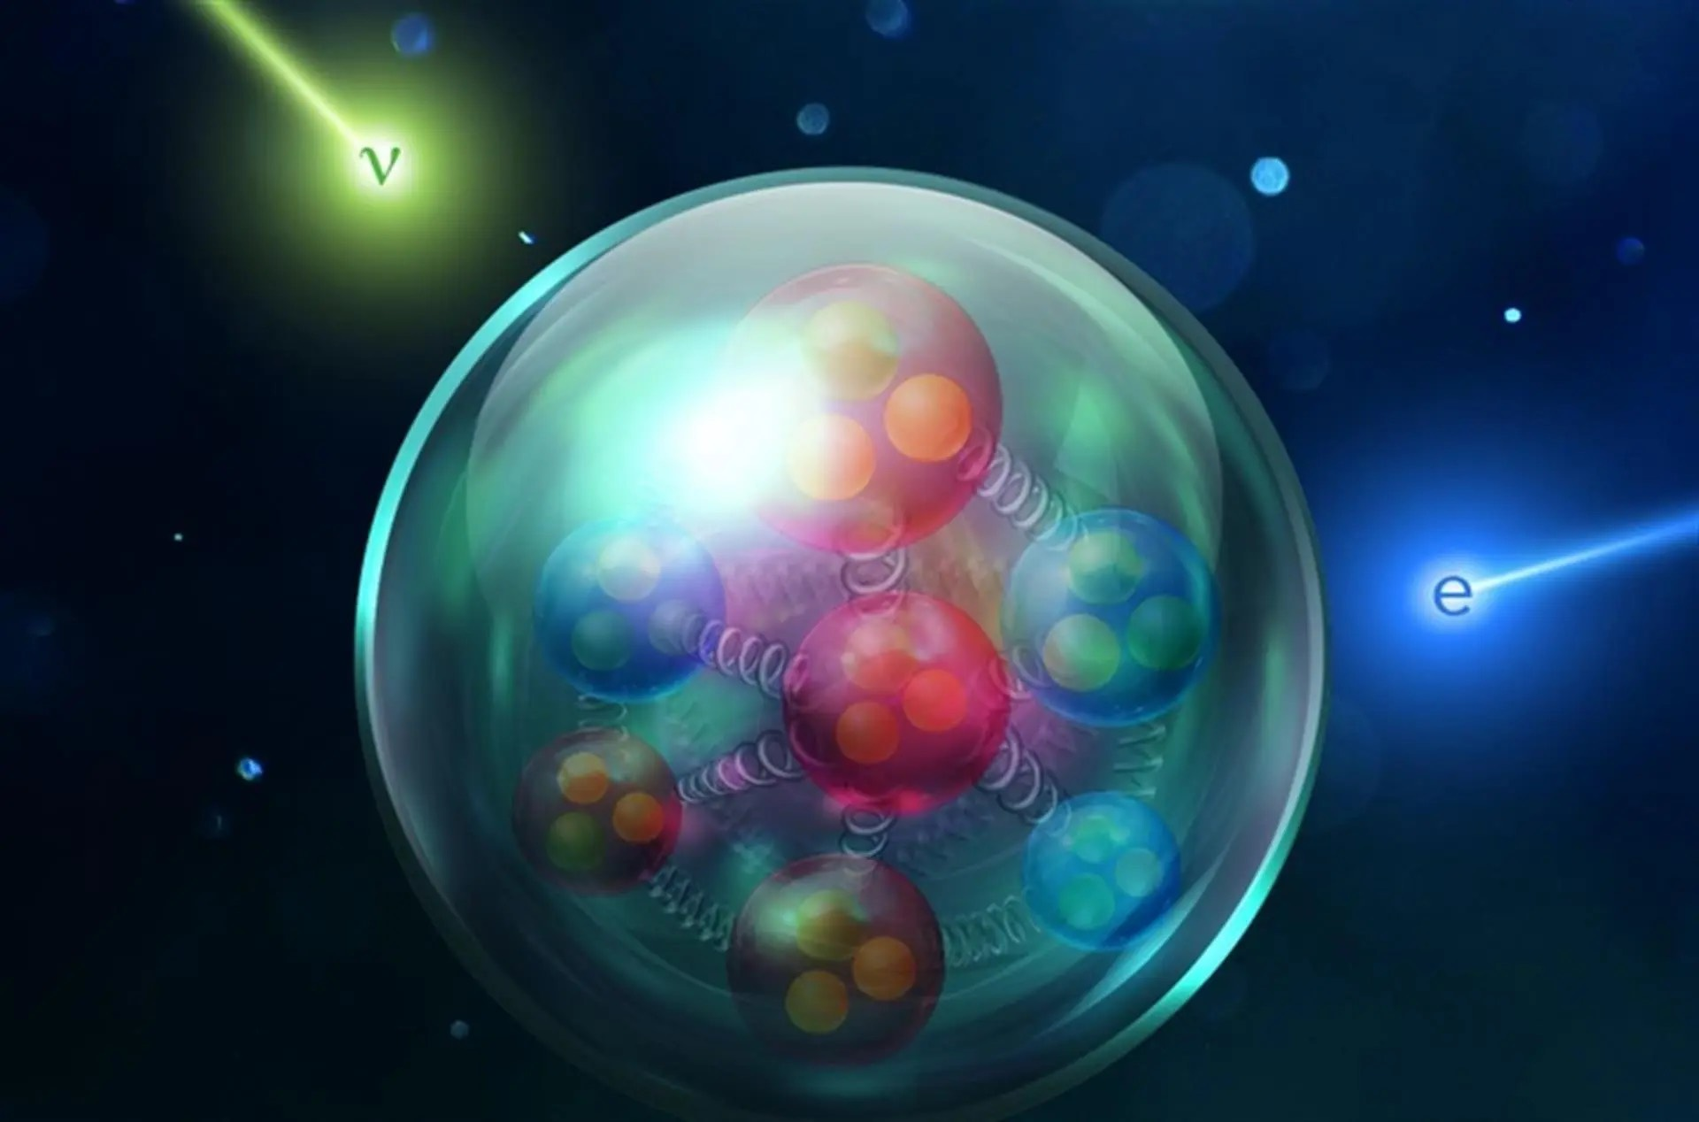
Factors Affecting Friction
Normal Force
Surface Area
Types of Surfaces
Temperature

Slide 6

The Role of Friction in Everyday Life
Walking and Running
Braking in Vehicles
Writing with a Pen or Pencil
Opening and Closing Doors

Slide 7

Benefits of Friction
Traction in Vehicles
Writing and Drawing
Gripping Objects

