Slide 1

Trusted Notifications: Reliable, Safe, and Timely
Designing a secure, fault-tolerant notification framework that users can trust
Name: Arijit Banik
College: Gauhati University
Roll no: GA.11
Problem Statement: 5

Slide 2




The Trust Crisis in Digital Notifications
Users depend on critical alerts—OTPs for login, transaction confirmations, and security updates. When notifications fail, trust erodes and security risks escalate.
Delivery Failures
Duplicates & Disorder
Missed or significantly delayed notifications leave users vulnerable during critical moments
Out-of-order or repeated alerts create confusion and diminish message credibility
Security Threats
Inconsistent Channels
Spoofed SMS and phishing attacks exploit weak sender verification systems
Unreliable delivery across SMS, email, and push with inadequate retry mechanisms

Slide 3
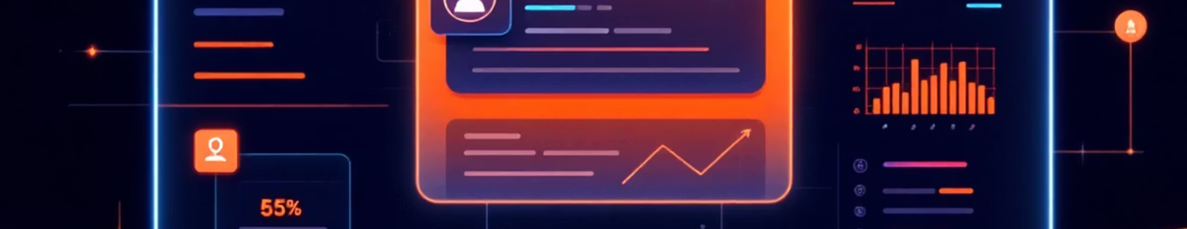
Defining Success: What Reliable Notifications Look Like
Core Principles
Performance Targets
Verified sender identity for every critical alert
OTP Example: SMS + App Push
Intelligent routing with clear event-to-channel mapping
Failover Speed: SMS fails → Push in under 10 seconds
Template consistency with anti-spoofing protections
Reliability Goal: ≥99% delivery within 30–60 seconds
Smart failover when primary channels fail

Slide 4
Understanding Notification Types & Channel Trade-offs
1
2
Authentication
Transaction Alerts
OTPs for login, transactions, and device binding—require instant, reliable delivery
UPI payments, card usage, debits/credits, refunds—users expect immediate confirmation
3
4
Security Updates
Service Notifications
Password changes, new device logins, suspicious activity—critical for account protection
EMI reminders, account statements, promotional offers—lower urgency but still important
Channel Comparison
Channel
Strengths
Vulnerabilities
SMS
Instant, universal reach
Spoofing risk, operator delays
Email
Rich content, detailed info
Spam filters, lower visibility
App Push
Secure, real-time delivery
Requires permissions, app install
In-App Inbox
Tamper-proof, persistent
Low immediate visibility

Slide 5
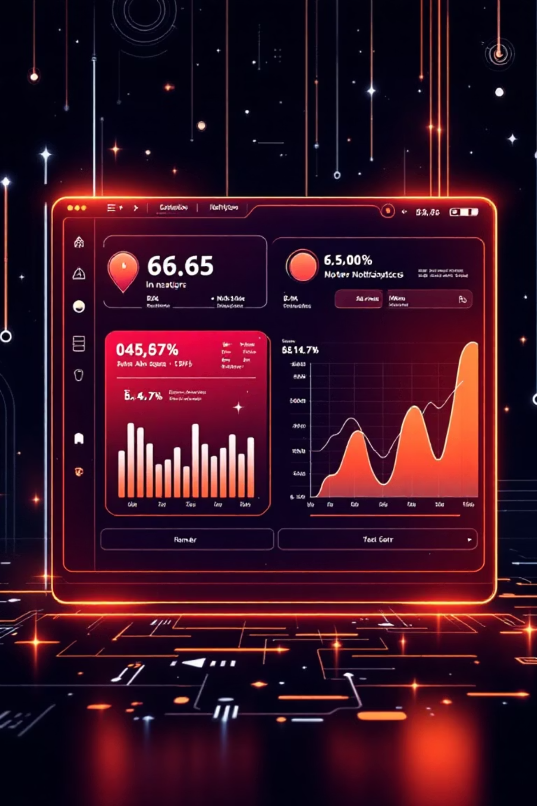
Data-Driven Insights: Where the System Breaks Down
Volume & Failure Patterns
Delivery Failure Root Causes
Highest traffic: OTP SMS and debit alerts dominate notification volume
Vendor issues: One specific SMS aggregator accounts for majority of failures
Failure concentration: Promotional and low-priority alerts show highest failure rates
Infrastructure: Telecom circle congestion during peak hours
Time vulnerability: Worst latency occurs between 2am–7am
Technical gaps: Missing or expired push notification tokens
Critical gap: High-value transactions show very low retry attempts—a significant risk exposure
Peak retry times: 12pm and 6–9pm show highest OTP retry requests

Slide 6




Root Causes: Why Notifications Fail
Fragmented Systems
No Orchestration
Multiple independent systems trigger notifications without coordination or central oversight
Missing central routing layer means manual vendor failover and poor optimization
Limited Visibility
Security Gaps
Weak observability leads to slow issue detection and delayed remediation
Non-standardized templates and weak sender authentication enable spoofing attacks

Slide 7
Solution: Central Notification Orchestrator
A unified platform that brings intelligence, security, and reliability to every notification
Unified Event Router
Multi-Channel Delivery
Single entry point for all notification events with intelligent classification and prioritization
Seamless orchestration across SMS, email, push notifications, and in-app inbox
Smart Retry & Failover
Security Layer
Automated vendor switching and channel fallback with intelligent backoff strategies
Verified sender IDs, digitally signed payloads, and template registry for anti-spoofing
Real-Time Monitoring
User Preferences
Comprehensive dashboards tracking delivery rates, latency, vendor health, and SLA compliance
Granular customer control over notification channels and frequency

Slide 8
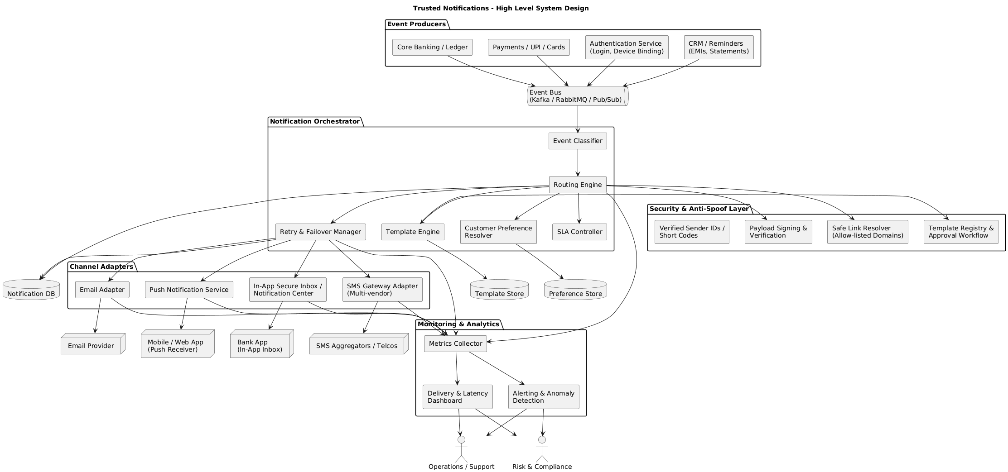

Slide 9
Intelligent Routing & Security Controls
Event-to-Channel Mapping Strategy
Event Type
Primary
Secondary
Fallback
OTP
SMS
Push
Email
High-Value Debit
Push
SMS
Email
Card-Not-Present
Push
SMS
—
Service Reminders
Push
—
In-App
Retry Logic
Anti-Spoofing Measures
Vendor failover: Auto-switch to Vendor 2 if Vendor 1 fails
Verified sender IDs: Registered short codes only
Channel fallback: SMS timeout at 10s triggers push notification
Digital signatures: Cryptographically signed message payloads
Idempotency: Unique message IDs prevent duplicate delivery
Template registry: All messages use approved formats
Throttling: Exponential backoff prevents retry storms
Safe-link resolver: Only bank-owned domains in URLs

Slide 10
Impact & Roadmap to Excellence
Expected Business Impact
40-60%
99%+
100%
SMS Failure Reduction
OTP Success Rate
Audit Visibility
Dramatic decrease in failed message delivery
Near-perfect authentication delivery
Complete operational transparency
Additional Benefits: Drastic reduction in phishing complaints, consistent user experience, and predictable notification behavior across all channels
Implementation Roadmap
Phase 1: Foundation
Phase 3: Monitoring
Build event catalog and criticality mapping
Deploy dashboards and observability tools
1
2
3
4
Phase 2: Core Build
Phase 4: Rollout
Define orchestrator APIs and integrate vendor channels
Internal testing → Beta group → Full deployment

