Slide 1
Final Project:
Coursera Applied Data Science Capstone
Arijit Bose

Slide 2
Coursera: Capstone Project:
Introduction/Business Problem:
Ravi is a businessman residing in Bangalore. He wants to find out the best possible location within Bangalore within his “Postcode” are for opening up a “Bengali Restaurant”.
He resides in Bangalore in a place having Postcode =”560067”.

Slide 3
Data Section:
Datasets which have been used in this project are as follows:
1) I used the first table from website “https://finkode.com/ka/bangalore.html” for Post office Names and Pin-code of Post Offices in Bangalore City in India.
2) I have downloaded a location data set from the website "http://www.geonames.org/export/zip/" which consists of Pin-Codes and Geospatial Co-ordinates of respective Pin-codes of India.
This dataset would be used to create the working “DataFrame” for the project. It consists of fields like Neighbourhood, State, District, Latitude and Longitude
3)
I have used "Average Housing Price Rate per Squate feet,Bangalore.csv" dataset from the website “https://www.99acres.com/property-rates-and-price-trends-in-bangalore”
I have used this data set to get the Housing Price rate of a particular location based on Pincode.
4) I have used Foursquare Location Data for retrieving Venue details for a particular Pincode in Bangalore.

Slide 4
Methodology:
1)I have wrangled data from the website https://finkode.com/ka/bangalore.html for names of Post offices and Pin codes for Bangalore (India).
2)I have downloaded a location data set from the website http://www.geonames.org/export/zip/ which consists of Pin-Codes and Geospatial Co-ordinates of respective Pin-codes of India. This dataset would be used to create the working “DataFrame” for the project. It consists of fields like Neighbourhood, State, District, Latitude and Longitude
3)I have used Foursquare API for getting Venue details nearby Pin code “560067”
4)The foursquare API returned only 1 predominant venue i.e. “IT Services”
Note: I have used Google Colab for performing this project work.

Slide 5
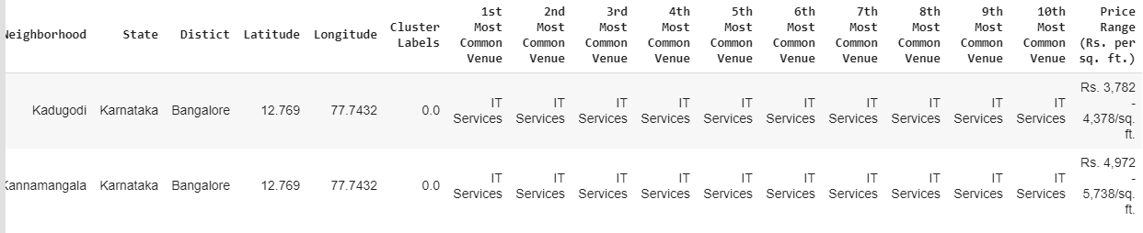
5)I have grouped rows by “Neighborhood” by taking the mean of the frequency of occurrence of each category so that I could apply K-Mean Clustering Algorithm later on.
6)I have used K-Means Clustering Algorithm segregating the Venues and Pin Locations
7)I have done a VLOOKUP of Average House Price Data retrieved fromthe data set from “”https://www.99acres.com/property-rates-and-price-trends-in-bangalore”. And I have merged this the final DataFrame.
Based on the Average Housing Price I have selected “Kadugodi” for opening up a Bengali restaurant, since housing Price is less as compared to the other Neighborhood.

Slide 6
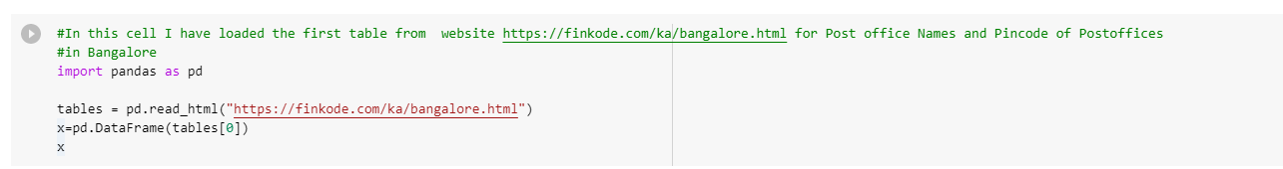
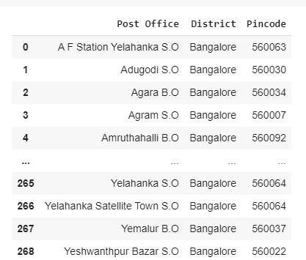
Screenshot of Code Snippets from the Project

Slide 7
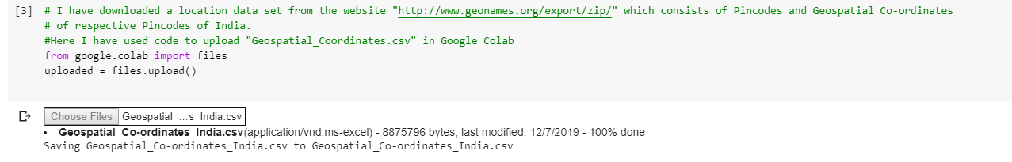

Slide 8
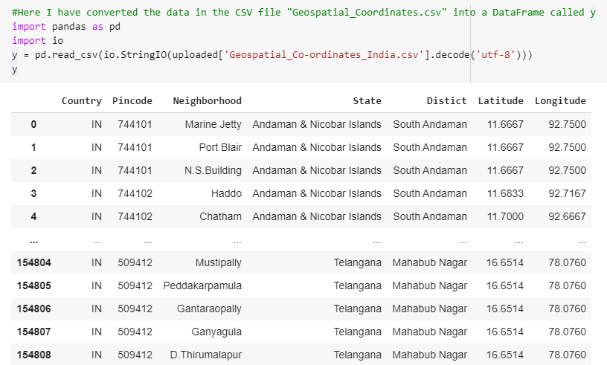

Slide 9
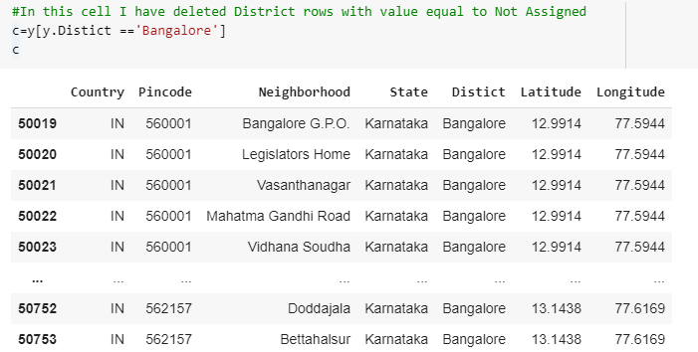

Slide 10
