Slide 1

eCommerce Search Audit
PetSmart | Prepared by Algolia

Slide 2
Search audit scorecard
5.8 /10
Strong Foundation, Unactivated Upside
0 critical 5 moderate 5 strengths
3/10 Semantic / NLP Search
4/10 Query Suggestions / Empty State
5/10 Content Commerce / Front-End UX
5/10 Dynamic Facets & Personalization
5/10 Recommendations & Merchandising
8/10 Intent Detection
8/10 Merchandising Consistency
9/10 Latency
9/10 Typo Tolerance
9/10 Search Intelligence

Slide 3
Areas of improvement

Slide 4
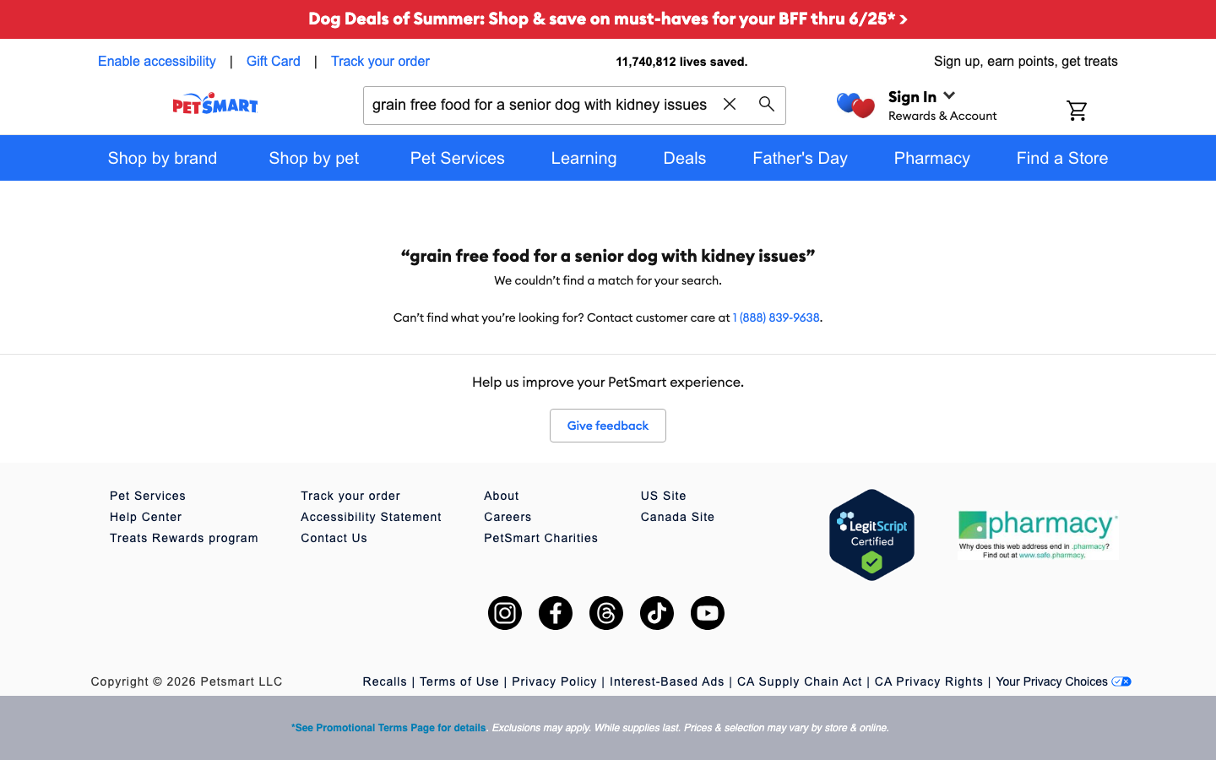
Conversational queries dead-end at zero results
WE TESTED
"grain free food for a senior dog with kidney issues"
WE EXPECTED
Semantic intent parsing surfaces senior/renal/grain-free diets, cat-specific calming aids, and a reptile setup kit even without literal keyword overlap.
WE FOUND
All three multi-attribute natural-language queries return 0 results and a bare 'We couldn't find a match' dead-end with no suggestions or fallbacks. Identical on mobile (12c).
What shoppers see today
With Algolia Algolia NeuralSearch (hybrid keyword + vector semantic) on the existing p-US_products index - an upgrade, not a migration. Closes long-tail and conversational intent that keyword matching cannot parse.
Verified against PetSmart Algolia search analytics (30-day window)

Slide 5
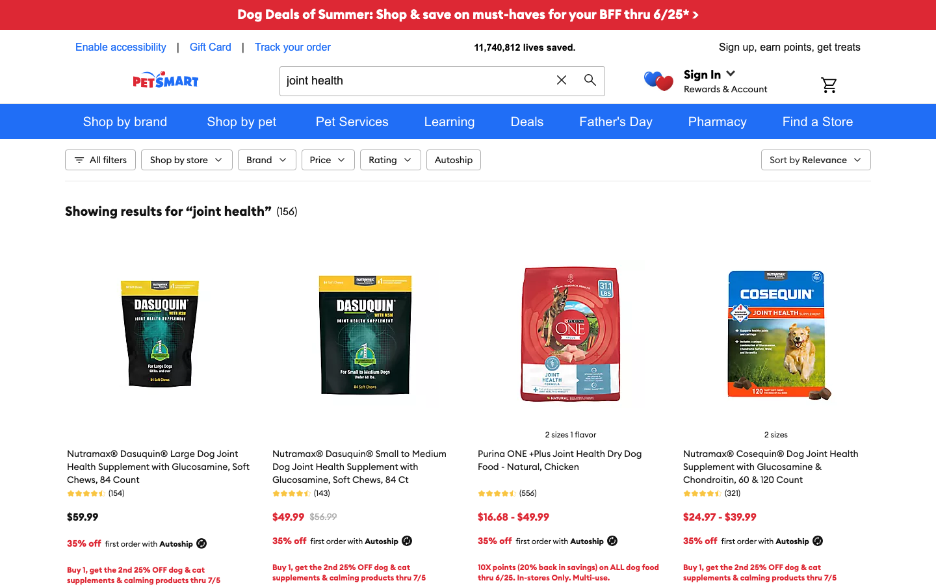
AI Personalization inert - userToken present, not re-ranking
WE TESTED
"joint health (anonymous vs dog-browsed session)"
WE EXPECTED
A dog-browsing session biases 'joint health' / 'salmon' toward dog products; a cat/fish session re-ranks accordingly (species-aware re-ranking).
WE FOUND
Anonymous and dog-browsed 'joint health' return a pixel-identical result set (156 hits, same top-4, same SSR queryID fd48591c). 'salmon' returns an all-dog top-4 for every session.
What shoppers see today
With Algolia Algolia AI Personalization + Dynamic Re-Ranking using the userToken/Insights data already flowing to App 97P6EWKR25 - consolidate three fragmented personalization vendors onto one surface.
Verified against PetSmart Algolia search analytics (30-day window)

Slide 6

Zero-results null state is a bare dead-end
WE TESTED
"zxqwbnm (gibberish)"
WE EXPECTED
A graceful null state with popular categories, Query Suggestions, or Recommend-powered best-sellers to rescue the session.
WE FOUND
0 results renders only 'We couldn't find a match', a phone number, and a 'Give feedback' button - no suggestions, no products, no recovery. PetSmart's own analytics show this is not an edge case: 15.98% of searches return zero.
What shoppers see today
With Algolia Wire the existing Query Suggestions + Recommend best-sellers into the null state; add NeuralSearch so far fewer queries hit zero in the first place.
Verified against PetSmart Algolia search analytics (30-day window)

Slide 7
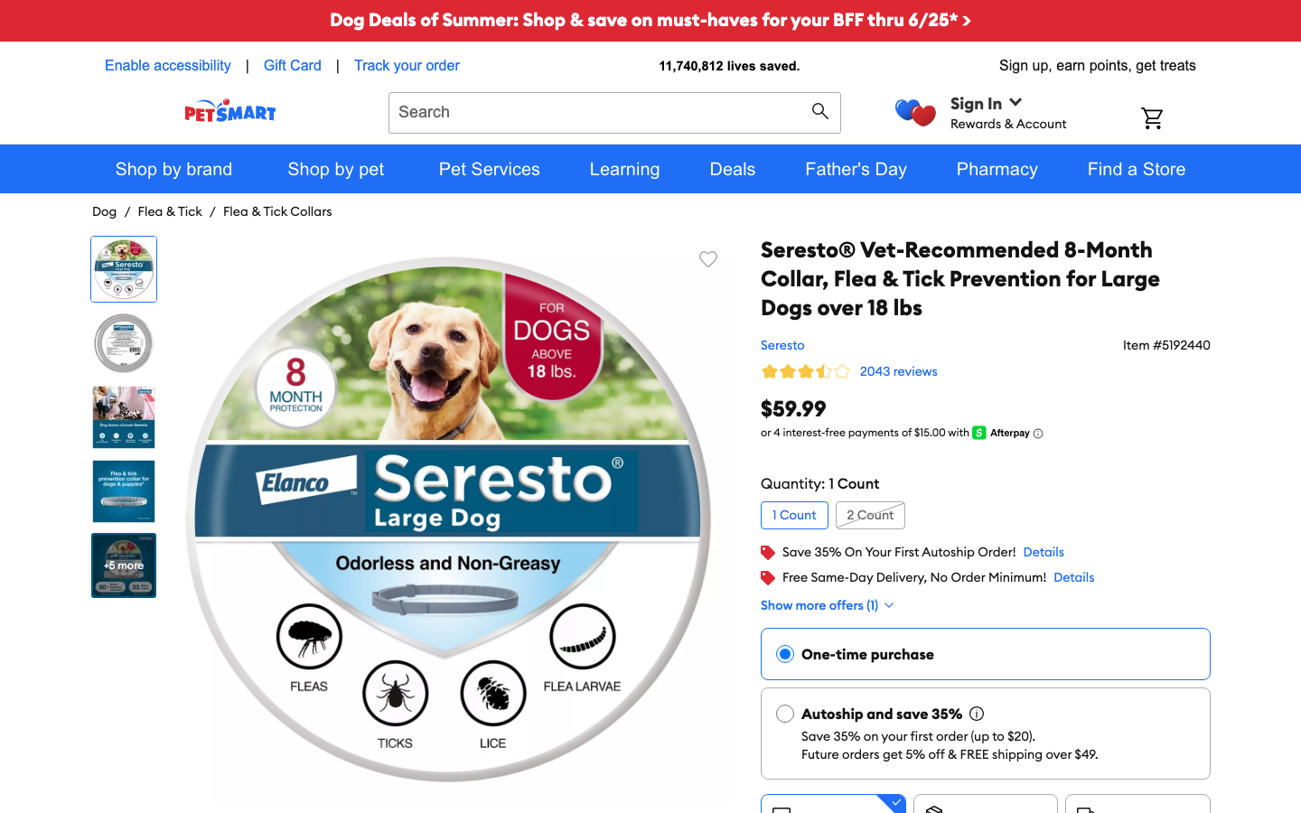
No Algolia Recommend cross-sell on results or PDP
WE TESTED
"flea and tick prevention (results + Seresto PDP)"
WE EXPECTED
Results and PDP show 'Frequently Bought Together' and complementary rails (shampoo, home spray, weight-correct dosing) powered by Algolia Recommend.
WE FOUND
Results page has no FBT carousel; the Seresto PDP shows a generic 'you may also like' (Granify/Einstein) and an Ordergroove Autoship CTA, but no Algolia Recommend FBT (fbt:false in DOM).
What shoppers see today
With Algolia Algolia Recommend (Frequently Bought Together / Related Products / Trending) keyed off the same catalog + Insights events already in App 97P6EWKR25.
Verified against algolia.com

Slide 8

No federated content + services search (moat siloed)
WE TESTED
"return policy"
WE EXPECTED
Federated search surfaces Contentful policy/help pages and PetSmart's grooming/training/boarding/Banfield service-booking pages alongside or above products.
WE FOUND
Both return 0 results and the bare dead-end. The product index is products-only; Contentful CMS help content and the entire in-store services moat are absent from the main search box.
What shoppers see today
With Algolia Algolia Federated Search (multi-index: products + Contentful content + services) so the channel where PetSmart beats Amazon/Chewy is actually searchable.
Verified against nielseniq.com

Slide 9
Where to start: a scoped proof of concept
Prove the lift on your live index in weeks, not quarters. A focused POC on the highest impact gap, measured against your own analytics.
1. commercetools co-sell to CITO Fancher. Engage Algolia's commercetools alliance team for a joint play: standardize PetSmart's existing Algolia deployment onto the native commercetools connector and pitch NeuralSearch activation to CITO Greg Fancher, who publicly champions an open plug-in platform. Lowest-friction, highest-leverage entry.
2. Activate NeuralSearch + zero-results recovery. Phase-1 quick win on the live p-US_products index: enable NeuralSearch and wire the existing Query Suggestions index into the zero-results null state. Low-risk config on App 97P6EWKR25, matches CITO's incremental buying philosophy. (F1, F3)
3. Turn on AI Personalization + consolidate Recommend. Activate AI Personalization + Dynamic Re-Ranking on the userToken/Insights data already flowing; move fragmented cross-sell (Granify/Einstein/Ordergroove) onto Algolia Recommend FBT. (F2, F4)
4. Federate services + content, close web↔app parity. Federate grooming/training/Banfield services + Contentful help content into search; standardize on the native commercetools connector; verify and close native-app AI-search parity. (F5)

