Slide 1
DOCUMENT LINEAGE REPORT
VALID
PO_NOT_FOUND
invoice_10119.pdf
End-to-end trace of one PDF through every table in the
idp_test_dev Intelligent Document Processing pipeline
Catalog / schema
idp_test_dev.idp_test_project
Volume
raw_documents/incoming
Document ID (SHA-256)
82cab592043beee3a078eb35e3e7be0f…
Tables examined
12 of 12 pipeline tables
Report generated
2026-09-09

Slide 2
OVERVIEW
Executive summary
What this document is
Pipeline outcome
Document type
invoice
validation_status
Invoice number
INV-20250010
VALID
Purchase order ref
PO-13352
Reached every gold table it qualifies for.
Totals reconcile exactly (variance $0.00).
Invoice date / due date
2025-01-17 / 2025-01-17
Seller (vendor)
Riverbend Marketing Studio
Three findings
Buyer (customer)
Keystone Logistics Partners
Currency
USD
Address fields mis-split
ai_parse_document put part of the Bill To
address into the Ship To column.
Total amount
$4,560.79
The five line items
Invoice has no matching PO
# | Description | Qty | Unit price | Amount
1 | Creative design (hours) | 8 | $93.48 | $747.84
2 | Ad spend management (hours) | 12 | $78.47 | $941.64
3 | Landing page build | 1 | $1,159.52 | $1,159.52
4 | Performance report | 1 | $385.23 | $385.23
5 | Campaign setup | 1 | $1,326.56 | $1,326.56
 | Subtotal |  |  | $4,560.79
Reconciliation returns PO_NOT_FOUND —
PO-13352 is absent from gold layer.
Local copy ≠ volume copy
sample_data/invoice_10119.pdf differs in
bytes from the ingested file.
idp_test_dev.idp_test_project · invoice_10119.pdf
1

Slide 3
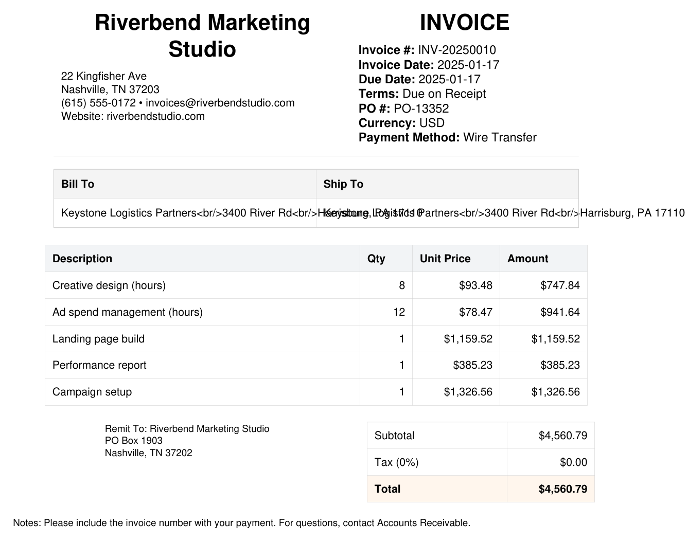
STAGE 0 · UNITY CATALOG VOLUME
The source document
Volume file metadata
Path
…/raw_documents/incoming/
File name
invoice_10119.pdf
Extension
pdf
Size on volume
3,141 bytes
Last modified
2026-09-08 12:35:09
Pages
1
Page size
612 × 792 pt (US Letter)
Identity is content-derived
document_id = sha2(document_content, 256)
82cab592043beee3a078eb35e3e7be0f
2eb97e1654169567486bcf17b5da06df
Verified — matches the downloaded volume file exactly.
The repo copy is a different file
Page 1 of 1, rendered from the file stored in the volume
sample_data/invoice_10119.pdf is 3,215 bytes with SHA-256
7fae6805… — the same invoice, but different bytes, so it would
hash to a new document_id rather than match this row.
idp_test_dev.idp_test_project · invoice_10119.pdf
2

Slide 4
COVERAGE · ALL 12 PIPELINE TABLES
Where this document appears
Every table in idp_test_dev.idp_test_project was queried for this document_id. Zero-row results are by design, not gaps.
# | Table | Type | Layer | Rows for this doc | Meaning
1 | bronze_documents | Streaming table | Bronze | 1 | Raw binary + file metadata
2 | silver_parsed_documents | Streaming table | Silver | 1 | ai_parse_document output
3 | silver_extracted_documents | Streaming table | Silver | 1 | ai_extract output
4 | silver_documents | Streaming table | Silver | 1 | Normalised + validated header
5 | silver_document_lines | Streaming table | Silver | 5 | One row per line item
6 | gold_documents | Materialized view | Gold | 1 | Passed validation
7 | gold_document_lines | Materialized view | Gold | 5 | Lines of valid documents
8 | gold_invoices | Materialized view | Gold | 1 | Invoice-shaped projection
9 | gold_purchase_orders | Materialized view | Gold | 0 | Correct — not a PO
10 | gold_receipts | Materialized view | Gold | 0 | Correct — not a receipt
11 | gold_invoice_po_reconciliation | Materialized view | Gold | 1 | Match attempt vs POs
12 | gold_vendor_spend | Materialized view | Gold | 1 | Rolls into Jan-2025 vendor row
idp_test_dev.idp_test_project · invoice_10119.pdf
3

Slide 5
HOW THE DOCUMENT MOVED THROUGH THE PIPELINE
Processing timeline
STEP 1
STEP 2
STEP 3
STEP 4
Ingested
Parsed
Extracted
Processed
bronze_documents
→
silver_parsed_documents
→
silver_extracted_documents
→
silver_documents
2026-09-08 13:08:42
+7.0s
2026-09-08 13:08:49
+14.3s
2026-09-08 13:09:04
+28m 25s
2026-09-08 13:37:29
Auto Loader picked up the file
ai_parse_document → 9 elements
ai_extract → 22 fields
Normalised, typed, validated
Reading the gaps
Parse took +7.0s and extraction a further +14.3s — these are the two AI-function calls and they dominate cost.
The +28m 25s gap before processed_at is not latency: silver_documents was refreshed in a later pipeline update, so its
current_timestamp() reflects that run rather than the original arrival.
idp_test_dev.idp_test_project · invoice_10119.pdf
4

Slide 6
STAGE 1 · RAW INGESTION
bronze_documents
Auto Loader (cloudFiles / binaryFile) reads the volume incrementally. This table stores the raw bytes plus file metadata; nothing has been interpreted yet.
document_id
82cab592043beee3a078eb35e3e7be…
source_modified_at
2026-09-08 12:35:09
source_file_path
dbfs:/Volumes/idp_test_dev/…
ingested_at
2026-09-08 13:08:42
source_file_name
invoice_10119.pdf
document_content
BINARY, 3,141 bytes
file_extension
pdf
Filter applied
extension in 10 supported types
file_size_bytes
3,141
Row count for this doc
1
Why file_size_bytes equals document_content length
Auto Loader's length column and the stored binary agree at 3,141 bytes, confirming the whole file was captured. The document_id is the SHA-256
of exactly those bytes, which makes re-ingesting an identical file idempotent at the identity level — but note it also means any byte-level change
(even re-saving the PDF) produces a brand-new document_id and therefore a second row rather than an update.
idp_test_dev.idp_test_project · invoice_10119.pdf
5

Slide 7
STAGE 2 · AI_PARSE_DOCUMENT
silver_parsed_documents
ai_parse_document (version 2.0) turned the PDF into 9 layout elements with bounding boxes and confidence scores. Output JSON is 2,734 bytes.
id | Type | Confidence | Content (truncated)
0 | text | 1.0000 | Riverbend Marketing ⏎ Studio
1 | title | 1.0000 | INVOICE
2 | text | 1.0000 | 22 Kingfisher Ave ⏎ Nashville, TN 37203 ⏎ (615) 555-0172 • invoices@riverbendstudi…
3 | table | 0.9854 | <table><tr><td>Invoice #:</td><td>INV-20250010</td></tr><tr><td>Invoice Date:</td>…
4 | table | 0.8974 | <table><tr><th>Bill To</th><th>Ship To</th></tr><tr><td>Keystone Logistics Partner…
5 | table | 0.9999 | <table><tr><th>Description</th><th>Qty</th><th>Unit Price</th><th>Amount</th></tr>…
6 | text | 1.0000 | Remit To: Riverbend Marketing Studio ⏎ PO Box 1903 ⏎ Nashville, TN 37202
7 | table | 0.9869 | <table><tr><td>Subtotal</td><td>$4,560.79</td></tr><tr><td>Tax (0%)</td><td>$0.00<…
8 | text | 1.0000 | Notes: Please include the invoice number with your payment. For questions, contact…
Element 4 is the weak link — confidence 0.8974, the lowest on the page
The Bill To / Ship To table was emitted as <td>Keystone Logistics Partners<br>3400 River Rd</td><td>Harrisburg, PA 17110</td>.
In the source PDF both cells hold the same full address and their text overlaps visually; the parser split it at the wrong boundary, leaving the city/state/ZIP
stranded in the Ship To column. Everything downstream inherits this — the defect originates at parse time, not at extraction.
idp_test_dev.idp_test_project · invoice_10119.pdf
6

Slide 8
STAGE 3 · AI_EXTRACT
silver_extracted_documents
ai_extract (version 2.1) mapped the parsed layout onto the 22-field business schema. error_message is null; output JSON is 1,773 bytes. Values shown as returned, before normalisation.
Schema field | Extracted value
bill_to_address | Keystone Logistics Partners, 3400 River Rd
buyer_name | Keystone Logistics Partners
currency | USD
discount_amount | NULL
document_date | 2025-01-17
document_number | INV-20250010
document_type | invoice
due_date | 2025-01-17
invoice_number | INV-20250010
notes | Please include the invoice number with you…
payment_method | Wire Transfer
Schema field | Extracted value
payment_terms | Due on Receipt
purchase_order_number | PO-13352
receipt_number | NULL
requested_ship_date | NULL
seller_name | Riverbend Marketing Studio
ship_to_address | Harrisburg, PA 17110
shipping_amount | NULL
subtotal | 4560.79
tax_amount | 0
total_amount | 4560.79
Four nulls, and they are all correct
discount_amount, shipping_amount, receipt_number and requested_ship_date are genuinely absent from this invoice, so a null is the right answer — ai_extract did not
hallucinate placeholder values. tax_amount came back as 0 rather than null because the document states "Tax (0%) $0.00" explicitly. The only questionable pair is
bill_to_address / ship_to_address, and that fault was inherited from the parse stage rather than introduced here.
idp_test_dev.idp_test_project · invoice_10119.pdf
7

Slide 9
STAGE 4 · NORMALISED & VALIDATED HEADER
silver_documents
Values are flattened out of the variant, trimmed, cast to typed columns (dates, DECIMAL(18,2)) and run through the validation rules.
document_type
invoice
currency
USD
subtotal
$4,560.79
business_document_number
INV-20250010
seller_name
Riverbend Marketing Studio
tax_amount
$0.00
document_number
INV-20250010
buyer_name
Keystone Logistics Partners
shipping_amount
NULL
invoice_number
INV-20250010
bill_to_address
Keystone Logistics Partner…
discount_amount
NULL
purchase_order_number
PO-13352
ship_to_address
Harrisburg, PA 17110
total_amount
$4,560.79
receipt_number
NULL
payment_method
Wire Transfer
calculated_total
$4,560.79
document_date
2025-01-17
payment_terms
Due on Receipt
total_variance
$0.00
due_date
2025-01-17
notes
Please include the invoice…
validation_status
VALID
requested_ship_date
NULL
line_items
5 (array<variant>)
processed_at
09-08 13:37:29
The arithmetic check passes cleanly
calculated_total = subtotal + tax + shipping − discount = 4,560.79 + 0.00 + 0 − 0 = $4,560.79, which equals the stated total_amount, so total_variance is $0.00.
That sits well inside the $0.02 tolerance, and document_type, business_document_number and total_amount are all present, so the validation chain falls
through to VALID. Note the pipeline coalesces nulls to 0 in this formula, so missing shipping and discount do not break the check.
idp_test_dev.idp_test_project · invoice_10119.pdf
8

Slide 10
STAGE 5 · EXPLODED LINE ITEMS
silver_document_lines
posexplode_outer over line_items produced 5 rows. Each is independently re-checked: quantity × unit_price is compared against the stated line amount.
# | Description | Qty | Unit price | Line amount | Calculated | Variance | Status
1 | Creative design (hours) | 8 | $93.48 | $747.84 | $747.84 | $0.00 | VALID
2 | Ad spend management (hours) | 12 | $78.47 | $941.64 | $941.64 | $0.00 | VALID
3 | Landing page build | 1 | $1,159.52 | $1,159.52 | $1,159.52 | $0.00 | VALID
4 | Performance report | 1 | $385.23 | $385.23 | $385.23 | $0.00 | VALID
5 | Campaign setup | 1 | $1,326.56 | $1,326.56 | $1,326.56 | $0.00 | VALID
 | Sum of line amounts |  |  | $4,560.79
Lines reconcile to the header
All five lines carry zero variance, and their sum — $4,560.79 — matches the header subtotal exactly. Because tax, shipping and discount are all
zero or null on this invoice, that same figure is also the document total, so header and line grain agree without any reconciling items. line_number came
straight from the document (source_line_number 1-5), so the derived fallback position was not needed.
idp_test_dev.idp_test_project · invoice_10119.pdf
9

Slide 11
STAGE 6 · GOLD LAYER PROJECTIONS
gold_documents · gold_invoices
gold_documents is silver_documents filtered to validation_status = VALID; this document passes, so it appears unchanged. gold_invoices then reshapes it with invoice-oriented column names.
gold_documents
gold_invoices (renamed projection)
document_type
invoice
invoice_number
INV-20250010
business_document_number
INV-20250010
purchase_order_number
PO-13352
invoice_number
INV-20250010
invoice_date ← document_date
2025-01-17
purchase_order_number
PO-13352
due_date
2025-01-17
seller_name
Riverbend Marketing Studio
vendor_name ← seller_name
Riverbend Marketing Studio
buyer_name
Keystone Logistics Partners
customer_name ← buyer_name
Keystone Logistics Partners
total_amount
$4,560.79
total_amount
$4,560.79
validation_status
VALID
payment_terms
Due on Receipt
gold_purchase_orders and gold_receipts return zero rows — correctly
Both views filter on document_type, so an invoice is excluded by design. The empty result is evidence the classifier worked, not evidence of a missing row. Of the 12 tables,
these two are the only ones where this document legitimately does not appear.
idp_test_dev.idp_test_project · invoice_10119.pdf
10

Slide 12
STAGE 6 · GOLD LAYER, CONTINUED
gold_document_lines · gold_invoice_po_reconciliation
gold_document_lines
All 5 silver lines survive the inner join against valid documents. The variance and calculated columns are dropped for consumers.
# | Description | Qty | Unit price | Line amount | Currency | Status
1 | Creative design (hours) | 8 | $93.48 | $747.84 | USD | VALID
2 | Ad spend management (hours) | 12 | $78.47 | $941.64 | USD | VALID
3 | Landing page build | 1 | $1,159.52 | $1,159.52 | USD | VALID
4 | Performance report | 1 | $385.23 | $385.23 | USD | VALID
5 | Campaign setup | 1 | $1,326.56 | $1,326.56 | USD | VALID
gold_invoice_po_reconciliation
Invoice side
match_status
invoice_number
INV-20250010
PO_NOT_FOUND
invoice_po_number
PO-13352
The invoice cites PO-13352, but no row in gold_purchase_orders carries that number, so the left join found nothing and every purchase_order_* column is null.
This is a content gap, not a pipeline fault — the referenced PO has simply never been ingested. The join is a left join, so the invoice is still reported rather than
silently dropped.
invoice_vendor_name
Riverbend Marketing Studio
invoice_currency
USD
invoice_total
$4,560.79
idp_test_dev.idp_test_project · invoice_10119.pdf
11

Slide 13
STAGE 6 · AGGREGATED CONTRIBUTION
gold_vendor_spend
This document does not have its own row here — it is aggregated. It contributes entirely to the January 2025 row for its vendor.
spend_month | vendor_name | Currency | Type | Docs | Subtotal | Tax | Shipping | Total spend | Contains this doc?
2025-01 | Riverbend Marketing Studio | USD | invoice | 1 | $4,560.79 | $0.00 | NULL | $4,560.79 | YES — this document
2025-02 | Riverbend Marketing Studio | USD | invoice | 1 | $2,750.00 | $220.00 | $45.00 | $2,915.00 | No — different invoice
Reading the aggregate
Riverbend Marketing Studio has two monthly rows. The 2025-01 row is this invoice alone: document_count 1, subtotal $4,560.79, tax $0.00 and total_spend $4,560.79
all match the header exactly. The 2025-02 row ($2,915.00) belongs to a different Riverbend invoice and is shown only to make clear which row this document drives.
shipping_amount is null on the January row because SUM over a single null input returns null rather than zero.
Grain check
date_trunc('month', document_date) on 2025-01-17 gives 2025-01-01, which is why the invoice lands in January. Since gold_vendor_spend reads only gold_documents,
a document that failed validation would silently vanish from vendor spend — worth remembering when reconciling these numbers against source systems.
The grain here is month × vendor × currency × document_type, so this one invoice can never appear as a row of its own.
idp_test_dev.idp_test_project · invoice_10119.pdf
12

Slide 14
APPENDIX · DOCUMENT → GOLD, FIELD BY FIELD
Field-level traceability
Each business field followed from the printed PDF through to its final gold value.
Field | On the PDF | ai_extract | silver_documents | gold_invoices | OK
Invoice number | INV-20250010 | INV-20250010 | INV-20250010 | INV-20250010 | Y
PO number | PO-13352 | PO-13352 | PO-13352 | PO-13352 | Y
Invoice date | 2025-01-17 | 2025-01-17 | 2025-01-17 (DATE) | 2025-01-17 | Y
Due date | 2025-01-17 | 2025-01-17 | 2025-01-17 (DATE) | 2025-01-17 | Y
Terms | Due on Receipt | Due on Receipt | Due on Receipt | Due on Receipt | Y
Currency | USD | USD | USD | USD | Y
Payment method | Wire Transfer | Wire Transfer | Wire Transfer | (not projected) | Y
Seller | Riverbend Marketing Studio | Riverbend Marketing Studio | Riverbend Marketing Studio | vendor_name (same) | Y
Buyer | Keystone Logistics Partners | Keystone Logistics Partners | Keystone Logistics Partners | customer_name (same) | Y
Bill to | Keystone…, 3400 River Rd, Harrisburg PA 17110 | Keystone…, 3400 River Rd | Keystone…, 3400 River Rd | (not projected) | N
Ship to | same as bill to | Harrisburg, PA 17110 | Harrisburg, PA 17110 | (not projected) | N
Subtotal | $4,560.79 | 4560.79 | 4560.79 | 4560.79 | Y
Tax | $0.00 | 0 | 0.00 | 0.00 | Y
Total | $4,560.79 | 4560.79 | 4560.79 | 4560.79 | Y
12 of 14 fields are faithful end to end. The two address fields are the single defect, and both trace back to the parse-stage table split.
idp_test_dev.idp_test_project · invoice_10119.pdf
13

Slide 15
CONCLUSION
Findings and recommendations
1
Bill To / Ship To are mis-split at parse time
ai_parse_document emitted the address table with the wrong cell boundary (confidence 0.8974, the page's lowest), so "Harrisburg, PA 17110" landed in Ship To while Bill To lost its city, state and ZIP. ai_extract then faithfully reproduced the bad split.
Recommendation: Consider validating that ship_to_address parses as a full address, or treat a Ship To that is shorter than its Bill To as suspect. Re-running with descriptionElementTypes enabled may also improve table segmentation.
2
The referenced purchase order is not in the lakehouse
Reconciliation returns PO_NOT_FOUND: the invoice cites PO-13352 but gold_purchase_orders holds no such number, so no three-way match is possible for this invoice.
Recommendation: This is a coverage gap in the source data, not a code defect. If PO matching matters, track the PO_NOT_FOUND rate as a pipeline health metric rather than inspecting invoices one at a time.
3
The local sample file no longer matches the ingested one
sample_data/invoice_10119.pdf is 3,215 bytes with SHA-256 7fae6805…, while the volume copy is 3,141 bytes with SHA-256 82cab592… — the value that became document_id. The invoice content is the same; the file was evidently regenerated after upload.
Recommendation: Because document_id is a content hash, re-uploading the local copy would create a second row for the same invoice rather than updating the existing one. Re-sync the local sample or drop it from the repo to avoid an accidental duplicate.
Overall: the pipeline handled this document correctly. It classified, validated and reconciled as intended, reaching all 10 tables it should and none of the 2 it should not.
idp_test_dev.idp_test_project · invoice_10119.pdf
14

Slide 16
APPENDIX · METHOD
How this report was produced
Every figure in this deck came from a live query against the workspace; nothing is transcribed by hand.
Workspace
dbc-6166fe71-87d7.cloud.databricks.com
Representative query
Target / catalog
dev → idp_test_dev.idp_test_project
SELECT *
FROM idp_test_dev.idp_test_project
.silver_documents
WHERE document_id =
'82cab592043beee3a078eb35e…';
Compute
Serverless Starter Warehouse (2X-Small)
Access path
SQL Statement Execution API 2.0
Auth
OAuth U2M bearer token via Databricks CLI v1.15.0
Source PDF
Downloaded from the volume, SHA-256 verified
Tables queried
12 (all non-internal tables in the schema)
Filter
document_id = '82cab592043beee3a078eb…'
Excluded from scope
12 internal __materialization_mat_* tables and the
pipeline event_log table. These are Lakeflow
implementation details rather than published
outputs of the medallion model.
Reproducing this
The same numbers can be pulled in VS Code: open the Databricks
extension's Catalog Explorer, attach the Serverless Starter Warehouse,
and run the query above against any of the 12 tables. The document_id
is the single join key that links every stage of the pipeline together.
idp_test_dev.idp_test_project · invoice_10119.pdf
15

