Slide 1
vaultofcodes
Final project – gui based todo list application
Presented by: arijit golui
Introduction
Working
Uses
Screen shots
Advantages
Future scopes
conclusion

Slide 2
introduction
Purpose: To create a user-friendly to-do list application with a graphical user interface (GUI).
Technologies Used: PyQt5 for the GUI, SQLite3 for the database.
Features:
Add tasks
Delete tasks
Mark tasks as completed
View all tasks
View only completed tasks
View tasks in progress
Undo mark as complete
Persistence: Application saves progress to a database, ensuring tasks persist after closing and reopening the app.

Slide 3
working
User Interface:
PyQt5: Provides the tools to create a visually appealing and functional interface.
Main Components: Task input field, task list display, buttons for various actions (add, delete, mark as complete, etc.).
Database:
SQLite3: Stores tasks, statuses, and other related information.
Database Operations: Add, update, delete, and retrieve tasks.
Example Workflow:
User adds a new task through the input field.
Task is saved to the SQLite3 database.
Task appears in the list of tasks.
User can mark the task as complete, which updates the database and the task list.
User can undo the mark as complete, reverting the task's status in the database.

Slide 4
uses
Personal Task Management:
Keep track of daily tasks and goals.
Organize tasks based on their status (completed, in progress).
Professional Use:
Manage work-related tasks and deadlines.
Ensure team members are aware of their responsibilities.
Educational Use:
Track assignments, projects, and study schedules.
General Productivity:
Improve time management.
Increase efficiency by keeping a clear list of tasks.

Slide 5
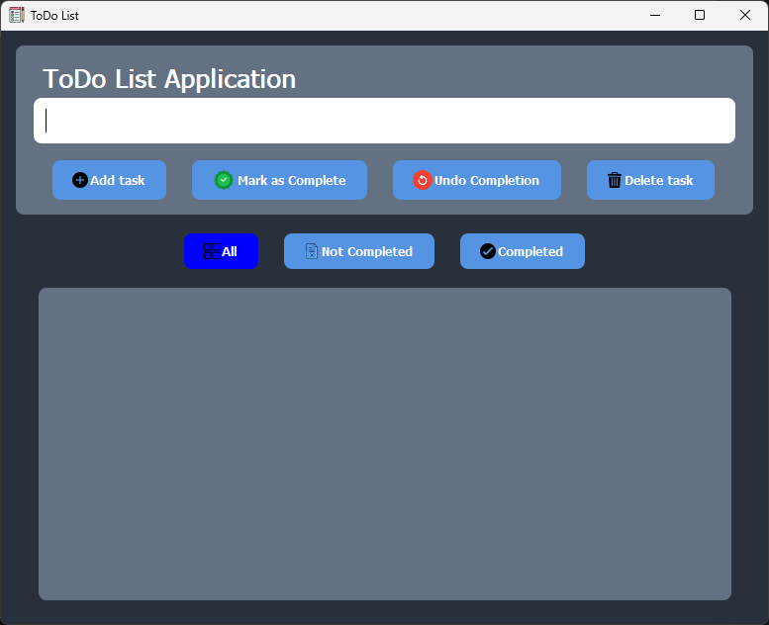
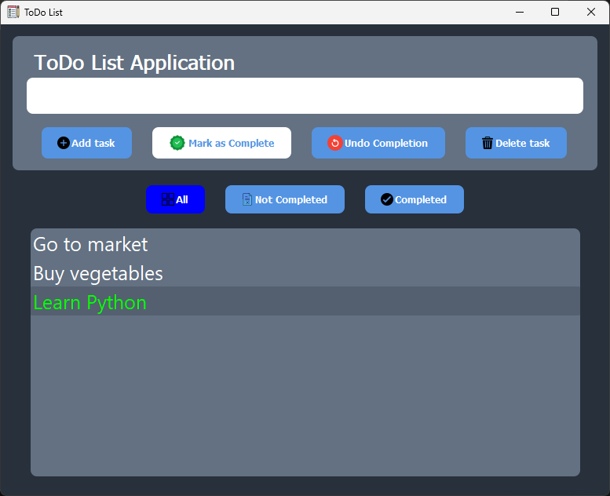
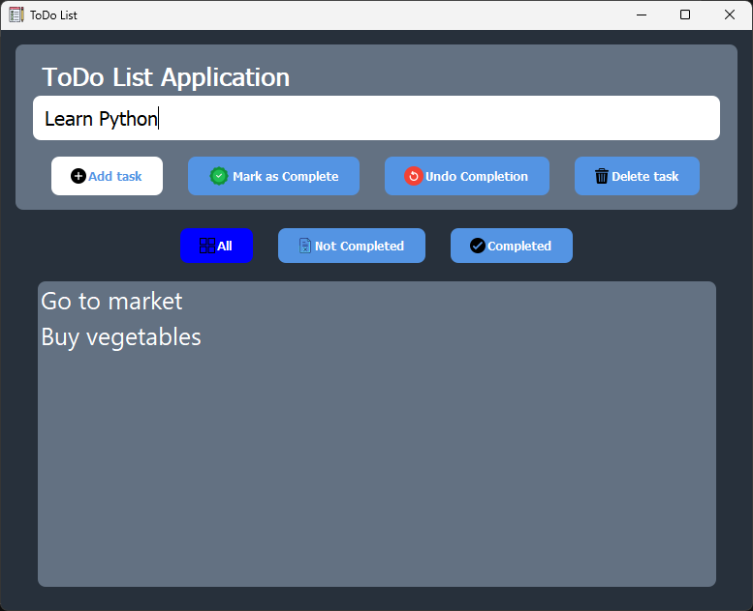
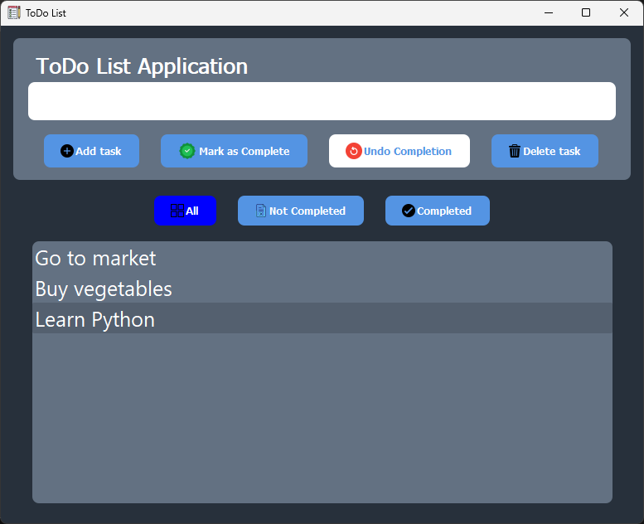
Screenshots
Main Page
Mark as complete Functionality
Add Functionality
Undo complete Functionality

Slide 6
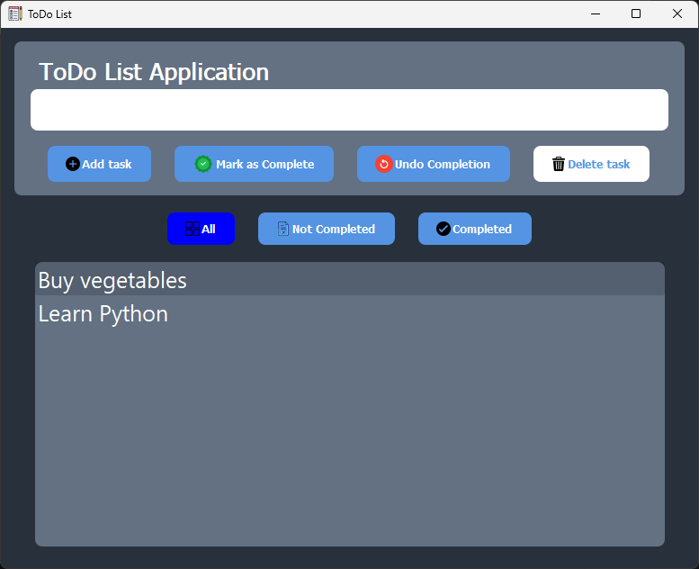
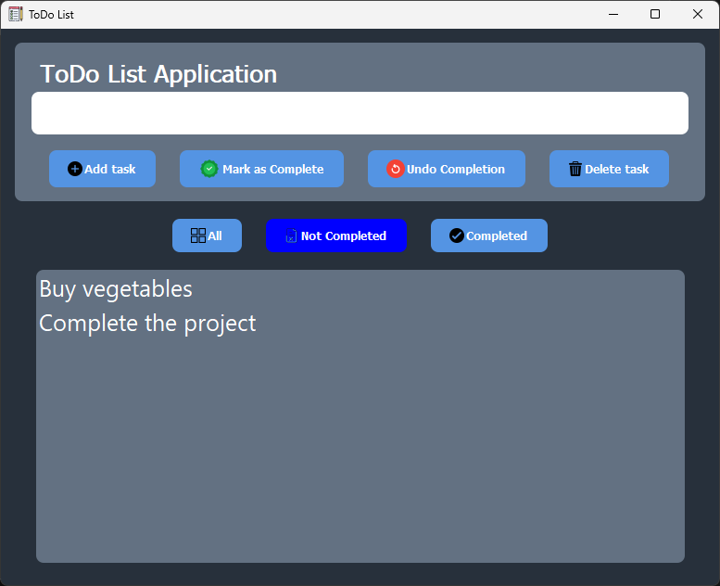
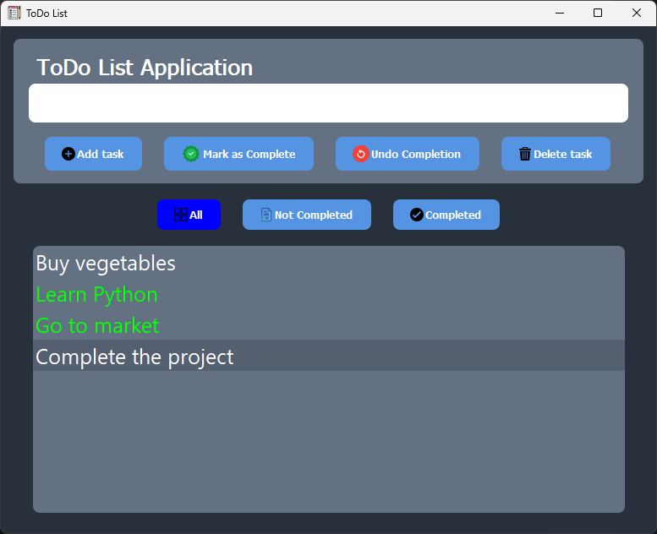
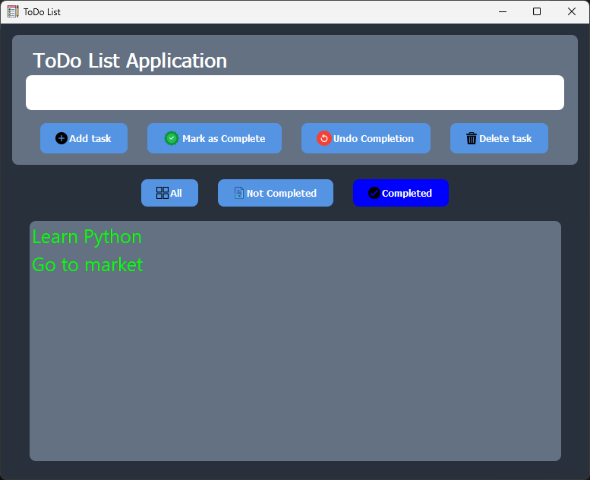
Screenshots
Delete tasks Functionality
View not completed tasks
View all tasks
View completed tasks

Slide 7
advantages
User-Friendly Interface: Intuitive design makes it easy to use.
Persistence: Tasks are saved between sessions due to the SQLite3 database.
Flexibility: Can handle multiple tasks and various statuses.
Undo Functionality: Allows for correction of accidental completions.

Slide 8
Future scopes
Mobile Application: Develop a mobile version to increase accessibility.
Web-Based Version: Create a web-based version to allow access from any device with internet connectivity.
Synchronization: Implement cloud synchronization to keep tasks updated across multiple devices.
Enhanced Features:
Priority Levels: Allow users to set priority levels for tasks.
Notifications: Add reminder notifications for upcoming tasks.
Collaboration: Enable multiple users to collaborate on shared task lists.
Integration with Other Tools: Integrate with calendars, email, and other productivity tools for a seamless user experience.

Slide 9
conclusion
We explored the development and features of a GUI-based to-do list application.
The application utilizes PyQt5 for the graphical interface and SQLite3 for database management.
Key functionalities include adding, deleting, and marking tasks as complete, with an additional undo option.
The application ensures task persistence across sessions, enhancing user experience.
You can find the code in this repository:
https://github.com/arijitgolui10/VaultofCodes_Python_Intern_FinalProject.git

Slide 10
THANKYOU

