Slide 1
E-Commerce Returns
Analysis Pipeline
Minor Project 3 — Artificial Intelligence
Data Preprocessing • Exploratory Data Analysis • Business Insights
6000
orders analyzed

Slide 2
Project Overview
A messy, raw e-commerce returns export was cleaned end-to-end and explored to surface actionable business insights.
1
2
3
4
5
Load Raw Data
Clean
Treat Outliers
Encode & Scale
Analyze
6,150 raw order records with quality issues
Missing values imputed, duplicates removed
IQR clipping on price, delivery, quantity
Label/one-hot encoding + Min-Max normalization
EDA + 6 business insights
Dataset snapshot after cleaning
6,000
0
21.6%
8
clean orders
missing values
overall return rate
product categories

Slide 3
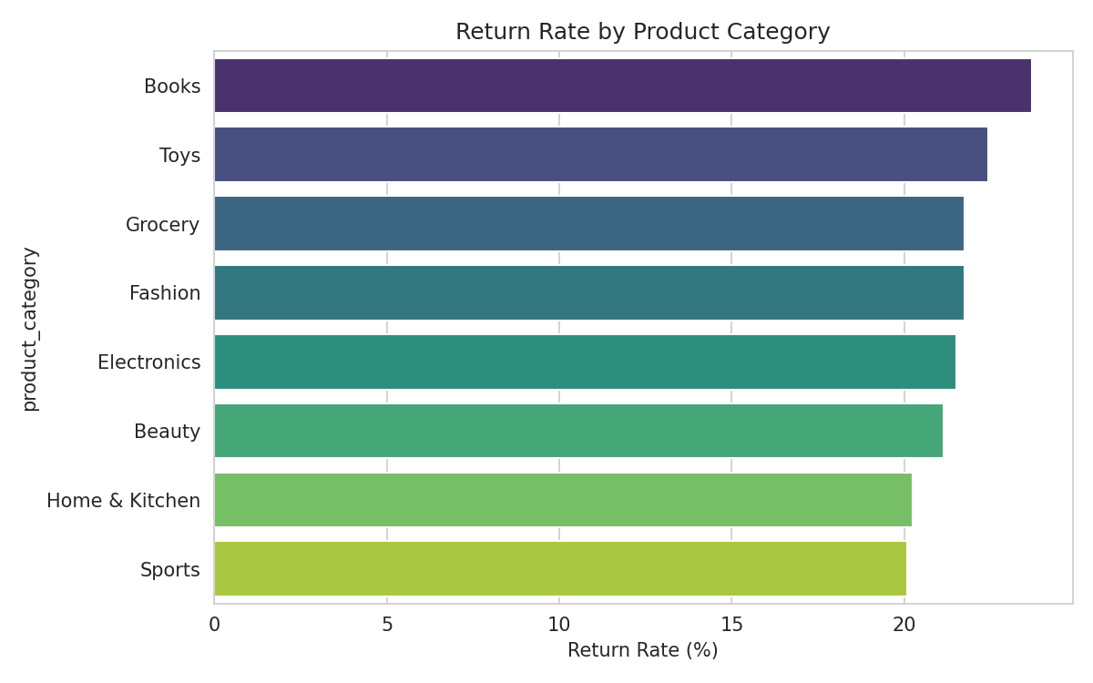
INSIGHT 1
Return Rate by Product Category
Books lead at 23.7% return rate
Toys and Grocery follow closely behind
Sports & Home/Kitchen are the most 'sticky' categories
TAKEAWAY
Low-cost, impulse-buy categories like Books and Toys see the highest returns — worth a closer look at product descriptions, sizing/edition clarity, and packaging quality for these SKUs.

Slide 4
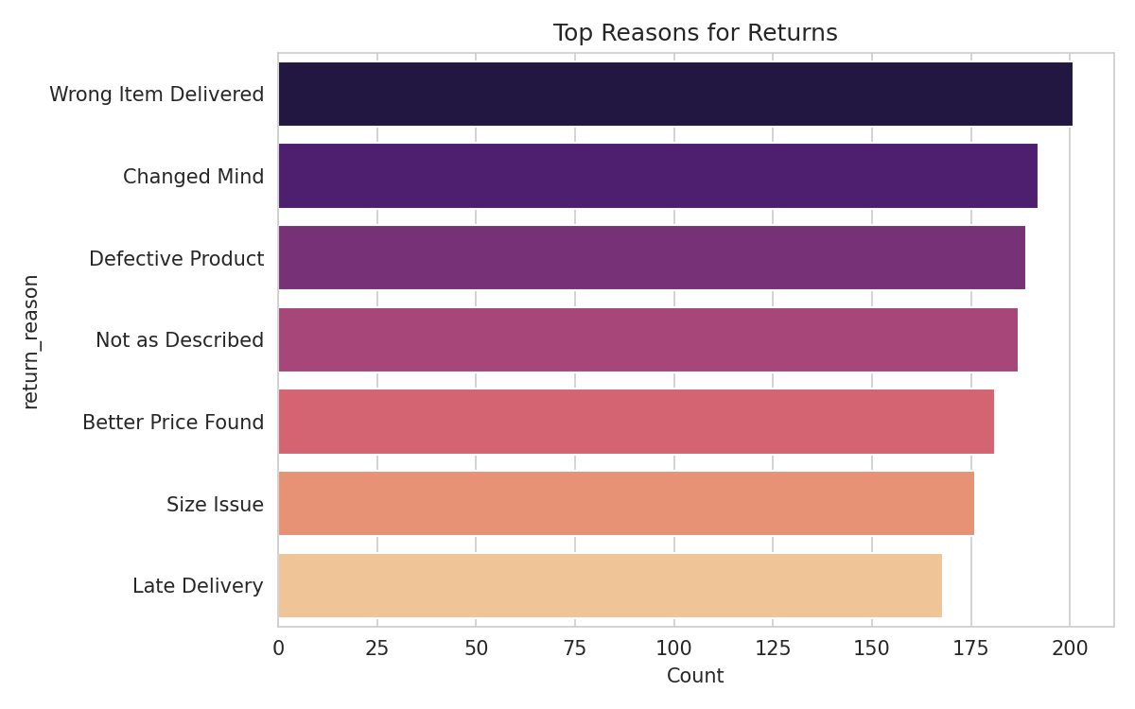
INSIGHT 2
Top Reasons Customers Return Items
"Wrong Item Delivered" is the #1 reason
"Changed Mind" and "Defective Product" follow
Late delivery is a comparatively minor driver
TAKEAWAY
Wrong-item errors point to a fulfilment/warehouse QA issue, while high 'Changed Mind' volume suggests improving pre-purchase content (photos, size charts, specs) to set correct expectations.

Slide 5
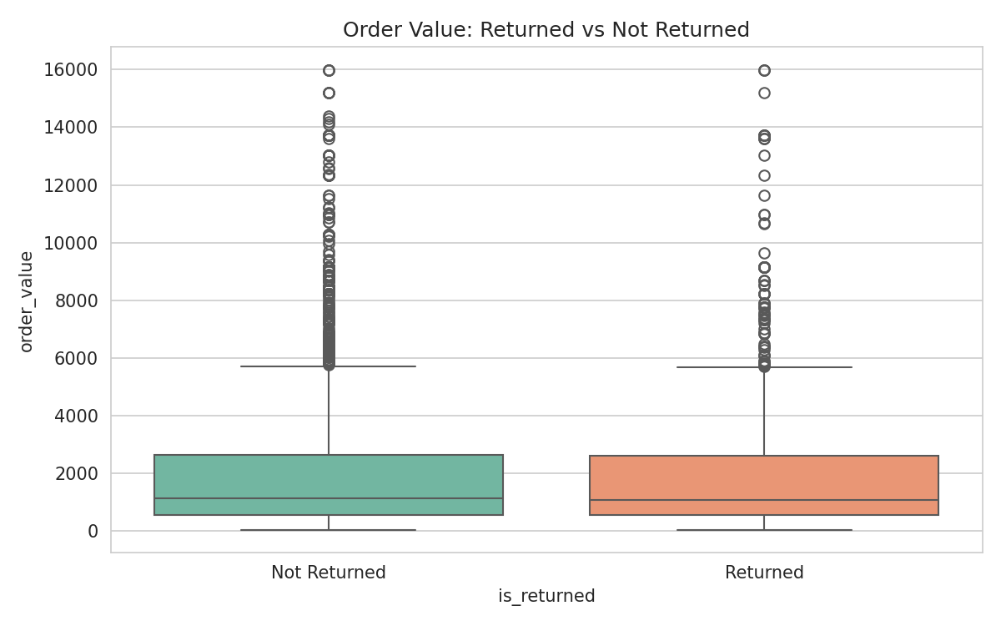
INSIGHT 3
Order Value: Returned vs. Kept Orders
Median order value is nearly identical either way
Returned: ~₹1,082 | Not returned: ~₹1,123
No strong link between spend level and return likelihood
TAKEAWAY
Because returns aren't concentrated in high-value orders, return-reduction initiatives should be applied broadly across the catalog rather than targeted only at premium products.

Slide 6
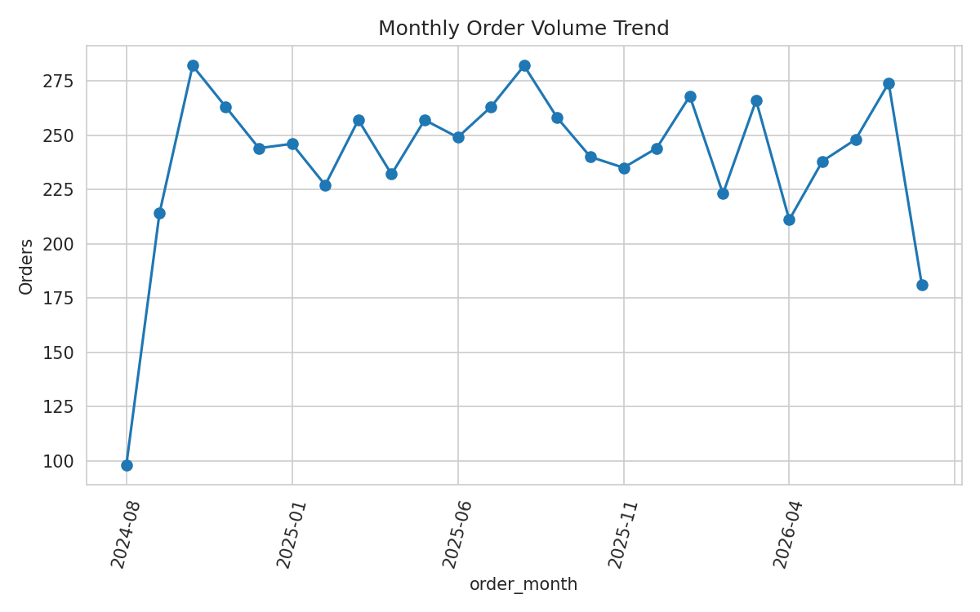
INSIGHT 4
Monthly Order Volume Trend
Clear upward trend across the 2-year window
Order volume roughly tripled from month 1 to now
Seasonal dips and spikes visible month to month
TAKEAWAY
Sustained growth in order volume means returns-processing capacity, warehouse staffing, and customer support should scale proportionally ahead of peak months.

Slide 7
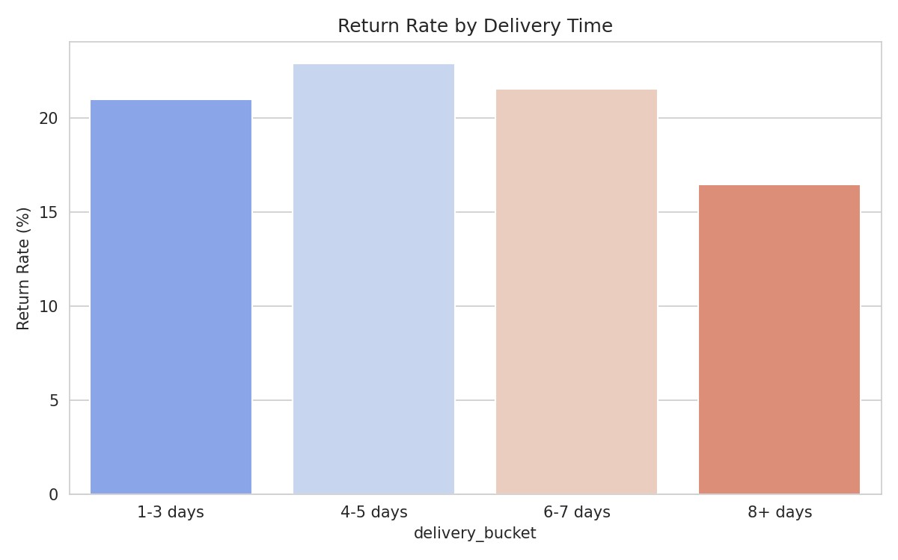
INSIGHT 5
Return Rate by Delivery Time
4-5 day deliveries show the highest return rate (22.9%)
8+ day (slow) deliveries show the lowest (16.5%)
Effect size is modest across all buckets
TAKEAWAY
Delivery speed has only a mild relationship with returns — it should be monitored but is not the primary lever for reducing return volume; fulfilment accuracy (Insight 2) matters more.

Slide 8
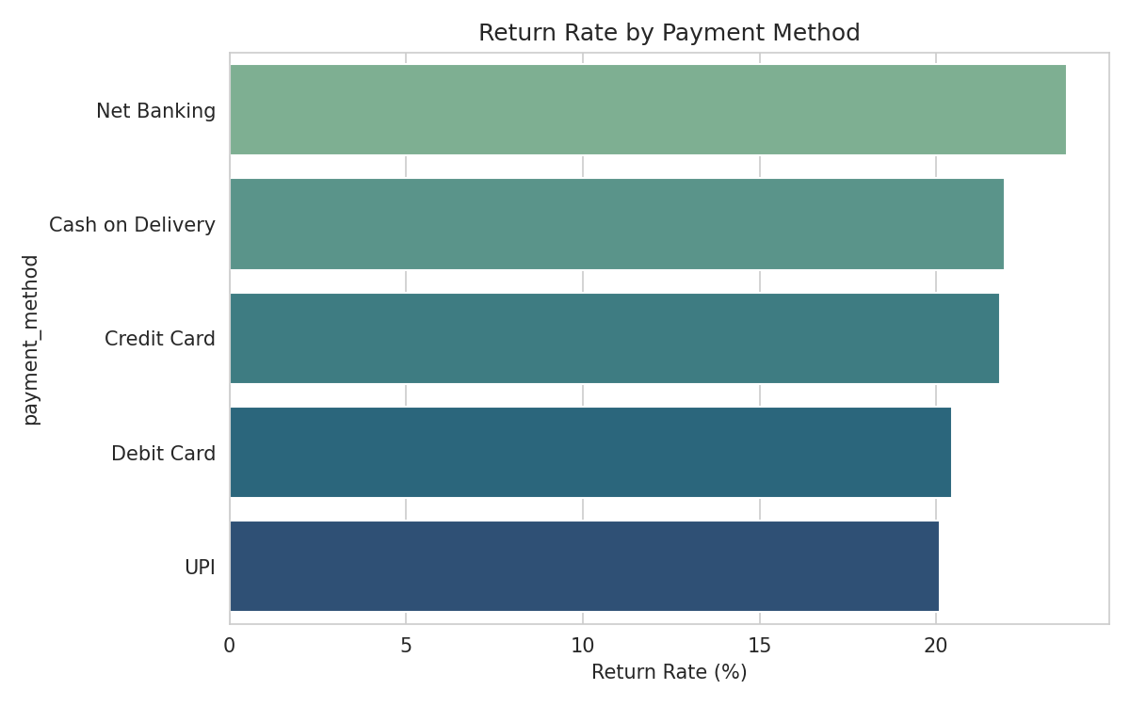
INSIGHT 6
Payment Method Returns & Regional Revenue
Net Banking has the highest return rate (23.7%)
UPI and Debit Card are the most 'reliable' methods
North region leads total revenue (₹2.6M)
TAKEAWAY
Net Banking orders merit a closer behavioral/fraud review given their elevated return rate, while the North region's revenue lead makes it a strong candidate for a dedicated regional fulfilment or marketing push.

Slide 9
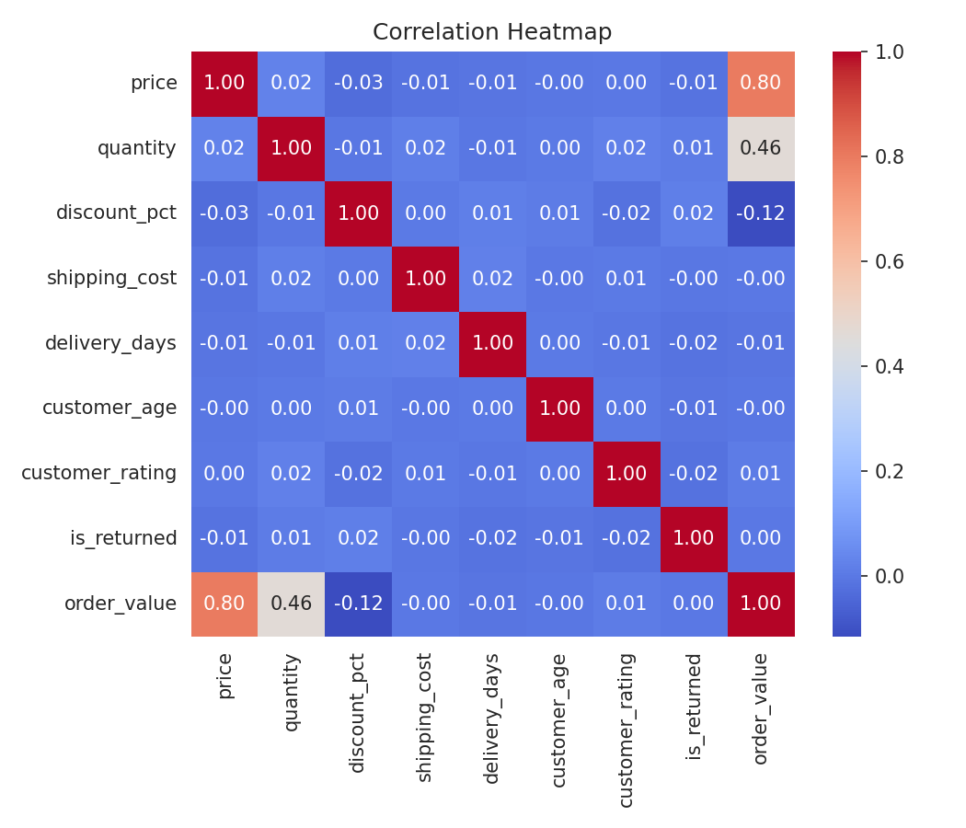
Feature Correlation Overview
How numeric features relate to each other and to the return outcome.
price and order_value are strongly positively correlated, as expected
is_returned shows only weak correlation with any single numeric feature
No numeric feature alone predicts returns — return behavior is driven more by categorical factors (category, reason, payment method) than by price or delivery timing
This justifies the multi-angle EDA approach used across the six insights

Slide 10
Recommendations
01
02
Audit fulfilment accuracy
Improve listings for Books & Toys
Wrong-item delivery is the top return driver — prioritize warehouse QA checks.
Highest-return categories; clarify editions, sizing, and product photos.
03
04
Scale ops with order growth
Review Net Banking transactions
Order volume is trending up — plan staffing & returns capacity ahead of peaks.
Elevated return rate on this payment method warrants a behavioral check.
05
06
Apply-return fixes catalog-wide
Double down on North region
Returns aren't value-concentrated, so fixes should span the full catalog.
Highest revenue region — strong candidate for a dedicated fulfilment hub.

Slide 11
Deliverables
Cleaned Dataset
ecommerce_returns_cleaned.csv — 6,000 rows, zero missing values, outliers treated
EDA Notebook
Ecommerce_Returns_Analysis_Pipeline.ipynb — full Colab-ready pipeline, step by step
Insight Presentation
This report — 6 business insights with visualizations & recommendations
Thank you

