Slide 1
Dakshta
-By Team Surya
Arijit Mukhopadhyay
Mohit Mantry
Arush

Slide 2
Appendix
Briefing, Opportunities and Challenges – Slide 1
Objectives and Model Assumptions – Slide 2
Basic Model – Slide 3
Rationale behind the Model – Slide 4
Results and Implications – Slide 4
Alternate Approach and Improvements – Slide 5
Value Addition – Slide 6

Slide 3





Briefing
Digital ride-hailing services like Uber and Ola, has changed the cab service industry and with the adoption of Industry 4.0 is destined to bring even more opportunities and challenges in the industry. But, the Covid Pandemic has brought newer challenges for this service to address for.
Opportunities
Challenges
Faster adoption of Industry 4.0
Increase in customer demand
Increase in number of cabs and drivers
Improvement of connectivity between cities
Because of safety concerns, commuters are asking more for single-person rides.
Deadheading was a major problem.
Still not able to reduce pollution as envisioned.
At presently, these services are at a financial loss. Uber posted a net loss of $8.5 billion in 2019, which improved to $6.8 billion in 2020.

Slide 4
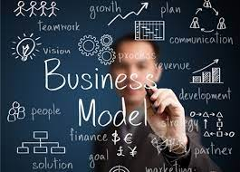

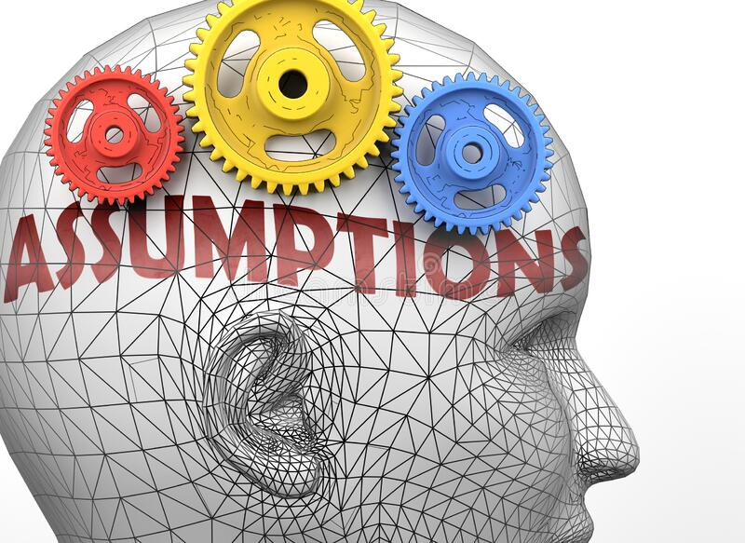
Basic Model
Objectives: The basic objective of the model is to figure out an optimize route for the drivers according to the customer location and drop-point, and to focus on minimizing cost and time taken.
Assumptions
There are few assumptions taken while building this model for the ease of calculation. These are:
All taxis run at a constant speed on the road network.
The estimated time taken to reach the destination point is known and can be predicted.
The time window for booking passengers are fixed and known.
Distance is calculated using formula: 69* (sqrt((lat1-lat2)^2 + (long1-long2)^2)).
Cost is proportional to distance covered.
Minimizing of total distance covered will eventually be leading towards minimizing in cost and waiting time of the customers.
Since, the Covid pandemic, customers are majorly opting for individual ride, so in this model we have only taken into consideration of individual rides.

Slide 5
Decision Variables
Constraints
X1 = Driver ED62 selected for customer EA11
X2 = Driver ED62 selected for customer EA34
X3 = Driver ED62 selected for customer EA22
------------------------------------------------------------
------------------------------------------------------------
X29 = Driver ED06 selected for customer EA33
X30 = Driver ED06 selected for customer EA37
SUM(X1,X2,X3,X4,X5) <=1 (A driver can either take one customer or he would be idle. It would be similar for other drivers too.
SUM(X1,X6,X11,X16,X21,X26) = 1 (A customer can book exactly one driver).
Numbers of drivers = 5.
Objective Function
Total Distance covered = Minimize
Optimization of distance for the customers booking at 5:02

Slide 6


Rationale Behind the Model
Final Results
First, we have considered that if a driver who will be picking a particular customer is denoted by 1 for that customer. And if not, on that cell it is denoted by 0.
Second, Driver ID is taken in the rows and Customer ID in the columns.
Third, we have taken the sum for each row should be equal to 1 or 0. This is because a driver may or may not pick a customer.
Fourth, the sum for each column it must be 1. And the final sum should always be equal to 5. This is because all customers must be picked up.
Fifth, we have created 4 groups of customers based upon their booking time.
Finally, we have repeated this above process for each group and found the optimized distance covered.
Optimal Route to be followed to minimize distance
The total optimal distance is 92.32 km. By covering this distance, the cost of the business and the waiting time for the customers is minimized.

Slide 7


How Good is It?
Alternative Approaches
As we have already included all the constraints, the solution looks like the best option in the present scenario.
As far us our understanding of the case and analyzing the dataset, the solution provide appears to be optimal.
We can add further complexities to model, like number of sharing customers, taking road traffic into consideration (it will be impacting the fare).
By including sensitivity analysis or advance analytics by python, we can make the model more robust in nature.
Further Improvements
To handle bigger data sets and provide result within reasonable computational time, this model needs further improvements.
We can use historical traffic system based on GPS data collected from users, also various advanced software can be deployed like Gurafu, used by Uber. Also, we can collaborate with data collection agency and use database to mapping user movement data as well.

Slide 8
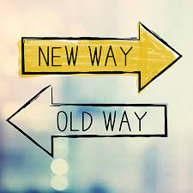

New Approach
A newer approach needs to be adopted while tackling dynamic datasets. This can be implementing sophisticated software, or building a SaaS platform, or can take help from GPS system to predict and map optimum routes for drivers. We can use advance analytics by python to get better result.
Value Addition
The solution will be adding immense value to the enterprise, since it will be helping them to take a data-driven business decision. Furthermore, through the optimal solution, they can plan the optimal route of the cabs that needs to be followed to reduce operational cost and customer waiting time.

Slide 9
Thank you!
Any questions?

