Slide 1
Project
BigMart - Predict Item Sales Price

Slide 2
Dataset Details –
This is a dataset collected data from 10 different stores from different cities for 1559 products.
Key features from the dataset are
Item_Identifier - Unique product ID
Item_Weight - Weight of the product
Item_Fat_content - Product with Fat Content
Item_MRP - Retail price of the product
Outlet Identifier - Unique store ID
Outlet_Size - Size of the store
Item_Outlet_Sales - Item Sales price.
BigMart dataset has total of (14204, 13) records and was separately provided with train(8523, 13) and test (5681, 12) dataset.

Slide 3
Dataset Details –
It has following 12 attributes with continuous and categorical values with Unique Values –
Item_Fat_Content has 5 unique values
Item_Identifier has 1559 unique values
Item_MRP has 8052 unique values
Item_Outlet_Sales has 3494 unique values
Item_Type has 16 unique values
Item_Visibility has 13006 unique values
Item_Weight has 416 unique values
Outlet_Establishment_Year has 9unique values
Outlet_Identifier has 10 unique values
Outlet_Location_Type has 3 unique values
Outlet_Size has 4 unique values
Outlet_Type has 4 unique values

Slide 4
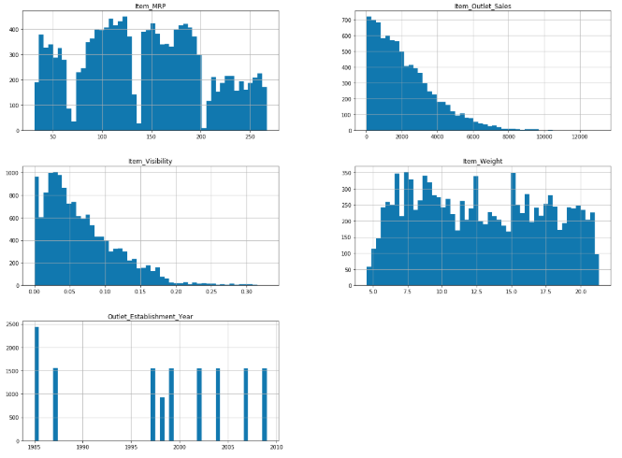
Data Visualization –
Histogram shows the distribution of data of different variables –
Correlation plot informs about the relation between variables -
Plotting Histogram from Dataset

Slide 5
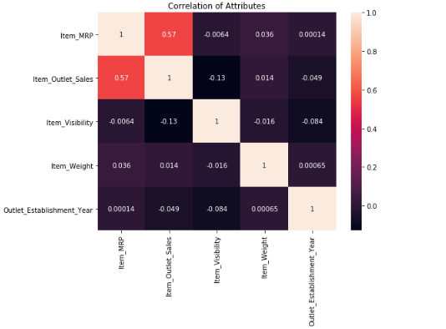
Correlation Between Attributes

Slide 6
Data Exploration – Analyzed and plotted the categorical and continuous feature summaries to see which feature is closely related with target variable. This helped us with deciding which feature are influencing the prediction.
Data Preprocessing –
Missing values (2439) of item weight is replaced with mean.
Missing values (4016) of outlet size observations, which been replaced with mode.
Updated the Typo in category of Item Fat Content like “LF” and “low fat” seen in the dataset to single category “Low Fat”.
Low Fat 9185
Regular 5019
Created a new category for “Non consumable” as “Non-Edible” in Low Fat category.
Low Fat 6499
Regular 5019
Non-Edible 2686
Years of store operation as new column.

Slide 7
Data Cleaning and Feature engineering – Encoding and imputing missing values in the data and checking for outliers with replacing with mean values and relabeling the values in categorical columns as to bring consistencies. Also, added additional columns for effective feature engineering.
Applied the One-Hot Encoding on all the categorical attributes in dataset-
'Item_Fat_Content’
'Outlet_Location_Type’
'Outlet_Size’
'Outlet_Type’
'Item_Type_Combined’
'Outlet_Identifier’
Final Dataset Attributes after Data Cleaning –
'Item_MRP', 'Item_Visibility', 'Item_Weight', 'Outlet_Years', 'Outlet', 'Item_Fat_Content_0', 'Item_Fat_Content_1', 'Item_Fat_Content_2', 'Outlet_Location_Type_0', 'Outlet_Location_Type_1', 'Outlet_Location_Type_2', 'Outlet_Size_0', 'Outlet_Size_1', 'Outlet_Size_2', 'Outlet_Type_0', 'Outlet_Type_1', 'Outlet_Type_2', 'Outlet_Type_3', 'Item_Type_Combined_0', 'Item_Type_Combined_1', 'Item_Type_Combined_2', 'Outlet_Identifier_OUT010', 'Outlet_Identifier_OUT013', 'Outlet_Identifier_OUT017', 'Outlet_Identifier_OUT018', 'Outlet_Identifier_OUT019', 'Outlet_Identifier_OUT027', 'Outlet_Identifier_OUT035', 'Outlet_Identifier_OUT045', 'Outlet_Identifier_OUT046', 'Outlet_Identifier_OUT049’

Slide 8
Model Experiments
Baseline Models - Simple Linear Regression, which has resulted with RMSE of 1133.786612.
When plotted for feature importance outlet_size2 and Item_fat_content_0 has shown high importance.
Model Hypertuning - Using “GridsearchCV” and “RandomizedSearchCV”, has been used for tuning the model and calculating the root mean square error with and without Pipeline.
Along with below model as part of experiments for hyper tuning -
- Ridge L2 regularization has resulted with RMSE ( Ridge) of 1116.9849907714172
- Lasso L1 regularization has resulted with RMSE ( Lasso ) of 1116.9838603195938
- GridsearchCV with Ridge has resulted with RMSE of 1116.9933586894301
- RandomizedSearchCV with Ridge has resulted with RMSE of 1116.993353559343
Decision Tree has resulted with RMSE of 1103.6182109310132 and with hypertuned, it’s 1085.1691970044897.
When plotted for feature importance Item_MRP and Outlet_type_0 has shown high importance.
Random Forest resulted with RMSE of 1088.9521464102056 and with hypertuned, it’s 1080.2740112559875.
When plotted for feature importance Item_MRP and Outlet_type_0 has shown high importance.

Slide 9
Results –
Model Evaluation - After all the experiments and results captured, “RandomForestRegressor with Hypertuning”
model has provided better predictions in comparison with other models.
Consolidated Results of Model and their RMSE scores -
Base model (RMSE - 1133.786612)
Ridge(RMSE - 1116.984991)
Lasso (RMSE - 1116.983860)
Ridge with Grid Search (RMSE - 1116.993359)
Ridge with Random Search (RMSE -1116.993354)
LR after feature selection(RMSE -1116.809449)
Decision Tree without Tuned (RMSE -1103.618211)
Decision Tree with Hyper Parameter Tuned (RMSE -1085.169197)
Random Forest without Tuned (RMSE -1088.952146)Random Forest with Hyper Parameter Tuned (RMSE -1080.274011)
Model Significance – Significance of two best models DecisionTree and RandomForest
The p-value is 0.00000 for a t-score of -21.46703. The two machine learning pipelines are different (reject H0) (t_score, p_value) = (-21.47, 0.00000). Machine learning Random Forest model is better than Decision Tree.

Slide 10
Kitchen Sink – Ensemble Approach
Implemented multiple algorithm with LinearRegression(),Lasso(), Ridge(), DecisionTreeRegressor(), RandomForestRegressor() with fitting and predicting.
Simple averaging the prediction outcome .

