Slide 1

Fraudulent Transaction Clustering Using DBSCAN-Based Anomaly Detection
CASE-STUDY BASED REPORT | MACHINE LEARNING | B.TECH
Arikela Sumanjali (2520090190)
Gatik Sharma (2520090223)
Guide: Dr. Y. Lakshmi Prasanna, Asst. Professor
Department of CS&IT, K L University, Hyderabad
Academic Year 2026-27

Slide 2
Introduction
1
Background
2
Domain
3
Why it is needed
Digital payments are growing fast, and so is fraud. Fraudsters keep changing their tactics.
Unsupervised machine learning: clustering groups similar transactions without needing labels.
Static rules and supervised models struggle with new, unseen fraud patterns.

Slide 3
Problem Statement
1
Existing problem
2
Challenges
3
Who is affected
Spot unusual transactions without fraud rules or labels, then check them against isFraud.
Rule systems raise many false alarms, and fraud is only 0.13% of the data.
Banks, payment providers and customers who lose money to fraud.

Slide 4
Motivation
1
Why this project
2
Real-world need
3
Industry interest
To test whether label-free clustering can surface real fraud in transaction data.
Institutions process millions of transactions daily and cannot review each one.
Anomaly detection can adapt to fraud tactics that labeled models have never seen.

Slide 5
Objectives
Main objective: detect anomalous transactions with DBSCAN and test whether they match actual fraud.
1
Explore the data
2
Prepare features
EDA on 6.36M PaySim transactions.
Select, one-hot encode and scale features.
3
Apply DBSCAN
4
Evaluate outliers
Find clusters and noise points (anomalies).
Compare with isFraud: precision, recall, F1.

Slide 6
Existing System
Current approaches
Limitations
Rule-based systems with fixed thresholds
Supervised ML trained on labeled history
Both depend on past, known fraud patterns
Static rules are easy to evade
Many false positives overwhelm analysts
Supervised models miss zero-day fraud
Large labeled datasets are required

Slide 7
Proposed System
Proposed solution
How it helps
Unsupervised DBSCAN on scaled transaction features
Dense groups define normal behavior
Points outside clusters (label -1) are anomalies
isFraud is used only afterwards, for evaluation
No fraud labels needed during detection
No predefined rules or thresholds
No need to choose the number of clusters
Can flag new, unseen patterns

Slide 8
System Architecture
1
Input
2
Processing
3
Model
4
Output
PaySim transactions: 6,362,620 rows x 11 columns
Feature selection, one-hot encoding of type, scaling, 100,000-row sample
DBSCAN with eps = 0.5 and min_samples = 10
Cluster labels, anomalies (-1), PCA plots, precision / recall / F1
isFraud never enters the model. It is compared with the detected anomalies only after clustering.

Slide 9
Methodology / Workflow
1
2
3
4
5
6
7
Load Data
EDA
Select Features
Encode & Scale
Sample
DBSCAN
Evaluate
PaySim CSV, 11 columns
Types, fraud, balances
6 numeric + type
One-hot, StandardScaler
100,000 random rows
eps 0.5, min_samples 10
Metrics and PCA plots

Slide 10
Technology Stack
Language
Python
Data handling
Pandas, NumPy
ML library
scikit-learn: StandardScaler, DBSCAN, PCA, metrics
Visualization
Matplotlib, Seaborn
Environment
Python notebook (Jupyter / Colab)
Data source
PaySim CSV file (no database used)

Slide 11
System Modules
1
Data Loading
2
EDA
3
Preprocessing
Reads the PaySim CSV and checks shape and types.
Transaction types, fraud rates, correlations.
One-hot encoding, cleaning, standard scaling.
4
DBSCAN Module
5
Evaluation
6
Visualization
Clusters a 100,000-row sample; noise becomes anomalies.
Confusion matrix, precision, recall and F1 against isFraud.
PCA plots of clusters and detected anomalies.

Slide 12
Dataset / Input Data
6,362,620
11
0.129%
Transactions (PaySim, synthetic)
Attributes per transaction
Fraud: 8,213 transactions
Features: step, amount, four balance fields and one-hot transaction type (11 in total)
Cleaning: inf values set to NaN, then 0; no missing values or duplicates found
Scaling: StandardScaler applied to all 11 features
isFraud is held out and used only to evaluate the anomalies

Slide 13
Exploratory Data Analysis
Key findings
Fraud occurs only in TRANSFER and CASH_OUT
TRANSFER has the highest fraud rate (0.77%)
Average fraud amount is 1.47M vs 0.18M for normal
Extreme imbalance: 8,213 fraud vs 6.35M normal

Slide 14
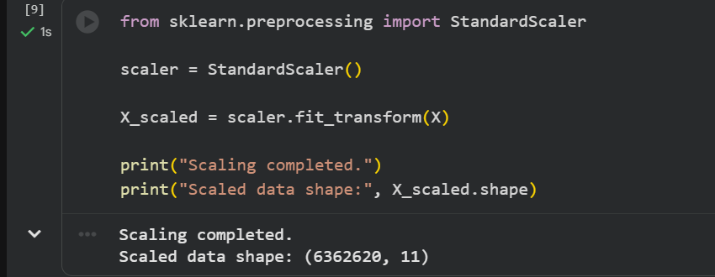
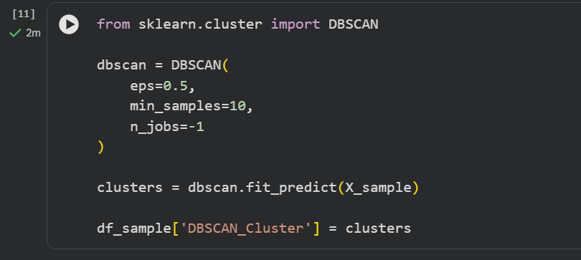
Implementation
Select 6 numeric features and one-hot encode transaction type
Clean inf/NaN values and standardize with StandardScaler
Draw a 100,000-row random sample (seed 42)
Fit DBSCAN (eps 0.5, min_samples 10); label -1 marks an anomaly
Compare with isFraud and reduce to 2D with PCA for plots

Slide 15
Algorithm / Model
Why DBSCAN
0.5
Density-based: needs no labels or cluster count
Finds clusters of any shape
Marks sparse points as noise (-1)
Noise points are natural anomaly candidates
eps: neighborhood radius
10
min_samples: points needed for a dense core
15
clusters found, plus noise points

Slide 16
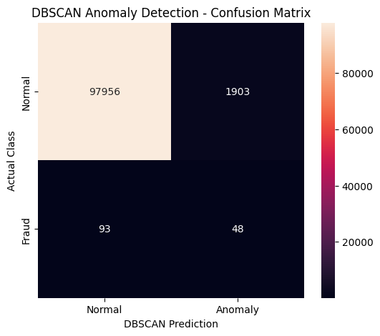
Results
0.0246
Precision: 48 of 1,951 flagged were fraud
0.3404
Recall: 48 of 141 frauds were caught
0.0459
F1 score on the 100,000-row sample
Confusion matrix: 1,951 anomalies out of 100,000 transactions

Slide 17
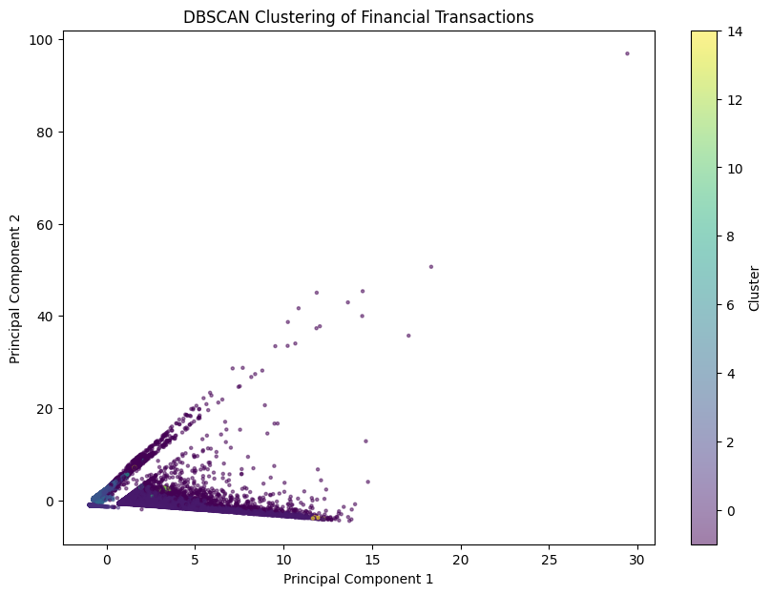
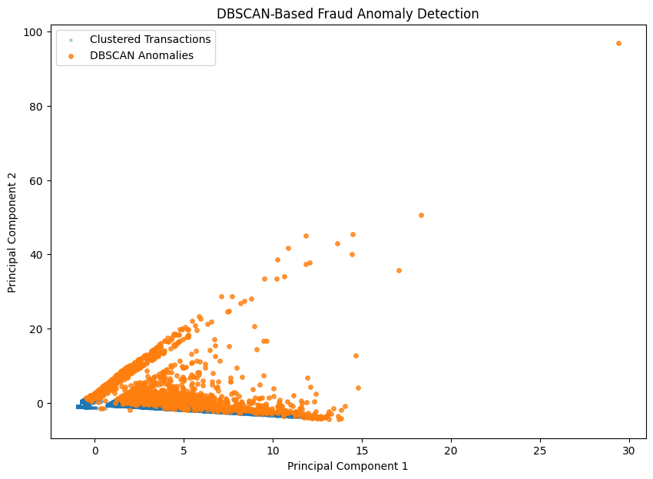
Visualizing the Anomalies
Clusters in PCA space
DBSCAN anomalies (orange) vs clustered points

Slide 18
Result Analysis
1
Fraud caught
2
False alarms
3
Versus random
48 of 141 frauds (34%) were flagged as outliers; 93 were missed.
1,903 normal transactions were flagged too, so precision is only 2.5%.
Fraud is 0.14% of the sample, so DBSCAN precision is about 17x higher.

Slide 19
Advantages
1
No labels needed
2
Finds new patterns
Detection works without fraud labels or predefined rules.
Can flag unseen, zero-day fraud behavior.
3
No cluster count
4
Built-in outliers
Unlike K-Means, DBSCAN does not need k up front.
Noise points directly give anomaly candidates.

Slide 20
Applications
1
Banks
2
Mobile money
3
Payment apps
Screening large daily transaction volumes.
Spotting unusual TRANSFER and CASH_OUT activity.
First-stage alerts for risk teams.
4
E-commerce
5
Insurance
6
Fraud analysts
Flagging abnormal purchase behavior.
Surfacing suspicious claim patterns.
Prioritizing cases for manual review.

Slide 21
Limitations
1
Low precision
2
Sample only
1,903 false alarms against 48 true hits.
Only 100,000 of 6.36M transactions were clustered.
3
Fixed parameters
4
Synthetic data
eps = 0.5 and min_samples = 10 were not tuned.
PaySim is simulated; outliers are unusual, not always fraudulent.

Slide 22
Future Scope
1
Tune parameters
2
Better features
3
Other detectors
Use a k-distance plot to choose eps and min_samples.
Add balance-mismatch features per transaction.
Compare Isolation Forest, LOF and autoencoders.
4
Hybrid approach
5
Full dataset
6
Deployment
Combine clustering with supervised models.
Scale clustering beyond the 100,000-row sample.
Real-time scoring in a payment pipeline.

Slide 23
Conclusion
What was achieved
DBSCAN grouped 100,000 transactions into 15 clusters and flagged 1,951 as anomalies.
1
Key outcome
It caught 48 of 141 frauds (34% recall), but precision was only 2.5%.
2
Overall contribution
Label-free clustering works as a first-stage filter; pair it with richer features or supervised models.
3

